Slide 1
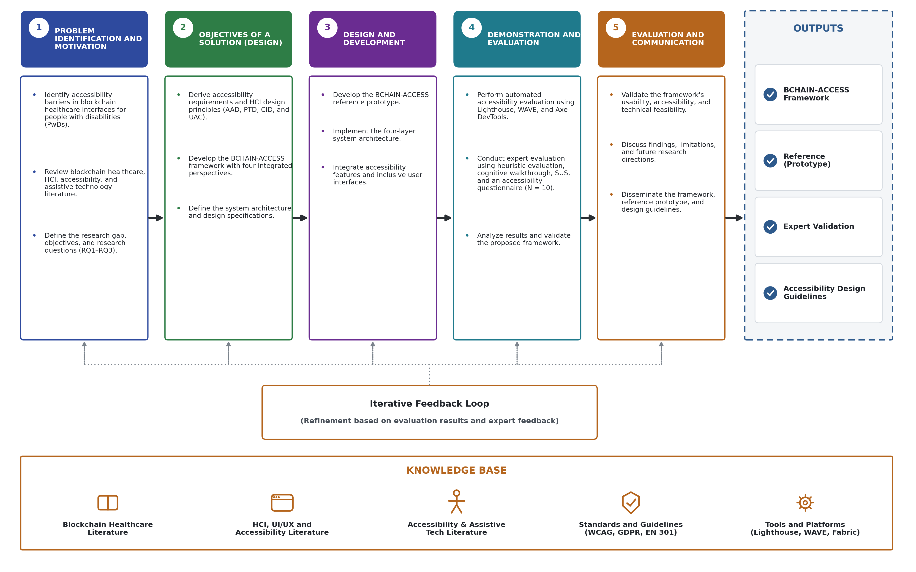
Figure 1. Design Science Research (DSR) methodology

Slide 2
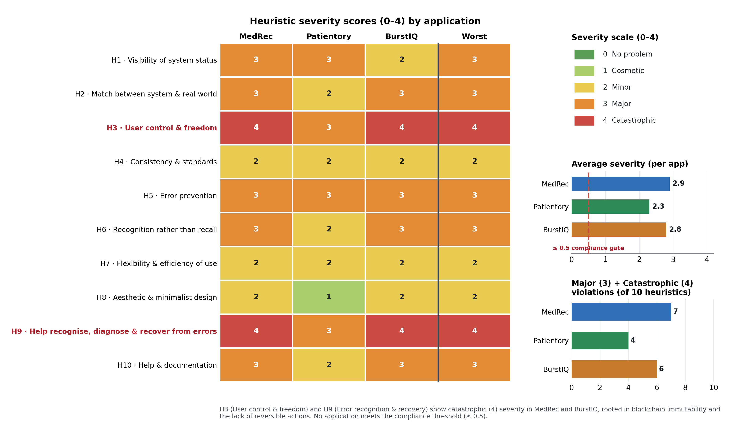
Figure 2. Nielsen heuristic evaluation of three blockchain healthcare applications

Slide 3
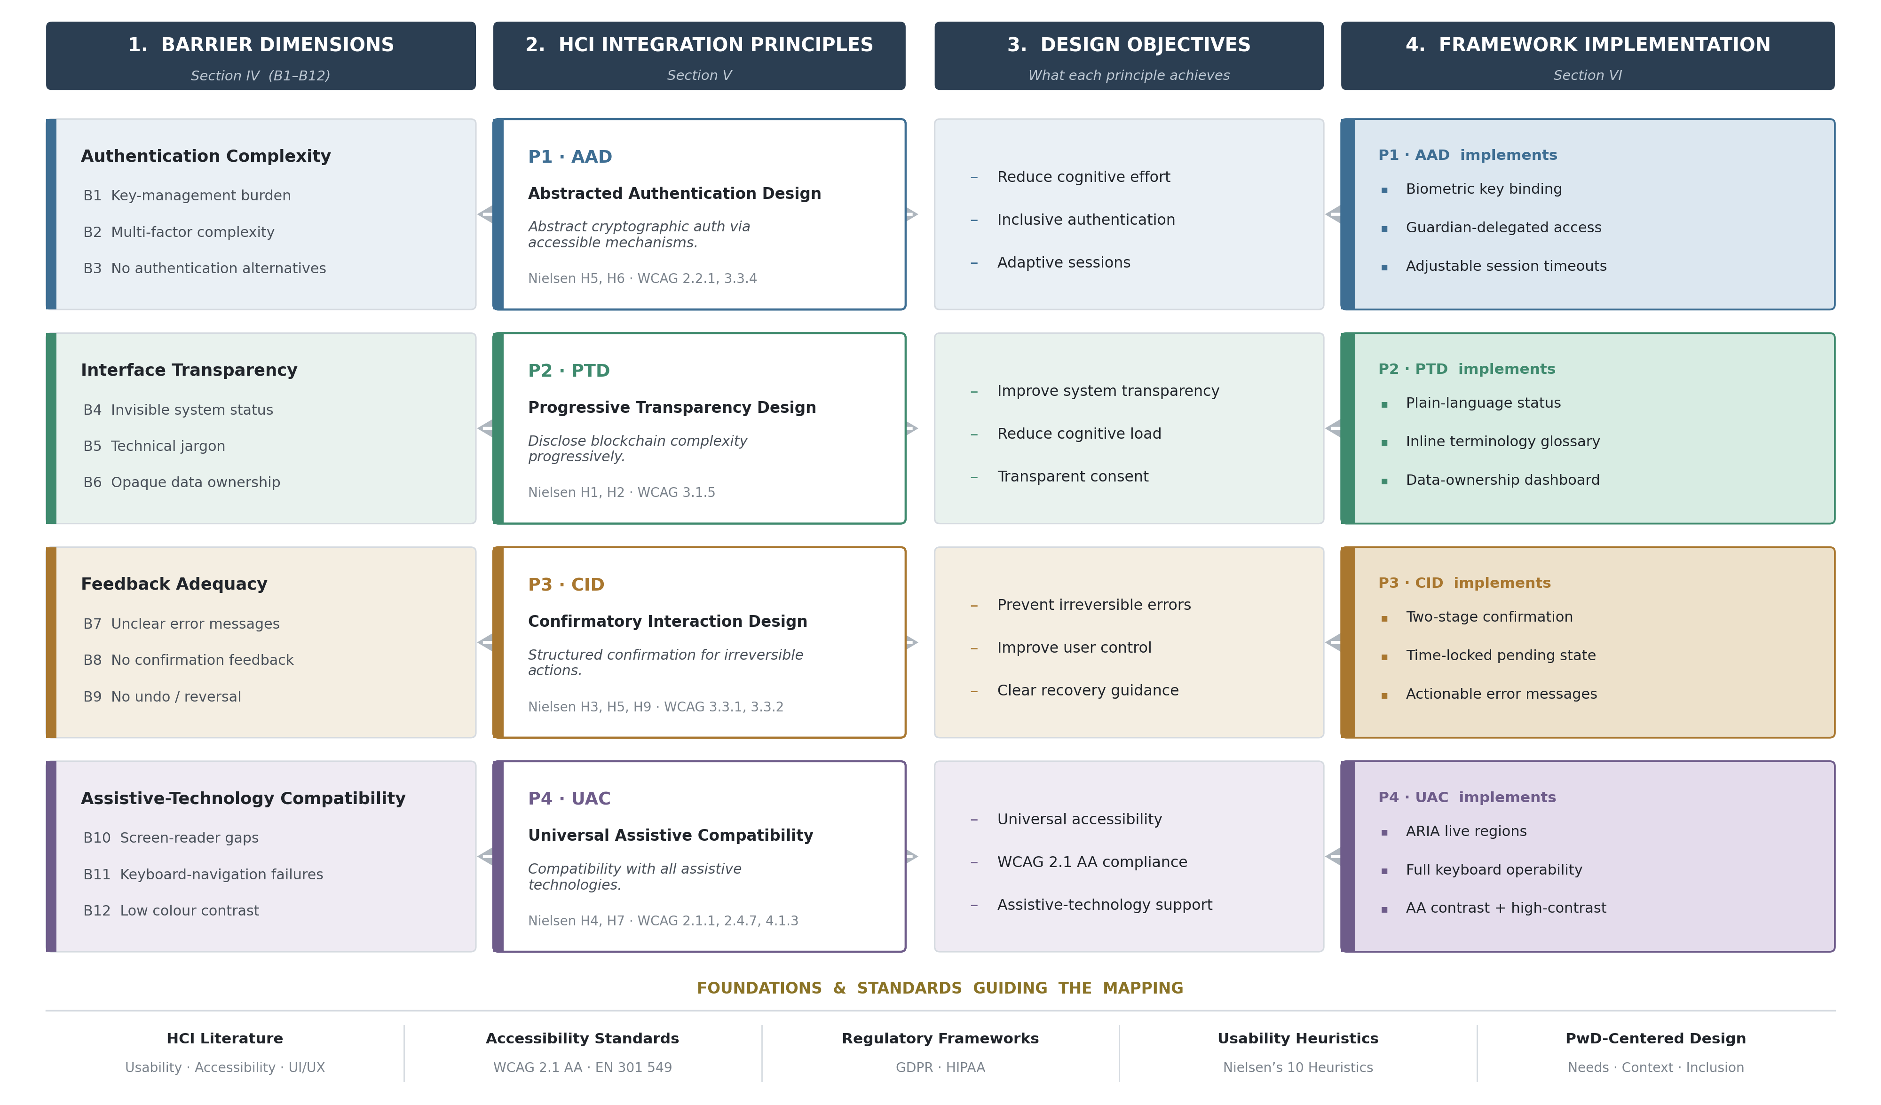
Figure 3. Mapping of barriers to design principles, objectives, and implementation

Slide 4
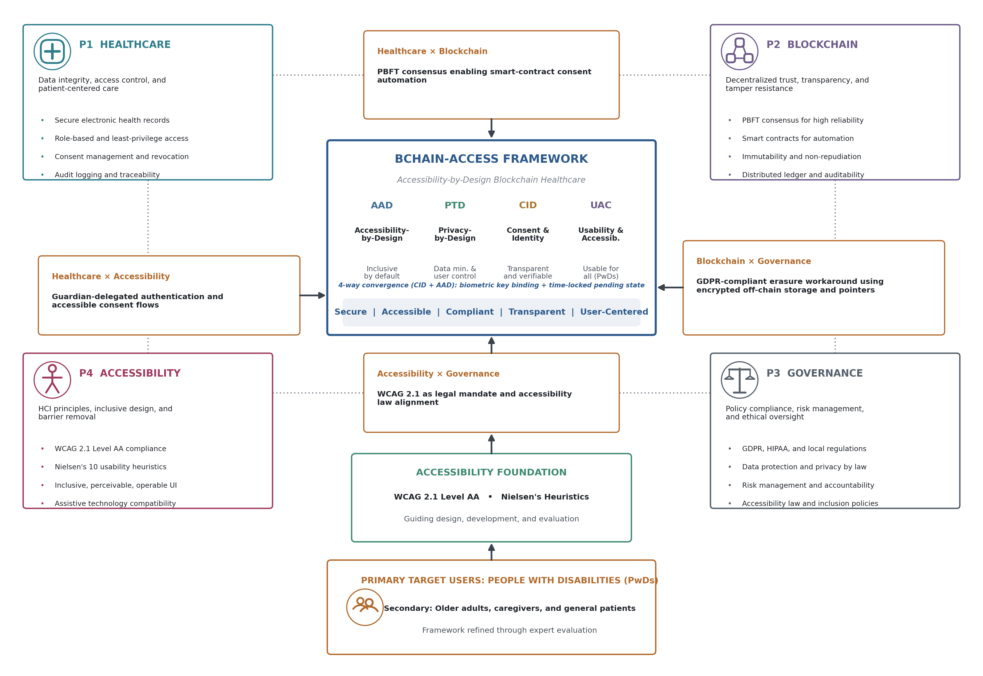
Figure 4. Integrated BCHAIN-ACCESS framework

Slide 5
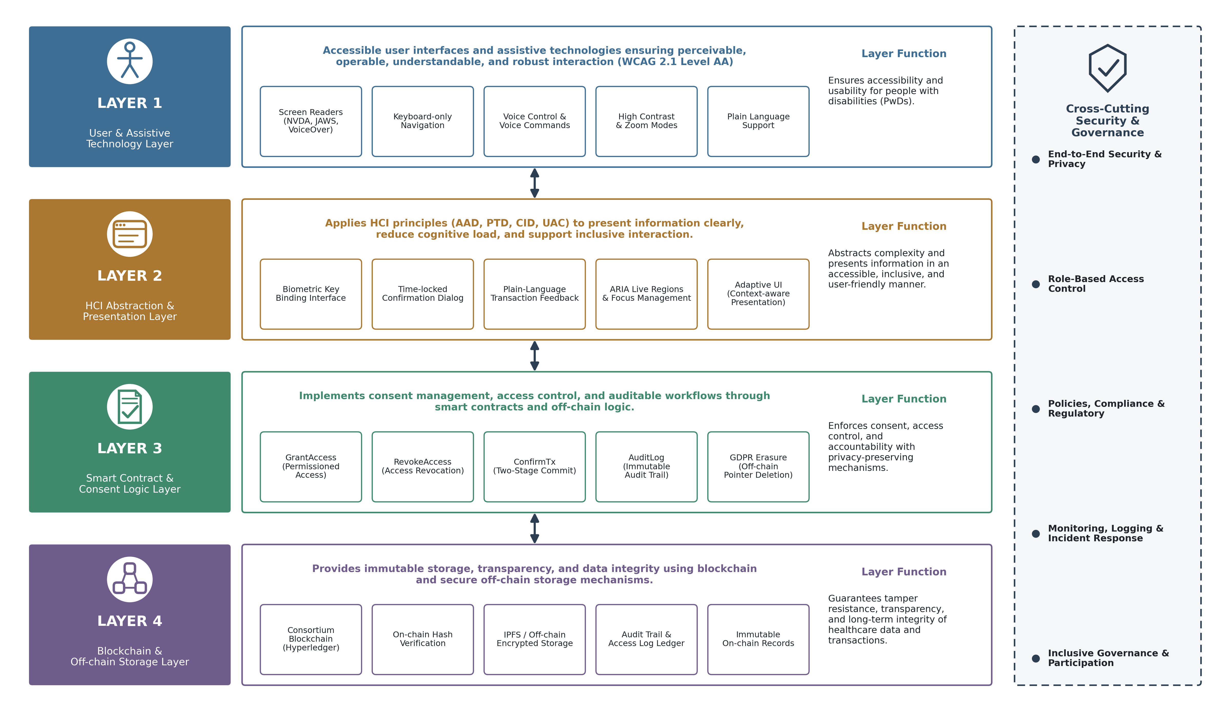
Figure 5. Four-layer BCHAIN-ACCESS architecture

Slide 6
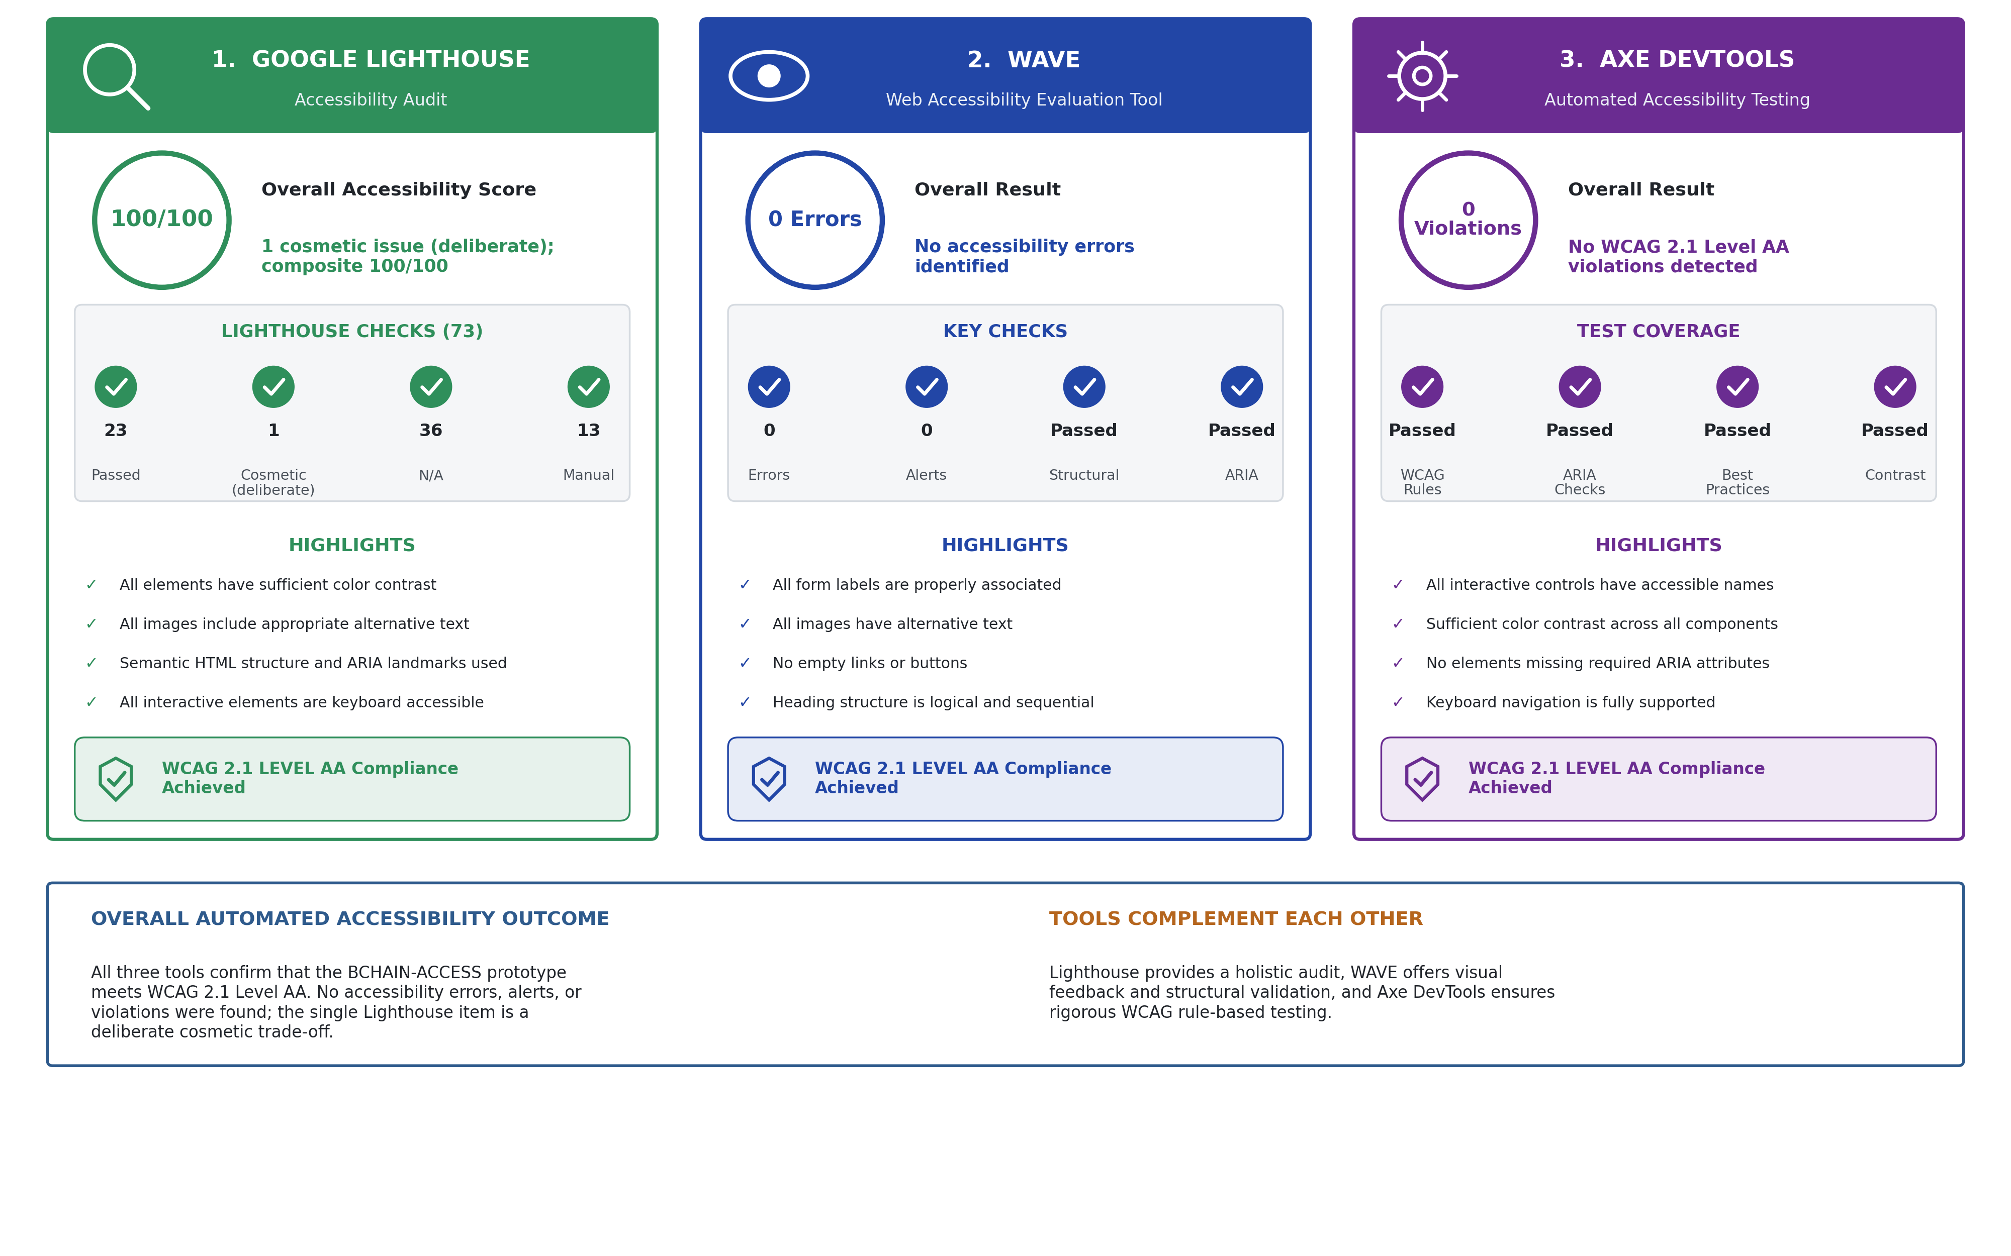
Figure 6. Automated accessibility audit (Lighthouse, WAVE, Axe DevTools)

Slide 7
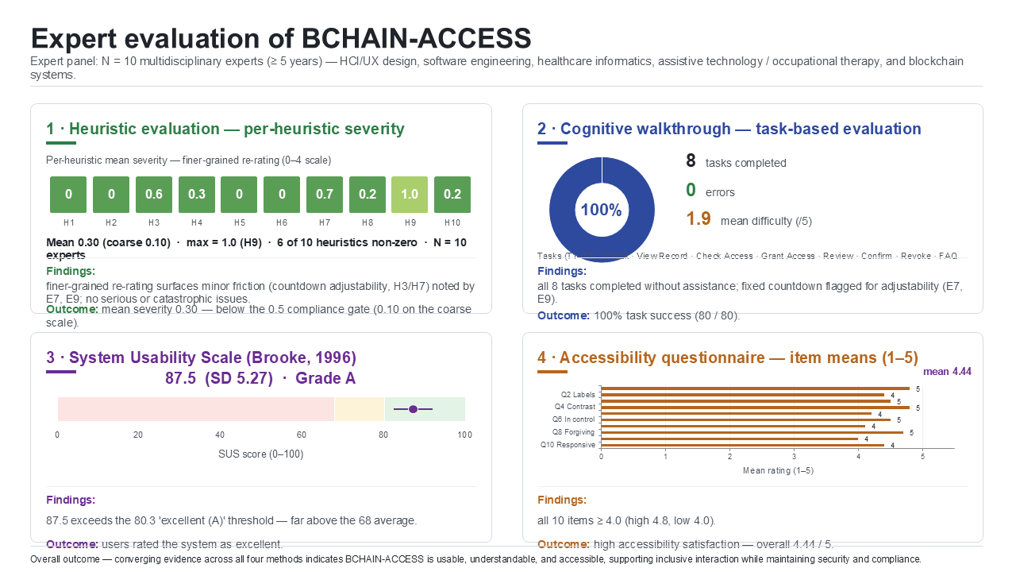
Figure 7. Expert evaluation of the BCHAIN-ACCESS prototype

