Slide 1
INSTRUCTIONS
Use Font size 22 to 28 and Font Style Times New Roman (body)
Do not change the Template: Heading / Title of the slides
Do not change font style or colours
Do not copy paste paragraphs: use only Bullet Points
Maximum slide Limit is 20 only
As per the number of supervisor allotted adopt slide-2 or slide-3
Please display the required meaningful Content or images or tables
Change the footer accordingly using insert tab then click on header & footer tab and edit it
Save the PPT with Register No, Dept and Review no, example: 23xxxxxxxxx_CSE

Slide 2

Title: Student Record Management Web Apllication
Student Name: M Shanmukhi
Student ID: 2520090076
Cluster:04
Section: 15
Under the Guidance
of
Supervisor Name: Sudhakar
Assistant Professor
Department of CSE

Slide 3
OUTLINE
Abstract
Existing System
Proposed System
System Architecture
Project Modules
Objectives
Co’s Attainments - FWD
Co1
Co2 …….. 5. Co5
Screen Shots for FWD & DSA
Conclusion
Geo-Tagged Photos

Slide 4
Abstract
Student Record Management System is a web-based application.
Helps manage student academic records efficiently.
Stores information such as student details, attendance, subjects, and grades.
Provides easy access to academic data for administrators.
Improves record management compared to manual systems.

Slide 5
Existing System
Student records maintained manually using registers or spreadsheets.
Difficult to update and maintain large data.
Time-consuming record search process.
Risk of data loss or duplication.
No centralized system for attendance and grades.

Slide 6
Proposed System
Web-based student management system.
Allows easy student record storage and management.
Provides modules for:
Students
Subjects
Attendance
Grades
Reports
Simple dashboard for monitoring academic information.

Slide 7
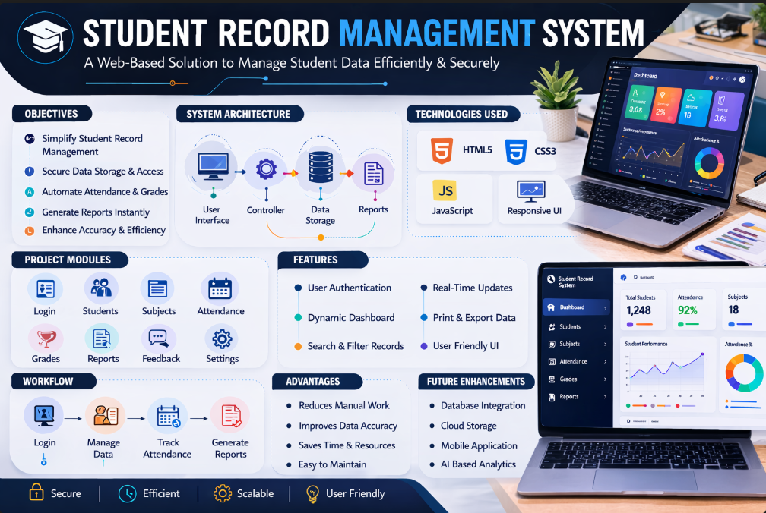
System Architecture

Slide 8
Project Modules
Login Module
Student Module
Subject Module
Attendance Module
Grades Module
Reports Module
Feedback Module

Slide 9
Objectives
Develop an efficient student record management system.
Simplify student data storage and retrieval.
Improve accuracy of attendance and grade records.
Reduce manual work in academic management.
Provide easy access to academic reports.

Slide 10
Co’s Attainments - FWD
CO1: Understand frontend web development concepts.
CO2: Design responsive web interfaces using HTML and CSS.
CO3: Implement dynamic features using JavaScript.
CO4: Develop interactive web applications.
CO5: Integrate multiple frontend modules effectively.

Slide 11
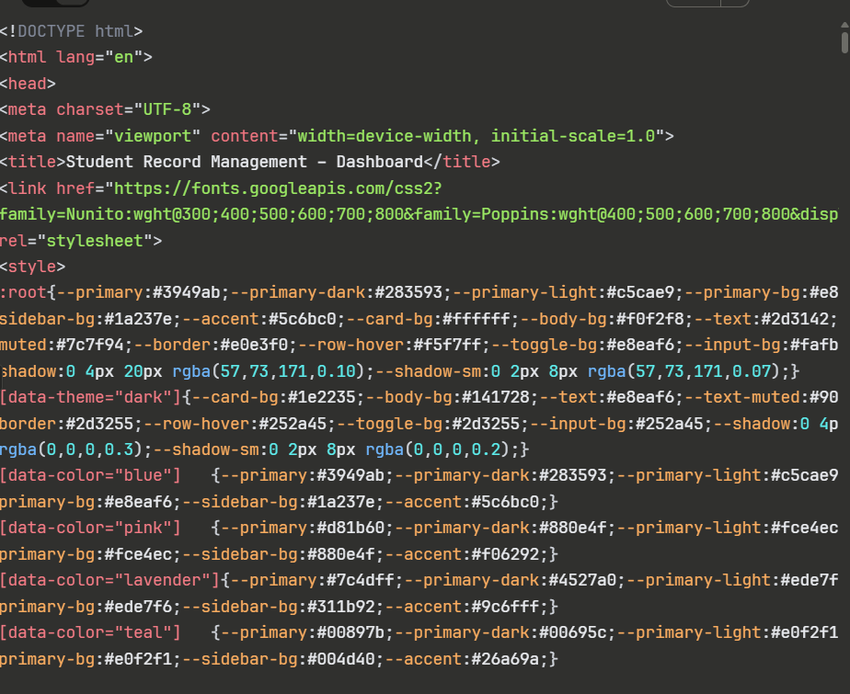
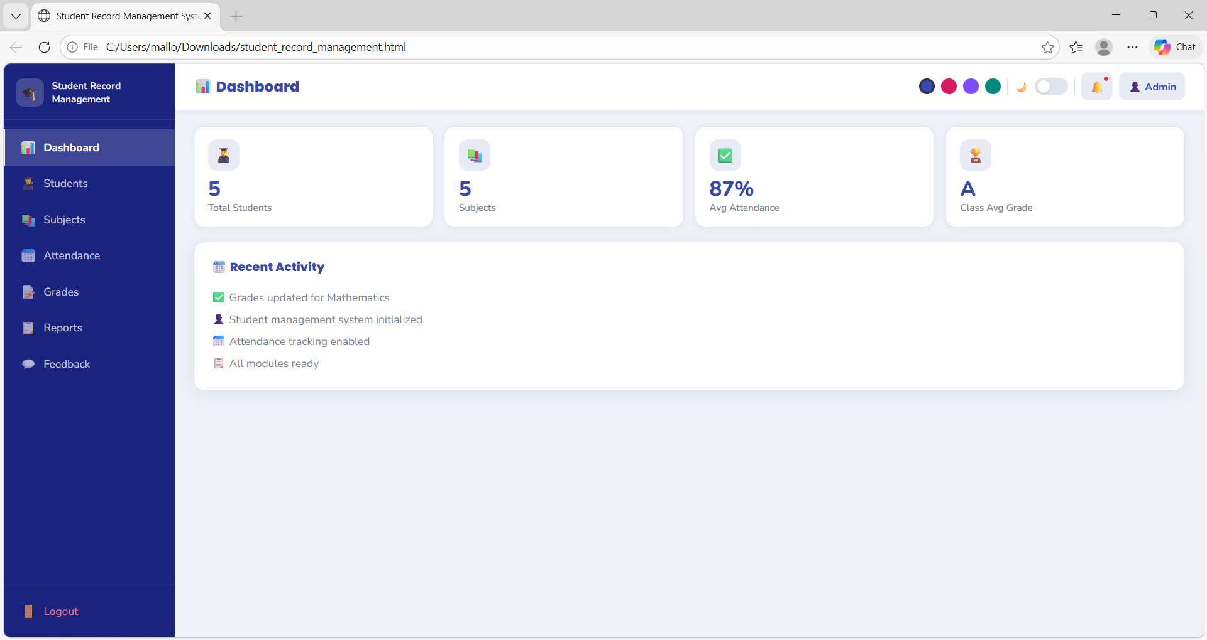
Screenshots for FWD

Slide 12
Conclusion
Developed a web-based Student Record Management System.
System simplifies academic data management.
Provides quick access to student records and reports.
Reduces manual effort and improves efficiency.
Can be enhanced with database and authentication features in future.

Slide 13
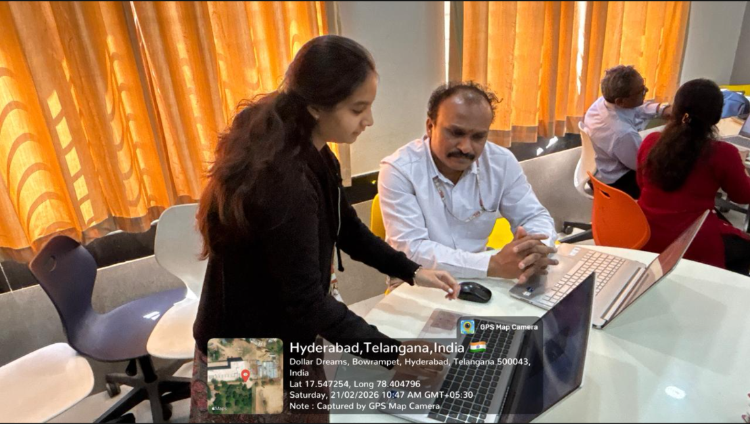
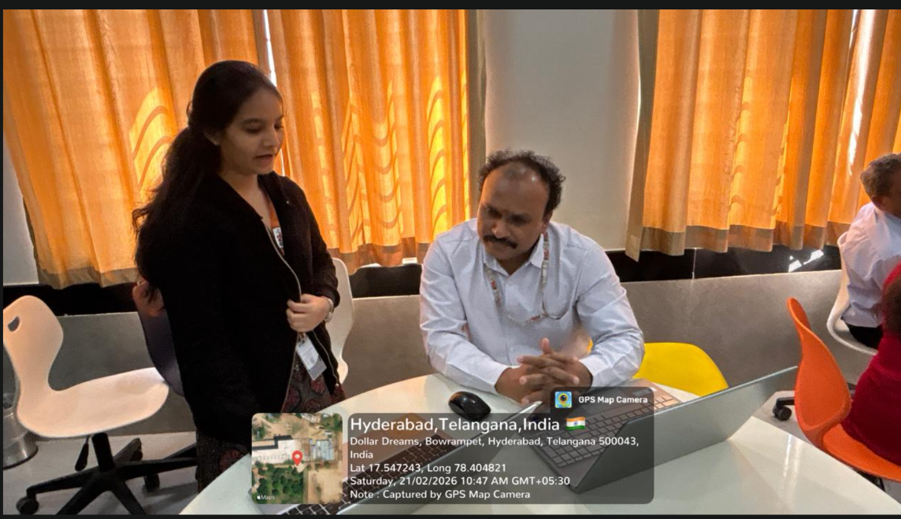
Geo- Tag Photos

Slide 14
THANK YOU

