Slide 1
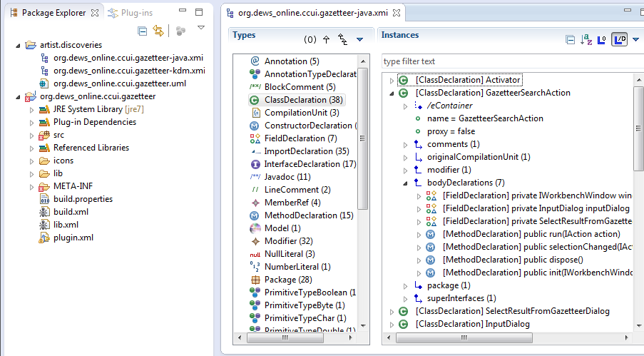
UML Model Discovery: Inputs

Slide 2
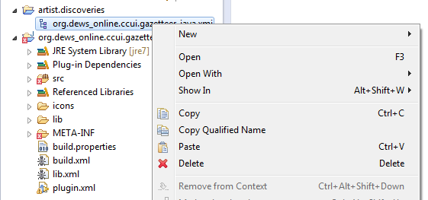
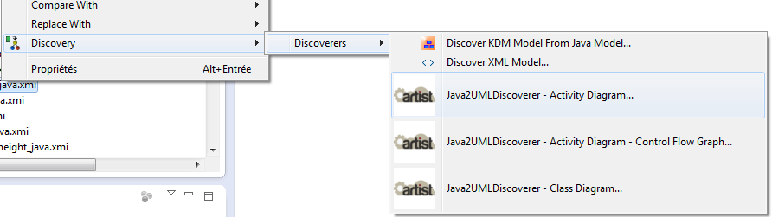
UML Model Discovery: direct from Java (class diagram)

Slide 3
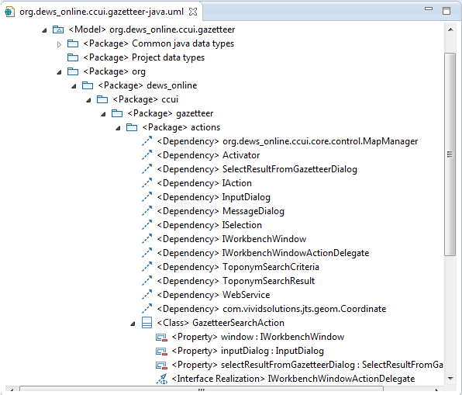
UML Model Discovery: direct from Java (class diagram)

Slide 4
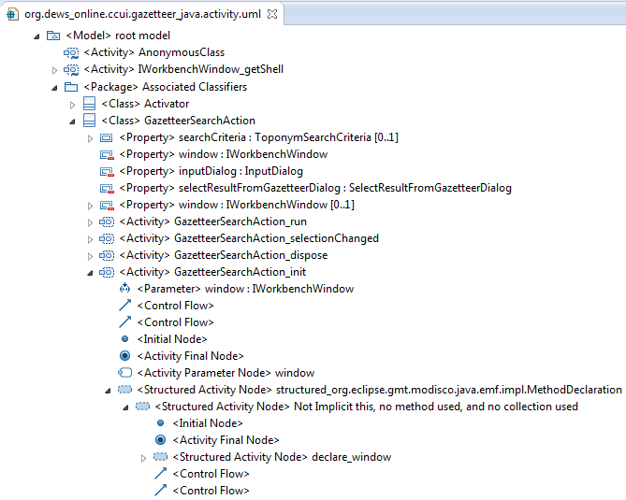
UML Model Discovery: direct from Java (activity diagram)

