Slide 1
Analysis of ATL Transformations
Matthieu Allon
Valerio Cosentino
© AtlanMod - atlanmod-contact@mines-nantes.fr
Notes:
29/05/13
29/05/13
29/05/13
29/05/13

Slide 2
Outline
Problem Description
Goal
Possible Approaches
Graph representation and uses cases
Feedbacks
31/05/13
© AtlanMod - atlanmod-contact@mines-nantes.fr
Notes:
29/05/13
29/05/13
29/05/13
29/05/13

Slide 3
Problem Description
ATL transformations can be difficult to understand
  Rules
    How they are connected each other
  Helpers
    Unused helpers
    What they do
The ATL debug does not help a lot
31/05/13
© AtlanMod - atlanmod-contact@mines-nantes.fr
Notes:
29/05/13
29/05/13
29/05/13
29/05/13

Slide 4
Goal
Facilitate the understanding of ATL transformations
  Graph representations
    Portolan
    SVG
  Offer a new solution to debug ATL transformations
31/05/13
© AtlanMod - atlanmod-contact@mines-nantes.fr
Notes:
29/05/13
29/05/13
29/05/13
29/05/13

Slide 5
Possible Approaches
Static Analysis
  ATL transformation files
Dynamic Analysis
  ATL engine
31/05/13
© AtlanMod - atlanmod-contact@mines-nantes.fr
Notes:
29/05/13
29/05/13
29/05/13

Slide 6
Possible Approaches
Static analysis
  Advantages:
    Input model independency
  Drawbacks:
    Input metamodel analysis
    Recursion identification
    Types in ATL transformation (OclAny) ?
    ATL metamodel dependency ?
31/05/13
© AtlanMod - atlanmod-contact@mines-nantes.fr
Notes:
29/05/13
29/05/13
29/05/13
29/05/13

Slide 7
Possible Approaches
Dynamic analysis
  Advantages:
    Recursion identification
    ATL engine stack information
  Drawbacks:
    Input model dependency
    Different ATL engines (EMFTVM)
    Increasing of memory use/computational time?
31/05/13
© AtlanMod - atlanmod-contact@mines-nantes.fr
Notes:
29/05/13
29/05/13
29/05/13
29/05/13

Slide 8
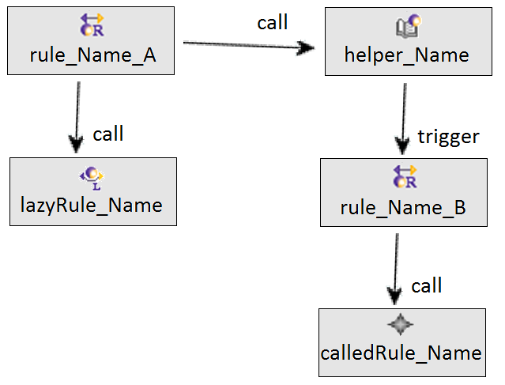
Graph representation
Elements representation :
31/05/13
© AtlanMod - atlanmod-contact@mines-nantes.fr
Notes:
29/05/13
29/05/13
29/05/13
29/05/13

Slide 9
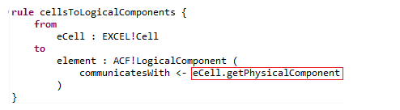

Graph use cases
Trigger of rules :
  One rule calling a helper :
31/05/13
© AtlanMod - atlanmod-contact@mines-nantes.fr
Notes:
29/05/13
29/05/13
29/05/13
29/05/13

Slide 10
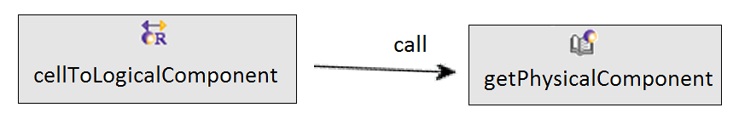
Graph use cases
Trigger of rules :
  One rule calling a helper :
31/05/13
© AtlanMod - atlanmod-contact@mines-nantes.fr
Notes:
29/05/13
29/05/13
29/05/13
29/05/13

Slide 11
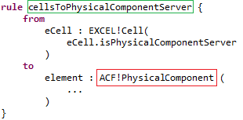
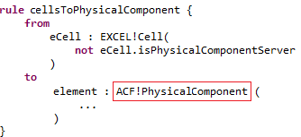
Graph use cases
Trigger of rules :
  And two others which generate the same element :
31/05/13
© AtlanMod - atlanmod-contact@mines-nantes.fr
Notes:
29/05/13
29/05/13
29/05/13
29/05/13

Slide 12
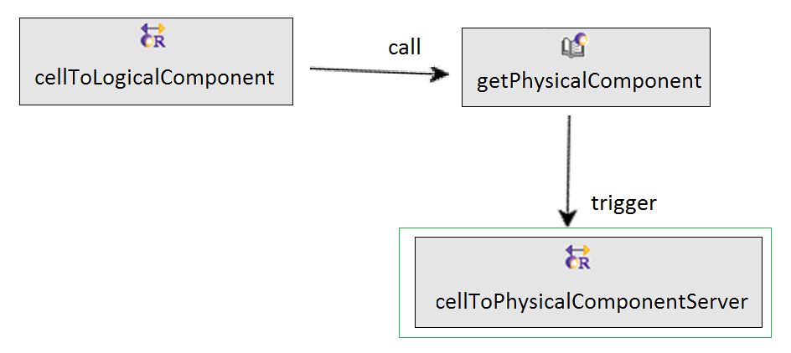
Graph use cases
Trigger of rules :
  The graph allow to know which rule is triggered
31/05/13
© AtlanMod - atlanmod-contact@mines-nantes.fr
Notes:
29/05/13
29/05/13
29/05/13
29/05/13

Slide 13
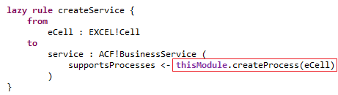
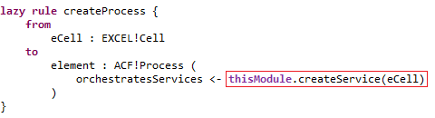
Graph use cases
Recursion with rules / helpers :
  Recursion with two lazy rules
31/05/13
© AtlanMod - atlanmod-contact@mines-nantes.fr
Notes:
29/05/13
29/05/13
29/05/13
29/05/13

Slide 14
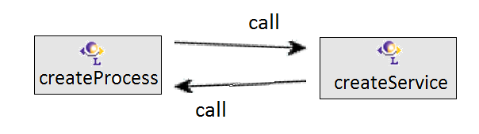
Graph use cases
Recursion with rules / helpers :
  The graph allows to know where is the recursion
31/05/13
© AtlanMod - atlanmod-contact@mines-nantes.fr
Notes:
29/05/13
29/05/13
29/05/13
29/05/13

Slide 15
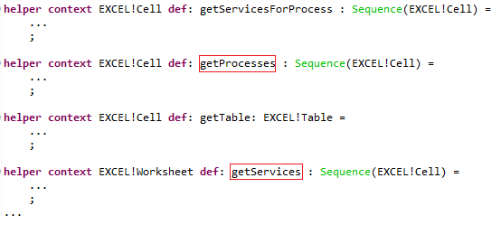
Graph use cases
Helpers / rules used :
  How to quicly know which helpers are used ?
31/05/13
© AtlanMod - atlanmod-contact@mines-nantes.fr
Notes:
29/05/13
29/05/13
29/05/13
29/05/13

Slide 16
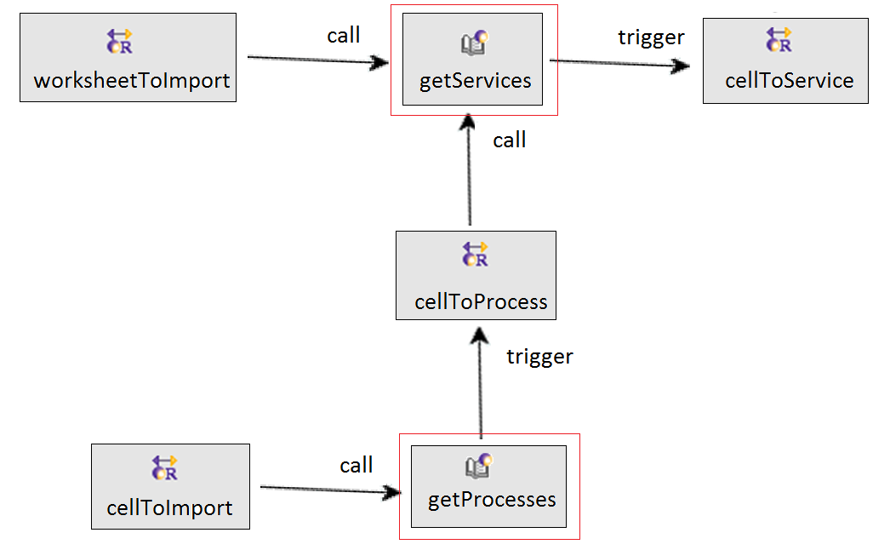
Graph use cases
Helpers / rules used :
  Graph allows to know which helpers are used
31/05/13
© AtlanMod - atlanmod-contact@mines-nantes.fr
Notes:
29/05/13
29/05/13
29/05/13
29/05/13

Slide 17
Feedbacks
31/05/13
© AtlanMod - atlanmod-contact@mines-nantes.fr
Notes:
29/05/13
29/05/13
29/05/13
29/05/13

