Slide 1
PSYC 3400 Statistical Methods in Psychological Research
Science and Statistics Matthew Crump

Slide 2
class: pink, center, middle, clear

Slide 3
Course Overview

Slide 4
class: pink, center, middle, clear

Slide 5
Why is statistics a required course?

Slide 6
Psychological Facts & Theories
Psychological science produces facts and theories.
–
“Facts” are produced by collecting measurements about psychological phenomena, and by running experiments to establish the root causes of the phenomena
–
“Theories” are working explanations of a set of facts, they describe how causal forces work to produce the psychological phenomena

Slide 7
Facts depend on Evidence
“Facts” about psychology are only as good as the evidence for them.
Facts can be relied upon when the evidence for their existence is indispustable (clear-cut). There are many reliable findings in Psychology.
You should not believe every fact you hear!
Many findings in psychology are unreliable (other researchers can’t reproduce them), some are faked! and, others are downright silly.

Slide 8
Theories must explain evidence
The whole point of theories is to explain evidence, or the credible facts about a psychological phenomena of interest
There are many good, strong, theories in Psychology capable of explaining many aspects of Psychological phenomena, BUT:
You should not believe every theory you hear about in Psychology! Many “theories” do not explain the facts. Some “theories” aren’t theories at all, they are just someone’s opinion.

Slide 9
class: pink, center, middle, clear

Slide 10
Umm, How can we trust the facts and theories in Psychology?
You need to learn how to evaluate the evidence

Slide 11
All Psychology needs statistics
Psychologists run experiments to test research questions and claims
–
2. The experiments produce measurements, or evidence
Statistics are used to evaluate the evidence
–
Does the evidence support the claim?
–
Does the evidence not support the claim?

Slide 12
When you hear a scientific claim…
You could accept the claim because “a Scientist said it was true”
You could evaluate the evidence for claim and decide for yourself if the evidence warrants the claim.
Just because a scientist makes a claim, doesn’t make it true

Slide 13
class: pink, center, middle, clear

Slide 14
The case of power-posing

Slide 15
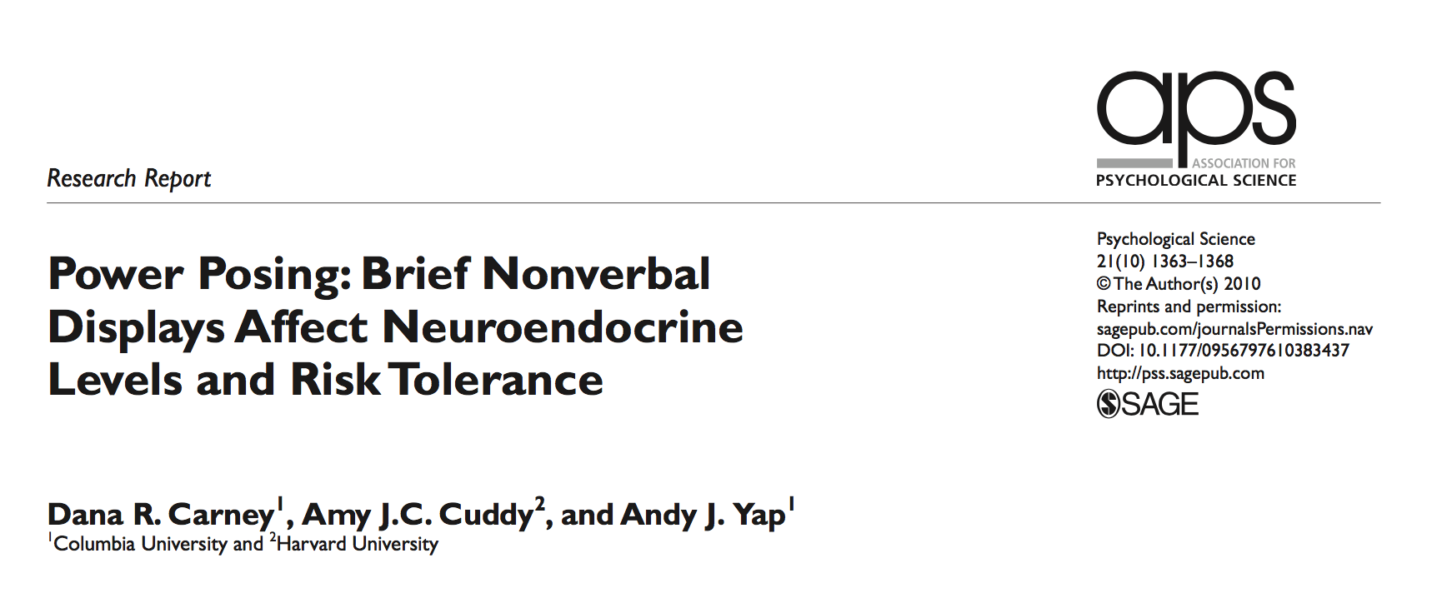
Can a powerful pose change your life?

Slide 16
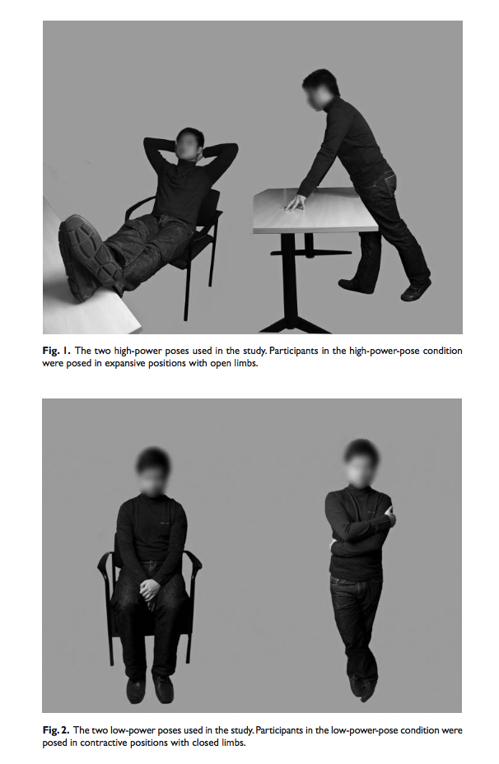
High vs. low power poses

Slide 17
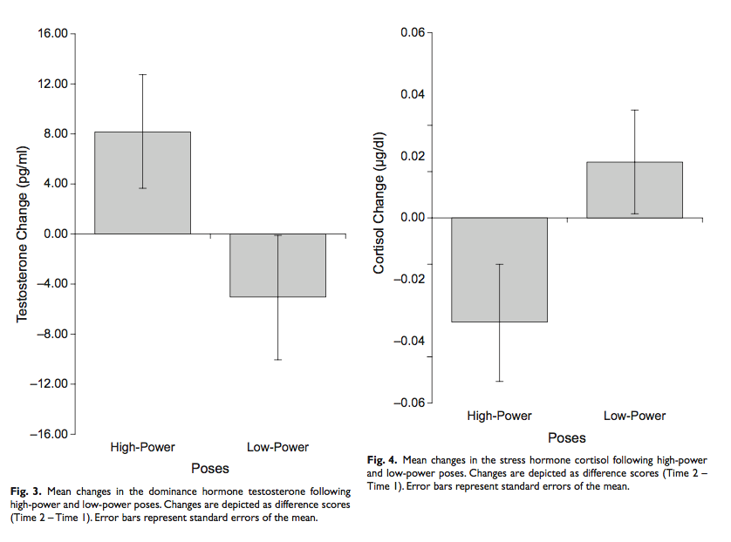
The “evidence”

Slide 18

Big claims gone public
Amy Cuddy gave a TED Talk (viewed by 48 million people) claiming power posing can change your life!
link to ted talk

Slide 19
The problem:
Only a single study, with weak evidence
Many other labs tried to reproduce the findings, but they failed to replicate
Lesson 1: Don’t believe everything you hear just because Science says so.
Lesson 2: To understand Psychological science, you must understand how to evaluate evidence produced by Psychological science.

Slide 20
class: pink, center, middle, clear

Slide 21
Course Overview

Slide 22
Course Resources
This is a zero-textbook cost course. All of the resources are online and FREE!
Course Website https://crumplab.github.io/psyc3400
FREE Textbook https://crumplab.github.io/statistics
FREE Lab Manual https://crumplab.github.io/statisticsLab

Slide 23
Skills you learn in this course
Using data to answer questions about Psychology
–
Foundational statistical concepts
–
How to make your computer do statistics for you
–
How to think with data
–
How to critically evaluate research findings

Slide 24
class: pink, center, middle, clear

Slide 25
How this course works

Slide 26
Lectures
Generally 2 per week
We talk about statistics
Read the chapters assigned for each week
Ask questions
Attendance sheet handed out at beginning of class (missed class policy in a bit)

Slide 27
Weekly Quizzes (25% of grade)
New quiz every week
Complete quiz on Blackboard (the blackboard account for your lecture section)
Can re-take as many times as you want
Always recieve grade on last attempt (not best attempt)
DO YOUR QUIZ BY YOURSELF
Must complete quiz by end of week deadline
Quizzes are worth 25% of final grade
You will see many of the quiz questions on the midterm and final.

Slide 28
Midterm (10% of grade)
Multiple choice questions. Many taken from the quizzes
More info about midterm as we get closer

Slide 29
Final (25% of grade)
Multiple choice questions. Many taken from the quizzes
Final is cumulative (75% last half of course, 25% first half)

Slide 30
Labs (40% of grade)
Each week you will learn how to do statistics in R and R-studio, a free program for statistics. Labs have three parts
Lab exercises (learning) (1 point pass/fail, must attend lab and submit your work to pass)
Generalization, attempt to solve a problem using what you learned (1 point pass/fail, must submit something even if it doesn’t work)
Writing. Answer some concep questions (2 points, Graded by Lab instructor).

Slide 31
Extra Credit
I will announce opporunities for extra credit as we go through the course. Extra credit opportunities may count for up to 2% of your final grade.

Slide 32
Let’s look at the course website
https://crumplab.github.io/psyc3400

Slide 33
R and R-studio
Download R https://www.r-project.org
Download R-studio https://www.rstudio.com
Or, use R-studio Cloud in your web-browser https://rstudio.cloud

