Slide 1
Foundations for statistical inference
whodunnit? Matthew Crump

Slide 2
class: pink, center, middle, clear

Slide 3
Did chance produce your difference?

Slide 4
Issues for this class
Sampling distribution of the mean differences
Experiments
Crump test

Slide 5
class: pink, center, middle, clear

Slide 6
What is statistical inference?

Slide 7
Descriptive vs. inferential statistics
Descriptive statistics: - Tools for summarizing the shape, center, and variance of sample data
Inferential statistics: - Tools for making educated guesses about where the sample data came from

Slide 8
Making inferences about chance
Let’s say you run an experiment: You measure two samples in each of two experimental conditions, and you find a difference between the sample means.
Question:
Did the experimental manipulation cause the difference between the sample means?
Could random chance (sampling error) have caused the difference?

Slide 9
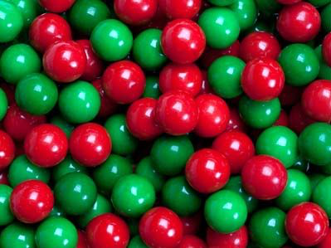
Gumballs: A silly start
.pull-left[ 1. 50% red and green balls 2. You are blindfolded 3. You grab 5 balls with left hand, then 5 with right hand
Question:
Can using your left hand cause you to grab more green balls?
]
.pull-right[

Slide 10
]

Slide 11
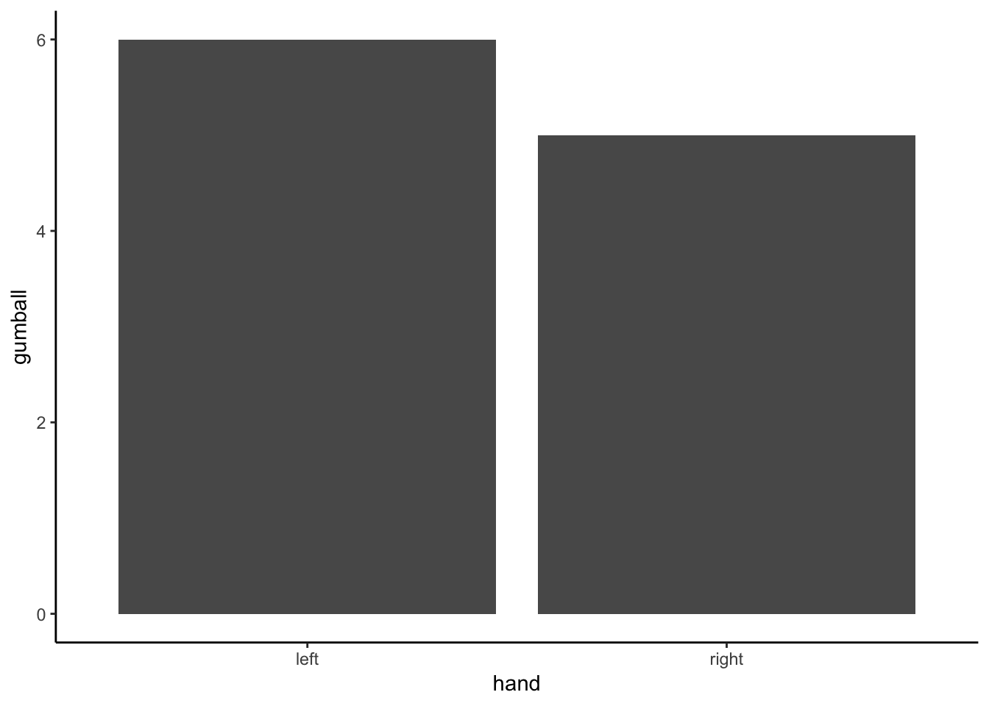
Outcome of one experiment

Slide 12
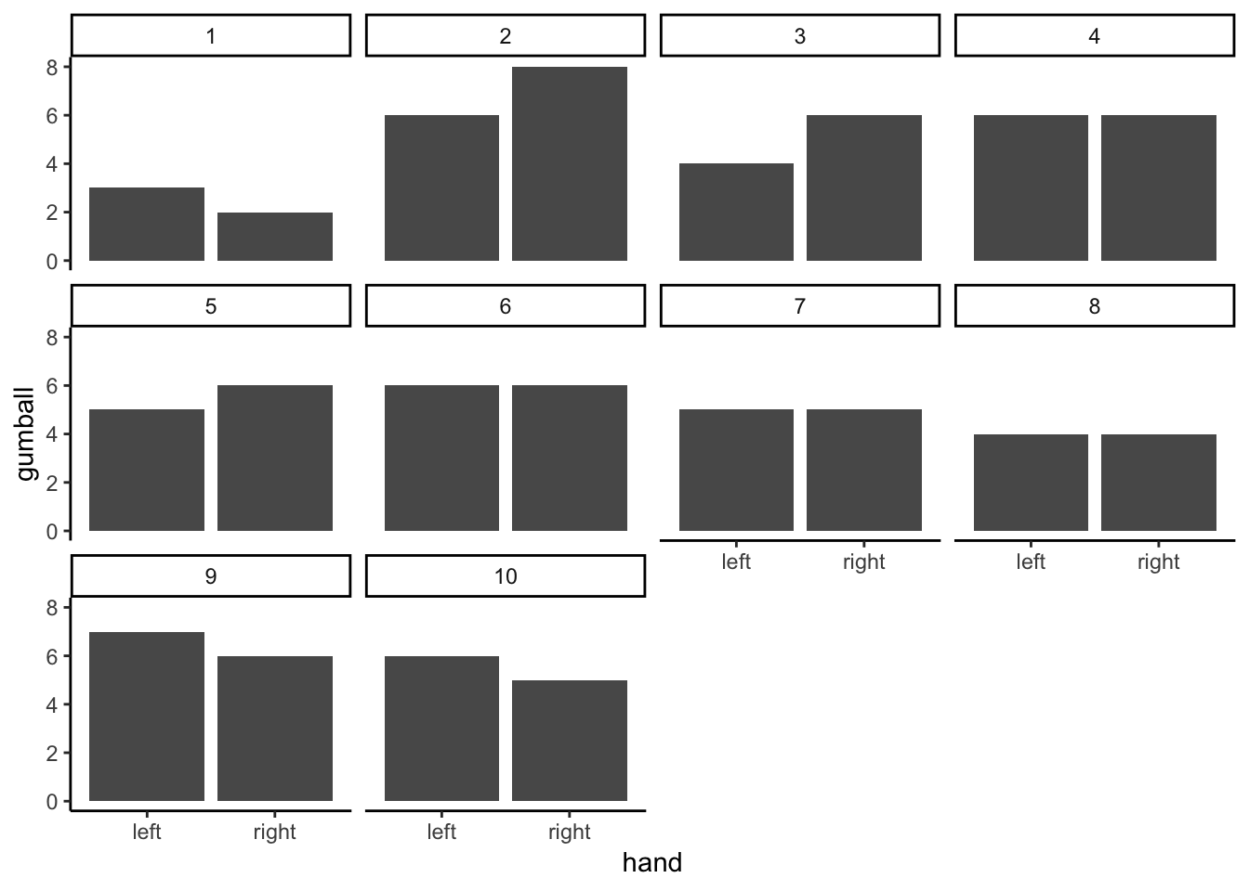
Outcome of many experiments

Slide 13
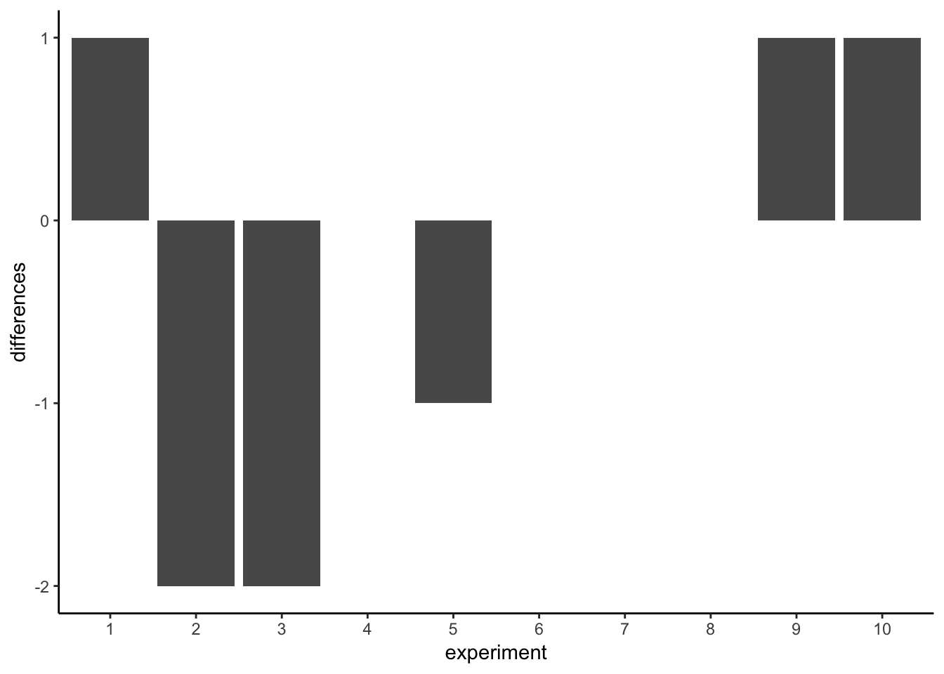
Difference scores

Slide 14
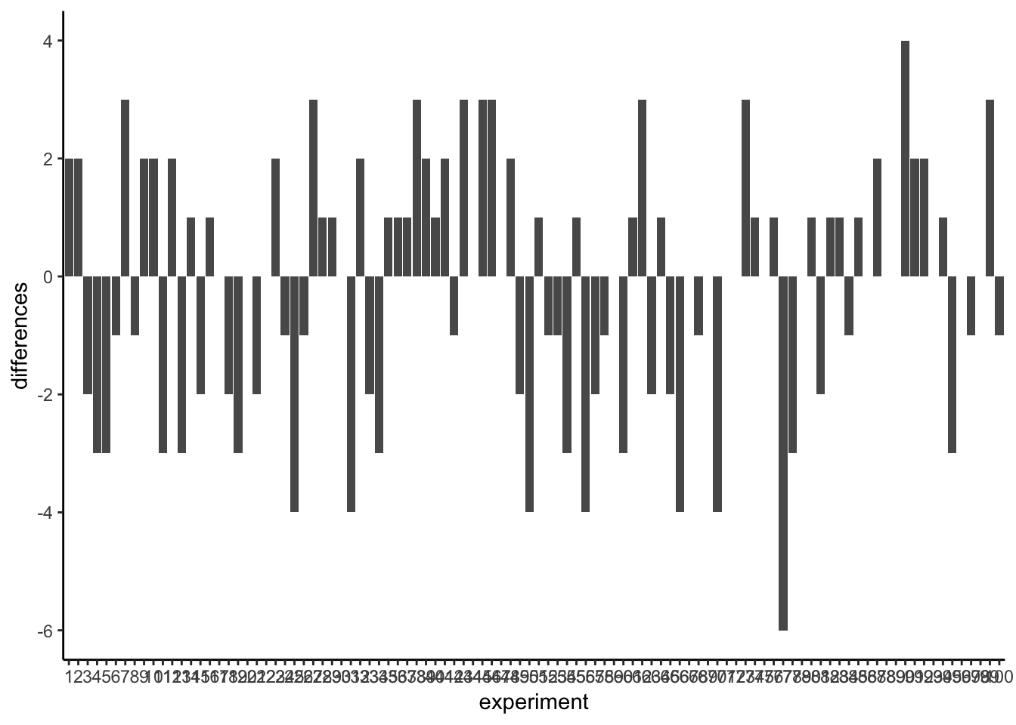
Difference scores (100 sims)

Slide 15
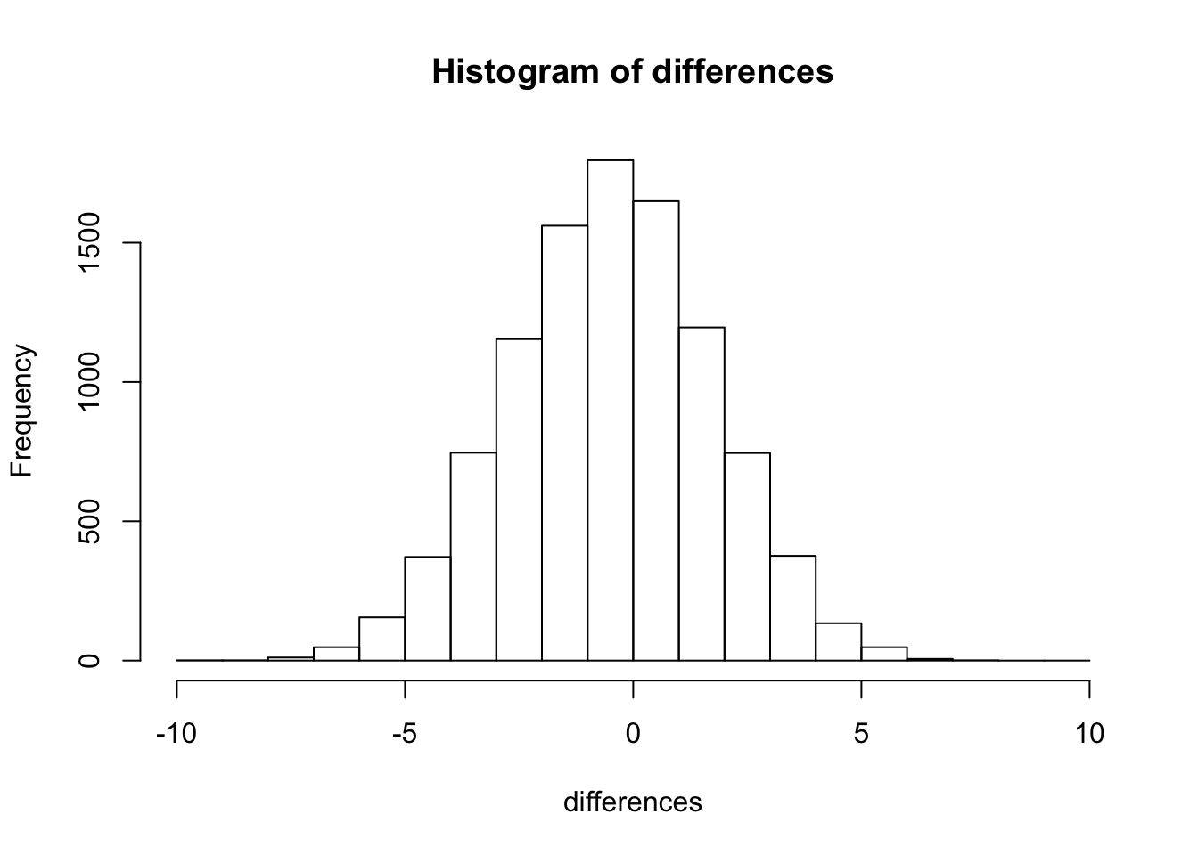
Histogram: Difference scores

Slide 16
Interpretation
.pull-left[
The sampling distribution of mean difference scores shows the range of mean differences that can be produced by chance alone.
We can use this to evaluate the outcome of an experiment
]
.pull-right[

Slide 17
]

Slide 18
Interpretation
.pull-left[
What if mean difference was 0?
What if mean difference was 3?
What if mean difference was 6?
]
.pull-right[

Slide 19
]

Slide 20
How much evidence do you need?
How big would the mean difference need to be? to convince you that the difference was not caused by chance

Slide 21
class: pink, center, middle, clear

Slide 22
Experiments

Slide 23
Experiments
Experiments are tools we use to uncover causal forces. At minimum they must have:
One independent variable
The Manipulation
must have at least 2 levels
One dependent variable
The Measurement

Slide 24
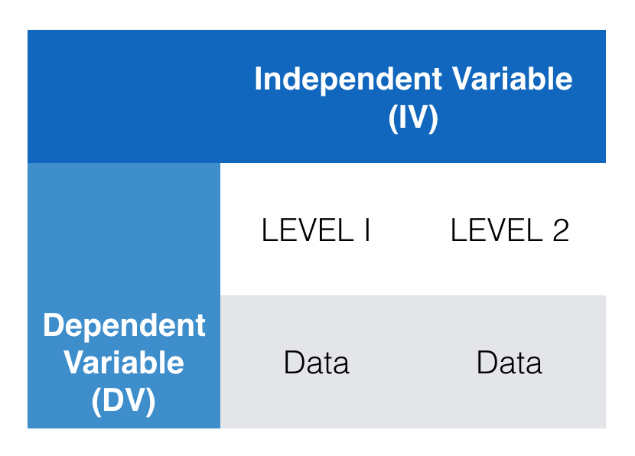
A simple experiment

Slide 25
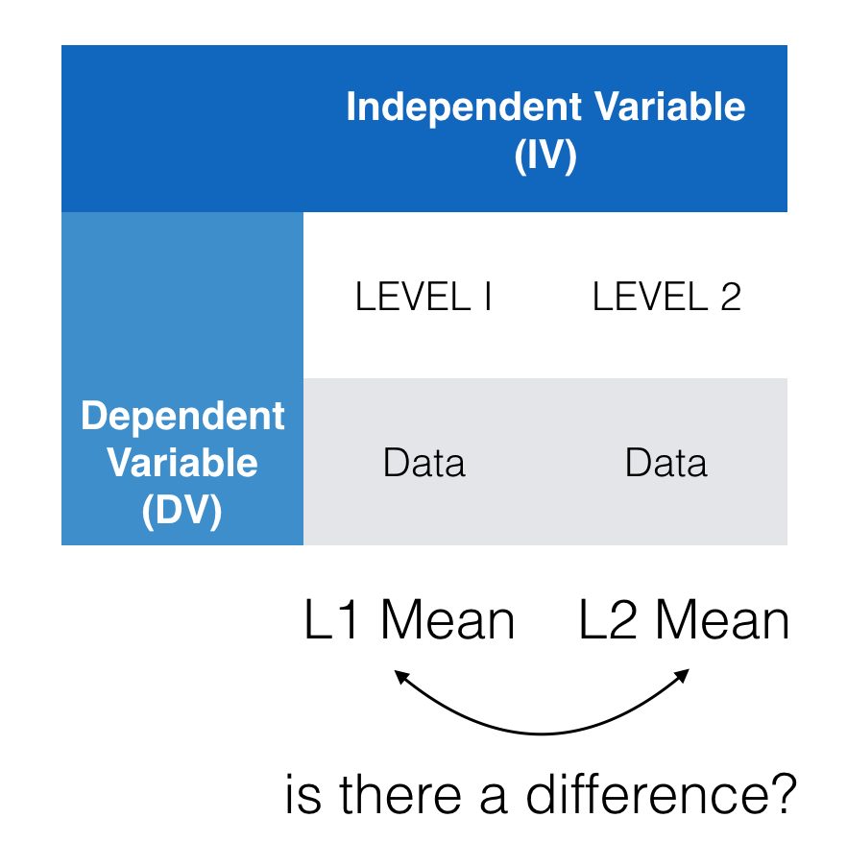
The empirical question

Slide 26
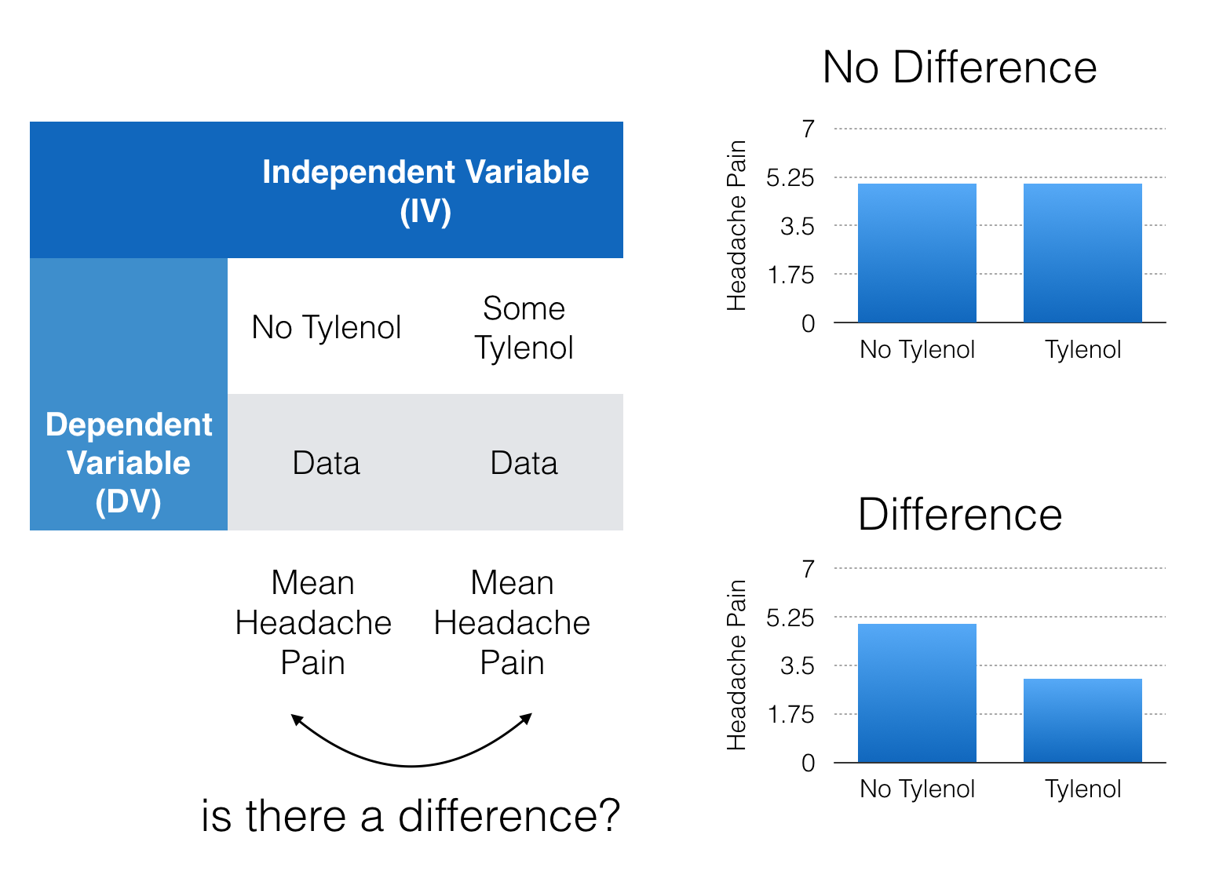
Interpreting the outcomes

Slide 27
Interpreting the outcomes
We run experiments to determine if a manipulation can cause differences in a measurement.
If we find a difference, it could mean:
Manipulation caused the difference
A confound caused the difference
Difference was produced by chance

Slide 28
The role of chance
Question: How can we know if a difference we observed was produced by chance?
Answer: We find out the range of differences that chance can produce, then we compare our observed difference to this range.

Slide 29
The Crump Test
A made up test to illustrate the process of statistical inference
Frequency of occurence (what is not alot)
Simulating chance
Judgment and Decision-making
Experiment design
Power

Slide 30
Frequency of occurence
We will be finding out how often chance produces mean differences of particular sizes
Let’s say chance produced a difference of 5 fairly often, if we found a difference of 5, we would know that chance could have produced it.
When would we say that an outcome does not occur very often?

Slide 31
Infrequent events
How many times does something need to happen for it to happen not very much, or even really not at all?
Rare enough for you to not worry about it at all happening to you?

Slide 32
Lightning strikes
Would you go outside everyday if you thought that you would get hit by lightning 1 out of every 10 days?
What about?
1/100 days (3 times per year)
1/1,000 days (once every 2.7 years)
1/10,000 days (once every 27 years)
1/100,000 days (once every 273 years)
Where do you draw the line?

Slide 33
Drawing the line
There is no objective line defining rare events. You need to pick one you are comfortable with.
Let’s pick 1/10,000
We are saying that if an event happens once in 10,000 times, it is a rare event.

Slide 34
Textbook Example
Experiment with two groups, A and B. Let’s imagine there is no manipulation, so we are measuring sampling from the same population twice.
Each group has 10 subjects (N=10)
Samples are taken from a normal population with mean=100, and sd = 20
rnorm(10,mean=100, sd=20)

Slide 35
set paramaters of simulation
sims_to_run <- 10000 sample_n <- 10 dist_mean <- 100 dist_sd <- 20

Slide 36
run simulation
mean_differences <- length(sims_to_run) for(i in 1:sims_to_run){ mean_A <- mean(rnorm(sample_n, dist_mean, dist_sd)) mean_B <- mean(rnorm(sample_n, dist_mean, dist_sd)) mean_differences[i] <- mean_A - mean_B }

Slide 37
Histogram: Mean differences

Slide 38
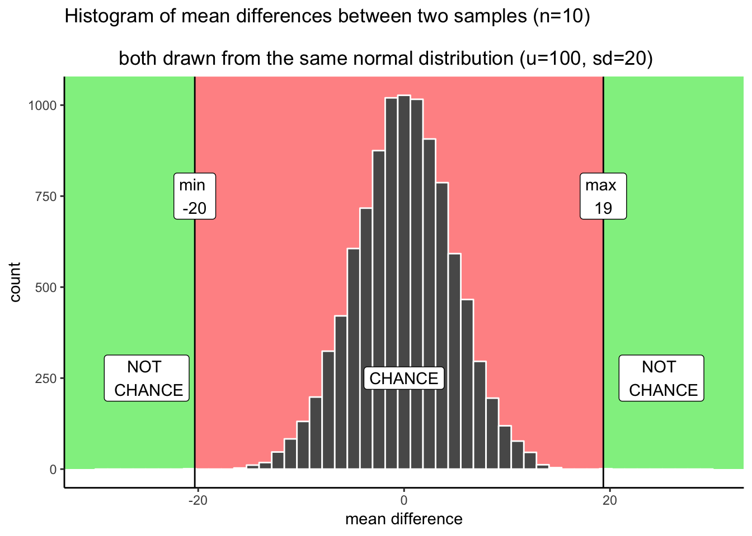
The Chance window

Slide 39
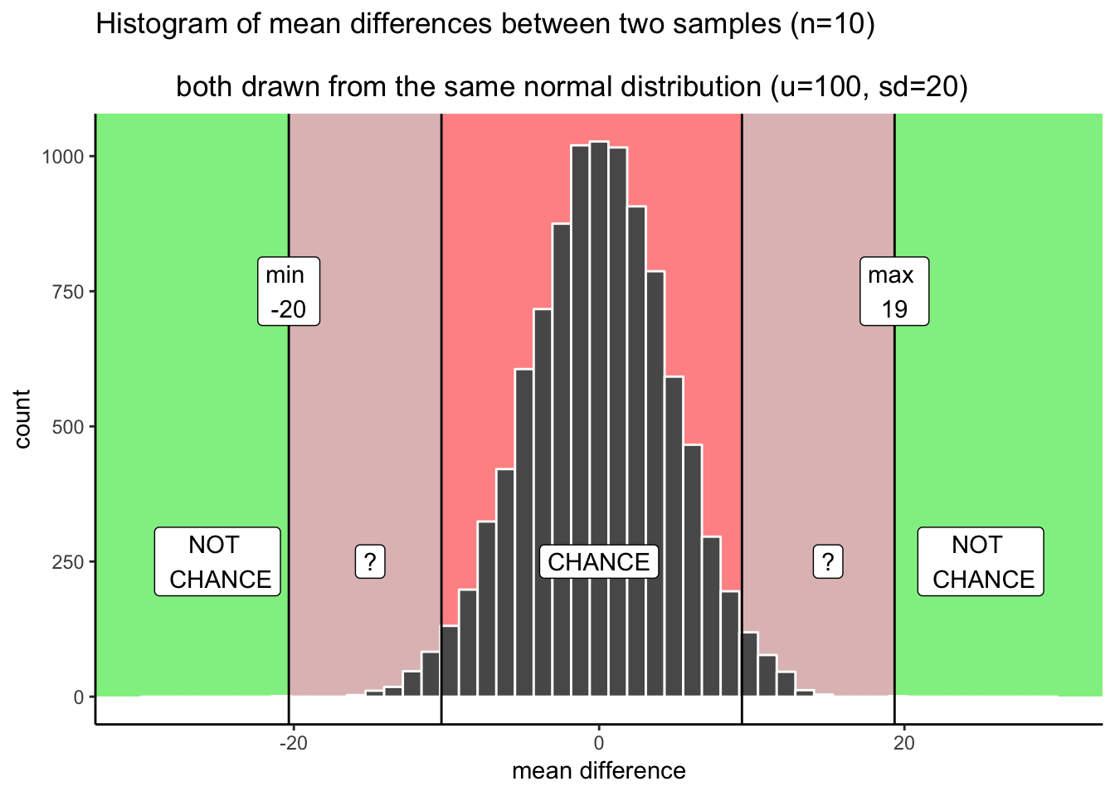
Allowing for uncertainty

Slide 40
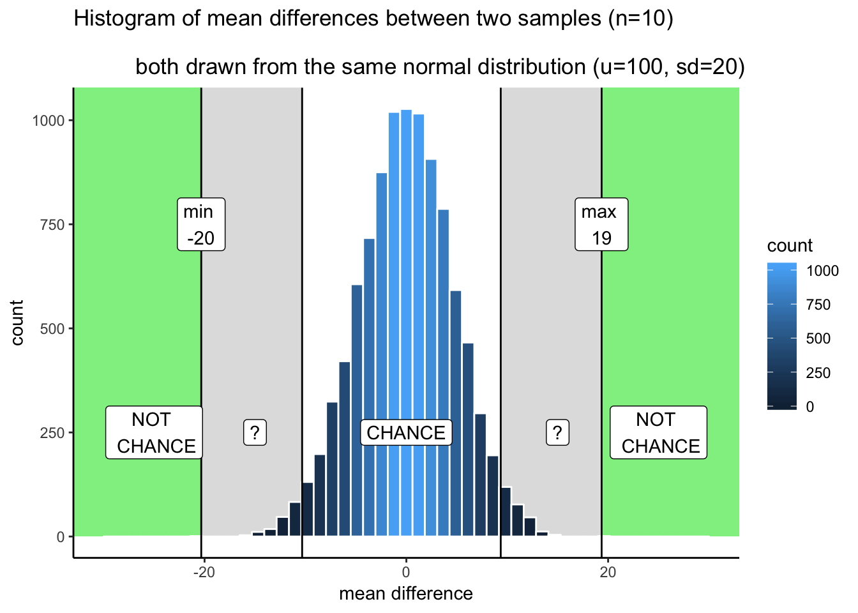
Shades of uncertainty

Slide 41
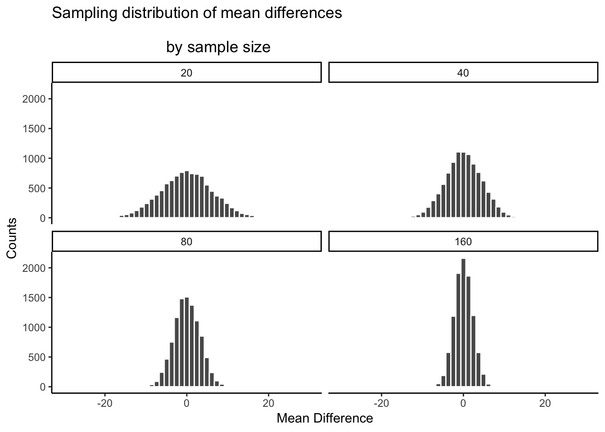
Sample size

Slide 42
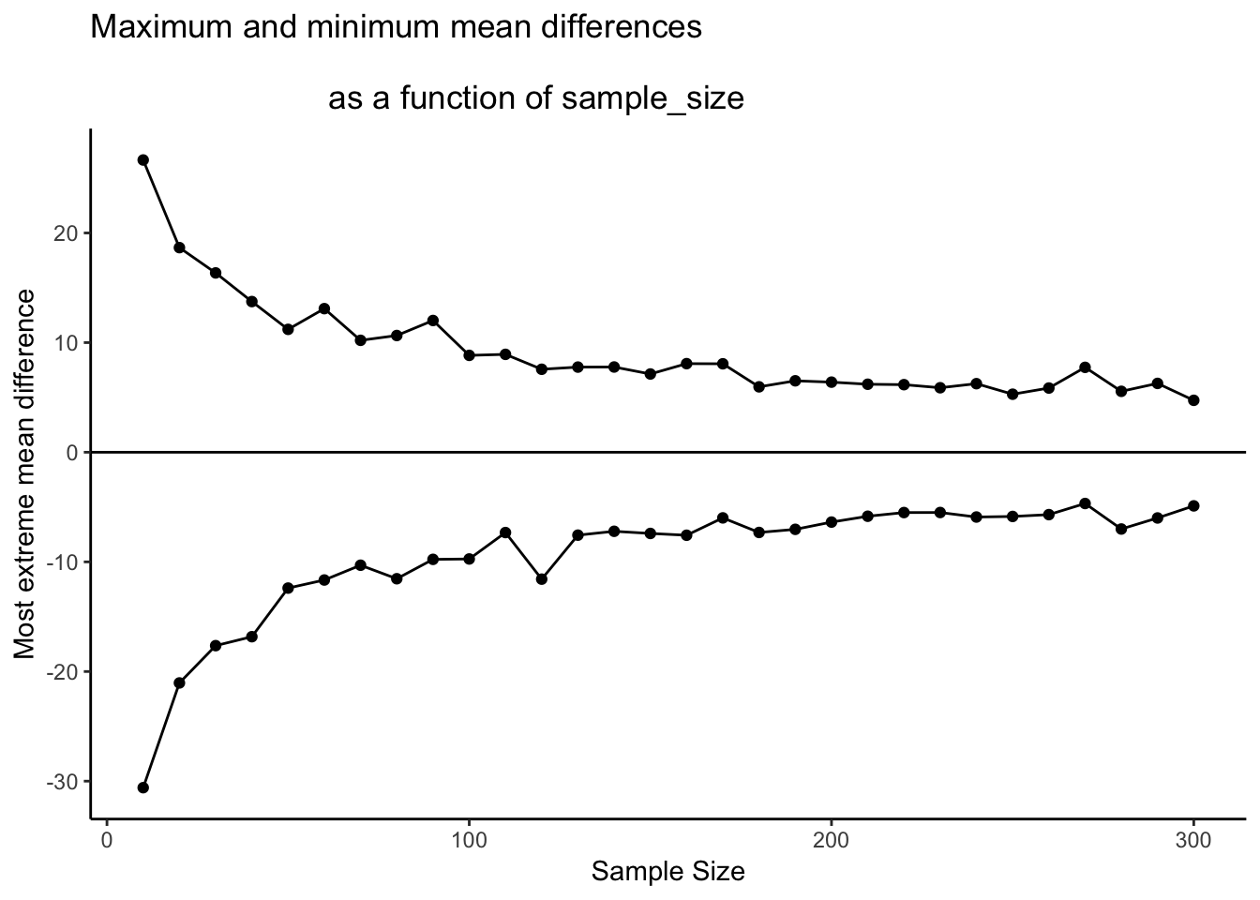
Differences that chance can produce

Slide 43
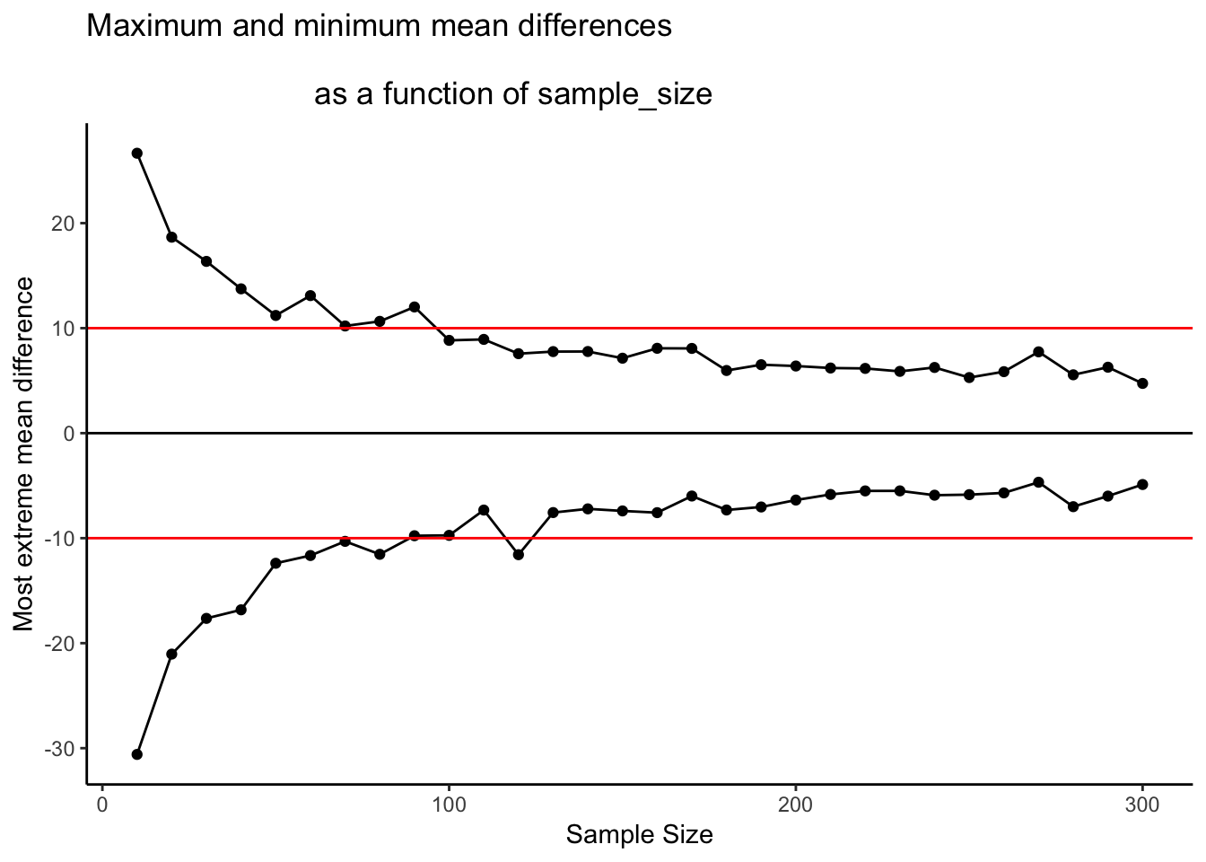
Sample-size and detecting differences

Slide 44
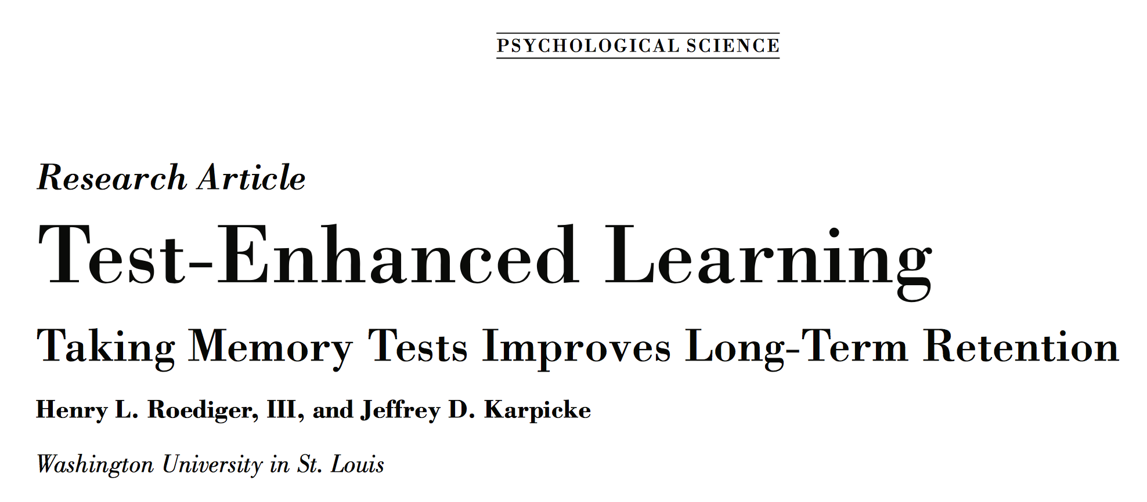
Test-enhanced learning

Slide 45
The experiment
Question: Does being tested on the material cause you to remember it better later?
Study-Study group: Studied some text twice
Study-Test group: Studied some text, then given brief quizzes about the text

Slide 46
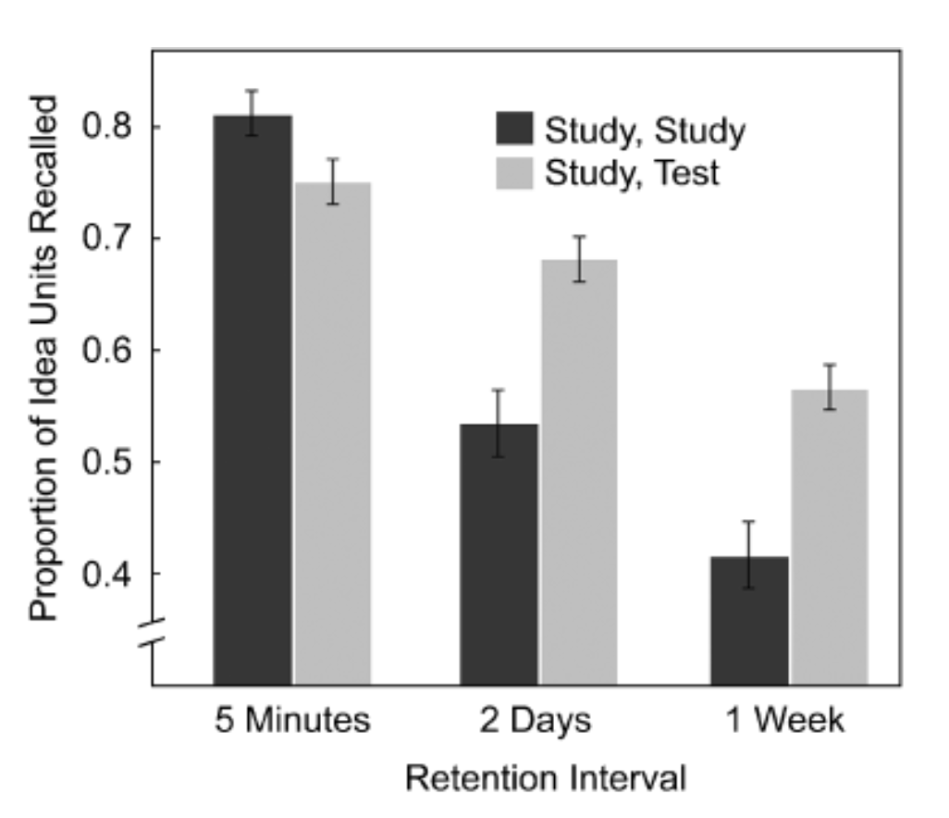
the data

Slide 47
Estimate parameters
Assume both samples came from same distribution, estimated parameters from paper:
sims_to_run <- 100 sample_n <- 40 dist_mean <- .49 dist_sd <- .168

Slide 48
run simulation
Simulate 100 times
mean_differences <- length(sims_to_run) for(i in 1:sims_to_run){ mean_control_A <- mean(rnorm(sample_n, dist_mean, dist_sd)) mean_control_B <- mean(rnorm(sample_n, dist_mean, dist_sd)) mean_differences[i] <- mean_control_A - mean_control_B }

Slide 49
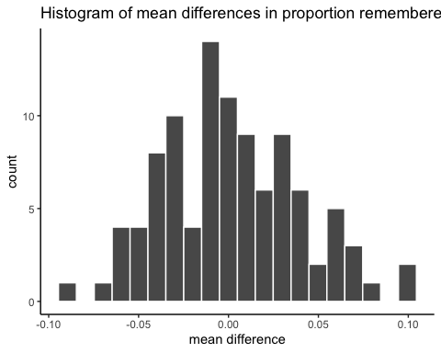
plot mean differences

Slide 50
find range, make a judgment
## [1] -0.09112991
## [1] 0.09797992
-observed mean difference was .14

Slide 51
Next class: Randomization Test
Thursday, October 4th: Randomizing data from a sample for statistical inference, and intro to hypothesis testing

