Slide 1
t-tests
Paired sample Matthew Crump

Slide 2
class: pink, center, middle, clear

Slide 3
t-tests and designs

Slide 4
Three kinds of t-tests
one-sample
paired-sample
Independent sample

Slide 5
One-sample t-test
Purpose: Compare sample mean to a hypothetical population mean

Slide 6
Paired-sample t-test
Purpose: Compare two sample means in a within-subjects design
Within-subjects design: Same subjects are measured across both levels of the experimental manipulation (independent variable)

Slide 7
Consider this
Within-subjects experiment, n=5, all subjects are measured in level A and B of the experiment.
subjects
level_A
level_B
1
1
4
2
4
8
3
3
7
4
6
9
5
5
10

Slide 8
Empirical question
Did the manipulation (A vs. B) cause a difference in the measure?
subjects
level_A
level_B
1
1
4
2
4
8
3
3
7
4
6
9
5
5
10

Slide 9
Difference scores
How could a t-test be used to analyze the difference scores?
subjects
level_A
level_B
differences
1
1
4
3
2
4
8
4
3
3
7
4
4
6
9
3
5
5
10
5

Slide 10
Paired samples t-test
.pull-left[
Purpose: Compare two means from paired samples
${\overset{‾}{X}}_{D}$ = mean of difference scores
$u_{0}$ = hypothetical population mean of 0
$s_{D}$ = sample standard deviation of difference scores (divide by n-1)
$n$ = sample-size
]
.pull-right[
$t=\frac{\overset{‾}{X_{D}}−u_{0}}{{\text{SEM}}_{D}}$
$t=\frac{\overset{‾}{X_{D}}−u_{0}}{\frac{s_{D}}{\sqrt{n}}}$
$s=\sqrt{\frac{∑{\left(x_{i}−\overset{‾}{X}\right)}^{2}}{N−1}}$
]

Slide 11
In other words
.pull-left[
A paired samples t-test is a one-sample t-test applied to the difference scores
We are testing the null-hypothesis that the differences have a mean of 0 (u=0).
]
.pull-right[
Observed $t$ for paired samples test:
$t=\frac{\text{Mean of Difference scores}}{\text{SEM of Difference scores}}$
]

Slide 12
Calculating Difference scores
Assume 5 subjects participated in both conditions (A and B) of an experiment.
A <-c(1,4,3,6,5) B <-c(4,8,7,9,10) difference <- B-A print(difference)
## [1] 3 4 4 3 5

Slide 13
Calculating Mean and SEM
A <-c(1,4,3,6,5) B <-c(4,8,7,9,10) difference <- B-A # Calculate Mean mean(difference)
## [1] 3.8
# Calculate SEM sd(difference)/sqrt(length(difference))
## [1] 0.3741657

Slide 14
Calculate t (paired samples)
A <-c(1,4,3,6,5) B <-c(4,8,7,9,10) difference <- B-A mean_D <- mean(difference) SEM_D <- sd(difference)/sqrt(length(difference)) # calculate t mean_D/SEM_D
## [1] 10.15593

Slide 15
using the t.test() function
There are two ways to use the t.test() function to calculate t for paired samples
Treat the data as difference scores
A <-c(1,4,3,6,5) B <-c(4,8,7,9,10) difference <- B-A t.test(difference)$statistic
## t ## 10.15593

Slide 16
using the t.test() function
Use both variables for each sample, and set paired=TRUE
A <-c(1,4,3,6,5) B <-c(4,8,7,9,10) t.test(A,B, paired=TRUE)$statistic
## t ## -10.15593
Note: t is (-) here because the t.test formula computes the differences as the first variable minus the second variable.

Slide 17
class: pink, center, middle, clear

Slide 18
Hypothesis testing

Slide 19
Where did t come from?
We can compute t for a paired sample
Next Steps for hypothesis testing:
Big Question: Could our observed t be produced by chance alone?
How can we figure this out?

Slide 20
Null distribution of t
Answer: We need to find out what kind of ts can be produced by chance alone
we need to find the null distribution of t

Slide 21
What is the null distribution of t?
Null distribution of t: - the distribution of t values that would occur by chance alone if the experimental manipulation caused no difference in the sample means

Slide 22
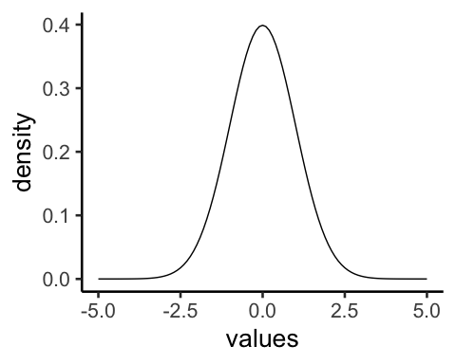
Hypothetical possibilities
.pull-left[
The null
both samples come from the same distribution

Slide 23
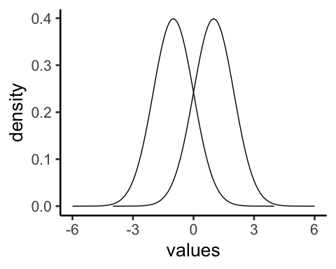
]
.pull-right[
The “alternative”
each sample comes from it’s own distribution

Slide 24
]

Slide 25
Considering the null
.pull-left[
The null
both samples come from the same distribution

Slide 26
]
.pull-right[
Question:
.font80[ - if we sampled two sets of scores from the same distribution, what would we expect for the sampling distribution of the mean difference scores? - how about the sampling distribution of t?]
]

Slide 27
Observed vs. critical t
Observed t: - the t-value that you calculate from your data
Critical t: - a t-value associated with the null-distribution - depends on alpha, and df - e.g., if alpha =.05, then any t bigger than critical t occurs 5% of the time by chance

Slide 28
simulating t
The following slide allows you to explore simulating a null and alternative distributions for a paired sample t-test
pick n (sample-size)
choose mean of normal distribution for each sample
choose sd of normal distribution
choose number of simulations

Slide 29
class: center, middle, clear
<iframe style=“width:100%;height:100%;border-style:none;”, src=“https://crumplab.shinyapps.io/pairedTtest/” />

Slide 30
Questions to ask
When each sample comes from the same distribution, what is the average mean difference between the samples?
–
What happens to the range of the sampling distribution of mean differences as sample-size increases?
–
What happens to the range of the sampling distribution of mean differences as the standard deviation of the population increases?

Slide 31
More questions
If the two samples are taken from the same distribution, what percent of the time will be the observed t-value be greater than critical t?
What happens to observed t when the samples are taken from distributions with different means?
What are some ways (e.g., change sample-size, sd, mean difference) to ensure that observed t will generally be larger than critical t?

Slide 32
Critical t
Critical t is set by two properties:
the alpha criterion
whether the test is directional (one-tailed) or non-directional (two-tailed)

Slide 33
Directional test (reminder)
A directional test assumes that the experimental manipulation will cause a difference in a particular direction.
mean for A > (greater than) mean for B
mean for A < (less than) mean for B

Slide 34
Critical t (one-tailed) example
Critical t for a directional (one-tailed) test
alpha = 0.05, or 5%
Critical t is the t-value associated with a null-distribution where this t-value or larger occurs 5% of the time.

Slide 35
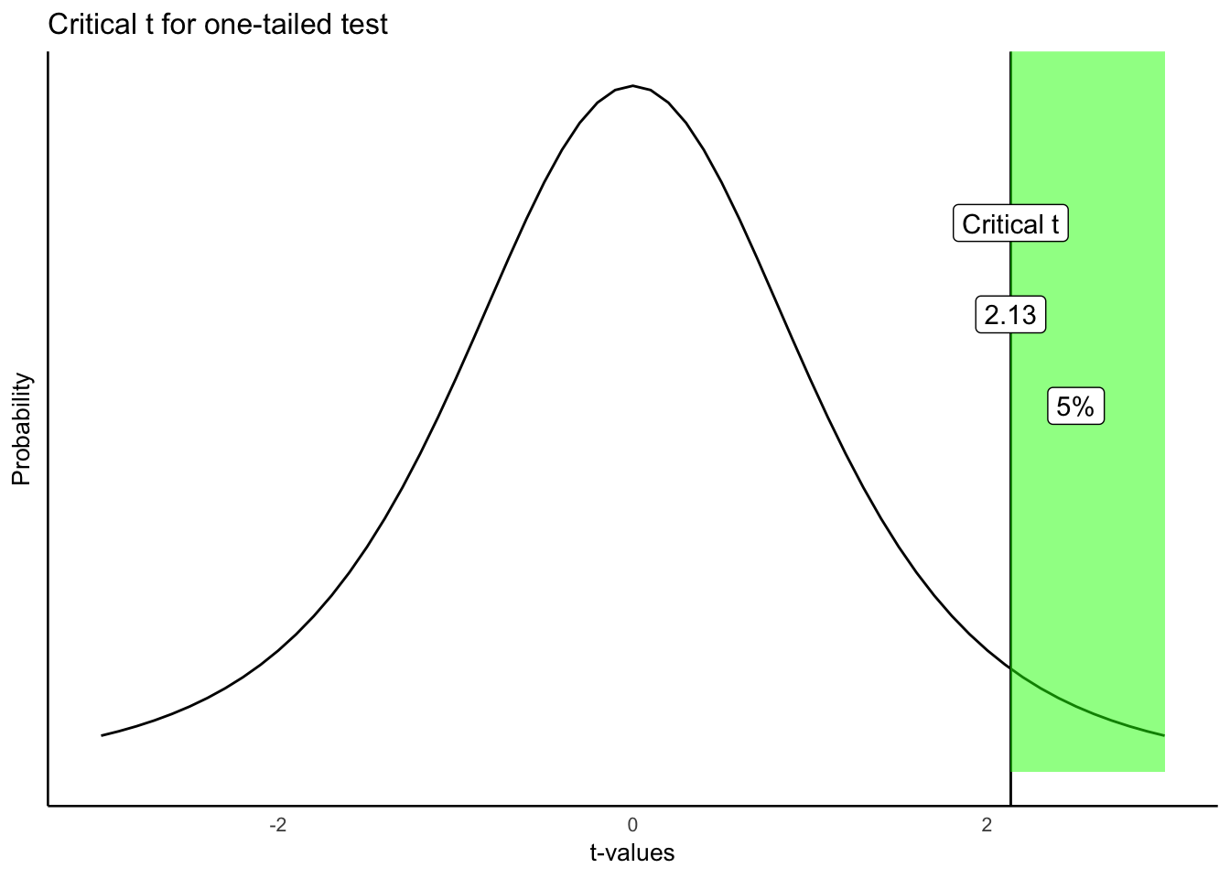
Critical t (one-tailed)

Slide 36
Critical t depends on df and alpha
.pull-left[
The table shows values of critical t for a one-tailed test
alpha values of .10, .05, and .01
degress of freedom from 5 to 100
]
.pull-right[
df
p_10
p_05
p_01
5
1.48
2.02
3.36
6
1.44
1.94
3.14
7
1.41
1.89
3.00
8
1.40
1.86
2.90
9
1.38
1.83
2.82
10
1.37
1.81
2.76
20
1.33
1.72
2.53
50
1.30
1.68
2.40
100
1.29
1.66
2.36
]

Slide 37
Non-Directional test
A non-directional test assumes that the experimental manipulation will cause any difference.
mean for A != (will not equal) mean for B
E.g.,
Mean for A could be bigger or smaller than mean for B

Slide 38
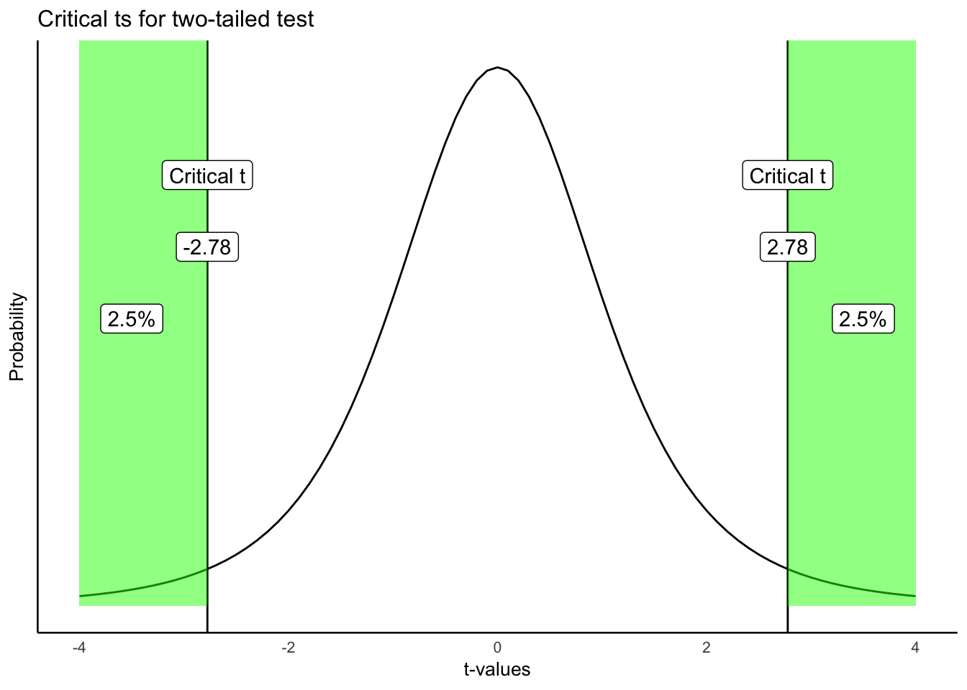
Non-directional test (2-tailed)

Slide 39
Comparing critical t (1 vs 2 tailed)
.pull-left[
One-tailed
df
p_10
p_05
p_01
5
1.48
2.02
3.36
10
1.37
1.81
2.76
20
1.33
1.72
2.53
50
1.30
1.68
2.40
100
1.29
1.66
2.36
]
.pull-right[
Two-tailed
df
p_10
p_05
p_01
5
2.02
2.57
4.03
10
1.81
2.23
3.17
20
1.72
2.09
2.85
50
1.68
2.01
2.68
100
1.66
1.98
2.63
]

Slide 40
Making decisions
.pull-left[ One-tailed - reject null - observed t in green area - fail to reject null - observed t in white area
]
.pull-right[

Slide 41
]

Slide 42
Making decisions
.pull-left[ Two-tailed - reject null - observed t in green area - fail to reject null - observed t in white area
]
.pull-right[

Slide 43
]

Slide 44
class: pink, center, middle, clear

Slide 45
Example from lab

Slide 46
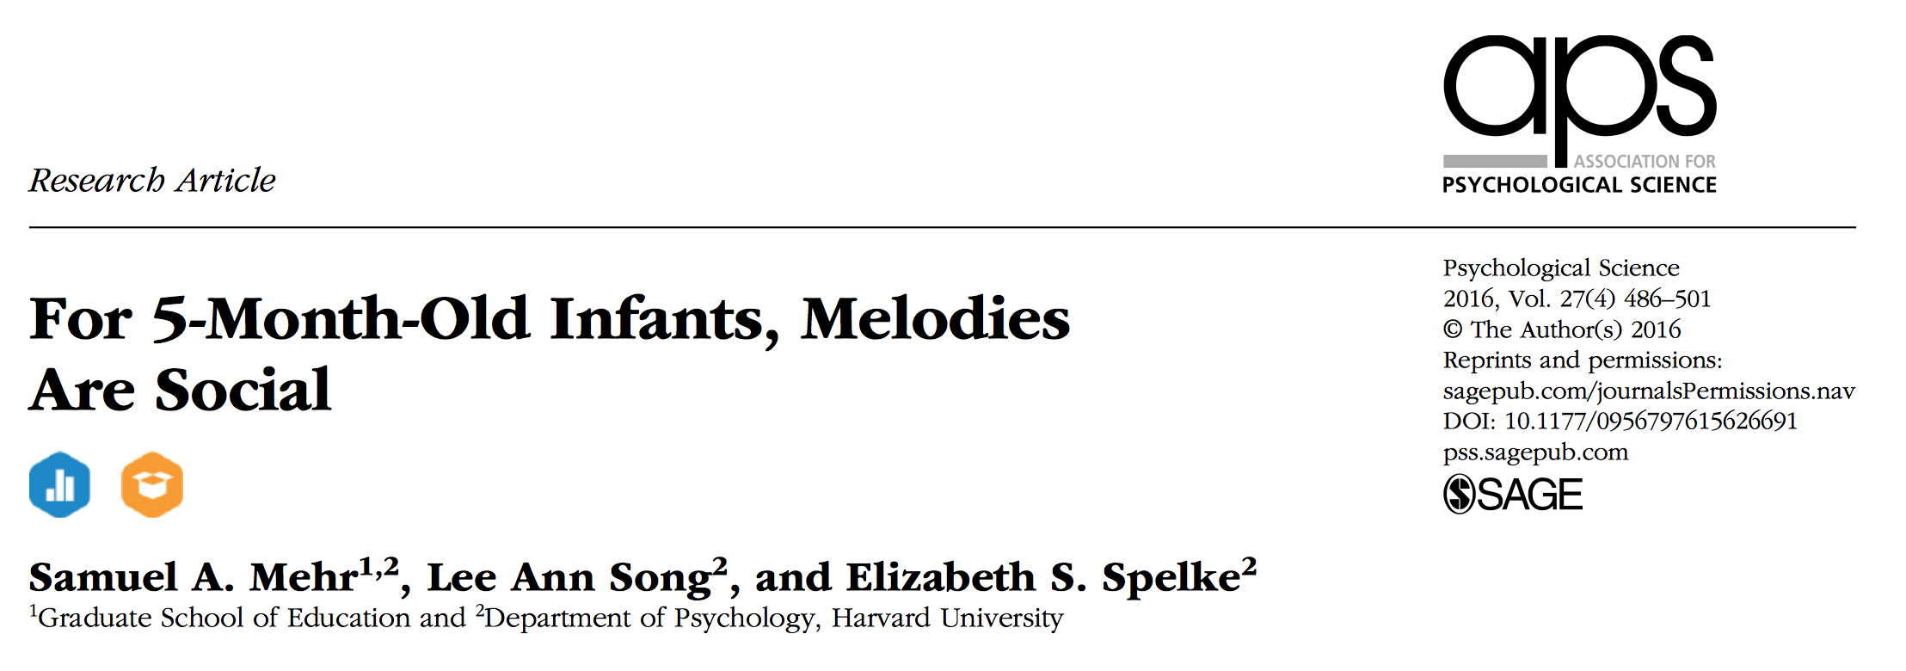
Mehr, Song, and Spelke (2016)

Slide 47
Research question
Do infants use melodies as a cue about social interaction?
If an infant heard and watched an unfamiliar adult singing a familiar melody, would they pay more attention to that person (by looking at them)?

Slide 48
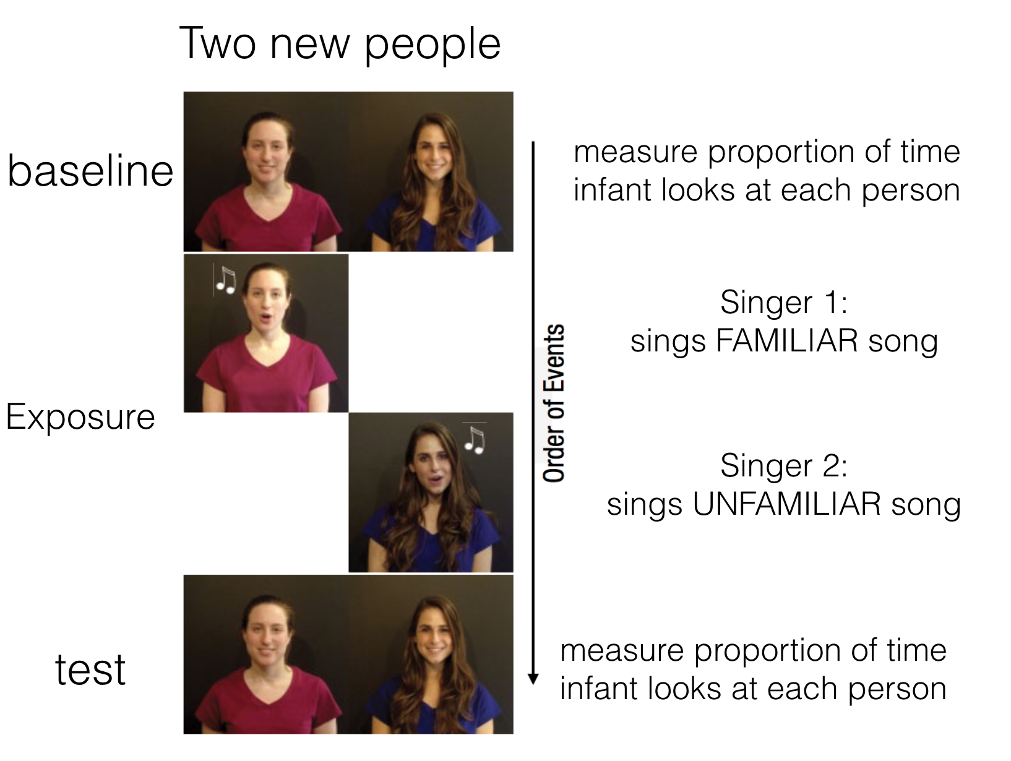
Study design

Slide 49
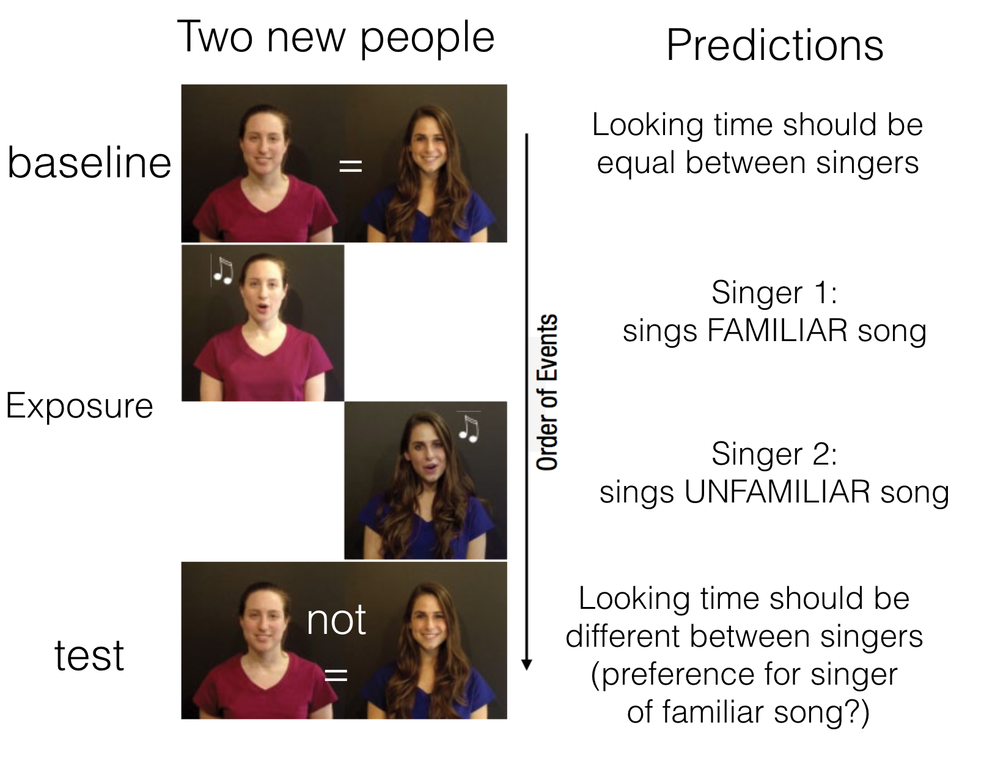
Study predictions

Slide 50
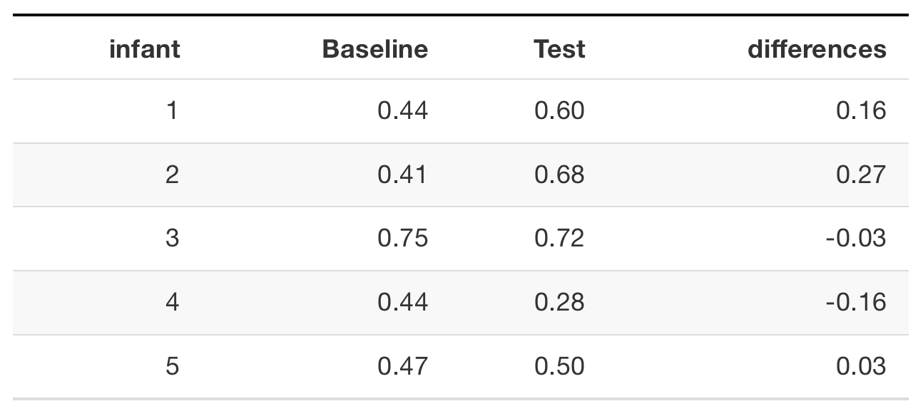
Data from first 5 infants

Slide 51
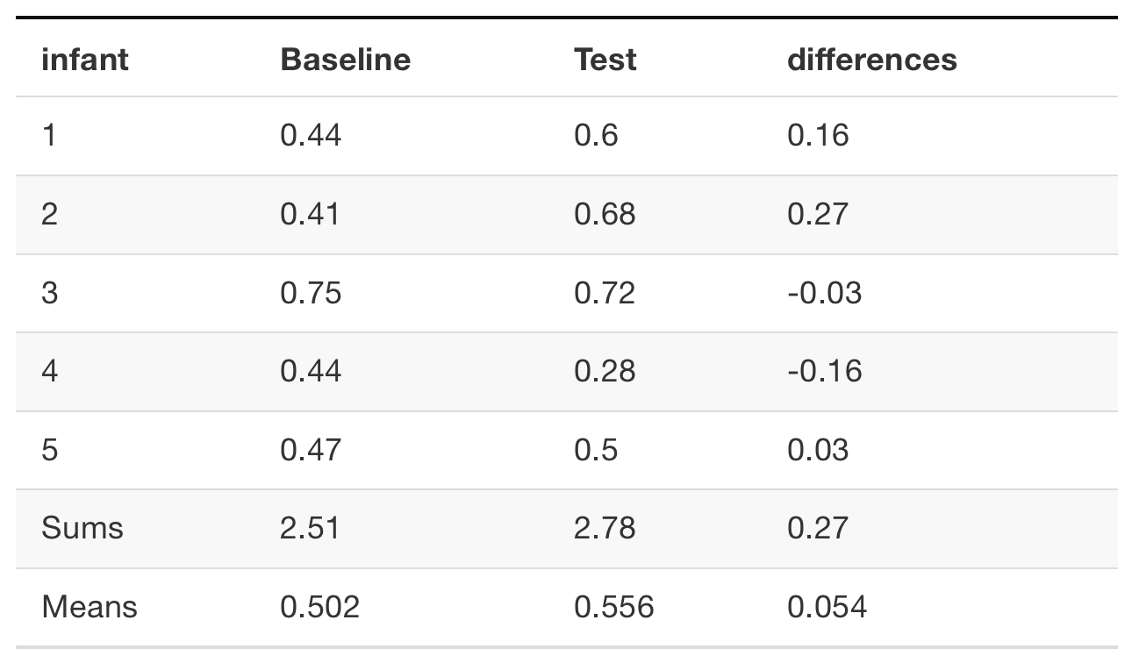
Means

Slide 52
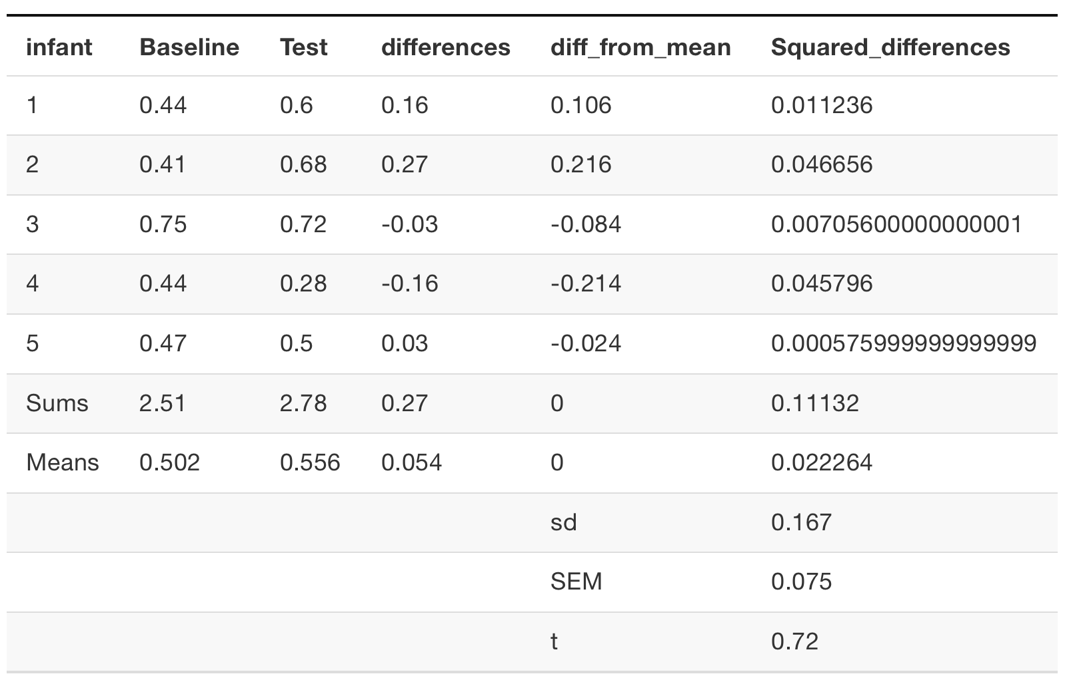
observed t

Slide 53
r code
baseline <- c(.44,.41,.75,.44,.47) test <- c(.6,.68,.72,.28,.5)

Slide 54
r results (two-tailed)
t.test(test,baseline,paired=TRUE)
## ## Paired t-test ## ## data: test and baseline ## t = 0.72381, df = 4, p-value = 0.5092 ## alternative hypothesis: true mean difference is not equal to 0 ## 95 percent confidence interval: ## -0.1531384 0.2611384 ## sample estimates: ## mean difference ## 0.054

Slide 55
Interpretation (two-tailed)
The results from the two-tailed test were:
t(4) = .723, p = .5092
Interpretation:
p is the probability that the null-distribution produces an absolute value of t=.723 or larger
50.92% of t-values from the null-distribution (assuming no difference) are larger than .723, and smaller than -.723.

Slide 56
r results (one-tailed)
t.test(test,baseline,paired=TRUE, alternative="greater")
## ## Paired t-test ## ## data: test and baseline ## t = 0.72381, df = 4, p-value = 0.2546 ## alternative hypothesis: true mean difference is greater than 0 ## 95 percent confidence interval: ## -0.1050478 Inf ## sample estimates: ## mean difference ## 0.054

Slide 57
Interpretation (one-tailed)
The results from the one-tailed test were:
t(4) = .723, p = .2546
Interpretation:
p is the probability that the null-distribution produces a value of t=.723 or larger
25.46% of t-values from the null-distribution (assuming no difference) were larger than .723.

Slide 58
Increasing N
We only looked at data from the first 5 infants…
We found that the observed t-value could easily have been produced by chance, and we did not reject the null-hypotheses (p-values were not less than .05)
Let’s see what happens when we use all of the data

Slide 59
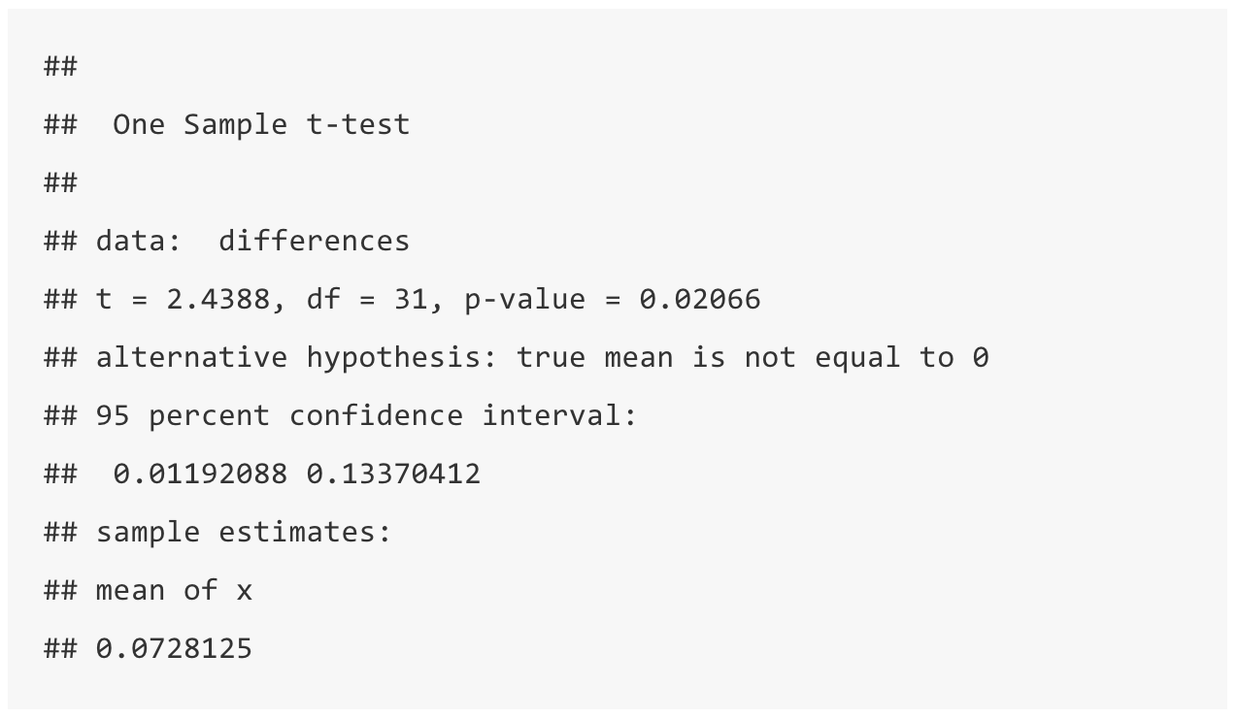
results using all of the data

Slide 60
Next class: Independent sample t-test
Tuesday, October 16th: Independent samples t-tests

Slide 61
Reminder
Quiz for this week will be posted tonight (Thursday, Oct. 11), Due NEXT THURSDAY, Oct. 18 end of day.
Midterm review sheet will be posted before next class. I will announce on blackboard.

