Slide 1
t-tests
Independent Sample Matthew Crump

Slide 2
#overview
Independent samples t-test calculation
Example from lab
Directional and non-directional test
t-test assumptions

Slide 3
class: pink, center, middle, clear

Slide 4
t-tests and designs

Slide 5
Three kinds of t-tests
one-sample
paired-sample
Independent sample

Slide 6
Independent Sample t-test
Purpose: Compare two sample means in a between-subjects design
Between-subjects design: Different subjects are measured across both levels of the experimental manipulation (independent variable)

Slide 7
Consider this
Between-subjects experiment, n=5, different subjects are measured in group A and B of the experiment.
subjects_A
A
subjects_B
B
1
1
6
4
2
4
7
8
3
3
8
7
4
6
9
9
5
5
10
10

Slide 8
Empirical question
Did the manipulation (A vs. B) cause a difference in the measure?
subjects_A
A
subjects_B
B
1
1
6
4
2
4
7
8
3
3
8
7
4
6
9
9
5
5
10
10

Slide 9
Can’t use Difference scores
Unlike a paired samples t-test, we can’t look at the difference scores for a between-subjects design. Why not?
subjects_A
A
subjects_B
B
1
1
6
4
2
4
7
8
3
3
8
7
4
6
9
9
5
5
10
10

Slide 10
Independent samples t-test
.pull-left[
Purpose: Compare two means from different samples
${\overset{‾}{X}}_{1}$ = mean of sample 1
${\overset{‾}{X}}_{2}$ = mean of sample 2
$s_{p}$ = pooled standard deviation
$s_{p}^{2}$ = pooled variance
$n$ = sample-size
$df$ = $n_{1}+n_{2}−2$
]
.pull-right[
$t=\frac{\overset{‾}{X_{1}}−\overset{‾}{X_{2}}}{s_{p}\sqrt{\frac{1}{n_{1}}+\frac{1}{n_{2}}}}$
$s_{p}^{2}=\sqrt{\frac{\left(n_{1}−1\right)s_{\text{X1}}^{2}+\left(n_{2}−1\right)s_{\text{X2}}^{2}}{n_{1}+n_{2}−2}}$
]

Slide 11
Pooled standard deviation
$s_{p}$ (standard deviation) and $s_{p}^{2}$ (variance) are pooled estimates (combined).
We have two samples 1. The basic idea is to find the average of the standard deviations 2. The formula makes the estimate unbiased

Slide 12
R: Calculating t
The t.test() function assumes independent samples by default. We do need to set the var.equal=TRUE option.
A <-c(1,4,3,6,5) B <-c(4,8,7,9,10) t.test(A,B,var.equal = T)$statistic
## t ## -2.832353

Slide 13
Calculating pooled estimate
A <-c(1,4,3,6,5) B <-c(4,8,7,9,10) mean_dif <- mean(A)-mean(B) numerator <- (4*var(A)) + (4*var(B)) denominator <- 5+5-2 sp2 <- sqrt(numerator/denominator) t<- mean_dif/(sp2*sqrt((1/5)+(1/5))) t
## [1] -2.832353

Slide 14
class: pink, center, middle, clear

Slide 15
Lab Example

Slide 16
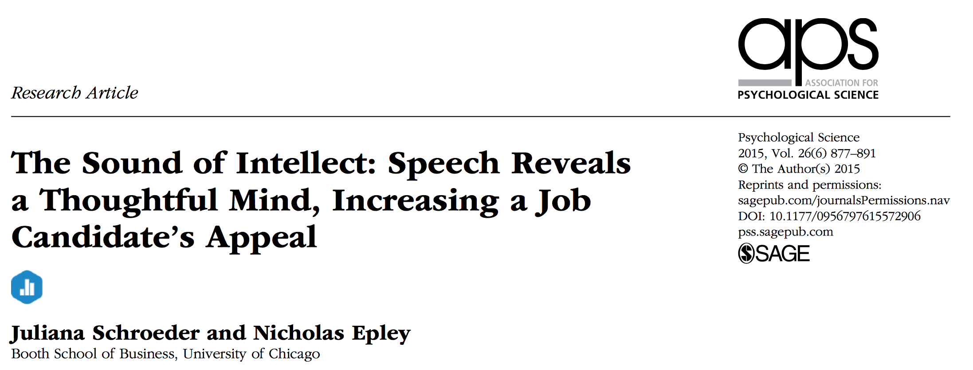
Schroeder and Epley (2015)

Slide 17
Research Question
Are evaluations of a person’s intellect better conveyed through writing or speaking?

Slide 18
Method
Job applicants in an interview give both a written statement, and an audio version of them reading the statement
Interviewers (profesional recruiters) read or listen to each statement, and rate each applicant (intellect, general impression, Hiring likelihood)

Slide 19
IVs and DVs
IVs: - Read written transcript vs. Listen to spoken audio transcript
DVS: - Intellect rating (0-10) - general impression rating (0-10) - hiring likelihood rating (0-10)

Slide 20
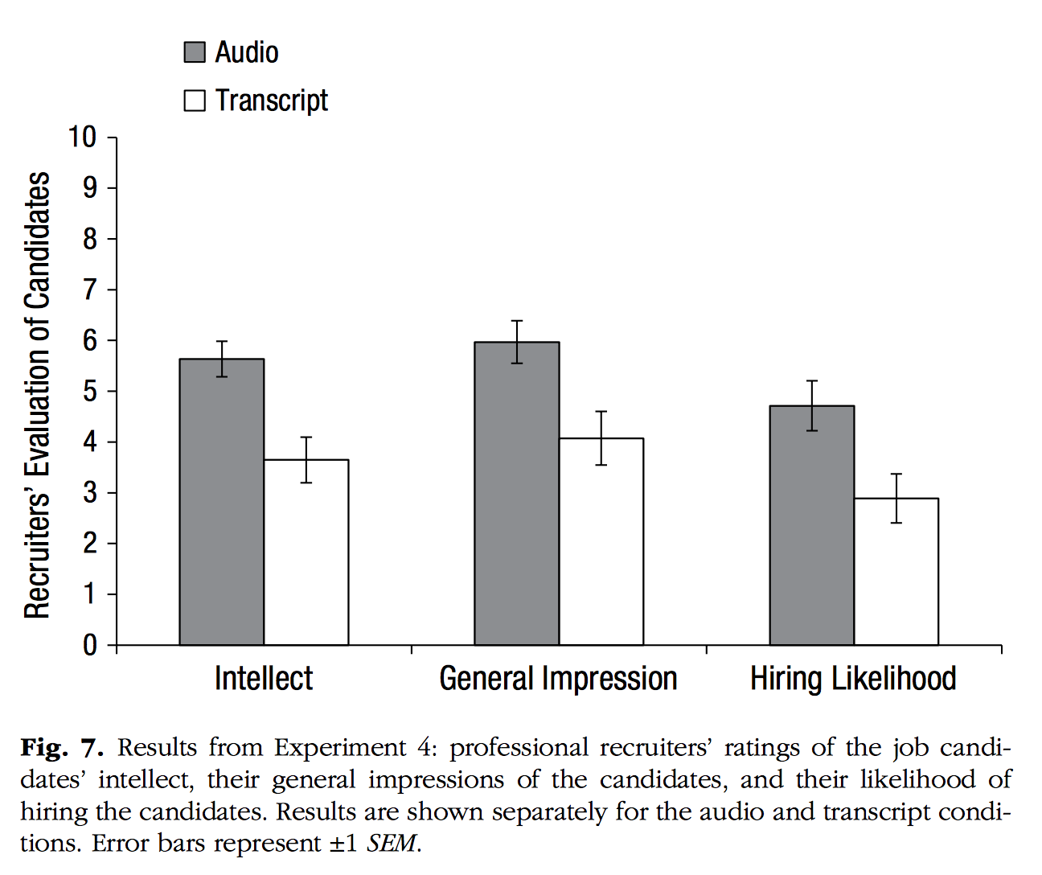
The results

Slide 21
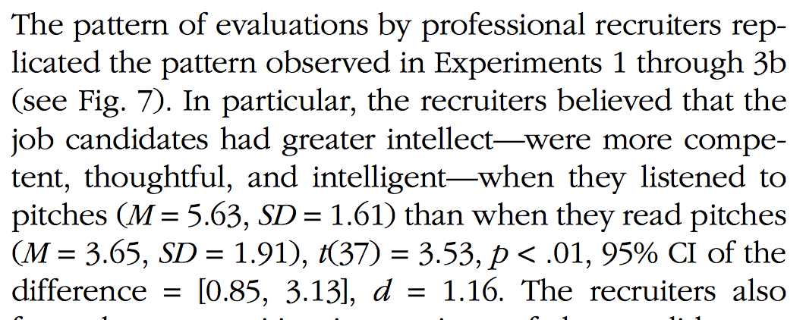
The write-up

Slide 22
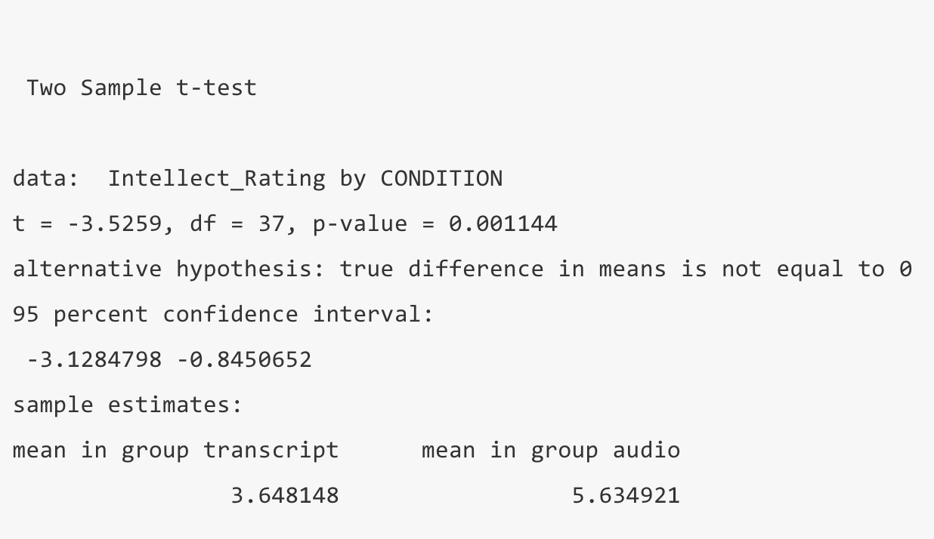
R analysis

Slide 23
class: pink, center, middle, clear

Slide 24
Directional vs. non-directional tests

Slide 25
Critical t
Critical t is set by two properties:
the alpha criterion
whether the test is directional (one-tailed) or non-directional (two-tailed)

Slide 26
Directional test (reminder)
A directional test assumes that the experimental manipulation will cause a difference in a particular direction.
mean for A > (greater than) mean for B
mean for A < (less than) mean for B

Slide 27
Critical t (one-tailed) example
Critical t for a directional (one-tailed) test
alpha = 0.05, or 5%
Critical t is the t-value associated with a null-distribution where this t-value or larger occurs 5% of the time.

Slide 28
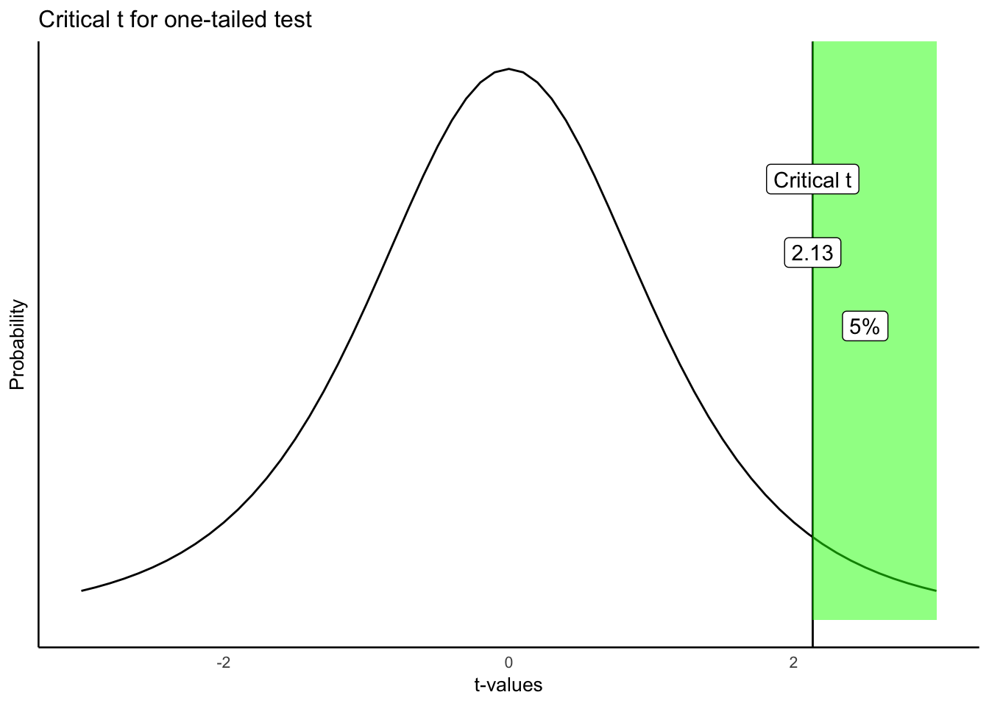
Critical t (one-tailed)

Slide 29
Critical t depends on df and alpha
.pull-left[
The table shows values of critical t for a one-tailed test
alpha values of .10, .05, and .01
degress of freedom from 5 to 100
]
.pull-right[
df
p_10
p_05
p_01
5
1.48
2.02
3.36
6
1.44
1.94
3.14
7
1.41
1.89
3.00
8
1.40
1.86
2.90
9
1.38
1.83
2.82
10
1.37
1.81
2.76
20
1.33
1.72
2.53
50
1.30
1.68
2.40
100
1.29
1.66
2.36
]

Slide 30
Non-Directional test
A non-directional test assumes that the experimental manipulation will cause any difference.
mean for A != (will not equal) mean for B
E.g.,
Mean for A could be bigger or smaller than mean for B

Slide 31
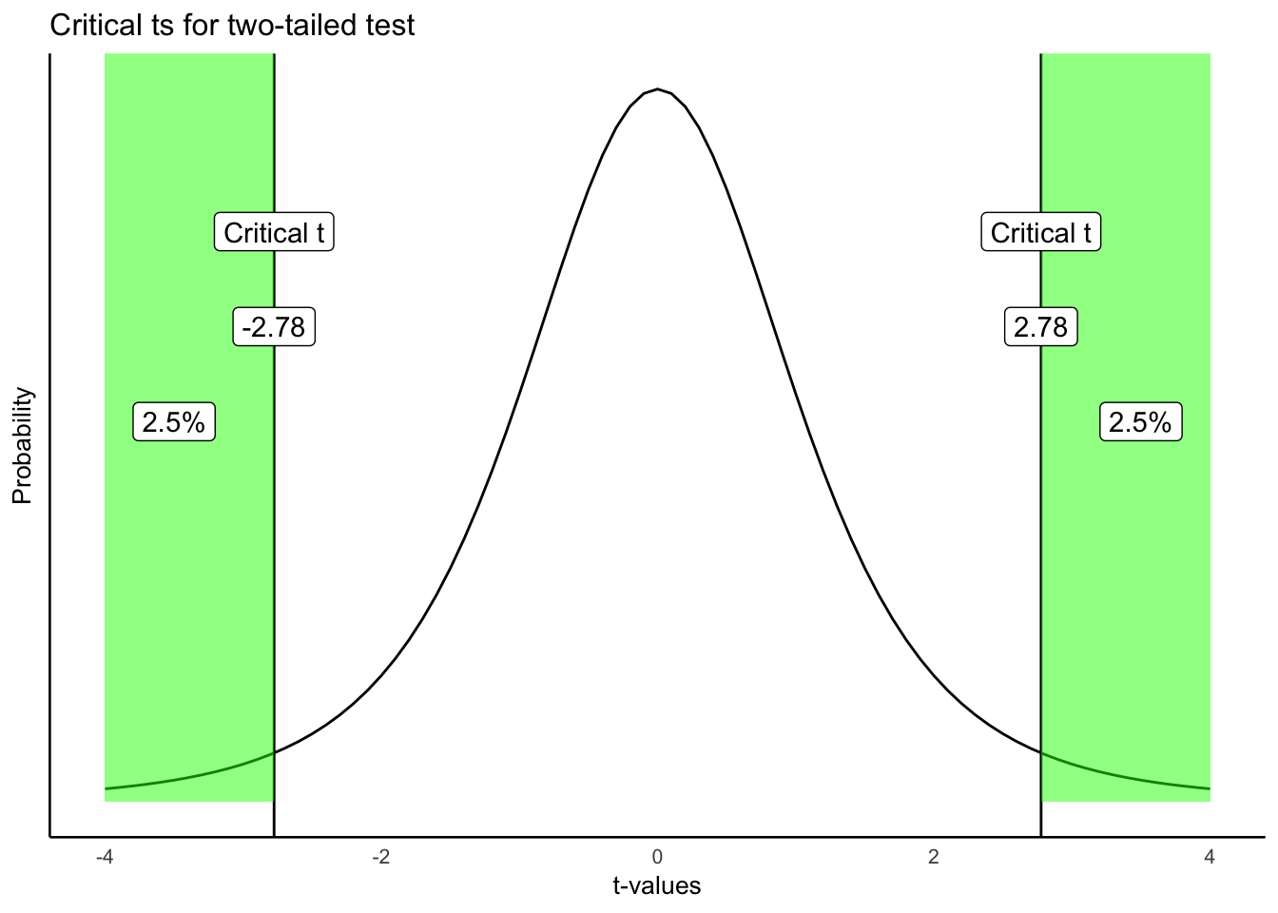
Non-directional test (2-tailed)

Slide 32
Comparing critical t (1 vs 2 tailed)
.pull-left[
One-tailed
df
p_10
p_05
p_01
5
1.48
2.02
3.36
10
1.37
1.81
2.76
20
1.33
1.72
2.53
50
1.30
1.68
2.40
100
1.29
1.66
2.36
]
.pull-right[
Two-tailed
df
p_10
p_05
p_01
5
2.02
2.57
4.03
10
1.81
2.23
3.17
20
1.72
2.09
2.85
50
1.68
2.01
2.68
100
1.66
1.98
2.63
]

Slide 33
Making decisions
.pull-left[ One-tailed - reject null - observed t in green area - fail to reject null - observed t in white area
]
.pull-right[

Slide 34
]

Slide 35
Making decisions
.pull-left[ Two-tailed - reject null - observed t in green area - fail to reject null - observed t in white area
]
.pull-right[

Slide 36
]

Slide 37
class: pink, center, middle, clear

Slide 38
t-test assumptions

Slide 39
class: center, middle, clear
<iframe style=“width:100%;height:100%;border-style:none;”, src=“https://crumplab.shinyapps.io/indTtest/” />

Slide 40
Next class: Power and Effect-size
Quiz on t-tests starts today, due next Monday
Midterm review next Monday
Midterm review sheet and info is posted on Blackboard

