Slide 1
One-Factor ANOVA
Between-subjects designs Matthew Crump

Slide 2
class: pink, center, middle, clear

Slide 3
ANOVAs

Slide 4
Overview
ANOVA concepts
one-factor between subjects example
Look at the last few slides for quiz tips (using R)

Slide 5
ANOVA
ANOVA stands for ANalysis Of VAriance

Slide 6
Purpose of ANOVA
Statistical inference test for multiple (2 or more) groups
The kind of ANOVA you run depends on the experimental design. This week we focus on Between-Subjects designs

Slide 7
Heads up
The end result of an ANOVA gives back similar information as a t-test
t(df) = t-value, p = p-value
F(df1, df2) = F-value, p = value
Reporting of F-tests also typically include one more thing:
F(df1, df2) = F-value, MSE = MS error value, p = value

Slide 8
Fast Example
A <- c(20,11,2) B <- c(6,2,7) C <- c(2,11,2) IV <- as.factor(rep(c("A","B","C"),each=3)) DV <- c(A,B,C) df <- data.frame(IV,DV)

Slide 9
R: aov()
aov(DV~IV,df)
## Call: ## aov(formula = DV ~ IV, data = df) ## ## Terms: ## IV Residuals ## Sum of Squares 72 230 ## Deg. of Freedom 2 6 ## ## Residual standard error: 6.191392 ## Estimated effects may be unbalanced

Slide 10
R: summary()
The summary() function provides the ANOVA table
aov_results <- aov(DV~IV,df) summary(aov_results)
## Df Sum Sq Mean Sq F value Pr(>F) ## IV 2 72 36.00 0.939 0.442 ## Residuals 6 230 38.33

Slide 11
Things we need to understand
The logic of the ANOVA
What each part of the ANOVA table tells us
Let’s start by looking at the example for the next lab on ANOVA.

Slide 12
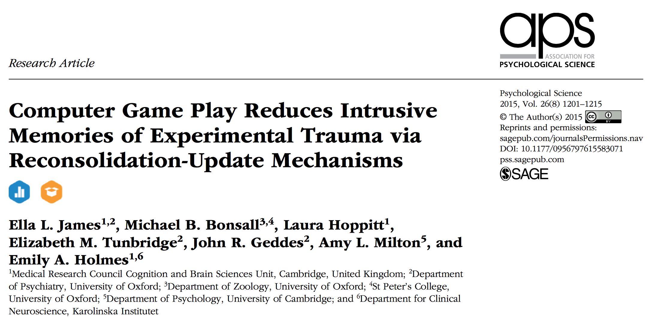
ANOVA lab example

Slide 13
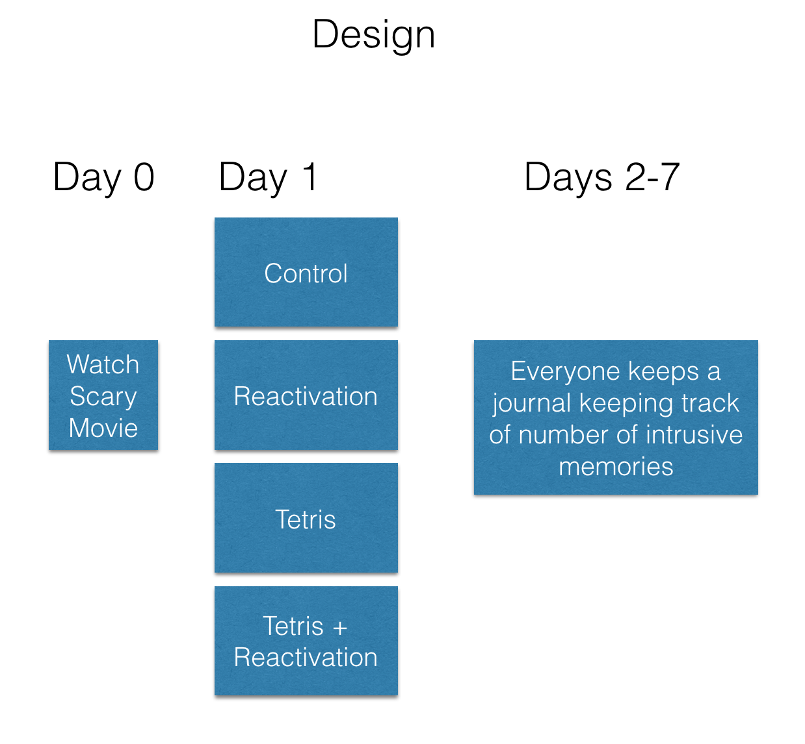
class: center, middle, clear, nopad

Slide 14
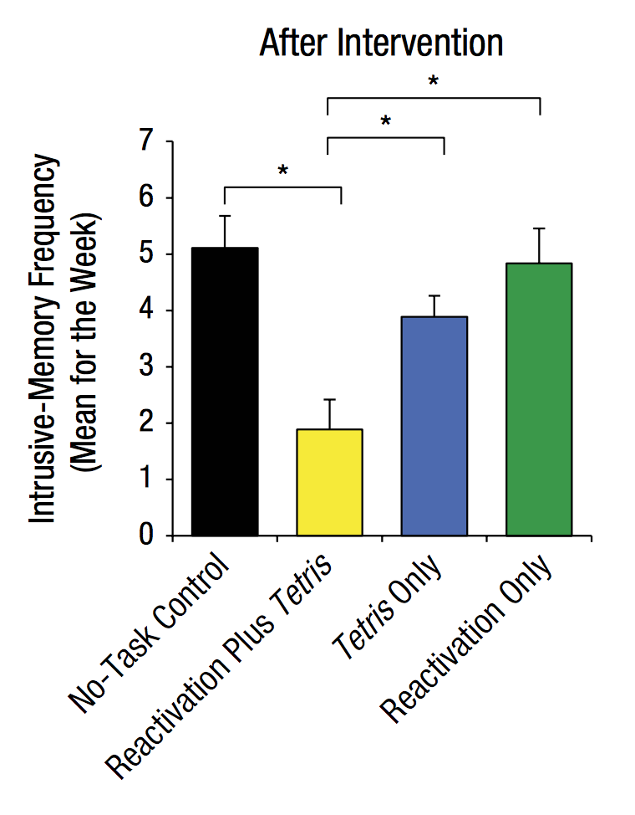
Results

Slide 15
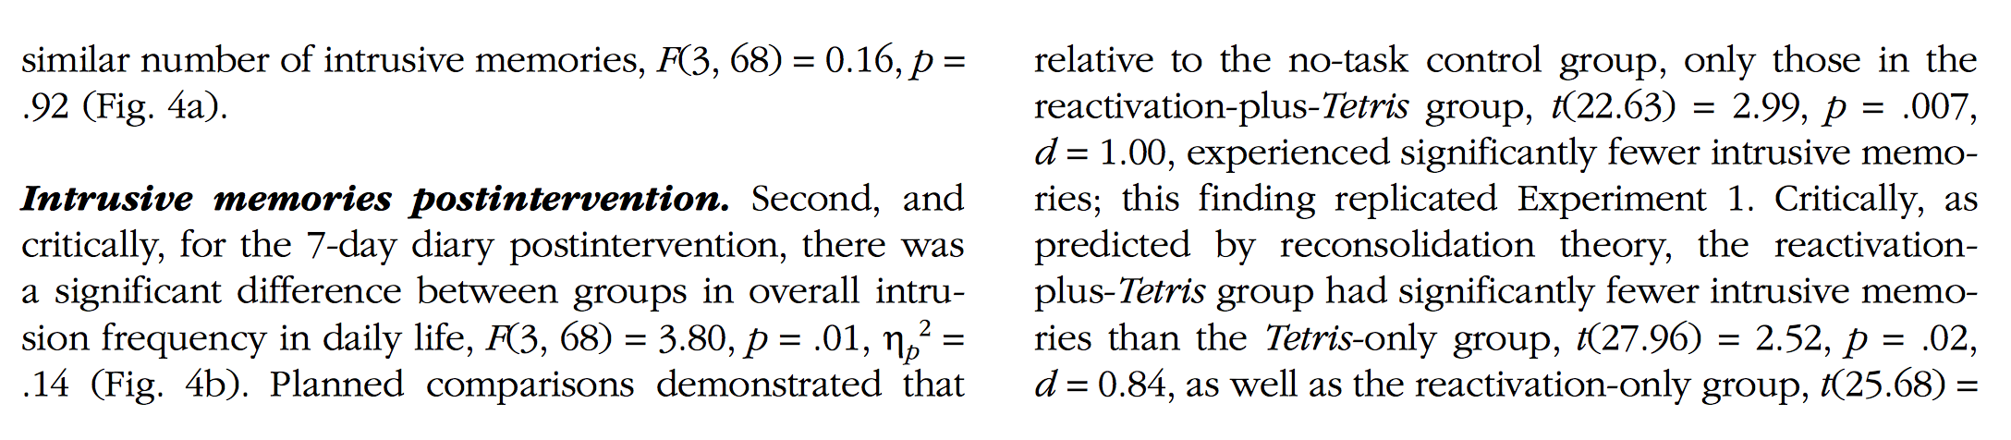
Write-up

Slide 16
Things we need to understand
The logic of the ANOVA
What each part of the ANOVA table tells us

Slide 17
ANOVA is an omnibus test
Omnibus definition: comprising many items
ANOVAs can test for differences among many means (2 or more)
Test question: Are there any differences among the means?
If the answer is yes, then we still do not know which specific means are different from one another.

Slide 18
F-value
F is a ratio between two variances
## Df Sum Sq Mean Sq F value Pr(>F) ## IV 2 72 36.00 0.939 0.442 ## Residuals 6 230 38.33
$F=\frac{{\text{MSE}}_{\text{Effect}}}{{\text{MSE}}_{\text{Error}}}$ $F=\frac{{\text{Mean Squared Error}}_{\text{IV}}}{{\text{Mean Squared Error}}_{\text{Residuals}}}$
36/38.33
## [1] 0.9392121

Slide 19
MSE: Mean squared Error (effect)
MSE (Mean Squared Error) is the SS (sums of sqaures) divided by the degrees of freedom
## Df Sum Sq Mean Sq F value Pr(>F) ## IV 2 72 36.00 0.939 0.442 ## Residuals 6 230 38.33
${\text{MSE}}_{\text{Effect}}=\frac{{\text{SS}}_{\text{Effect}}}{{\text{df}}_{\text{Effect}}}$ ${\text{MSE}}_{\text{IV}}=\frac{{\text{SS}}_{\text{IV}}}{{\text{df}}_{\text{IV}}}$
72/2
## [1] 36

Slide 20
MSE: Mean squared Error (error)
MSE (Mean Squared Error) is the SS (sums of sqaures) divided by the degrees of freedom
## Df Sum Sq Mean Sq F value Pr(>F) ## IV 2 72 36.00 0.939 0.442 ## Residuals 6 230 38.33
${\text{MSE}}_{\text{Error}}=\frac{{\text{SS}}_{\text{Error}}}{{\text{df}}_{\text{Error}}}$ ${\text{MSE}}_{\text{Residuals}}=\frac{{\text{SS}}_{\text{Residuals}}}{{\text{df}}_{\text{Residuals}}}$
6/230
## [1] 0.02608696

Slide 21
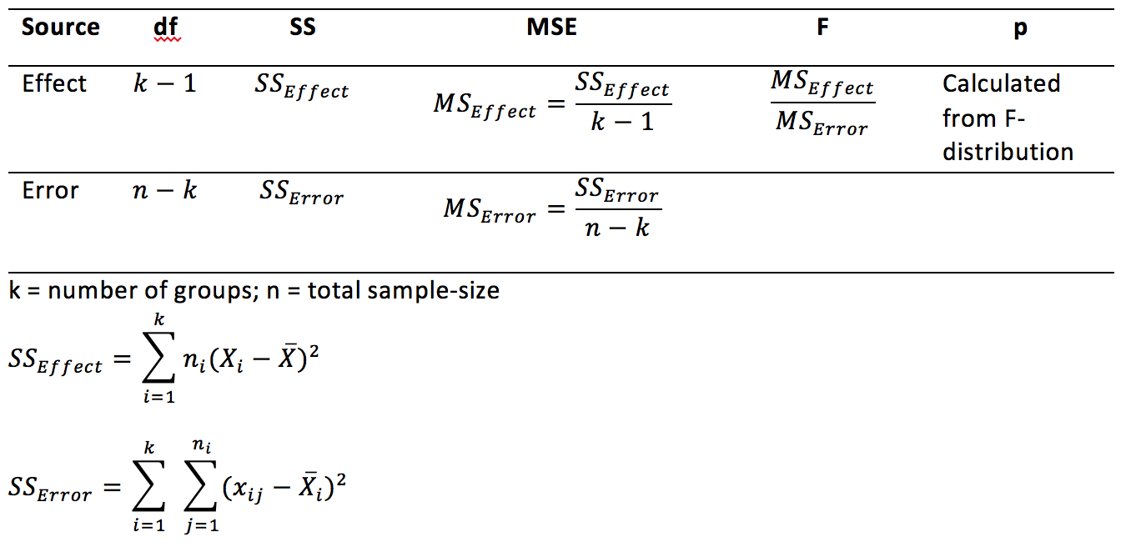
ANOVA reference table

Slide 22
class: pink, center, middle, clear

Slide 23
The big idea

Slide 24
Partitioning the Variance
Idea is to split up the variance in the data into two parts:
The part due to the manipulation (IV)
The leftover part, due to random error

Slide 25
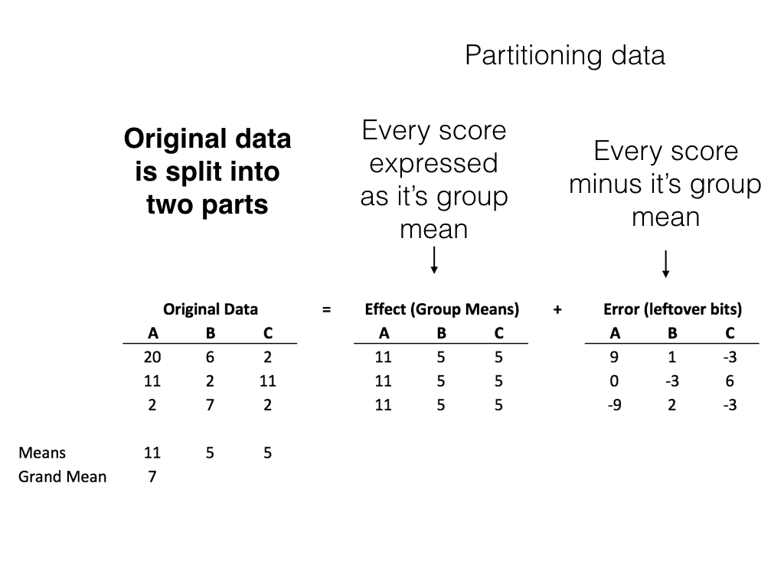
class: center, middle, clear, nopad

Slide 26
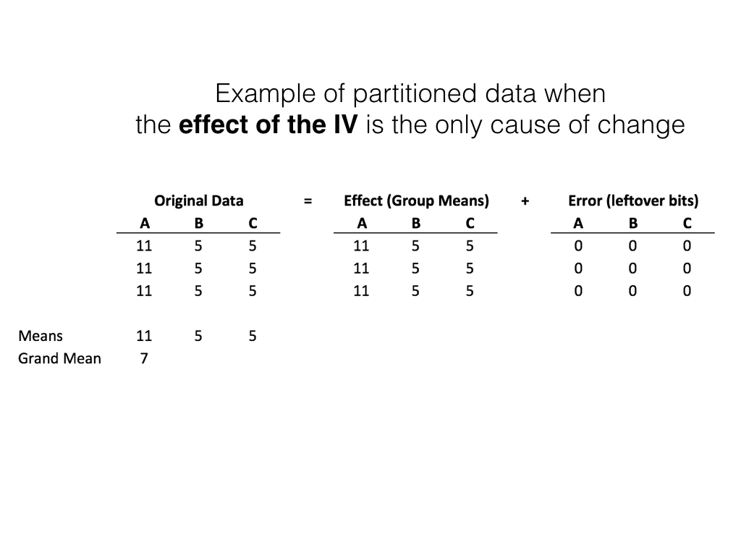
class: center, middle, clear, nopad

Slide 27
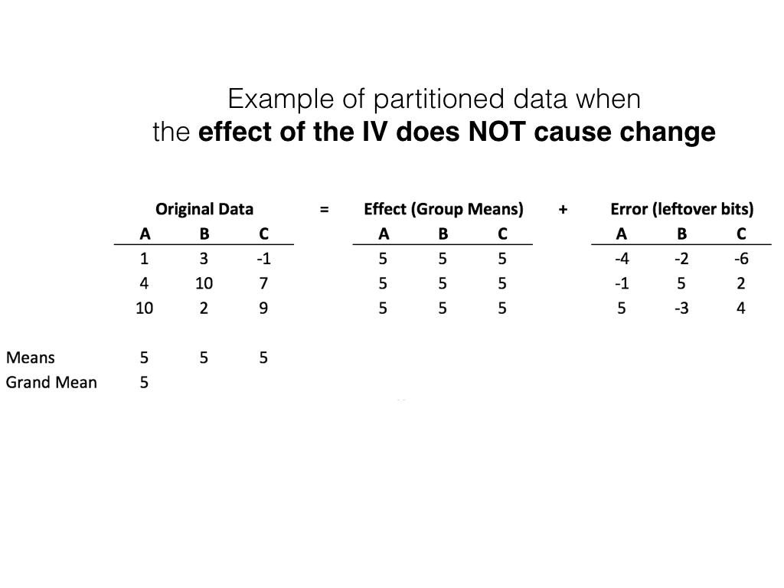
class: center, middle, clear, nopad

Slide 28
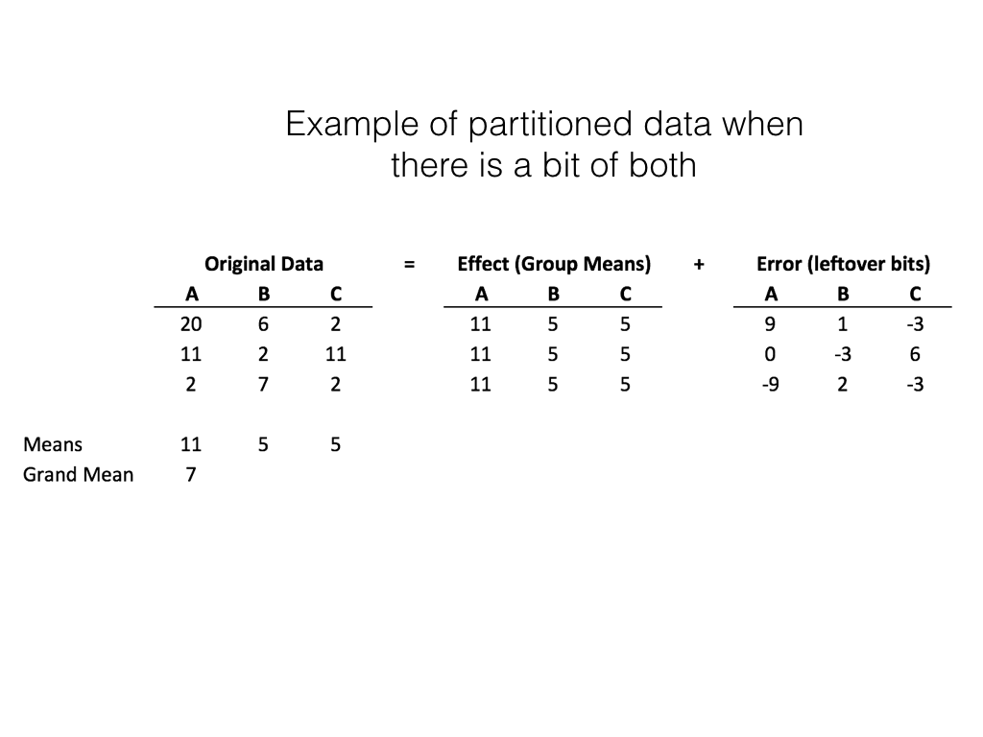
class: center, middle, clear, nopad

Slide 29
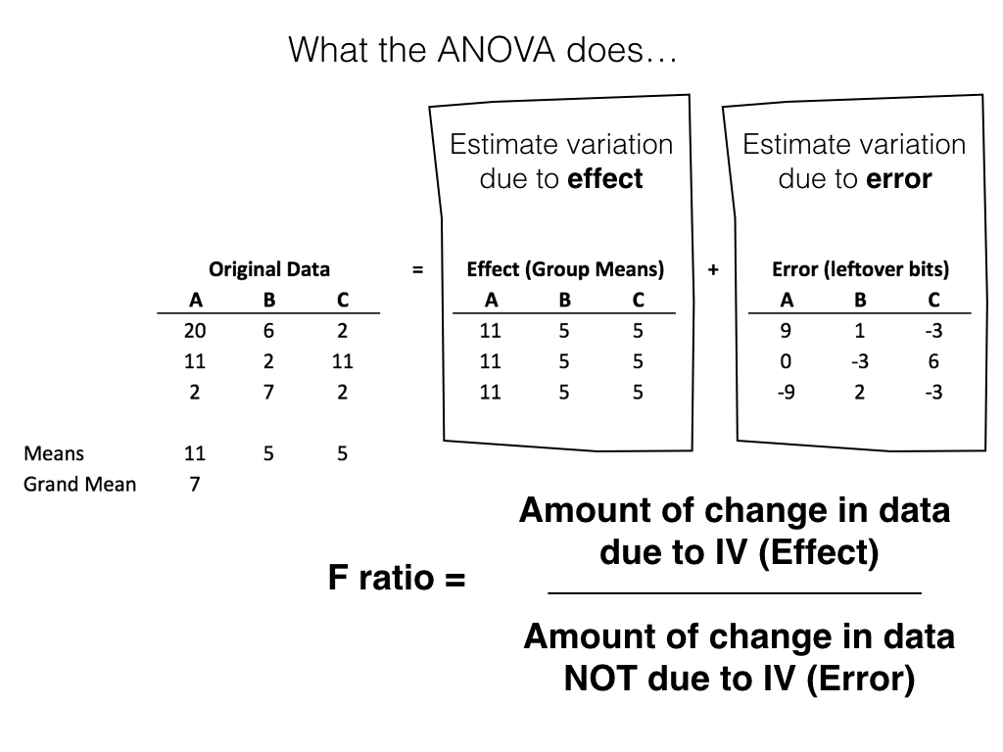
class: center, middle, clear, nopad

Slide 30
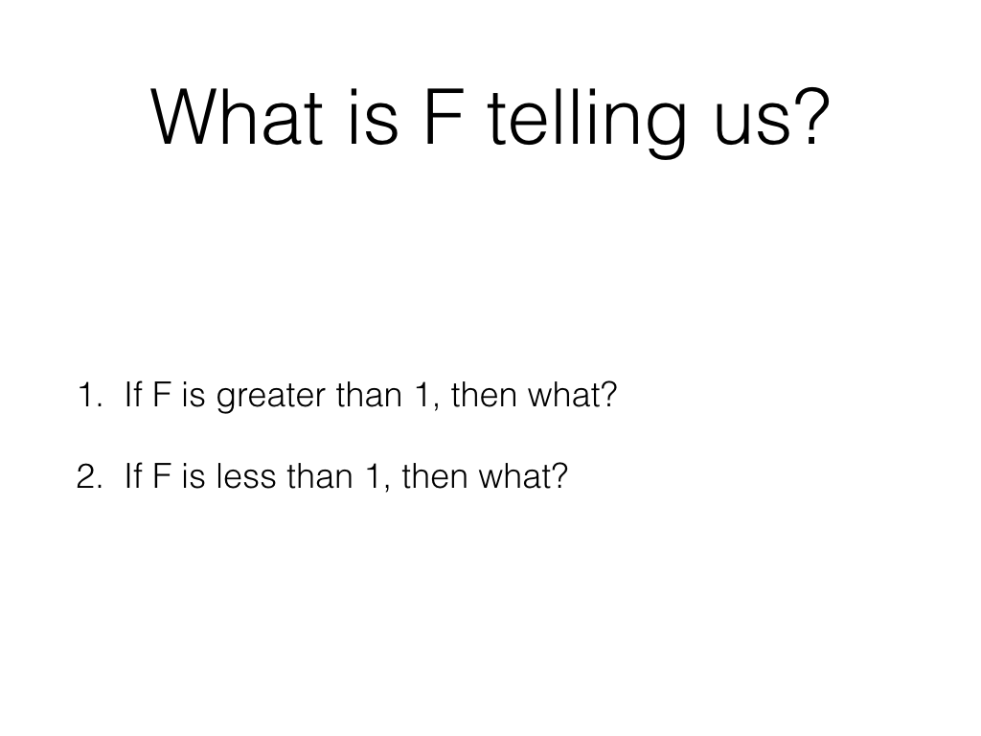
class: center, middle, clear, nopad

Slide 31
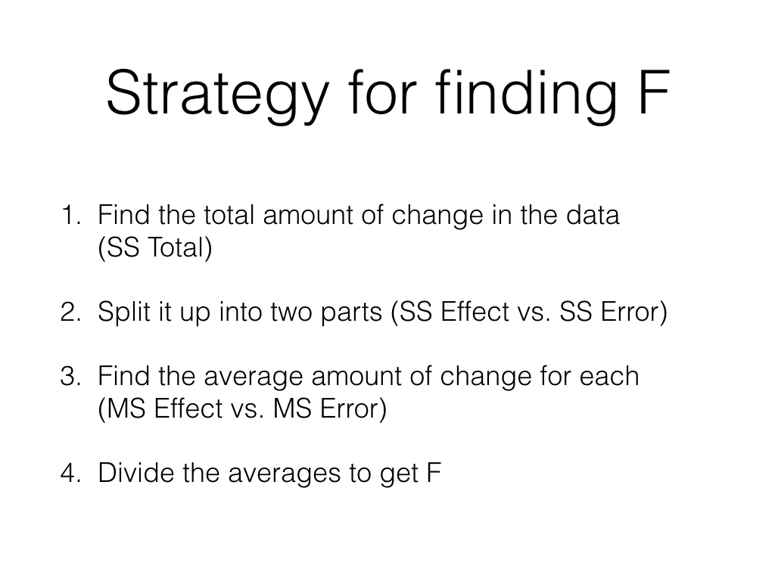
class: center, middle, clear, nopad

Slide 32
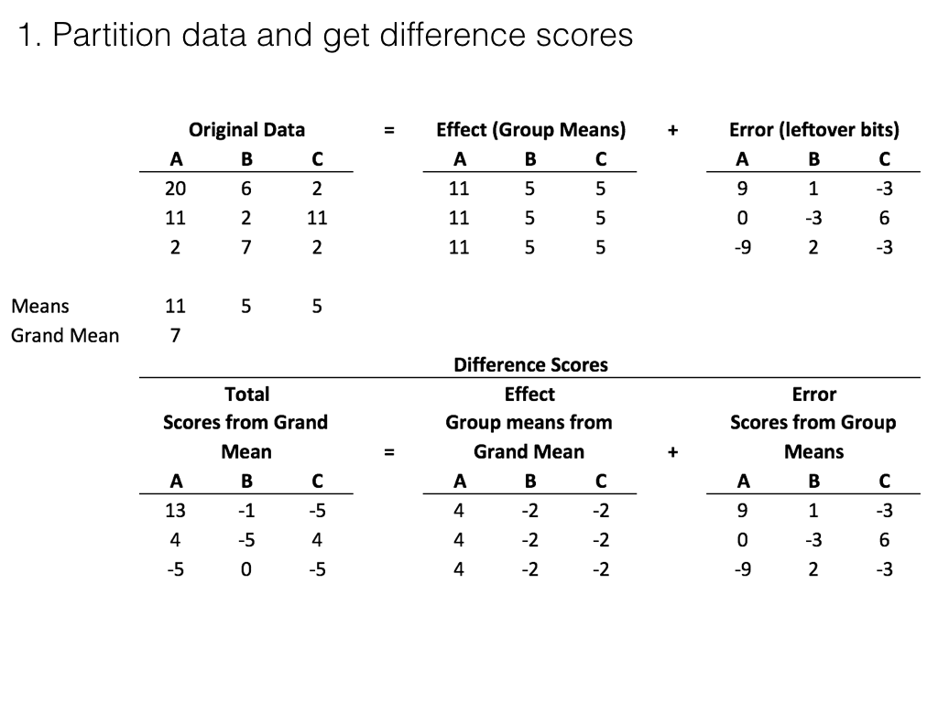
class: center, middle, clear, nopad

Slide 33
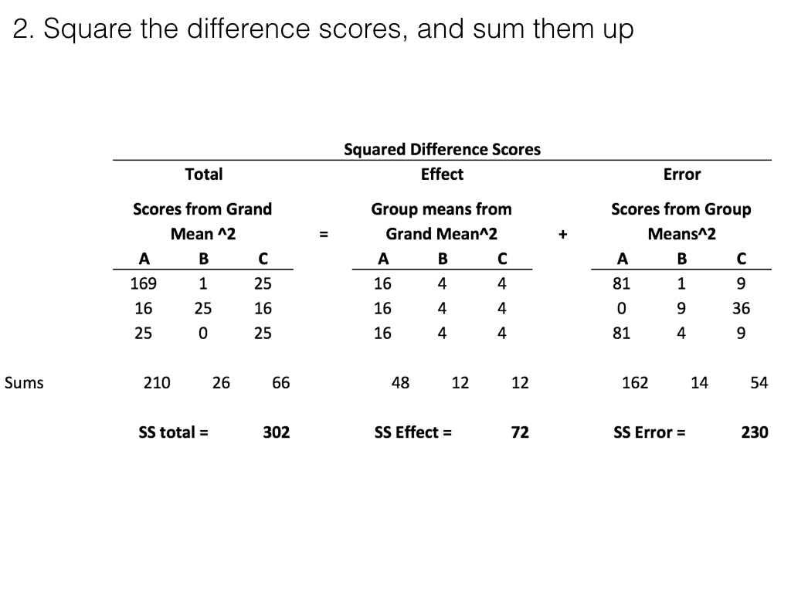
class: center, middle, clear, nopad

Slide 34
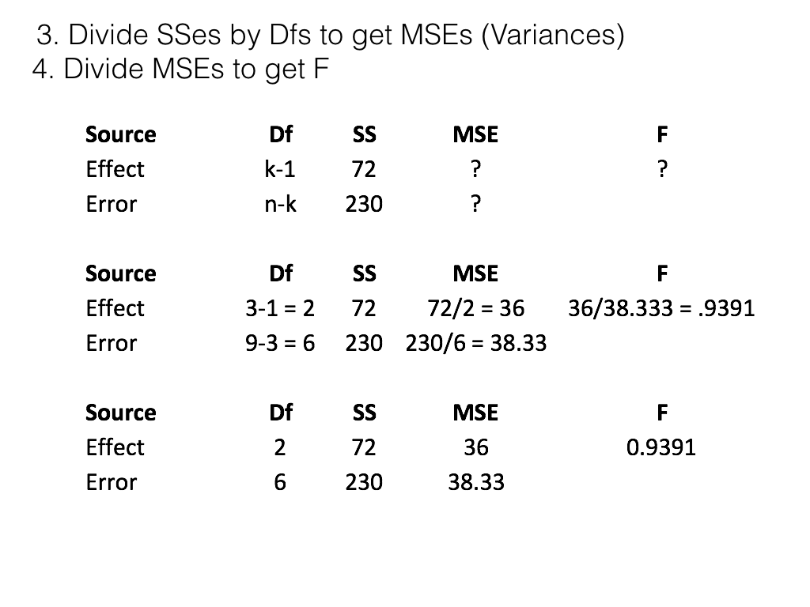
class: center, middle, clear, nopad

Slide 35
SS total
$SS_{\text{Total}}=SS_{\text{Effect}}+SS_{\text{Error}}$
$SS_{\text{Total}}=SS_{\text{Can Explain}}+SS_{\text{Can’t Explain}}$
$SS_{\text{Total}}=SS_{\text{Change due to manipulation}}+SS_{\text{Change due to Chance}}$
$SS_{\text{Total}}=\sum_{i=1}^{n}{{\left(x_{i}−\overset{‾}{X}\right)}^{2}}$
$x_{i}$ = each score
$\overset{‾}{X}$ = Grand Mean of all scores

Slide 36
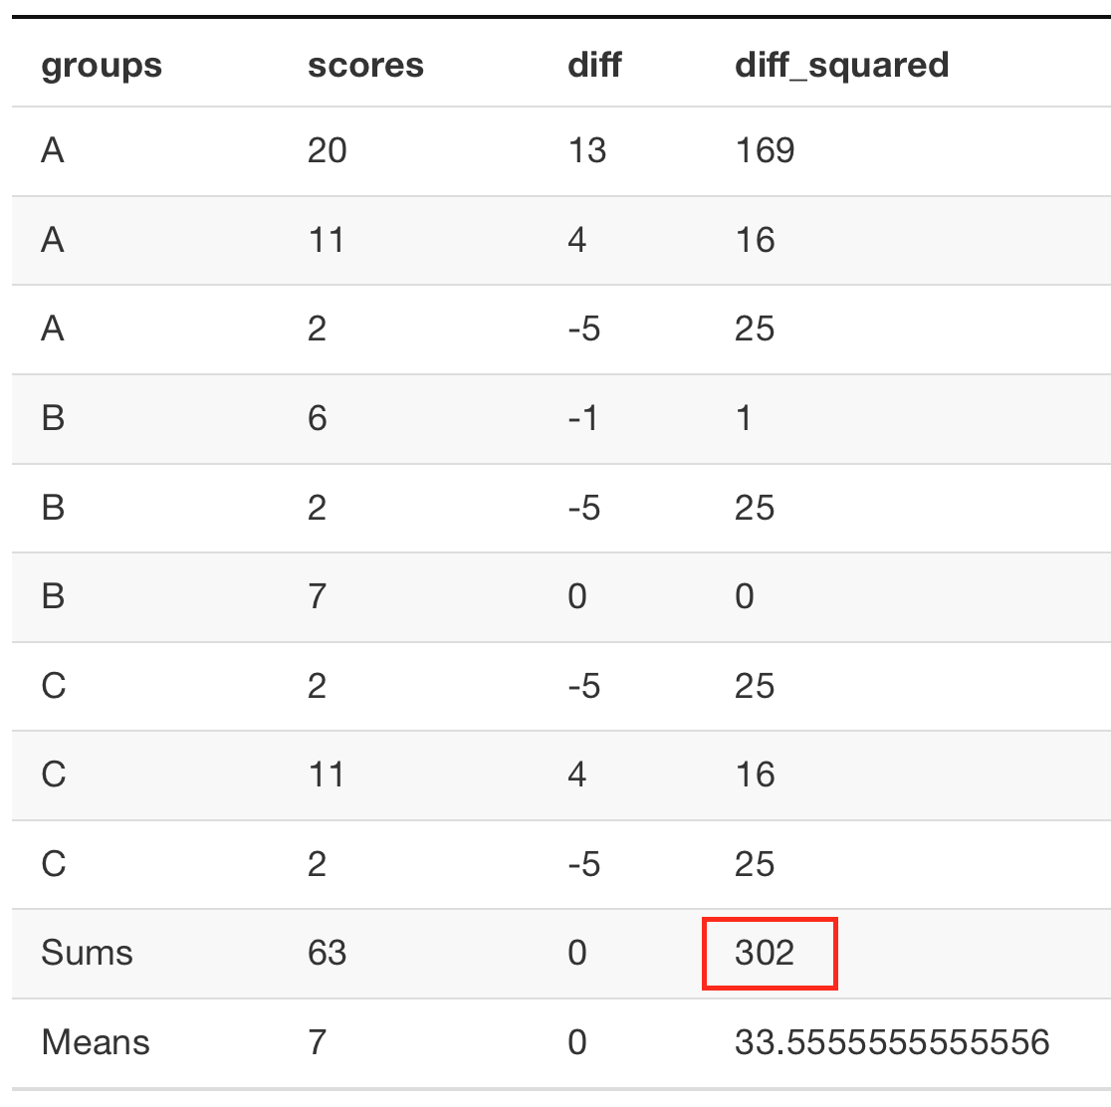
SS total example

Slide 37
R: SS total
$SS_{\text{Total}}=\sum_{i=1}^{n}{{\left(x_{i}−\overset{‾}{X}\right)}^{2}}$
the sum of the squared differences between every score and the grand mean
A <- c(20,11,2) B <- c(6,2,7) C <- c(2,11,2) all_scores <- c(A,B,C) grand_mean <- mean(all_scores) SS_total <- sum((all_scores-grand_mean)^2) print(SS_total)
## [1] 302

Slide 38
Remember what SS represents?
SS (the sums of squares) is a single number representing the sum of all of the change in the data.
Specifically, the squared deviations from each score from the mean

Slide 39
Question
What are some sources of change that could cause $SS_{\text{Total}}$ for a set of data to increase or decrease?
what properties of the sample data could be changed that would increase or decrease $SS_{\text{Total}}$?

Slide 40
SS total and the Effect (IV)
A successful manipulation (IV) will cause an effect (e.g., cause differences between the sample means)
Question: How can the effect of an IV cause increases or decreases to $SS_{\text{Total}}$?

Slide 41
SS total and sampling error
Sampling error is due to existing variability in the data.
Question: How can the effect of sampling error cause increases or decreases to $SS_{\text{Total}}$?

Slide 42
The F-distribution
Let’s examine some ANOVA concepts by simulation in R.
https://crumplab.github.io/psyc3400/Presentations/bw_ANOVA.html

Slide 43
Quiz help
The next few slides show examples of computing parts of the ANOVA table in R

Slide 44
The entire ANOVA table: Step 1
Put the data into a dataframe. One column should code the levels of the IV, and the other column should include the DV
A <- c(20,11,2) B <- c(6,2,7) C <- c(2,11,2) IV <- as.factor(rep(c("A","B","C"),each=3)) DV <- c(A,B,C) df <- data.frame(IV,DV)

Slide 45
The entire ANOVA table: Step 2
summary(aov(DV~IV, df))
## Df Sum Sq Mean Sq F value Pr(>F) ## IV 2 72 36.00 0.939 0.442 ## Residuals 6 230 38.33

Slide 46
SS total
The sum of the squared deviations between each score and the grand mean.
A <- c(20,11,2) B <- c(6,2,7) C <- c(2,11,2) all_scores <- c(A,B,C) grand_mean <- mean(all_scores) SS_total <- sum((all_scores-grand_mean)^2) print(SS_total)
## [1] 302

Slide 47
SS total using the ANOVA table
Add up both of the Sums of Squares…
summary(aov(DV~IV, df))
## Df Sum Sq Mean Sq F value Pr(>F) ## IV 2 72 36.00 0.939 0.442 ## Residuals 6 230 38.33

Slide 48
SS effect
$SS_{\text{Effect}}=\sum_{i=1}^{k}{n_{i}}{\left(X_{i}−\overset{‾}{X}\right)}^{2}$
Each score is treated as it’s group mean. Then, all of these “group mean” scores for each subject is subtracted from the grand mean. The SS effect is the sum of these squared deviations.

Slide 49
R: SS effect
A <- c(20,11,2) B <- c(6,2,7) C <- c(2,11,2) grand_mean <- mean(c(A,B,C)) scores_as_grp_means <- c(rep(mean(A),3), rep(mean(B),3), rep(mean(C),3)) SS_Effect <- sum((scores_as_grp_means-grand_mean)^2) print(SS_Effect)
## [1] 72

Slide 50
SS effect from ANOVA table
Or, just look at the Sums of squares in the first row of the ANOVA table (for IV in this case, which represents the effect).
summary(aov(DV~IV, df))
## Df Sum Sq Mean Sq F value Pr(>F) ## IV 2 72 36.00 0.939 0.442 ## Residuals 6 230 38.33

Slide 51
SS error
The sum of the squared deviations between each score and it’s group mean.

Slide 52
R: SS error
A <- c(20,11,2) B <- c(6,2,7) C <- c(2,11,2) scores_as_grp_means <- c(rep(mean(A),3), rep(mean(B),3), rep(mean(C),3)) SS_Error <- sum((scores_as_grp_means-c(A,B,C))^2) print(SS_Error)
## [1] 230

Slide 53
SS error from ANOVA table
Or, just look at the Sums of squares in the second row of the ANOVA table (for residuals in this case, which represents the error).
summary(aov(DV~IV, df))
## Df Sum Sq Mean Sq F value Pr(>F) ## IV 2 72 36.00 0.939 0.442 ## Residuals 6 230 38.33

Slide 54
Getting F and p from ANOVA table
Put the ANOVA summary into a variable
anova_variable <- summary(aov(DV~IV, df))
Get F and associated p
anova_variable[[1]]$`F value`
## [1] 0.9391304 NA
anova_variable[[1]]$`Pr(>F)`
## [1] 0.4417359 NA

Slide 55
Getting Df, SS, and MS
anova_variable[[1]]$Df
## [1] 2 6
anova_variable[[1]]$`Sum Sq`
## [1] 72 230
anova_variable[[1]]$`Mean Sq`
## [1] 36.00000 38.33333

Slide 56
Next class: More ANOVA
ANOVA quiz begins Wednesday, April 3rd, due next wednesday

