Slide 1
Data Simulation I
Power and Effect Size Matthew Crump

Slide 2
Overview
Power
Effect-size
Simulating data for a t-test for sample-size planning

Slide 3
Experiment Design Question
I am planning to run an experiment, how many subjects do I need?

Slide 4
Power and Effect-size
Statistical Power
A property of designs. The likelihood that a design will detect a true effect when there is a true effect to be detected
Effect size
Some measure of the size or magnitude of the effect in question

Slide 5
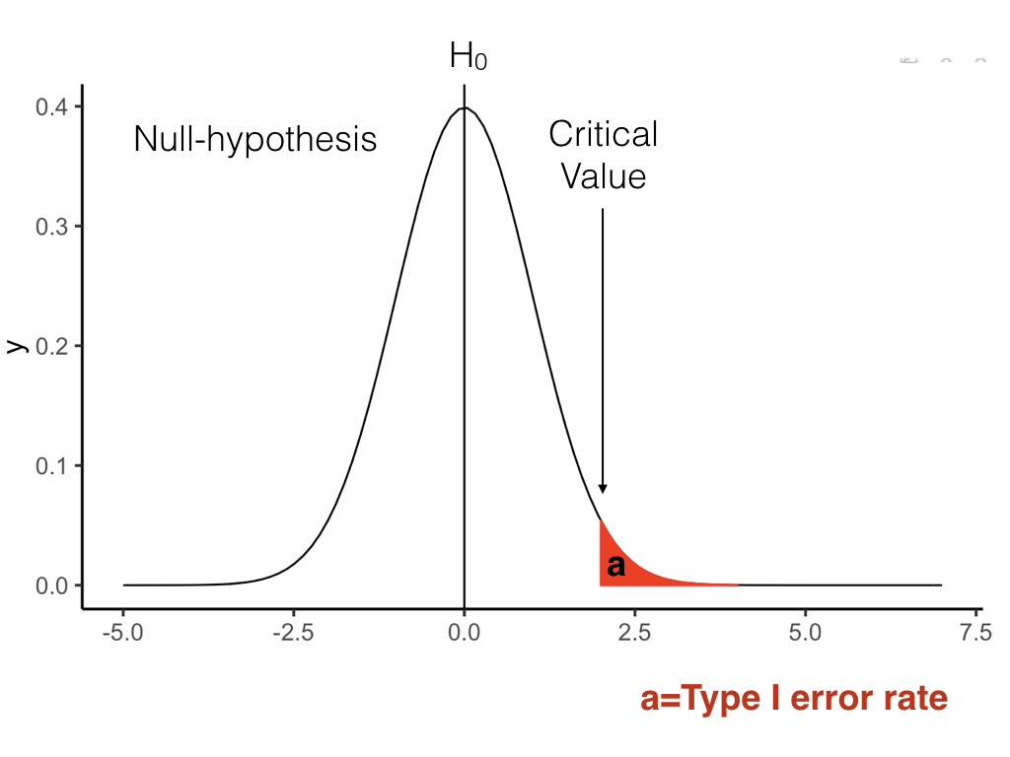
class: center, middle, clear, nopad

Slide 6
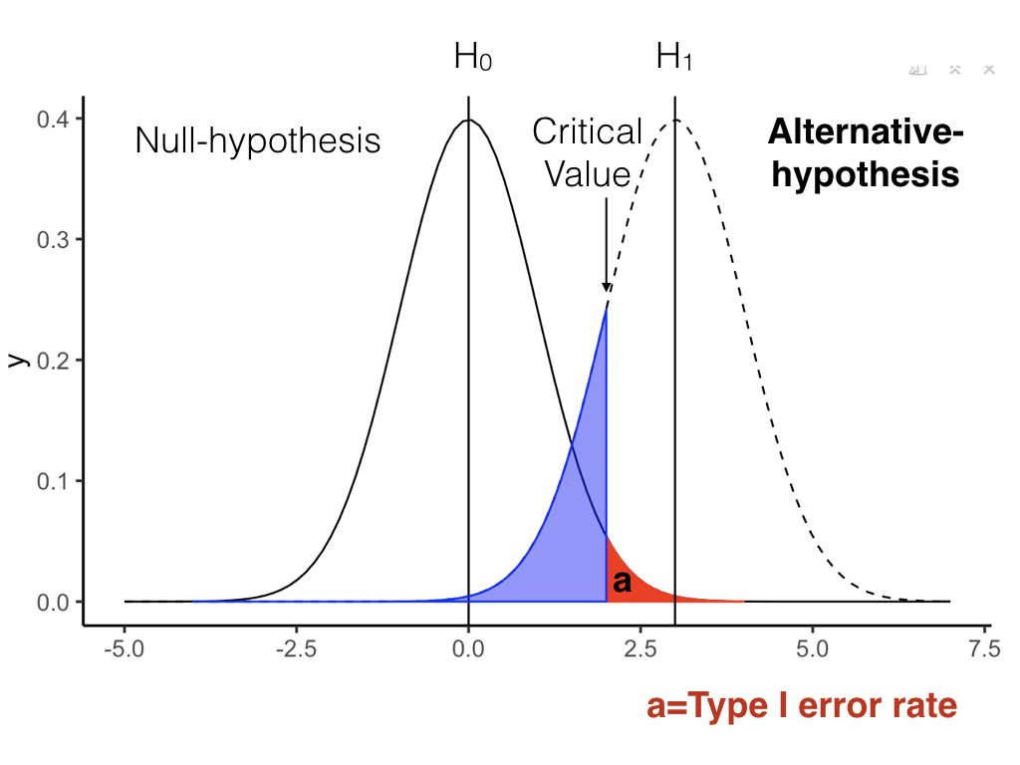
class: center, middle, clear, nopad

Slide 7
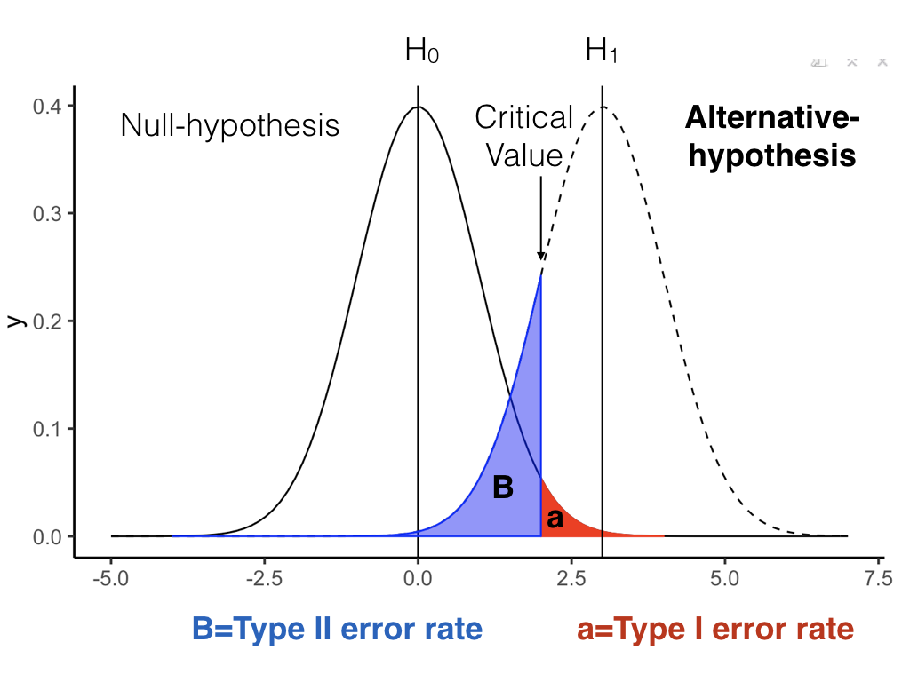
class: center, middle, clear, nopad

Slide 8
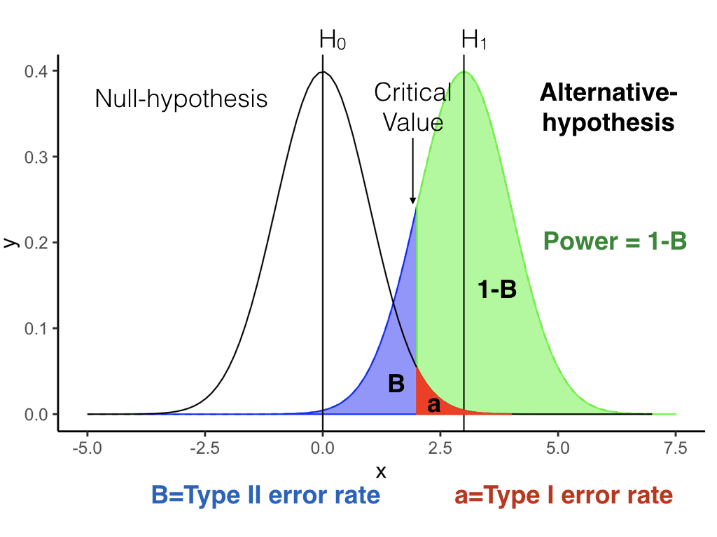
class: center, middle, clear, nopad

Slide 9
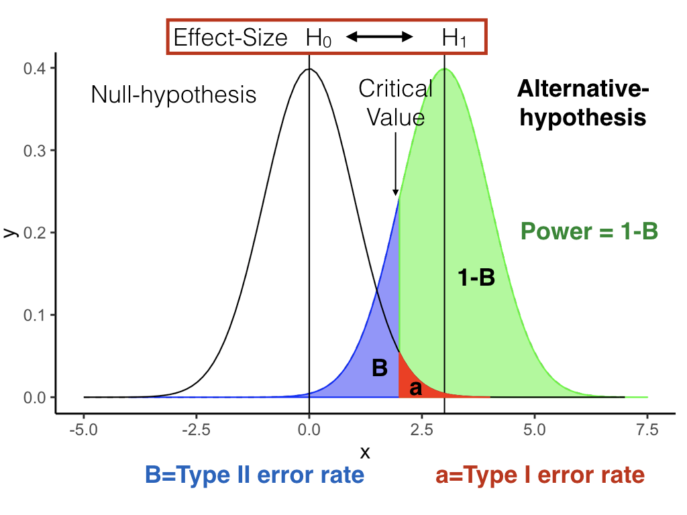
class: center, middle, clear, nopad

Slide 10
Power
You will often see researchers conducting a power-analysis of their design before they conduct the research.
In a paper, they will report something like this:
“Our design needed an N of 50 to achieve power .8 to detect an effect of d=.5”

Slide 11
Cohen’s d
A standardized measure of effect-size
Within-subject design
$d=\frac{\left|u1−u2\right|}{\text{sd}}$
Between-subject design
$d=\frac{\left|u1−u2\right|}{{\text{sd}}_{\text{pooled}}}$

Slide 12
Interpeting d
d=0, no mean difference
d=1, the difference between means is 1 sd
d=2, the difference between means is 2 sds.

Slide 13
What is a big or small d?
Conventional recommendations by Cohen:
d = .2 (small)
d = .5 (medium)
d >= .8 (large)

Slide 14
More interpretation of d
Researchers should establish for themselves a minimum effect-size of interest.
Minimum effect-size of interest depends on the research question
For example:
d = .1, is small (and perhaps meaningless) if we are talking about whether a drug cures symptom like headache pain
d = .1 is small (but meaningful) if we are using theories to test for the presence or absence of an effect

Slide 15
Data-simulation
A process for simulating the results of an experiment
Useful for understanding the likely outcomes of a particular design
General method, can be applied to many kinds of designs
Useful for sample-size planning

Slide 16
simulating a t-test
Link:
T-test simulations

Slide 17
Next class:
Data simulation for ANOVAs
No quiz this week. We’ll have the next one starting Tuesday

