Slide 1
PSYC 3400 Statistical Methods in Psychological Research
Science and Statistics Matthew Crump

Slide 2
class: pink, center, middle, clear

Slide 3
Course Overview

Slide 4
class: pink, center, middle, clear

Slide 5
Why is statistics a required course?

Slide 6
Psychological Facts & Theories

Slide 7
Psychological science produces facts and theories.
–
“Facts” are produced by collecting measurements about psychological phenomena, and by running experiments to establish the root causes of the phenomena
–
“Theories” are working explanations of a set of facts, they describe how causal forces work to produce the psychological phenomena

Slide 8
Facts depend on Evidence

Slide 9
“Facts” about psychology are only as good as the evidence for them.
Facts can be relied upon when the evidence for their existence is indispustable (clear-cut). There are many reliable findings in Psychology.
You should not believe every fact you hear!
Many findings in psychology are unreliable (other researchers can’t reproduce them), some are faked! and, others are downright silly.

Slide 10
Theories must explain evidence

Slide 11
The whole point of theories is to explain evidence, or the credible facts about a psychological phenomena of interest
There are many good, strong, theories in Psychology capable of explaining many aspects of Psychological phenomena, BUT:
You should not believe every theory you hear about in Psychology! Many “theories” do not explain the facts. Some “theories” aren’t theories at all, they are just someone’s opinion.

Slide 12
class: pink, center, middle, clear

Slide 13
Umm, How can we trust the facts and theories in Psychology?

Slide 14
You need to learn how to evaluate the evidence

Slide 15
All Psychology needs statistics

Slide 16
Psychologists run experiments to test research questions and claims
–

Slide 17
2. The experiments produce measurements, or evidence
Statistics are used to evaluate the evidence
–
Does the evidence support the claim?
–
Does the evidence not support the claim?

Slide 18
When you hear a scientific claim…

Slide 19
You could accept the claim because “a Scientist said it was true”
You could evaluate the evidence for claim and decide for yourself if the evidence warrants the claim.
Just because a scientist makes a claim, doesn’t make it true

Slide 20
class: pink, center, middle, clear

Slide 21
The case of power-posing

Slide 22
Can a powerful pose change your life?

Slide 23
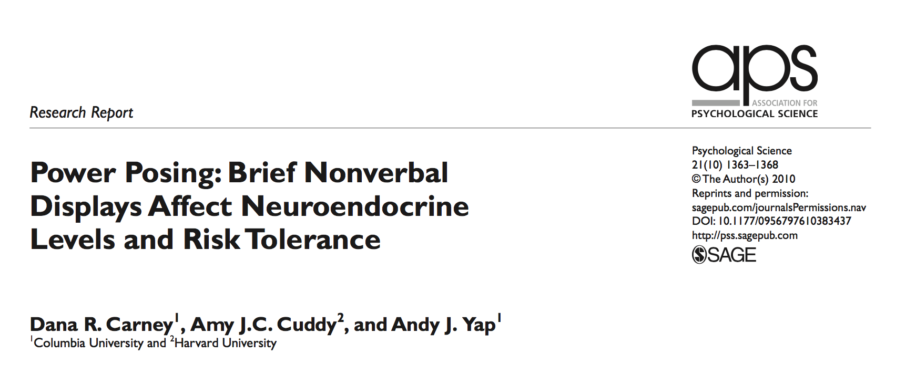

Slide 24
High vs. low power poses

Slide 25
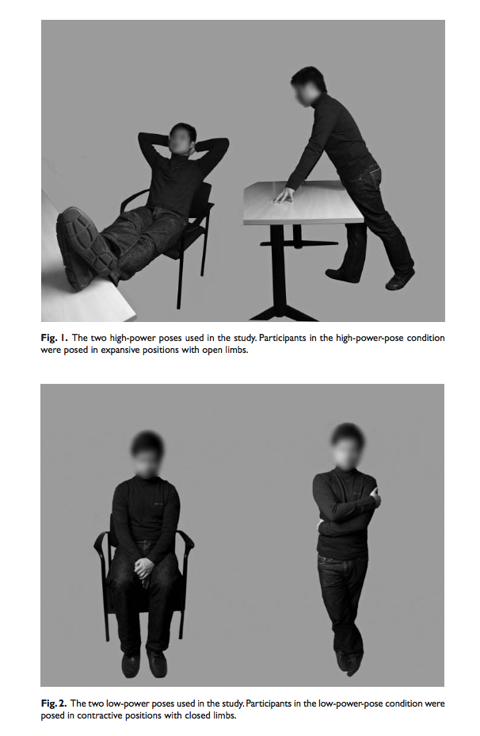

Slide 26
The “evidence”

Slide 27
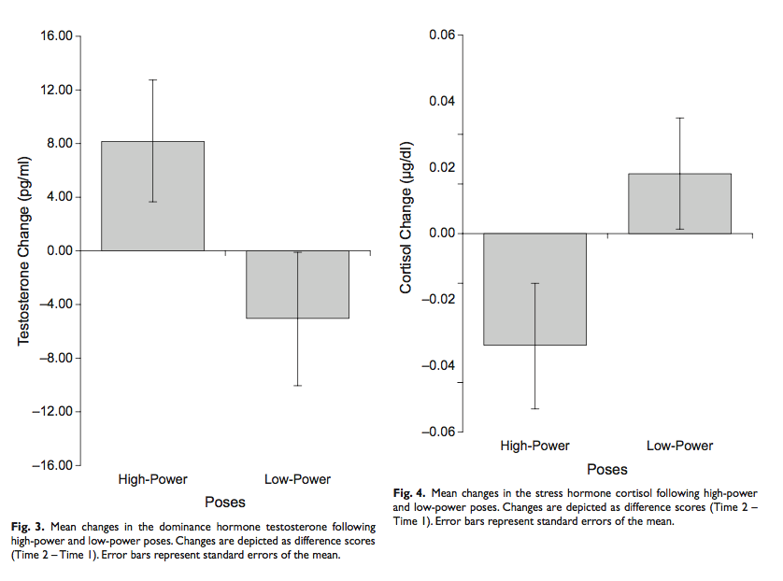

Slide 28
Big claims gone public

Slide 29

Amy Cuddy gave a TED Talk (viewed by 48 million people) claiming power posing can change your life!
link to ted talk

Slide 30
The problem:

Slide 31
Only a single study, with weak evidence
Many other labs tried to reproduce the findings, but they failed to replicate
Lesson 1: Don’t believe everything you hear just because Science says so.
Lesson 2: To understand Psychological science, you must understand how to evaluate evidence produced by Psychological science.

Slide 32
class: pink, center, middle, clear

Slide 33
Course Overview

Slide 34
Course Resources

Slide 35
This is a zero-textbook cost course. All of the resources are online and FREE!
Course Website https://crumplab.github.io/psyc3400
FREE Textbook https://crumplab.github.io/statistics
FREE Lab Manual https://crumplab.github.io/statisticsLab

Slide 36
Skills you learn in this course

Slide 37
Using data to answer questions about Psychology
–
Foundational statistical concepts
–
How to make your computer do statistics for you
–
How to think with data
–
How to critically evaluate research findings

Slide 38
class: pink, center, middle, clear

Slide 39
How this course works

Slide 40
Lectures

Slide 41
Generally 2 per week
We talk about statistics
Read the chapters assigned for each week
Ask questions
Attendance sheet handed out at beginning of class (missed class policy in a bit)

Slide 42
Weekly Quizzes (25% of grade)

Slide 43
New quiz every week
Complete quiz on Blackboard (the blackboard account for your lecture section)
Can re-take as many times as you want
Always recieve grade on last attempt (not best attempt)
DO YOUR QUIZ BY YOURSELF
Must complete quiz by end of week deadline
Quizzes are worth 25% of final grade
You will see many of the quiz questions on the midterm and final.

Slide 44
Midterm (10% of grade)

Slide 45
Multiple choice questions. Many taken from the quizzes
More info about midterm as we get closer

Slide 46
Final (25% of grade)

Slide 47
Multiple choice questions. Many taken from the quizzes
Final is cumulative (75% last half of course, 25% first half)

Slide 48
Labs (40% of grade)

Slide 49
Each week you will learn how to do statistics in R and R-studio, a free program for statistics. Labs have three parts
Lab exercises (learning) (1 point pass/fail, must attend lab and submit your work to pass)
Generalization, attempt to solve a problem using what you learned (1 point pass/fail, must submit something even if it doesn’t work)
Writing. Answer some concep questions (2 points, Graded by Lab instructor).

Slide 50
Extra Credit

Slide 51
I will announce opporunities for extra credit as we go through the course. Extra credit opportunities may count for up to 2% of your final grade.

Slide 52
Let’s look at the course website

Slide 53
https://crumplab.github.io/psyc3400

Slide 54
R and R-studio

Slide 55
Download R https://www.r-project.org
Download R-studio https://www.rstudio.com
Or, use R-studio Cloud in your web-browser https://rstudio.cloud

