Slide 1
Variability
Describing differences Matthew Crump

Slide 2
class: pink, center, middle, clear

Slide 3
We already know what lots of numbers look like

Slide 4
Lots of Numbers look like this
Like this
58
-64
62
21
15
-15
78
94
-38
-59
-10
90
63
89
44
-73
69
54
22
-89
61
-9
-84
-89
67
-40
8
17
37
21
69
39
-83
41
71
-46
38
-38
-15
69
32
73
-30
-90
-58
-2
81
79
-34
-35
91
77
39
-79
51
52
27
72
-83
-87
44
8
43
-23
-36
-20
-93
23
-98
21
58
85
-50
48
57
-87
44
-47
29
53
24
-44
-76
-8
-52
44
29
-95
-96
32
-89
81
-85
45
-12
-70
10
-58
-88
-81
-89
13
-90
51
86
-65
-68
-60
63
-23
72
-50
-24
57
96
69
-31
-8
-60
-17
83
-22
-46
-4
-25
71
-47
-29
100
26
50
-25
-33
8
31
-90
17
9
-81
-70
56
-54
-95
-3
-9
91
5
71
-25
45
-98
73
-98
-99
54
64
-50
82
-29
48
22
29
32
-66
83
27
-23
64
42
63
-40
-22
10
-72
16
-59
-26
50
-38
32
10
-4
-74
-49
-14
-94
37
45
7
-45
27
5
-81
-5
95
-80
-80
-52
-94
59

Slide 5
Summary numbers
We want to reduce the big set of numbers down to a few numbers that we can look at and make sense of.
Sameness (Central Tendency)
What are all the numbers close to? (topic from last class)
Differentness (Variance)
How different are the numbers? (topic for this class)

Slide 6
class: pink, center, middle, clear

Slide 7
Graph the numbers to get a better look at the differences

Slide 8
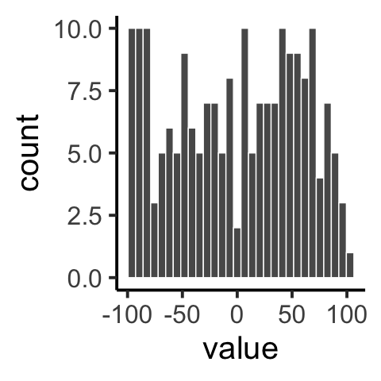
Histogram
We can see the spread in the data, there are different numbers…

Slide 9
class: pink, center, middle, clear

Slide 10
Range

Slide 11
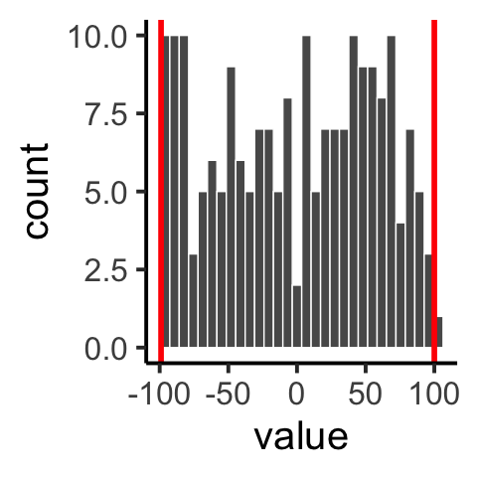
The Range

Slide 12
The Range
The range is two numbers.
minimum value: the smallest number in the data
maximum value: the largest number in the data
1 4 3 6 5 7 6 8 7 6 9
Range is (1,9)
smallest number is 1
largest number is 9

Slide 13
min()
Use the min() function to find the smallest value in a variable in R
x <- c(1,4,3,6,5,7,6,8,7,6,9) min(x)
## [1] 1

Slide 14
max()
Use the max() function to find the largest value in a variable in R
x <- c(1,4,3,6,5,7,6,8,7,6,9) max(x)
## [1] 9

Slide 15
Thinking about the range
Pros: Great way to find out the largest possible difference
Cons: The biggest possible difference is probably not representative of all the differences in the numbers

Slide 16
Some numbers
Here are two sets of numbers. What is the range? Does it do a good job showing the average differences?
1 5 6 5 4 5 6 5 4 5 6 5 4 100
1 2 1 2 1 1 1 1 2 2 2 2 1 2

Slide 17
Average differences
It would be nice if we could find a way to measure the average amount of differences.
This average could be a representative value that summarizes the differences between the numbers

Slide 18
Average differences
What should the average difference for these numbers be?
1 2 1 2 1 1 1 1 2 2 2 2 1 2
All of the numbers are 1s or 2s.
The difference between 1 and 2 is 1
It seems the average difference should be 1 (+ or -)

Slide 19
Differences between numbers
Consider these 10 numbers:
1 3 4 5 5 6 7 8 9 24
We can see there are some differences, they are not all the same.
We can measure the differences, by finding the difference between each score, and every other scores
e.g., 1-3 = 2, 1-4 = 3, etc.

Slide 20
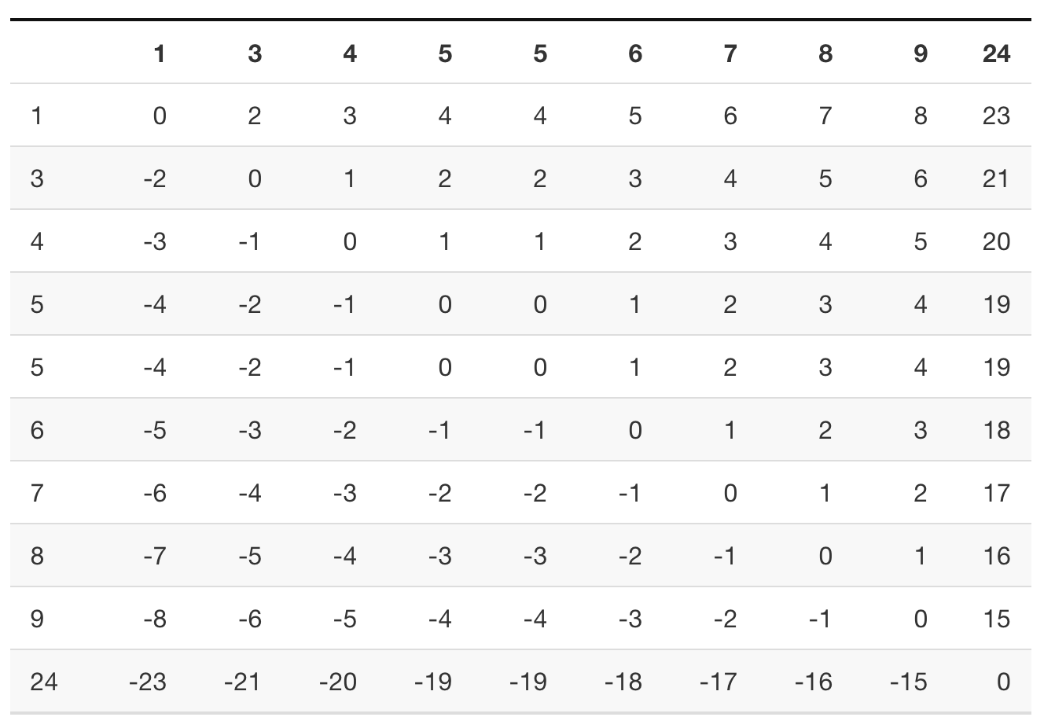
Difference scores

Slide 21
Problem: The sum = 0

Slide 22
Summarizing the difference scores
4. The sum adds up to 0…
5. How can we solve the problem?
1. We can find the differences between scores
2. There are lots of difference scores
Even though we can see the difference scores have different values, we can’t summarize them in the normal fashion

Slide 23
class: pink, center, middle, clear

Slide 24
Difference scores from the mean

Slide 25
Difference scores from the mean
Consider these numbers:
1 6 4 2 6 8
We can compute the mean to describe the central tendency of the numbers
How far off is the mean for each number? This is the amount of error
The difference scores from the mean show how far off (different) each score is from the mean
difference score = $\overset{‾}{X}−x_{i}$

Slide 26
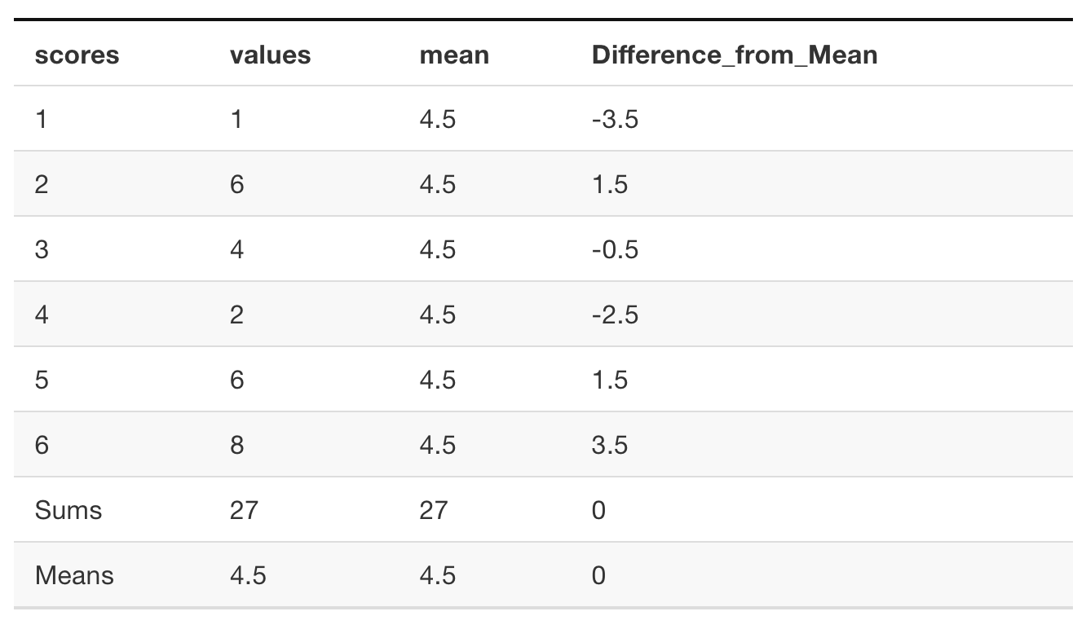
Difference scores from the mean

Slide 27
sum = 0, Same problem…

Slide 28
Mean is the balancing point
2. Half of the data is on one side of the mean, the other half is on the other side
3. Difference scores from mean will always sum to 0
The mean is the balancing point in the data

Slide 29
The mean minimizes the deviations
The mean is the only number that minimizes the sum of the deviations (difference scores)
$\sum_{i=1}^{i=N}{\left(\overset{‾}{X}−x_{i}\right)}=0$
–
If the mean difference scores will always sum to 0, how can we find a sum for the difference scores that does not sum to 0?

Slide 30
class: pink, center, middle, clear

Slide 31
Squared Deviations

Slide 32
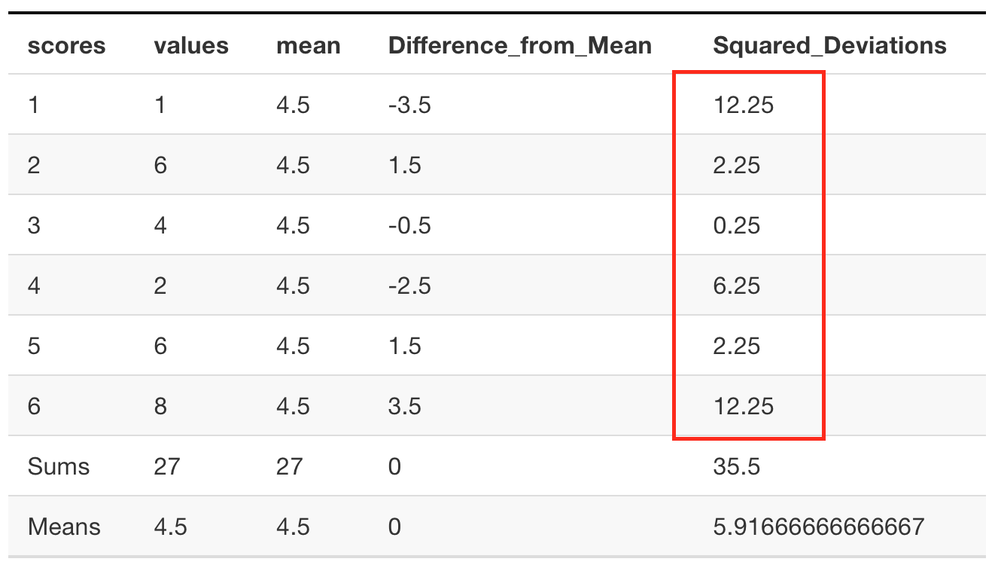
Squared deviations

Slide 33
Squared deviations
Why square the deviations (differences between mean and each score)?
Squaring converts all the negative numbers to postive numbers
This allows us to sum them all up, and not get 0!

Slide 34
class: pink, center, middle, clear

Slide 35
SS (Sum of squared deviations)

Slide 36
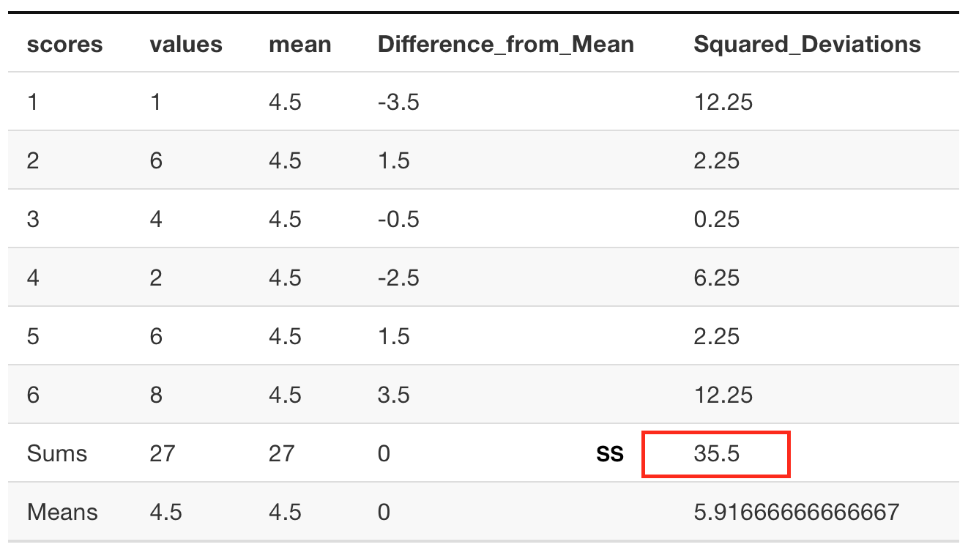
SS (sum of squared deviations)

Slide 37
SS (sum of squared deviations)
The formula for the sum of squared deviations (SS, also called sum of squares) is:
$SS=\sum_{i=1}^{i=N}{{\left(\overset{‾}{X}−x_{i}\right)}^{2}}$

Slide 38
What next?
3. How can we find the average? Remember, we want a single number that does a good job of representing the differences…
We’ve found a way to sum up the differences (SS)
–
We used the squared differences from the mean, and added them all up

Slide 39
class: pink, center, middle, clear

Slide 40
Variance

Slide 41
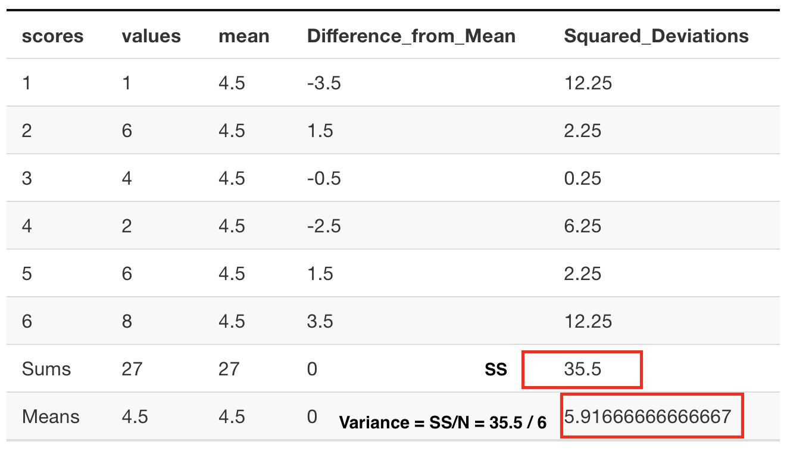
Variance = SS/N

Slide 42
Jargon
Learning statistics can be confusing because there are many new terms, and some of them refer to normal everyday concepts
Everyday words:
Variability & Variance: The things aren’t all the same, they have some variability
Statistical Variance: The average of the sum of the squared difference scores from the mean

Slide 43
Variance
The average of the sum of the squared difference scores from the mean
$Variance=SS/N$
$Variance=\frac{\sum_{i=1}^{i=N}{{\left(\overset{‾}{X}−x_{i}\right)}^{2}}}{N}$
Usefulness
Pros: The variance provides us with one summary number about the average differences
Cons: We squared the differences, so the variance doesn’t directly relate to size of the original differences

Slide 44
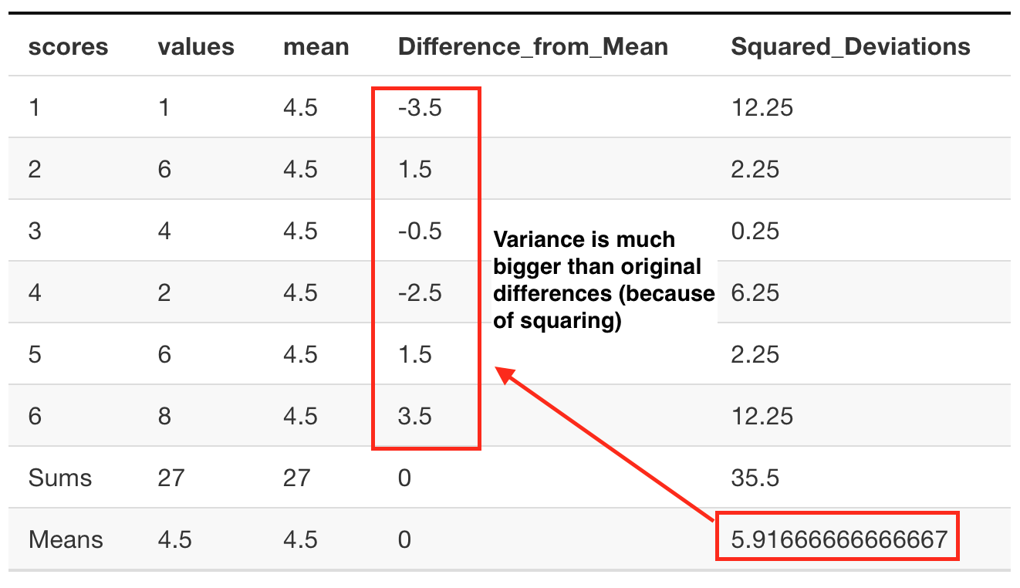
The variance is too big

Slide 45
What to do?
2. The variance is too big because of squaring
3. What can we do to solve the problem, and make our summary number in the range of the actual differences?
We are searching for a summary number to represent the differences in our data.

Slide 46
Square root the variance
Squaring numbers makes them bigger (e.g., $2^{2}=4$)
Square rooting numbers brings them back down to their unsquared size (e.g., $\sqrt{2^{2}}=2$)
Let’s square root the variance

Slide 47
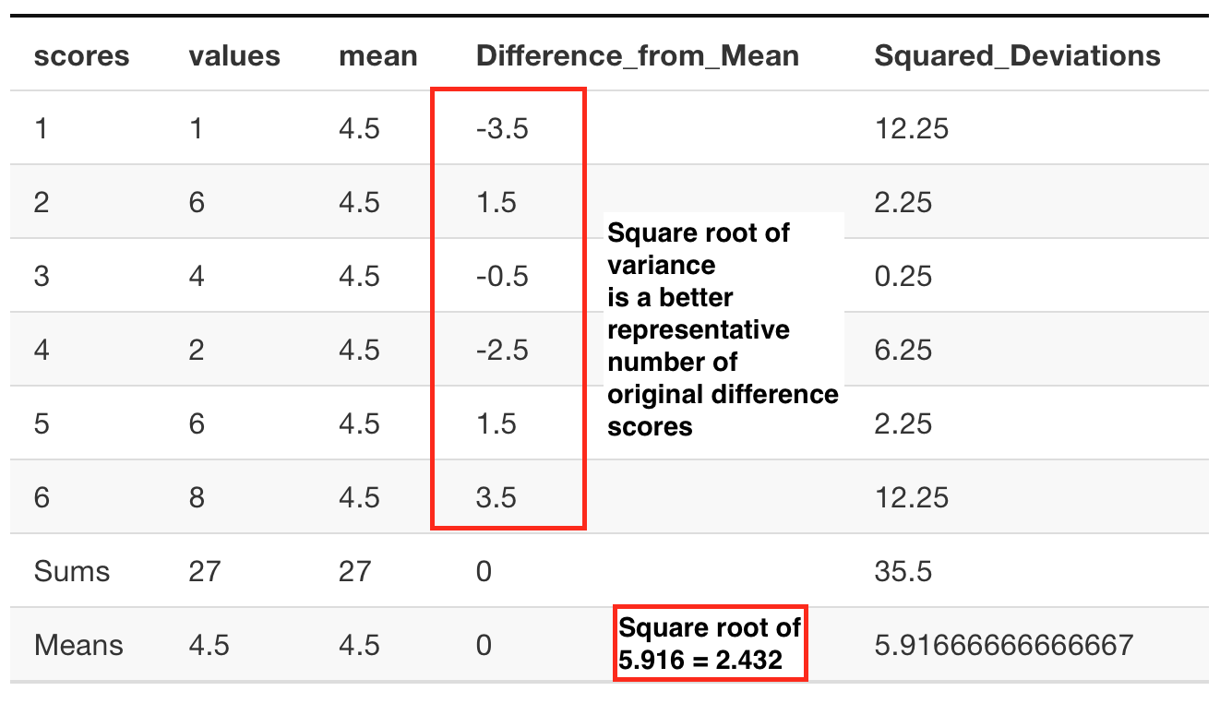
Square root the variance

Slide 48
class: pink, center, middle, clear

Slide 49
Standard Deviation

Slide 50
Standard deviation = sqrt(variance)
When we took the square root of the variance, we also did something else, called computing the standard deviation.
$\text{standard deviation}=\sqrt{\text{variance}}$
$\text{standard deviation}=\sqrt{\frac{SS}{N}}$
$\text{standard deviation}=\sqrt{\frac{\sum_{i=1}^{i=N}{{\left(\overset{‾}{X}−x_{i}\right)}^{2}}}{N}}$
The standard deviation is a summary of the variability in the data that is in the same scale as the original differences

Slide 51
Standard Deviation

Slide 52
Populations vs samples
There are different formulas for the variance and standard deviation, depending on whether your data represents an entire population of scores, or just a sample (a subset of the population).
Population: Divide by N (this is what you will do for the quiz, we tell you to divide by N)
Sample: Divide by N-1 (this is what you will do when you are working with samples later on this class)
The differences are explained in week 4 (distributions and sampling)

Slide 53
class: pink, center, middle, clear

Slide 54
Data sense with Descriptives

Slide 55
What if?
Someone told you they had some numbers with:
–
Mean = 100, Standard Deviation = 25
–
What would most of the numbers be like?
What would be a good summary of the average differences in the data?
What kind of numbers would you expect to see or not see?

Slide 56
Animating the standard deviation

Slide 57
class: pink, center, middle, clear

Slide 58
R tips

Slide 59
Warning
R has functions for variance and standard deviation…
But, they divide by N-1, not N
We talk about what this means later in the course, and why R does this
For now, you can’t use the R formulas sd() or var()

Slide 60
R: Mean difference scores
x <- c(8,2,6,4,6,2,4,4) mean(x)-x
## [1] -3.5 2.5 -1.5 0.5 -1.5 2.5 0.5 0.5
sum(mean(x)-x)
## [1] 0

Slide 61
R: Squared deviations
x <- c(8,2,6,4,6,2,4,4) (mean(x)-x)^2
## [1] 12.25 6.25 2.25 0.25 2.25 6.25 0.25 0.25

Slide 62
R: SS, sum of squares
x <- c(8,2,6,4,6,2,4,4) sum((mean(x)-x)^2)
## [1] 30
More explicit code:
x <- c(8,2,6,4,6,2,4,4) squared_deviations <- (mean(x)-x)^2 SS <- sum(squared_deviations) SS
## [1] 30

Slide 63
R: Variance
x <- c(8,2,6,4,6,2,4,4) squared_deviations <- (mean(x)-x)^2 SS <- sum(squared_deviations) N <- length(x) variance <- SS/N variance
## [1] 3.75

Slide 64
R: Standard Deviation
x <- c(8,2,6,4,6,2,4,4) squared_deviations <- (mean(x)-x)^2 SS <- sum(squared_deviations) N <- length(x) variance <- SS/N standard_deviation <- sqrt(variance) standard_deviation
## [1] 1.936492

Slide 65
Next class: Correlation
Today we looked measures of variability, to summarize differences in the data
Next class (Monday, 11th) we look at how measurements of more than one variable can be related to one another (correlation)
Quiz 2 is due Monday, 11th @ 11:59pm

