Slide 1
Correlation
Regression, interpretation, and chance Matthew Crump

Slide 2
class: pink, center, middle, clear

Slide 3
Correlations can occur by chance

Slide 4
Issues for this class
What is Regression?
Interpretation of Correlations
Correlation and chance

Slide 5
class: pink, center, middle, clear

Slide 6
Regression

Slide 7
Regression
geometric interpretation of correlation
can be used for prediction

Slide 8
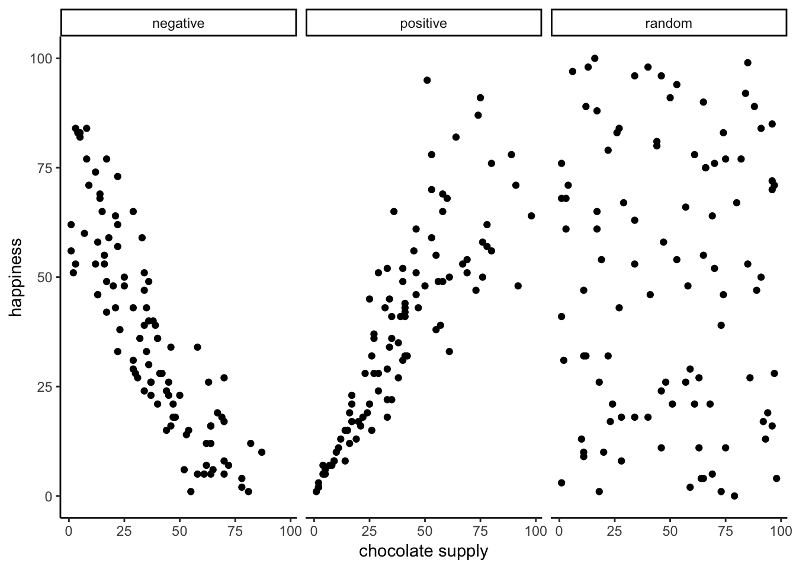
Examples of correlation

Slide 9
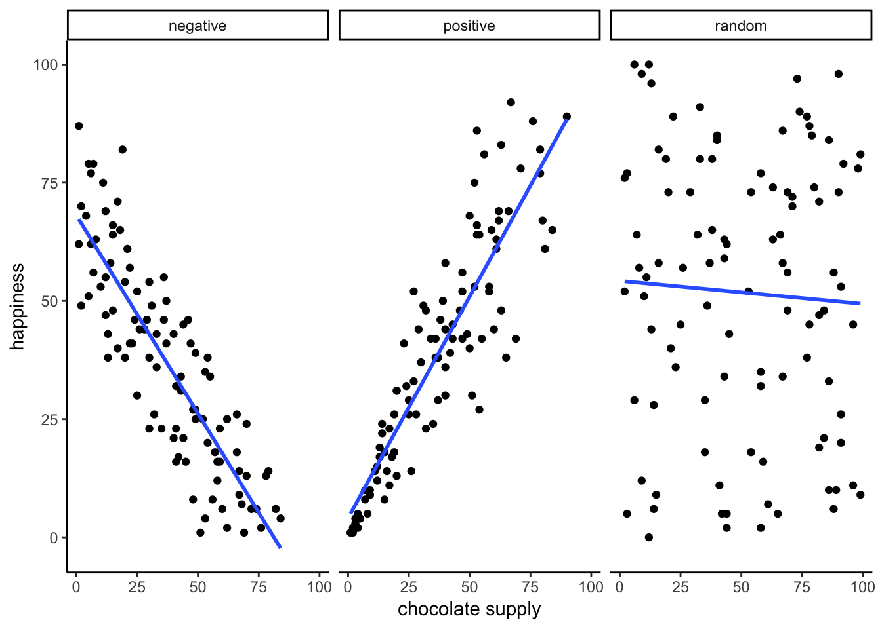
Correlation with Regression lines

Slide 10
What is a regression line?
the best fit line
what makes it the best fit line?

Slide 11
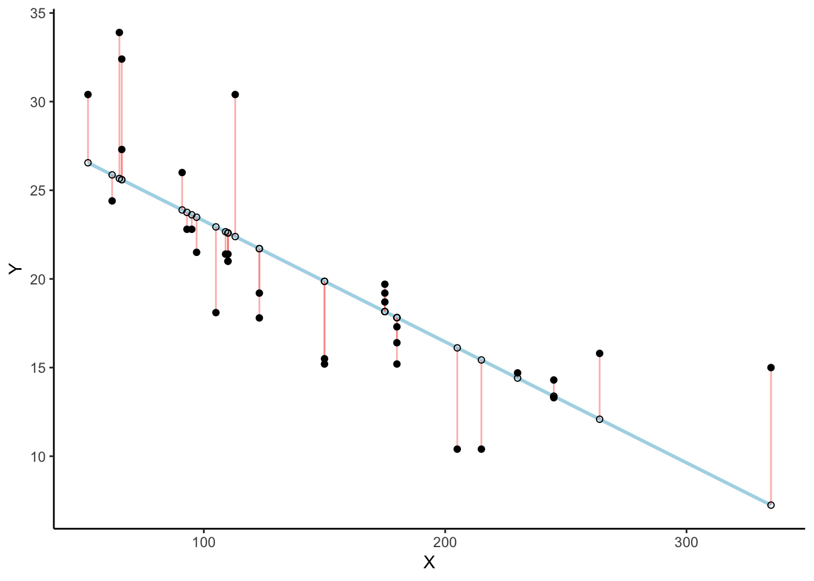
Residuals and error

Slide 12
What is a regression line?
the best fit line
what makes it the best fit line?
The regression line minimizes the sum of the residuals

Slide 13
Animated Residuals

Slide 14
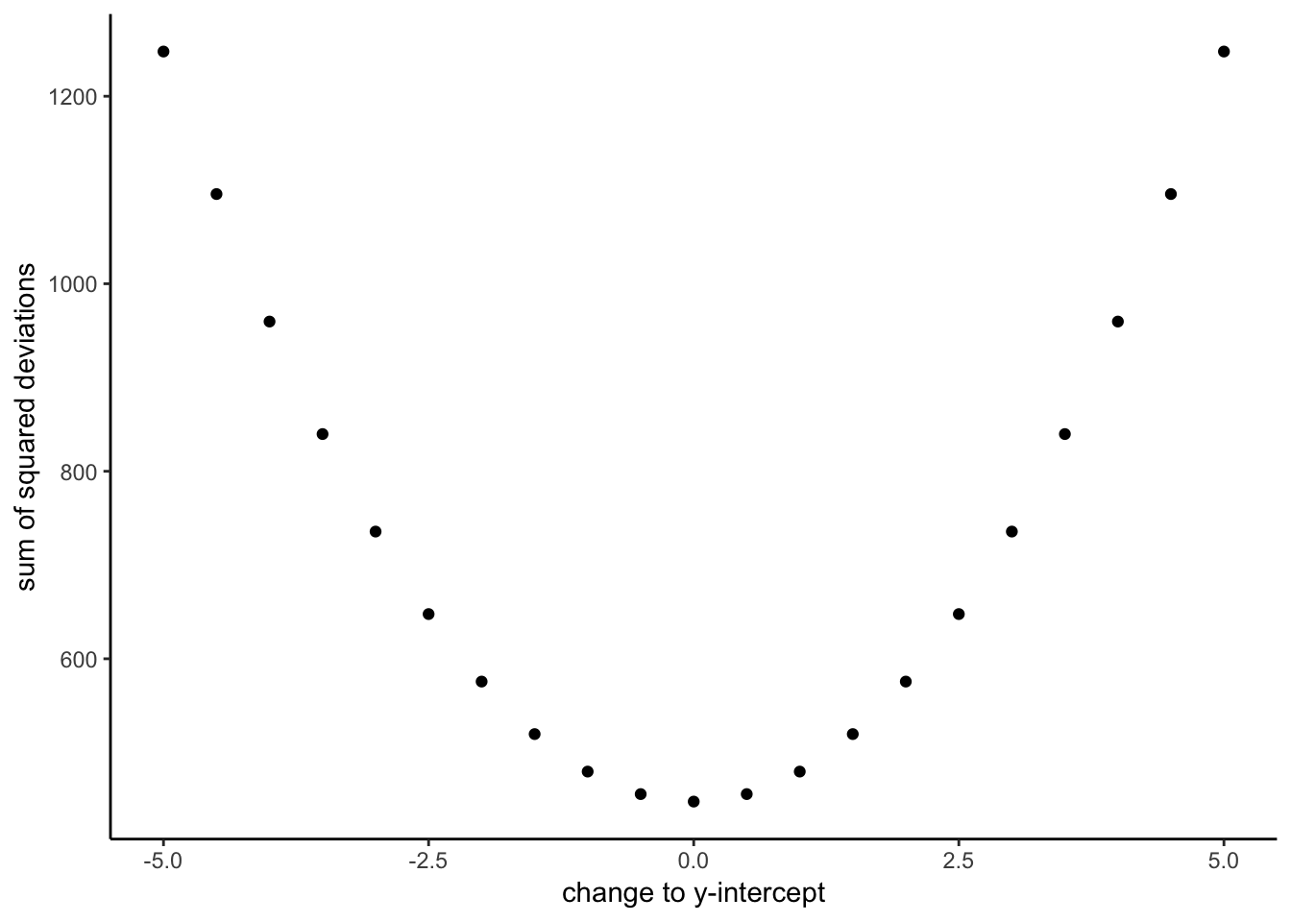
Minimizing the error

Slide 15
Finding the best fit line
how do we find the best fit line?
First step, remember what lines are…

Slide 16
Equation for a line
$y=mx+b$
$y=\text{slope}*x+\text{y intercept}$
y = value on y-axis
m = slope of the line
x = value on x-axis
b = a constant for the y-intercept

Slide 17
class: center, middle, clear
<iframe style=“width:100%;height:100%;border-style:none;”, src=“https://crumplab.shinyapps.io/Lines/” />

Slide 18
solving for y
$y=.5x+2$
What is the value of y, when x is 0?
$y=.5*0+2=0+2=2$
What is the value of y, when x is 4?
$y=.5*4+2=2+2=4$

Slide 19
solving for x
$y=.5x+2$
What is the value of x, when y is 4?
$4=.5*x+2$
$4−2=.5*x$
$2=.5*x$
$\frac{2}{.5}=x$
$x=4$

Slide 20
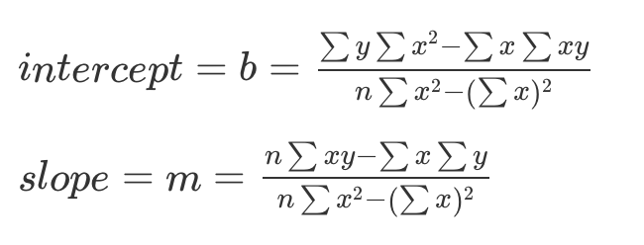
Finding the best fit line

Slide 21
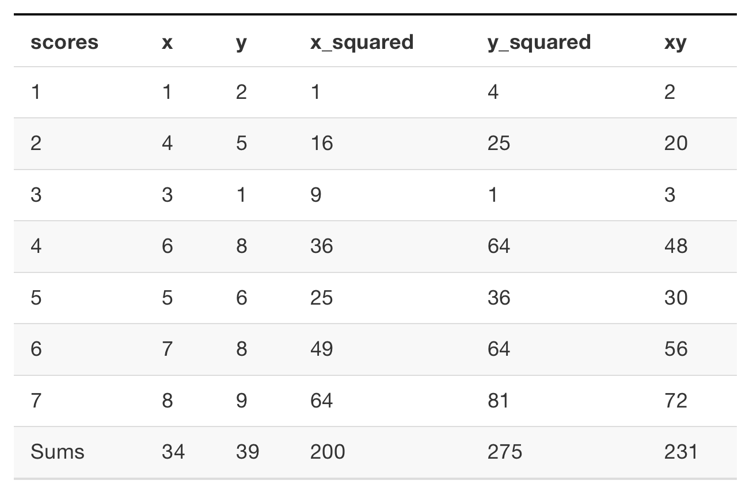
sample data

Slide 22
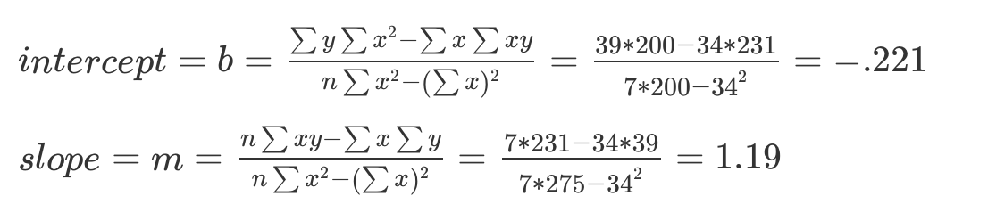
sample calculations

Slide 23
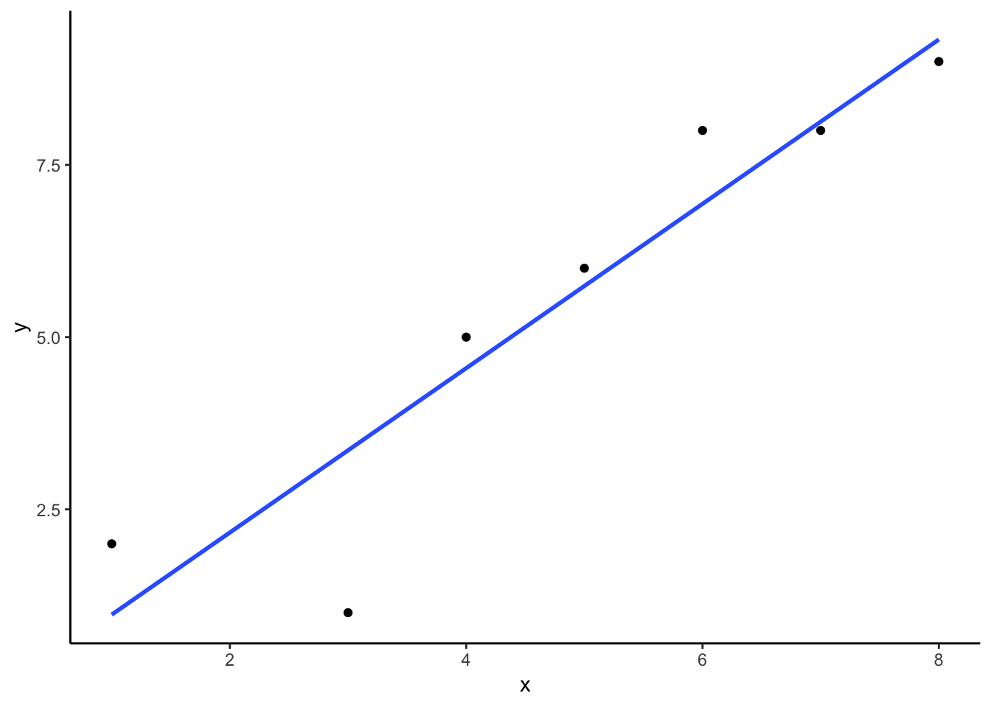
scatterplot plus regression line

Slide 24
R: intercept and slope
x <- c(1,4,3,6,5,7,8) y <- c(2,5,1,8,6,8,9) df <- data.frame(x,y) coef(lm(y~x, data=df))
## (Intercept) x ## -0.2213115 1.1926230

Slide 25
Reminders: y-intercept
What does the y-intercept mean?
It is the value where the line crosses the y-axis when x = 0.

Slide 26
Reminders: slope
What does the slope mean?
The slope tells you the rate of change. For example, for every 1 unit of x, you move the the “slope” amount on y.
E.g., if slope = .5, then for every 1 unit of x, you increase y by .5 units.

Slide 27
class: pink, center, middle, clear

Slide 28
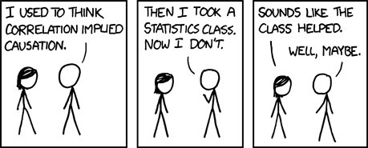
Interpreting Correlations

Slide 29
What do correlations mean?
Could mean that one variable causes change in another variable
BUT, it can mean other things…
Causal direction problem
Non-linear problem
Spurious correlations
Chance problem

Slide 30
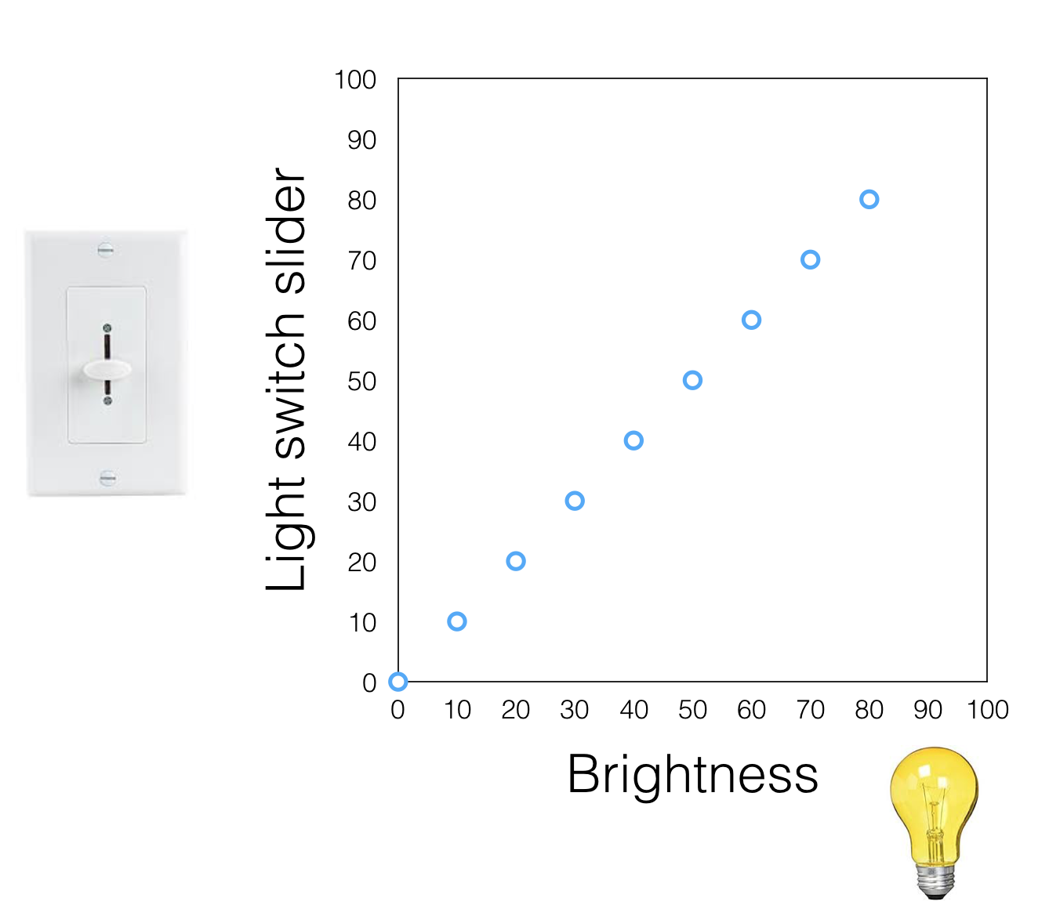
Correlations as causes

Slide 31
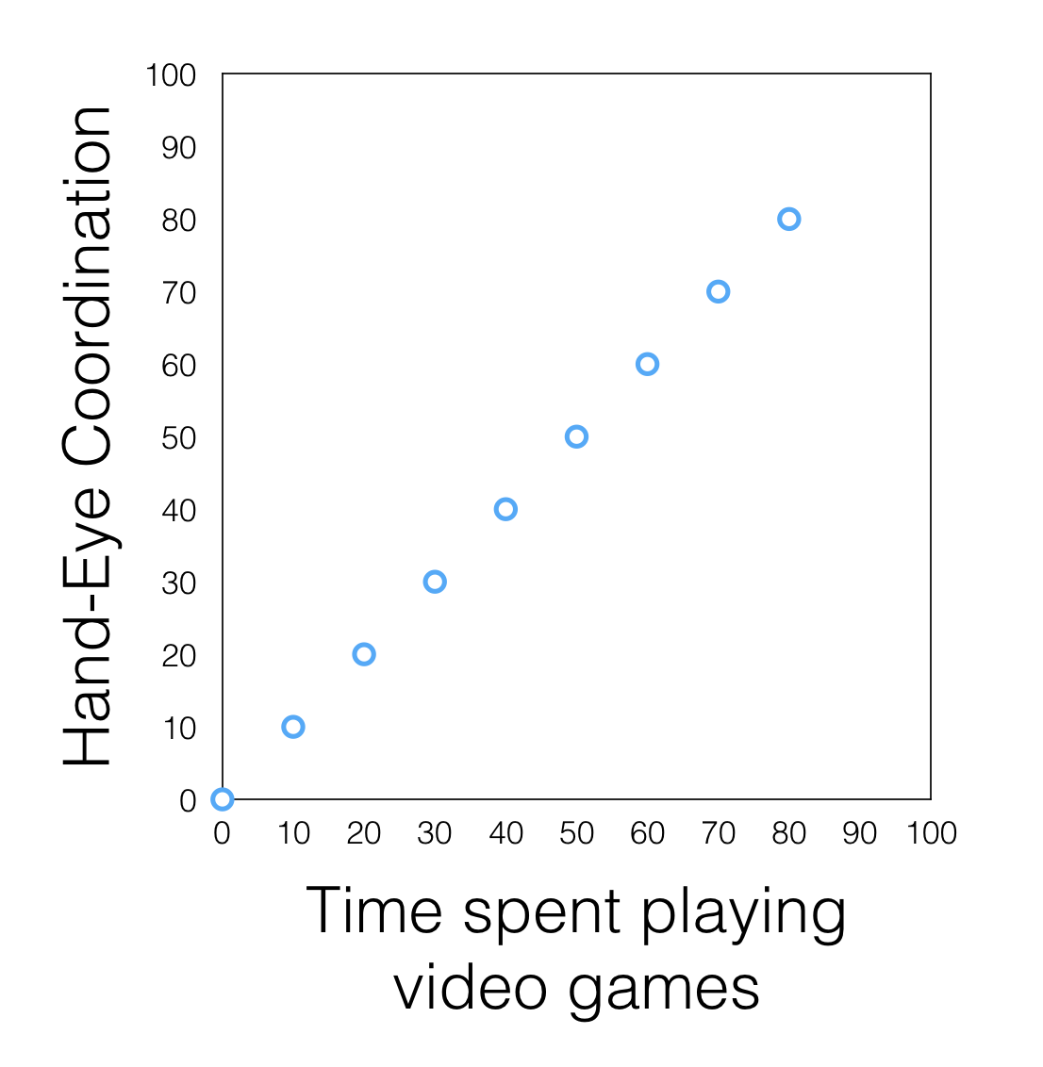
Causal Directionality problem

Slide 32
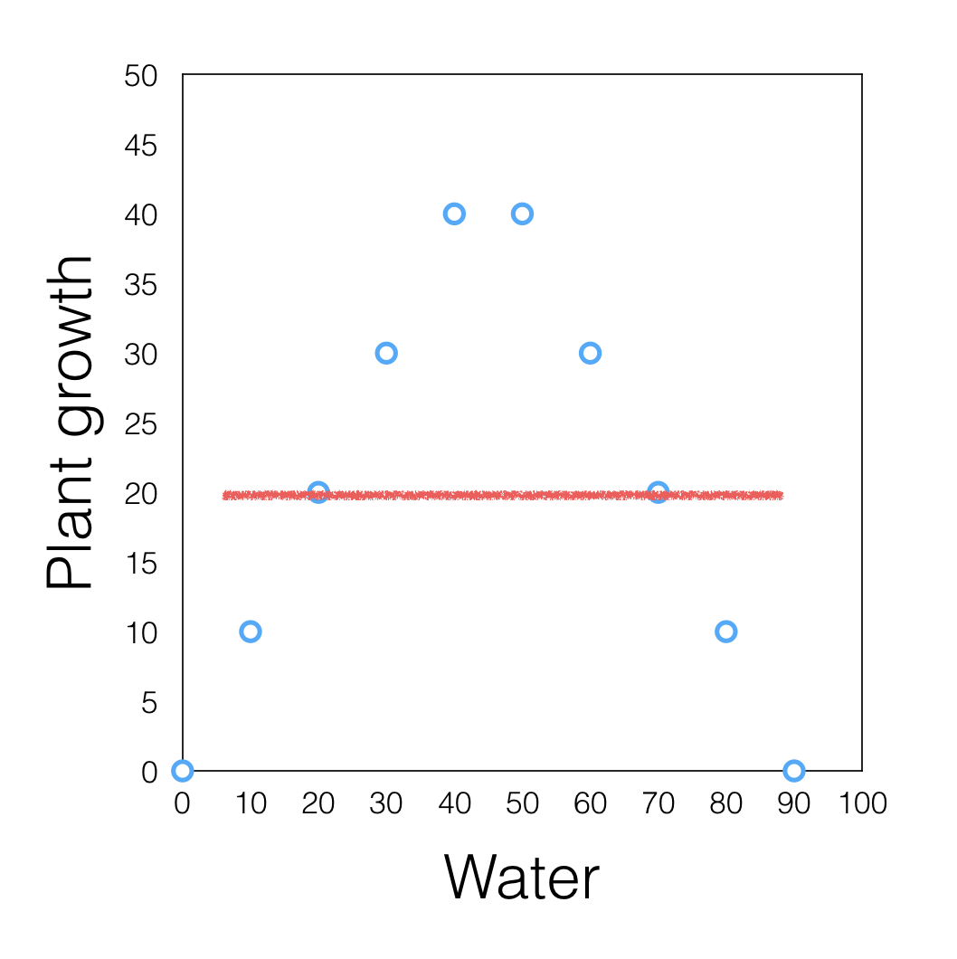
Nonlinearity problem

Slide 33
Spurious correlations
http://www.tylervigen.com/spurious-correlations

Slide 34
Chance problem
Correlations between two variables can occur by chance, and be completlely meaningless

Slide 35
class: pink, center, middle, clear

Slide 36
Correlations and Random Chance

Slide 37
What is Randomness?
Two related ideas:
Things have equal chance of happening (e.g., a coin flip)
50% heads
50% tails
Independence: One thing happening is totally unrelated to whether another thing happens
the outcome of one flip doesn’t predict the outcome of another

Slide 38
Two random variables
On average there should be zero correlation between two variables containing randomly drawn numbers
The numbers in variable X are drawn randomly (independently), so they do not predict numbers in Y
The numbers in variable Y are drawn randomly (independently), so they do not predict numbers in X
If X can’t predict Y, then correlation should be 0 right?

Slide 39
R: random numbers
runif() allows you to sample n random numbers between a minimum and maximum value. Numbers in the range have an equal chance of occuring.
runif(n=5, min=0, max=5)
## [1] 1.523961 3.750362 1.109250 1.841306 1.482938
runif(n=5, min=0, max=5)
## [1] 3.571274 1.443787 1.494780 4.274973 2.406056

Slide 40
“Random” Correlations
x <- runif(n=5, min=0, max=5) y <- runif(n=5, min=0, max=5) x
## [1] 4.881241 2.697059 2.083607 4.932645 3.674339
y
## [1] 2.776441 0.976859 1.609550 1.037079 4.308040
cor(x,y)
## [1] 0.1889162

Slide 41
class: center, middle, clear
<iframe style=“width:100%;height:100%;border-style:none;”, src=“https://crumplab.shinyapps.io/ChanceCorrelation/” />

Slide 42
Small N “random” correlations

Slide 43
What is chance capable of?
We can see that randomly sampling numbers can produce a range of correlations, even when there shouldn’t be a “correlation”
–
What is the average correlation produced by chance?
–
What is the range of correlations that chance can produce?

Slide 44
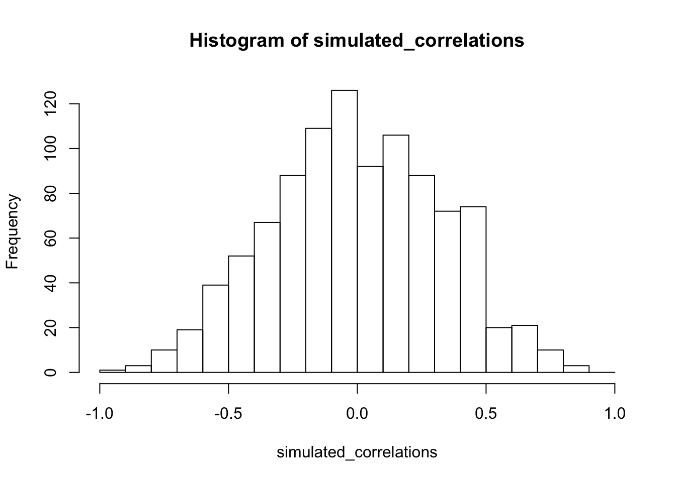
Simulating what chance can do

Slide 45
The role of sample size (N)

Slide 46
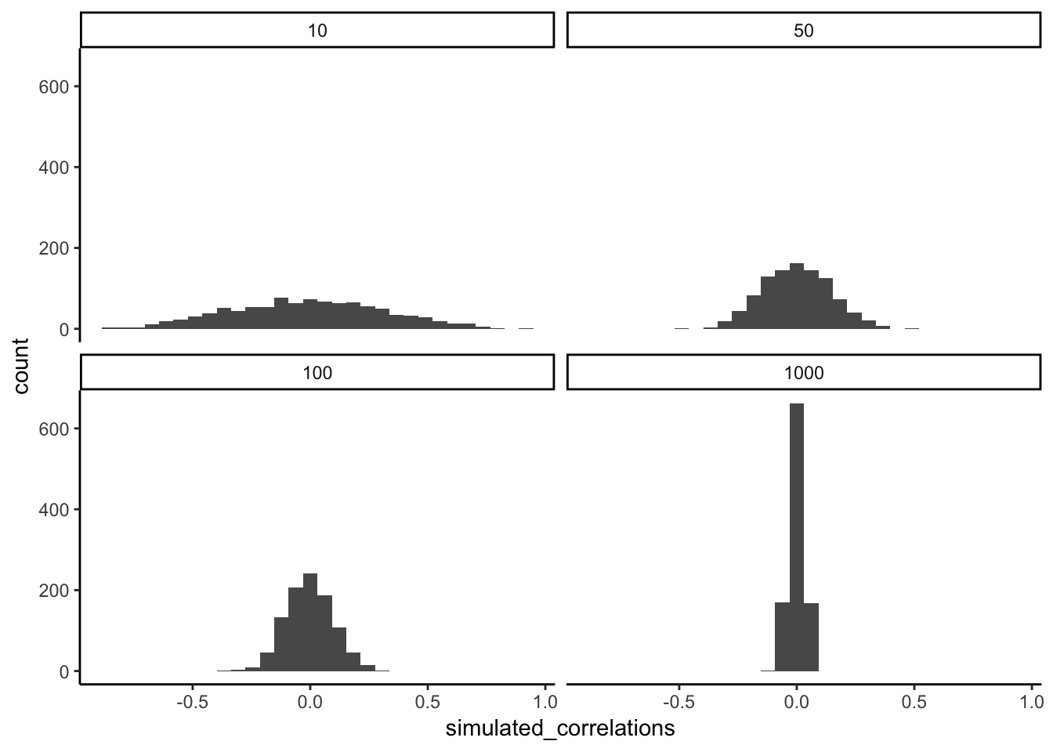
The role of sample size (N)
The range of chance correlations decreases as N increases

Slide 47
class: pink, center, middle, clear

Slide 48
Statistical Inference (The rest of this course)

Slide 49
The inference problem
Let’s say we found a correlation, (r = .5)
We know chance can sometimes produce correlations
Problem for inference: - Is the correlation real? Is one variable really related to the other? - Or, is the correlation spurious, and just happened to occur by chance?

Slide 50
Making inferences about chance

Slide 51
Next class: Distributions
NO CLASS, Monday 18th - College Closed
Wednesday, February 20th: We explore ideas about samples, populations, and distributions

Slide 52
Reminder
Quiz 2 for descriptives is due today @ 11:59pm
Quiz 3 for correlation/regression opens today, due Monday Feb 25th

