Slide 1
Distributions
and a little bit of probability Matthew Crump

Slide 2
class: pink, center, middle, clear

Slide 3
Chance does things

Slide 4
Big ideas for this course
Psychology interpets patterns in data to draw conclusions about psychological processes
–
Chance can produce “patterns” in data
–
Problem: How can we know if the pattern is real, or simply a random accident produced by chance

Slide 5
Solutions
Need to understand what chance is
–
Need to find out what chance can actually do in a particular situation
–
Create tools to help us determine whether chance was likely or unlikely to produce patterns in the data

Slide 6
Issues for this class
Probability Basics
Distributions
Sampling from distributions

Slide 7
class: pink, center, middle, clear

Slide 8
Probability Basics

Slide 9
What is a probability?
A number bounded between 0 and 1
Describes the “chances” or “likelihood” of an event

Slide 10
Proportions and Percentages
Percentage (%) : A ratio between event frequency, and total frequency, expressed in units of 100.
Proportion : a decimal version (range between 0-1)
$100\%=\frac{100}{100}=1=1*100=100\%$
$50\%=\frac{50}{100}=.5=.5*100=50\%$
$\frac{2}{4}=.5=.5*100=50\%$

Slide 11
Two probability statements
A coin has a 50% chance of landing heads
p(heads) = .5
–
There is a 10% chance of rain tomorrow
p(rain tomorrow) = .1

Slide 12
Frequentist vs. Bayesian
Probability is defined differently depending on philosophical tradition.
Frequentist: The long-run chances (odds) of an event occurring
Bayesian: Degree of belief

Slide 13
A fair coin
A fair coin has a 50% chance of landing heads or tails
Frequentist: If you flip this coin an infinity of times, in the long run half of the outcome will be heads, and half will be tails
Bayesian: I am uncertain about the outcome, I can’t predict what it will be.

Slide 14
10% chance of rain tomorrow
10% chance of rain tomorrow refers to a single event that hasn’t yet occurred
Frequentist: I don’t know what to say. Tomorrow it will rain or not rain, so there will be a 0% or 100% chance of rain, we’ll find out after tomorrow happens
Bayesian: It is unlikely to rain tomorrow, I won’t bring an umbrella.

Slide 15
class: pink, center, middle, clear

Slide 16
50% chance

Slide 17
Coin flipping
I made R flip a fair coin 100 times:
## [,1] [,2] [,3] [,4] [,5] [,6] [,7] [,8] [,9] [,10] ## [1,] "T" "H" "T" "H" "H" "T" "H" "H" "H" "T" ## [2,] "T" "H" "T" "T" "T" "H" "H" "T" "H" "H" ## [3,] "T" "H" "T" "T" "H" "H" "T" "T" "T" "H" ## [4,] "T" "H" "T" "H" "T" "H" "T" "T" "H" "T" ## [5,] "T" "T" "T" "H" "T" "H" "T" "T" "T" "T" ## [6,] "H" "H" "T" "H" "T" "H" "H" "H" "H" "T" ## [7,] "H" "H" "H" "T" "H" "H" "T" "H" "H" "T" ## [8,] "H" "T" "H" "H" "H" "T" "H" "T" "T" "H" ## [9,] "T" "H" "T" "T" "T" "T" "H" "H" "H" "H" ## [10,] "H" "T" "T" "H" "T" "T" "H" "T" "T" "T"

Slide 18
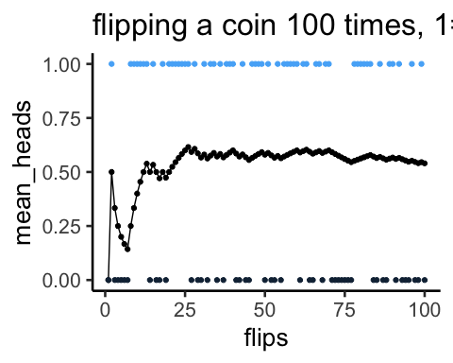
Flipping a coin 100 times

Slide 19
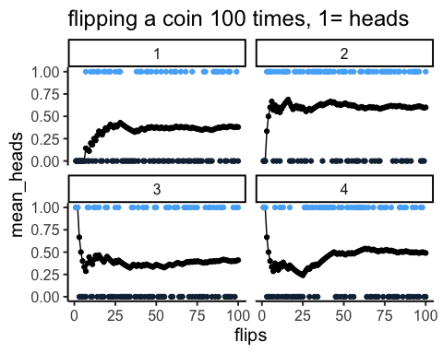
Four simulations

Slide 20
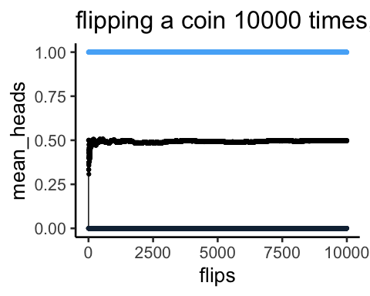
Flipping a coin 10000 times

Slide 21
coin flipping summary
50% heads/tails means that over the long run, you should get half heads and half tails
When sample size (number of flips) is small, you can “randomly” get more or less than 50% heads
Chance is lumpy

Slide 22
Discrete probability distributions
Defines the probability of each item in a set.
All probabilities must add up to 1

Slide 23
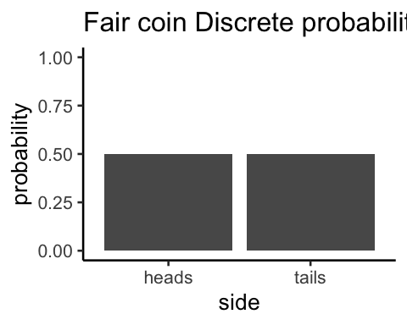
Coin flipping distribution

Slide 24
class: pink, center, middle, clear

Slide 25
What can the coin flipping distribution do?

Slide 26
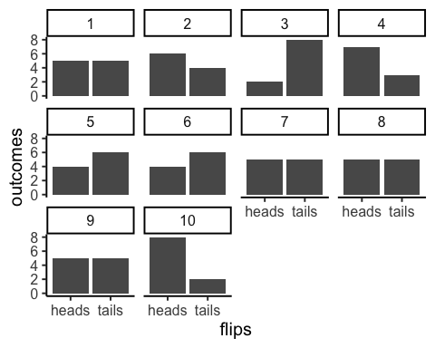
10 sets of 10 flips

Slide 27
flipping a coin 10 times
We expect to get 5 heads and 5 tails on average
But, we often do not get exactly 5 heads and 5 tails
Randomly sampling from the distribution can produce a variety of answers

Slide 28
simulating 10 flips many times
Steps:
Flip a coin 10 times
count the number of heads, save the number
Repeat above 1,000 times or more
plot the histogram of number of heads

Slide 29
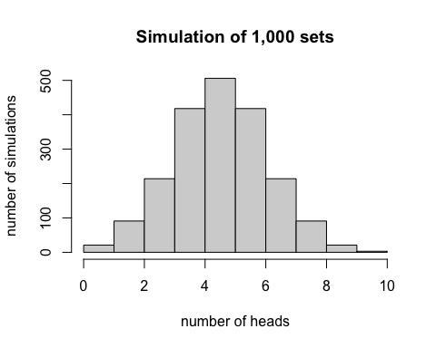
Distribution of heads (10 flips)

Slide 30
Summary of simulation
Chance produces a range of outcomes (number of heads out of 10)
Chance most frequently produces 5 heads and 5 tails
Chance produces more extreme outcomes with increasingly less frequency (lower probability)
E.g., chance is very unlikely to produce 9 out of 10 heads

Slide 31
flipping a coin 100 times
What if we simulated flipping a coin 100 times, what would the range of outcomes be?

Slide 32
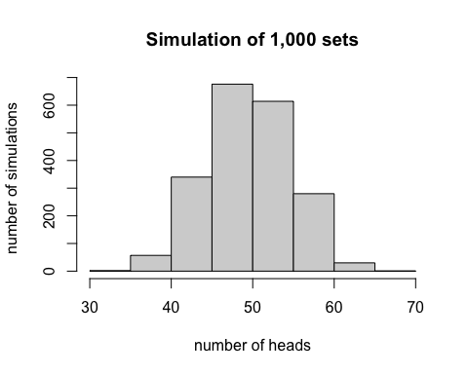
flipping a coin 100 times

Slide 33
class: pink, center, middle, clear

Slide 34
Distributions

Slide 35
Distributions
A tool to define the chances of getting particular numbers
Distributions have shapes
Higher values indicate higher chance of getting a value

Slide 36
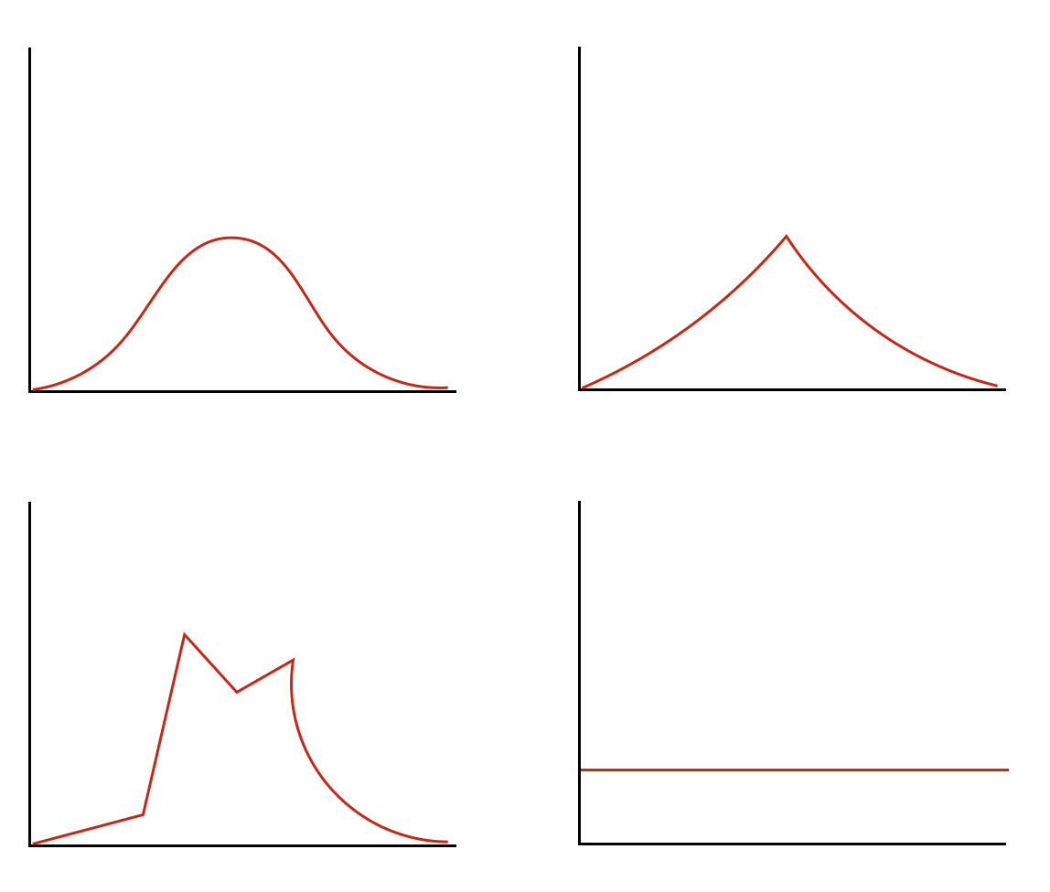
Distributions have shapes

Slide 37
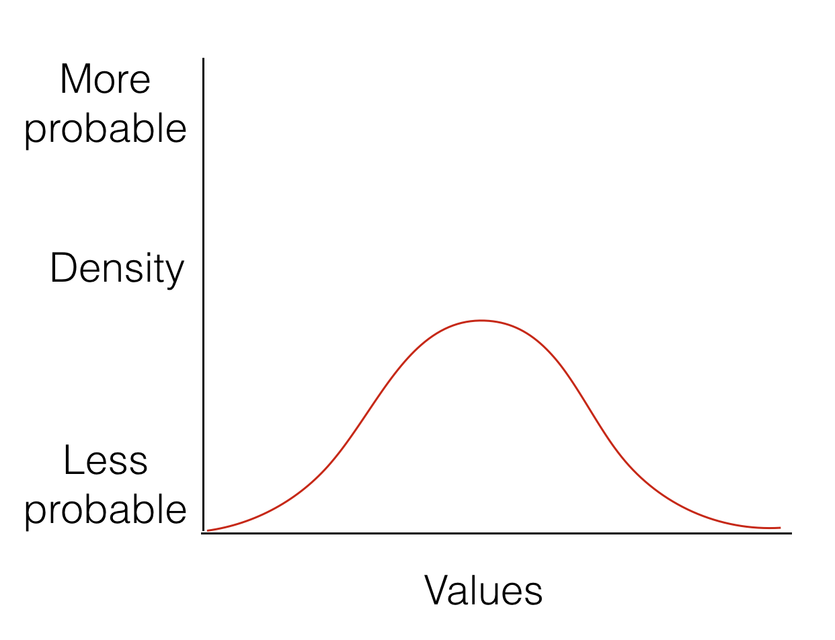
Area under the curve

Slide 38
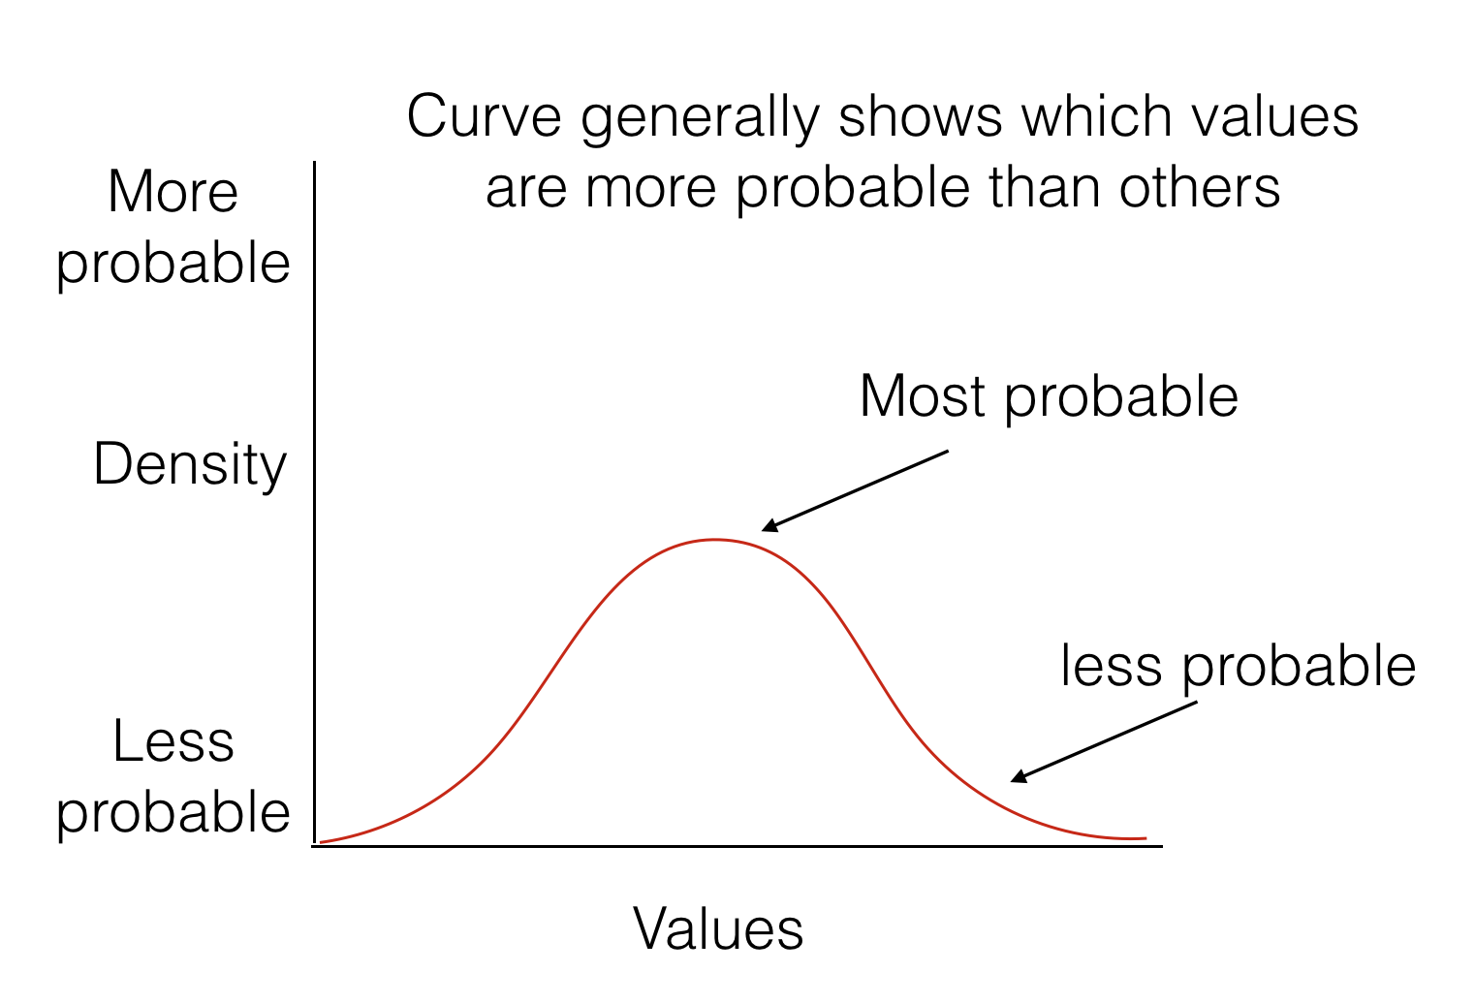
Interpreting distributions

Slide 39
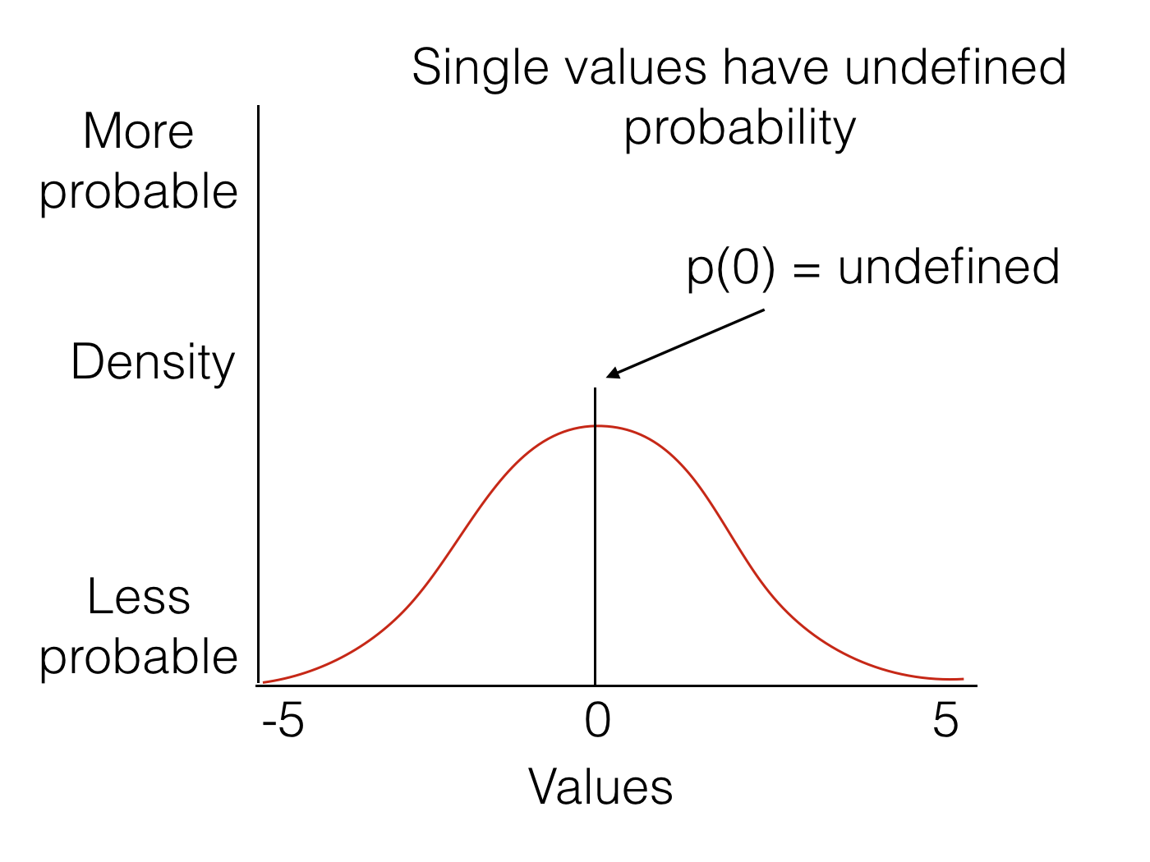
Point Estimates

Slide 40
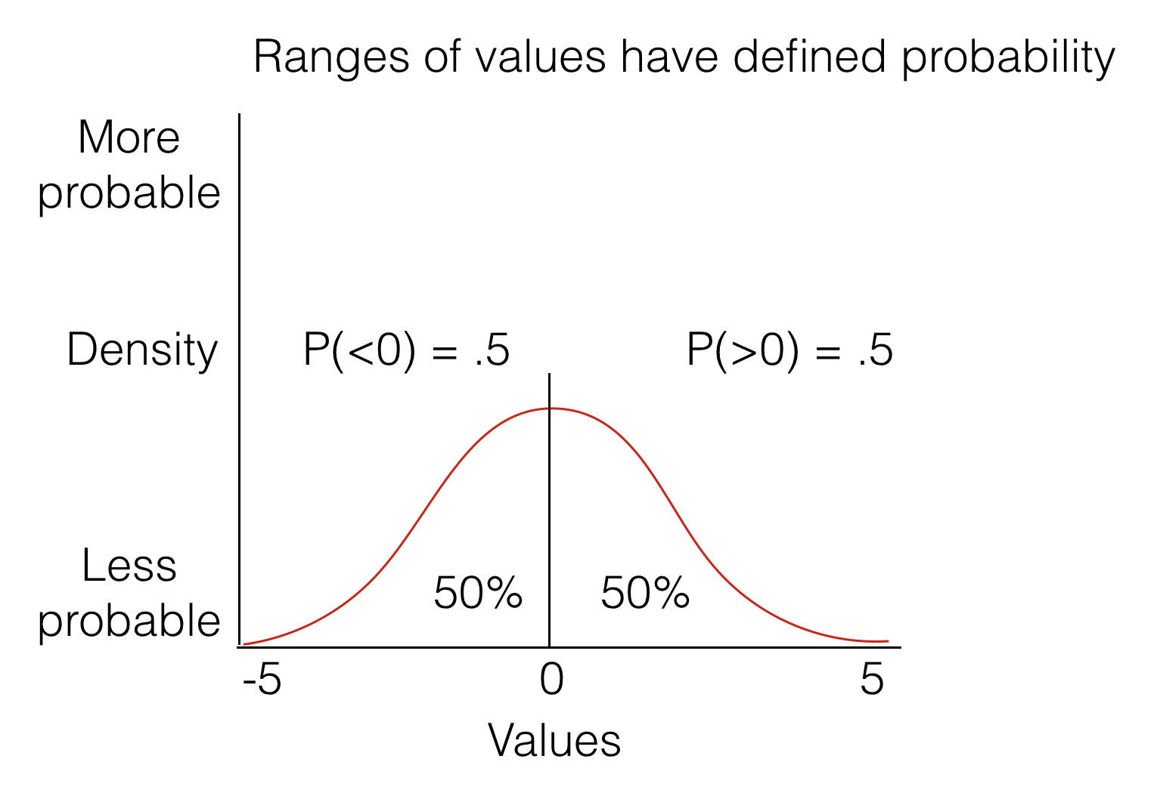
Probability ranges

Slide 41
Uniform Distribution
Definition:
All numbers in a particular range have an equal (uniform) chance of occuring

Slide 42
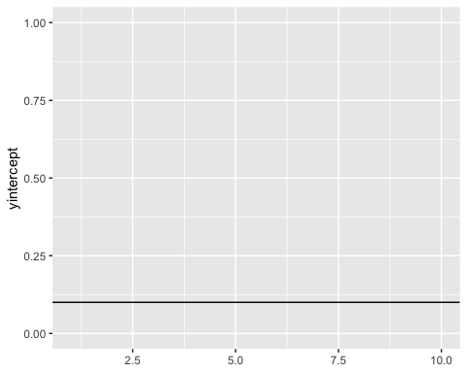
Uniform Distribution

Slide 43
Sampling from a uniform
R let’s you sample numbers from a uniform distribution
runif(n=3,min=0,max=10)
## [1] 1.746938 1.778435 7.846825
runif(n=3,min=0,max=10)
## [1] 0.7716399 5.3224551 2.2824644

Slide 44
looking at samples

Slide 45
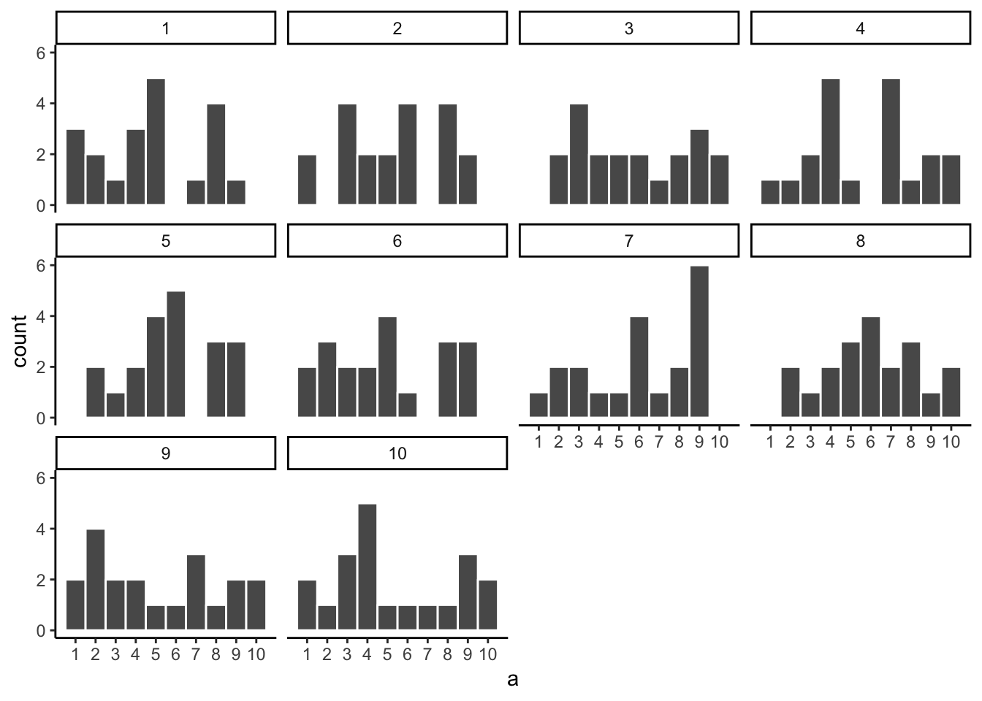
Random samples are not all the same

Slide 46
Samples estimate the distribution
Samples are sets of numbers taken from a distribution
–
Samples become more like the distribution they came from, as sample size (N) increases

Slide 47
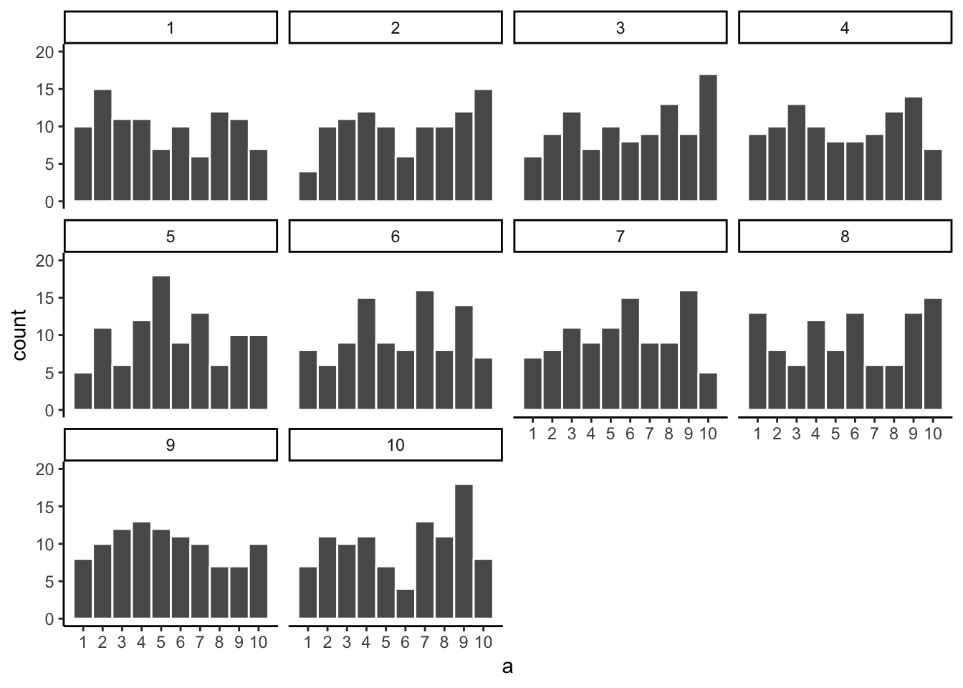
Uniform: N=100

Slide 48
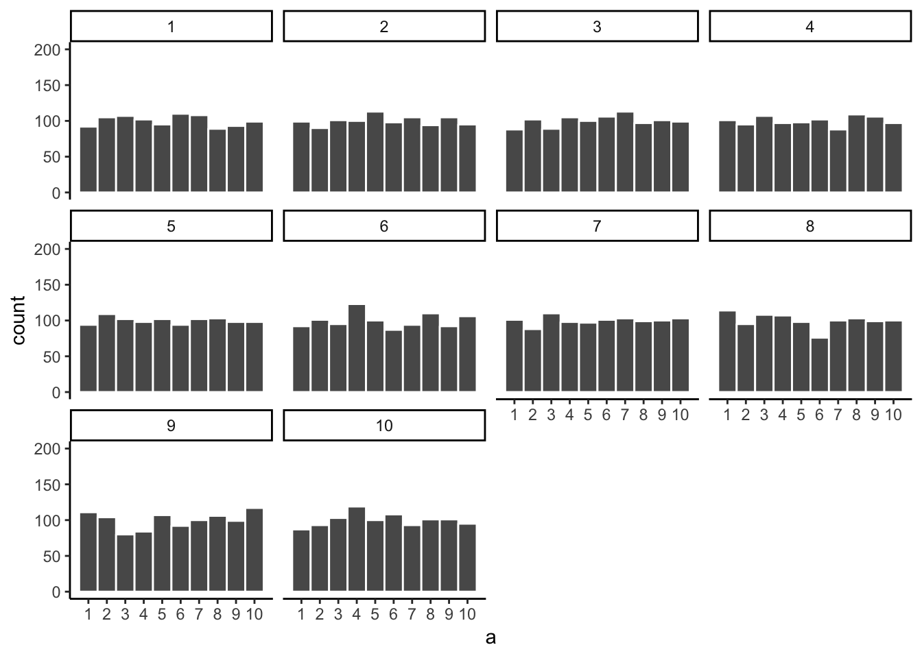
Uniform: N=1,000

Slide 49
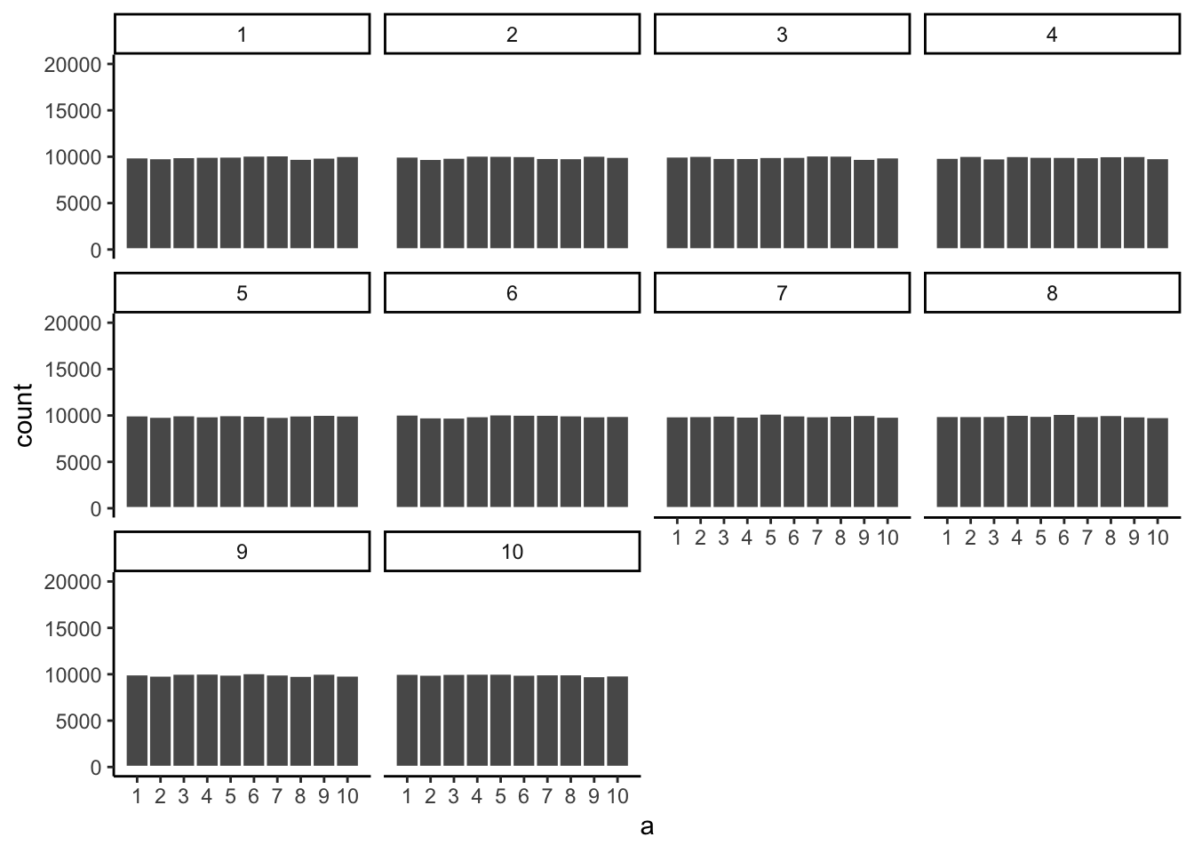
Uniform: N=100,000

Slide 50
class: pink, center, middle, clear

Slide 51
Some questions

Slide 52
Samples and distributions
How do samples relate to distributions?
–
Samples come from distributions
Samples approximate the distribution they came from as sample-size increases

Slide 53
Is my sample likely?
Let’s say you take a sample of numbers from a distribution.
Is your sample representative of the population?
Was your sample likely (you would usually get a sample like this), or unlikely (you got a weird sample, usually you would not get a sample like this)

Slide 54
Simulation and sampling
How can we know if a sample we obtained is “normal”, or “weird”?
–
We can find out by simulating the process of sampling.
We sample some numbers, measure the sample, then repeat
We can now look at how our measurement of the sample behaves

Slide 55
Animation of sample mean

Slide 56
What to notice
The histogram shows that each sample is different
But, the mean of each sample is always around 5.5
We have measured a property of the sample (the mean), each time.

Slide 57
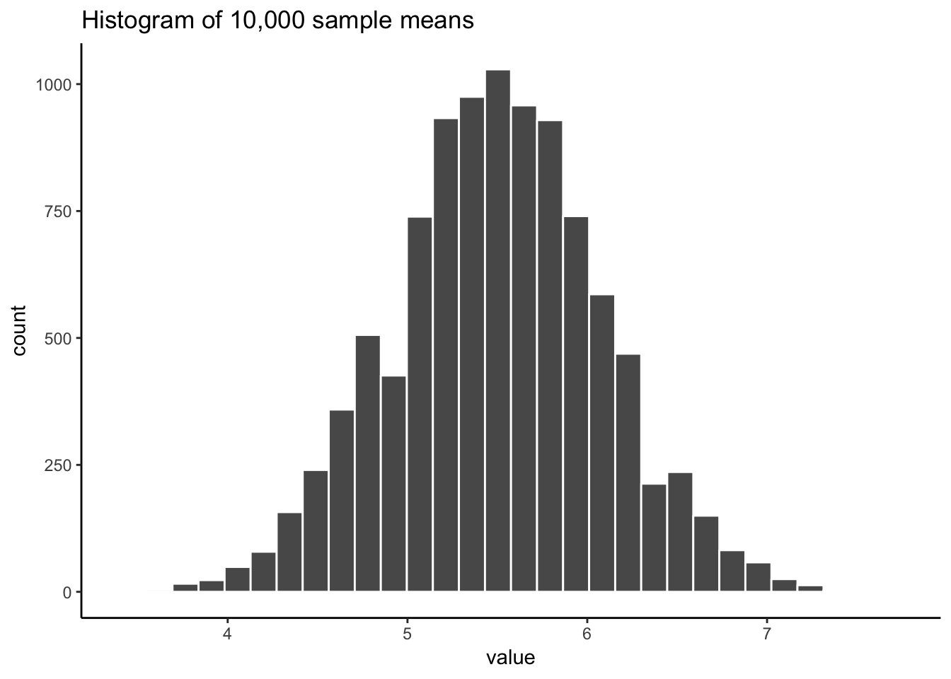
Something Curious

Slide 58
Next class: Sampling
Monday, February 25th: We explore ideas about samples, populations, and distributions
Regression/Correlation quiz due Monday Feb 25th.

