Slide 1
Sampling
seeing what samples can do Matthew Crump

Slide 2
class: pink, center, middle, clear

Slide 3
Make sure you understand sampling distributions

Slide 4
class: pink, center, middle, clear

Slide 5
Make sure you understand this next graph

Slide 6
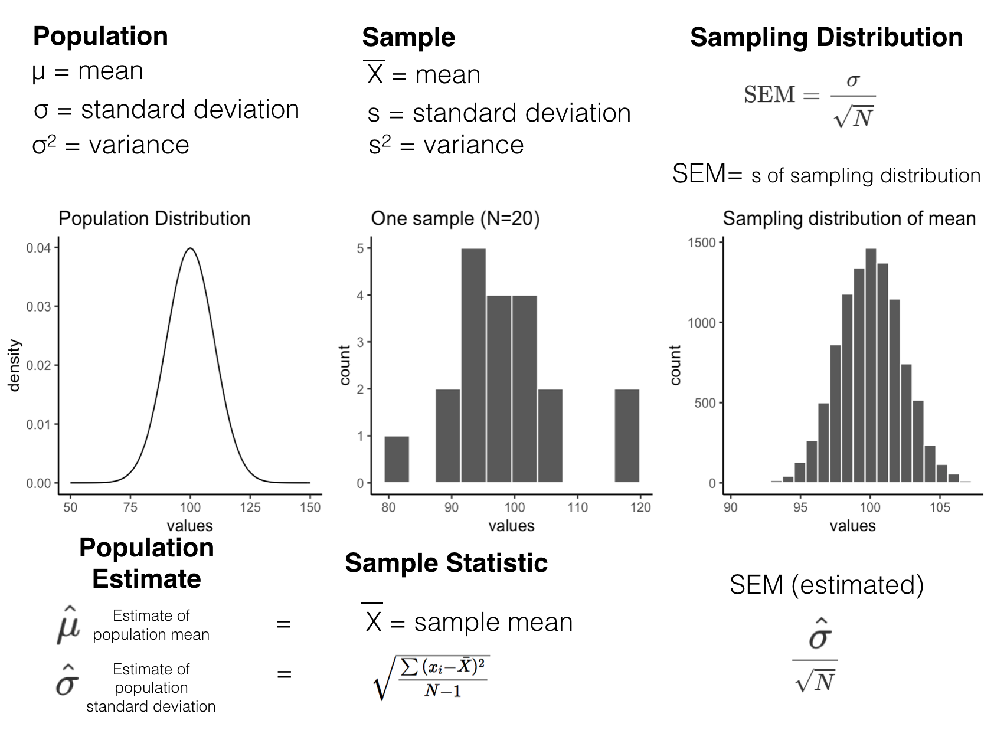
class: center, middle, clear

Slide 7
Big ideas for this course
Psychology interpets patterns in data to draw conclusions about psychological processes
–
Chance can produce “patterns” in data
–
Problem: How can we know if the pattern is real, or simply a random accident produced by chance

Slide 8
Issues for this class
Sampling distributions
Normal distributions and central limit theorem
Estimation

Slide 9
class: pink, center, middle, clear

Slide 10
Samples and populations

Slide 11
Samples and populations
Population: A defined set of things
Sample: a subset of the population

Slide 12
Random Sampling
- Random samples ensure that each value in a sample is drawn independently from other values
- all values in the population have a chance of being in the sample
A process for generating a sample (taking things from a population)

Slide 13
Example: Sampling heights of people
Let’s say we wanted to know something about how tall people are. We can’t measure the entire population (it’s too big). So we take a sample.
–
What would happen if:
We only measured really tall people (biased sample)
–
We randomly measured a bunch of people?

Slide 14
Population statistics
Populations have statistics. For example,
The population of all people has:
A distributions of heights
The distribution has a mean (mean height of all people)
The distribution has a standard deviation

Slide 15
The population problem
In the real world, we usually do not have all of the data for the entire population.
So, we never actually know:
The population distribution
The population mean
The population standard deviation, etc.

Slide 16
The sampling solution
Unknown: The population
Solution: Take a sample of the population
Samples will tend to look the population they came from, especially when sample-size (N) is large.
We can use the sample to estimate the population.

Slide 17
The sampling problem
We take samples, and use them to estimate things. This works well when we have large, representative samples.
But, how do we know if the sample we obtained is “normal”, or happens to be “weird”?
Solution: We need to learn how the process of sampling works. We can use R to simulate the process of sampling. Then we can see how samples behave.

Slide 18
Samples become populations
As sample-size increases, the sample becomes more like the population.
As sample N approaches the population N, the sample becomes the population.

Slide 19
Law of large numbers
As sample-size increases, properties of the sample become more like properties of the population
Example:
As sample-size increases, the mean of the sample becomes more like the mean of the population

Slide 20
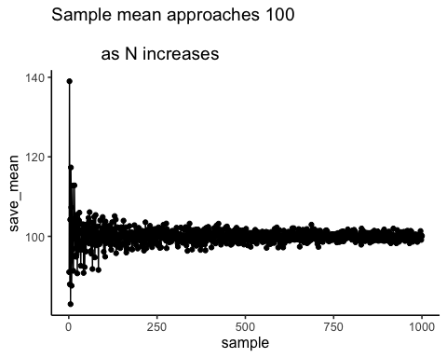
Simulation: Population mean=100

Slide 21
The sampling problem
We take samples, and use them to estimate things. This works well when we have large, representative samples.
But, how do we know if the sample we obtained is “normal”, or happens to be “weird”?
Solution: Sampling Distributions

Slide 22
class: pink, center, middle, clear

Slide 23
Sampling distributions

Slide 24
What are sampling distributions?
Definition: The distribution of a sample statistic
Example:
Many samples are drawn from the same distribution
A statistic (e.g., mean, standard deviation) is computed for each sample, and saved
The sampling distribution is the distribution of the measured statistic for each sample
Sampling distributions can be simulated in R

Slide 25
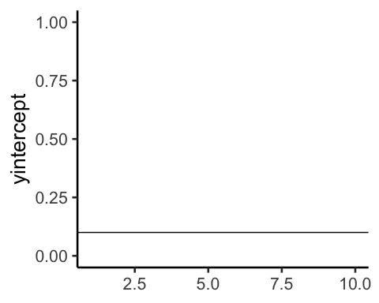
Begin with a distribution

Slide 26
Take many samples
Save a sample statistic (e.g., mean) for each sample

Slide 27
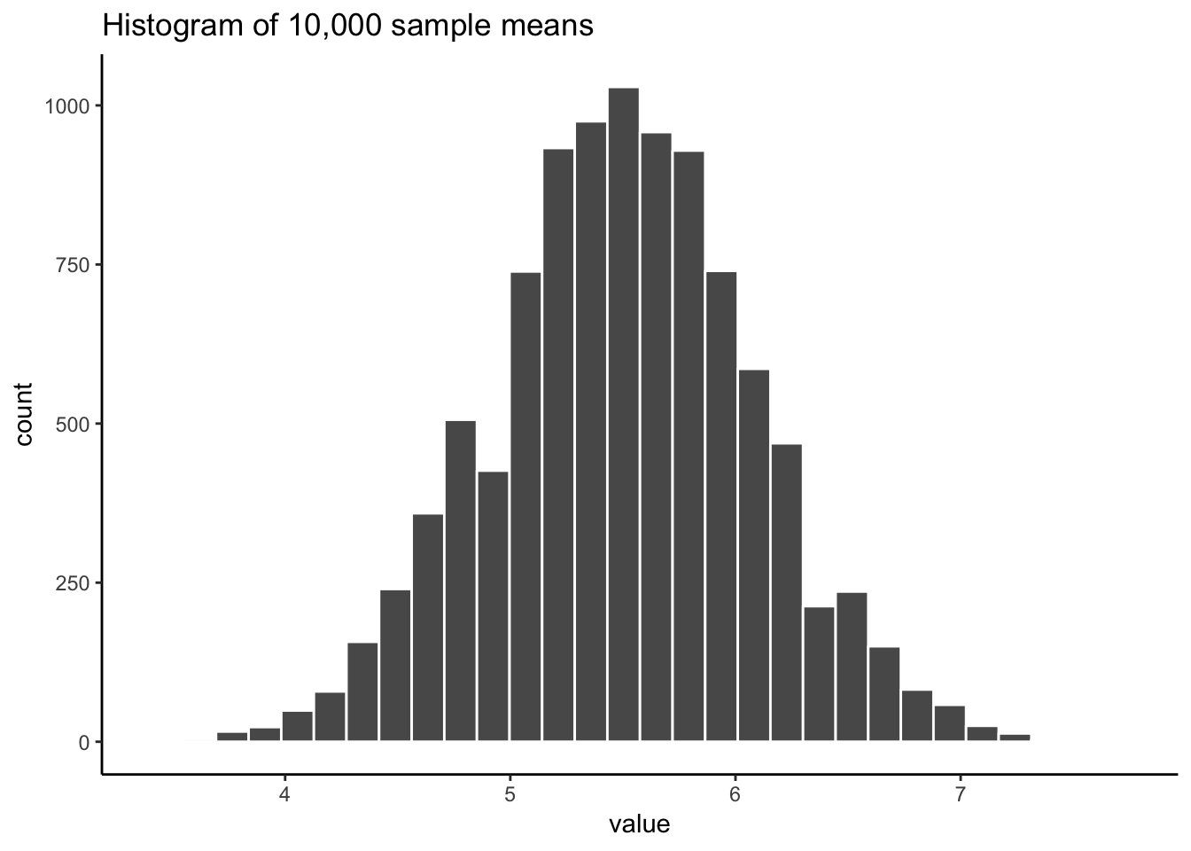
Plot distribution of sample statistic

Slide 28
Sampling distribution is bell-shaped
Notice that the sampling distribution of the mean is bell-shaped, also called a Normal Distribution.

Slide 29
Sampling distributions for anything
A sampling distribution can be found for any sample statistic.
Choose a statistic to measure (e.g., mean, median, variance, standard deviations, max, min, etc.)
Measure statistics for each sample
Plot the sampling distribution

Slide 30
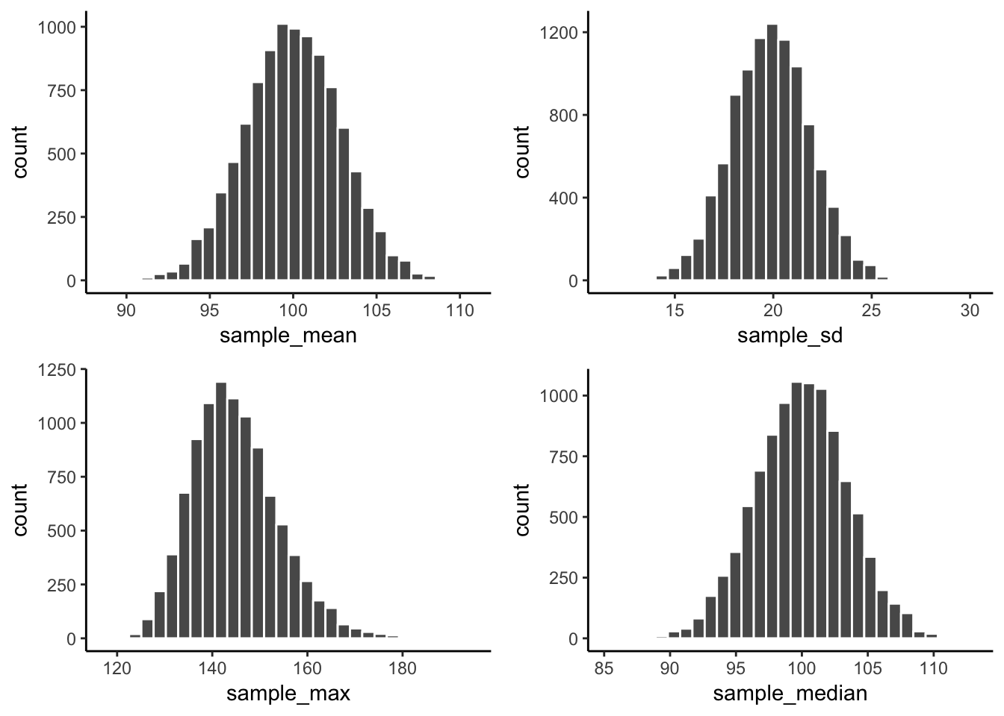
A few sampling distributions

Slide 31
Use for sampling distributions?
Question: What does a sampling distribution tell us?
Answer:
The distribution of values a sample statistic can take, for a sample of a particular size
In other words,
Gives us information about range and probability of obtaining particular sample statistics

Slide 32
Sampling distribution of the mean

Slide 33
Standard error of the mean (SEM)
Definition: the standard deviation of the sampling distribution of the sample means
Formulas: Can be computed directly for samples of any size if you know the standard deviation of the population distribution.
$\text{SEM}=\frac{\text{standard deviation}}{\sqrt{N}}$
$\text{SEM}=\frac{σ}{\sqrt{N}}$
$σ$ = population standard deviation

Slide 34
SEM
What does the SEM (standard error of the mean) tell you.
Let’s say your sample mean was 5, and the SEM was 2.
The SEM is the standard deviation of the sampling distribution of the sample mean
Now you know that your sample mean is 5, but as an estimate of the population mean, that number varies a little bit. SEM tells you how much in standard deviation units.

Slide 35
Central limit theorem
With enough samples, sampling distributions are approximately normal distributions
Sampling distributions have the same shape as a normal distribution, even when the distribution that the sample came from does not have a normal shape.

Slide 36
class: pink, center, middle, clear

Slide 37
Normal Distributions

Slide 38
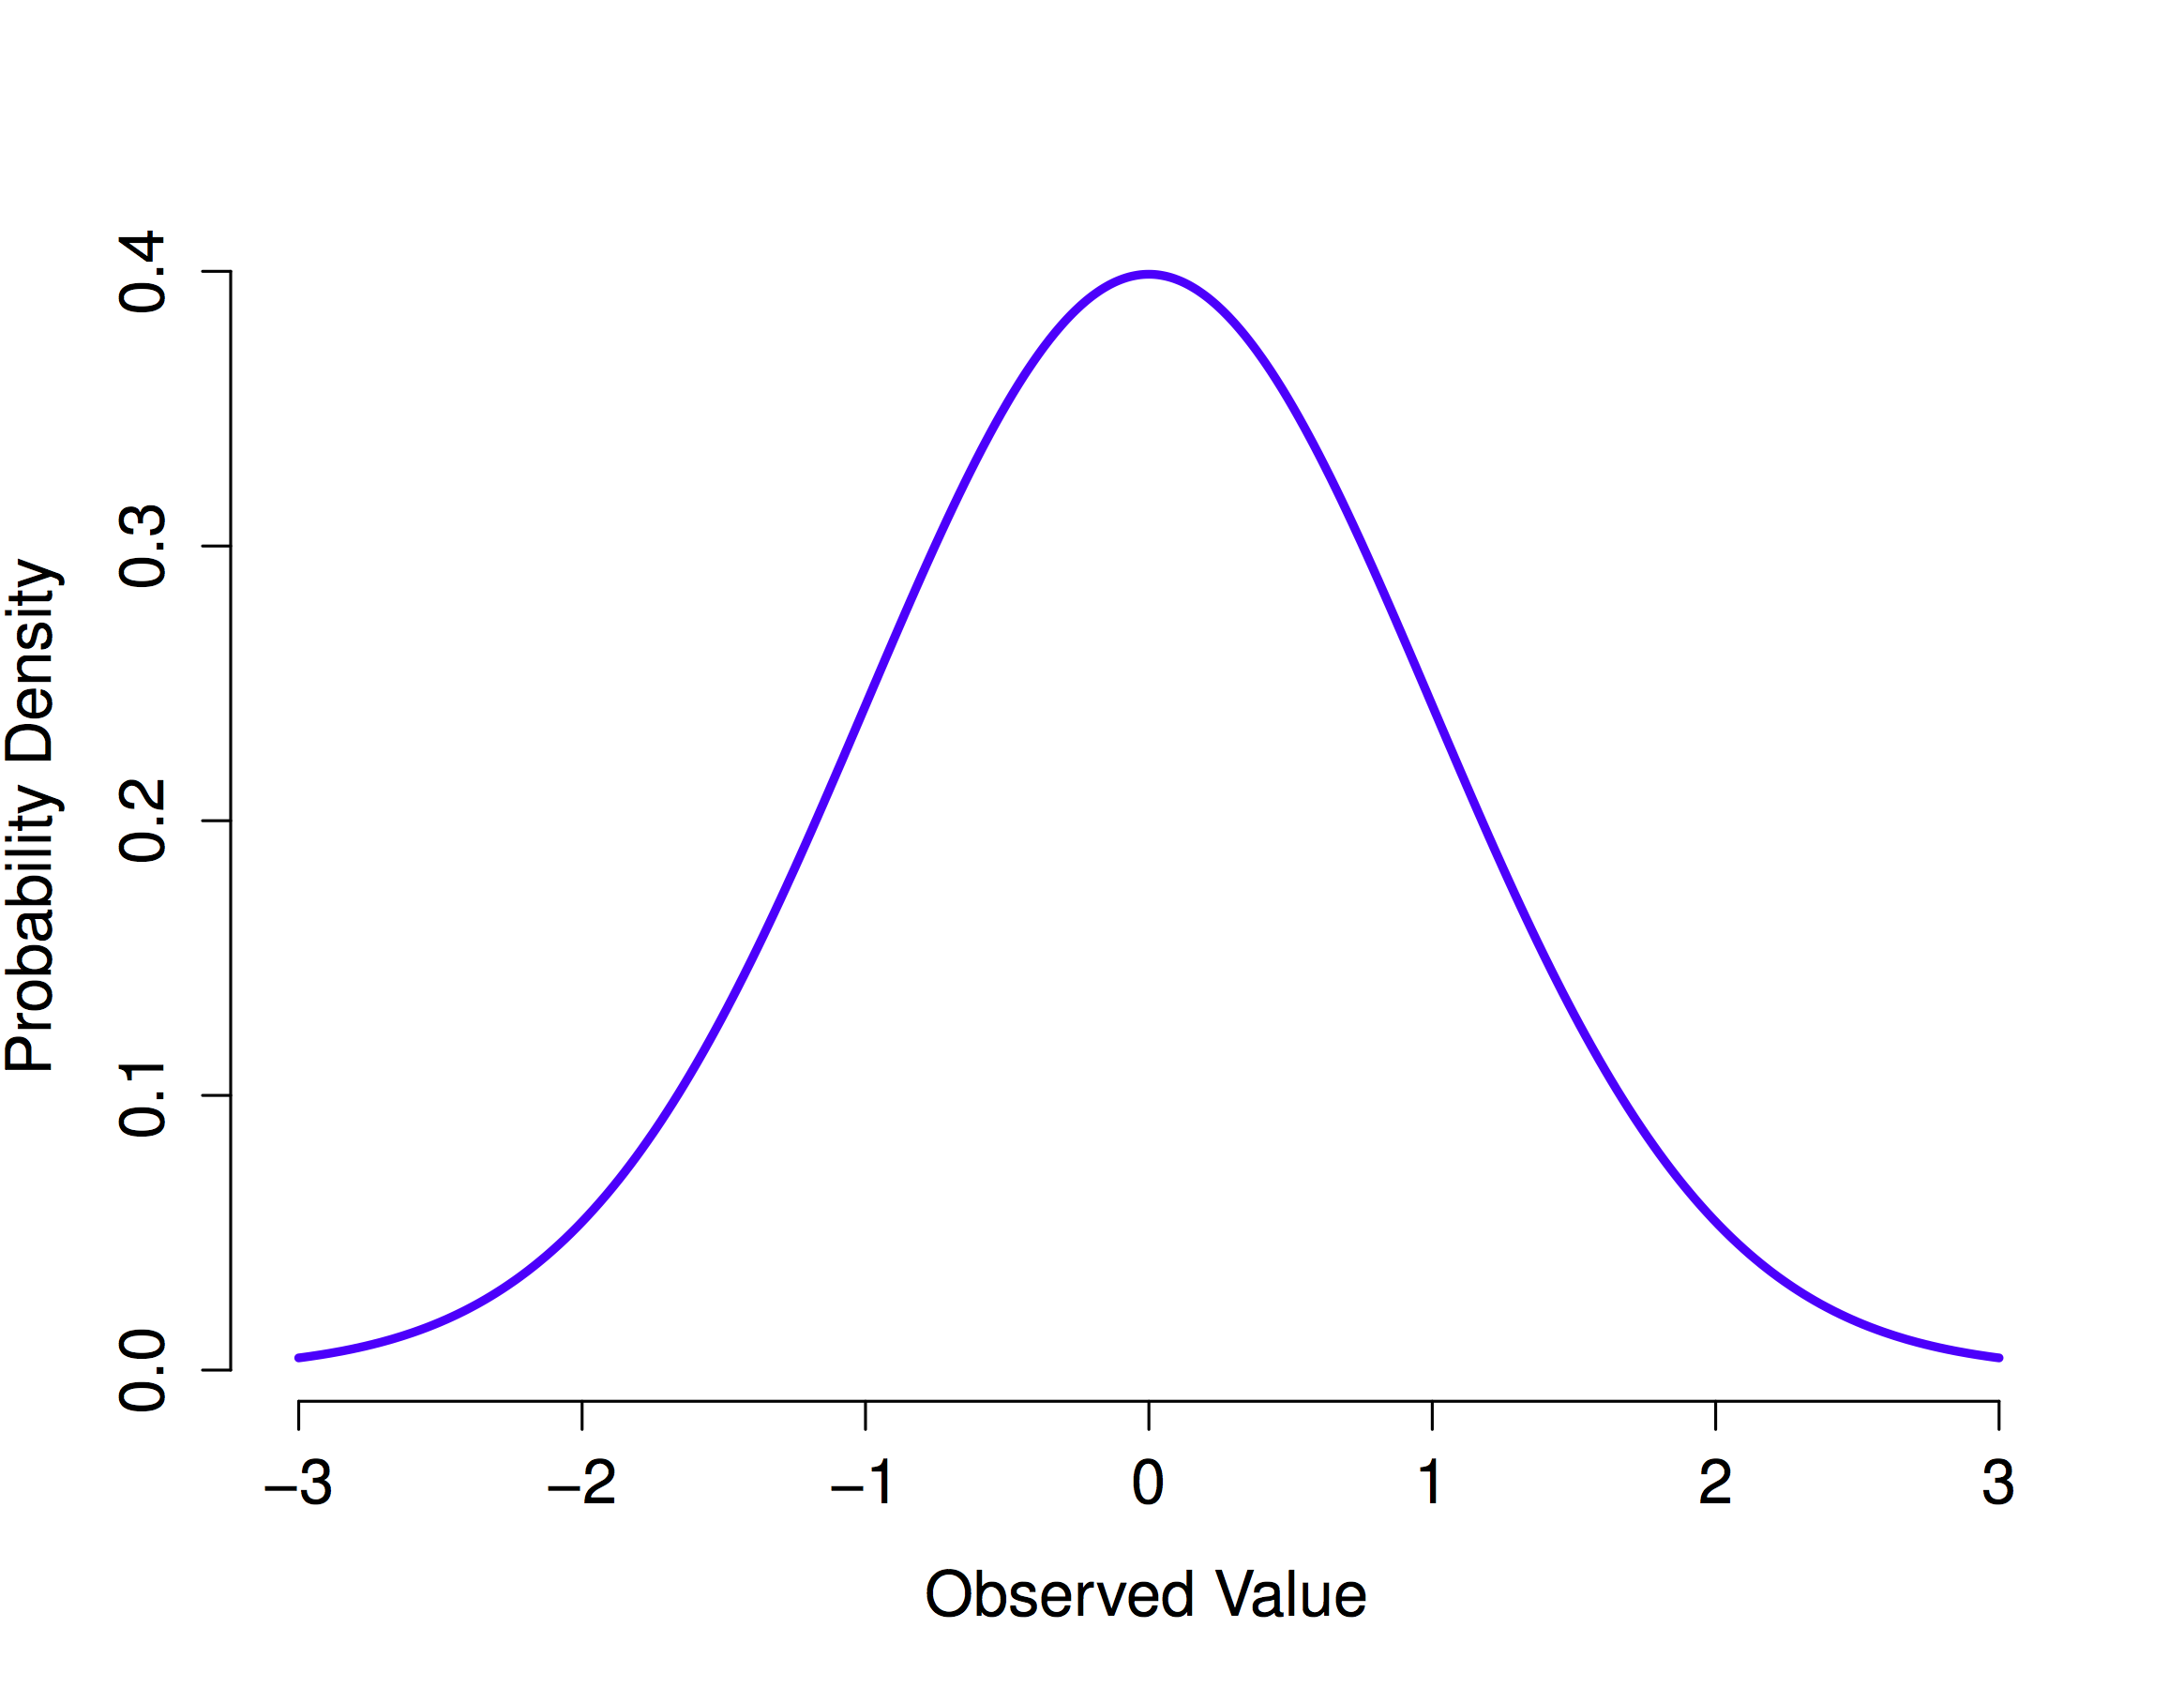
Normal distributions are bell-shaped

Slide 39
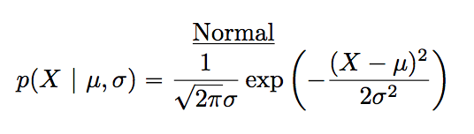
Normal distribution formula

Slide 40
Normal distribution parameters
Normal distributions have two important parameters that change their shape:
The mean (where the peak of the distribution is centered)
The standard deviation (how spread out the distribution is)

Slide 41
Normal: Changing the mean

Slide 42
Normal: Changing standard deviation

Slide 43
rnorm()
R has a function for generating numbers from a normal distribution.
n = number of samples
mean = mean of distribution
sd = standard deviation of distribution
rnorm(n=100, mean = 50, sd = 25)

Slide 44
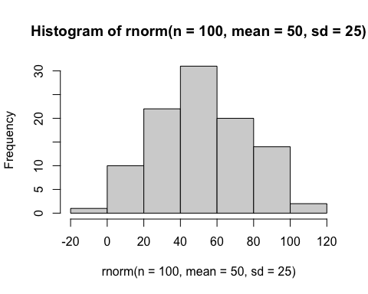
plotting a sample from a normal
hist(rnorm(n=100, mean=50, sd=25))

Slide 45
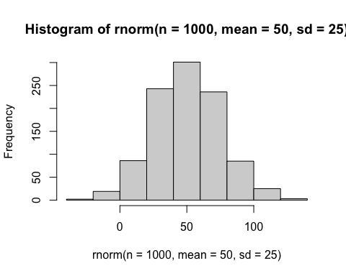
increasing N
hist(rnorm(n=1000, mean=50, sd=25))

Slide 46
Animating the central limit theorem

Slide 47
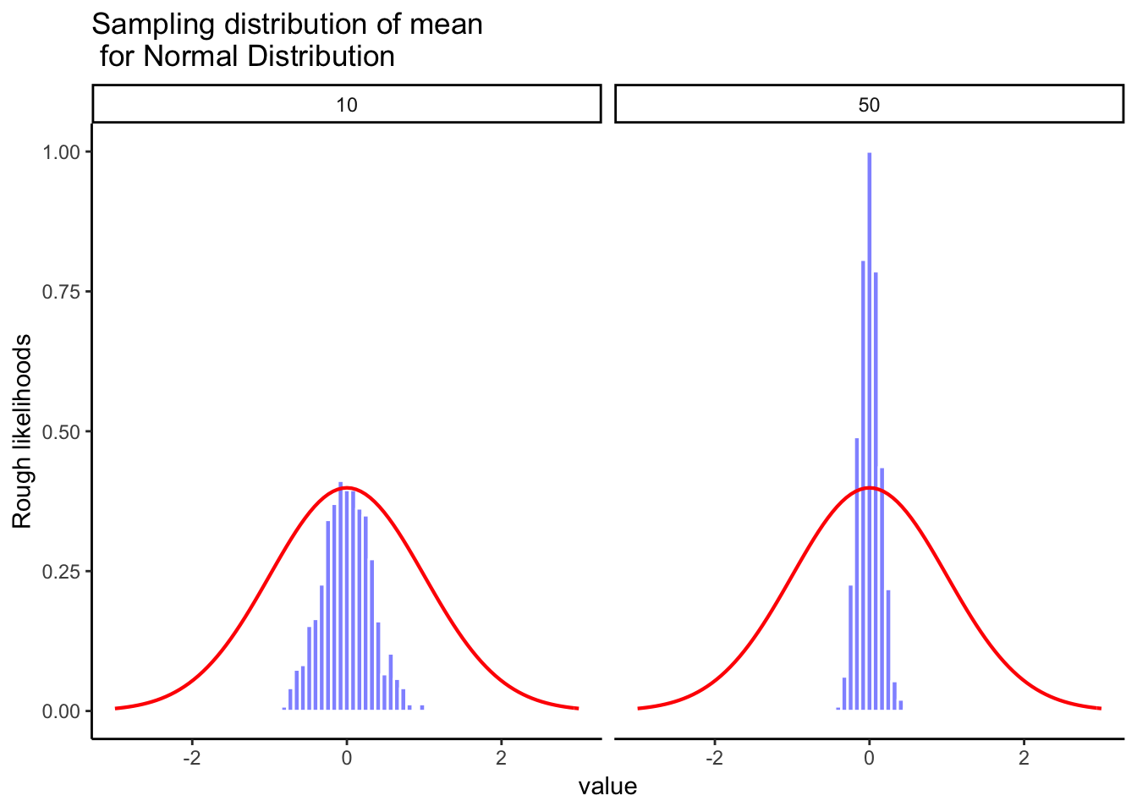
Normal & central limit

Slide 48
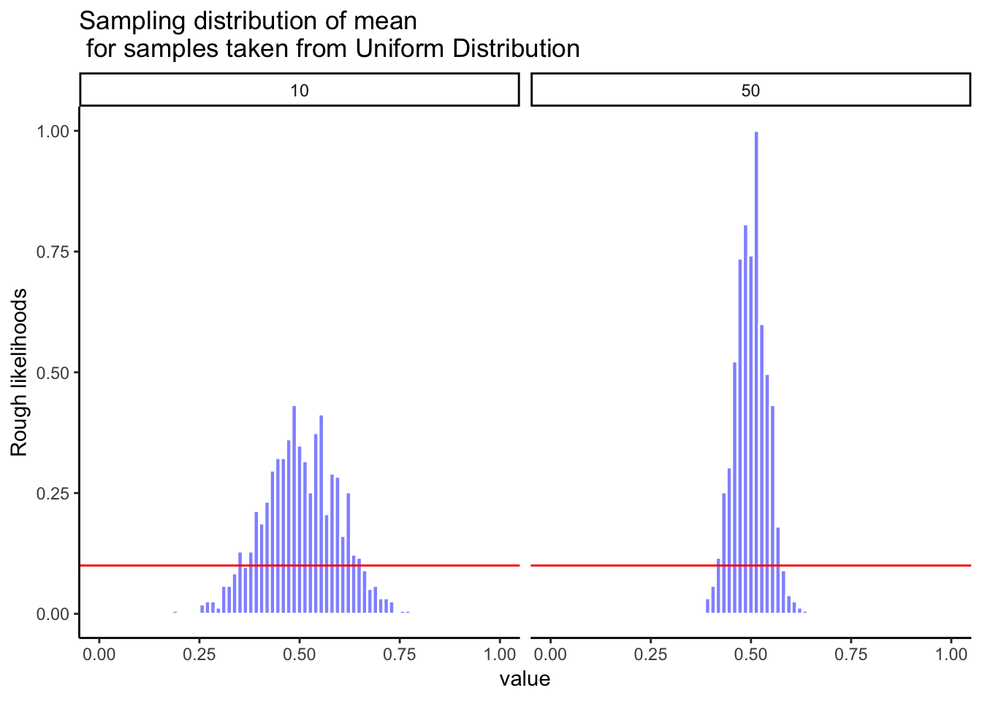
Uniform & central limit

Slide 49
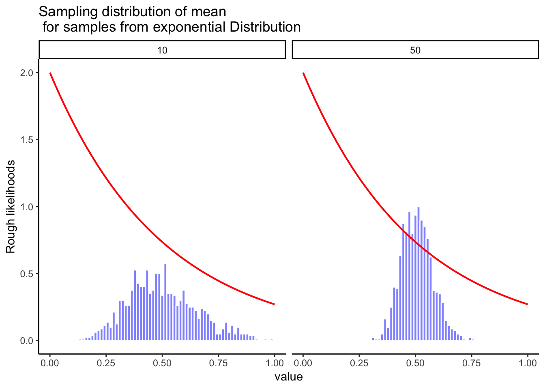
exponential & Central limit

Slide 50
Importance of central limit theorem
We see that our sample statistics are distributed normally
We can use our knowledge of normal distributions to help us make inferences about our samples.
Question:
A. What do we need to know about the normal distribution to make use of it?

Slide 51
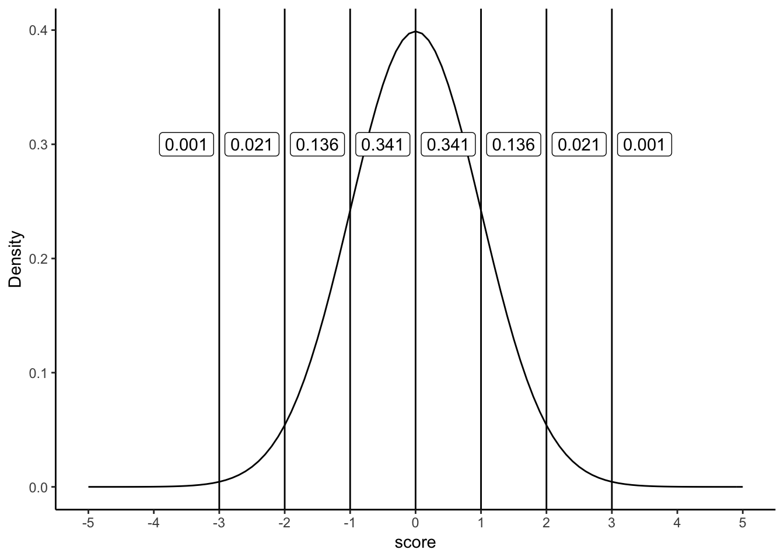
Normal distributions and probability

Slide 52
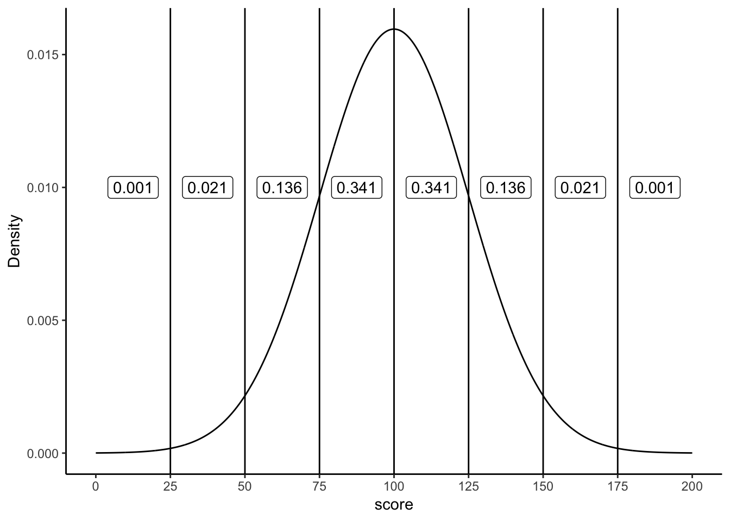
Normal distributions and probability

Slide 53
pnorm()
Use the pnorm() function to determine the proportion of numbers up to a particular value
q = quantile
What proportion of values are smaller than 0, for a normal distribution with mean =0, and sd= 1?
pnorm(q=0, mean= 0, sd =1)
## [1] 0.5

Slide 54
pnorm() continued
What proportion of values are between 0 and 1, for a normal distribution with mean =0, and sd =1?
lower_value <- pnorm(q=0, mean= 0, sd =1) higher_value <- pnorm(q=1,mean=0, sd=1) higher_value-lower_value
## [1] 0.3413447

Slide 55
class: pink, center, middle, clear

Slide 56
Estimation

Slide 57
Goals of estimation
Use statistics of samples to estimate the statistics of the population (parent distribution) they came from
Use statistics of samples to estimate “error” in the sample

Slide 58
Biased vs. unbiased estimators
Biased estimators: Sample statistics that are give systematically wrong estimates of a population parameter
Unbiased estimators: Sample statistics that are not biased estimates of a population parameter

Slide 59
Sample means are unbiased
The mean of a sample is an unbiased estimator of the population mean

Slide 60
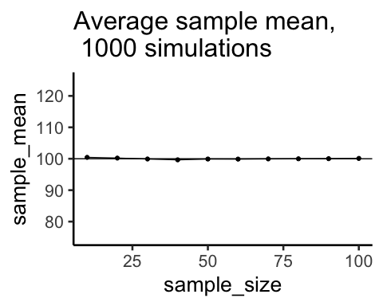
Sample demonstration

Slide 61
Standard deviation is biased
The standard deviation formula (dividing by N) is a biased when applied to a sample, is a biased estimator of the population standard deviation.
Formula for Population Standard Deviation
$\text{Standard Deviation}=\sqrt{\frac{∑{\left(x_{i}−\overset{‾}{X}\right)}^{2}}{N}}$

Slide 62
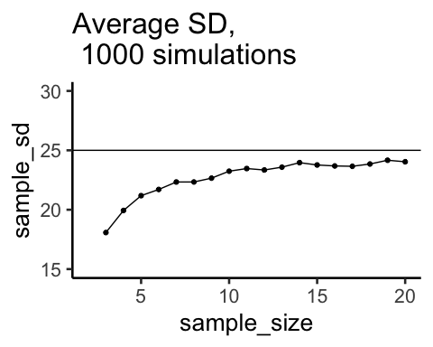
Sample demonstration

Slide 63
Sample Standard Deviation
If we divide by N-1, which is the formula for a sample standard deviation, we get an unbiased estimate of the population standard deviation
Formula for Sample Standard Deviation
$\text{Standard Deviation}=\sqrt{\frac{∑{\left(x_{i}−\overset{‾}{X}\right)}^{2}}{N−1}}$

Slide 64
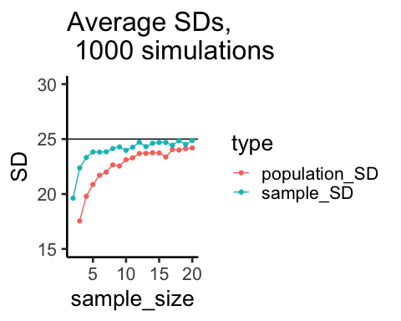
Sample demonstration

Slide 65
class: center, middle, clear

Slide 66
sd() and SEM in R
sd() computes the standard deviation using N-1
x <- c(4,6,5,7,8) sd(x)
## [1] 1.581139
SEM is estimate of standard deviation divided by square root of N
sd(x)/sqrt(length(x))
## [1] 0.7071068

Slide 67
Questions for yourself
What is the difference between a population mean and sample mean?
What is the difference between a population standard deviation and sample standard deviation?
There are two standard deviation formulas for a sample, one divides by N, and the other divided by N-1. What is the difference between the two?

Slide 68
More questions
What is a sampling distribution, how is it different from a single sample?
What is the sampling distribution of the sample means?
What is the standard error of the mean (SEM), and how does it relate to the sampling distribution of the sample means?

Slide 69
Even more questions
What is the difference between the standard error of the mean, and the estimated standard error of the mean?

Slide 70
Next class: Inference
Wednesday, February 27th: We explore foundational ideas for statistical inference
Correlations quiz due today @ 11:59pm
Distribution/Sample quiz begins today, due Next Monday @ 11:59pm

