Slide 1
t-tests
one sample Matthew Crump

Slide 2
class: pink, center, middle, clear

Slide 3
Student’s t-test

Slide 4
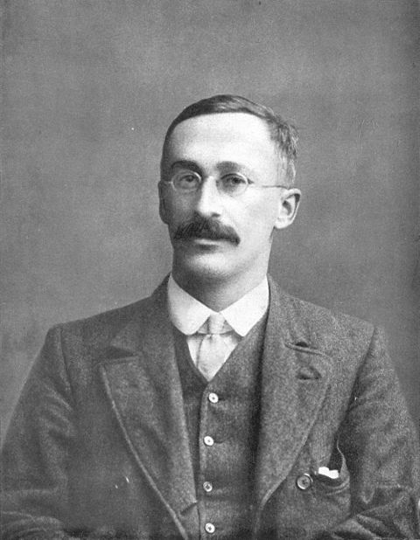
William Sealy Gosset
.pull-left[
Creator of t-test (1908)
Worked for Guiness breweries, published under a pseuodnym (student)
]
.pull-right[

Slide 5
]

Slide 6
class: center

Slide 7

The Guiness Problem

Slide 8
This Class
The t statistic
Experimental design and t-tests
One-sample t-test

Slide 9
Common ratio in inferential stastics
Many inferential statistics have a common form
.center[ $\text{Inferential statistic}=\frac{\text{Measure of Effect}}{\text{Measure of Error}}$]
Measure of effect = Some measure of the pattern in data Measure of error = Some measure of random fluctuation in the data

Slide 10
t-statistic (big idea)
(FYI, no one really knows what t stands for…)
.center[ $t=\frac{\text{Mean}}{\text{Standard Error of the Mean}}$]
Why would anyone bother dividing a mean by the SEM?

Slide 11
Confidence in mean
Mean
SEM
t
5
0.1
50.0
5
0.5
10.0
5
1.0
5.0
5
5.0
1.0
5
10.0
0.5

Slide 12
Two questions
What must be true if a t-value is less than 1?
What must be true if a t-value is greater than 1?

Slide 13
a bit of R
my_t <- function(x){ mean(x)/(sd(x)/sqrt(length(x))) } sample <- c(1,5,4,3,6,7) my_t(sample)
## [1] 4.913538
t.test(sample)$statistic
## t ## 4.913538

Slide 14
The sampling distribution of t
Take a sample of size n from a normal population
Compute t
Repeat many times
Plot the distribution

Slide 15
Simulating the t distribution
ts <- c() for(i in 1:1000){ sample <- rnorm(10,0,1) ts[i] <- t.test(sample)$statistic }

Slide 16
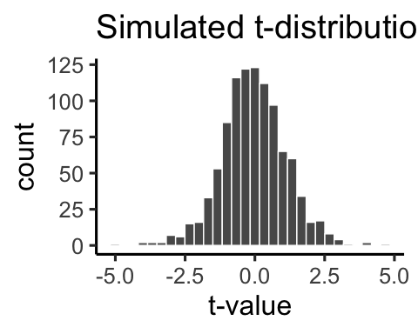
Plotting the histogram

Slide 17
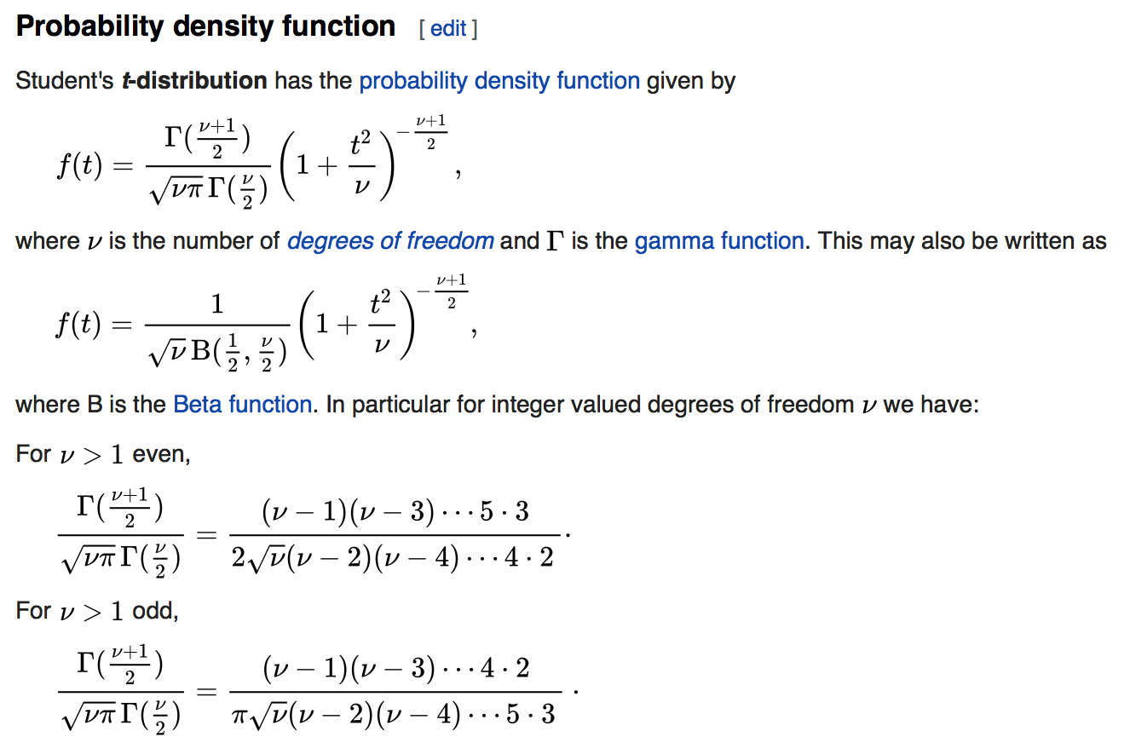
Formula for t-distribution

Slide 18
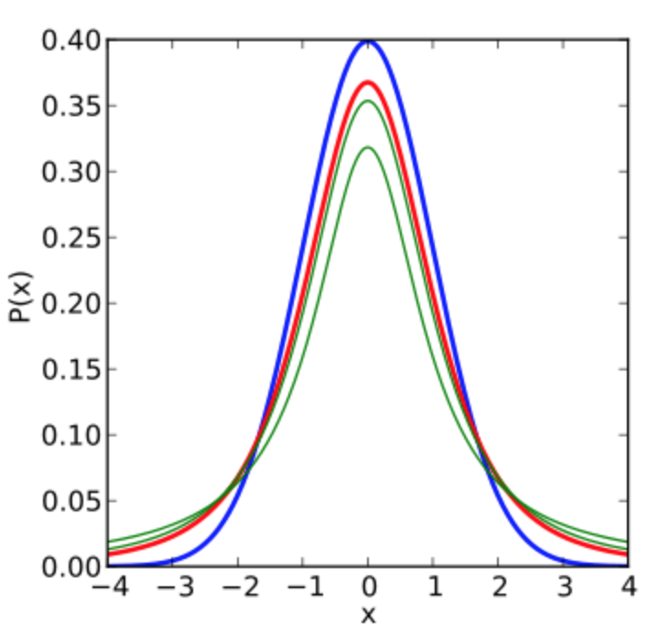
t distributions
.pull-left[
shaped like a normal
but, more spread out
depends on sample-size (df)
blue is normal(0,1)
red is t(df=1)
green is t(df=2, and df=3)
]
.pull-right[

Slide 19
]

Slide 20
ts and ps
.pull-left[
t-distribution with 9 degrees of freedom
one-directional test
Only 5% of ts are larger than 1.8331129
]
.pull-right[
]

Slide 21
class: center

Slide 22
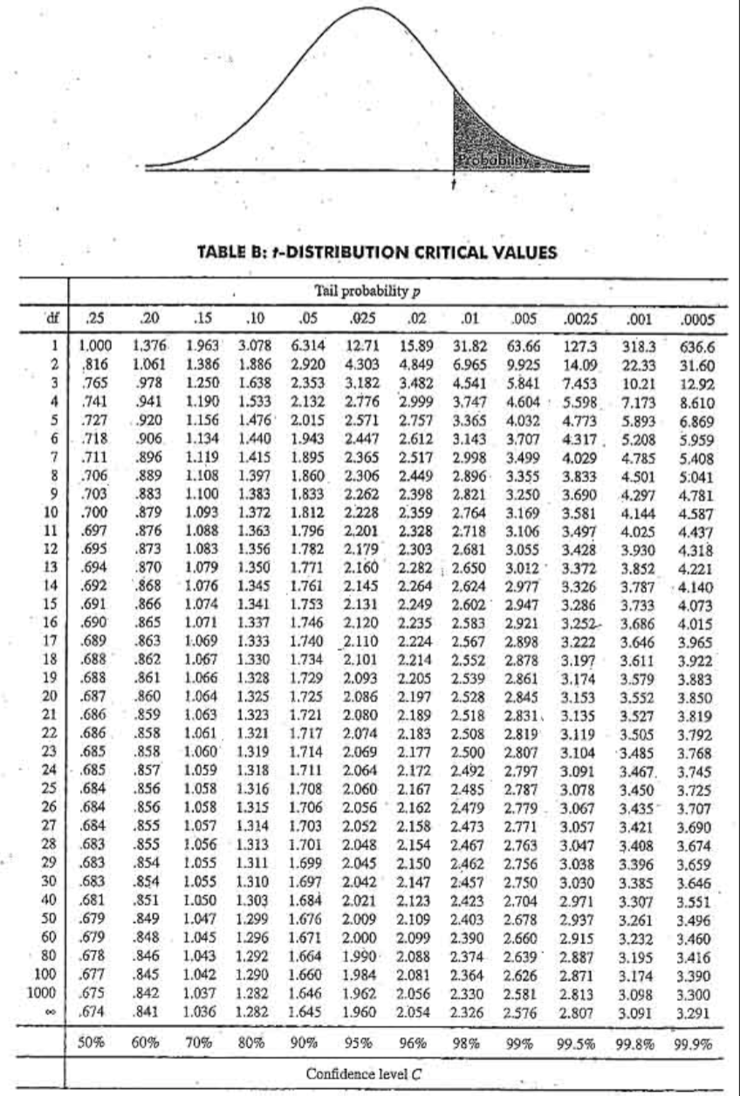
ts and ps the old way

Slide 23
pt(): find p for a t
Use the pt() function to find the probability (p) of t-values (from smallest possible to value of t)
Must supply t-value, and df.
For a t-distribution (df=9), what is the probability that a t-value will be 0 or smaller?
pt(q=0,df=9)
## [1] 0.5

Slide 24
pt(): more examples
For a t-distribution (df=9), what is the probability that a t-value will be 1 or smaller?
pt(q=1,df=9)
## [1] 0.8282818
For a t-distribution (df=9), what is the probability that a t-value will be 1 or greater?
1-pt(q=1,df=9)
## [1] 0.1717182

Slide 25
qt(): find t for a p
Use the qt() function to find the t-value associated with a particular p-value.
Must supply p-value, and df.
For a t-distribution (df=9), what value of t has a probability of .5?
qt(p=0.5,df=9)
## [1] 0

Slide 26
qt(): more examples
For a t-distribution (df=9), what value of t or smaller occurs 95% of the time?
qt(p=.95,df=9)
## [1] 1.833113
For a t-distribution (df=9), what value of t or smaller occurs 5% of the time
qt(p=.05,df=9)
## [1] -1.833113

Slide 27
comparing solutions
A simulated t-distribution gives similar p-values to analytic answer (using pt())
all_ts<-replicate(10000,t.test(rnorm(10,0,1))$statistic) length(all_ts[all_ts<=2])/10000
## [1] 0.9601
pt(2,9)
## [1] 0.9617236

Slide 28
class: pink, center, middle, clear

Slide 29
t-tests and designs

Slide 30
Three kinds of t-tests
one-sample
paired-sample
Independent sample

Slide 31
One-sample t-test
Purpose: Compare sample mean to a hypothetical population mean

Slide 32
Paired-sample t-test
Purpose: Compare two sample means in a within-subjects design
Within-subjects design: Same subjects are measured across both levels of the experimental manipulation (independent variable)

Slide 33
Independent-sample t-test
Purpose: Compare two sample means in a between-subjects design
Between-subjects design: Different subjects are measured across both levels of the experimental manipulation (independent variable)

Slide 34
class: pink, center, middle, clear

Slide 35
One-sample t-test

Slide 36
One-sample t-test
.pull-left[
Purpose: Compare sample mean to a hypothetical population mean
$\overset{‾}{X}$ = sample mean
$u$ = hypothetical population mean
$s$ = sample standard deviation (divide by n-1)
$n$ = sample-size
]
.pull-right[
$t=\frac{\overset{‾}{X}−u}{\text{SEM}}$
$t=\frac{\overset{‾}{X}−u}{\frac{s}{\sqrt{n}}}$
$s=\sqrt{\frac{∑{\left(x_{i}−\overset{‾}{X}\right)}^{2}}{N−1}}$
]

Slide 37
An example
subjects | scores
1 | 0.50
2 | 0.56
3 | 0.76
4 | 0.80
5 | 0.90
.pull-left[
Question:
What population did this sample come from?
mean(scores)
## [1] 0.704
sd(scores)
## [1] 0.1681666
]
.pull-right[

Slide 38
]

Slide 39
Best guesses
Remember
The sample mean is our best estimate of the population mean
The sample standard deviation (dividing by N-1) is our best estimate of the population standard deviation

Slide 40
One possibility
subjects | scores
1 | 0.50
2 | 0.56
3 | 0.76
4 | 0.80
5 | 0.90
.pull-left[
.font70[Our sample statistics are consistent with the data coming from a normal distribution with the following mean and standard deviation]
mean(scores)
## [1] 0.704
sd(scores)
## [1] 0.1681666
]
.pull-right[

Slide 41
]

Slide 42
Testing other possibilities
The one sample t-test allows us to test other possibilities. For example:
Could the data have come from a normal distribution with…
mean = .25
mean = .5
mean = .75

Slide 43
Conducting the t-test
Steps:
Compute the observed t-value $t_{\text{observed}}$
Set alpha criteria (p <. 05)
We will conduct a directional test
Find the probability that t could be $t_{\text{observed}}$ or larger

Slide 44
Computing t for one-sample test
Could the scores have come from a normal distribution with mean =.25?
$t=\frac{\overset{‾}{X}−u}{\frac{s}{\sqrt{n}}}$
scores<-c(.5,.56,.76,.8,.9) effect <- (mean(scores)-.25) error <- sd(scores)/sqrt(5) t <- effect/error t
## [1] 6.036722

Slide 45
Compute the associated p-value
Use pt(), df (degrees of freedom) is n-1.
pt(t,df=4) # left side
## [1] 0.9981017
1-pt(t,df=4) # right side
## [1] 0.001898315

Slide 46
Looking at the evidence
Our sample mean was 0.704
Observed t was 6.0367217
The associated p was 0.0018983
What does this mean?
The probability that our sample mean (or greater) came from normal distribution with (mean =.25, sd = 0.1681666) is 0.0018983.

Slide 47
Making a decision
Write up of results:
We conducted a one sample t-test comparing the sample mean (0.704) against a population mean of .25, t(4) = 6.04, p = 0.0019.
Our conclusion
We set an alpha criteria of p<.05. We reject the hypothesis that our sample mean came from a normal population with mean =.25, and sd = 0.17.

Slide 48
t.test()
R has a t-test function that let’s you do all three kinds of t-tests. Here is how you conduct a one-sample t-test using the function.
scores<-c(.5,.56,.76,.8,.9) t.test(scores, mu = .25, alternative="greater")
alternative=“greater” specifies a directional test: to find probability of t or greater
alternative=“lesser” directional test to find probability of t or less

Slide 49
t.test() output
t.test(scores, mu=.25, alternative="greater")
## ## One Sample t-test ## ## data: scores ## t = 6.0367, df = 4, p-value = 0.001898 ## alternative hypothesis: true mean is greater than 0.25 ## 95 percent confidence interval: ## 0.5436715 Inf ## sample estimates: ## mean of x ## 0.704

Slide 50
testing u =.5
t.test(scores, mu=.5, alternative="greater")
## ## One Sample t-test ## ## data: scores ## t = 2.7125, df = 4, p-value = 0.0267 ## alternative hypothesis: true mean is greater than 0.5 ## 95 percent confidence interval: ## 0.5436715 Inf ## sample estimates: ## mean of x ## 0.704

Slide 51
testing u =.75
t.test(scores, mu=.75, alternative="greater")
## ## One Sample t-test ## ## data: scores ## t = -0.61165, df = 4, p-value = 0.7131 ## alternative hypothesis: true mean is greater than 0.75 ## 95 percent confidence interval: ## 0.5436715 Inf ## sample estimates: ## mean of x ## 0.704

Slide 52
Extracting values
The t.test() function generates a bunch of output, sometime you might want to to extract the t-value, and the p-value.
x <- t.test(scores, mu=.75, alternative="greater") x$statistic
## t ## -0.6116502
x$p.value
## [1] 0.7130873

Slide 53
class: pink, center, middle, clear

Slide 54
Thinking ahead to paired samples-test

Slide 55
Consider this
Within-subjects experiment, n=5, all subjects are measured in level A and B of the experiment.
subjects
level_A
level_B
1
1
4
2
4
8
3
3
7
4
6
9
5
5
10

Slide 56
Empirical question
Did the manipulation (A vs. B) cause a difference in the measure?
subjects
level_A
level_B
1
1
4
2
4
8
3
3
7
4
6
9
5
5
10

Slide 57
Difference scores
How could a one-sample t-test be used to analyze the difference scores?
subjects
level_A
level_B
differences
1
1
4
3
2
4
8
4
3
3
7
4
4
6
9
3
5
5
10
5

Slide 58
Next class: Paired-Sample t-test
Thursday, October 11th: paired sample t-tests

Slide 59
Reminder
Quiz 5 is due today Tuesday, October, 9th end of day (11:59pm).
Quiz for this week will be posted tonight or tomorrow.
No quiz next week (midterm review)

