Slide 1
Power and Effect-size
Experiment planning Matthew Crump

Slide 2
class: pink, center, middle, clear

Slide 3
Don’t run an experiment that is designed to fail

Slide 4
class: pink, center, middle, clear

Slide 5
How? Power analysis, effect-size, and sample-size planning

Slide 6
#overview
Z-score reminder
Effect-size
Power
Sample-size planning

Slide 7
class: pink, center, middle, clear

Slide 8
z-scores

Slide 9
z-score review
Formula for z-score
$z=\frac{\text{score}−\text{mean}}{\text{SD}}$

Slide 10
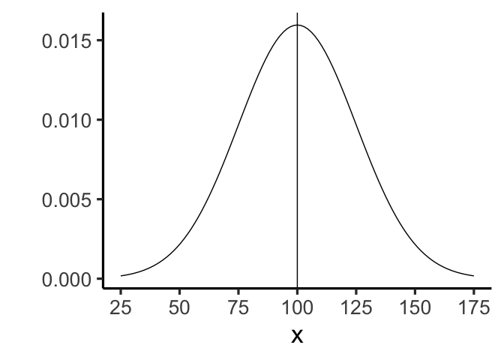
what does z tell us?
A z-score tells us how far away a score is from the mean, in standard deviation units

Slide 11
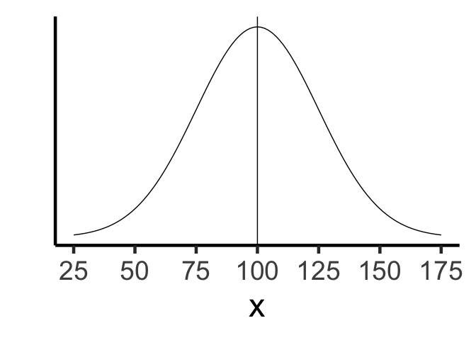
What is Z?
.pull-left[ - Mean = 100 - SD = 25 - Score = 125 - z = ?]
.pull-right[

Slide 12
]

Slide 13
What is Z?
.pull-left[ - Mean = 100 - SD = 25 - Score = 50 - z = ?]
.pull-right[

Slide 14
]

Slide 15
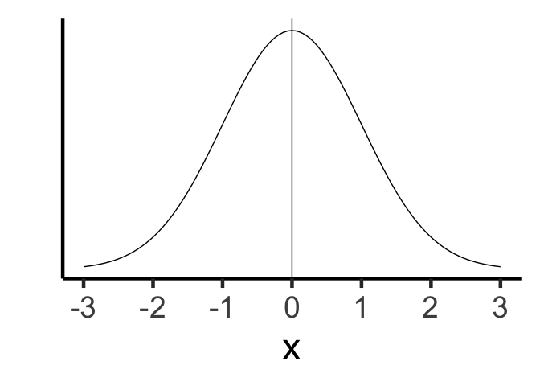
What is Z?
.pull-left[ - Mean = 0 - SD = 1 - Score = 1.5 - z = ?]
.pull-right[

Slide 16
]

Slide 17
review of z
when z=1, the score is 1 sd from the mean
when z=2, the score is 2 sd from the mean
when z=3, the score is 3 sd from the mean

Slide 18
class: pink, center, middle, clear

Slide 19
Effect-size

Slide 20
Effect-size
When we run an experiment, we are interested in whether the manipulation caused a difference in our measurement
If, our manipulation causes a difference in our measurement, then there will be an effect.
Effect-size refers to how big or small the effect is

Slide 21
Measures of effect-size
There are many different measures of effect size. Consider the simplest measure for two groups, A and B.
Mean difference
The difference between the mean of A, and the mean of B, is a measure of the effect size.
Large mean difference is a large effect
Small mean difference is a small effect

Slide 22
How big is big?
What if the mean difference is 50, is that big or small?
What if the mean difference is 1, is that big or small?

Slide 23
Relative to what?
Mean differences can be interpreted if we know what the difference is relative to.
mean A = 1000, mean B = 1050
difference=50
5% increase, not so big
mean A = 1, mean B = 2
difference=1
100% increase, pretty big

Slide 24
Cohen’s D
Cohen’s D express a mean difference between two samples in terms of standard deviation units (like a z-score). This allows us to know something about the relative size.
D = .1 (mean difference is shifted by .1 SD)
D = 1 (mean difference is shifted by 1 SD)
D = 2 (mean difference is shifted by 2 SD)

Slide 25
Cohen’s D formula
The general idea is:
$d=\frac{\text{MeanA}−\text{MeanB}}{SD}$

Slide 26
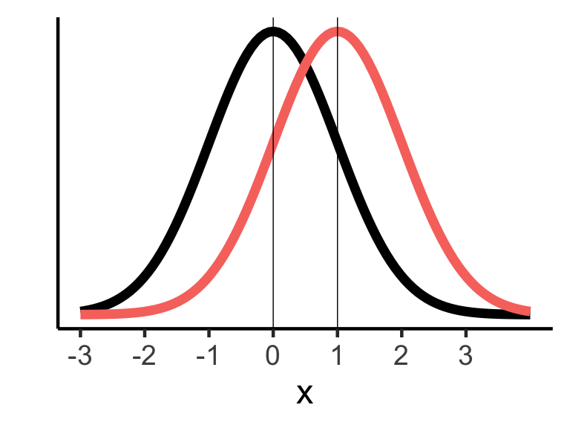
M=0, SD=1, D=1
A = Black, B = Red, Cohen’s D = 1

Slide 27
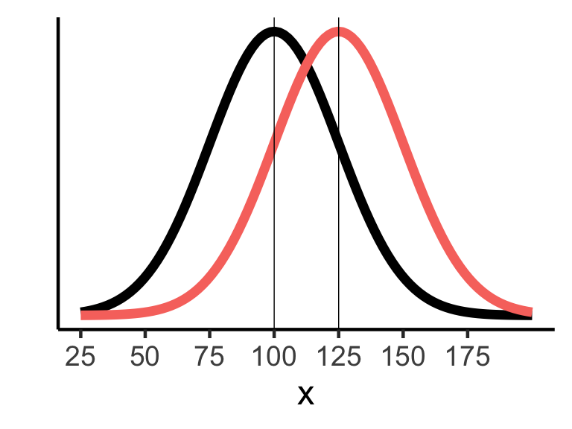
M=100, SD=25, D=1
A = Black, B = Red, Cohen’s D = 1

Slide 28
No-difference
If there is no difference, how big is Cohen’s D?
What do the distributione for A and B look like?

Slide 29
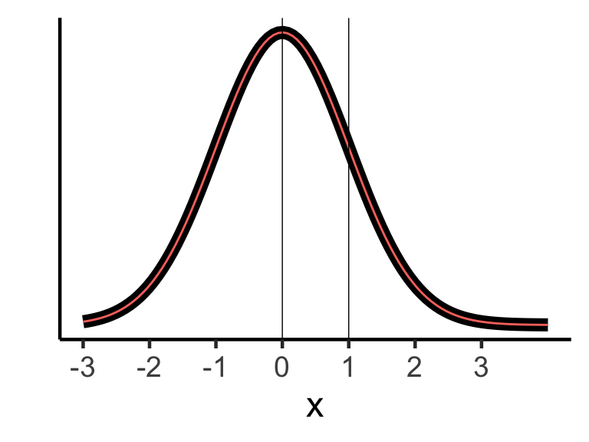
No-difference
A and B come from the same distribution, no difference

Slide 30
Interpreting Cohen’s D
Cohen gives these recommendations:
Small: d = .2
Medium: d =.5
Large: d >= .8
Note d’s larger than 1 are really big, they shift the whole distribution by a whole standard deviation, that’s a lot!

Slide 31
D’s in Psychology
Many effects in Psychology are small, with d around .2.
One reason is that we measure people, and people are highly variable.

Slide 32
class: pink, center, middle, clear

Slide 33
Power

Slide 34
Power
Power is the probability of rejecting the null-hypothesis, when there is a TRUE DIFFERENCE
Power = .2, You will reject the null-hypothesis 20% of the time (20/100 experiments)
Power = .8, (considered high power), You will reject the null-hypothesis 80% of the time (80/100 experiments)

Slide 35
Power is a property of a design
Every design has it’s own Power to detect effects of different sizes.
The power of a design depends on: - sample-size (n) - Effect-size (d) - alpha-criterion

Slide 36
General info about power
Increasing sample-size, increases power
Increasing effect-size, increases power
Lowering alpha (making it easier to reject null), increases power

Slide 37
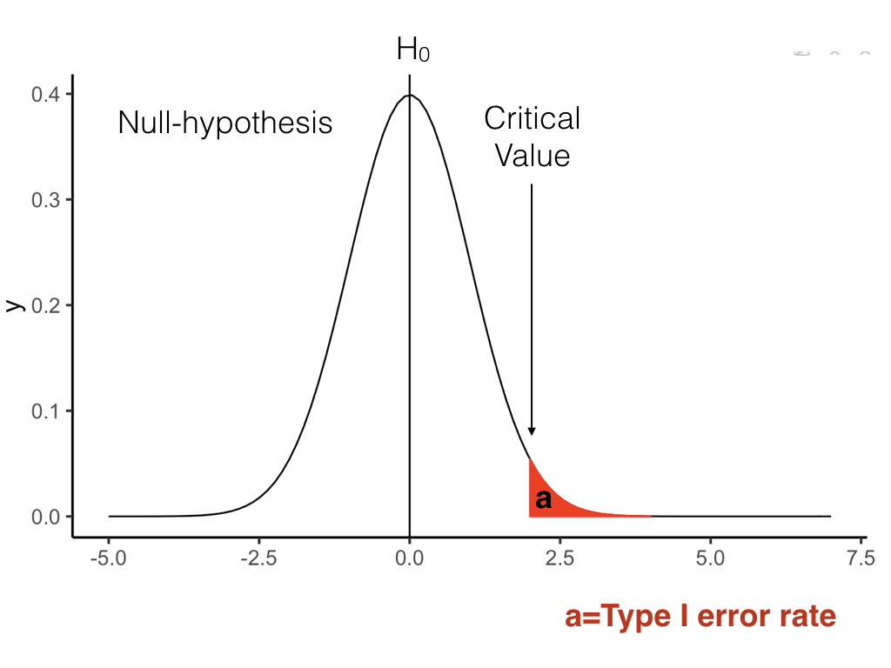
type I error

Slide 38
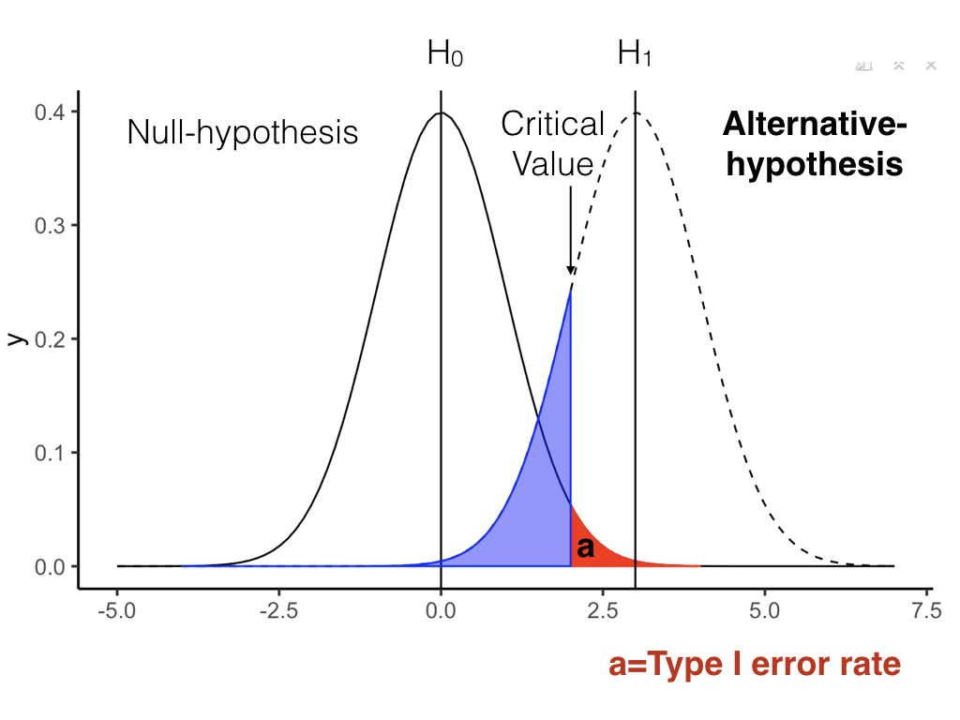
Alternative Hypothesis (d > 0)

Slide 39
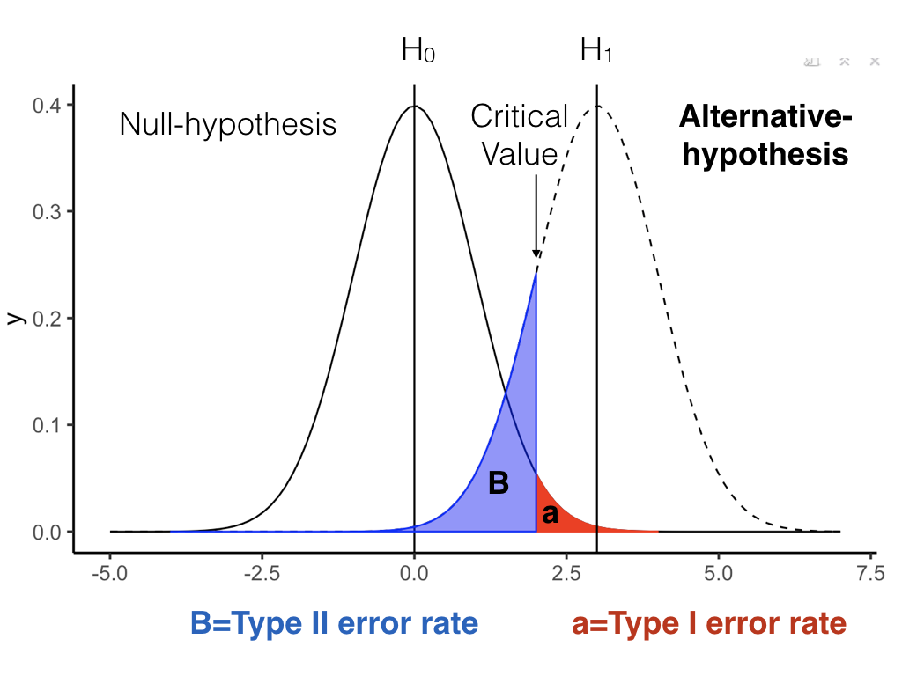
B = type II error

Slide 40
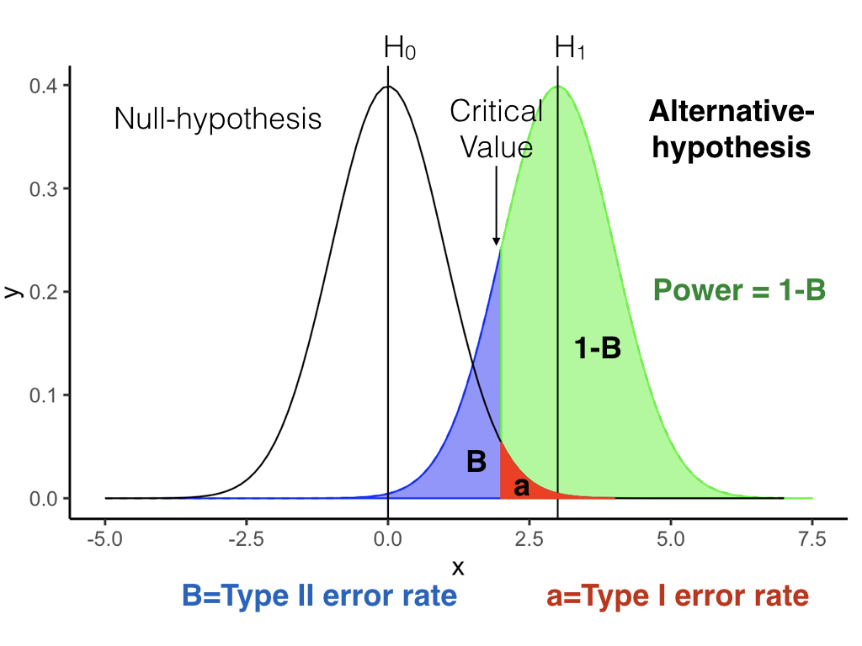
Power = 1-B

Slide 41
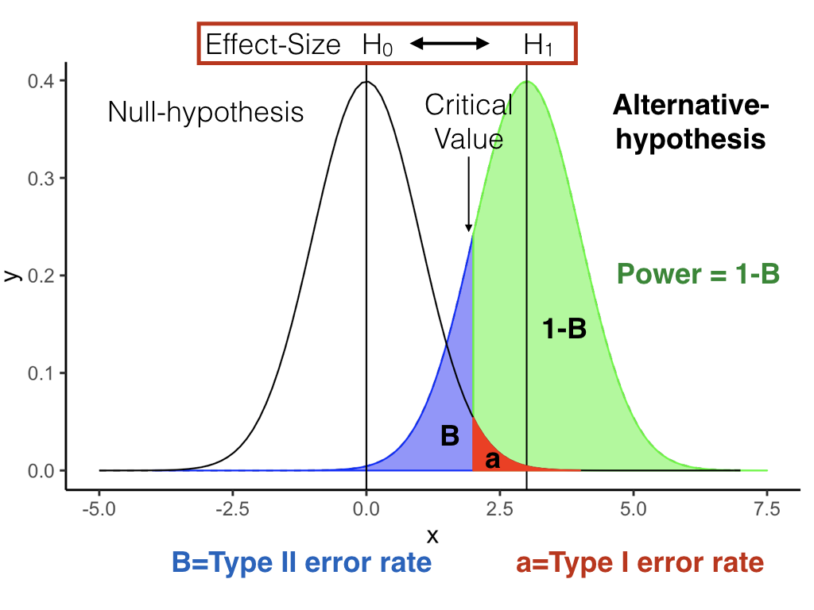
Power and effect-size

Slide 42
Paired-sample t-test (n=10)
Get 1,000 t-values assuming null is true
Get 1,000 t-values assuming alternative is true (d=1)
t_null <- replicate(1000,t.test(rnorm(10,0,1), rnorm(10,0,1), paired=TRUE)$statistic) t_alt <- replicate(1000,t.test(rnorm(10,1,1), rnorm(10,0,1), paired=TRUE)$statistic)

Slide 43
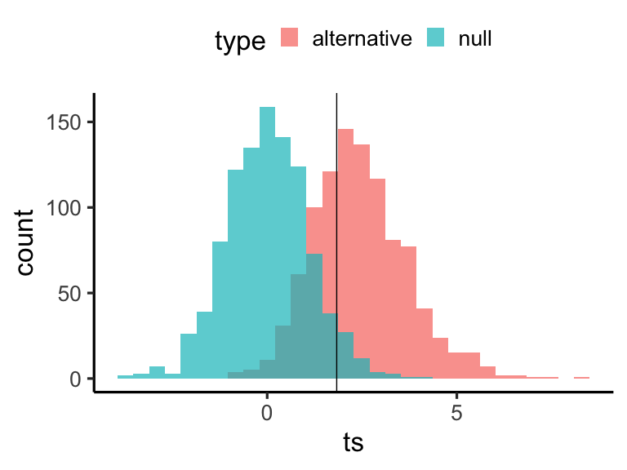
look at both t-distributions
power = 0.669 to detect d=1

Slide 44
Increase N from 10 to 50
Get 1,000 t-values assuming null is true
Get 1,000 t-values assuming alternative is true (d=1)
t_null <- replicate(1000,t.test(rnorm(50,0,1), rnorm(50,0,1), paired=TRUE)$statistic) t_alt <- replicate(1000,t.test(rnorm(50,1,1), rnorm(50,0,1), paired=TRUE)$statistic)

Slide 45
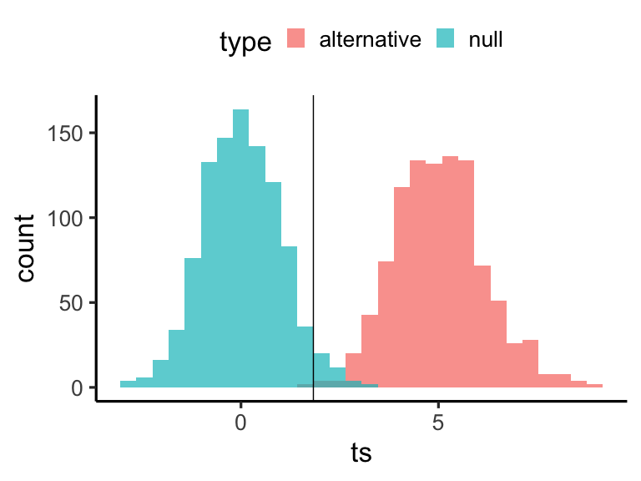
n=50
power = 0.998 to detect d=1

Slide 46
N=10, Increase d to 2
Get 1,000 t-values assuming null is true
Get 1,000 t-values assuming alternative is true (d=1)
t_null <- replicate(1000,t.test(rnorm(10,0,1), rnorm(10,0,1), paired=TRUE)$statistic) t_alt <- replicate(1000,t.test(rnorm(10,2,1), rnorm(10,0,1), paired=TRUE)$statistic)

Slide 47
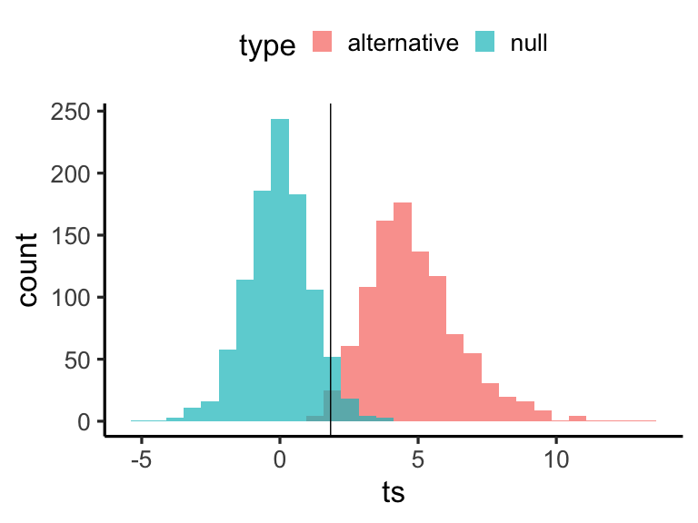
n=10, d=2
power = 0.991 to detect d=2

Slide 48
Power curves
A specific design, e.g.,
Paired samples t-test, with n =10
Has different levels of power, to detect effects of different size. This can be shown on a power curve.

Slide 49
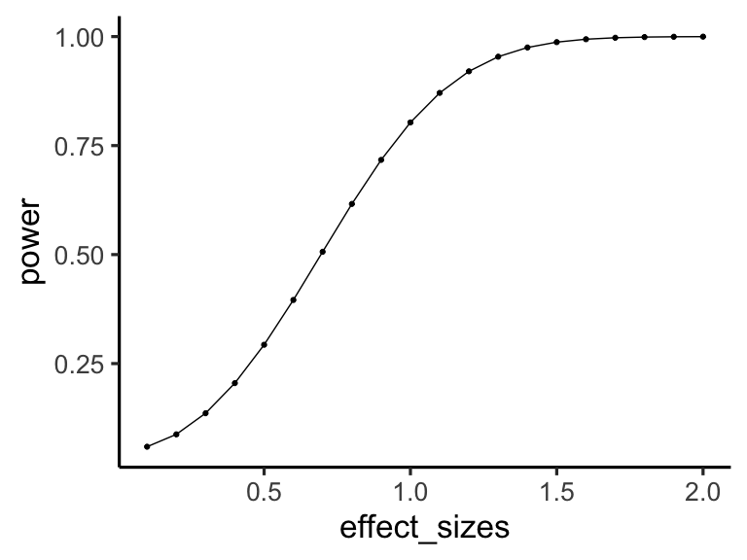
Power curve, t.test, n=10

Slide 50
Sample-size planning
How many subjects do you need for your experiment?
Establish a minumum effect-size of interest
Conduct a power-analysis, to show how power changes as a function of sample-size to detect the minimum effect size of interest

Slide 51
Example
Minimum effect-size of interest, d = .2
Plot the power function

Slide 52
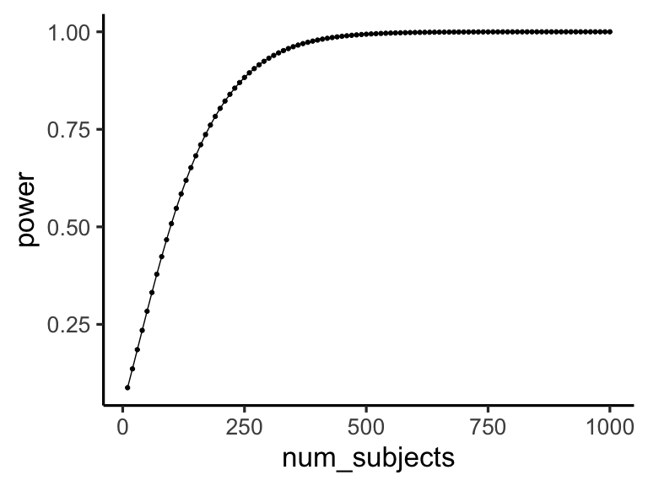
power as a function of n

Slide 53
class: pink, center, middle, clear

Slide 54
Don’t run an experiment that is designed to fail

Slide 55
class: pink, center, middle, clear

Slide 56
How? Do a power analysis, beforehand

Slide 57
Next class: Midterm Review
Quiz on t-tests, due next Monday
Midterm review next Monday
Midterm review sheet and info is posted on Blackboard

