Slide 1
One-Factor ANOVA continued
Between-subjects designs Matthew Crump

Slide 2
Overview
Visual intution for Observed F
The F-distribution
Statistical inference with F’s
Examples

Slide 3
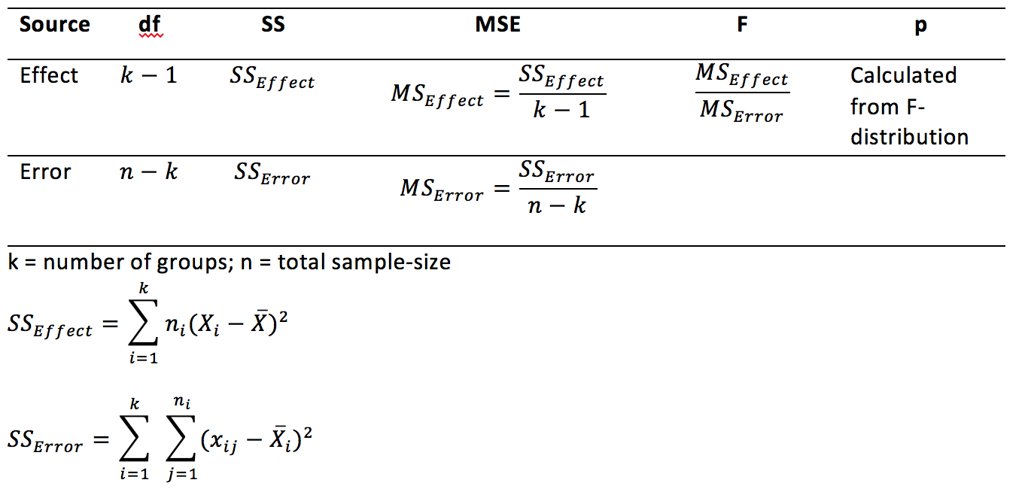
Observed F
Observed F is computed directly from the data:

Slide 4
F is a ratio of variances
$F=\frac{MS_{\text{Effect}}}{MS_{\text{Error}}}$
F is greater than 1 when the variance due to mean differences between the groups is larger than the remaining error variance
F is less than 1 when the variance due to to mean differences between the groups is smaller than the remaining error variance

Slide 5
Visualizing the sources of variance
The one-factor ANOVA splits up the total variance into two parts, one for the effect of the means, and one for the remaining unexplained variance.
Let’s look at some graphs with sample data and see if we can form intuitions about the value of F

Slide 6
Questions to answer
How big is the variation between the group means? This tells us about the variation due to the effect.
How big is the variation between each group mean and the scores in each group? This tells us about the leftover variation due to sampling error.
Is one bigger than the other?

Slide 7
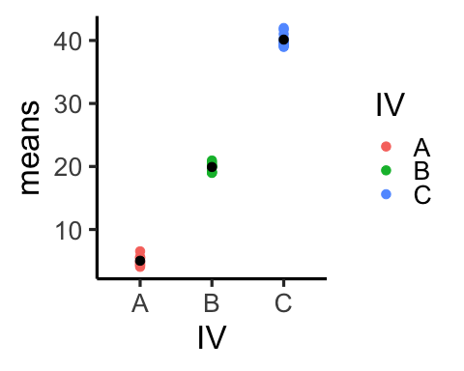
Example 1
.pull-left[

Slide 8
]
.pull-right[
MS Effect = 3102.32
MS Error = 0.73
F = 4237.73
]

Slide 9
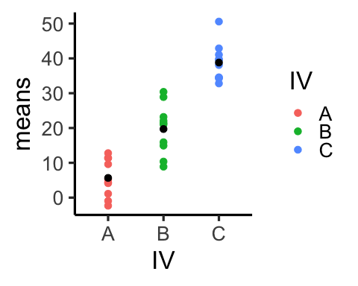
Example 2
.pull-left[

Slide 10
]
.pull-right[
MS Effect = 2767.47
MS Error = 36.36
F = 76.11
]

Slide 11
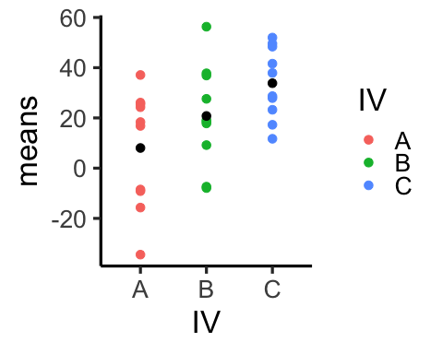
Example 3
.pull-left[

Slide 12
]
.pull-right[
MS Effect = 1663.4
MS Error = 380.96
F = 4.37
]

Slide 13
Summary of Examples 1-3
The examples had:
Systematic mean differences between the groups
Increasing variance within each group (from example 1 to 3)
Result:
F was large for Example 1, and decreased for E2 and E3 as the error variance increased (compared to the effect variance)

Slide 14
Null examples
Let’s sample data into three groups from the same normal distribution. - 3 groups - n = 10 in each group - mean = 10 - standard deviation = 20

Slide 15
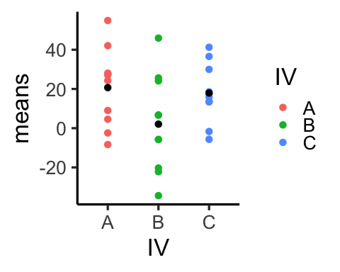
Null Example 1
.pull-left[

Slide 16
]
.pull-right[
MS Effect = 1011.44
MS Error = 412.41
F = 2.45
]

Slide 17
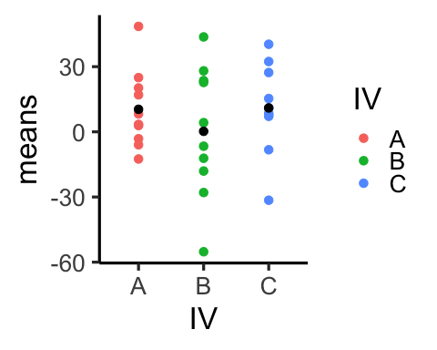
Null Example 2
.pull-left[

Slide 18
]
.pull-right[
MS Effect = 364.79
MS Error = 549.39
F = 0.66
]

Slide 19
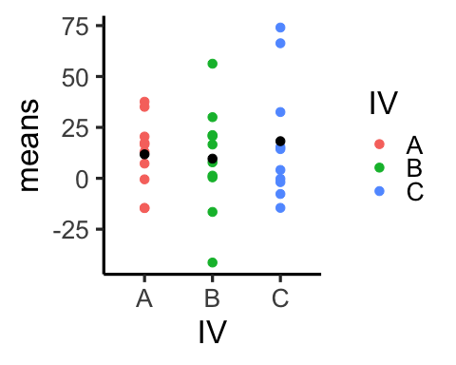
Null Example 3
.pull-left[

Slide 20
]
.pull-right[
MS Effect = 199.55
MS Error = 651.66
F = 0.31
]

Slide 21
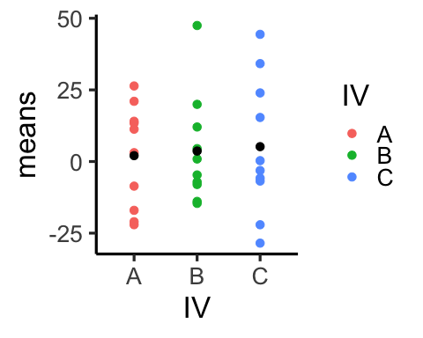
Null Example 4
.pull-left[

Slide 22
]
.pull-right[
MS Effect = 24.59
MS Error = 414.67
F = 0.06
]

Slide 23
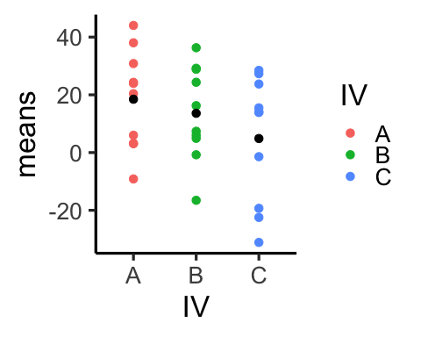
Null Example 5
.pull-left[

Slide 24
]
.pull-right[
MS Effect = 475.58
MS Error = 348.48
F = 1.36
]

Slide 25
Summary Null Examples
Remember: we sampled scores into each group from the same population, so on average the means for each group should be the same, but they are not always the same because of sampling error
By chance: - variation between groups can be larger or smaller than variation within groups - F-values can be larger or smaller than 1 by chance

Slide 26
The sampling distribution of F
The sampling distribution of F is a hypothetical distribution. It shows the distribution of F-values you could get for particular situations:
depends on n per group
number of groups
the population the scores come from

Slide 27
How does F behave under the null?
In order to use an observed F-value for statistical inference, we need to know what kind of F-values can be produced by chance alone, when all of the sample data for each group is taken from the same population.

Slide 28
Simulating an F distribution in R
This simulates a null-distribution
save_f<-c() for(i in 1:1000){ A <- rnorm(10,10,20) B <- rnorm(10,10,20) C <- rnorm(10,10,20) DV <- c(A,B,C) IV <- rep(c("A","B","C"),each=10) df <- data.frame(IV,DV) sum_aov <- summary(aov(DV~IV,df)) save_f[i] <- sum_aov[[1]]$`F value`[1] }

Slide 29
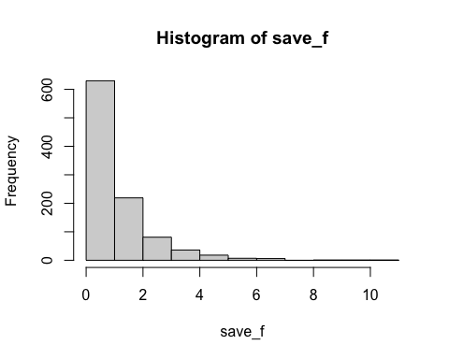
histogram of simulated Fs
hist(save_f)

Slide 30
Analytic formula for F-distribution
see wikipedia page on the F-distribution

Slide 31
F-distribution shape
right-skewed
changes depending on dfs for the numerator and denominator
Question: Can you ever get an F less than 0?

Slide 32
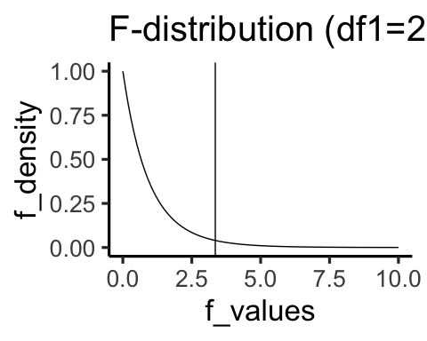
Critical F (alpha= .05)
Critical F (2,27) = 3.3541308

Slide 33
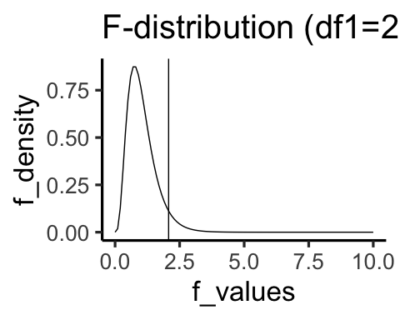
Critical F (alpha= .05)
Critical F (9,50) = 2.0733512

Slide 34
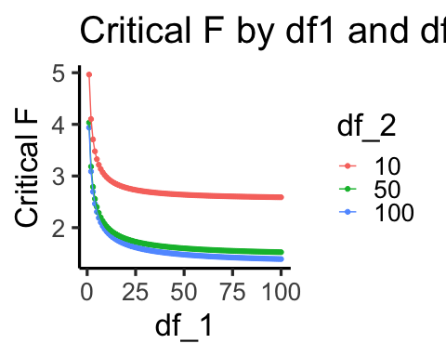
Critical F by df1 and df2

Slide 35
Statistical inference with F
Observed F = the f-value you got from your data
p-value = the probability of obtaining your f-value or larger by chance
Critical F = the f-value associated with your alpha criterion (and df1, df2)
p-value = set by the alpha criterion

Slide 36
Rejecting the Null
Decisions:
Reject the null: When the p-value for the observed F is smaller than alpha (or, F observed is larger than F critical)
Fail to reject: When the p-value for the observed F is larger than alpha (or, F observed is smaller than F critical)

Slide 37
What does rejecting the null mean?
Rejecting the null = the mean differences between the groups are unlikely to be produced by chance

Slide 38
F-tests are non-directional
Why?

Slide 39
An R example
We simulate data from a between-subjects design with 3 groups.
n = 10 in each group
all sample data comes from a normal with standard deviation = 5
we program some differences in to the means

Slide 40
simulate the data
A <- rnorm(10,20,5) B <- rnorm(10,20,5) C <- rnorm(10,40,5) DV <- c(A,B,C) IV <- rep(c("A","B","C"),each=10) df <- data.frame(IV,DV)

Slide 41
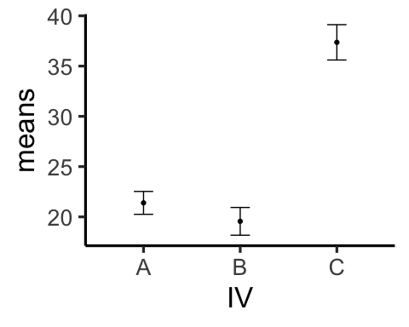
plot the data

Slide 42
Conduct the ANOVA
summary(aov(DV~IV,df))
## Df Sum Sq Mean Sq F value Pr(>F) ## IV 2 1918.7 959.3 45.76 2.13e-09 *** ## Residuals 27 566.1 21.0 ## --- ## Signif. codes: 0 '***' 0.001 '**' 0.01 '*' 0.05 '.' 0.1 ' ' 1

Slide 43
Conduct follow-up comparisons
The ANOVA will only test the omnibus question…Are there any differences anywhere?
Need to concuct additional tests to compare specific means…
There are numerous recommendations for the “right” way to do this…For now we do follow-up t-tests, and discuss the implications of this choice in later lectures.

Slide 44
conduct follow-up t-tests A vs. B
t.test(A,B,var.equal=T)
## ## Two Sample t-test ## ## data: A and B ## t = 1.0267, df = 18, p-value = 0.3182 ## alternative hypothesis: true difference in means is not equal to 0 ## 95 percent confidence interval: ## -1.921775 5.595357 ## sample estimates: ## mean of x mean of y ## 21.39142 19.55463

Slide 45
conduct follow-up t-tests A vs. C
t.test(A,C,var.equal=T)
## ## Two Sample t-test ## ## data: A and C ## t = -7.6268, df = 18, p-value = 4.806e-07 ## alternative hypothesis: true difference in means is not equal to 0 ## 95 percent confidence interval: ## -20.37127 -11.57199 ## sample estimates: ## mean of x mean of y ## 21.39142 37.36305

Slide 46
Write-up the results
See the lab manual for some examples and tips

Slide 47
class: pink, center, middle, clear
Some questions to start thinking about

Slide 48
Obtaining statistical significance
Let’s say you set your alpha criterion to .05 for your statistical test.
If your experimental manipulation does not work (causes no change across levels), what proportion of the time would you expect to reject the null-hypothesis?

Slide 49
More questions
If your experimental manipulation does work, what proportion of the time would you expect to reject the null-hypothesis?
If your experimental manipulation does work, what proportion of the time would you expect to fail to reject the null-hypothesis?

Slide 50
Even more questions
Assume your experimental manipulation does work, and it causes some change between levels
What can you change about your experimental design to increase the proportion of times you would reject the null hypothesis?

Slide 51
Next class: Repeated measures ANOVA
First ANOVA quiz due Wednesday, April 10th.

