Slide 1
Repeated measures ANOVA
Within-subjects designs Matthew Crump

Slide 2
Overview
Repeated Measures ANOVA
New partition for subjects
Lab example

Slide 3
Repeated measures ANOVA
When to use:
Your design is within-subjects
Your IV has multiple levels (2 or more).

Slide 4
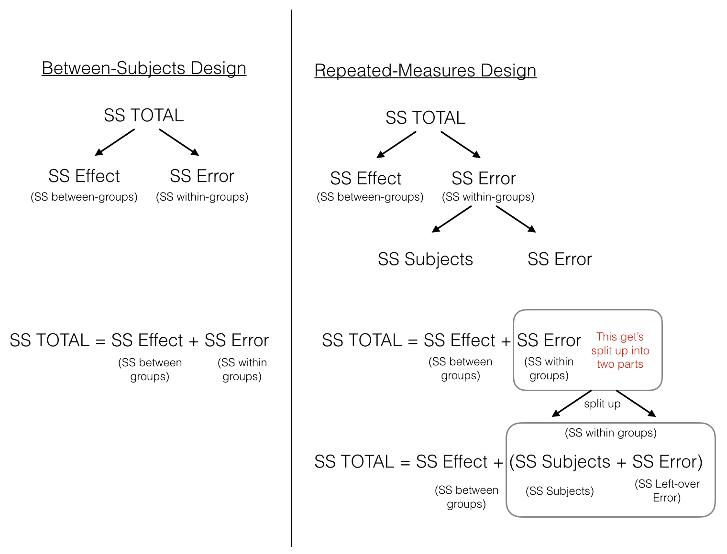
class: center, middle, clear, nopad

Slide 5
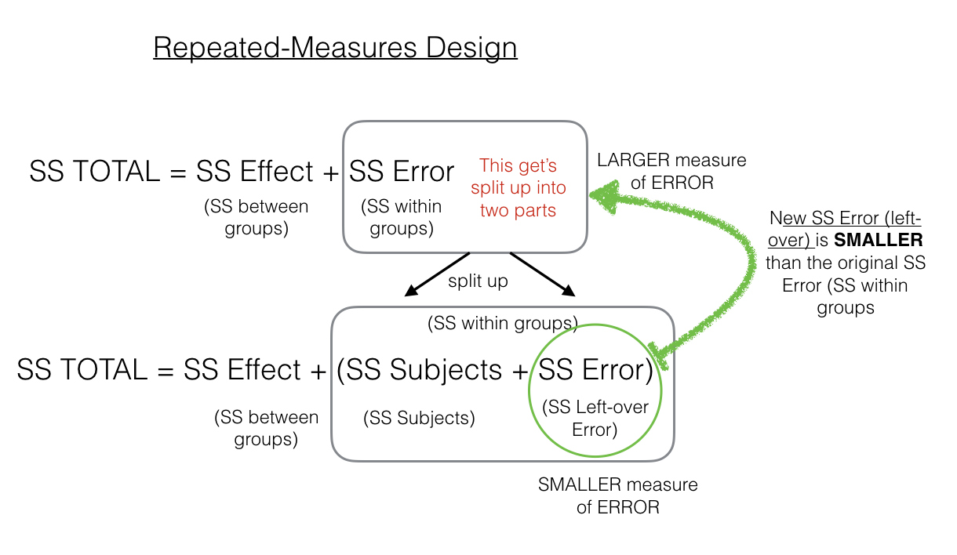
A new partition for Subjects

Slide 6
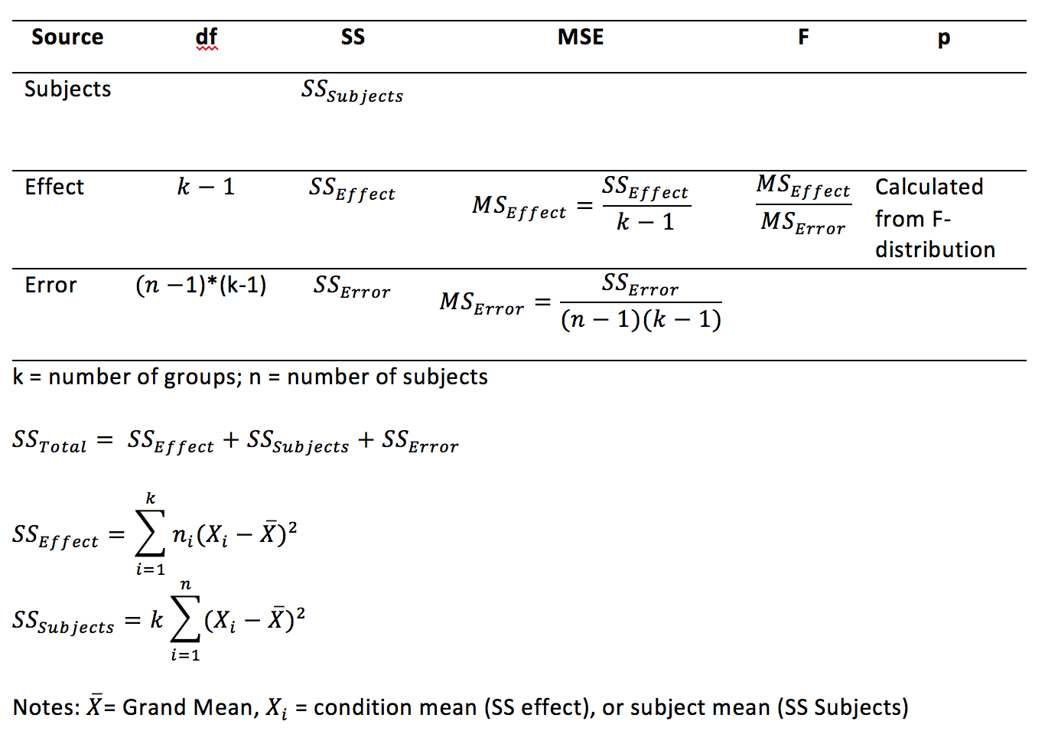
class: center, middle, clear, nopad

Slide 7
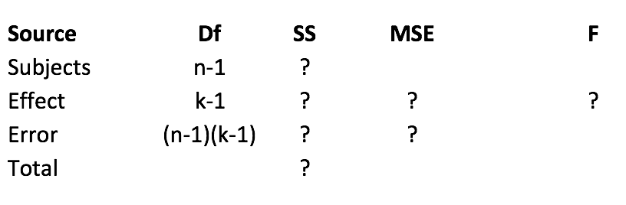
Goal: Fill in this table

Slide 8
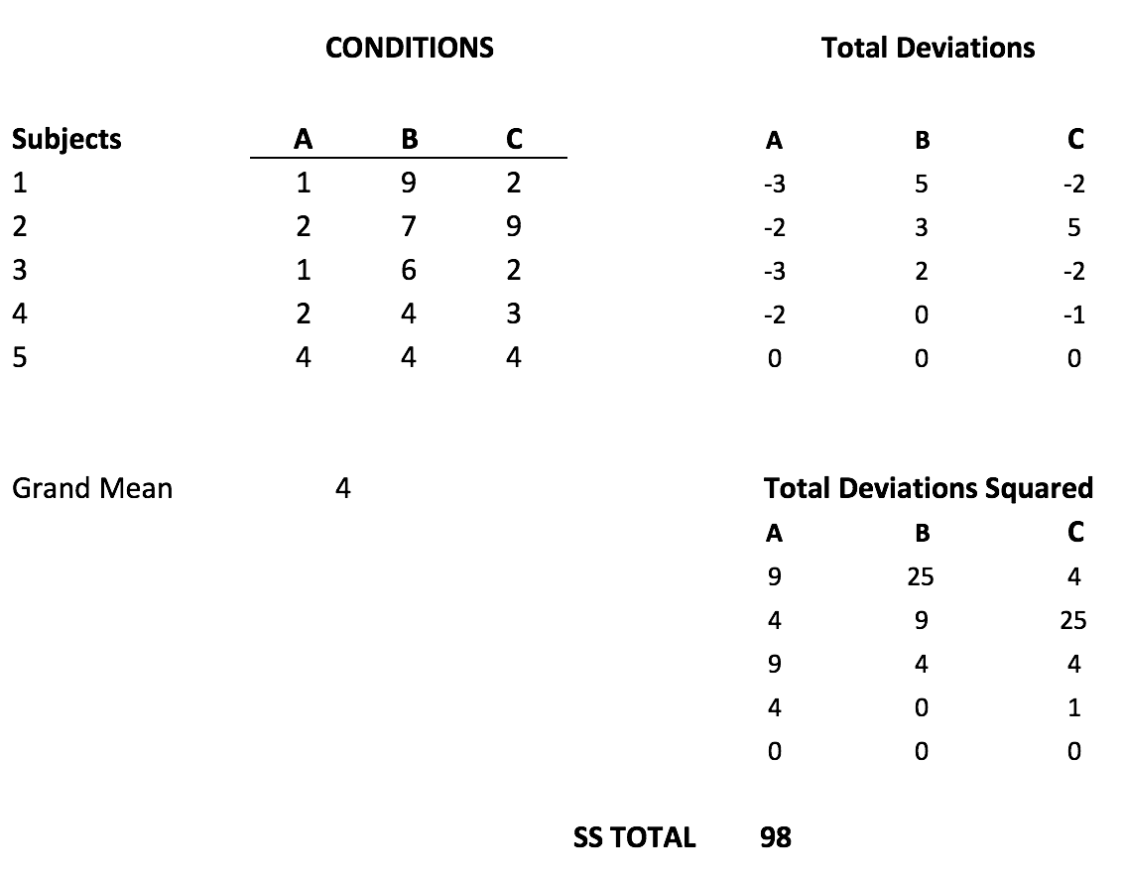
SS TOTAL

Slide 9
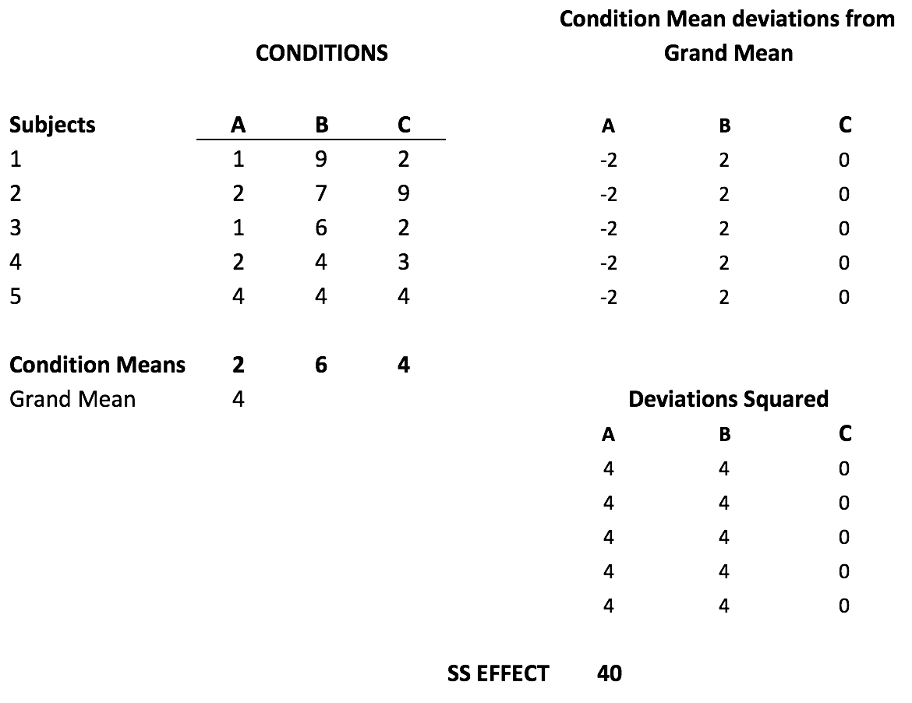
SS Effect

Slide 10
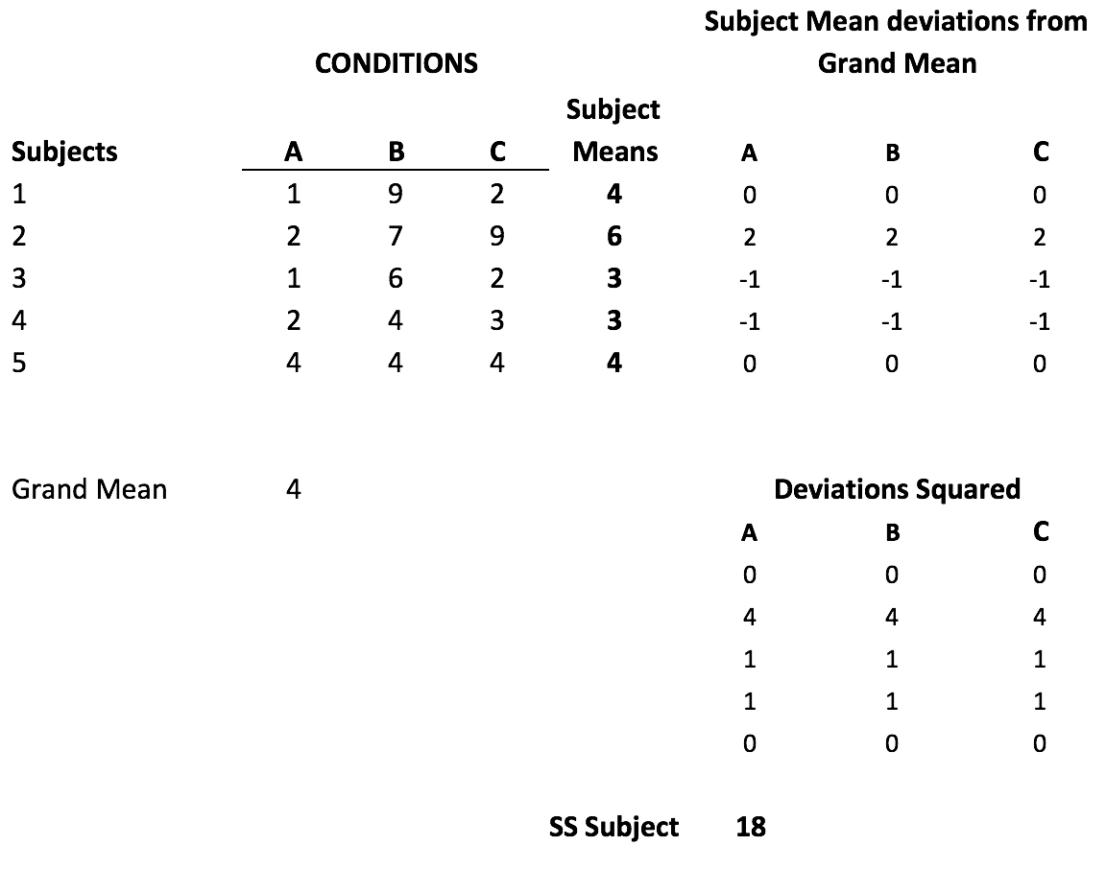
SS Subject

Slide 11
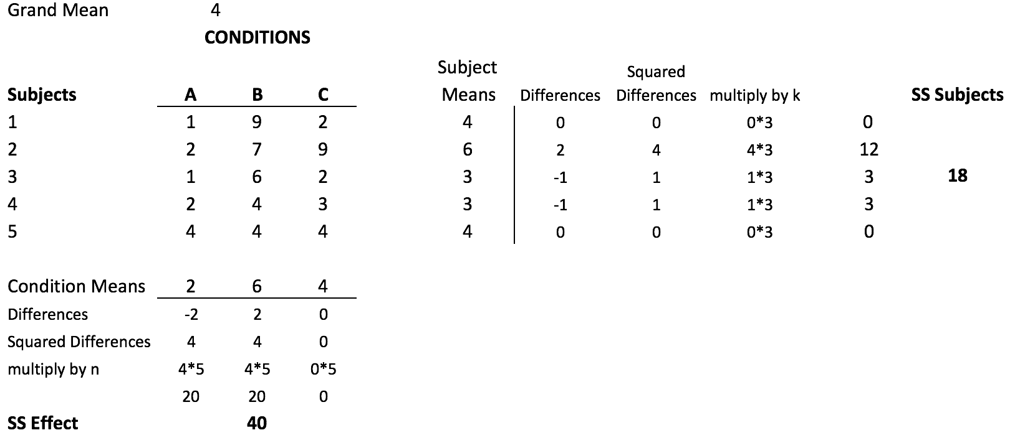
Again: SS effect and subject

Slide 12
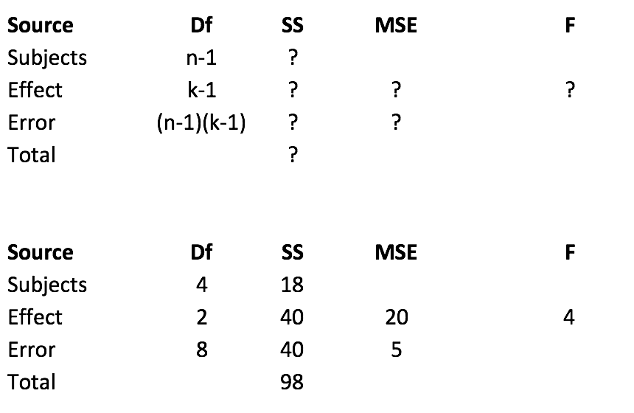
ANOVA table

Slide 13
R for RM anova
A <- c(1,2,1,2,4) B <- c(9,7,6,4,4) C <- c(2,9,2,3,4) DV <- c(A,B,C) subjects <- as.factor(c(1,2,3,4,5)) IV <- rep(c("A","B","C"), each=5) df <- data.frame(subjects,IV, DV)

Slide 14
the data frame (rows 1:8)
subjects
IV
DV
1
A
1
2
A
2
3
A
1
4
A
2
5
A
4
1
B
9
2
B
7
3
B
6

Slide 15
the data frame (rows 9:15)
subjects
IV
DV
9
4
B
4
10
5
B
4
11
1
C
2
12
2
C
9
13
3
C
2
14
4
C
3
15
5
C
4

Slide 16
R anova formula for repeated measures
aov(DV~IV + Error(subjects/IV), df)
summary(aov(DV~IV+Error(subjects/IV),df))

Slide 17
R anova table
## ## Error: subjects ## Df Sum Sq Mean Sq F value Pr(>F) ## Residuals 4 18 4.5 ## ## Error: subjects:IV ## Df Sum Sq Mean Sq F value Pr(>F) ## IV 2 40 20 4 0.0625 . ## Residuals 8 40 5 ## --- ## Signif. codes: 0 '***' 0.001 '**' 0.01 '*' 0.05 '.' 0.1 ' ' 1

Slide 18
calculating SS subjects
library(dplyr) subject_means <- df %>% group_by(subjects) %>% summarise(means=mean(DV)) grand_mean <- mean(df$DV) n_groups <- length(unique(df$IV)) SS_subjects <- n_groups*sum((subject_means$means-grand_mean)^2) print(SS_subjects)
## [1] 18

Slide 19
Fs and ps
R has pf() and qf() functions for finding critical values of F given a particular p-value, and p-values associated with particular Fs

Slide 20
pf()
What is the p-value associated with F(3,27) = 2.15 ?
pf(q, df1, df2) (q is the f-value, stands for quantile)
1-pf(2.15, 3, 27)
## [1] 0.1172199
An F of 2.15 or larger, with degrees of freedom (3,27), occurs with this probability.

Slide 21
qf()
Assume an alpha of .05. What is the critical value of F, with degrees of freedom (3,27)?
qf(p, df1, df2)
qf(.95, 3, 27)
## [1] 2.960351
We set p to .95. Fs larger than the critical value will occur less than 1-.95=.05 of the time.

Slide 22

Lab Example

Slide 23
Research question
One research question was whether we would replicate previous finding showing that people type faster when the letters are in word or word like arrangements, compared to random strings
Word: truck
english-like: quemp
random: wxzjy

Slide 24
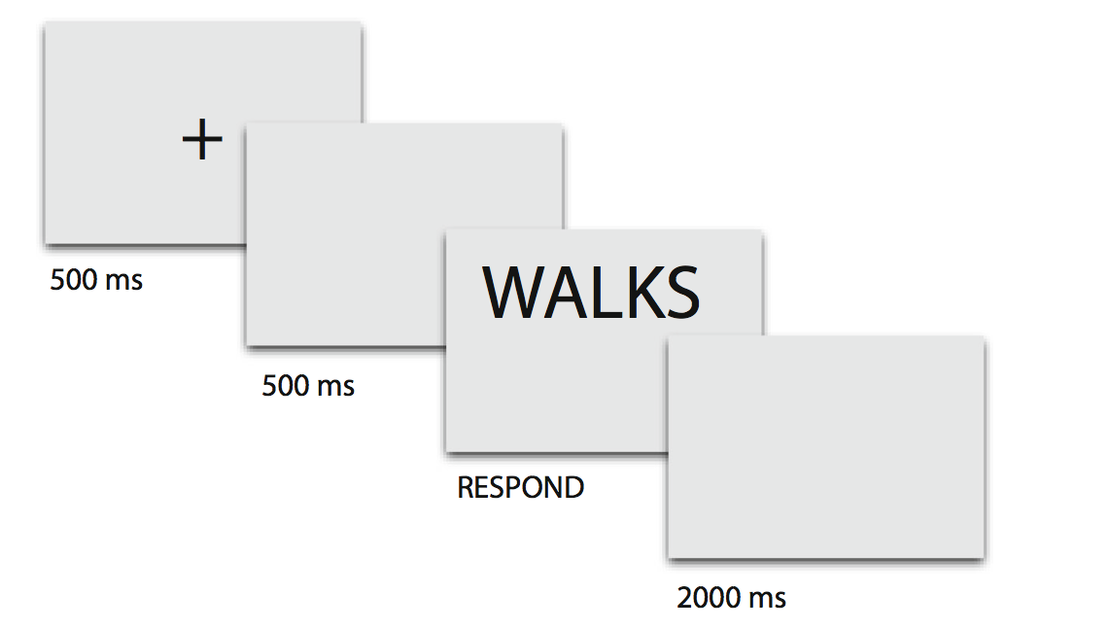
Repeated Measures Design
everybody typed letters in the word, english-like, and random conditions

Slide 25
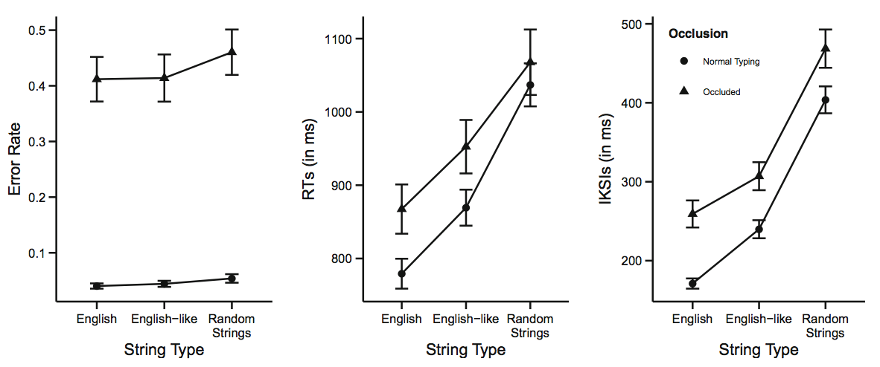
Results

Slide 26
Next class: Repeated measures ANOVA II
First ANOVA quiz due Wednesday, April 10th
Repeated measures ANOVA quiz will begin Wednesday, April 10th
Review of extra-credit assignment on Wednesday, April 10th

