Slide 1
Unsupervised Learning

Slide 2
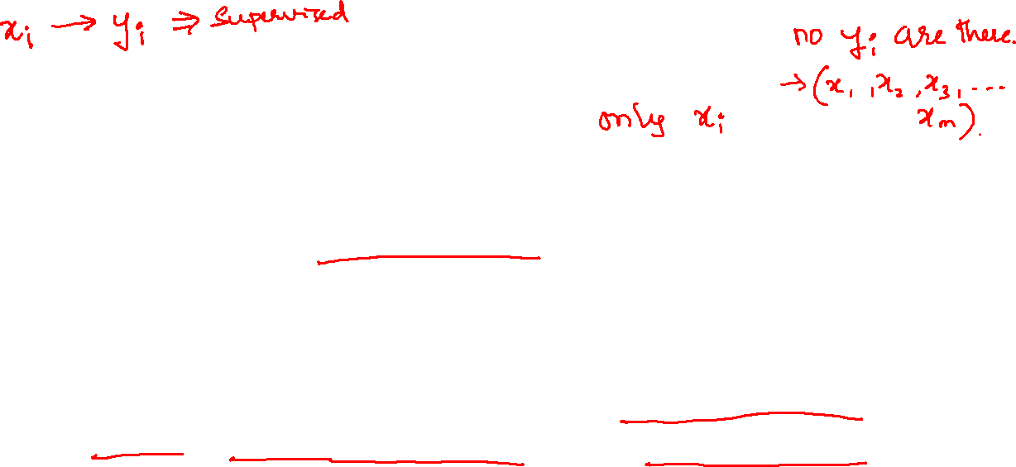
Unsupervised Learning
The learning goal is to understand the data, learn from it and then produce the results.
Learning data is unlabeled data – contains only indicative signals without any description attached. We need to find structure of the data underneath, to discover hidden information, or to determine how to describe the data.
Unsupervised learning can be used to detect anomalies, such as fraud or defective equipment, or to group customers with similar online behaviors for a marketing campaign.

Slide 3
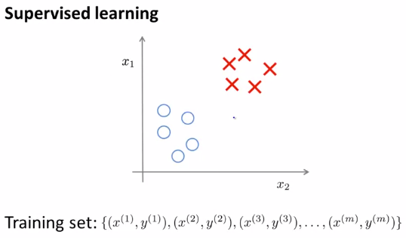
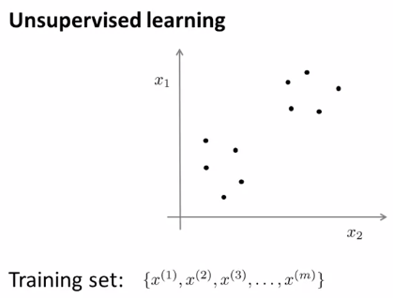
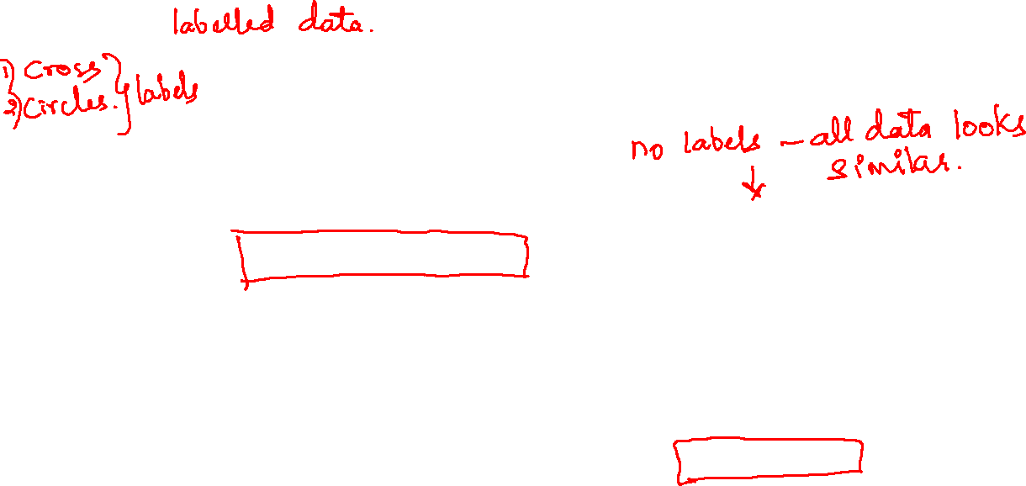
Supervised Vs. Unsupervised

Slide 4
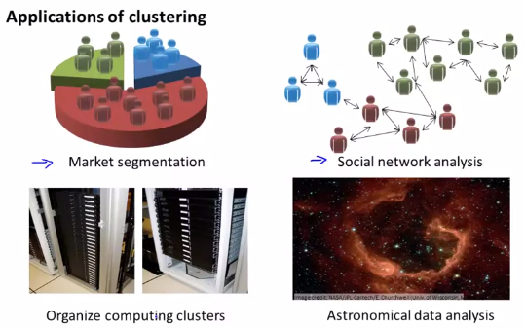
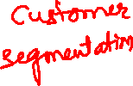
A

Slide 5
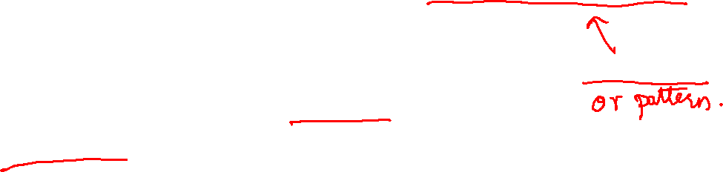
Unsupervised Learning
The training set is of the form { x(1), x(2), …., x(m) } without labels y(i).
In unsupervised learning, you are given an unlabeled dataset and are asked to find “structure” in the data.
Clustering is an example of unsupervised learning.

Slide 6
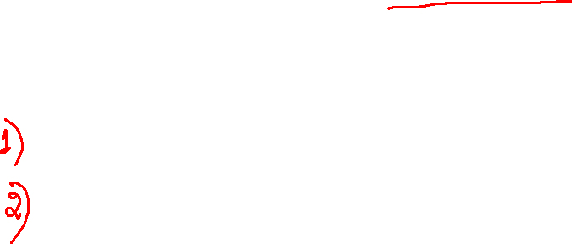
K-Means
It is an iterative algorithm involving two steps:
Cluster assignment
Move centroid

Slide 7
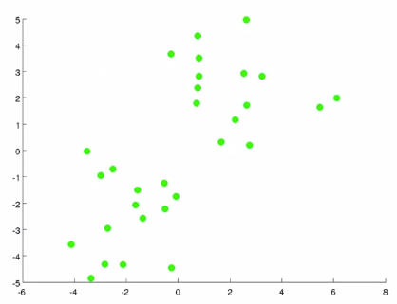
K-Means Algorithm
Suppose we have the following data and want to group them into one or more clusters.

Slide 8
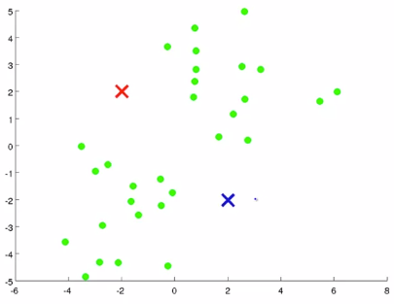
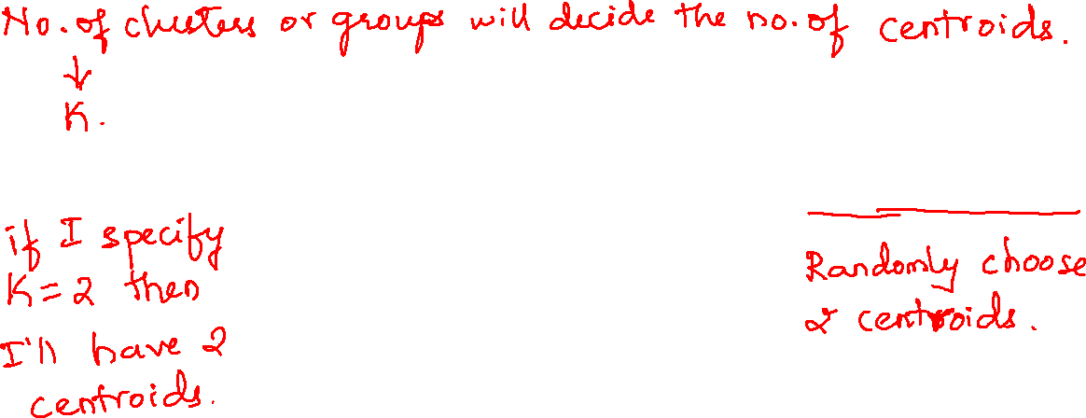
K-Means Step 1
Choose cluster centroids – red & blue if, you want two clusters.

Slide 9
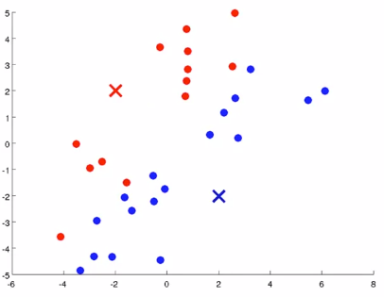
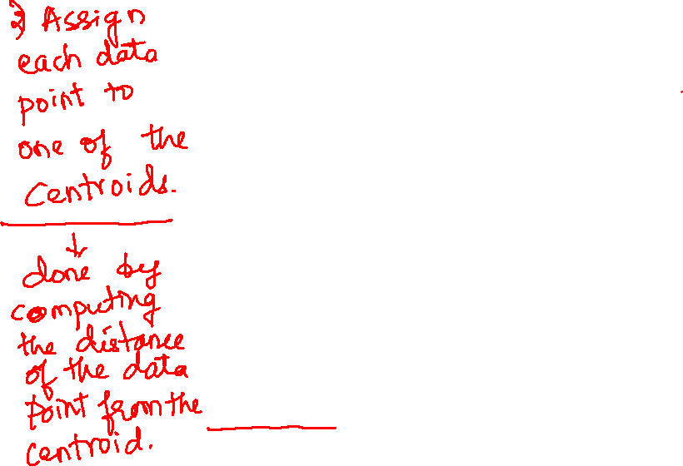
K-Means – Clustering Assignment
Going through each of the green dots and depending on whether it's closer to the red cluster centroid or the blue cluster centroid, it is going to assign each of the data points to one of the two cluster centroids.
Coloring each data point as red or blue according to the
proximity of the data point
to the centroid.

Slide 10
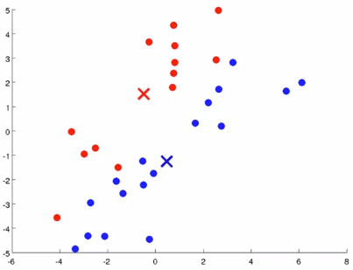
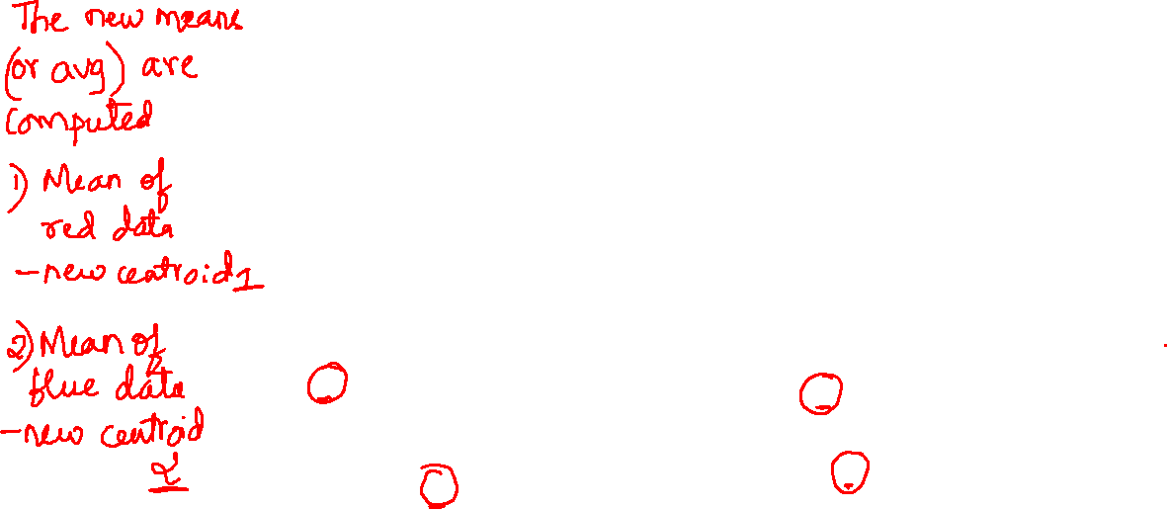
K-Means – Moving Centroid
Compute the average (mean) of all red points.
Move the red centroid to the computed average.
Repeat for blue points.

Slide 11
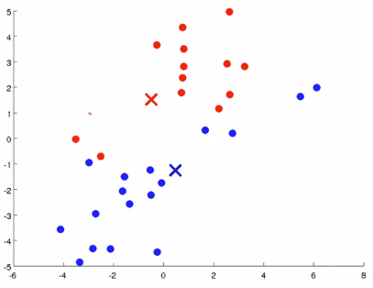
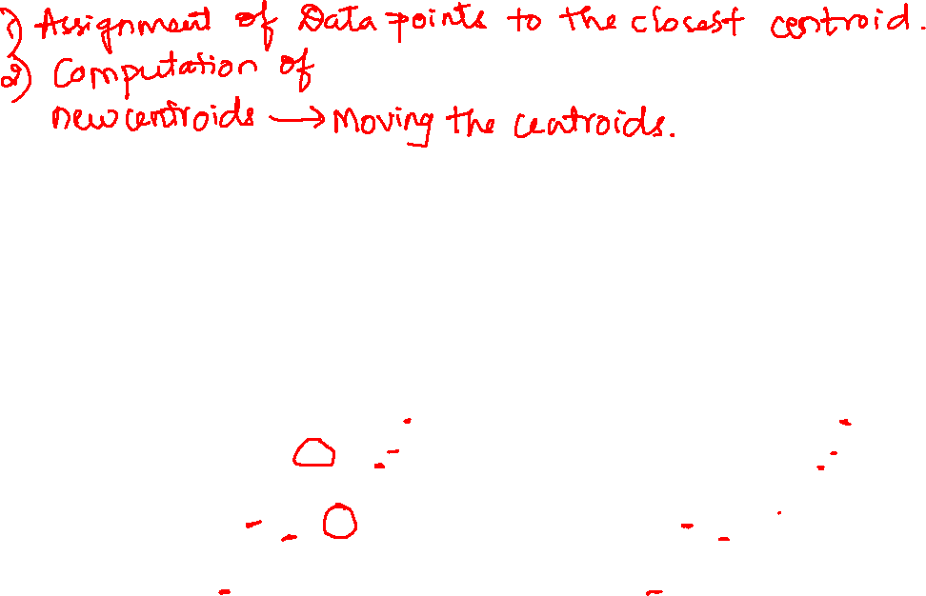
K-Means Iteration
Redo the cluster assignment step with new centroids (re-color the data points as red or blue using the new centroids).

Slide 12
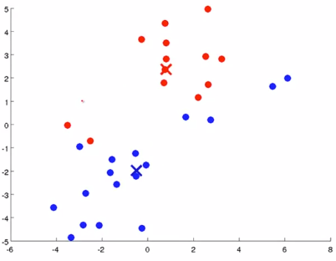
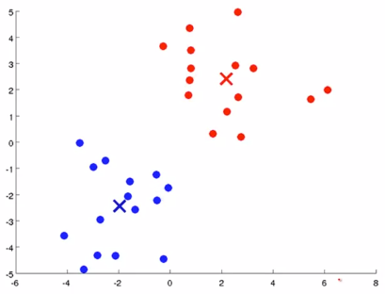
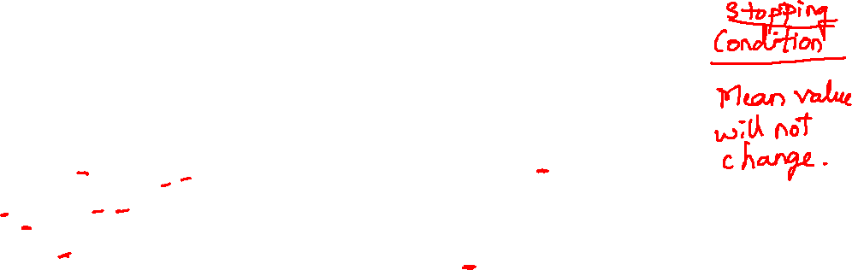
Repeat the Moving centroid step.
Repeat the cluster assignment step.
From here onwards the average (mean) won’t change and hence the centroids won’t change.

Slide 13
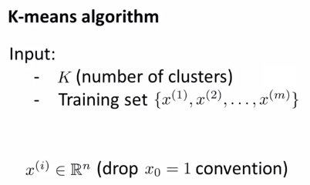
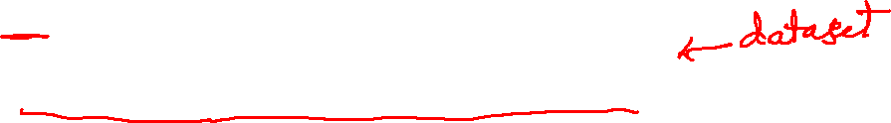

Slide 14
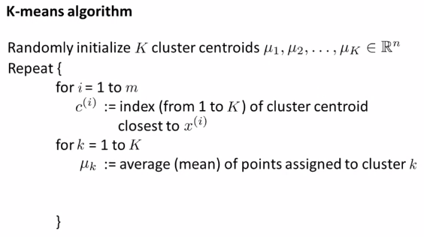
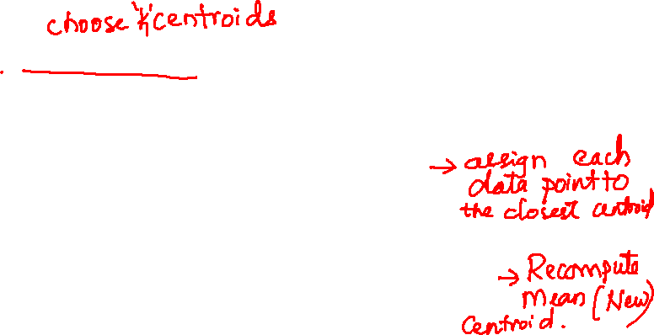

Slide 15
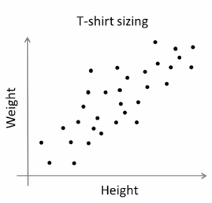
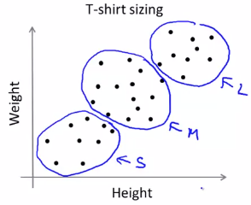
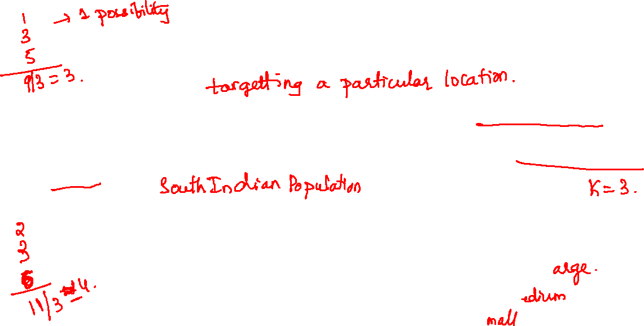
K-means for non-separated clusters
Usually used in market segmentation. Eg: T-shirt sizing where you want to design and sell three size types – small, medium, large.

Slide 16
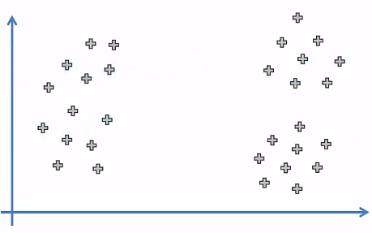
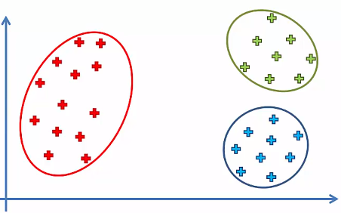
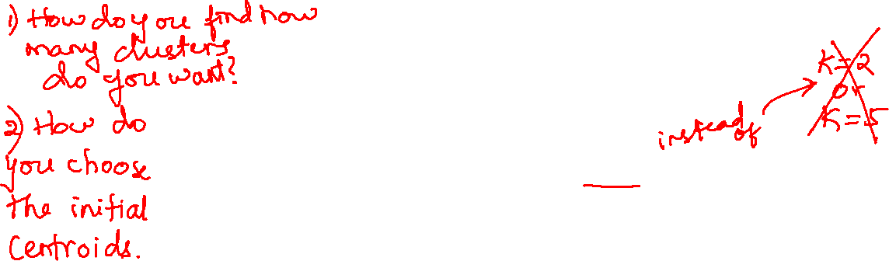
Random Initialization Trap
Suppose we have the following data.
If are lucky enough to choose K=3 clusters and our algorithm works fine then we will have the right clusters formed.

Slide 17
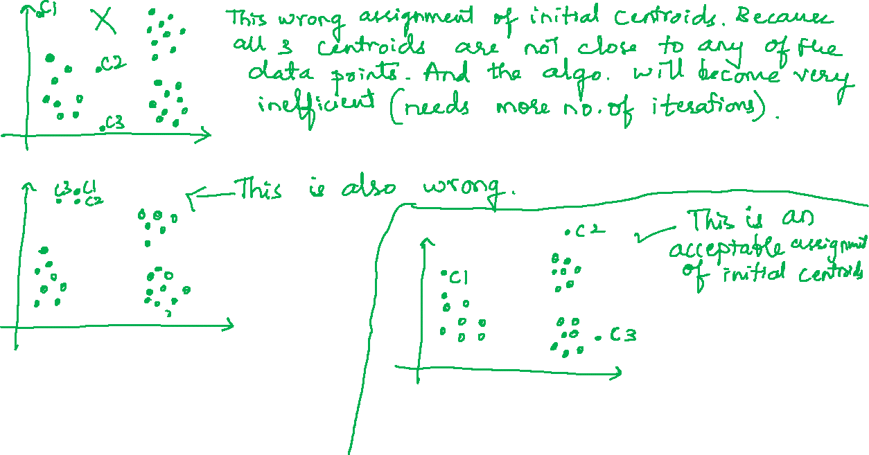

Slide 18
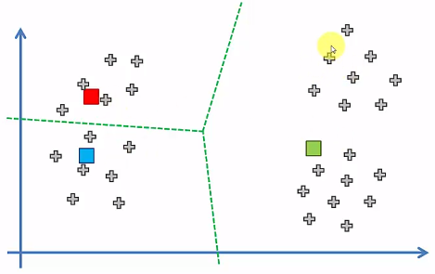
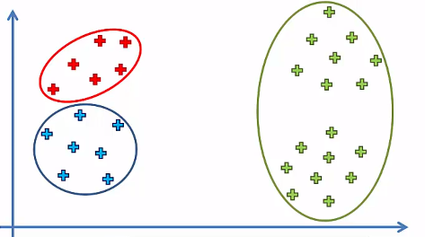
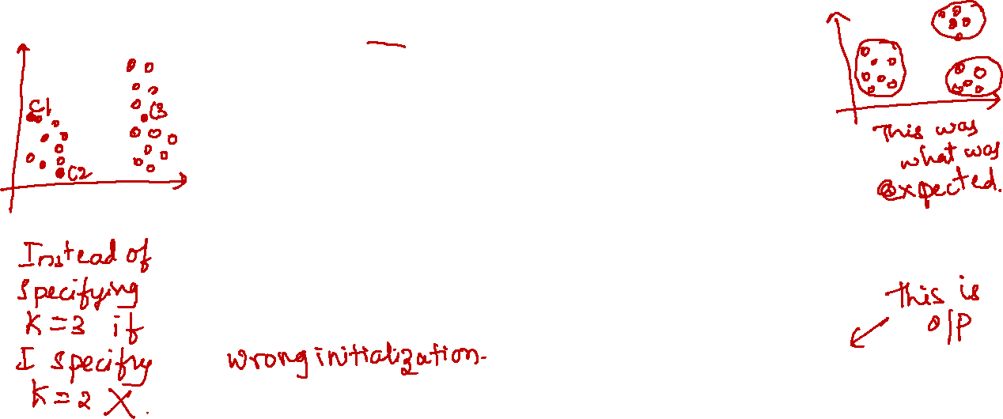
Random Initialization Trap
If are unlucky and choose a bad random initialization for clusters i.e., an incorrect centroids then, we would get the wrong clusters as shown below.
Hence this would dictate the outcome of the algorithm which is not good.

Slide 19
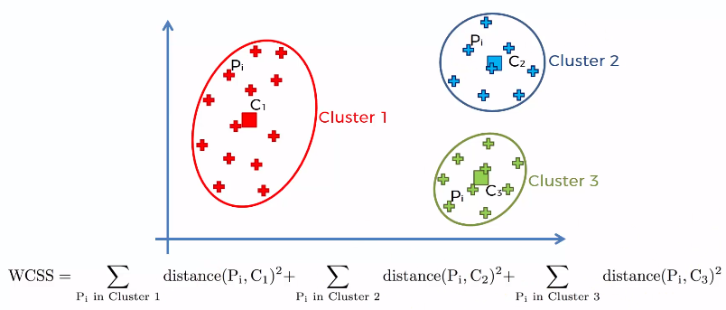
Solution
To overcome the random initialization trap we need to choose the right number of clusters and proper centroids.
In order to choose the no.of clusters (2 is better or 3, or 5 or 10) we are going to compute the following :

Slide 20
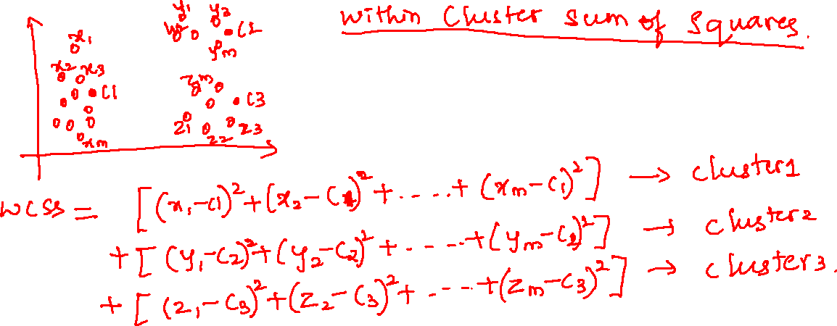

Slide 21
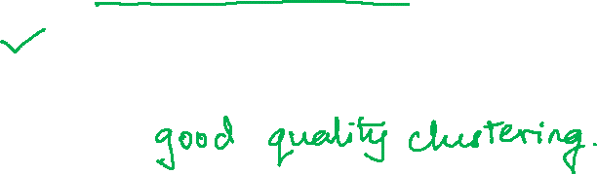
Within Cluster Sum of Squares – WCSS
It is the sum of squares of distances between each data point – Pi and the cluster’s centroid – Ci.
This is a metric which would help us decide the number of clusters.
The lesser the value of WCSS is a representation of better performance of the algorithm.

Slide 22
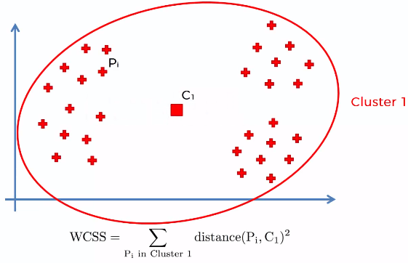
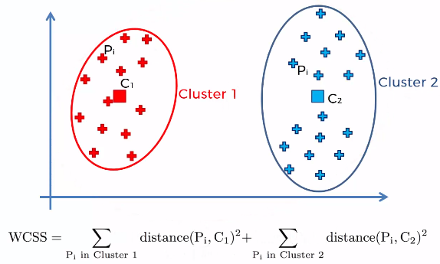
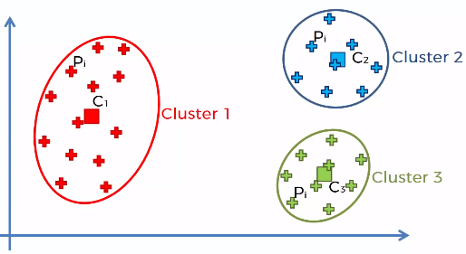
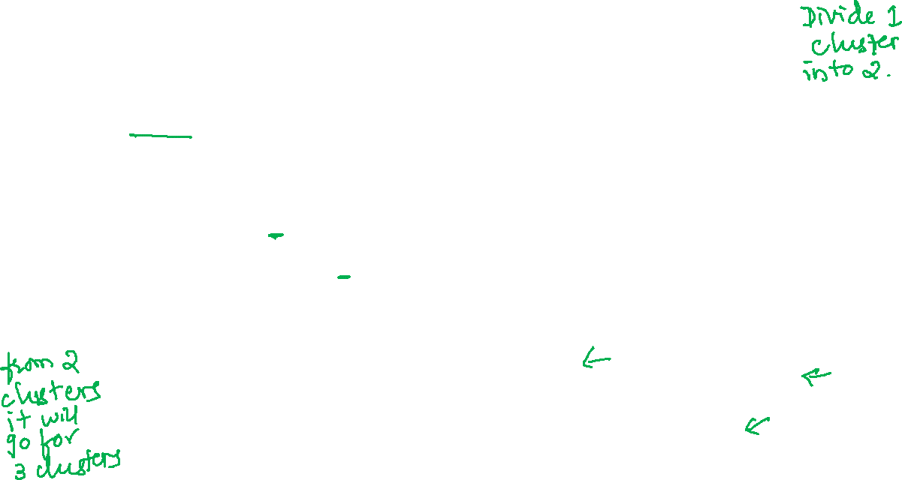
1) Suppose we consider the entire dataset as only one cluster. Here WCSS will be large.
3) Further no.of clusters is increased to 3 and now WCSS will be lesser than the previous one.
2) Now if we increase the no.of clusters to 2. The WCSS will less than the previous one.

Slide 23
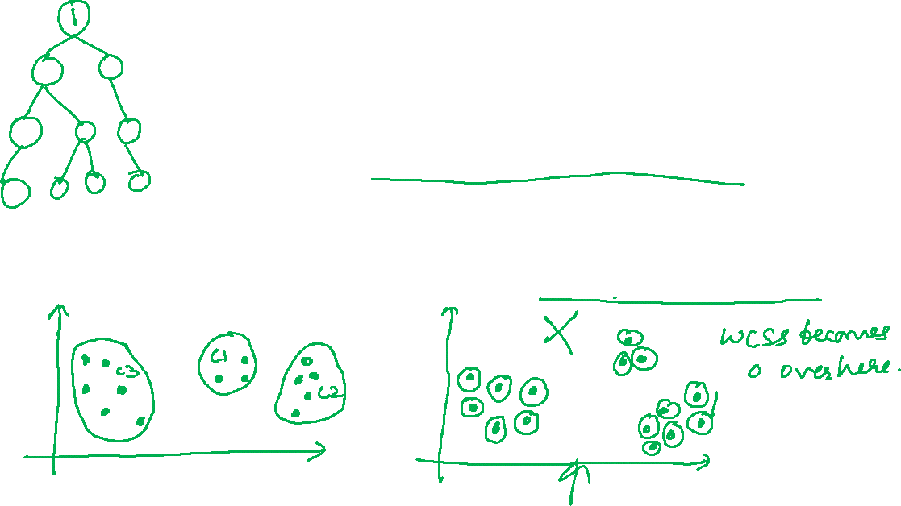
Within Cluster Sum of Squares – WCSS
So as the no.of clusters increases the WCSS decreases. Say we have 10 data points then having 10 clusters i.e., no.of clusters = no.of data the WCSS would be 0. Because all the distances would be 0. This is not a better idea.

Slide 24
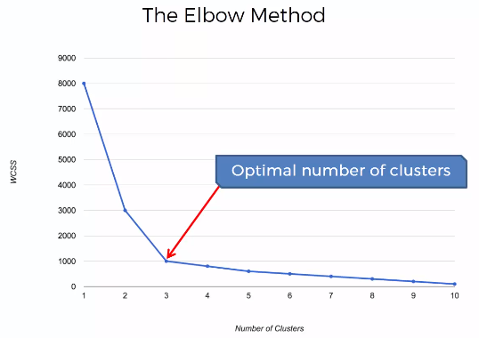
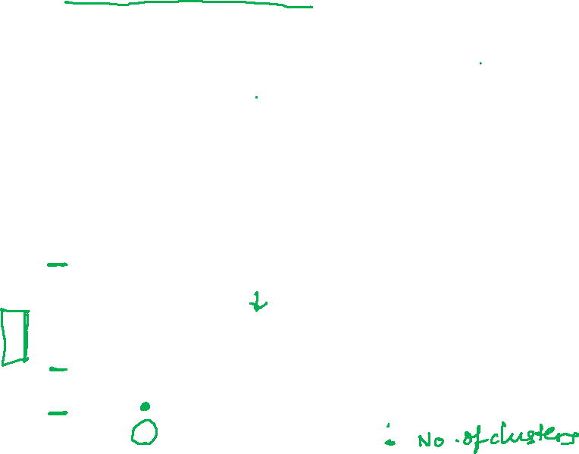
Elbow Method
To decide the optimum no.of clusters we will use the Elbow Method.
Plot the WCSS against the no.of clusters & pick the point from where the WCSS value flattens out.

