Slide 1
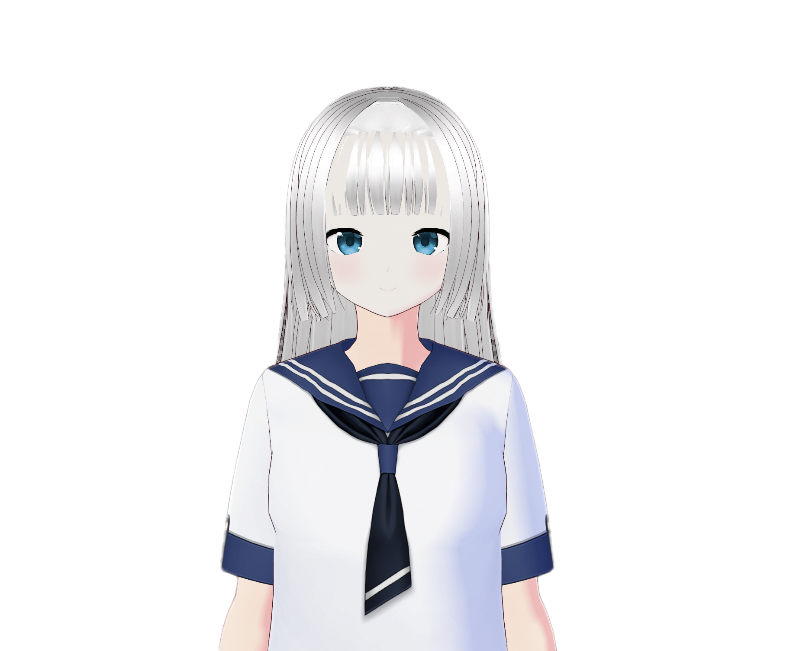
MYRA
Generative AI
Desktop Companion

Slide 2
Myra
Generative AI Desktop Companion
Myra is a Generative AI-powered desktop companion designed for natural human–AI interaction, acting as an intelligent digital companion rather than a passive tool.
Large Language Models
Uses LLMs to understand user queries and generate context-aware responses.
Dynamic Conversations
Goes beyond traditional rule-based assistants by producing dynamic, non-scripted conversations.
Multimodal Experience
Combines text, vision, speech, and avatar interaction into a single AI experience.
Persistent Identity
Uses AI to create a persistent personality and conversational identity.
Adaptive & Memory-Driven
Generative AI enables Myra to respond differently depending on context, memory, and user interaction.
Interactive Digital Companion
The vision is to transform AI from a passive chatbot into an interactive desktop companion.

Slide 3
Generative AI & Large Language Models
Core Conversational Brain
At the core of Myra is an LLM-based conversational brain responsible for reasoning and response generation.
LLMs generate human-like responses by understanding the semantic meaning and context of user input.
Myra maintains multi-turn conversations instead of treating every question independently.
Prompt engineering controls Myra's personality, tone, behavior, and response style.
Generative models allow responses to be created dynamically rather than retrieved from predefined scripts.
The LLM combines user input, memory, and visual observations before responding.
This makes Myra capable of acting as a conversational, reasoning, and productivity assistant.

Slide 4

Multimodal Generative AI
Multimodal Generative AI
Myra demonstrates Multimodal AI, where multiple forms of information are processed together.
Text: User questions and conversational instructions.
Speech: Voice input is converted into text using Speech-to-Text AI.
Vision: Visual information from the environment can be interpreted using a Vision-Language Model (VLM).
Context Fusion: Information from different modalities can be combined before generating a response.
Generative AI allows Myra to transform multimodal inputs into natural-language explanations and conversations. This creates a more human-like interaction where the AI can listen, understand, see, reason, and respond.

Slide 5
Vision-Language Models & AI Perception
Connecting Vision & Language
Myra uses Vision-Language Model (VLM) technology to connect visual information with language.
A VLM can analyze an image and generate natural-language descriptions of its contents.
Users can ask questions such as “What is in my room?” or “What am I holding?”.
Visual information is converted into semantic context that can be provided to the LLM.
Generative AI enables Myra to move from simple object detection toward meaningful visual understanding.
Combining computer vision with an LLM allows Myra to reason about what it sees and communicate conversationally.
Shift from AI that only detects → AI that understands & explains.

Slide 6

AI Memory, Personalization & Autonomous Behavior
Persistent Memory & Personalization
Myra uses persistent conversational memory to maintain continuity between interactions. Memory allows the AI to remember relevant information about previous conversations and relationships. Retrieved memories can be added to the LLM's context to generate more personalized responses. Personalization helps Myra develop a consistent AI persona and conversational relationship.
Autonomous Proactive Behavior
Event-driven AI enables Myra to respond to changes in its environment, rather than waiting for a command. This creates proactive AI behavior, where the system can initiate interactions when relevant events occur. The combination of LLM + memory + perception + events moves Myra toward an autonomous AI companion.

Slide 7

Generative Voice, Embodiment & Future of Myra
Voice, Presence & Future Vision
Generative AI transforms text into natural, expressive speech, allowing responses to carry emotion, tone, and personality.
Embodiment: A 3D avatar with facial expressions and lip-sync provides visual presence instead of plain text on a screen.
Integrated System: Combines Generative AI, Multimodal AI, Voice AI, and Embodied AI into one platform.
Future Tech: Richer emotional interaction, gesture recognition, spatial audio, and long-term memory.
Long-Term Vision: An AI companion that can perceive, reason, remember, communicate, and interact autonomously.

