Slide 1

SALES & CUSTOMER MARKETING ANALYTICS
Data-Driven Insights for Better Business Decisions
Projects : Sales Dashboard & Customer/Marketing Dashboard
Presented by : Mallikarjun
Date : August 2026

Slide 2
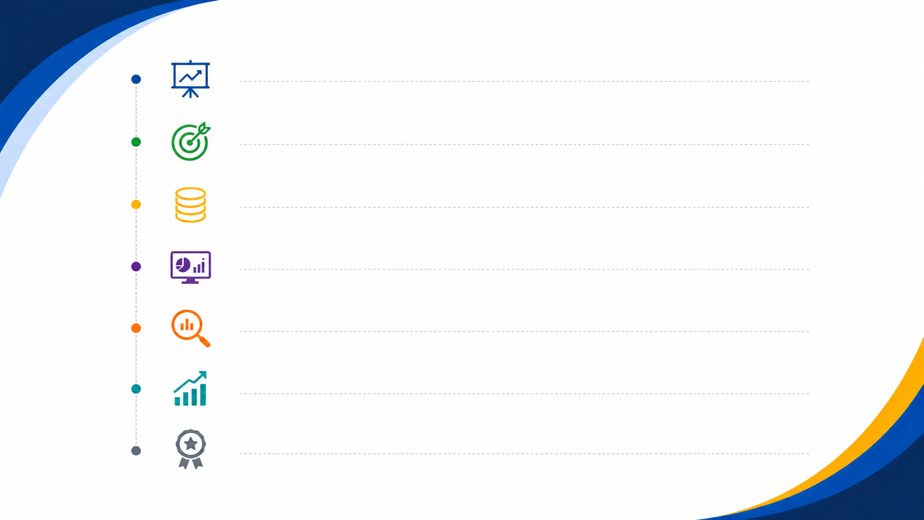
01 — Project Overview 02 — Objectives 03 — Data & Methodology 04 — Dashboard Overview 05 — Key Insights 06 — Recommendations 07 — Conclusion
AGENDA

Slide 3

PROJECT OVERVIEW
This project analyzes sales, customer, and marketing performance.
The dashboards provide a clear view of revenue, customers, campaigns, and business performance.
Interactive dashboards help users monitor KPIs and identify trends.
The analysis supports data-driven business decisions.

Slide 4
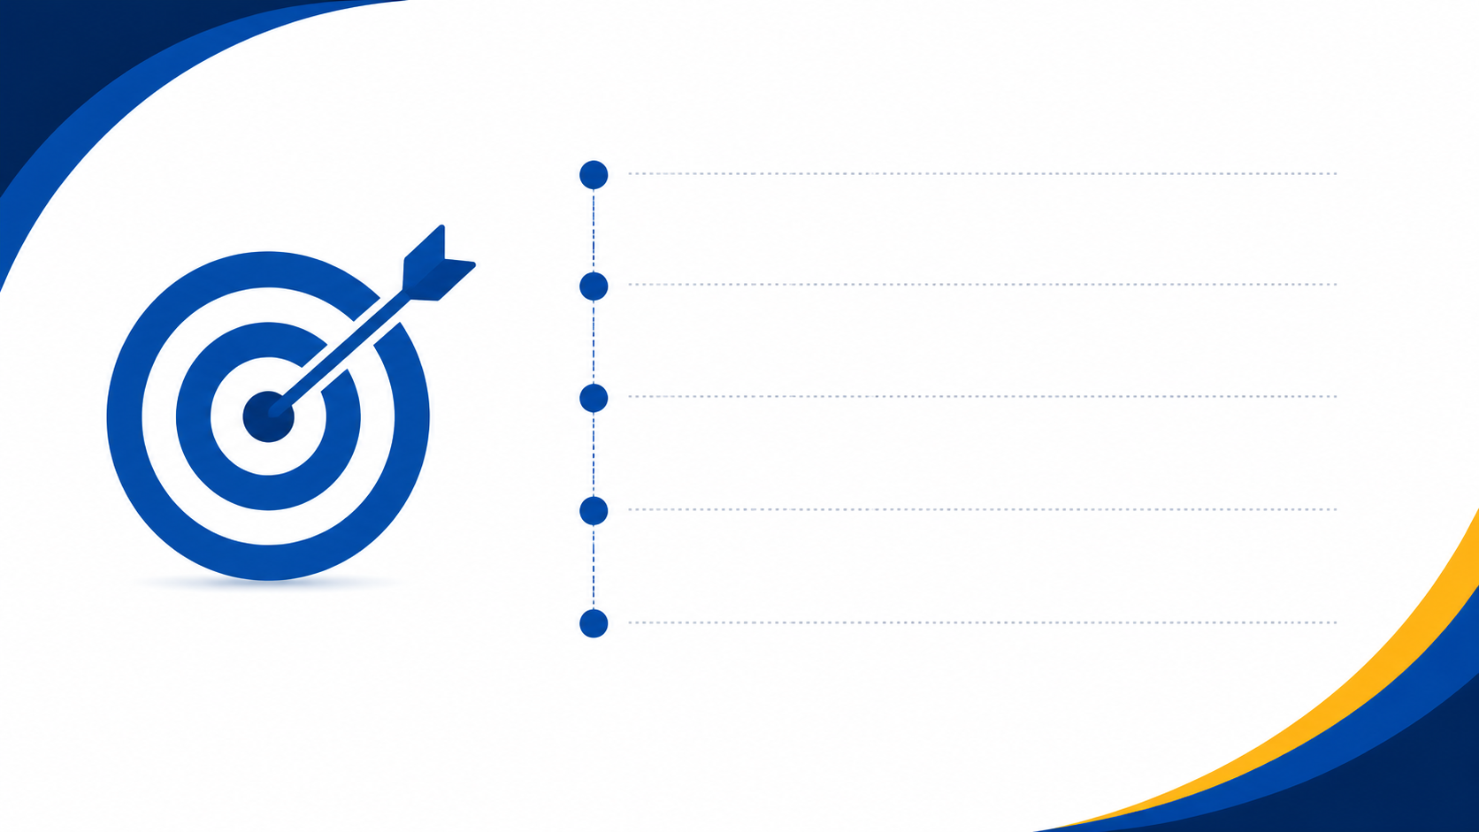
Track overall sales and revenue performance.
Analyze customer segments and purchasing behavior.
Measure marketing spend and campaign performance.
Identify top-performing products, customers, and channels.
Provide actionable insights for better business decisions.
OBJECTIVES

Slide 5

DATA & METHODOLOGY
DATA SOURCES
TOOLS USED
METHODOLOGY
Sales Data
Customer Data
Product Data
Marketing Data
Campaign Data
Excel
Power BI
Power Query
Tableau
MySQL
Python
Data Cleaning
Data Transformation
KPI Calculation
Data Visualization
Dashboard Development

Slide 6

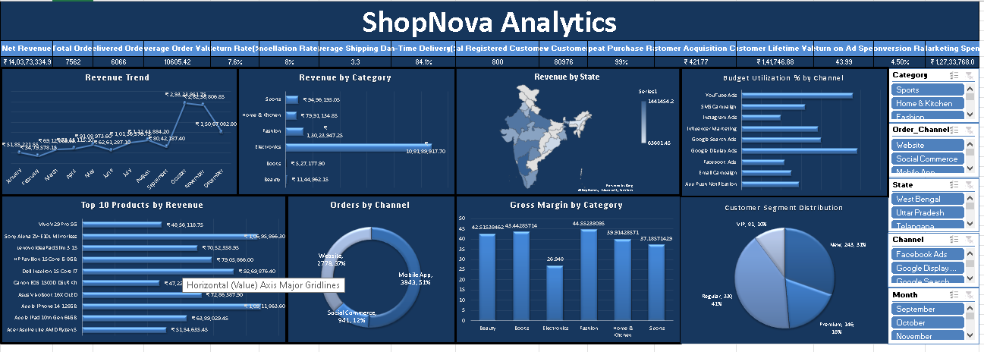
Excel Dashboard

Slide 7
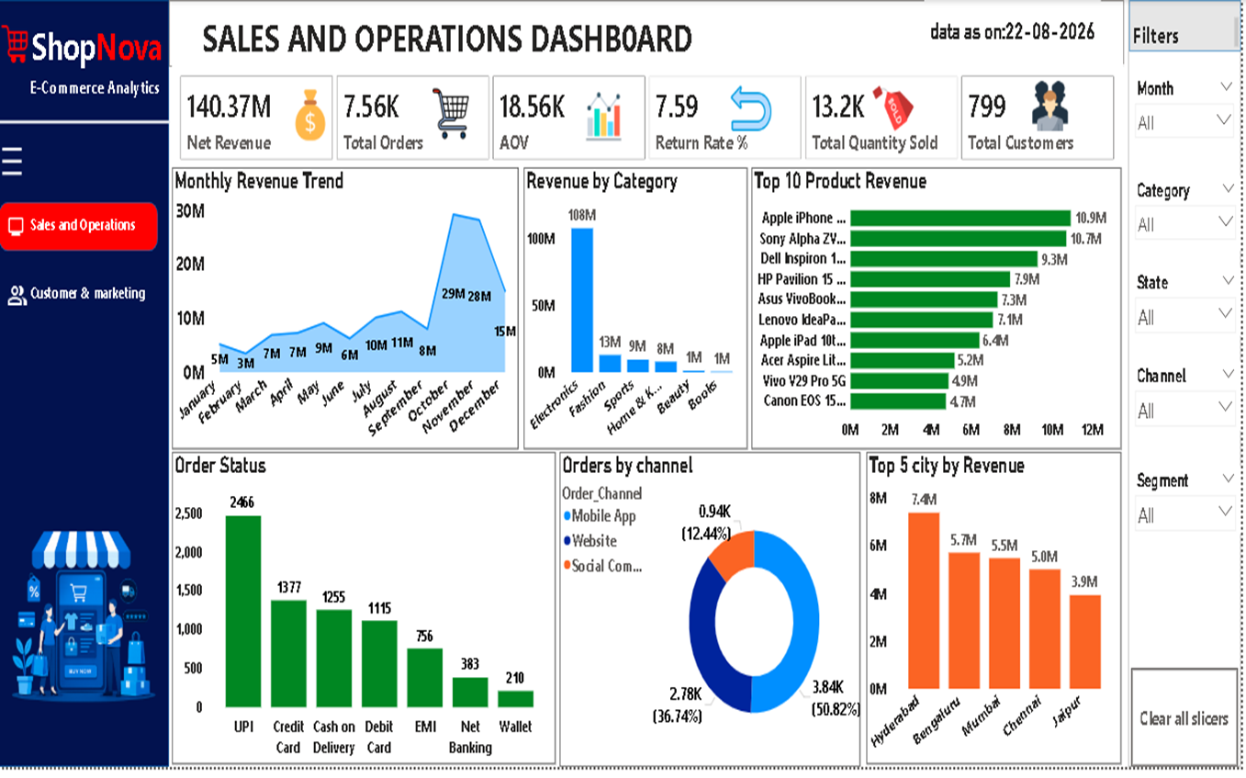
Power BI Dashboard

Slide 8
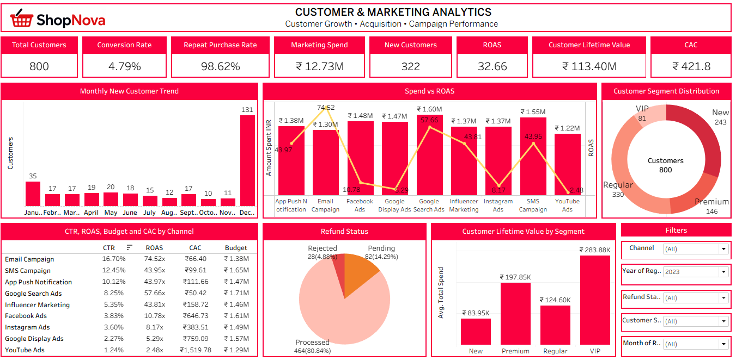
Tableau Dashboard

Slide 9
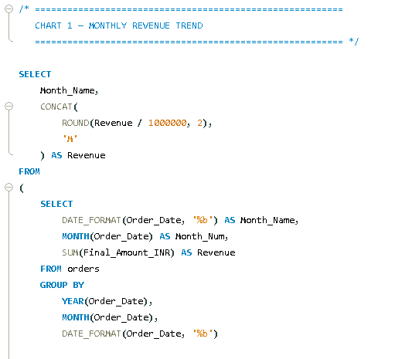
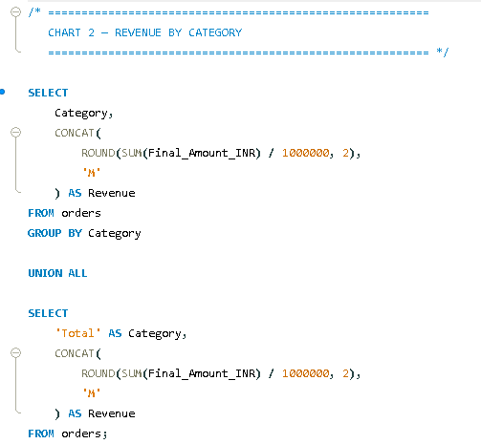
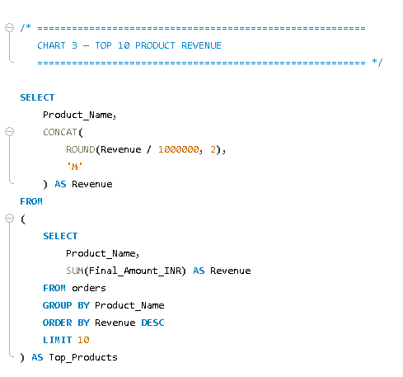
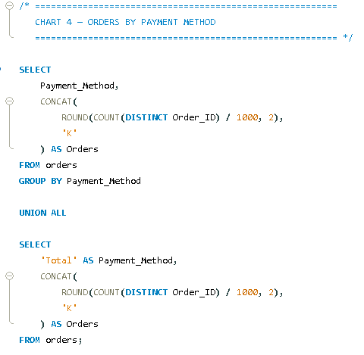
MySQL Work

Slide 10
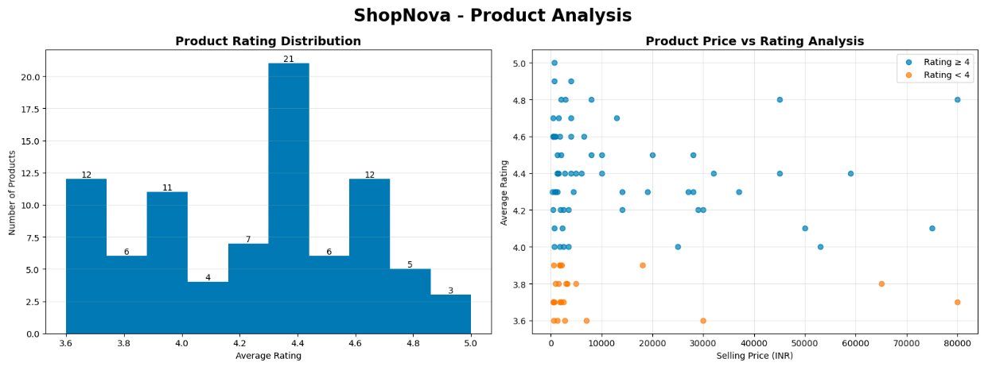
Python work

Slide 11
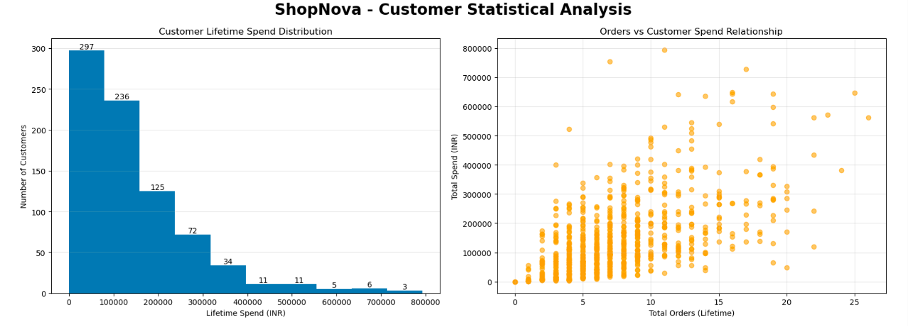
Python work

Slide 12
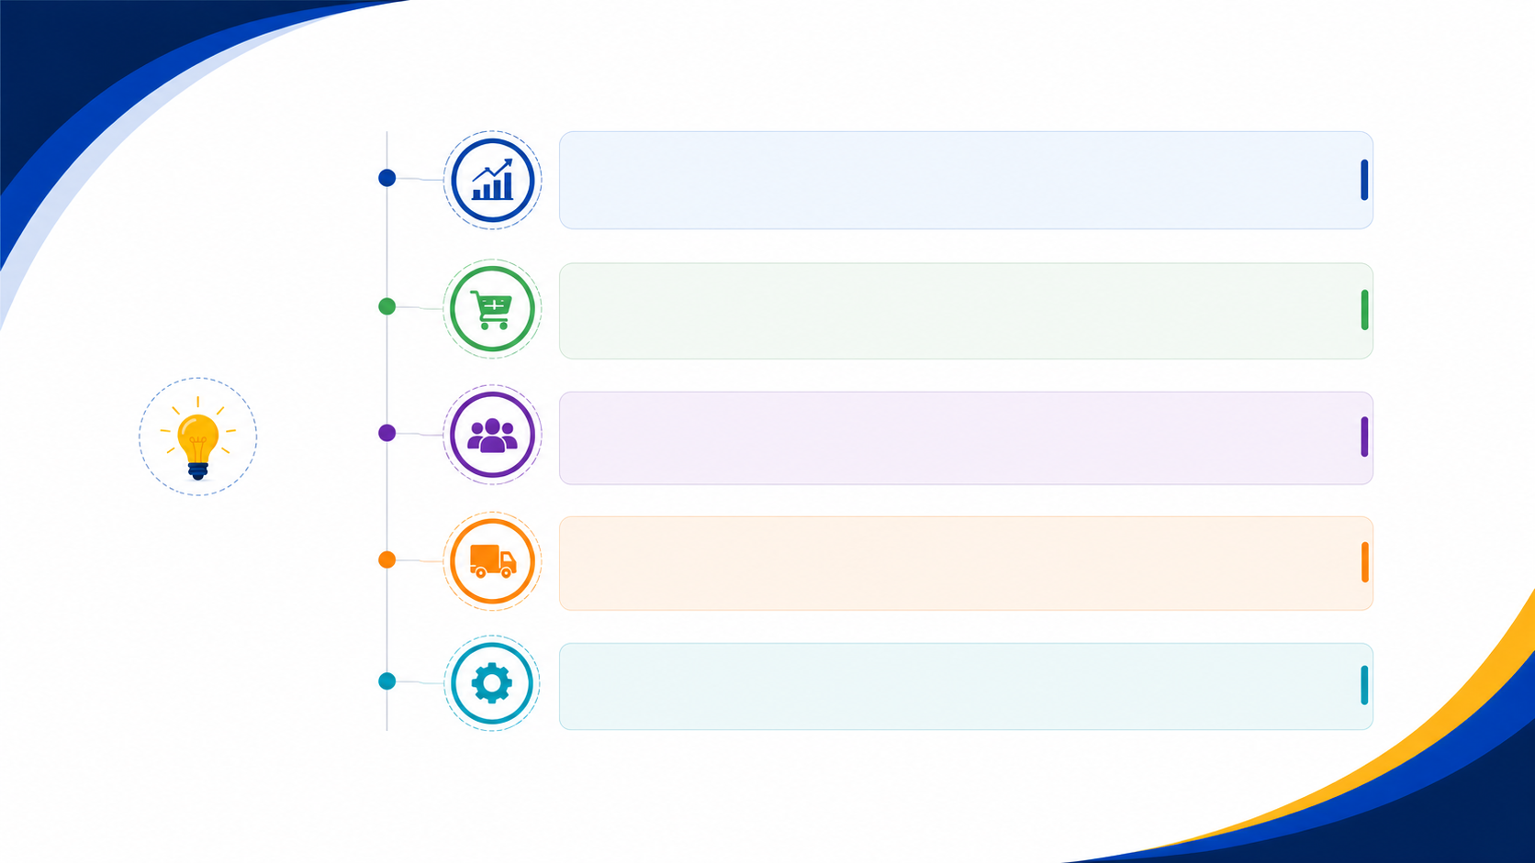
KEY INSIGHTS
Strong Revenue: Net Revenue reached ₹140.37M with 7.56K orders and an AOV of ₹18.56K.
Electronics Leads Sales: Electronics generated ₹108M, making it the top-performing category.
Strong Customer Purchase Rate: The purchase rate is 97.38%, with 322 new customers.
High Marketing Performance: Email Campaign achieved the highest ROAS at 7.5K%, followed by Google Search at 5.8K%.
Customer Value: CLV peaked at ₹159K in June, while Regular customers were the largest segment at 330 (41.25%).

Slide 13
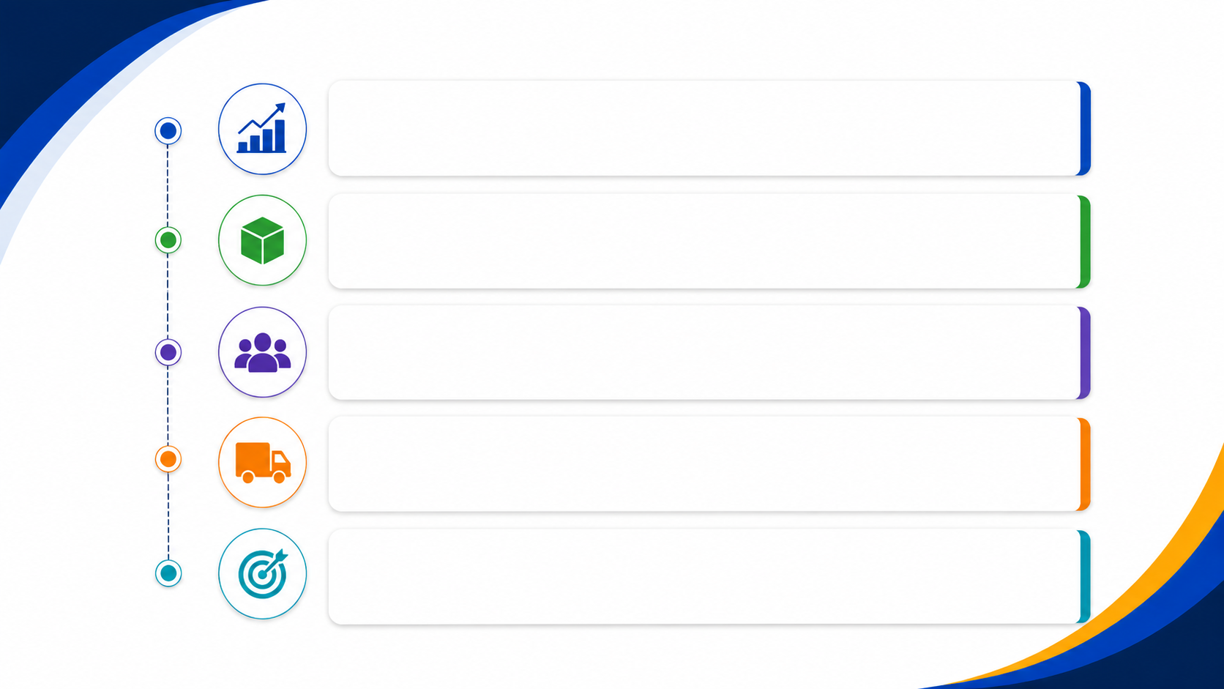
RECOMMENDATIONS
Promote Electronics: Focus on high-performing electronics products to maximize revenue growth.
Invest in High-ROAS Channels: Increase investment in Email Campaigns and Google Search and review low-performing channels.
Improve Customer Retention: Convert the 322 new customers into repeat customers through loyalty offers and personalized campaigns.
Reduce Returns: Analyze the 7.59% return rate and improve product quality, descriptions, and customer support.
Increase Customer Value: Use targeted offers and cross-selling strategies to increase CLV beyond ₹159K.

Slide 14
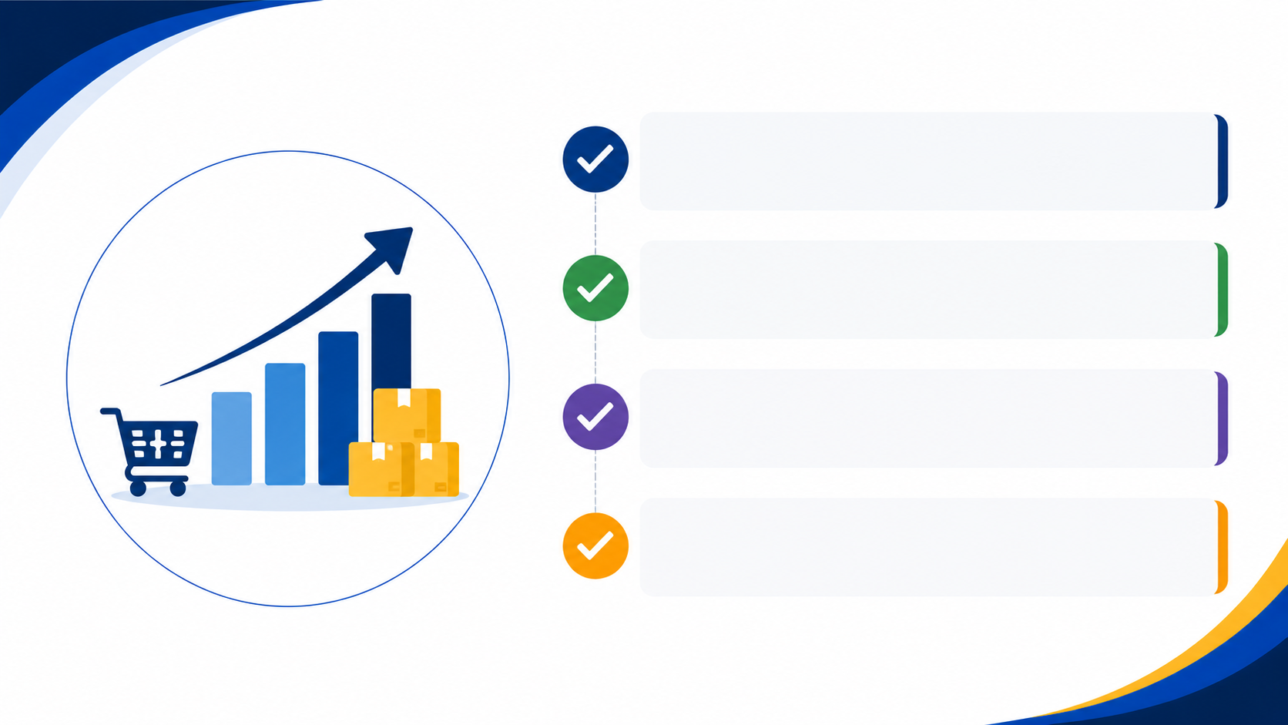
CONCLUSION
The dashboards provide a clear view of sales, customer, and marketing performance.
They help identify trends, opportunities, and performance gaps.
Interactive visuals make business data easy to understand.
Data-driven insights can support better decisions and business growth.

Slide 15

THANK YOU!
Thank you for your time and attention.

