Slide 1



INSURANCE
ANALYTICS
DATA DRIVEN INSIGHT FOR
SMARTER DECISIONS
Prepared by : Mallikarjun
Date : August 2026

Slide 2

AGENDA
01 Project Overview
02 Date Overview
03 Key Performance Indicators
04 Dashboard Overview
05 Key Insights
06 Recommendations & Conclusion

Slide 3

PROJECT OVERVIEW
Objective
Analyze insurance policy, customer, premium and claims data.
Identify important business trends and performance.
Support better customer and insurance decisions.
Scope
Customer analysis , Policy analysis, Premium analysis , Claims analysis , Renewal and lapse analysis.
Tools Used
Excel, MySQL , Power BI, Tableau, Python.
Data Source
Insurance policy and claims dataset

Slide 4

DATA OVERVIEEW
Total Policies
5,000+
Time Period
Dec 2014 – Dec 2024
Data Sources
Customer information, Policy, Claims,
Payments, Additional Fields
Data Preparation
Data cleaning , Missing-value checking ,Data validation, Transformation , Dashboard-ready dataset

Slide 5
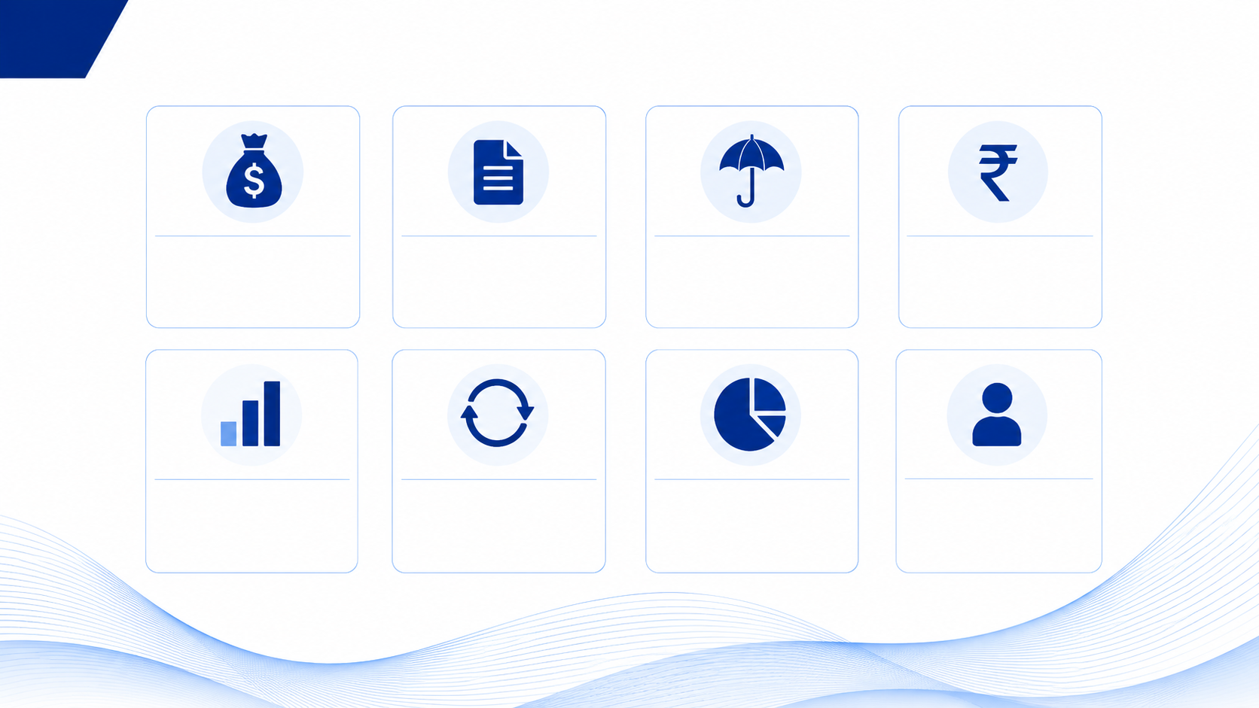
KEY PERFORMANCE INDICATORS
Total Premium
$ 5.26M
Total Policies
5,000
Total Claims
5,000
Total Claim Amount
$ 251M
Approved Claims
1,712
Denied Claims
1,638
Pending Claims
1,650
Total Customers
3,148

Slide 6

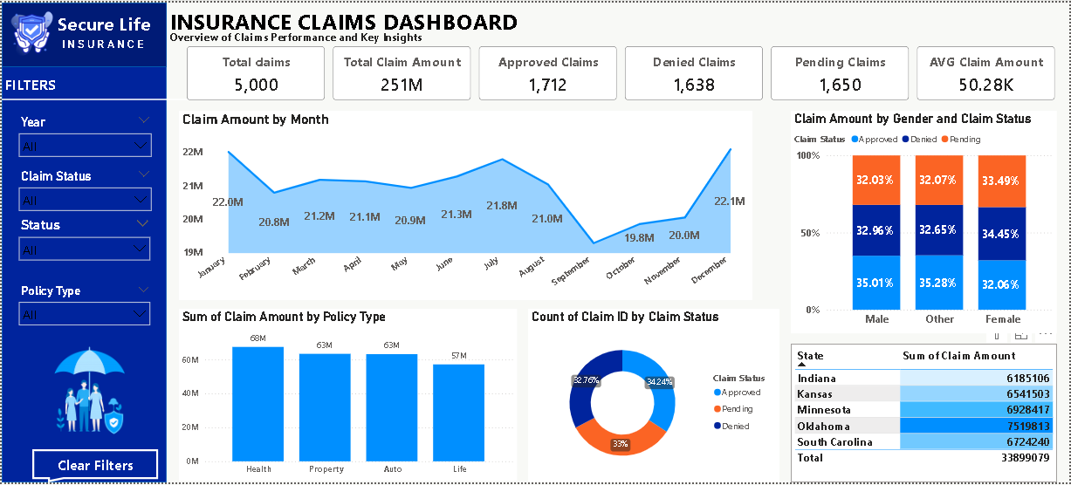
Power BI Dashboard

Slide 7
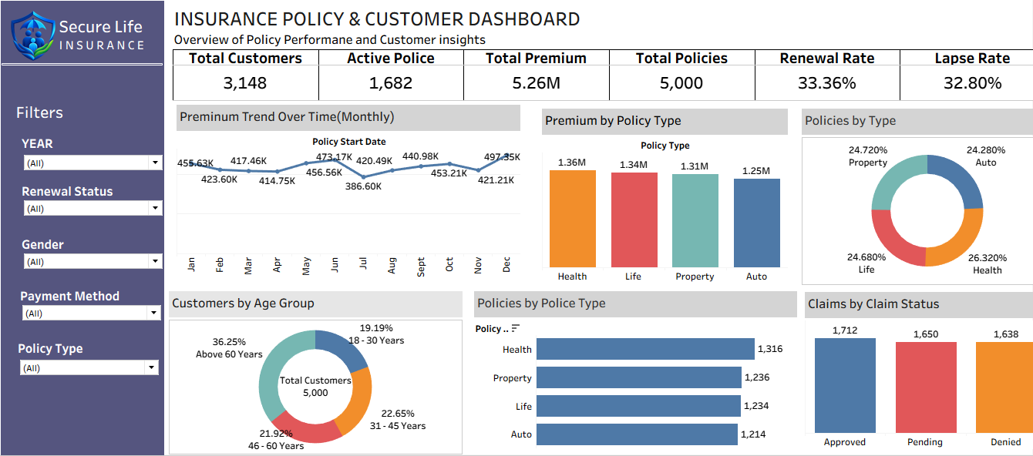
Tableau Dashboard

Slide 8
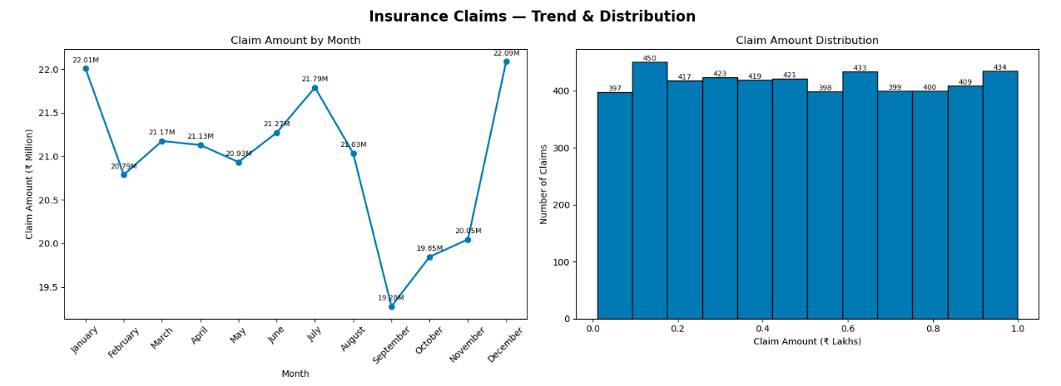
Python Work

Slide 9
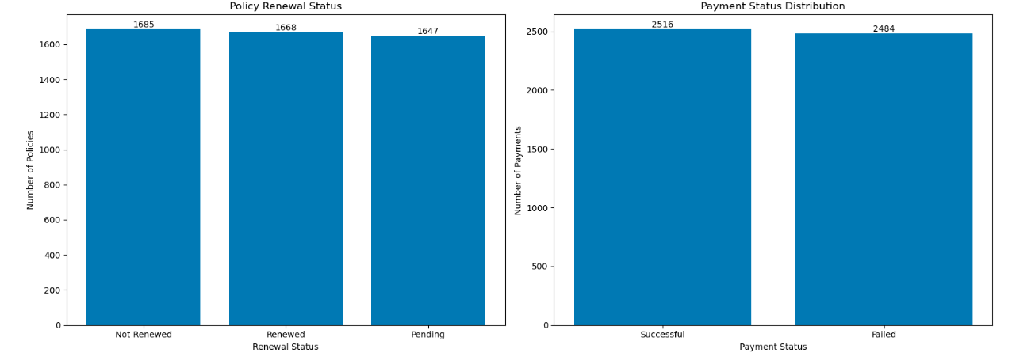
Python Work

Slide 10

KEY INSIGHTS
Customer Base: The analysis covers 3,148 customers and 5,000 insurance policies across different policy types.
Premium Performance: The total premium is ₹5.26M, with Health policies contributing the highest premium among the policy types.
Renewal & Lapse: The renewal rate is 33.36%, while the lapse rate is 32.80%, showing an opportunity to improve customer retention.
Claims Performance: The dashboard records 5,000 claims, including approved, pending, and denied claims.
Customer & Policy Trends: Customer age groups, policy types, payment methods, and claim status provide useful insights for business decision-making

Slide 11

RECOMMENDATIONS
Improve Customer Retention: Develop targeted retention programs for customers whose policies are approaching expiry.
Increase Renewals: Send timely renewal reminders and provide suitable offers to encourage customers to renew their policies.
Reduce Policy Lapses: Identify customers at high risk of lapse and take proactive steps to retain them.
Improve Claims Management: Analyze pending and denied claims to reduce processing time and improve customer satisfaction.
Personalized Insurance Offers: Use customer and policy data to provide suitable insurance products and cross-selling opportunities.

Slide 12

CONCLUSION
The insurance analysis provides a clear understanding of customers, policies, premiums, renewals, and claims. The dashboards help identify important business trends and performance areas.
The analysis shows opportunities to improve customer retention, policy renewals, claims management, and personalized customer offerings. By using data-driven insights, the insurance business can improve customer satisfaction, operational efficiency, and overall business performance.

Slide 13

THANK YOU!

