Slide 1

Supply Chain Analytics Project
Perpared by : Mallikarjun
Date : June 2026

Slide 2
Contents
Overview
Business Objective
Data Sources
List of KPI’S
Dashboard
Insights
Recommendations
Conclusion

Slide 3



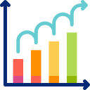
Project Overview
Goal is Improve supply chain performance and efficiency.
Focus on Orders,Inventory,Suppliers, Logistics & Delivery.
Outcome is Interactive dashboard for better business decisions.

Slide 4
Business Objective
Understand
Understand order, inventory, and supplier performance.
Monitor
Monitor delivery status, lead time, and shipping cost.
Optimize
Optimize inventory levels and improve on-time delivery.

Slide 5




Data Sources
Order Data (Order ID, Date, Quantity, Sales)
Supplier & Warehouse Data (Supplier, Warehouse, Region)
Shipping & Delivery Data (Ship Mode, Carrier, Delivery Status)
Product & Inventory Data (Product, Category, Inventory, Stock)

Slide 6
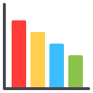
Solved KPIs – Order & Delivery Metrics
Total Orders
On-Time Delivery %
Average Delay Days
Fill Rate %

Slide 7



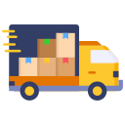
Solved KPIs – Supplier & Logistics Metrics
Supplier Reliability %
Average Lead Time
Shipping Cost
Delivery Delay by Carrier

Slide 8


Solved KPIs – Inventory Metrics Total Inventory
Total Inventory
Average Inventory
Days of supply

Slide 9
Solved KPIs – Revenue & Profit Metrics
💰 Total Revenue
💵 Gross Profit
📈 Gross Margin %
🌍 Revenue by Region

Slide 10
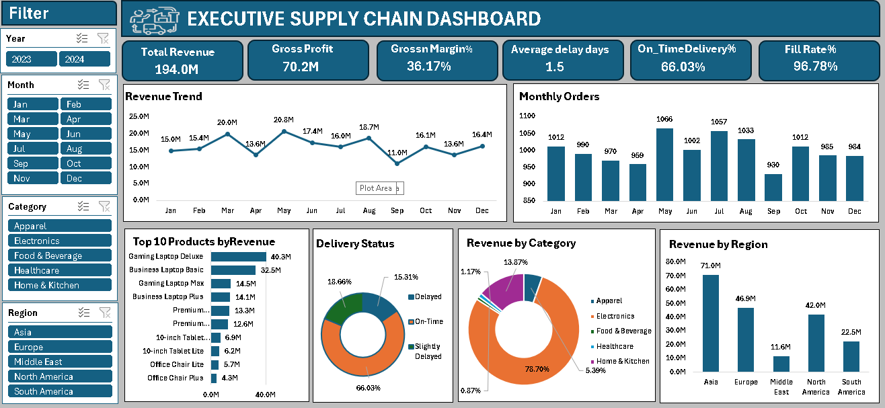
Excel Dashboard
Used for quick summaries, pivot tables, and validation

Slide 11
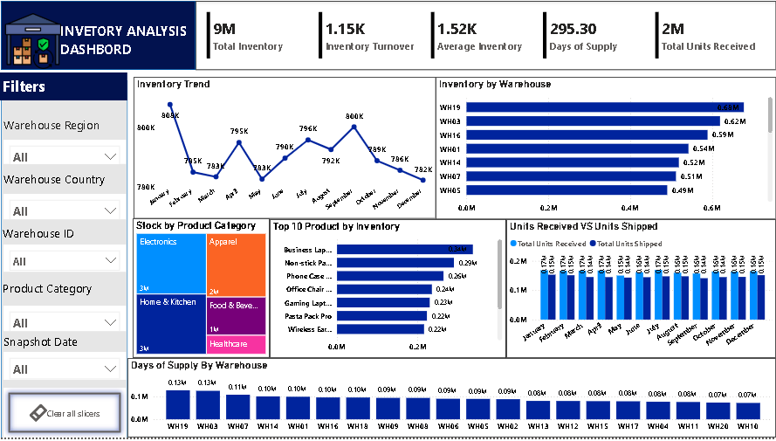
Power BI Dashboard
Used for interactive visuals, KPI comparison, and trend analysis

Slide 12
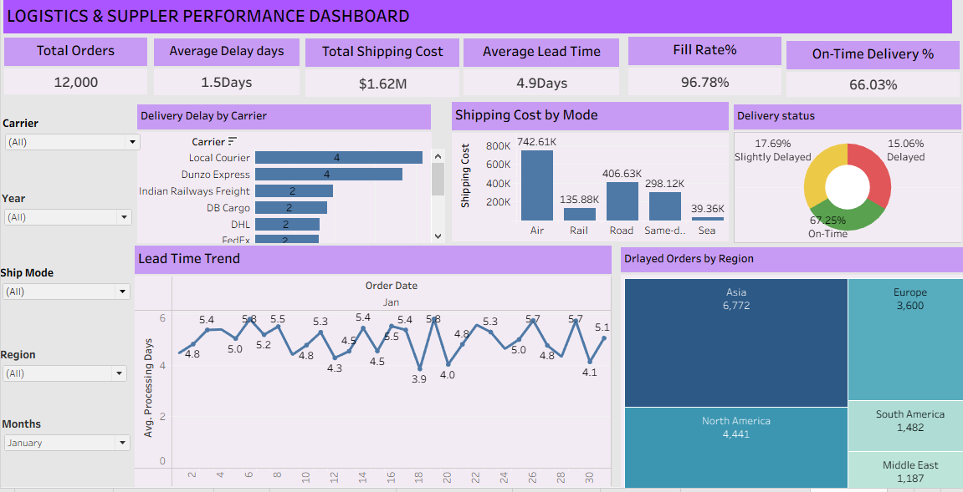
Tableau Dashboard
Used for advanced visual storytelling and route analysis

Slide 13
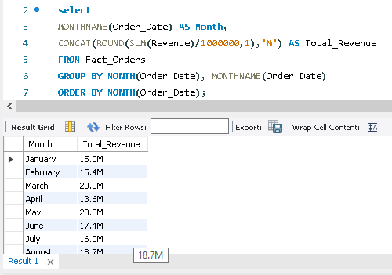
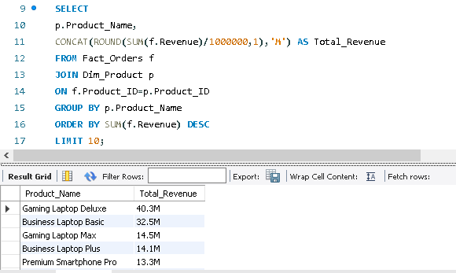
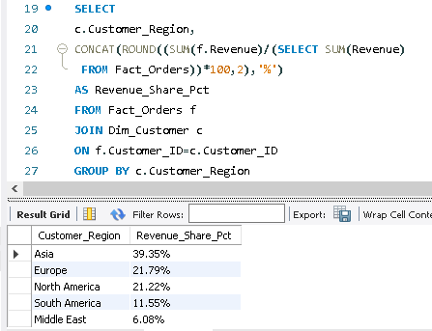
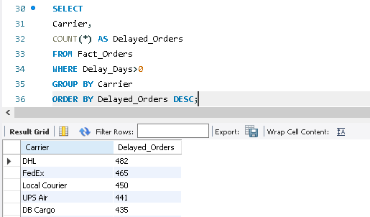
SQL Work
Used for data extraction, transformation, and KPI calculation

Slide 14
Key insights
Revenue: Total Revenue reached 194.0M with a 36.17% Gross Margin.
Delivery: On-Time Delivery is 66.03%, indicating room for improvement.
Inventory: Fill Rate of 96.78% shows strong inventory availability.
Region: Asia generated the highest revenue and recorded the highest number of delayed orders.
Shipping: Air shipping has the highest transportation cost among all shipping modes.
Warehouse: A few warehouses hold significantly more inventory than others, indicating an opportunity to optimize stock distribution.

Slide 15
Recommendations
Improve On-Time Delivery by optimizing delivery routes and carrier performance.
Strengthen Supplier Performance through regular monitoring and performance reviews.
Optimize Inventory Levels to reduce excess stock and prevent stockouts.
Reduce Shipping Costs by choosing cost-effective transportation modes.
Monitor KPIs Regularly using interactive dashboards for faster decision-making.

Slide 16
Conclusion
✅ Successfully analyzed Supply Chain performance using Excel, Power BI, Python, Mysql and Tableau.
✅ Identified key insights on Revenue, Inventory, Delivery, and Supplier Performance.
✅ Built interactive dashboards to support data-driven business decisions.
✅ Recommendations can help improve efficiency, reduce costs, and enhance customer satisfaction.

Slide 17
Thank You!

