Slide 1
Wall-E
The Weather Chat Bot

Slide 2
Motivation

Slide 3
Introduction
Wall-E helps the user by fetching the weather details like temperature, wind speed, rain forecast, humidity, UVI, air pressure for present day and the next day, for all the cities across USA, with the help of weather APIs.

Slide 4
Tech Stack
Rasa
Python
SQLite
APIs
OpenWeather
https:://openweathermap.org/
Weather.com
https://www.weatherapi.com/

Slide 5
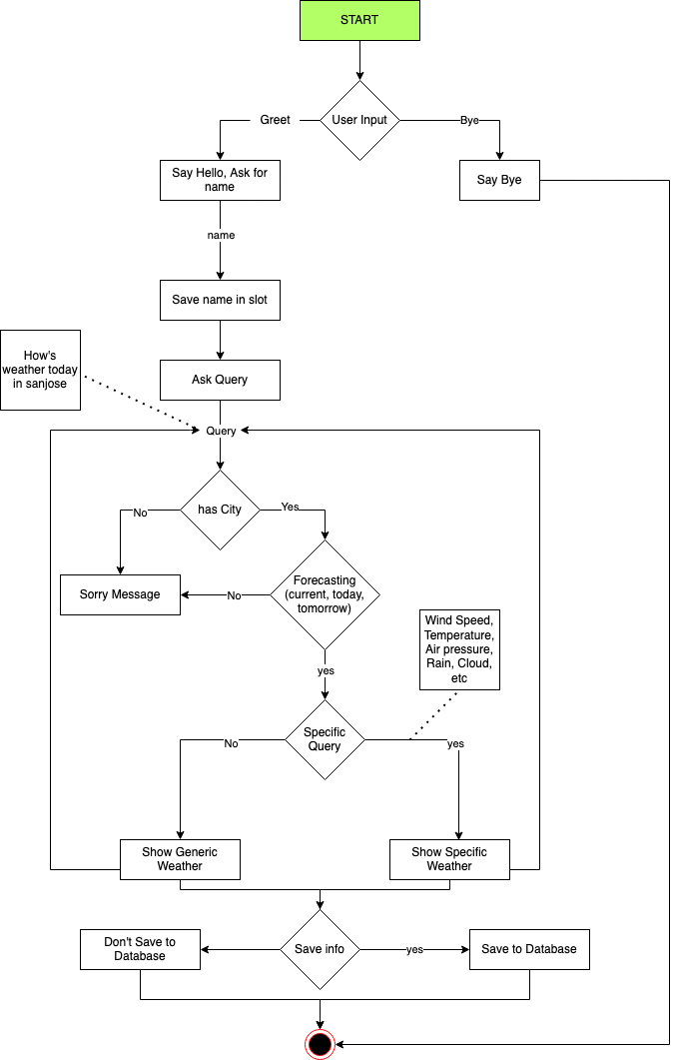
Conversation Flow

Slide 6
Queries
How’s the weather now in San Jose
What is the weather tomorrow in San Jose
Is it windy in San Jose today
Is it cloudy in Georgia today
Today rain in Michigan
Temperature current in Texas
Is it going to rain in Sunnyvale tomorrow
Humid today in Los Angels
What is the pressure in Auckland tomorrow
UVI in Texas today

Slide 7
Challenges Encountered
API Integration
Future Work
I would like to add the functionality that the bot can provide more details regarding weather across all the cities in the world.
Thank you
Aravindreddy Malluri

