Slide 1

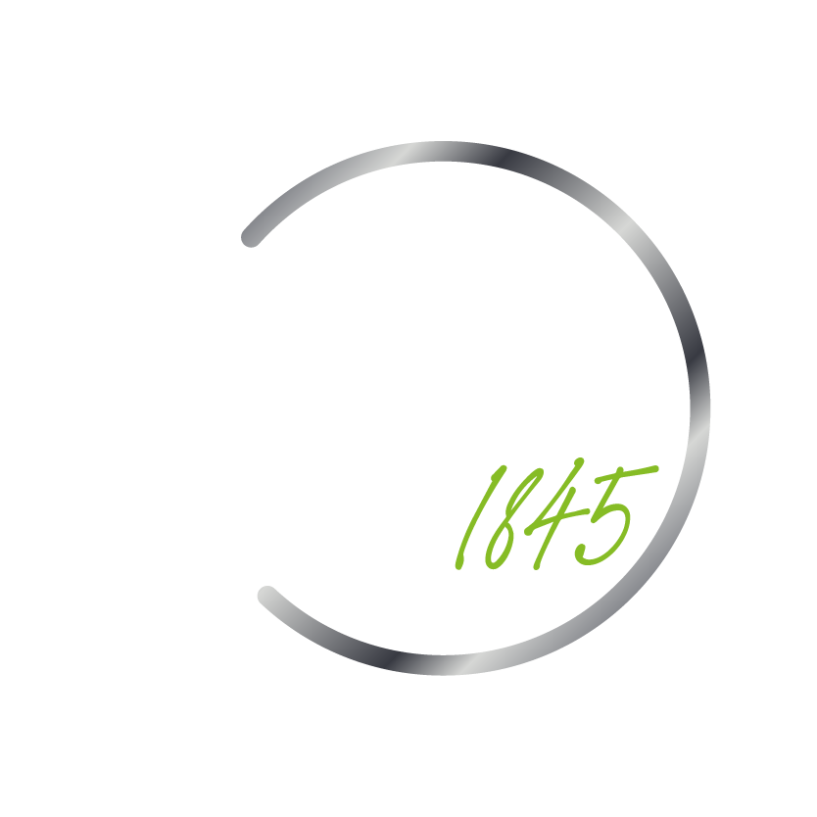



BookVista
Churn Prediction Model
Phase Guide
By Muhammad Al-Mahdi

Slide 2
Contents
03
06
The Problem
Phase 3
04
07
Phase 1
Questions
.
05
Phase 2

Slide 3
The Problem
BOOKVISTA would like to be able to predict which of their subscribers are likely to churn within 90 days of beginning a subscription, so that they can intervene somehow to prevent subscriber losses in the future.

Slide 4
Phase 1
Weeks 1 – 2:
Develop Project Phase timelines
Data Collection and download
Data Preprocessing
Weeks 2 -5:
Exploratory Data Analysis (EDA)
Feature Scaling
Feature Selection
Answer Data Exploration Questions

Slide 5
Phase 2
Weeks 5 – 9:
Model Selection
Train Model
Test Model
Model Evaluation – develop metrics

Slide 6
Phase 3
Weeks 9 - 12:
Hyperparameter Tuning
Create Final Deliverables:
A. Specify the 100 users BookVista should intervene on first.
B. Create adoption plan
C. Final slide deck

Slide 7
Questions?

