Slide 1
Greenhouse Control System
Murad Qasaimeh
Mamoun Al-Mardini

Slide 2
Introduction
Agriculture is essential in our life since early civilizations and it is the source for our food.
Greenhouse plays vital part in agriculture sector which can be used to grow plants under controlled climatic conditions for optimum production.

Slide 3
Objectives
The objective of this project is to control distributed greenhouse system, with the following functionality:
Irrigate the greenhouse (Manual, scheduled, Sensor).
provide light in the absence of sun.
Cooling the greenhouse to maintain the desired temperature.

Slide 4
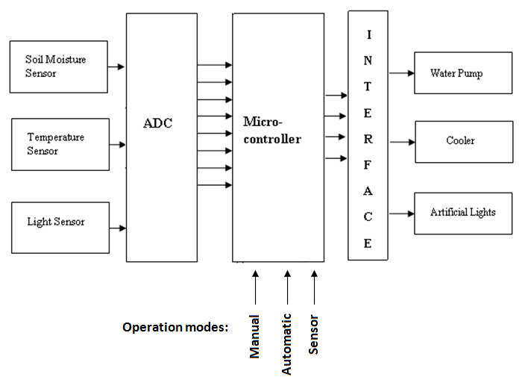
Block diagram

Slide 5
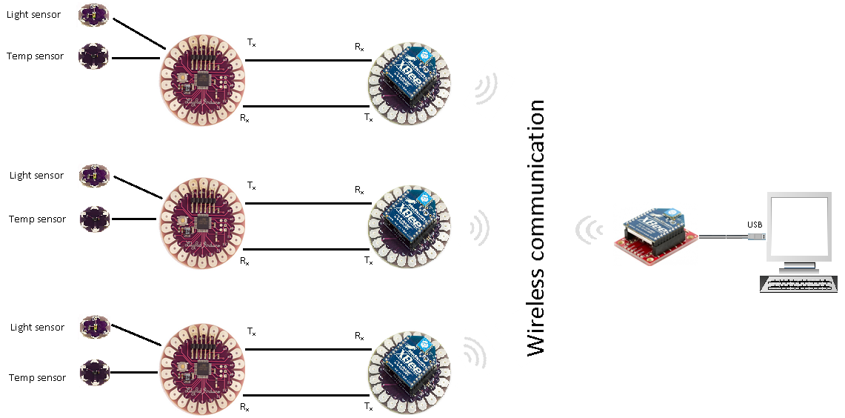
System Architecture

Slide 6
Flowchart
Automatic
Manual
Operation mode
Sensor
Irrigation will be on schedule
Farmer will do the job
Get sensor readings

Slide 7
Flowchart
Soil moisture
Light
Yes
No
No
Yes
Soil moisture >= threshold
Light >= threshold
Don’t open water Valve
Open water Valve
Artificial lights ON
Artificial lights OFF

Slide 8
Flowchart
Temperature
No
Yes
Temperature >= threshold
Cooling is Off
Cooling is ON

Slide 9
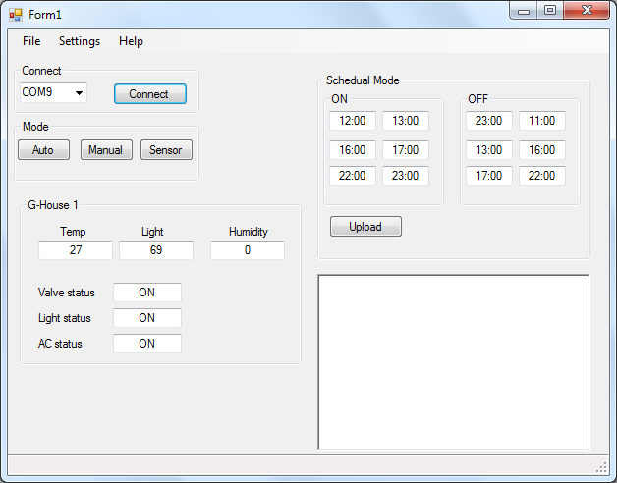
GUI

