Slide 1
Disjoint Path Routing Algorithms
The slides are adapted from slides by Prof. Rudra Dutta at NCSU
Preparation for Project Part 2
Yu Wang, UNC Charlotte

Slide 2
Disjoint Paths Algorithms
Simple approach (two-step) fails with trap topologies
Remedy - “remember” first path found by link reversal
  As in flow problems
Must be able to find shortest paths in presence of negative-cost arcs
Remedy - modify Dijkstra’s algorithm
  Can also use general purpose shortest path algorithm for negative-cost arcs
  Can also use graph transformation to eliminate negative-cost arcs

Slide 3
Dijkstra’s Algorithm
Given:
  Undirected graph G with nodes V,
  Source node A,
  Destination node Z
  Edge costs l(ij)
Use:
  N(i) = set of neighbors of i,
  d(i) = distance from A to i,
  S = set of nodes to which shortest distance has NOT been found,
  P(i) = predecessor of i in path from A

Slide 4
Dijkstra’s Algorithm
l(ij) cost of edge ij
N(i) = neighbors of i
d(i) = distance A to i
S = nodes not found
P(i) = predecessor of i
Initialize
  d(A) = 0; d(i) = l(Ai) for all i in N(A), ∝ for all other i
  S = all vertices except A
  P(i) = A for all i in S
Select new vertex to label permanently
  Choose j from S such that d(j) = min d(i), for i in S
  Remove j from S
  If j = Z, then stop; otherwise go to Step 3
Update distances
  For all i in N(j) such that i is also in S
    If d(j) + l(ij) < d(i), update d(i) to d(j) + l(ij) and set P(i) to j
  Back to Step 2

Slide 5
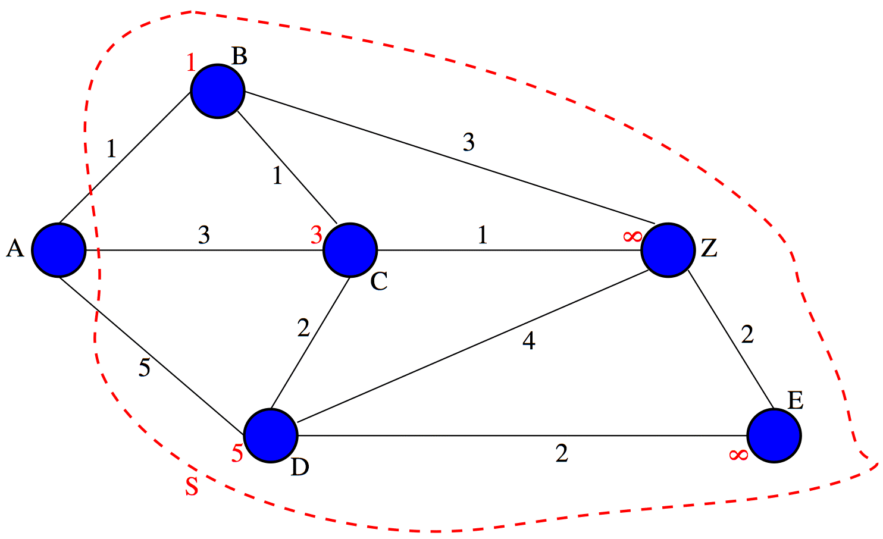
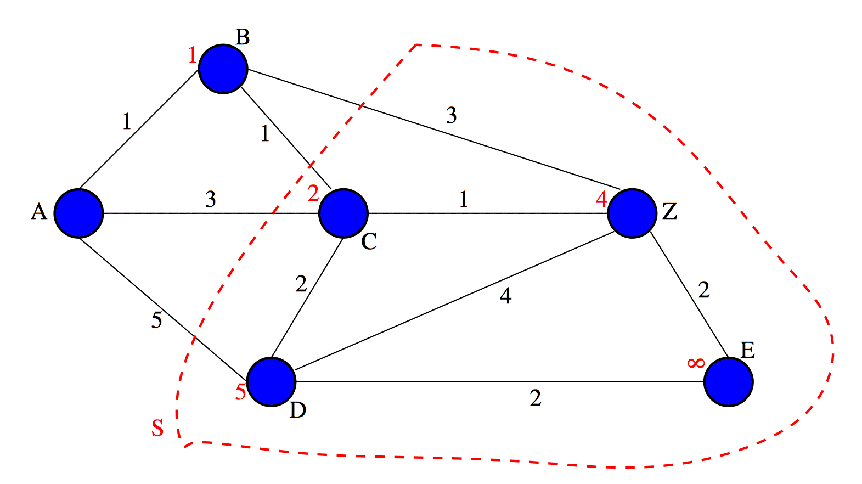
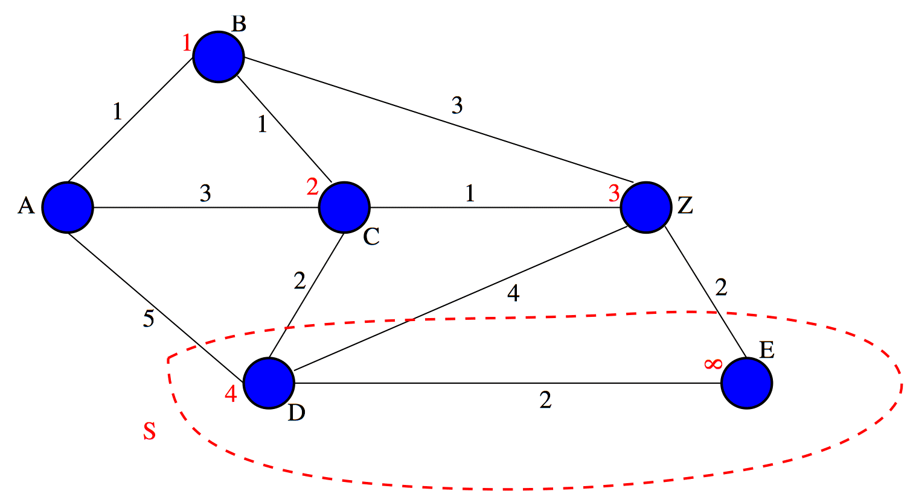
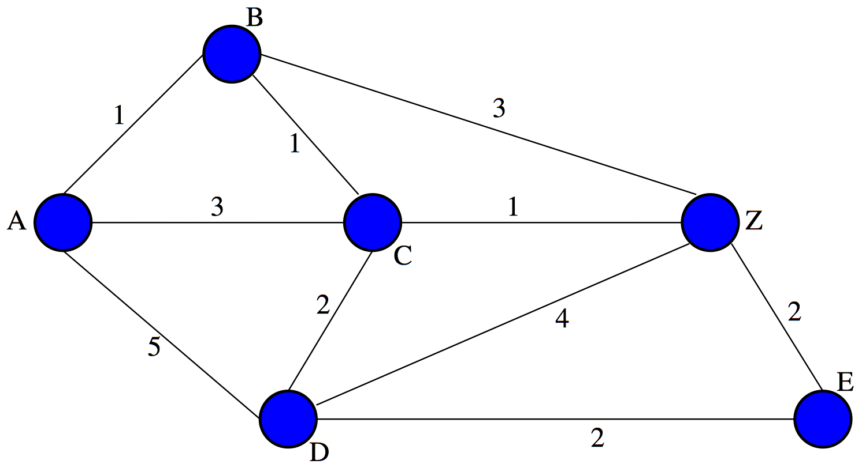
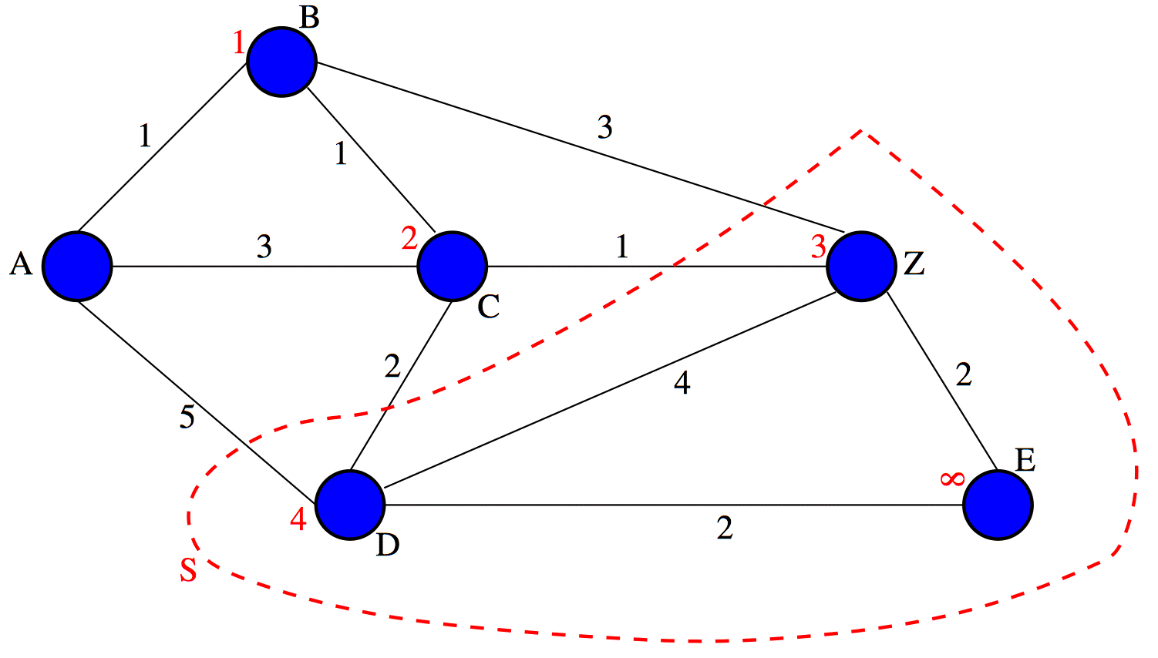
Dijkstra’s Algorithm - Example

Slide 6
Negative Cost Arcs
Many reasonable cost metrics are positive-only
However, sometimes negatives costs can turn up
  Sometimes introduced by specific desired transformations of graphs
Graph may have cycles
  Cycles with negative total costs exist
    Concept of shortest path?
  If negative cost arcs, but not cycles?
Specific family of such graphs generated by useful disjoint path routing algorithms
Dijkstra’s algorithm fails with negative arc costs

Slide 7
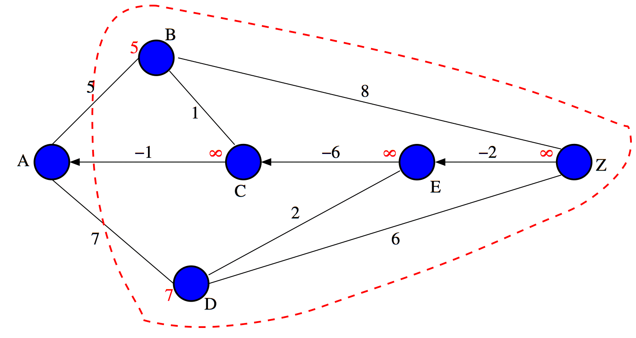
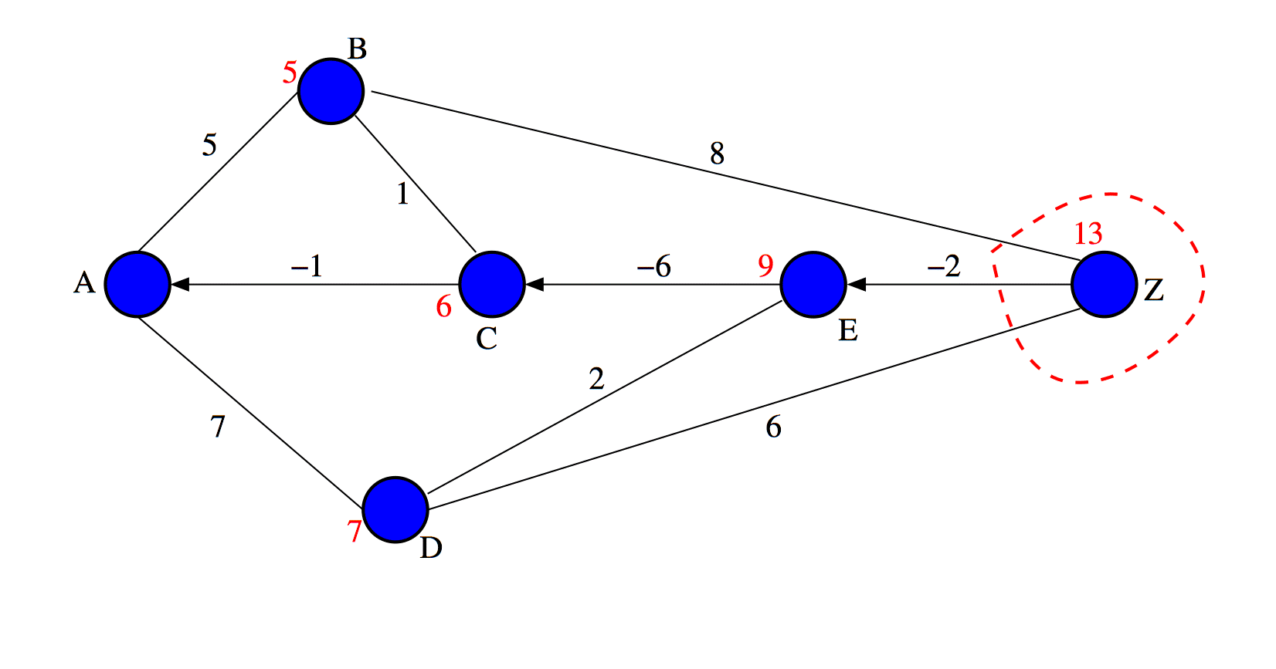
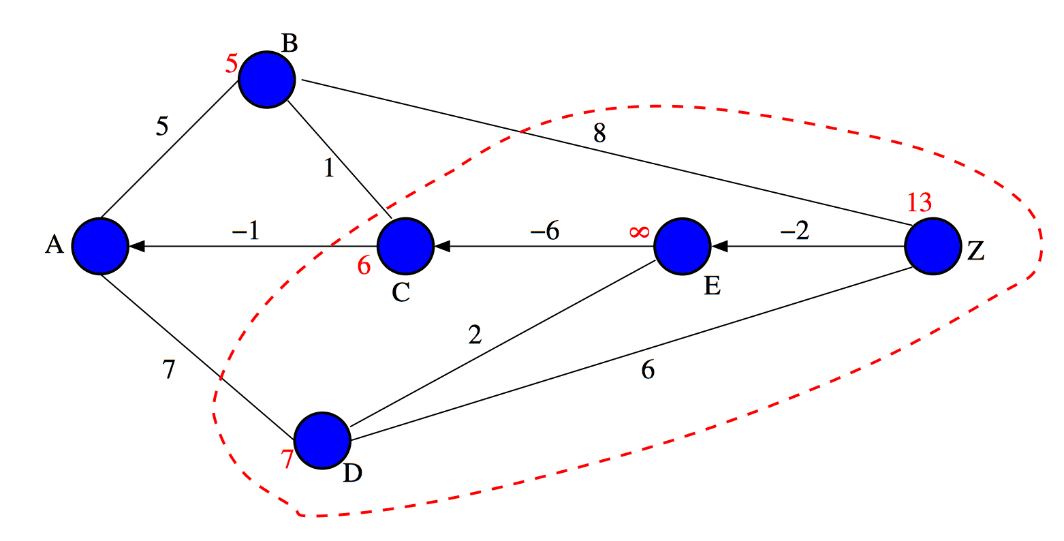
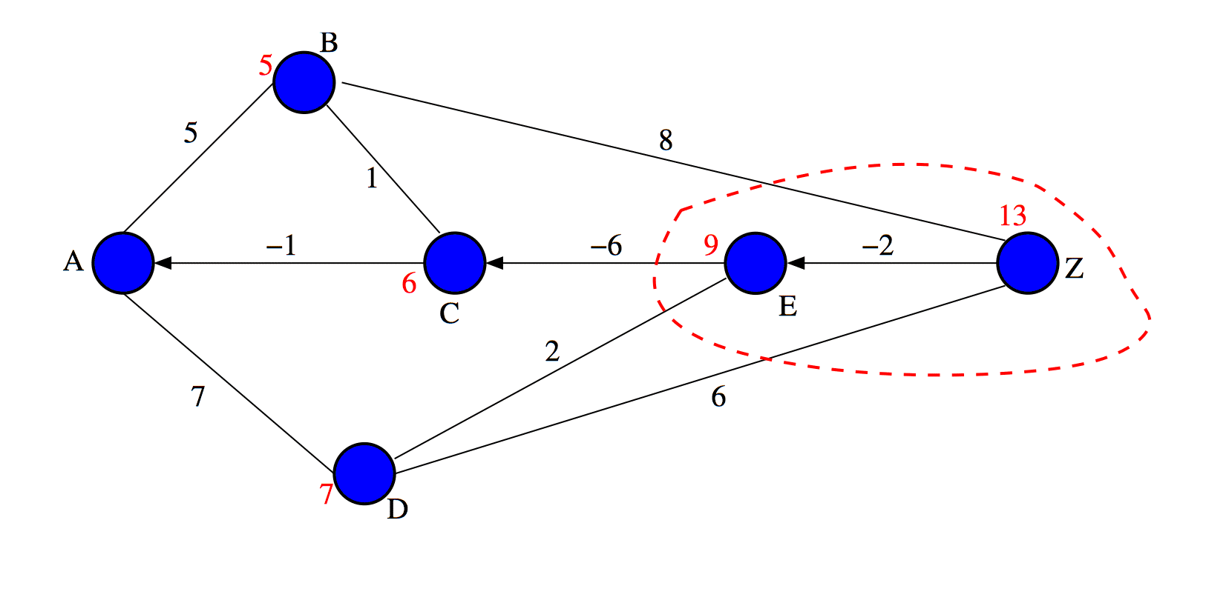
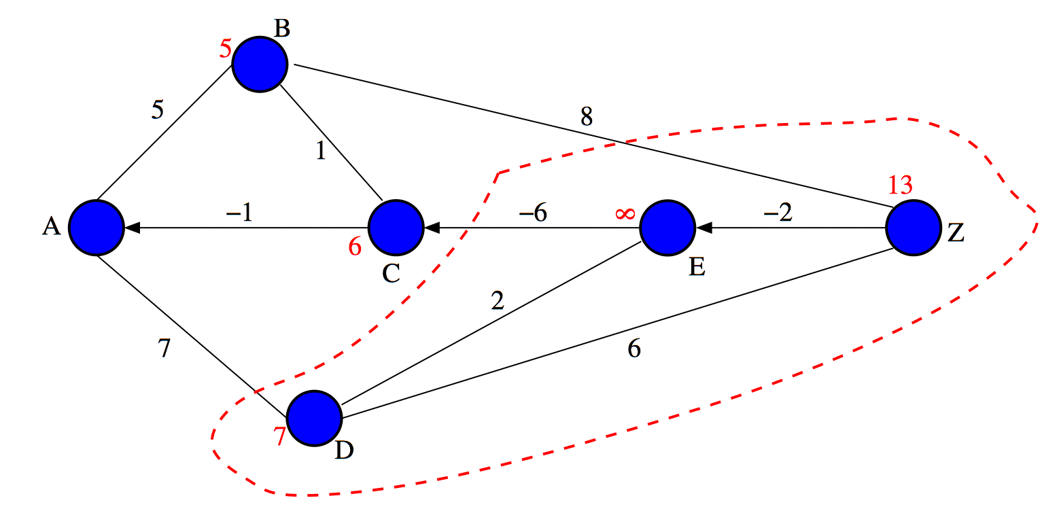
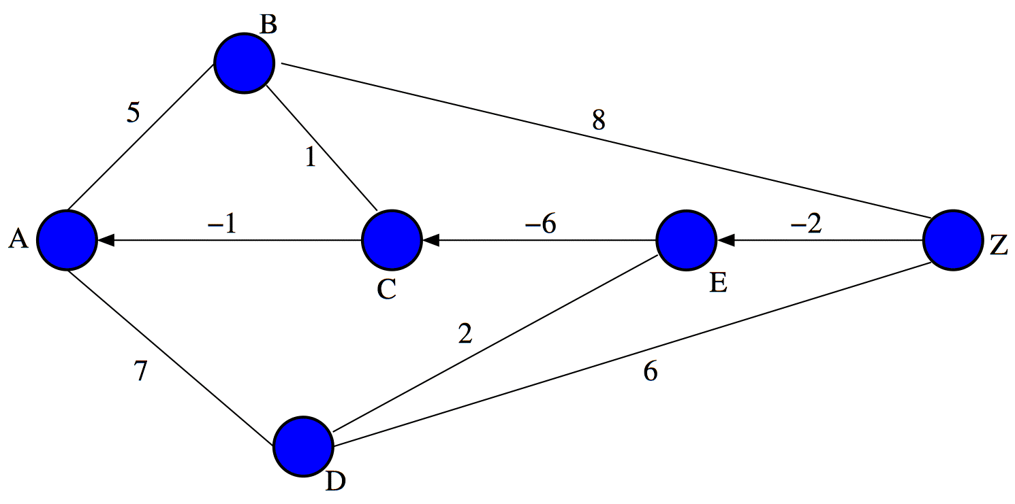
Failure of Dijkstra - Example

Slide 8
Dijkstra’s Algorithm - Modified
l(ij) cost of edge ij
N(i) = neighbors of i
d(i) = distance A to i
S = nodes not found
P(i) = predecessor of i
Initialize
  d(A) = 0; d(i) = l(Ai) for all i in N(A), ∝ for all other i
  S = all vertices except A
  P(i) = A for all i in S
Select new vertex to label permanently
  Choose j from S such that d(j) = min d(i), for i in S
  Remove j from S
  If j = Z, then stop; otherwise go to Step 3
Update distances
  For all i in N(j) such that i is also in S
    If d(j) + l(ij) < d(i), update d(i) to d(j) + l(ij) and set P(i) to j
  Back to Step 2
S = φ
-----------------------------
Also add i back to S

Slide 9
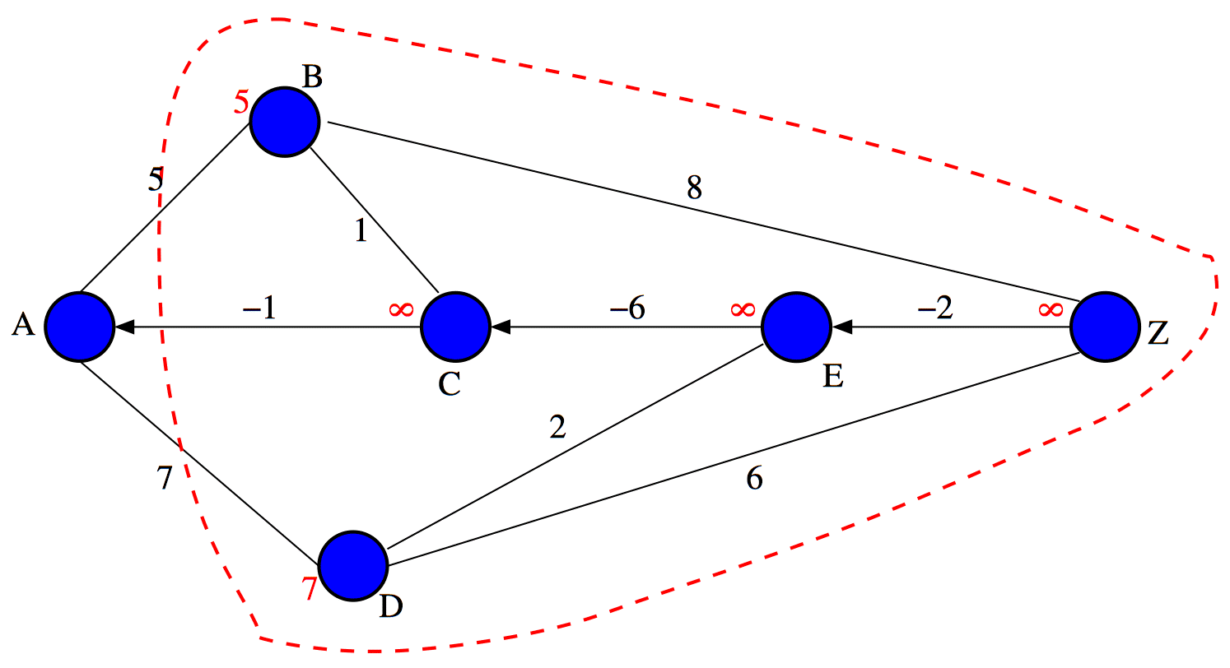
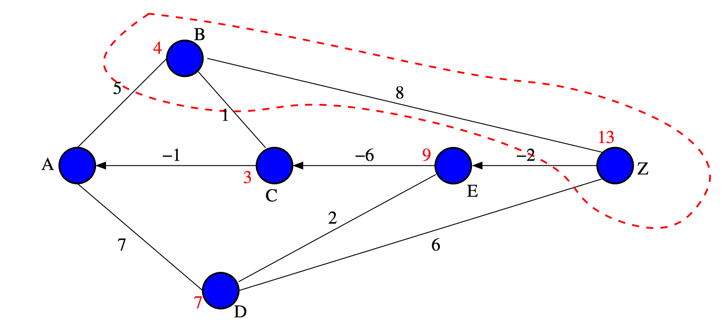
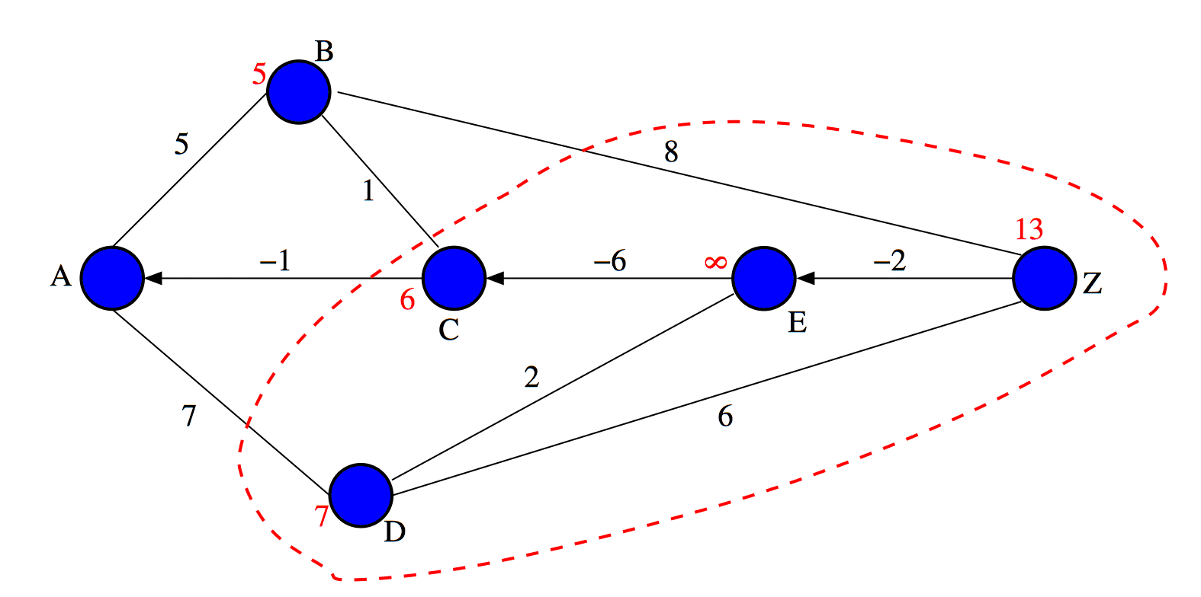
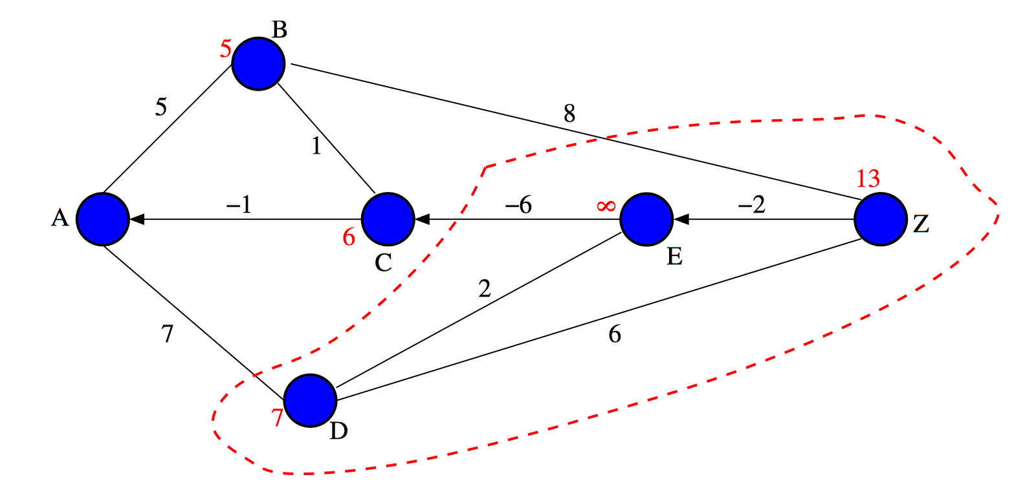
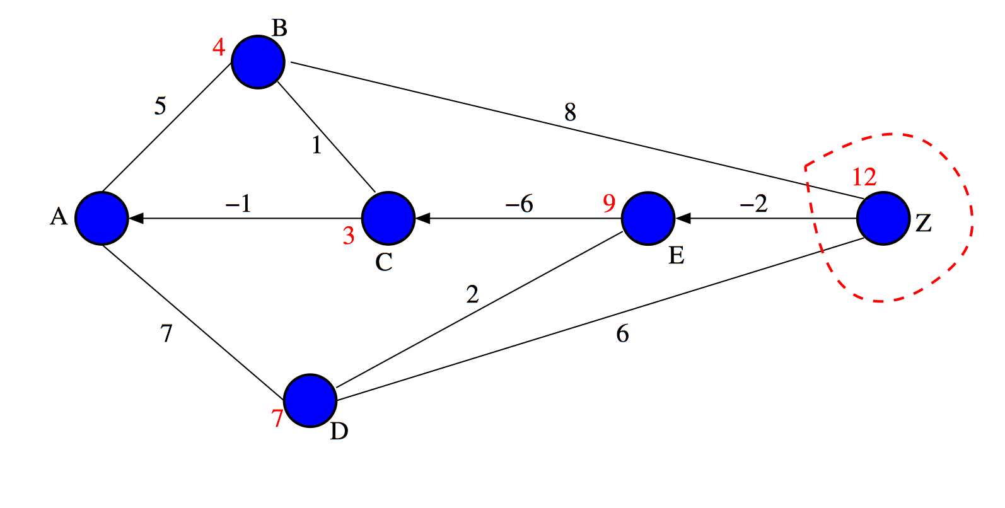
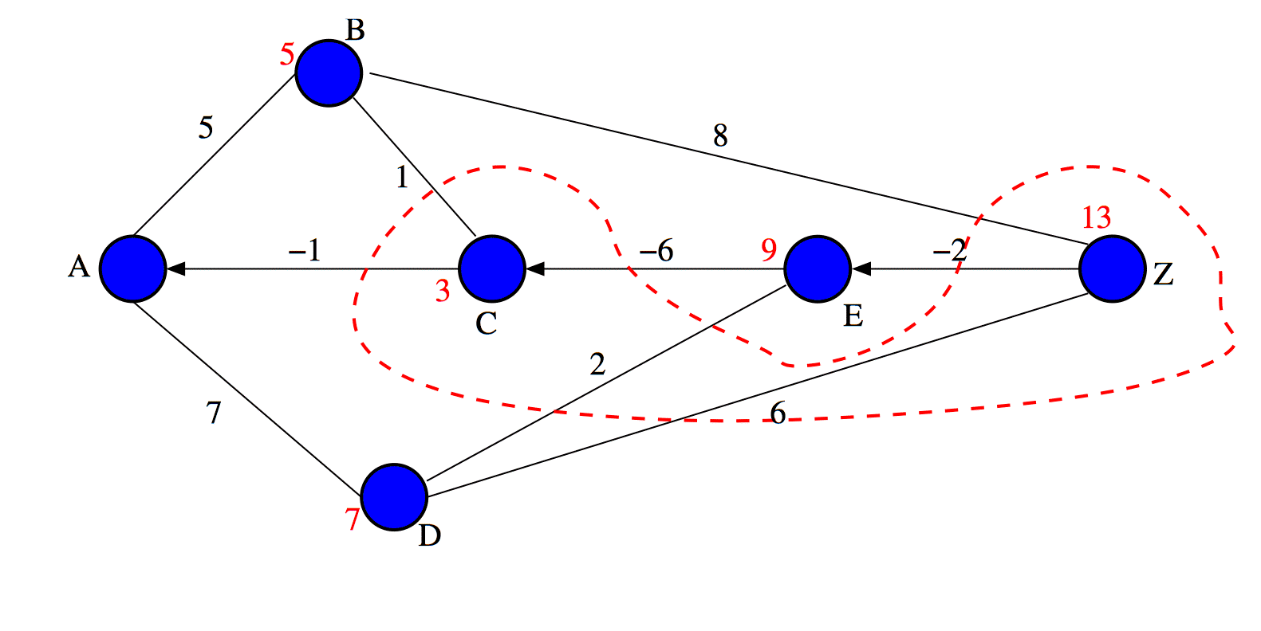
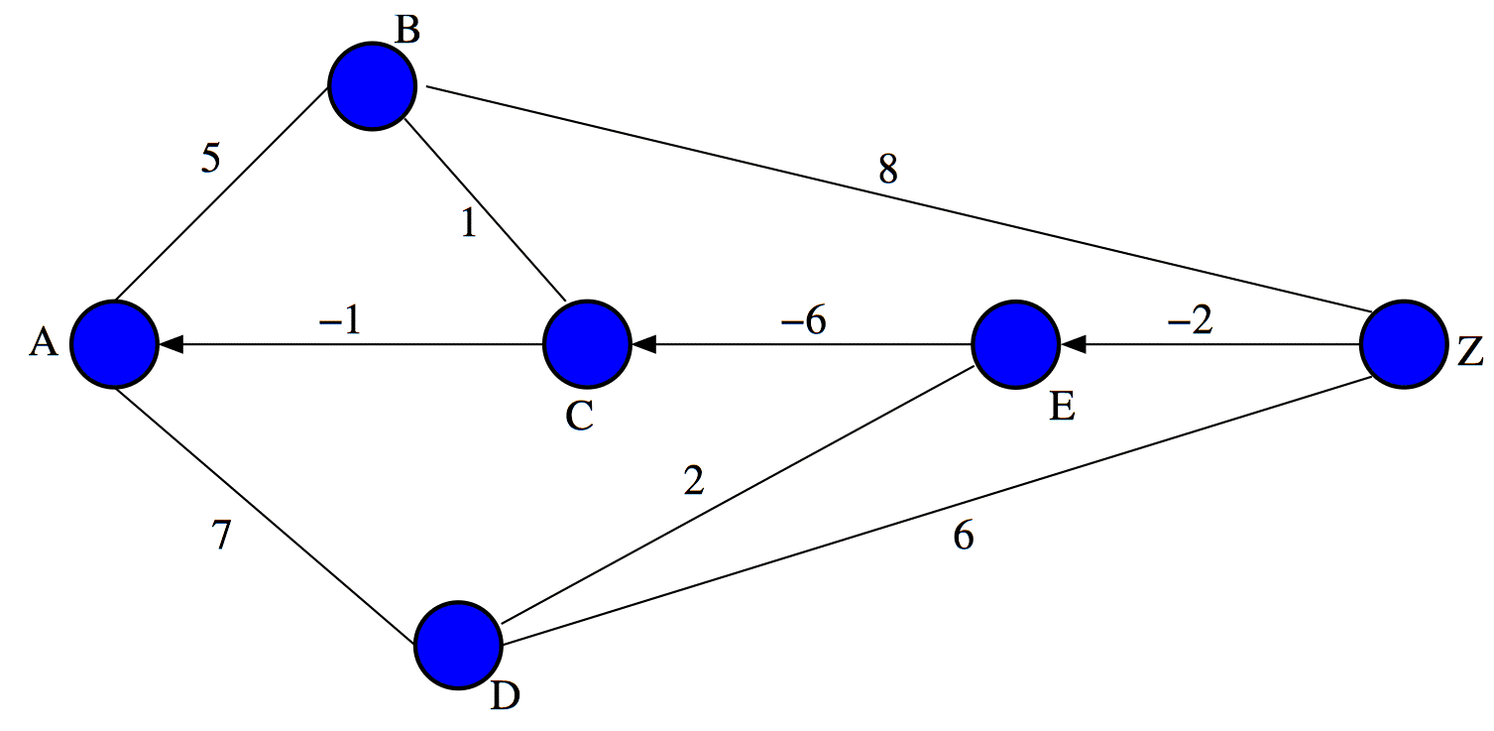
Modified Dijkstra - Example

Slide 10
Shortest Disjoint Path Pair
Objective: find a pair of paths between a source a destination that are:
  Edge-disjoint
  Sum of their lengths is minimum

Slide 11
Simple Two-step Approach Fails
Obvious approach - find one, then other
  May not find shortest pair
  May not find pair at all even when one exists
  Trap topology
B
2
1
D
1
1
1
A
Z
C
1
2
E

Slide 12
Shortest Disjoint Path Algorithms
Various types
  Most based on flow canceling approaches (like flow maximization)
  One early approach by Bhandari
  Other early approach by Suurballe (and with Tarjan)
Bhandari’s algorithm
  Simpler to state on undirected graphs
  Assumes original graph has non-negative edge costs
  Creates intermediate mixed graphs with negative directed arc costs
  Only specific family of such graphs - arcs form s-d path
  Modified Dijkstra’s algorithm works correctly on such graphs
  Can be used in lieu of more complicated negative cost algorithms
R. Bhandari, “Optimal diverse routing in telecommunication fiber networks”,
Proc. of IEEE INFOCOM (1994), 1498-1508.

Slide 13
Bhandari’s Algorithm
Find the shortest path from A to Z with the modified Dijkstra algorithm
Replace each edge of the shortest path by a single arc directed towards the source vertex
Make the length of each of the above arcs negative
Find the shortest path from A to Z in the modified graph with the modified Dijkstra algorithm
Transform to the original graph, and erase any interlacing edges of the two paths found
Group the remaining edges to obtain the shortest pair of edge-disjoint paths

Slide 14
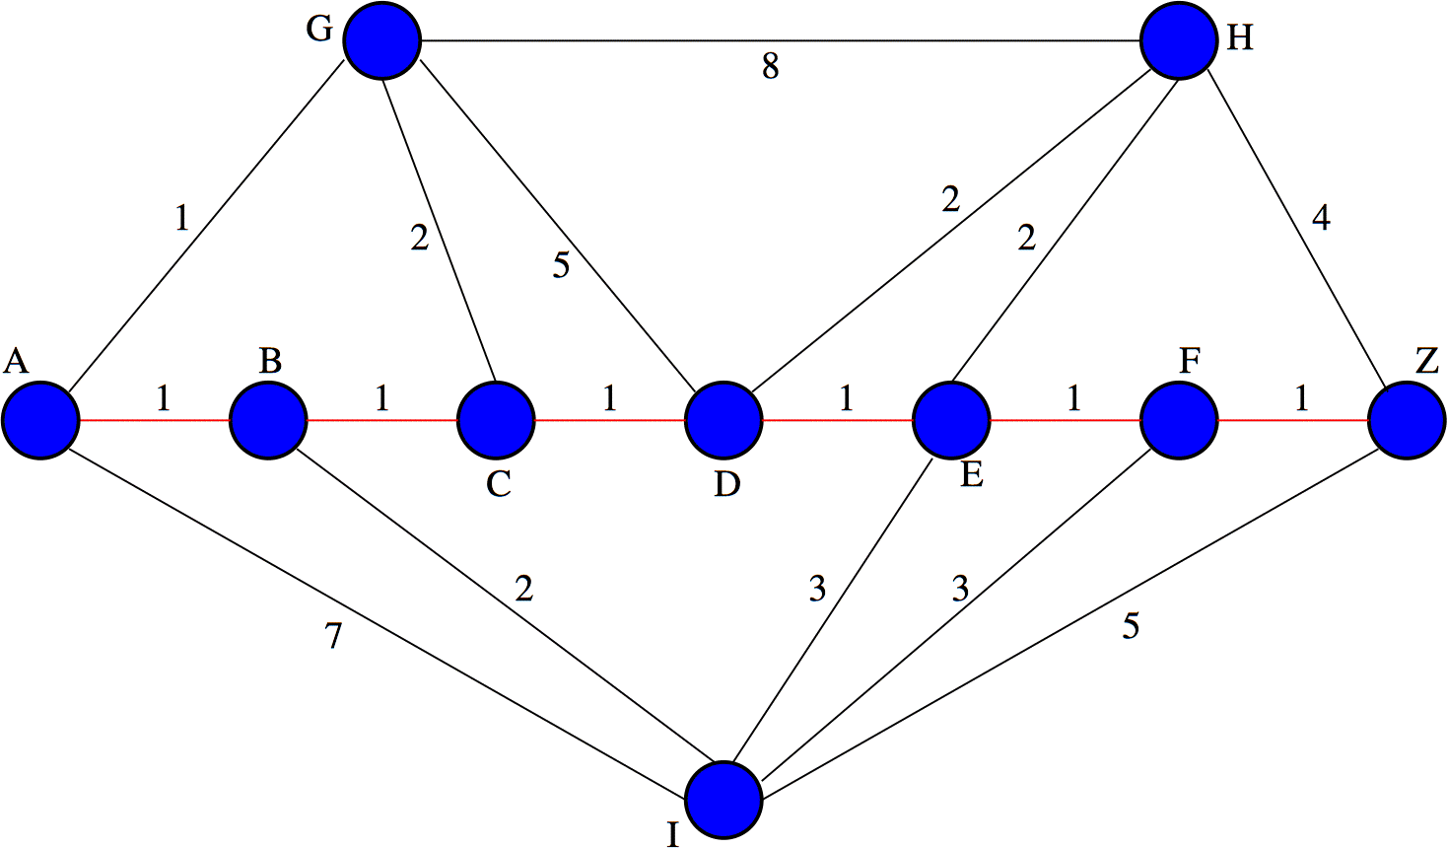
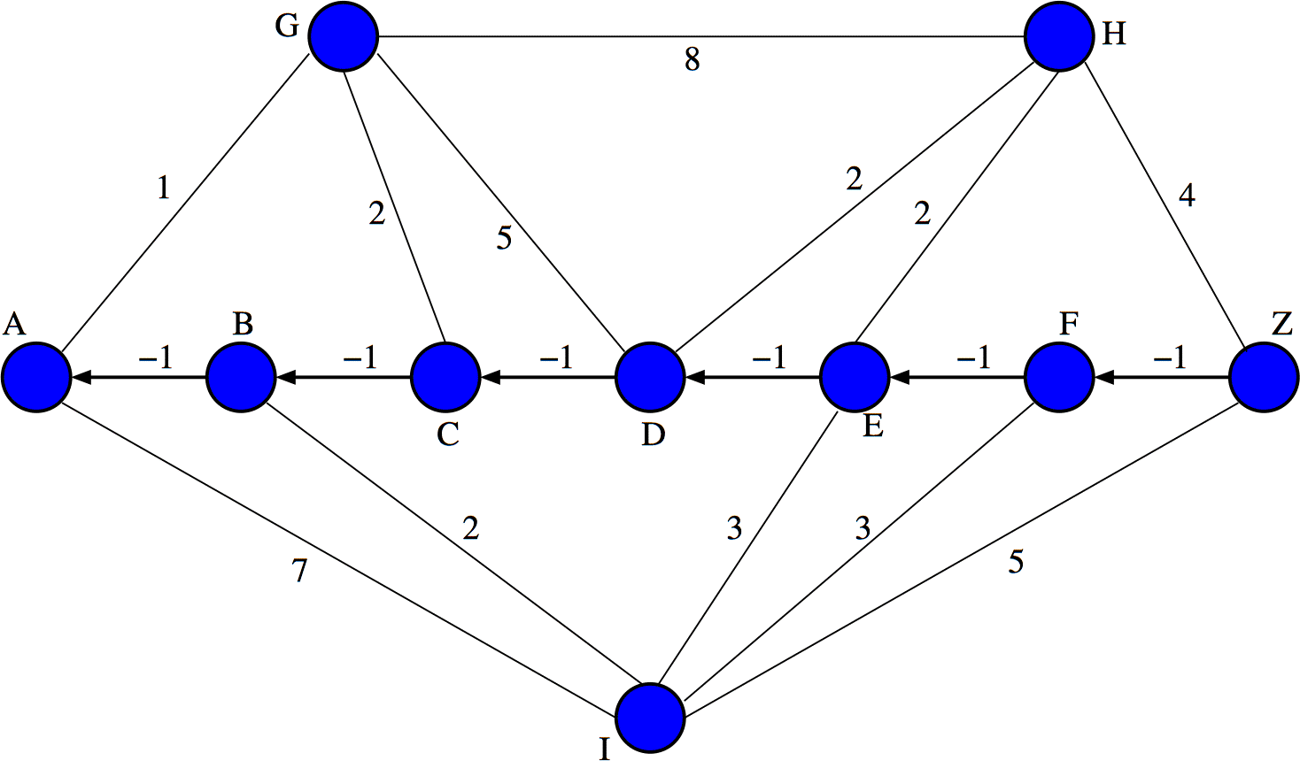
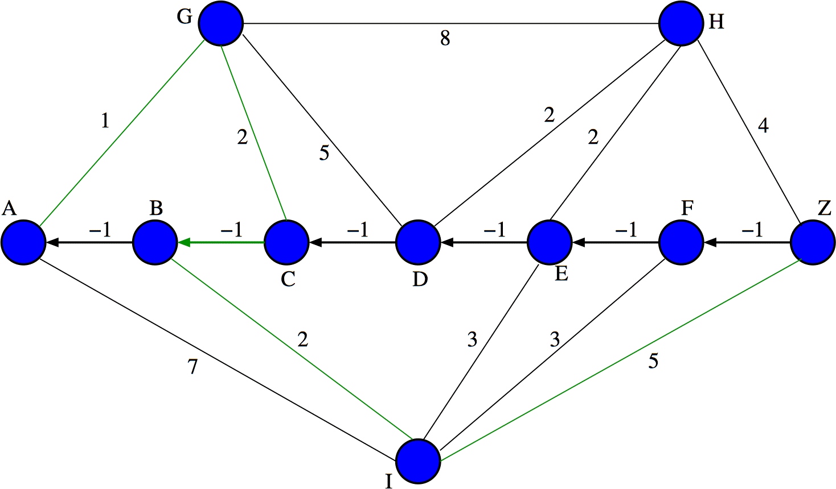
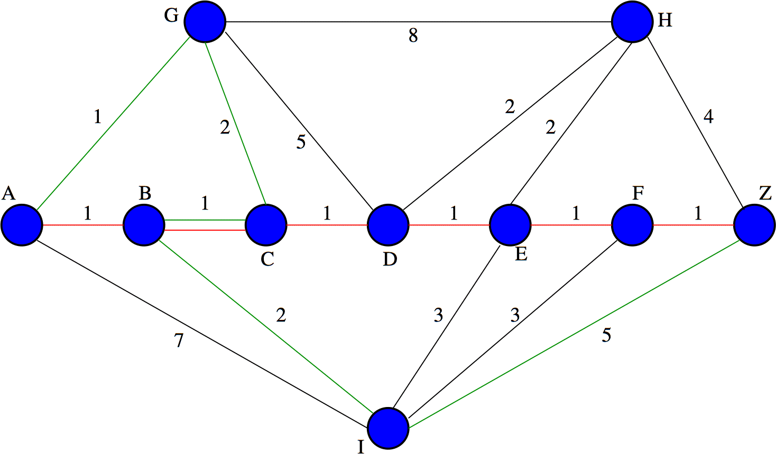
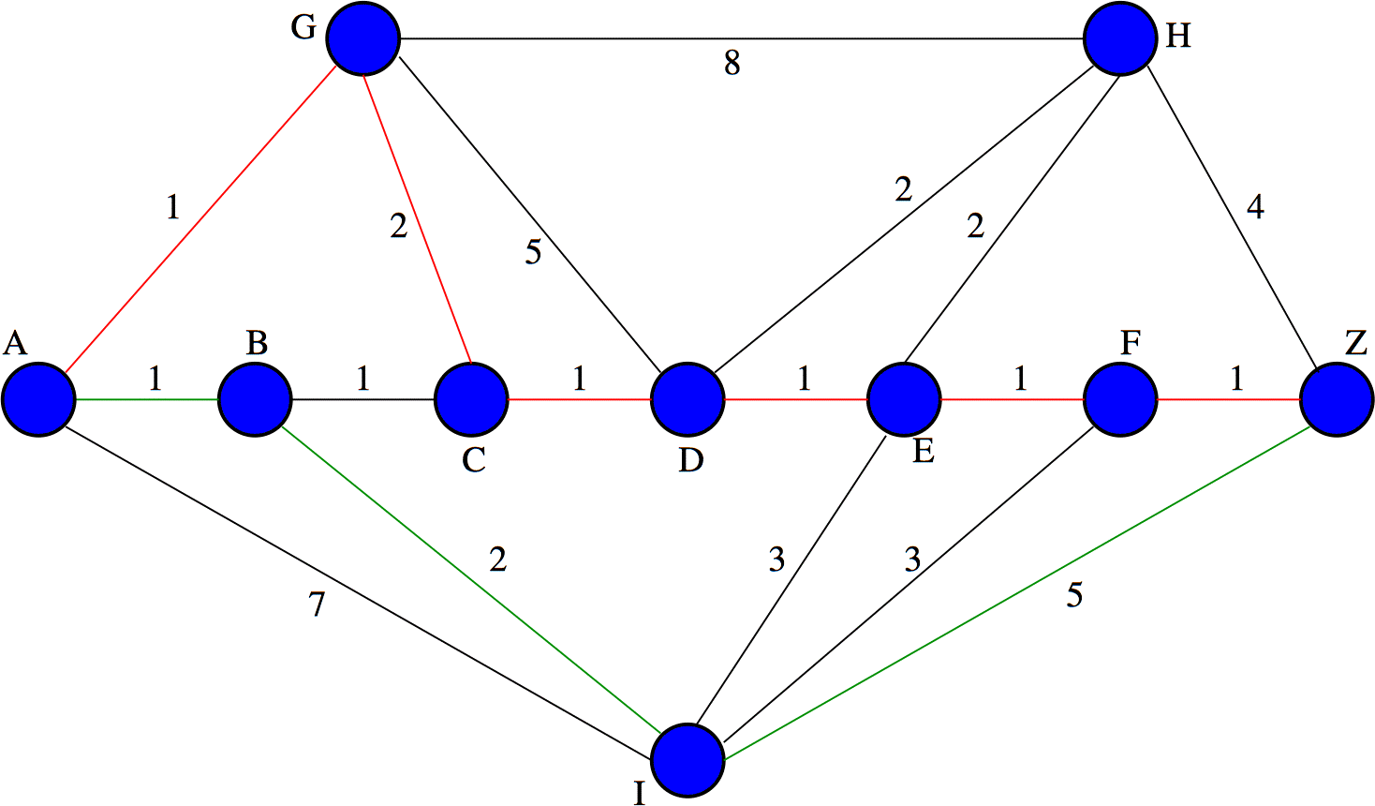
Bhandari’s Algorithm - Example
Copyright Rudra Dutta, NCSU, Spring, 2009

Slide 15
k Disjoint Paths
Can be generalized to obtain more disjoint paths
Edge-disjoint shortest triplet algorithm:
  Find the shortest edge-disjoint pair of paths between A and Z
  Replace the edges of the disjoint paths by arcs directed towards the source
  Make the length of the arcs negative
  Find the shortest path from A to Z in the modified graph using the modified Dijkstra algorithm
  Transform to the original graph, and erase any edges of this shortest path interlacing with the shortest edge-disjoint pair of paths
Straightforward generalization to k > 3

