Slide 1
REDDIT
Project Members:
Omar Alkhayyat (2121118117)
Ali Behbehani (2132131280)
Essa Alansari (2121117232)

Slide 2
Overview:
Reddit was founded by University of Virginia roommates Steve Huffman and Alexis Ohanian in 2005.
As of 2017
Reddit had 542 million monthly visitors.
234 million actual users.
#4 most visited website in U.S. And #8 in the world.
Has a market value of $1.8 billion.
The company has only 230 Employees.

Slide 3
Tools and skills:
Reddit API by using PRAW.
Popular topics.
Authors of these popular topics.
Pandas to store the data in dataframe.
Altair to visualize and compare the data we gathered.
Line chart.
Bar chart.
We used a sample of 3000 records.

Slide 4
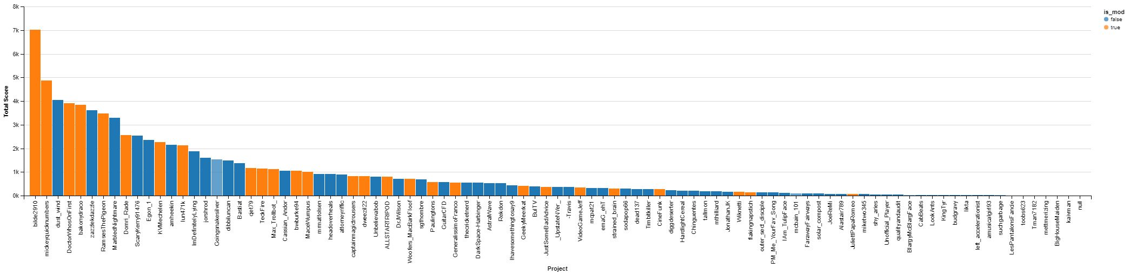
Charts and Insights:

Slide 5
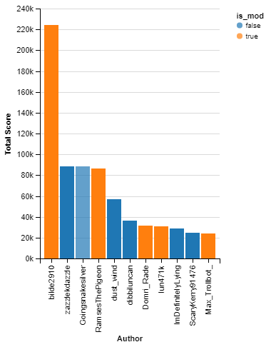
Authors vs Total score :
You can be one of the top users no matter if you are a moderator or normal user.
Number in highest total score is a moderator named (bilde2910)

Slide 6
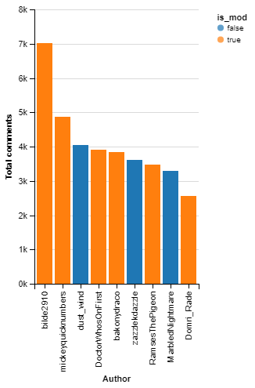
Authors vs Total number of comments
We can see that the user (bilde2910) has the highest number of comments as well as the previous chart which he got the highest total score, which means that he is the most active user in our sample.
we can also conclude that moderators got more comments than non-moderators.

Slide 7
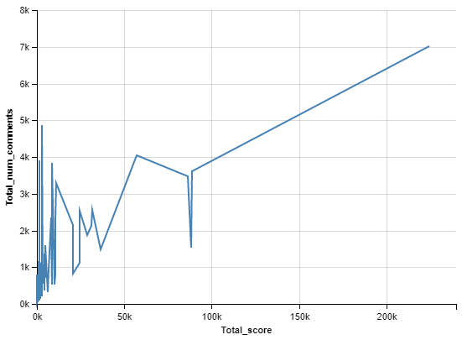
Total number of comments vs total score
number of comments and score goes as positive relationship with Total score reaches 80k.

Slide 8
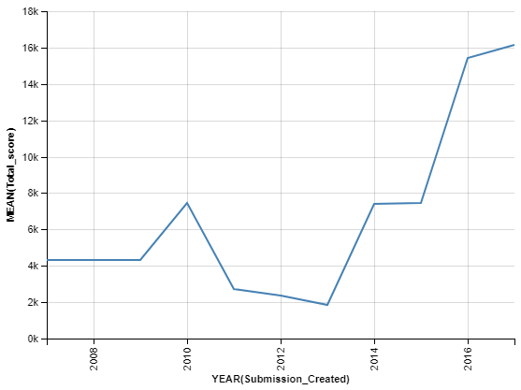
Average Total score over the years
The falling of 2010.
Matt donation.
The rising of 2013.
Bitcoin payment method.

Slide 9
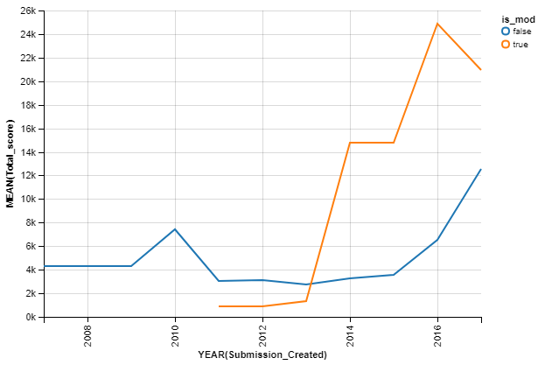
Featured Update
Two kinds of moderators:
full permission.
Limited permission.

