Slide 1

FP Phase 3 - Final Project
Final Project HCDR - PyTorch Deep Learning
Group: 11

Slide 2
Slides Outline:
Project Description: Here, we’ve summarized what the project is all about and the goals we are expecting to achieve from this project!
Summary EDA: In this section, we have described our dataset visually and tried to understand the data and gather insights from it.
Feature Engineering & Data Preprocessing: Using all the merged files in the dataset, we picked out the top 26 highly important features and used One Hot Encoding and Simple Imputer on them. Thus, preparing the data to be used in Pytorch.
Pytorch - Deep Learning: We implemented Pytorch using the above features having 1000 epochs with 4 hidden layers and Rectified Linear Unit (ReLu) as activation function.
Result & Result Discussion: In this section, we have attached our Kaggle Submission Screenshot, and shown the accuracy score of model performance of different models.
Conclusion: For this section, we have briefly discussed the project, its various phases and how effectively we predicted the Home Credit Default Risk.
Thus, we have divided the entire Phase III Slide into these sections and tried to work on the data.

Slide 3
Project Description
The objective of Home Credit is to correctly offer loans to individuals who can pay back and turn away those who cannot. The challenge lies in the great diversity of backgrounds of individuals who come to Home Credit to procure the loan. In this analysis, we aim to implement a variety of techniques to assess the idiosyncrasies of each customer and determine whether a customer will default.
In this phase of the project, we performed feature engineering by building new columns with the additional datasets provided within the data and used them to make further predictions. We performed Hyperparameter Tuning by using GridSearchCV and documented our results. We used ROC Curve, Confusion Metrics and Log Loss to predict our model performance.
Steps :-
During the Phase I and Phase II of the project, we achieved an accuracy of 73% and 74% respectively on Kaggle Submission.
For this Phase of the project, we used PyTorch to implement Neural Network.
Finally, we submitted our results on Kaggle and used Tensorboard to display our model performance, in addition to ROC AUC Curve, Confusion Matrix and Accuracy Score.

Slide 4
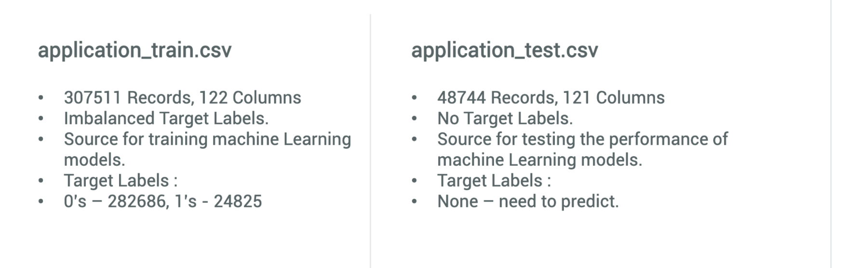
Data Description

Slide 5
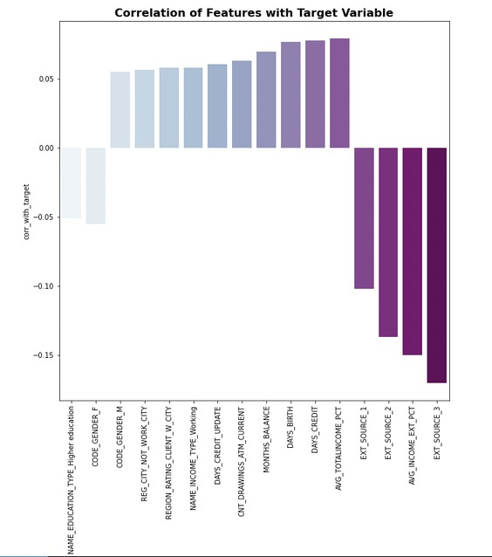
Exploratory Data Analysis on New Engineered Features
Here is the plot of correlation of the new variables with the target variable. We can see that the correlation has
improved on performing Feature Engineering.

Slide 6
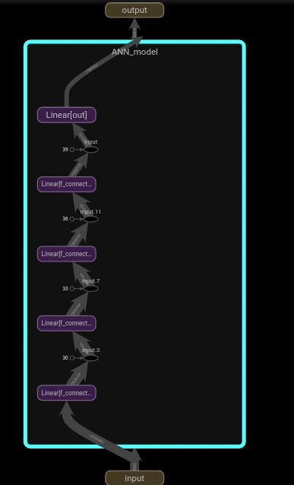
Modelling Pipeline

Slide 7
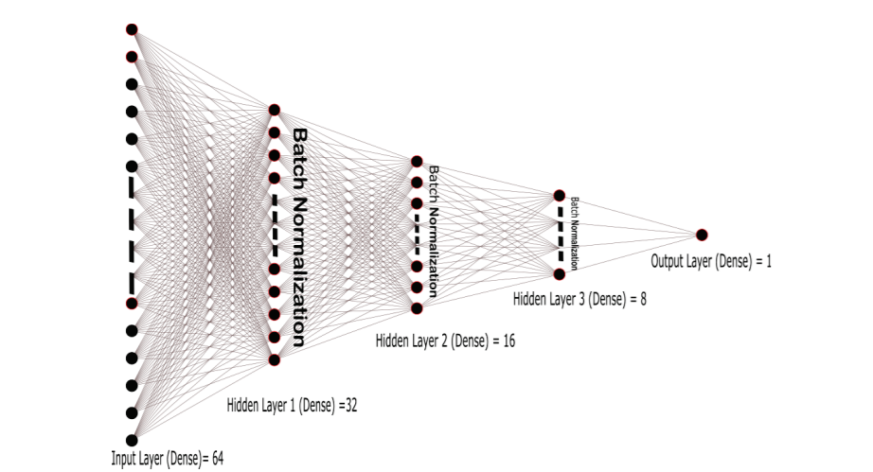
Neural Network/PyTorch (HCDR)

Slide 8
Neural Network/PyTorch (HCDR)
PyTorch is an open-source machine learning Python library used for deep learning implementations like computer vision (using TorchVision) and natural language processing. It was developed by Facebook’s AI research lab (FAIR) in 2016 and has since been adopted across the fields of data science and ML.
Deep learning is concerned with automatically generating representations from raw data in order to complete a task. Filters are improved during training in the ones versus zeros example by iteratively examining pairs of samples and target labels. Deep learning is achieved by a neural network's ability to consume input and extract usable representations from instances.
The implementation of a deep neural network (DNN) necessitates careful network building. The following are the main steps in building the network:
Defining the neural network's architecture, as well as its input and output
The training sets are used to teach the network to imitate the intended problem or task.
Before considering it for final usage, test the network's performance.

Slide 9
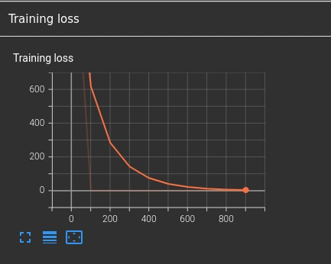
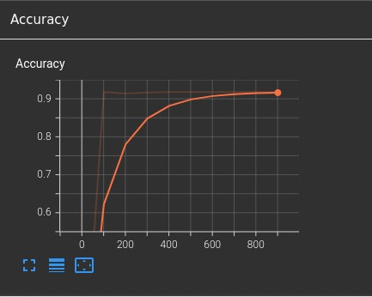
Results & Discussion of Results (Tensor Board):

Slide 10
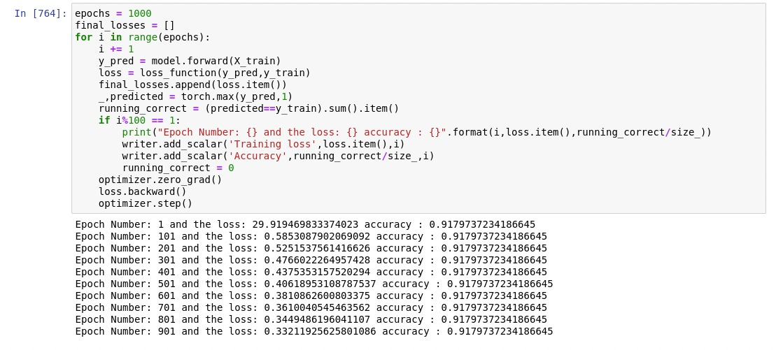
Results & Discussion of Results:

Slide 11
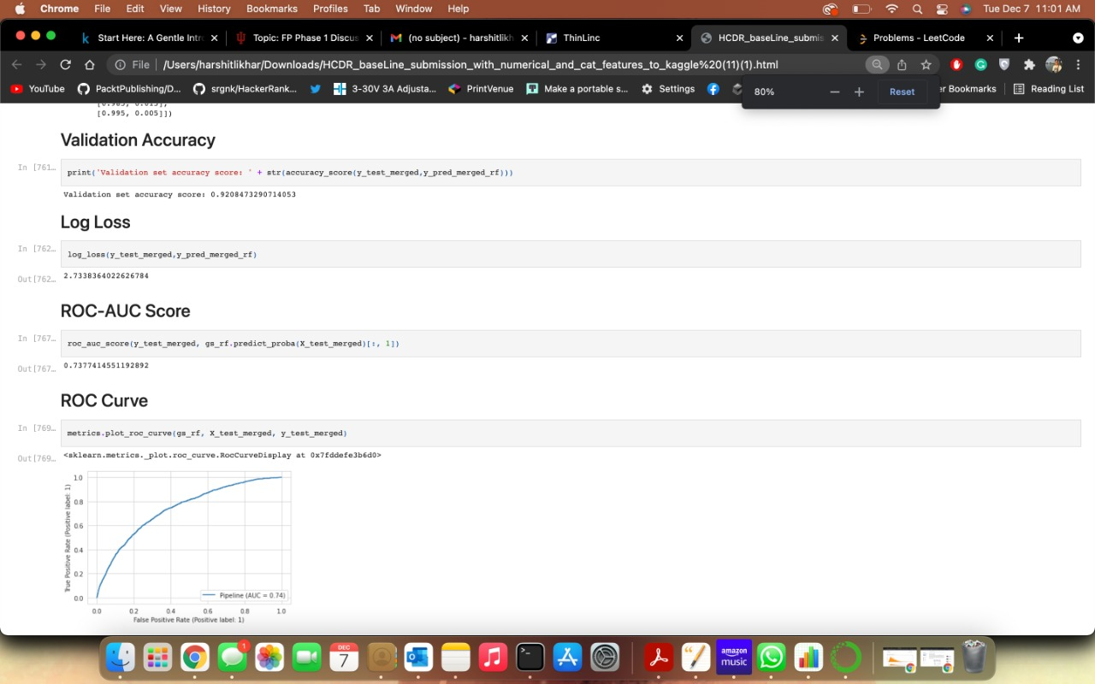
Results & Discussion of Results:

Slide 12
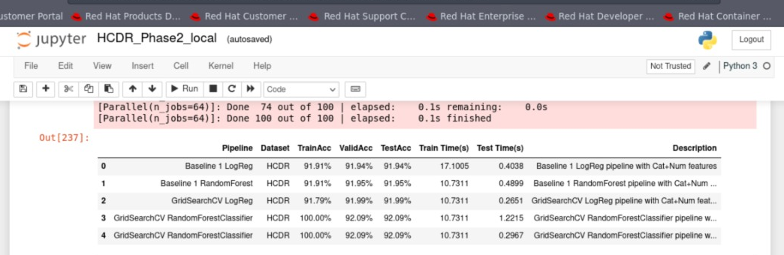
Results & Discussion of Results:

Slide 13
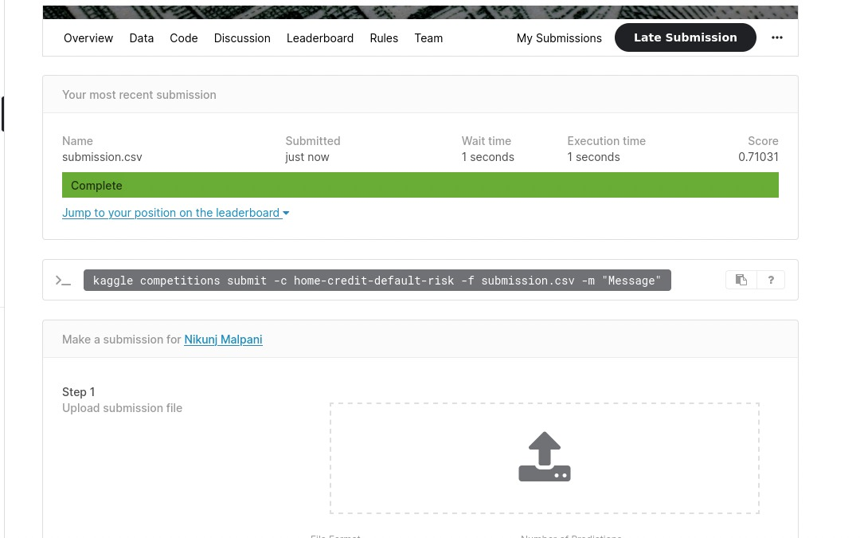
Screenshot of Kaggle Submission:

Slide 14
Conclusion and Next Steps:
For the Phase II of this Project, we built Logistic Regression and Random Forest Model, performed Hyperparameter Tuning using GridSearchCV and achieved an accuracy of over 92.1% with Random Forest and 92% with Logistic Regression.
Finally for the Phase III of the project, we implemented Neural Network using PyTorch Library.
We used around 26 highly important features for our model prediction with Leaky Rectified Linear unit as our Activation Function.
We also tried using synthetic sampling techniques like SMOTE and ADASYN to check if there was any change in the model performance.
Successively, we ran our model on the best parameters and found out an increase in the model accuracy and submitted the file on Kaggle.
We used Confusion Matrix, Log Loss, Accuracy, ROC Curve and CXE to evaluate the model performance.

