Slide 1
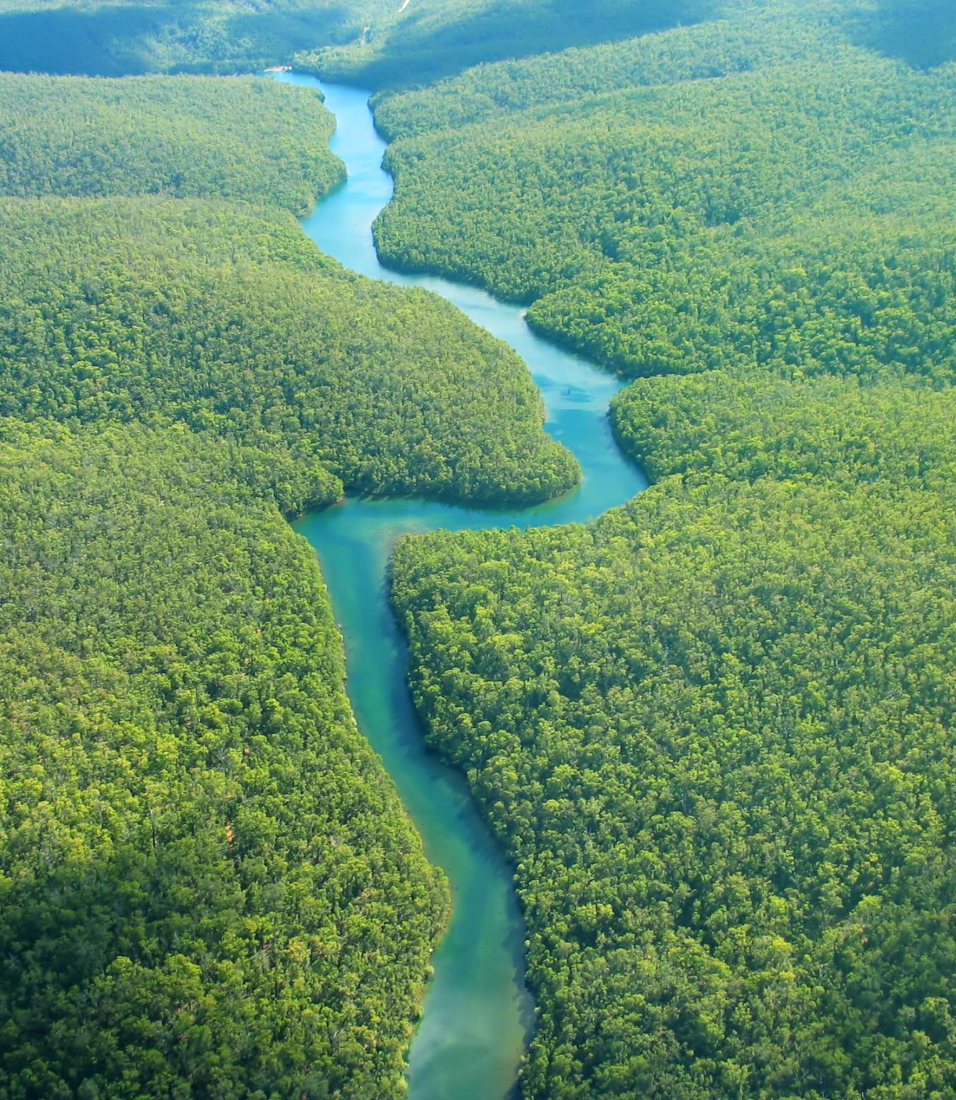
Predicting the Weather
Max LoGalbo

Slide 2
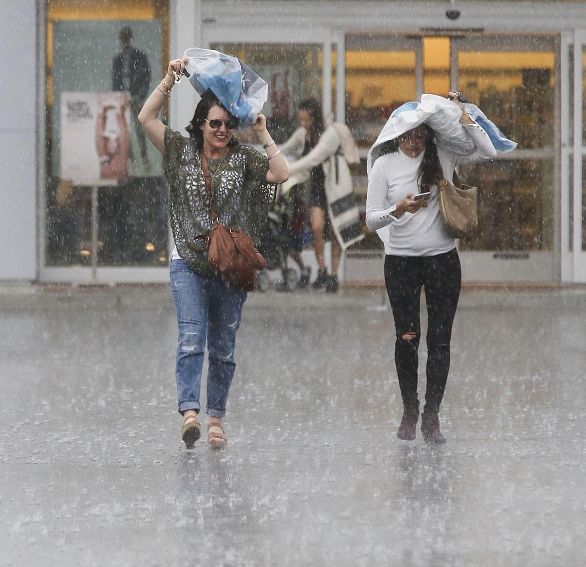
Initial Problem
Weather in Gainesville is Unpredictable
Idea:
Be able to predict if rain will occur or not
6 hrs
12 hrs
24 hrs
48 hrs

Slide 3
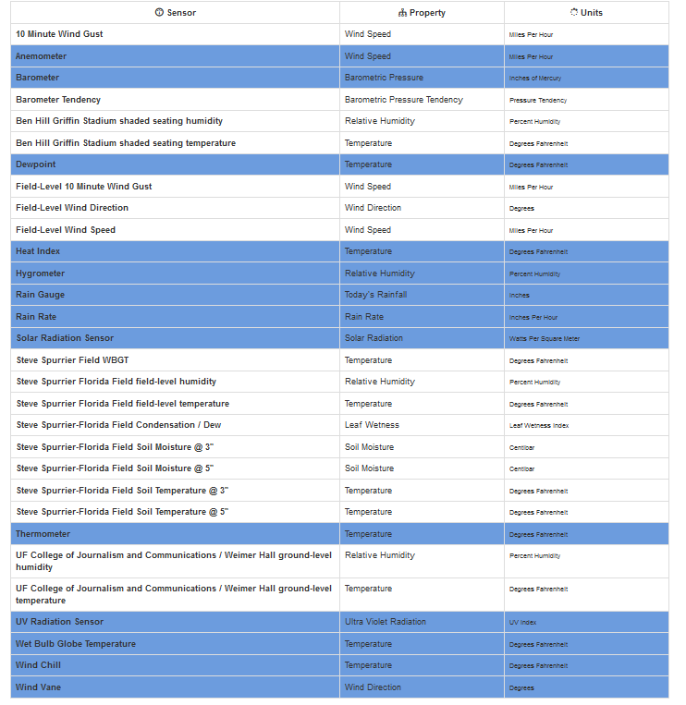
Data
Found at https://alachua.weatherstem.com/data
Various covariates
Temp, Barometer, etc.
Chose 13 separate covariates
Initially worked with Data from UCF, prefer Data from UF.

Slide 4
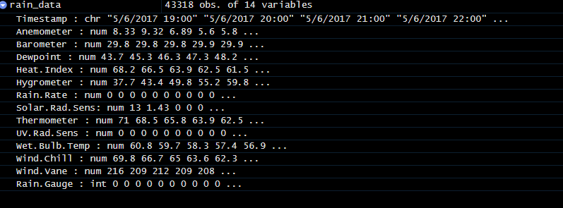
Intro to Data
Various covariates
Timestamp Data interesting
Many Entries, small # of covariates
No Dimensionality Reduction techniques
Various Scales
Will have to Normalize later

Slide 5
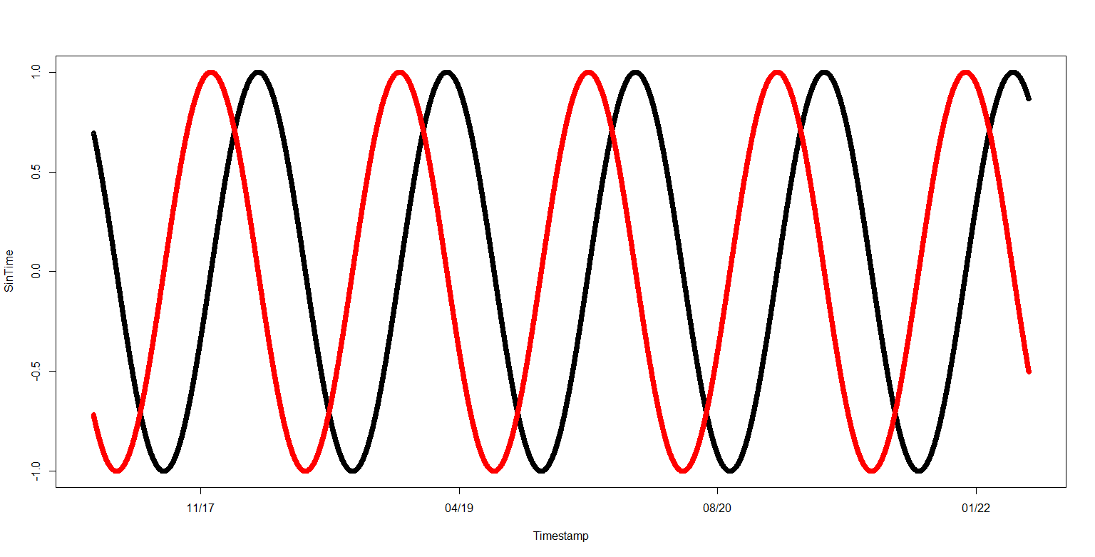
Data Cleaning
Convert “Rain Gauge” variable to Boolean (rain or no)
Clean a couple other variables from string to float
Convert strings of dates to Date class
Convert dates to cyclic features
Take sin and cos of seconds
Period = 1 year

Slide 6
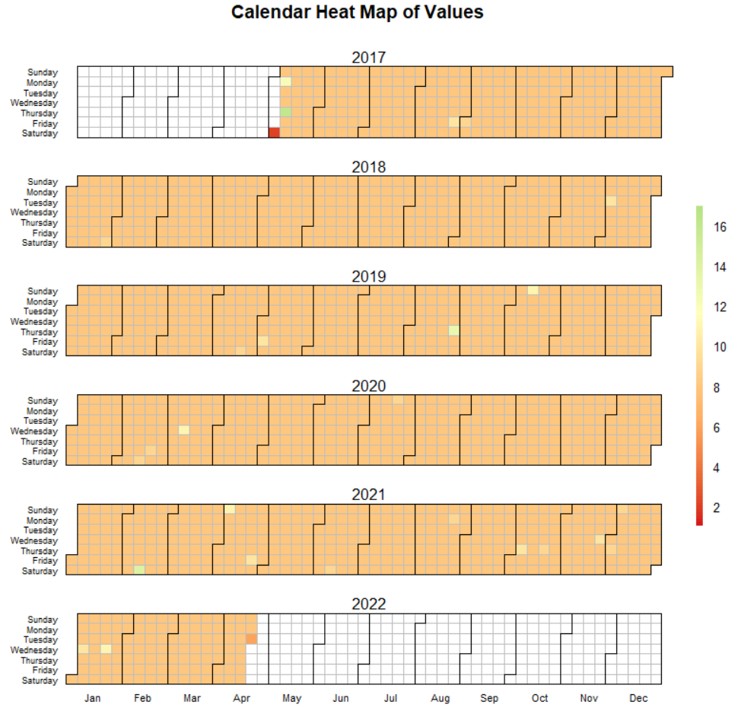
Incomplete Data
Lots of Data is Missing
UF misses every third hour of data!
Not a massive problem
Shifting the y variable by 6hrs, 12hrs, 24hrs, 48hrs will make no difference

Slide 7
Data Cleaning (cont).
Data Shifting
1st – Set up hash table -> keys = date
Values = rain/no
For each Time Period Difference
If there exists a value at date + difference
Set y_vals appropriately
Else – add to array to delete from y_vals at end
Min-Max Normalize
Applied to all covariates

Slide 8
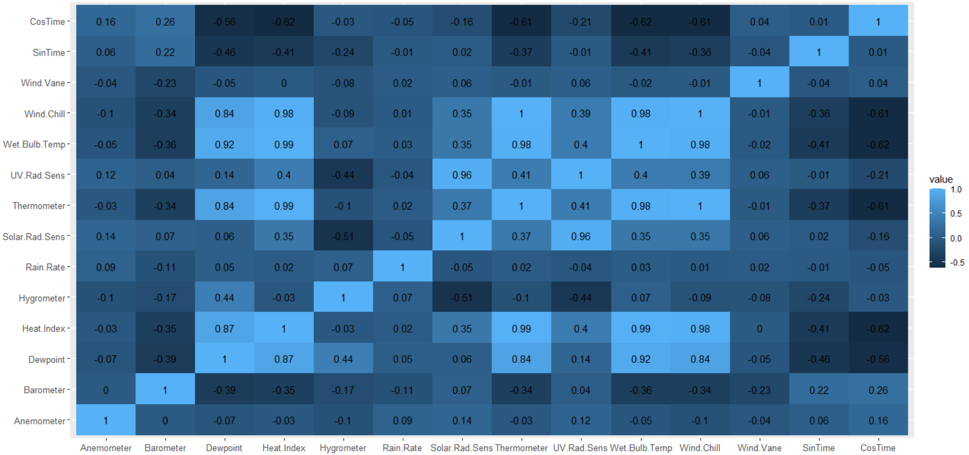
Correlation Exploration

Slide 9
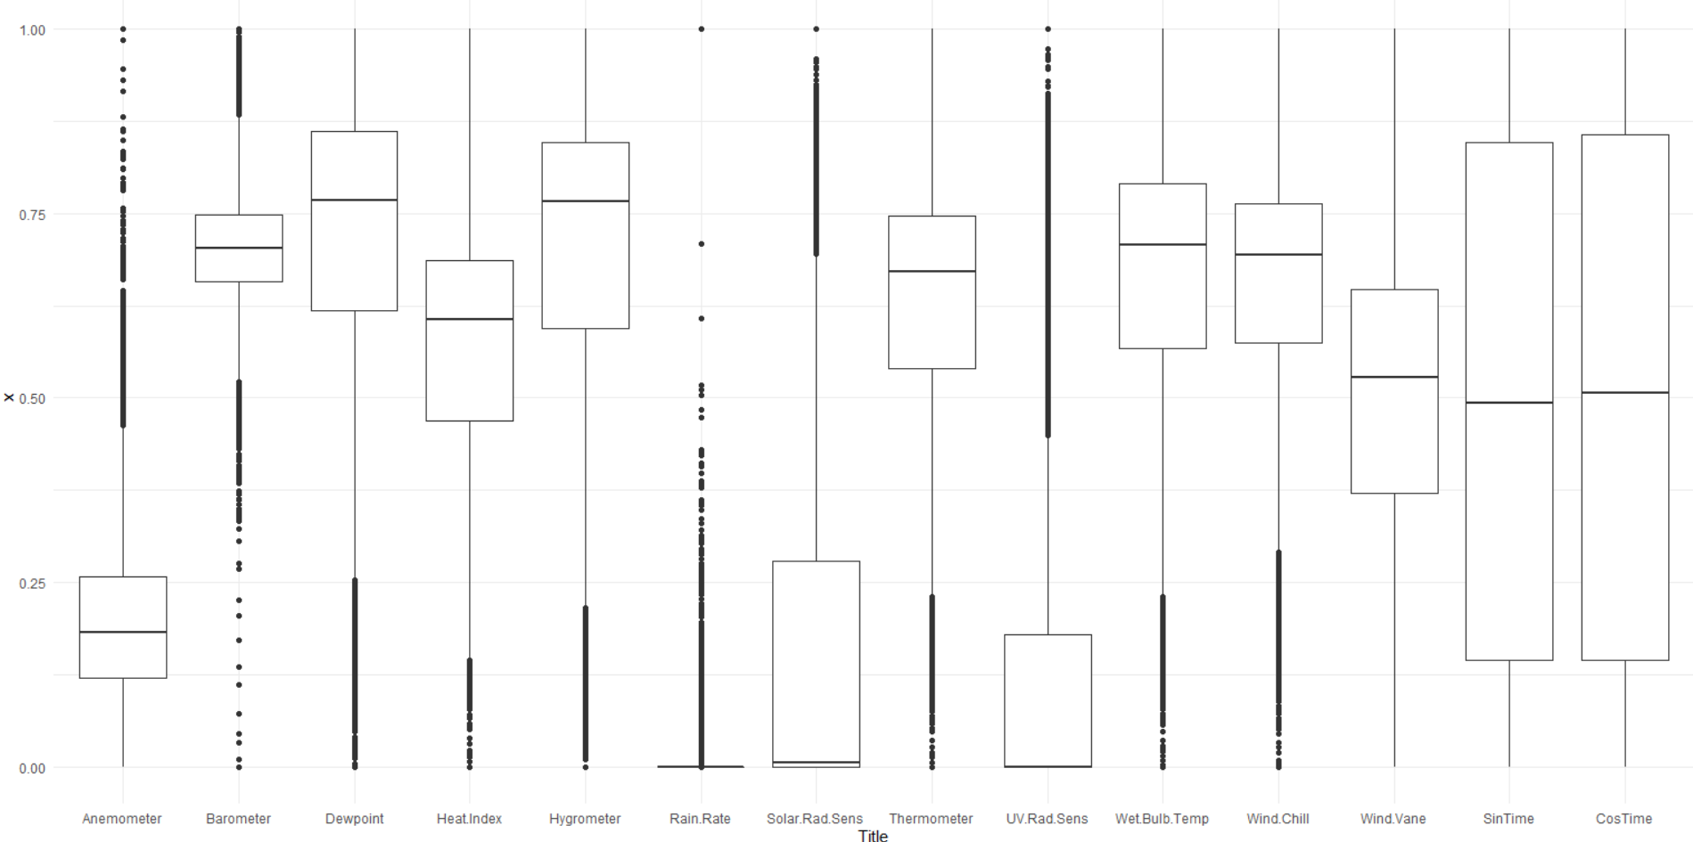
Exploration of Covariates

Slide 10
Models – Analyzed for Each Time Diff.
Logistic Regression (avg over 50 iterations)
LDA (avg over 50 iterations)
QDA (avg over 50 iterations)
KNN (look for best k from 1-25)
Simple Decision Tree (depth chosen via CV)
Random Forest (mtry = 5)
GBM (stayed with 1 set of hyperparameters)
Sum of KNN & RF – if 1 model says rains, model says rains
Sum of 1st 7 Models – if 1 model said rains, model says rains

Slide 11
Analyzing if Model Successful
Mainly interested in whether to pack an umbrella
Accuracy is certainly important
But, better to look at false negative rate (FNR)
Goal: Have small FNR and small error
A smaller FNR with cost of accuracy perhaps better

Slide 12
6 Hour Analysis
Error:
FNR:

Slide 13
12 Hour Analysis
Error:
FNR:

Slide 14
24 Hour Analysis
Error:
FNR:

Slide 15
48 Hour Analysis
Error:
FNR:

Slide 16
Conclusions:
Ensemble 1 tends to produce the best combination
Slightly higher error than RF, but significantly lower FNR
Many other models performed extremely poorly
QDA performed worse than other models on farther out data
Other than Ensembles – KNN & RF performed admirably

Slide 17
What’s Next?
Recurrent Neural Net (perfect for time series)
Would most likely have to impute data
Look into K-means Clustering
Cross-Validation for RF
Add Rain at Current Time as Covariate

Slide 18
Sources
Images
https://www.bakersfield.com/news/photo-gallery-caught-in-a-sudden-storm-in-bakersfield/collection_aa279c0f-19f4-51b4-bf1e-8d766714a3ae.html

