Slide 1
Threat by Association
A Corpus-Based Analysis of the Discursive Criminalization of Migrants and Displaced Communities in Western Media
Malorie Iovino
MSc Candidate in Computational Linguistics
Goldsmiths, University of London
AMLI 2025 Conference ● Liverpool Hope University ● September 2025

Slide 2
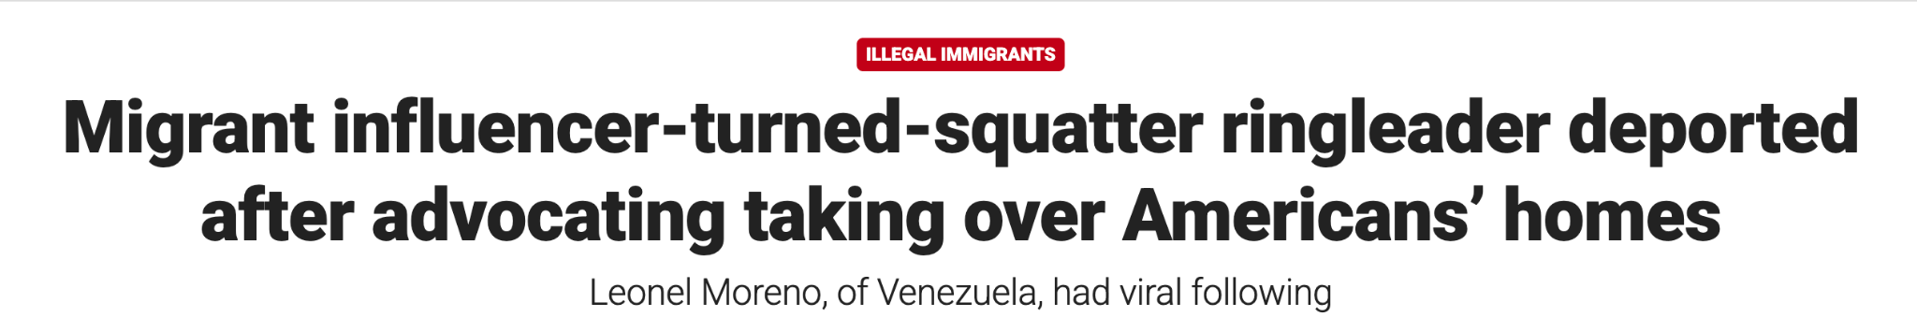
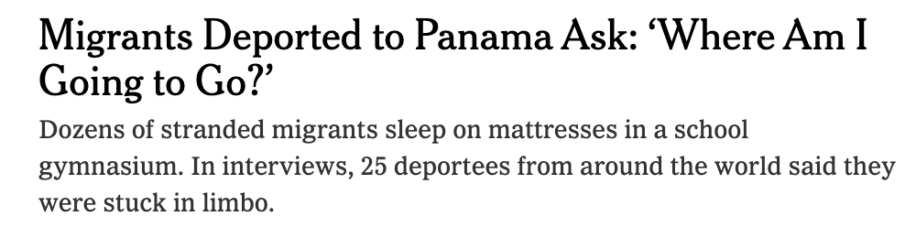
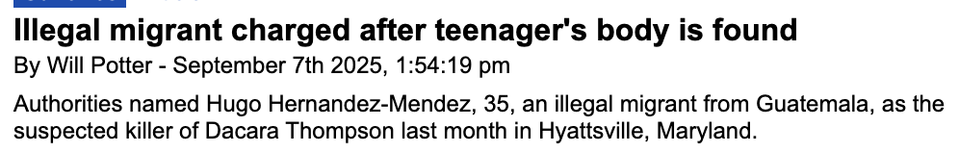
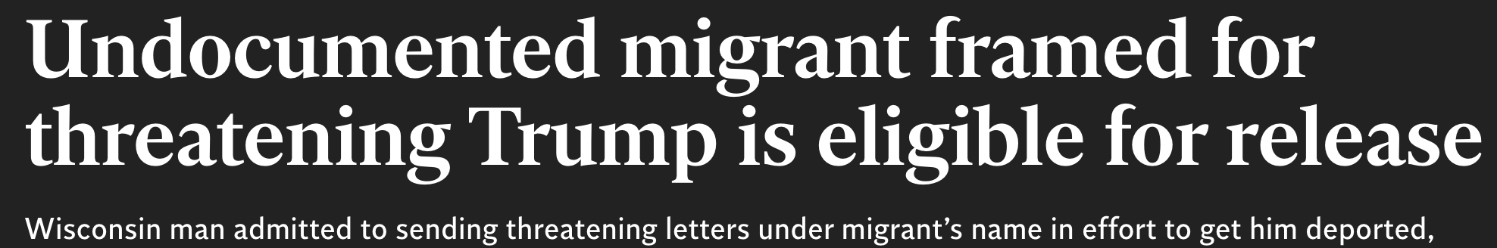

Slide 3
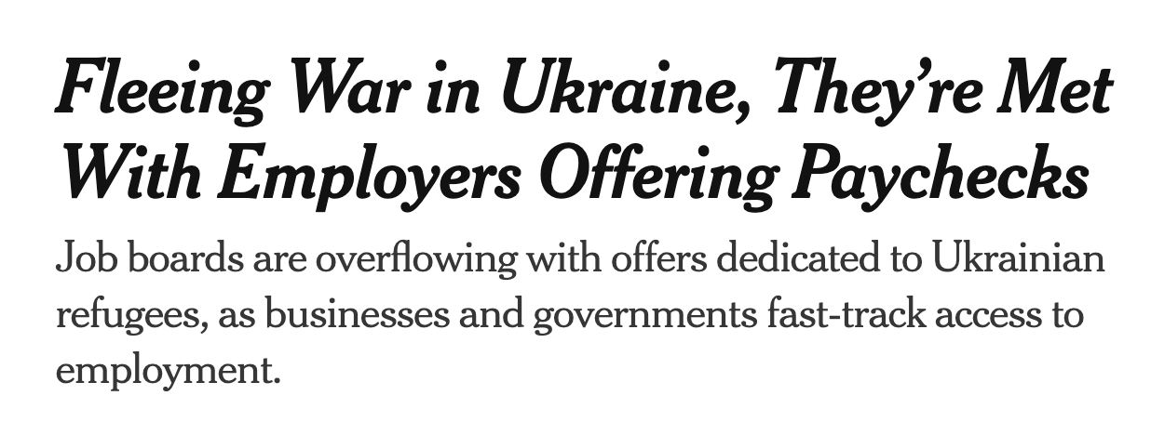
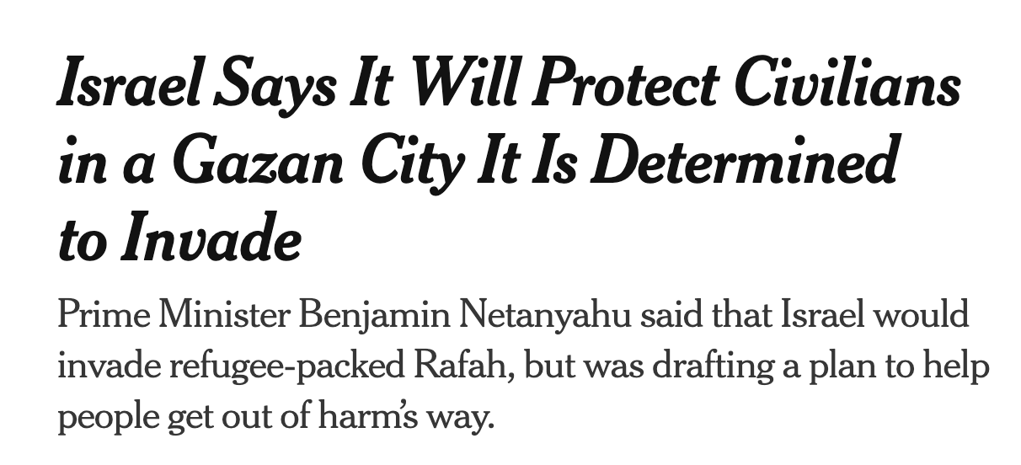
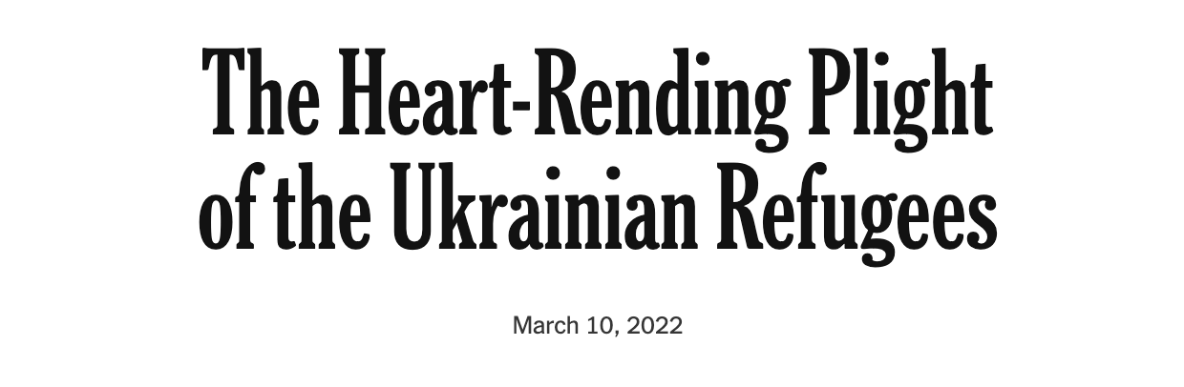
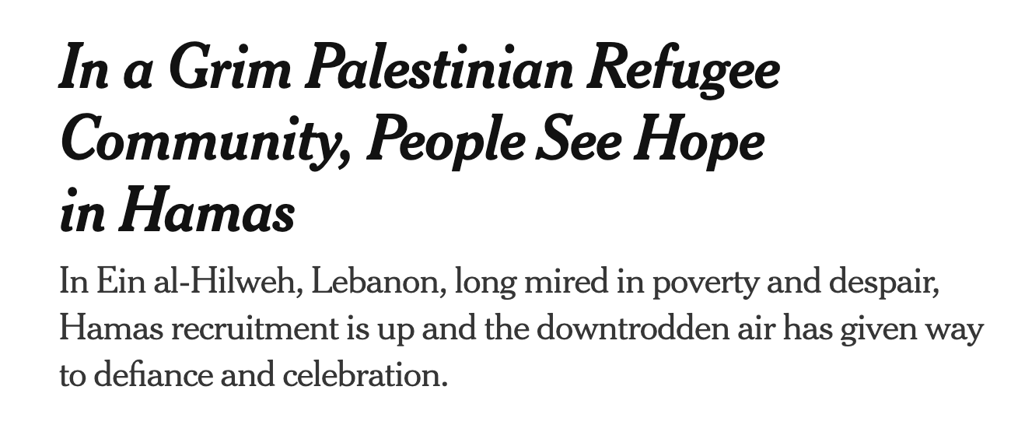
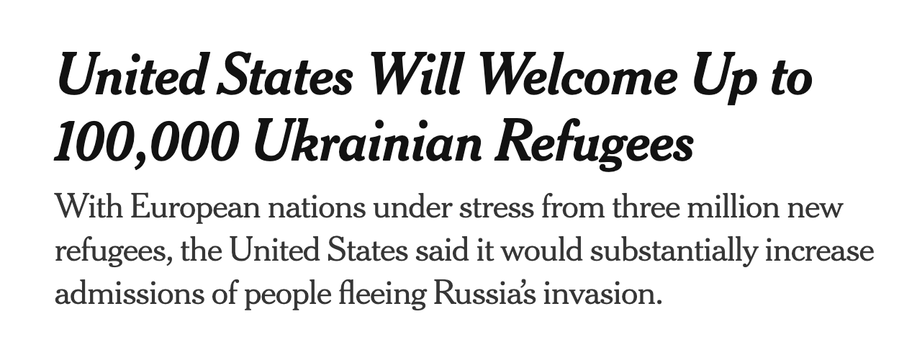
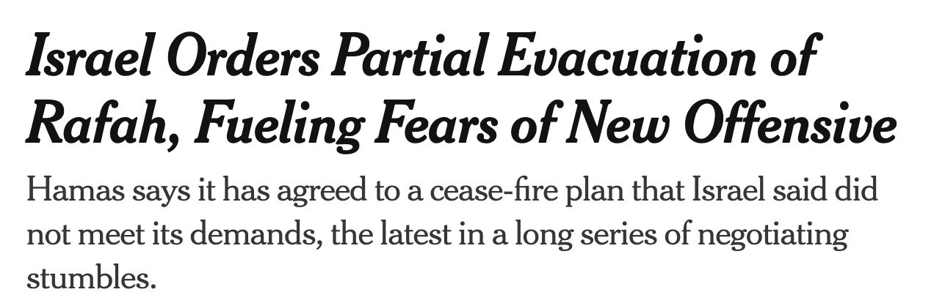

Slide 4
Research Question
How do Western, English-language news outlets use linguistic choices to construct displaced people differently across racial, religious, and geopolitical identities?
Focus Areas:
Systematic linguistic strategies that prescribe framing and agency to displaced communities
The role of lexical choices, and grammatical constructions as ideological tools
How journalism reflects allegiance to political entities and constituencies
Analyzing news sources ((2021-2025) covering Palestinians, Ukrainians, Mexicans, and Venezuelans
Parallel conflicts: Palestinians and Ukrainians both face bombardment and displacement from their homes - one by a Western ally, one by a Western adversary
Proximity test: Mexicans and Venezuelans flee similar crises but approach Western borders - testing how "compassion" changes when displacement isn't distant
Same timeframe (2021-2025): All four experiencing mass displacement simultaneously, eliminating temporal variables
Comparable humanitarian need: All fleeing violence, all seeking safety, all protected under international law - yet receive vastly different linguistic treatment
Intersectional identities: Allows analysis across race (white/brown), religion (Christian/Muslim), and geopolitical alignment (ally/adversary/neutral)

Slide 5
Methodology: Data & Corpus Creation
Keywords
General Search Terms (All populations):
'refugee OR refugees'
'migrant OR migrants'
'asylum seeker' OR 'asylum seekers'
'displaced OR displacement'
'immigrant OR immigrants OR immigration'
'flee OR fleeing OR fled'
Ukrainian-Specific Terms:
'Ukraine AND (refugee OR refugees)'
'Ukrainian AND (flee OR fled OR fleeing)'
'Ukraine AND displaced'
Palestinian-Specific Terms:
'Gaza AND (refugee OR refugees)'
'Palestinian AND displaced'
'Gaza AND humanitarian'
'Hamas' [included for context]
Latin American Terms:
'US border' AND (crossing OR migrant)
'migrant caravan'
'Mexico AND (border OR migration)'
'Venezuela AND (refugee OR migrant)'
Supplementary Corpus
Partisan Outlets
Primary Corpus
CNN: 900
40 articles purposively sampled
The Guardian: 808
Sources
New York Times
The Independent
Fox News
Daily Mail
Timeframe: Jan 2021 — Sep 2025

Slide 6
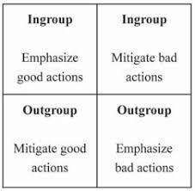
Methodology: Research Design & Framework
Two-phase design:
Computational Analysis (CNN + The Guardian)
Lexical choice
Collocations
Transitivity (agency vs passivity)
Critical Discourse Analysis (CDA) (Partisan corpus)
Headlines, URL framing, discourse analysis
Case studies (Anas al-Sharif & Kilmar Abrego García)
Discourse boundaries
Theoretical Anchors
Van Dijk’s Ideological Square: us vs them
Halliday’s Transitivity Model: agency in grammar
Lakoff & Johnson Metaphor Theory
Wodak’s Discourse-Historical Approach
Computational Framework
Collocation & keyword frequency analysis
_{Part-of-speech tagging}
Comparative distributions across populations
Visualizations of lexical + grammatical patterns

Slide 7
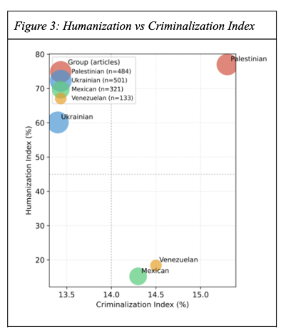
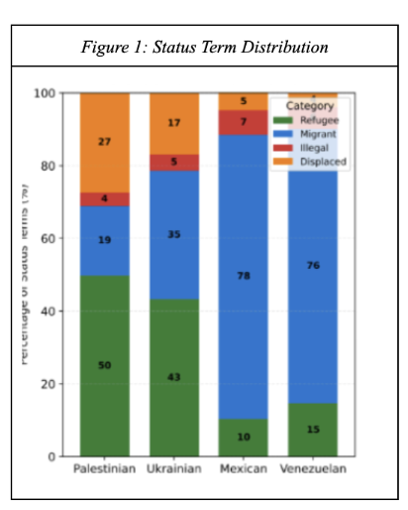
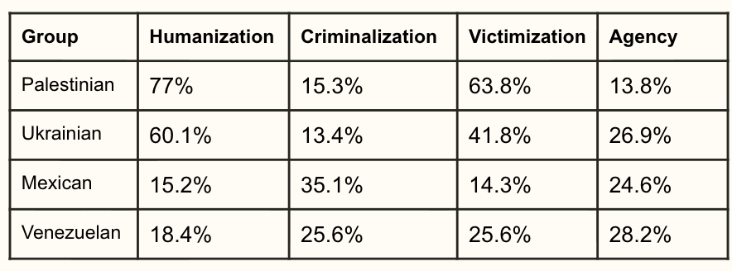
Findings: Lexical Choices
Lexical labels predetermine legal and moral obligations:
Refugee/displaced invokes protection under international humanitarian law
Migrant/illegal implies choice or criminality, legitimizes restriction
Palestinians: 77% refugee/displaced
Ukrainians: 60% refugee/displaced
Mexicans: 78% migrant
Venezuelans: 75% migrant

Slide 8
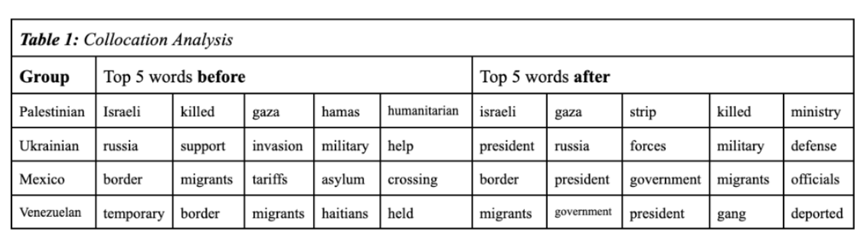
Findings: Collocation Patterns
Semantic Domains
Palestinians → conflict/violence terms; implies existence in violence without political legitimacy or agency
Ukrainians → state & strategy terms; legitimized resistance and allied support
Mexicans → geography & enforcement terms; movement as territorial violation
Venezuelans → governance terms; administrative objects

Slide 9
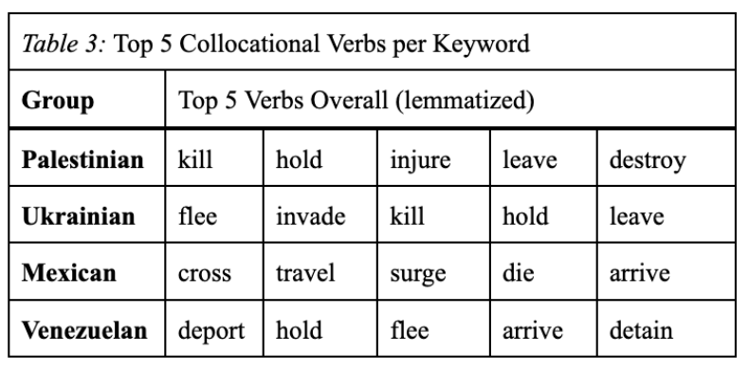
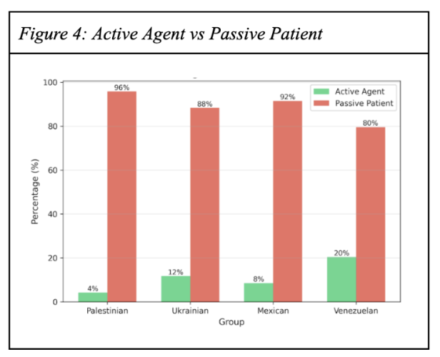
Findings: Transitivity & Grammatical Agency
Palestinians → violence & destruction (passive victims)
Ukrainians → active escape & defense (rational actors)
Mexicans → movement & transgression (criminal trespassers)
Venezuelans → administrative verbs (processed by the state)
Evaluative Hierarchy
Palestinians → sympathetic victims without agency; pity without empowerment
Ukrainians → Complex humans, vulnerable and rational
Latin Americans → Administrative problems, emigration is a logistical problem rather than a humanitarian crisis
Net Agency Scores:
Palestinians: -92
Ukrainians: -77
Mexicans: -83
Venezuelans: -59

Slide 10
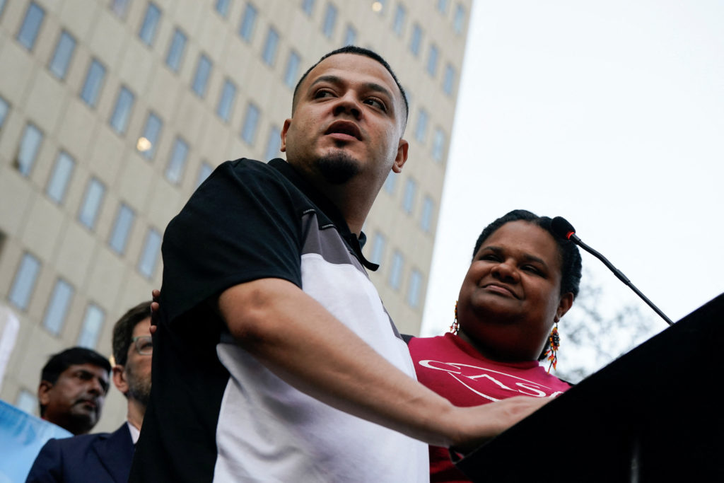
Case Study 1: Kilmar Abrego García
Kilmar Abrego García: Salvadoran Asylum-Seeker
Wrongfully deported from the U.S. for unfounded gang affiliation and human trafficking charges, later detained again
“Alleged” (unproven) association with MS-13
Coverage Split:
Fox News: criminal illegal alien, public safety threat
Daily Mail: gangbanger, “worst of the worst”
NYT: procedural framing (“wrongfully expelled”)
Independent: humanizing (Maryland construction worker, father of 3) explicit denial of gang ties

Slide 11
Fox News
Democrats outraged that alleged gang member could be sent to Uganda ‘Maryland man’ Kilmar Abrego García exposed in public records as ‘violent’ repeat wife beater
Democrats are expressing outrage that alleged gang member and illegal immigrant Kilmar Abrego García may be deported to Uganda… (DHS) posted on its official X account, "Kilmar Abrego Garcia is not and will never be a Maryland Man—he is a criminal illegal alien from El Salvador and public safety threat." … DHS called it "insane" that "sanctuary politicians chose to glorify and stand with an MS-13 gang member over the safety of American citizens.
New York Times
Abrego García Detained Again After Government Signaled It Would Re-Deport Him
Kilmar Armando Abrego Garcia, the immigrant who was wrongfully expelled to El Salvador in March and then brought back to face criminal charges, was detained again on Monday after the administration indicated that it planned to re-deport him to Uganda.

Slide 12
Daily Mail
Migrant Kilmar Abrego García’s two word insult for Trump as he’s arrested again by ICE and branded a ‘gangbanger’
DHS Secretary Kristi Noem slammed 'activist liberal judges' for Abrego Garcia's release from prison… (she) said: 'Activist liberal judges have attempted to obstruct our law enforcement every step of the way in removing the worst of the worst criminal illegal aliens from our country…Today, we reached a new low with this publicity hungry Maryland judge mandating this illegal alien who is a MS-13 gang member, human trafficker, serial domestic abuser, and child predator be allowed free,' she added.
The Independent
Kilmar Abrego García is back in jail and facing deportation. Here’s what to know
The Maryland construction worker, 30, was detained Monday in Baltimore by U.S. Customs and Immigration Enforcement after leaving a Tennessee jail on Friday. Administration officials have said he's part of the dangerous MS-13 gang, an allegation Abrego Garcia denies.

Slide 13
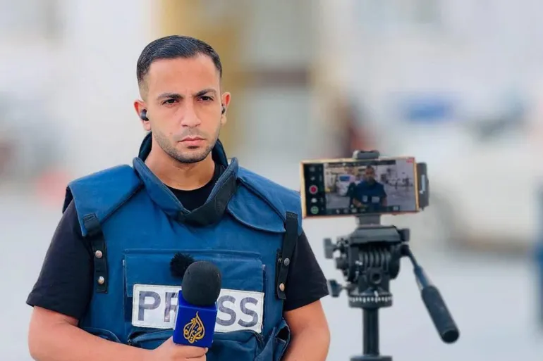
Case Study 2: Anas al-Sharif
Anas al-Sharif: Palestinian Al-Jazeera journalist in Gaza
Murdered by a targeted Israeli airstrike
One of hundreds of devastating and egregious displays of humanitarian law violations by Israel
Coverage split:
Fox News / Daily Mail: terrorist posing as a journalist
New York Times: more balanced, but state narrative foregrounded
Independent: humanized through direct quotes

Slide 14
Fox News
Israel says Al Jazeera journalist killed in airstrike was head of Hamas ‘terrorist cell’
The IDF struck the terrorist Anas al-Sharif, who posed as a journalist for Al-Jazeera Network, the Israeli military said in a statement. Anas al-Sharif served as the head of a terrorist cell in the Hamas terrorist organization and was responsible for advancing rocket attacks against Israeli civilians and IDF troops.
New York Times
Israel Strike Kills Al Jazeera Journalists, Network Says
The Israeli military [said] that it had targeted “the terrorist Anas al-Sharif, who posed as a journalist for the Al Jazeera network,” and had taken steps to “mitigate harm to civilians”... [they] accused Mr. al-Sharif of being “the head of a terrorist cell”... but Al Jazeera and Mr. al-Sharif denied the accusation, with the network saying the allegations were fabricated

Slide 15
Daily Mail
Israel kills Al Jazeera journalist it says was Hamas leader
Israel’s military said it targeted and killed a Hamas cell leader posing as an Al Jazeera journalist in an airstrike on Gaza City… “Al Sharif was the head of a Hamas cell and was responsible for advancing rocket attacks against civilians and IDF troops.” the Israeli military said in a statement, citing intelligence and documents found in Gaza as evidence.
The Independent
Anas al-Sharif: Who was the Al Jazeera journalist killed by Israel?
Since joining the Qatari broadcaster in December 2023, the father of two reported almost daily on the suffering of Palestinians in northern Gaza… Responding to the allegations, al-Sharif said: “I, Anas al-Sharif, am a journalist with no political affiliations. My only mission is to report the truth from the ground — as it is, without bias.

Slide 16
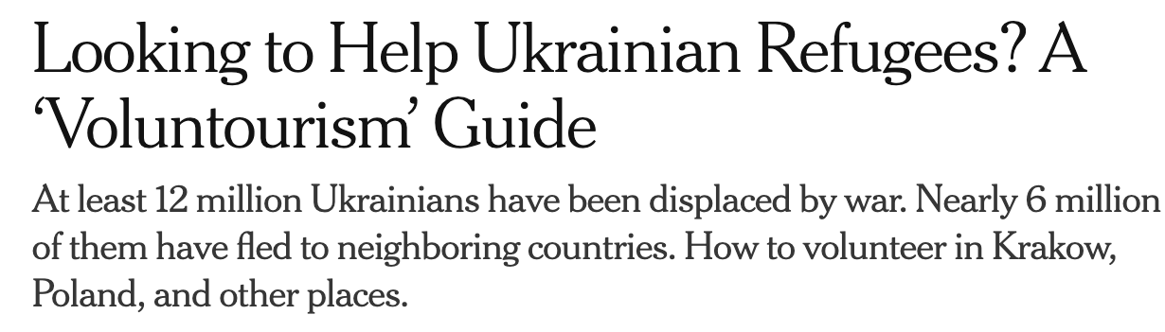
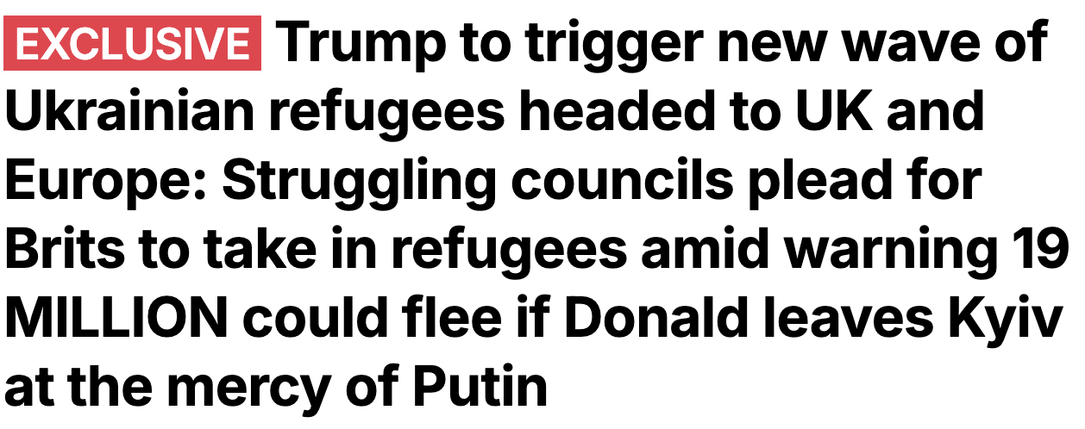
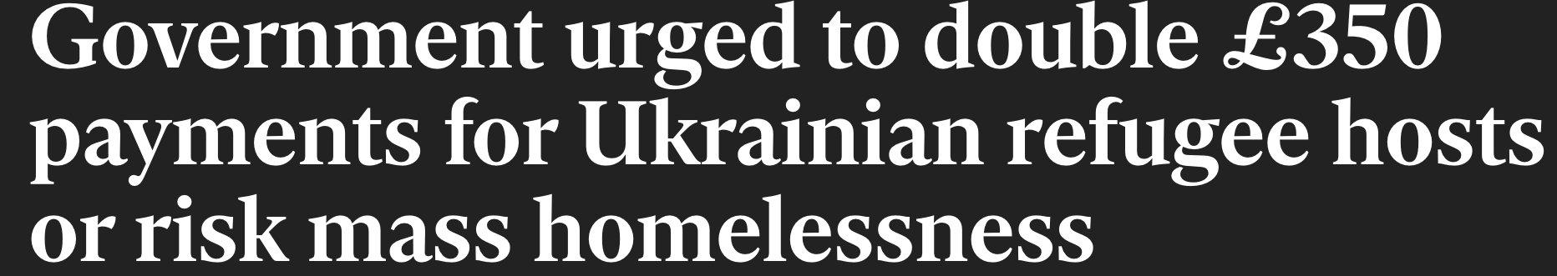
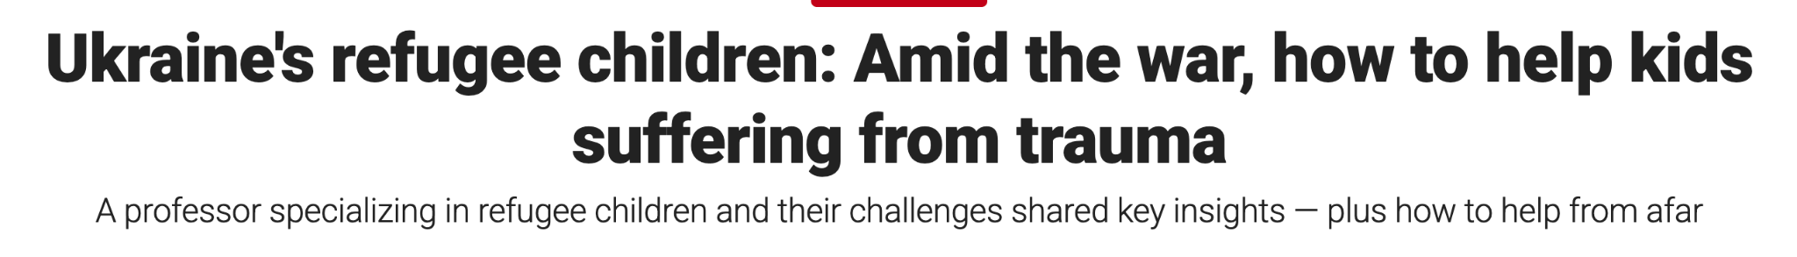
Ukraine Exception
Right-leaning and left-leaning media agree on Ukrainian humanity
The only population that receives unanimous support and sympathy
Empathy is possible, but selectively implied
The difference in media coverage isn’t about displacement itself, it’s about proximity to whiteness and Western geopolitical alignment

Slide 17
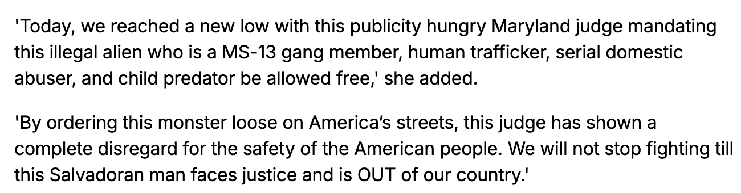
Constructing Threat & Legitimacy
Nominalization as a Weapon
Modifiers and pejorative epithets used to construct an identity that fits the narrative that aligns with the readers
Attribution markers employed to maintain journalistic integrity
https://www.dailymail.co.uk/news/article-15035407/kilmar-abrego-garcia-migrant-arrest-ice-insult-trump.html

Slide 18
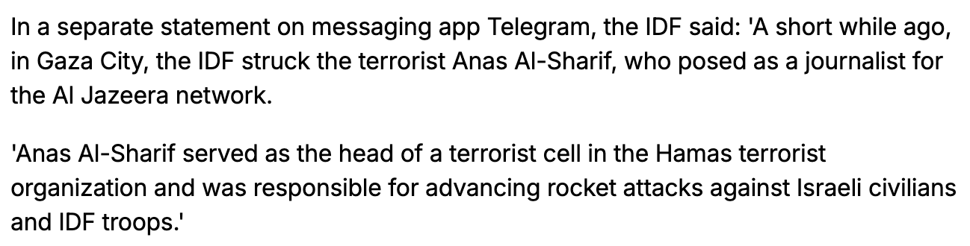
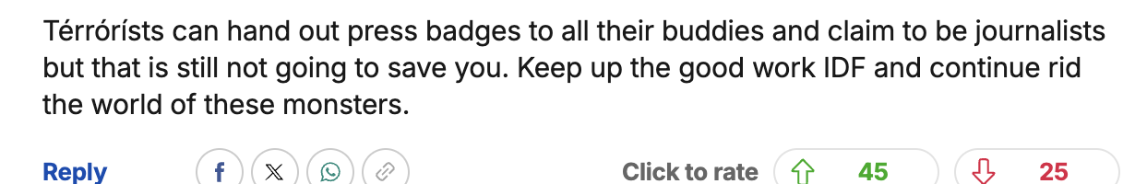
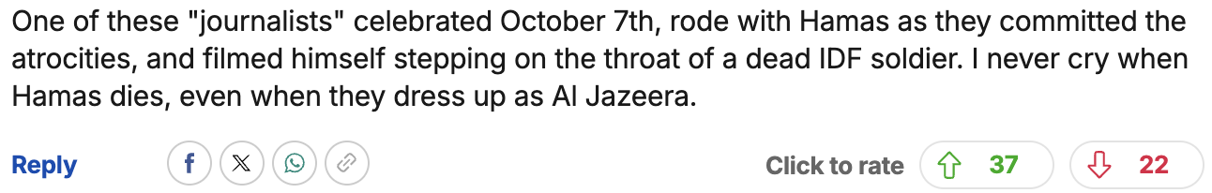
Constructing Threat & Legitimacy
October 7 Perpetual Frame:
“The crisis in Gaza began when Hamas terrorists stormed…”
Palestinian deaths: 61,000 “according to Hamas-led Gaza health authorities”
Every Palestinian death is filtered through this single event. Every death is a response and a justified form of reparation
https://www.dailymail.co.uk/news/article-14988159/Al-Jazeera-journalists-killed-Israeli-strike-tent-Gaza.html

Slide 19
Discourse Boundaries: Explicit Polarization in Partisan Media
Right-leaning | Left-leaning
Explicitly reproduce state or government claims without contest Heavy use of pejorative nominalizations (illegal alien, gangbanger, terrorist) Construct displaced people as threats to security, borders, and “civilization” Provide little or no humanization or contextualization | Tend to present themselves as more neutral Amplify victim voices (direct quotes, family context, humanitarian framing) Use procedural or bureaucratic framing (wrongfully expelled, detained again) Rarely fully contest state narratives, but soften or balance them
Requirements for Humanity
Palestinians must prove they are not affiliated with Hamas
Latinos must prove they’re not criminals
Ukrainians are presumed innocent
Language as Racial Violence
Nominalization: Brown people are threats to civilization (illegal alien, terrorist)
Agentification: White subjects act, brown objects are acted upon
Legitimization: White violence is defense, brown resistance is terrorism

Slide 20
Discussion & Implications
The Objectivity Spectrum
New York Times “undocumented” → Fox News “illegal alien” — same project, different volumes
Coded language provides plausible deniability
Neutral reporting operates within frameworks that predetermine deservingness
The Discursive Construction of Deservingness
Media sors displaced populations by proximity to Western power
Hierarchy maps onto: racial proximity, geopolitical alignment, economic utility
Media Discourse as Border Control
Language constructs how we perceive and handle migration
Every lexical choice participates in determining legal/moral obligations
Linguistic choices affect public perception, policy, and people’s livelihoods
Consequences
Public perception & policy: Criminalizing language legitimizes restrictive migration policies; humanizing frames shift support toward aid. Journalistic practice: Objectivity masks bias; reliance on state sources reproduces official rhetoric; financial/geographic ties constrain independence.
Lived experience: Lexical choices affect asylum outcomes, recognition of suffering, and whether displaced people are supported, surveilled, or expelled.

Slide 21
Conclusions: Linguistic Construction of Human Worth
Palestinians: The Sympathetic Victim Paradox
High humanitarian framing (77% refugee/displaced terms)
85% positive descriptors
95.8% passive voice (lowest agency)
Grievable but not agentive, perpetual victims without capacity for actions. Reaping the consequences of “their actions”
Ukrainians: Complete Humans
60% refugee terms
68% positive descriptors
11.7% active agency (highest)
Both vulnerable and strategic, lots of access and deservingness of humanitarian assistance. International empowerment and common enemy
Latin Americans: Administrative Problem
78% “migrant” (not refugee)
48% positive descriptors (lowest)
Neither grievable nor agentive, problem requiring management. Infiltrators disrupting Western “civility”.
Posed as threats and occupiers

Slide 22
Conclusions: Linguistic Construction of Human Worth
Core Paradox
Even sympathetic coverage can perpetuate disempowerment. Palestinians receive the most humanitarian language yet are denied grammatical agency - proving that pity without empowerment is still dehumanization.
This Reveals that this is not random bias, but systematic hierarchy based on proximity to whiteness, religious identity, and geopolitical alignment with Western interests
The criminalization of migration, the misrepresentation of journalists and working people, and the blatant disparities in how displaced communities are framed are controlled through linguistic and stylistic choices. language sorts displaced people into those worth saving and those worth sacrificing. This sorting system follows predictable lines - race, religion, and geopolitical utility.

Slide 23
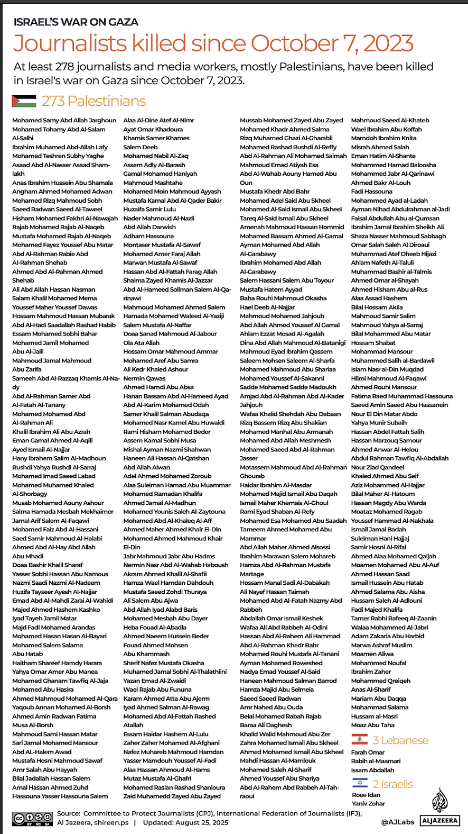
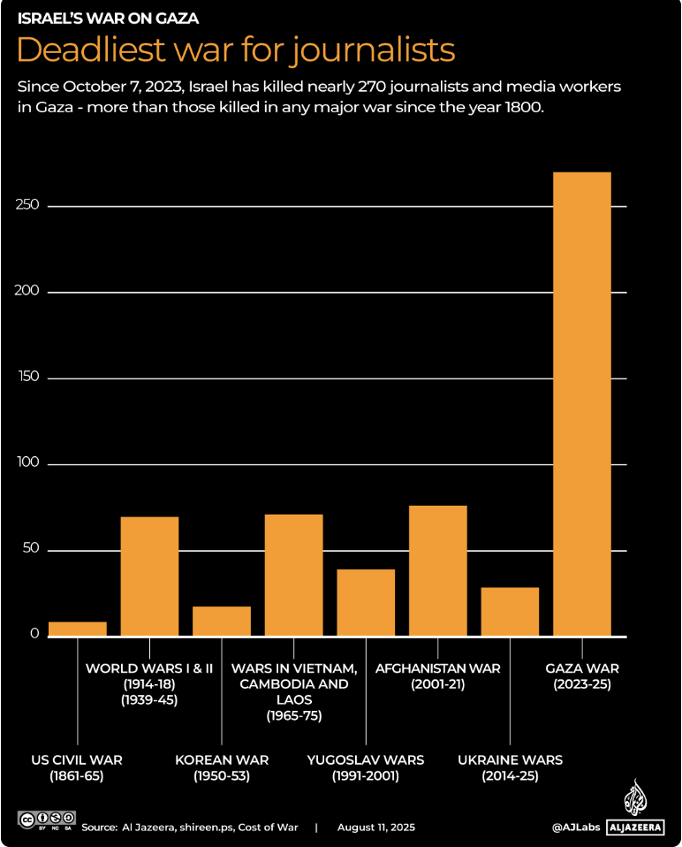
Israel’s War on Journalism & Western Complicity
Over 270 journalists and media workers have been targeted and killed in Gaza since October 2023
Journalists are explicitly protected under International Humanitarian Law. Targeting journalists is a direct and grave breach of the 1949 Geneva Convention
The financial and diplomatic support from the UK and the US shields Israel from accountability. Complicity creates impunity.
Without Western backing, this level of lawlessness would not be possible.

Slide 24
References
Baker, P. (2006). Using Corpora in Discourse Analysis. Continuum.
Butler, J. (2009). Frames of War: When Is Life Grievable? Verso.
Chen, L. et al. (2024). "Detecting Dehumanization: A BERT-based Approach." Computational Linguistics, 50(3).
Gabrielatos, C. & Baker, P. (2008). "Fleeing, Sneaking, Flooding." Journal of English Linguistics, 36(1).
Halliday, M. A. K. (1985). An Introduction to Functional Grammar. Edward Arnold.
KhosraviNik, M. (2010). "The Representation of Refugees, Asylum Seekers and Immigrants." Journal of Language and Politics, 9(1).
Lakoff, G. & Johnson, M. (1980). Metaphors We Live By. University of Chicago Press.
spaCy (Version 3.4.1). Explosion AI.
van Dijk, T. A. (2000). "New(s) Racism: A Discourse Analytical Approach." In Cottle, S. (Ed.), Ethnic Minorities and the Media.
Wodak, R. & Meyer, M. (2009). Methods of Critical Discourse Analysis. Sage.
Zawadzka, K. (2024). "Legitimising Refugees: A CDA of Ukrainian and Non-Ukrainian Refugees in Polish Media." CADAAD, 16(1).
Primary Corpus: CNN. (2021-2025). News articles. Retrieved via GDELT Project
The Guardian. (2021-2025). News articles. Retrieved via Guardian Open Platform API
Supplementary Sources: Fox News, Daily Mail, New York times, The Independent. (2023-2025). Selected articles.

Slide 25
Thank You

