Slide 1
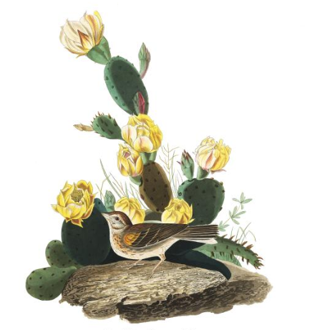
Linking avian pollination and frugivory to Cactaceae seed dispersal and successful facilitation.
Malory Owen
Master’s Thesis Proposal
Principal Investigator: Dr. Chris Lortie
Committee: Dr. Chris Lortie & Dr. Bridget Stutchbury

Slide 2
Positive Interactions
Positive Interactions
Facilitation
Foundational species
Keystone species

Slide 3
In the desert
Desert Ecosystems
Provides water and shade
Protects against herbivory, wind, and freezing temperature
Seeds must get to benefactor

Slide 4
Pollination
Magnet Hypothesis

Slide 5
Seed Dispersal
Allocation theory

Slide 6
Big picture questions
How strong are bird interactions for cacti of different
species
reproductive characteristics
Pollinators
Seed dispersers

Slide 7
Chapter 1: Fruiting metrics in Cactaceae—A Meta-Analysis
Comprehensive review and analysis of fruit and seeds in Cactaceae
Synthesize reports on allocation theory
Research Questions:
Do larger cacti individuals within the same species produce more fruits and/or larger fruits?
Do larger cacti individuals within the same species produce more seeds and/or larger seeds?
Do larger fruits produce more seeds compared within the same species?

Slide 8
Methods
Search terms: “cact*”, “seed”, “fruit”, “allocat*”, and “size”
Published in last 5 years
Ecology in discipline
Report regression or correlation coefficient

Slide 9
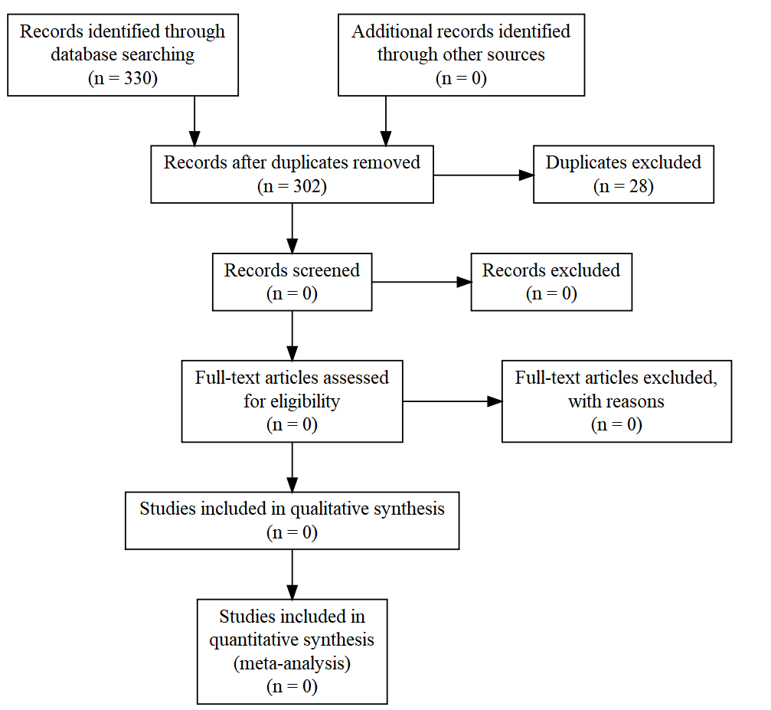

Slide 10
Chapter 2: Strength of birds as pollinators and seed dispersers in Cactaceae
Purpose:
Test strength pollinating and frugivorous birds to observed and experimentally manipulated characteristics of 3 taxa of cacti
Research Questions:
Is cactus size an indicator for fruit mass/abundance? For flower abundance?
Is there a positive relationship between number of seeds per fruit and fruit size in the cacti of interest?
Are frugivorous birds stronger dispersers for larger cacti?
Are pollinating birds (hummingbirds) optimally foraging at larger cacti?

Slide 11
Hypothesis & Predictions
Cacti size and flower, fruit, and seed production are positively related.
Larger cacti will produce more flowers, fruits, and seeds, as well as more massive fruits and seeds.
This will be true within species, but not between species.
Fruit mass and seed abundance are positively related.
Larger individual fruits will have more seeds than smaller fruits.
Frugivorous and pollinating birds optimally forage at cacti.
Birds will more frequently pollinate larger cacti, which have more flowers.
Birds will more frequently eat fruit at larger cacti, which have larger/more fruits.

Slide 12
Variables
Explanatory Variables
Mesohabitat: Open/Cactus
Species
Size: Small, Medium, Large
Percent fruit/flower: 0%, 50%, 100%
Response Variables
Mass of individual fruits
Mass of individual seeds
Number of fruits per cactus
Number of seeds per fruit
Species richness and diversity per cactus
Proportion of frugivorous birds present relative to non frugivorous birds

Slide 13
Study Sites
Sites
Sweeney Granite Mountains Desert Research Center, Mojave Desert
Wind Wolves Preserve, San Joaquin Valley

Slide 14
Study Species
Opuntia basilaris var. basilaris, Beavertail
Opuntia basilaris var. treleasei, Bakersfield Cactus
Cylindropuntia anthrocarpa

Slide 15
Methods: Site Metrics
Cactus density/diversity
Transects: 100m each, every 5m, 10m apart, 6 replicates
Bird density/diversity
1km transects
Every 7 days
All birds seen or heard
Cactus metrics
100 individuals of each species
Branching
X, Y, Z

Slide 16
Methods: Flowering Experiment
10 replicates of each combination of variables
270 total individuals
Showiness
Manipulated: 0%, 50%, 100% buds on cactus
Remove
Size
Small, medium, large
Binned after preliminary field season
Species
O. basilaris var. basilaris, O. basiliaris var. treleasei, C. anthrocarpa

Slide 17
Methods: Flowering Experiment
Focal observations
200-500mm digital camera
1 hour sessions in morning/evening
4 replications per variable combination and open
40 hours total

