Slide 1
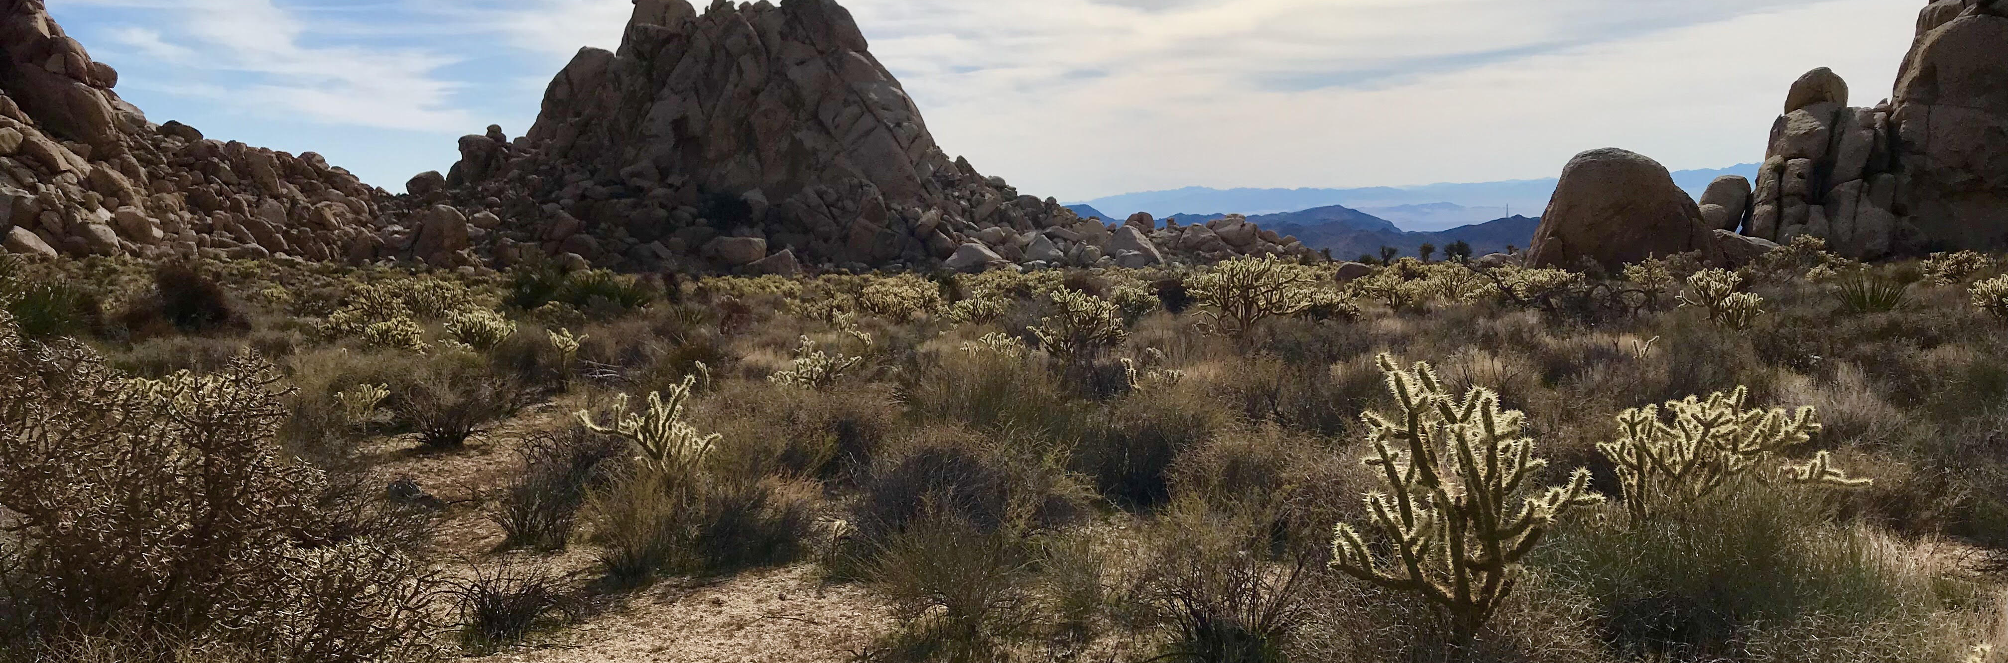


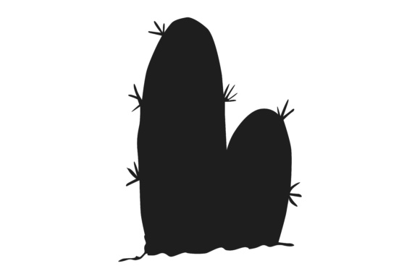













Metrics for Avian Double Mutualistic Interactions with Cactaceae A Preliminary Analysis towards Network Interactions in a Desert Ecosystem
Malory Owen¹ | Dr. Chris Lortie¹ | York University¹
Question
Methods
What species of cacti are most likely to facilitate double mutualistic interactions with birds?
Cylindropuntia acanthocarpa & Cylindropuntia enchinocarpa: walk 6 and 9 transects, respectively
Opuntia basilaris: haphazard
Major axis, minor axis, vertical axis
Health index 1-5
Scarification, rot, branch death
Geotag
Double Mutualism & Facilitation
Positive interactions drive ecosystem infrastructure
Birds are nectarivores and frugivores of cacti¹
Double mutualism: two positive interactions between interspecifics²
Harsh environments promote double mutualism³
Cacti are desert foundational species⁴
Results
Conclusion
Fish recruitment is influenced by degradation
The positive-feedback loop, triggered by disturbance events and perpetuated by habitat degradation, acoustic change, and reduced recruitment, presents challenge for reef recovery
But also a potential solution for restoration
Audio playbacks ethical for bringing fish back to reef?
Significantly quieter soundscape for all indices (Wilcoxon Signed-Rank, ACI, AC, SR, SPL, P=0.010, 0.002, 0.010, 0.002, PERMANOVA, P=0.005)
Figure 1: Do birds pollinate and disperse seeds of foundational plants?
Figure 2: Nectarivores visit higher and showier floral displays.⁵
Works Cited
Hypotheses and Predictions
de Groot, R. et al. Global estimates of the value of ecosystems and their services in monetary units. Ecosyst. Serv. 1, 50–61 (2012)
Baker, A. C., Glynn, P. W. & Riegl, B. Climate change and coral reef bleaching: An ecological assessment of long-term impacts, recovery trends and future outlook. Estuar. Coast. Shelf Sci. 80, 435–471 (2008).
Hughes, T. P. et al. Phase Shifts, Herbivory, and the Resilience of Coral Reefs to Climate Change. Curr. Biol. 17, 360–365 (2007).
Some cactus species are more attractive to pollinating and frugivorous birds than other
Different cactuses will have different sizes and health which may impact bird visitation
Fish recruitment was 40% lower in degraded soundscapes for all life stages (GLMM, P=0.002, P<0.001), taxa, and trophic levels (LMM, P ≤ 0.001–0.035, P ≤ 0.001–0.029)
Notes:
To change this poster, replace our sample content with your own. Or, if you'd rather start from a clean slate, press the New Slide button on the Home tab to insert a new page. Now enter your text and pictures in the empty placeholders. If you need more placeholders for titles, subtitles or body text, copy any of the existing placeholders, then drag the new one into place.

Slide 2






Slide 3




