Slide 1
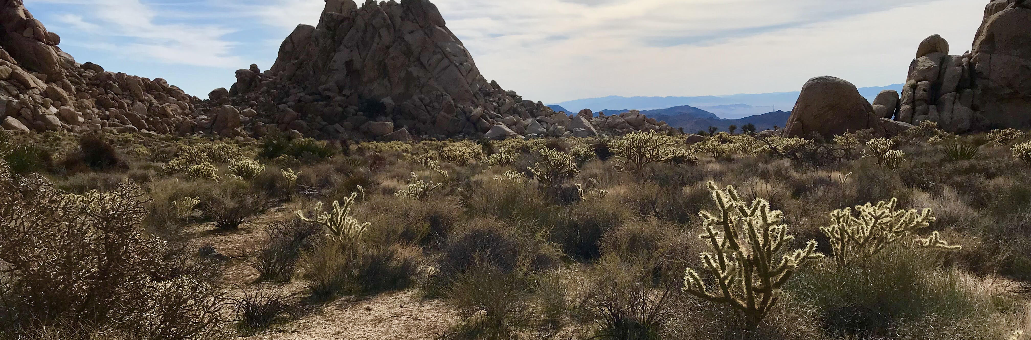
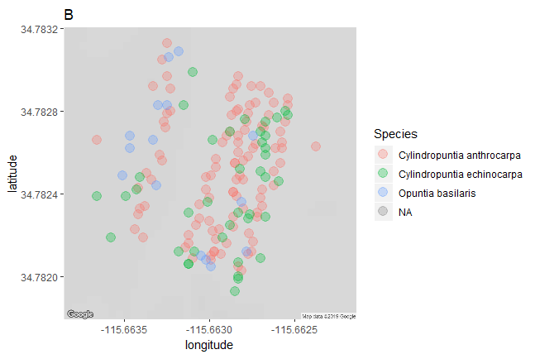


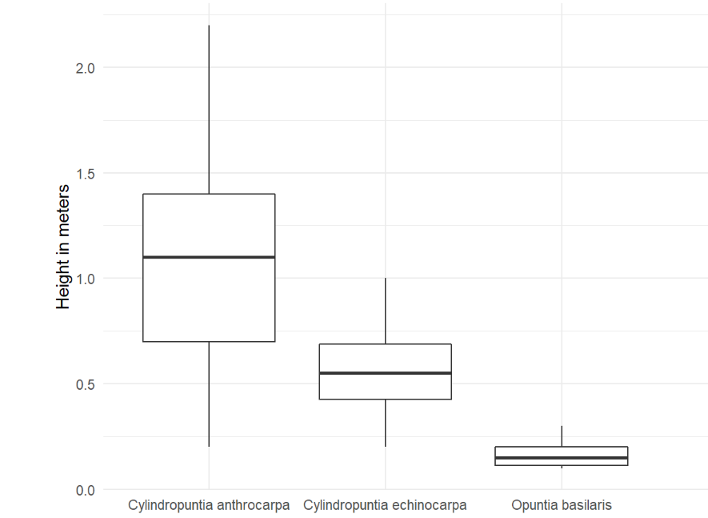

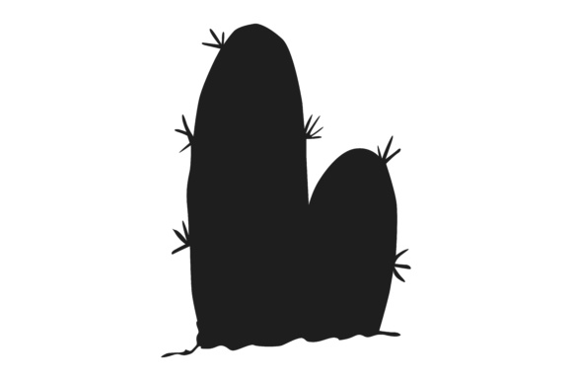


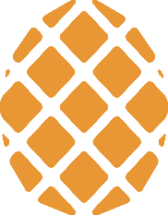


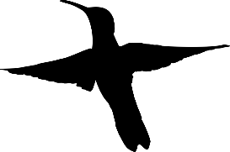


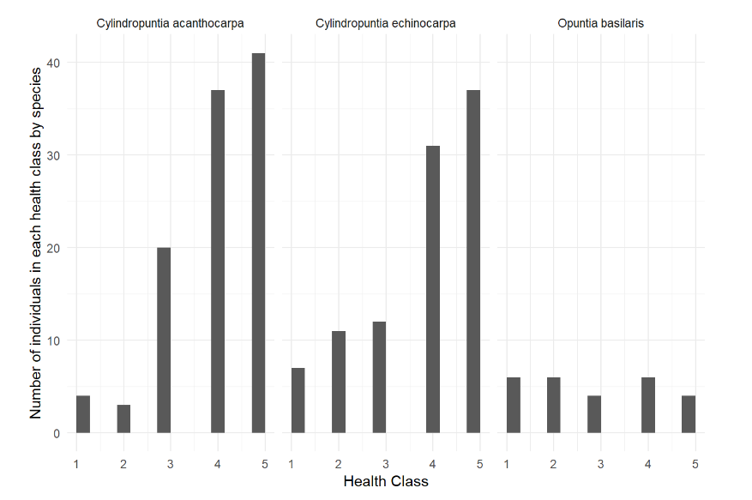



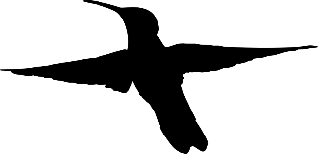
Metrics for Avian Double Mutualistic Interactions with Cactaceae A Preliminary Analysis towards Network Interactions in a Desert Ecosystem
Malory Owen¹ | Dr. Chris Lortie¹ | York University¹
Question
Methods
What species of cacti are most likely to facilitate double mutualistic interactions with birds?
Cylindropuntia acanthocarpa & Cylindropuntia enchinocarpa: walk 6 and 9 transects, respectively
Opuntia basilaris: haphazard
Major axis, minor axis, vertical axis
Health index 1-5
Scarification, rot, branch death
Geotag
Double Mutualism & Facilitation
Positive interactions drive ecosystem infrastructure¹
Birds are nectarivores and frugivores of cacti^{2, 3}
Double mutualism: two positive interactions between interspecifics⁴
Harsh environments promote double mutualism⁵
Cacti are desert foundational species⁶
Results
Figure 3: C. acanthocarpa was the most abundant and O. basilaris was the least abundant
Table 1: C. acanthocarpa had the largest size class bins.
Species | Small | Medium | Large
Cylindropuntia acanthocarpa | <85cm | 86cm - 152cm | >153cm
Cylindropuntia echinocarpa | <45cm | 46cm - 72cm | >73cm
Opuntia basilaris | <15cm | 16cm - 22cm | >23cm
Figure 4: C. acanthocarpa (1.04 meters) > C. echinocarpa (0.55 meters) > O. basilaris (0.17 meters)
Figure 1: Do birds pollinate and disperse seeds of foundational plants?
Each cactus species had significantly different mean heights (Kruskal-Wallis, Chi-square = 3.71, p > 0.0001, df = 52).
Conclusion
Frequency, size, and health were all strongest in C. acanthocarpa
Health will determine reproductive output, so healthiest species will have most success blooming/fruiting
Larger, more distinct differences in height between individuals more likely to translate to bird behavior
C. acanthocarpa will be study species in further experiments
Figure 2: Nectarivores visit higher and showier floral displays.⁷
Works Cited
Hypotheses and Predictions
Figure 5: C. acanthocarpa and C. echinocarpa had more individuals with health scores of 4 or 5, whereas O. basilaris had a even distribution of health scores.
Callaway, Ragan M. 1997. “Positive interactions in plant communities and the individualistic-continuum concept.” Oecologia 112: 143–49.
Montiel, Salvador, and Carlos Montaña. 2000. “Vertebrate Frugivory and Seed Dispersal of a Chihuahuan Desert Cactus” 146 (2): 221–29.
Gorostiague, P., and P. Ortega-Baes. 2016. “How specialised is bird pollination in the Cactaceae?” Plant Biology 18 (1): 63–72. doi:10.1111/plb.12297.
Kelly, Dave, Jenny J Ladley, Alastair W Robertson, and Jenny J Ladley. 2004. “Is dispersal easier than pollination ? Two tests in New Zealand Loranthaceae.” New Zealand Journal of Botany 42: 89–103. doi:10.1080/0028825X.2004.9512892.
Garcia, Maria B., Xavier Espadaler, and Jens M. Olesen. 2012. “Extreme Reproduction and Survival of a True Cliffhanger : The Endangered Plant Borderea chouardii.” PLOS One 7 (9): 1–7. doi:10.1371/journal.pone.0044657.
Filazzola, A., Lortie, C. J. 2014. “A systematic review and conceptual framework for the mechanistic pathways of nurse plants.” Global Ecology and Biogeography 23 (12): 1335-1345.
Wolf, L. L., and Hainsworth, A.R. 1990. “Non-Random Foraging by Hummingbirds : Patterns of Movement Between Ipomopsis.” Functional Ecology 4 (2): 149–57.
Some cactus species are more attractive to pollinating and frugivorous birds than other
Different cactuses will have different sizes and health which may impact bird visitation
C. acanthocarpa and C. echinocarpa are healthier than O. basilaris (Pearson’s Chi-squared Test, X-squared = 27.325, df = 8, p > 0.001).
Notes:
To change this poster, replace our sample content with your own. Or, if you'd rather start from a clean slate, press the New Slide button on the Home tab to insert a new page. Now enter your text and pictures in the empty placeholders. If you need more placeholders for titles, subtitles or body text, copy any of the existing placeholders, then drag the new one into place.

Slide 2



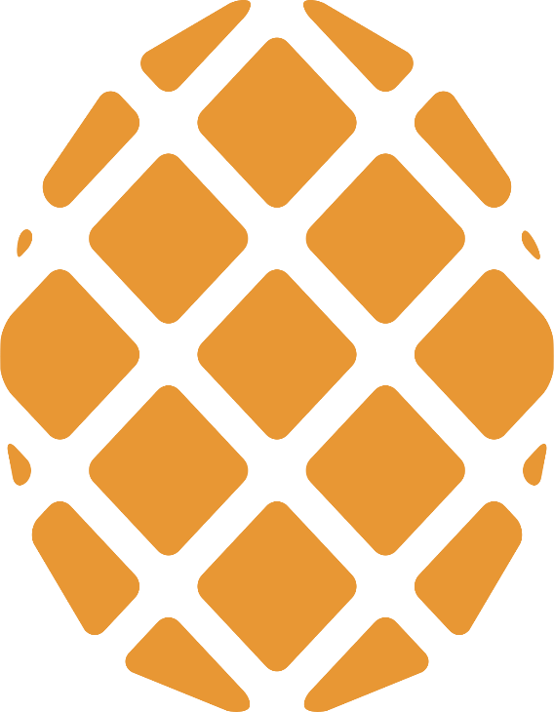


Slide 3




