Slide 1
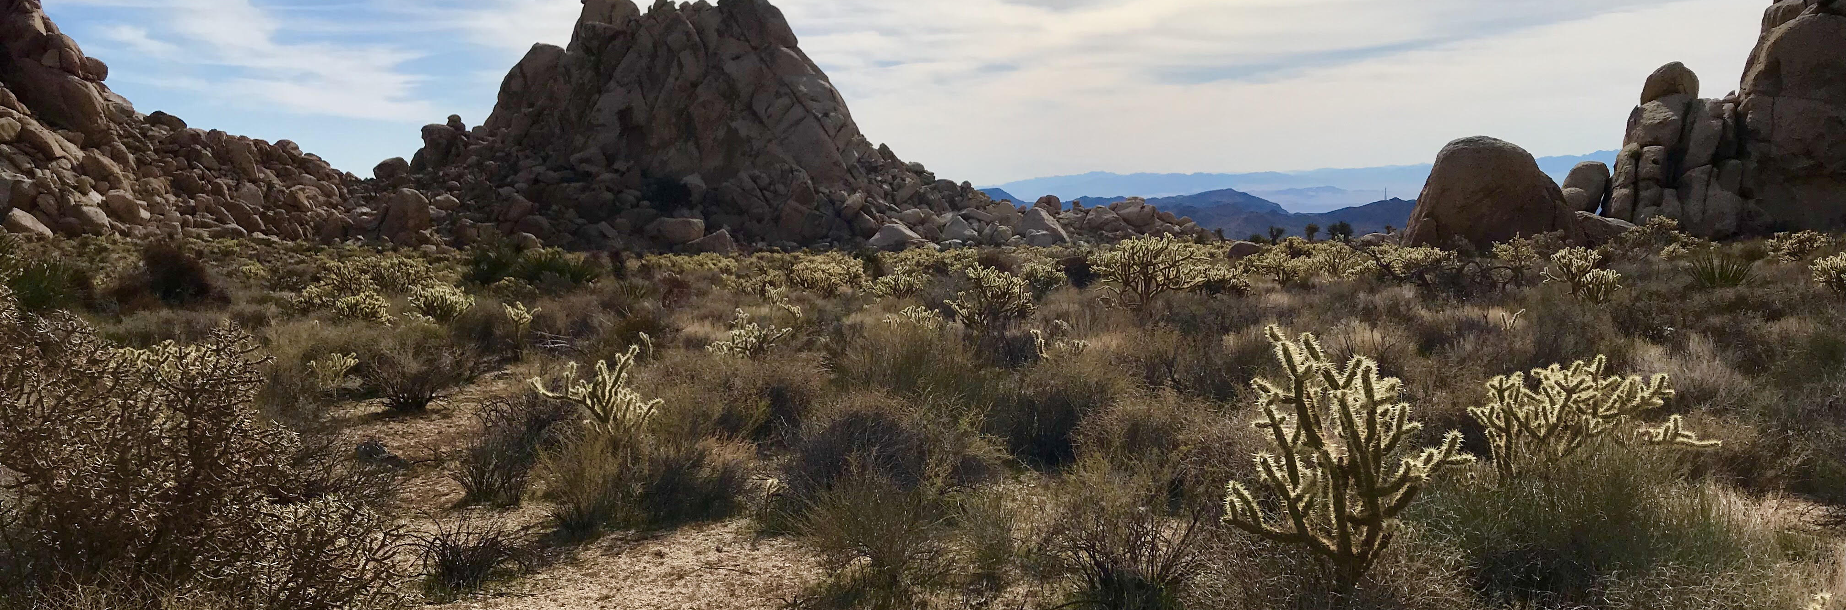


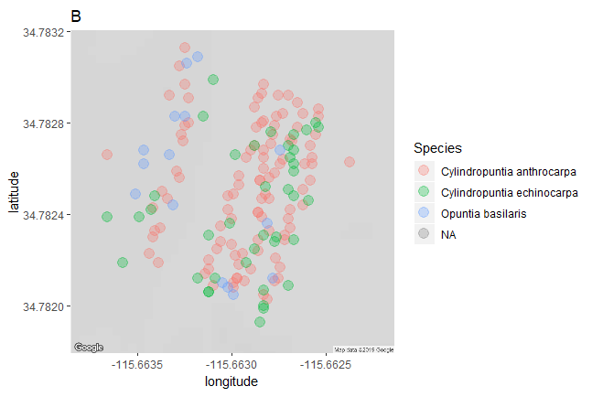

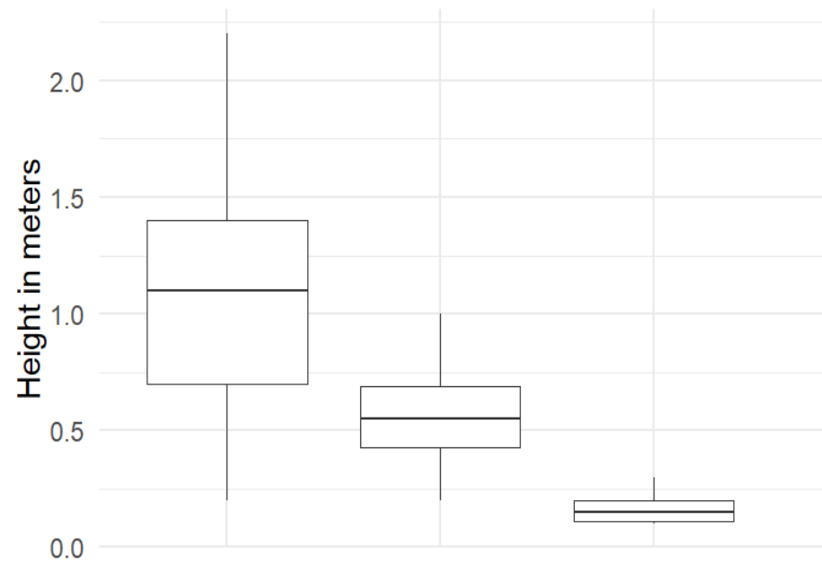

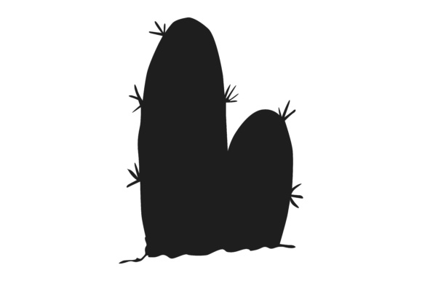








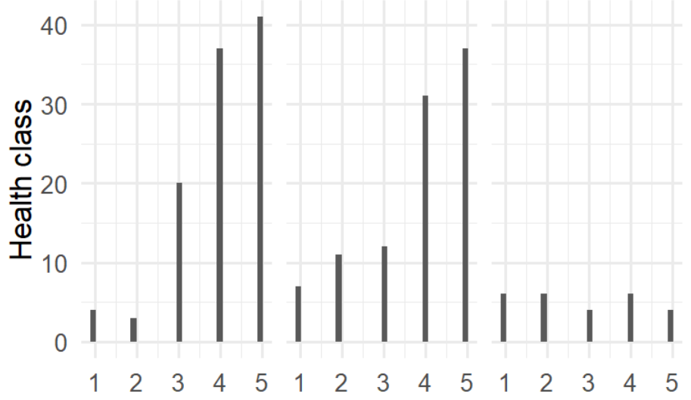




A Prickly Situation: Contrasting frequency and morphological measures in three cactus species
Malory Owen¹ | Dr. Chris Lortie¹ | York University¹ | www.ecoblender.org¹
Question
Methods
What measurable characteristics determine ecologically functional differences in three species of cacti?
Transects or haphazard sampling
Major axis, minor axis, vertical axis
Health index 1-5
Scarification, rot, branch death
Double Mutualism & Facilitation
Positive interactions drive ecosystem infrastructure¹
Birds are nectarivores and frugivores of cacti^{2, 3}
Double mutualism: two positive interactions between interspecifics⁴
Harsh environments promote double mutualism⁵
Cacti are desert foundational species⁶
Results
Figure 4:
C. acanthocarpa (1.04 meters) >
C. echinocarpa (0.55 meters) >
O. basilaris (0.17 meters)
Figure 3: C. acanthocarpa was the most abundant and O. basilaris was the least abundant
Table 1: C. acanthocarpa had the largest size class bins.
Species | Small | Medium | Large
Cylindropuntia acanthocarpa | <85cm | 86cm - 152cm | >153cm
Cylindropuntia echinocarpa | <45cm | 46cm - 72cm | >73cm
Opuntia basilaris | <15cm | 16cm - 22cm | >23cm
Cylindropuntia Cylindropuntia Opuntia
acanthocarpa echinocarpa basilaris
Conclusions/Future Research
Figure 1: Do birds pollinate and disperse seeds of foundational plants?
Each cactus species had significantly different mean heights (Kruskal-Wallis, Chi-square = 3.71, p > 0.0001, df = 52).
Because health and size may be strong predictors of reproductive output, all three cactus species will likely fulfill different ecological interaction niches. Additional studies surveying reproductive outputs against these traits will provide further insight into the way phenotypical differences impact positive interactions, mutualism, and eventual facilitation. These easily reproducible studies can be expanded upon by monitoring nectarivorous and frugivorous interactors at different phenological stages.
Number of individuals in each health class
Figure 2: Nectarivores visit higher and showier floral displays.⁷
Works Cited
Hypotheses and Predictions
Health Class
Callaway, Ragan M. 1997. “Positive interactions in plant communities and the individualistic-continuum concept.” Oecologia 112: 143–49.
Montiel, Salvador, and Carlos Montaña. 2000. “Vertebrate Frugivory and Seed Dispersal of a Chihuahuan Desert Cactus” 146 (2): 221–29.
Gorostiague, P., and P. Ortega-Baes. 2016. “How specialised is bird pollination in the Cactaceae?” Plant Biology 18 (1): 63–72. doi:10.1111/plb.12297.
Kelly, Dave, Jenny J Ladley, Alastair W Robertson, and Jenny J Ladley. 2004. “Is dispersal easier than pollination ? Two tests in New Zealand Loranthaceae.” New Zealand Journal of Botany 42: 89–103. doi:10.1080/0028825X.2004.9512892.
Garcia, Maria B., Xavier Espadaler, and Jens M. Olesen. 2012. “Extreme Reproduction and Survival of a True Cliffhanger : The Endangered Plant Borderea chouardii.” PLOS One 7 (9): 1–7. doi:10.1371/journal.pone.0044657.
Filazzola, A., Lortie, C. J. 2014. “A systematic review and conceptual framework for the mechanistic pathways of nurse plants.” Global Ecology and Biogeography 23 (12): 1335-1345.
Wolf, L. L., and Hainsworth, A.R. 1990. “Non-Random Foraging by Hummingbirds : Patterns of Movement Between Ipomopsis.” Functional Ecology 4 (2): 149–57.
Figure 5: C. acanthocarpa and C. echinocarpa had more individuals with health scores of 4 or 5, whereas O. basilaris had a even distribution of health scores.
Different species of cacti occupy different ecological and facilitating niches.
Different cactuses will have different sizes and health which impacts interactor visitation.
C. acanthocarpa and C. echinocarpa are healthier than O. basilaris (Pearson’s Chi-squared Test, X-squared = 27.325, df = 8, p > 0.001).
Notes:
To change this poster, replace our sample content with your own. Or, if you'd rather start from a clean slate, press the New Slide button on the Home tab to insert a new page. Now enter your text and pictures in the empty placeholders. If you need more placeholders for titles, subtitles or body text, copy any of the existing placeholders, then drag the new one into place.

Slide 2






Slide 3




Slide 4
