Slide 1
Trading Strategy

Slide 3
Overview
Import Section
Estimate Technical Indicator
Setup Trading Signal
Visualization

Slide 4
Import Section

Slide 5
[Date,Volume,Open,Close,High,Low] = importPriceData('Data_LCO_BrentCrudeOil.xlsx');

Slide 6
Estimate Technical Indicator

Slide 7
[Short,Long] = movavg(Close,5,20);

Slide 8
Setup Trading Signal

Slide 9
Signal = zeros(length(Close),1);
Signal(Short > Long) = 1;
Signal(Long > Short) = -1;
I_Buying = (Signal == 1);
I_Selling = (Signal == -1);

Slide 10
Visualization

Slide 11
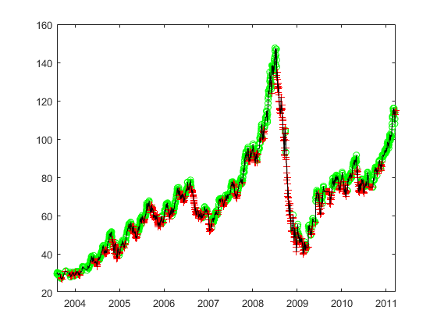
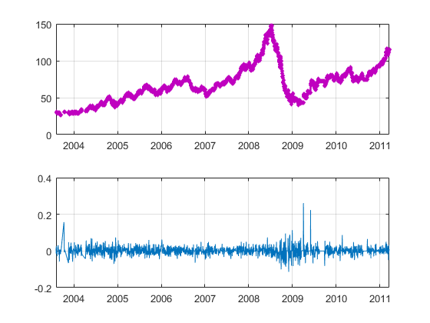
figure; plot(Date(I_Buying),Close(I_Buying),'go');
hold on
plot(Date(I_Selling),Close(I_Selling),'r+');
plot(Date,Close,'k');
createfigure1(Date,Close,Date(2:end),returns)

