Slide 1

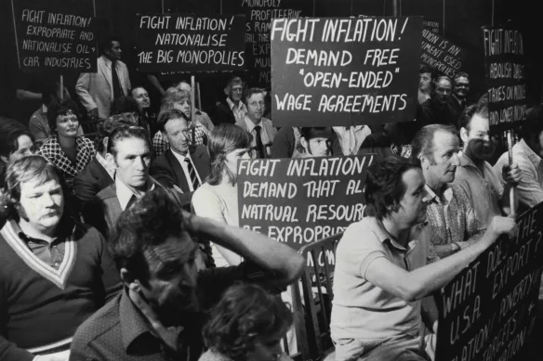
Are we heading for 1970’s-esque inflation?
USYD Fintech Bootcamp - Group 1
Malcolm Miller
Ogaga Edafe
Celine Zhao
Tom Mortlock-Chapman

Slide 2
Executive Summary – Could add some graphic to break this up
Hypothesis:
If current economic conditions are similar to the 1960-70’s, can we expect similar rampant inflation to the 1970’s?
Critical Questions (Agenda):
What was the economic climate in the decade preceding the 1970’s and how does this compare to the last decade
Is a rise in gold prices a lead indicator for inflation?
Is the stock market a lead indicator for inflation?
How correlated is the wage price index to inflation?
Is government spending correlated to inflation?
Abstract (Outcomes):
Describe whether the questions were answered to your satisfaction, and briefly summarise your findings

Slide 3
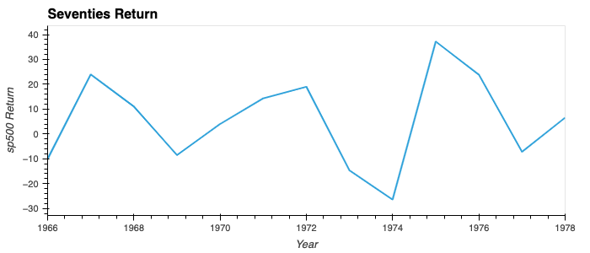
What did the 1970’s look like?
The economic crisis and recession of the mid-70’s was headlined by:
OPEC oil embargo in retaliation to countries supporting Israel in the Israeli-Arab War pumping the price of oil up nearly 300%.
Govt. spending significantly rising to X% of GDP
Stock market crashing in ’74 (-26.47%)
Wage prices rising X.X%
Overall persistent, spiraling inflation to peaks of 20%
STOCK MARKET GRAPH
INFLATION GRAPH OF 60s 70s
DATA TECHNIQUES
S&P 500 data, sourced csv through webpage and used the read_csv format to pull.

Slide 4
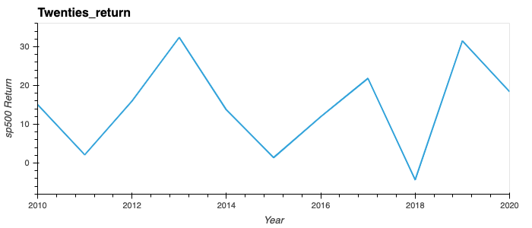
And what are we seeing now?
Significant recent rises in inflation under the guise of similar economic characteristics to the 60/70’s including:
EU embargos on Russian oil due to the conflict in Ukraine
Government spending at record levels
Wage price rising X%
Stock market crashing by 9.34% in 2022
Inflation rising to 8%
GRAPH
GRAPH
DATA TECHNIQUES
S&P 500 data, sourced csv through webpage and used the read_csv format to pull.

Slide 5
Critical Question 1 – Gold…
KEY FINDINGS
GRAPH
GRAPH
DATA TECHNIQUES

Slide 6
Critical Question 2 –
KEY FINDINGS
GRAPH
GRAPH
DATA TECHNIQUES

Slide 7
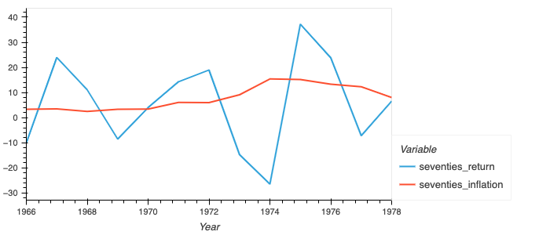
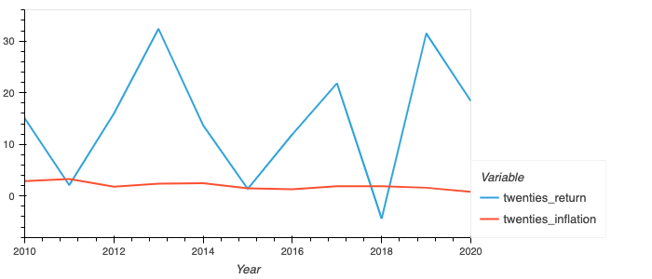
Critical Question 3 –
The stock market is not the most important indicator. However, it is one of the most well-known and widely followed.
Comparing the 70’s to the 20’s – the changes in inflation correlates slightly with the stock market. In more recent times there have been a bit more consistency with the rate of inflation, which makes it easier to spot a macroeconomic issue that may have varying impacts on stocks which could in turn increase market volatility. This still does not serve as an outright indicator. However, historically and even as seen on the seventies chart, higher inflation has correlated with lower stock market returns
GRAPH
GRAPH
DATA TECHNIQUES
S&P 500 data, sourced csv through webpage and used the read_csv format to pull.

Slide 8
Critical Question 4 –
KEY FINDINGS
GRAPH
GRAPH
DATA TECHNIQUES

Slide 9
Conclusion – Could add some graphic to break this up
Results - Critical Questions:
Similarities between periods outweighed differences?
Gold…
Govt. Spending…
Stock Market vs. CPI…
Wage Price Index…
Limitations
Infinite economic metrics to consider
If there was a definitive metric to approach and then you would hope our govt would have found it by now
Data sourcing limitations….
Answer to hypothesis…
Concluding statement describing whether the questions were answered to your satisfaction, and briefly summarise your findings

