Slide 1
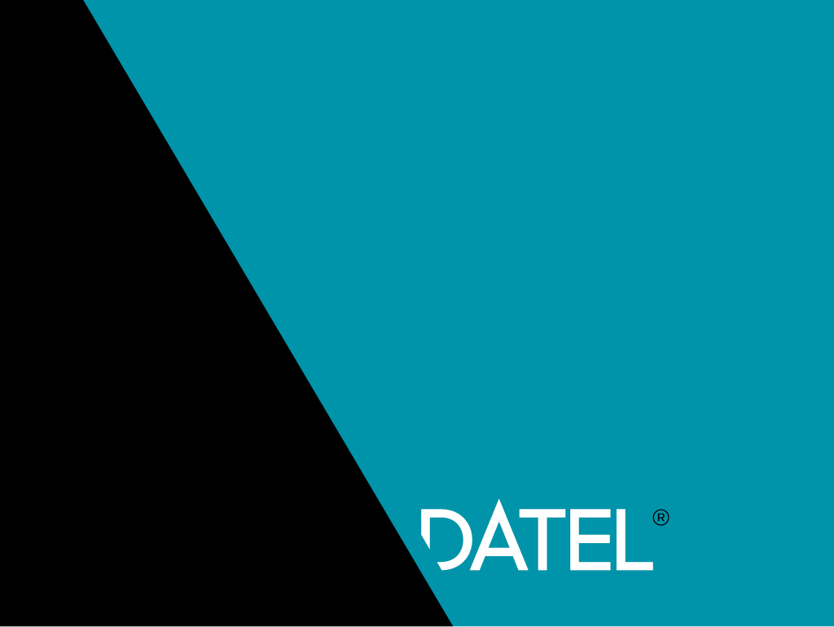
Tarkvara arhitektuur ja Arehitekt
05.11.2018
https://ee.linkedin.com/in/andrius-lokotaš-b95a4459

Slide 2

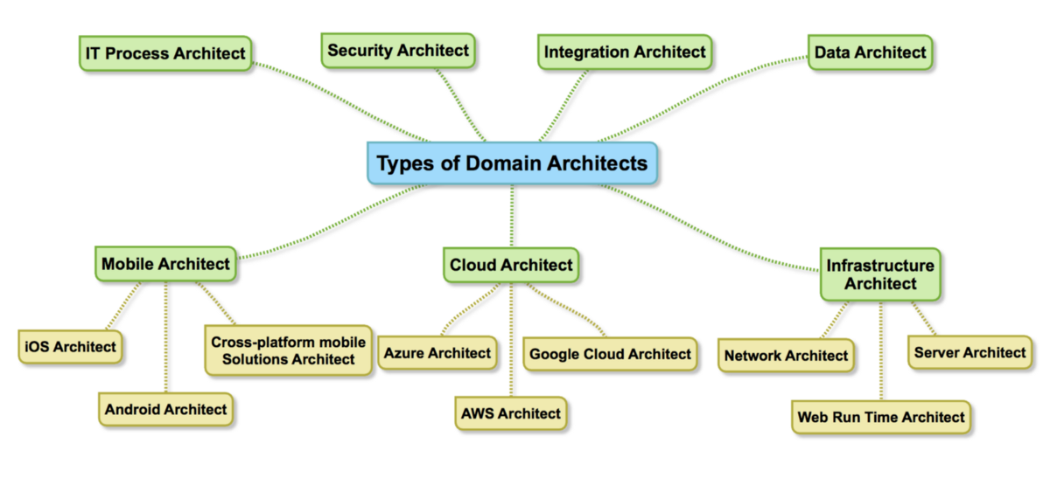
Kes on Arhitekt?
Arvasite et see on universaalne ühtne roll? … ei ole ☺

Slide 3
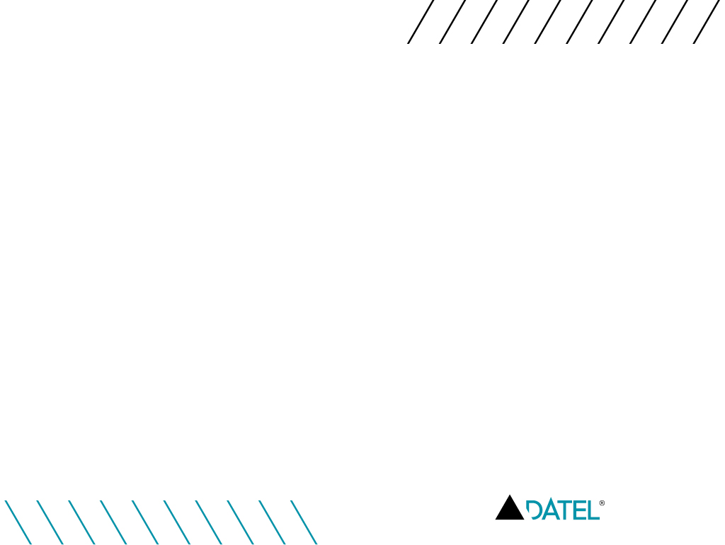
Arhitektide tüübid
System architect.
Solution architect.
Enterprise architect.
○ Affects one system and builds connections within it.
○ Focuses on the technical component of the development.
○ Helps the project manager to make management decisions.
○ Has deep knowledge of the technologies.
○ Participates in discussions of business.
○ Creates connections between several systems.
○ Provides communication between several teams.
○ Designs connections between systems.
○ Codes independently only solution prototypes.
○ Acts as a universal soldier of business and technology.
○ Affects all development of the company.
○ Works with high-level abstractions of the created systems.
○ Provides technical communications throughout the company.
○ Does not interact with the code.
○ Focuses on the business component.
○ Has a broad technical horizon.
○ Owns several domains.

Slide 4
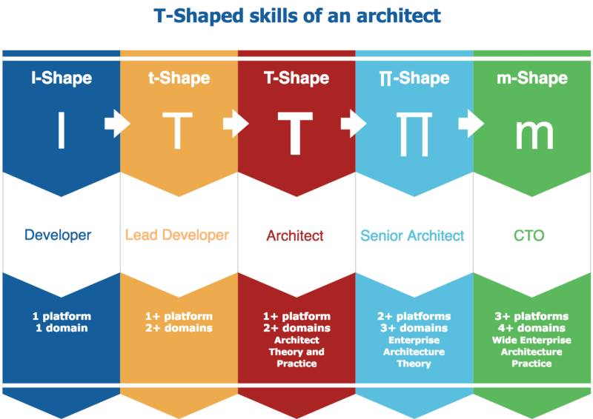
For example, developer level growth is described by a vertical bar. The developer learns new knowledge about frameworks, language, and development tools within the limits of one technical stack. The architect, however, must possess not only deep knowledge, but also have broad technical erudition across several platforms.
A domain architect must control the entire product development cycle. And being the closest person to the technical component of the platform and, at the same time, seeing it as a whole picture, the architect is fully responsible for the quality of the product on a particular platform.
* CTO = Chief technology officer

Slide 5
Teooria…
Kuidas meid on õpetatud ja mida alguses proovime teha…

Slide 6
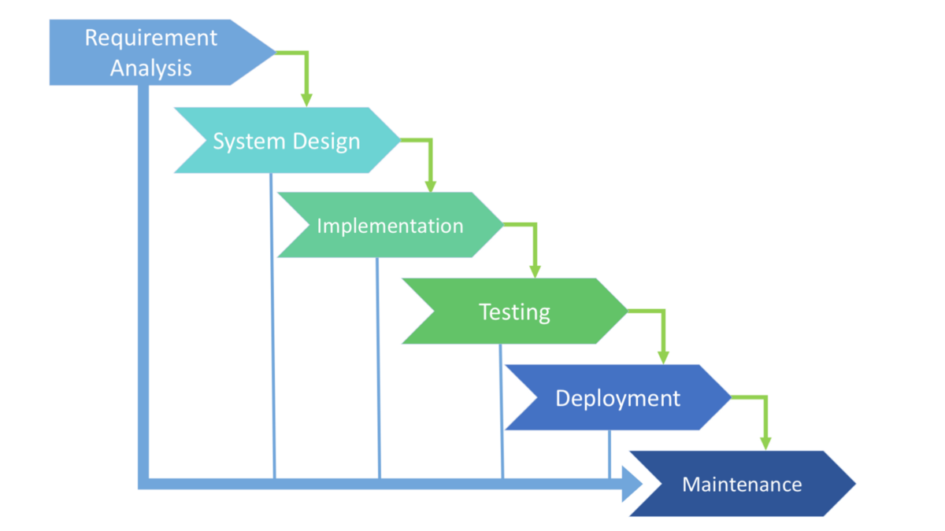
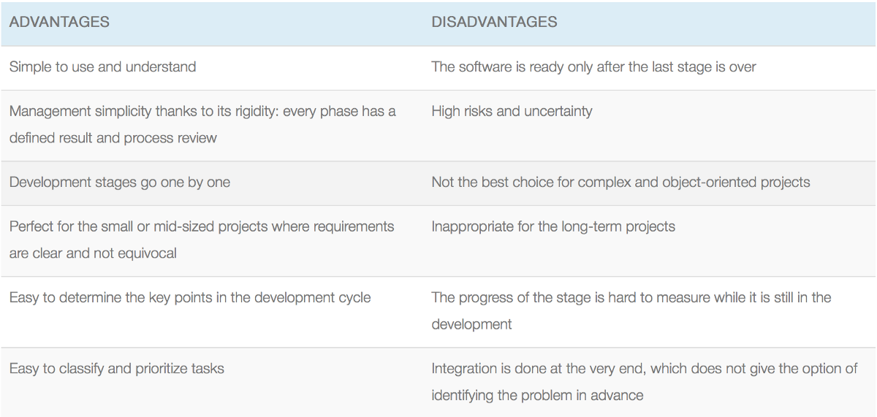
Waterfall SDLC* Model
Waterfall — is a cascade SDLC model, in which development process looks like the flow, moving step by step through the phases of analysis, projecting, realization, testing, implementation, and support. This SDLC model includes gradual execution of every stage completely. This process is strictly documented and predefined with features expected to every phase of this software development life cycle model.
Use cases for the Waterfall SDLC model:
The requirements are precisely documented
Product definition is stable
The technologies stack is predefined which makes it not dynamic
No ambiguous requirements
The project is short
* Software Development Life Cycle

Slide 7
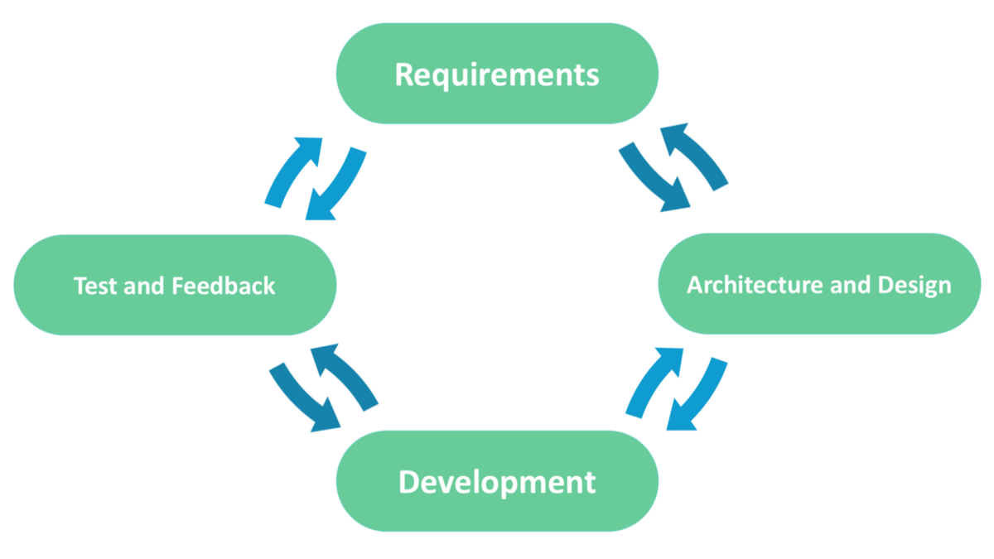
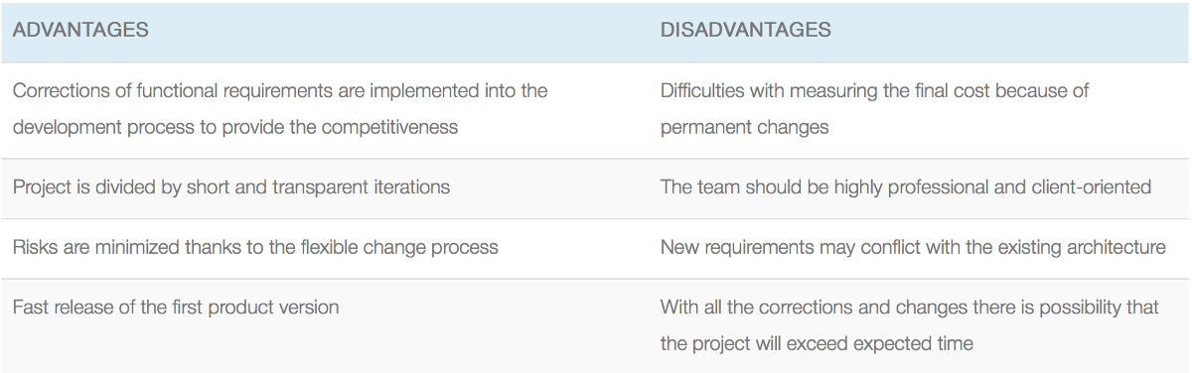
Agile SDLC Model
In the agile methodology after every development iteration, the customer is able to see the result and understand if he is satisfied with it or he is not. This is one of the advantages of the agile software development life cycle model. One of its disadvantages is that with the absence of defined requirements it is difficult to estimate the resources and development cost. Extreme programming is one of the practical use of the agile model. The basis of such model consists of short weekly meetings — Sprints which are the part of the Scrum approach.
Use cases for the Agile model:
The users’ needs change dynamically
Less price for the changes implemented because of the many iterations
Unlike the Waterfall model, it requires only initial planning to start the project

Slide 8
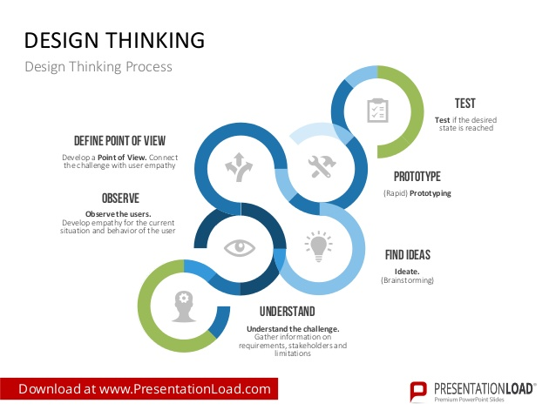
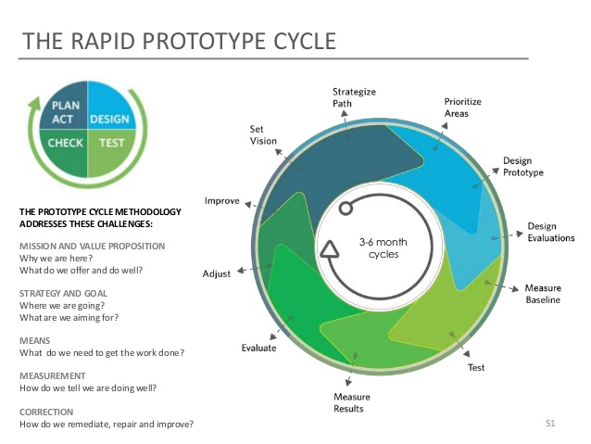
Enamus on nüüdseks agiilne…

Slide 9
Arhitektuuri tüübid
Mida nüüdisajal kasutatakse (moderne –vahva sõna?)

Slide 10
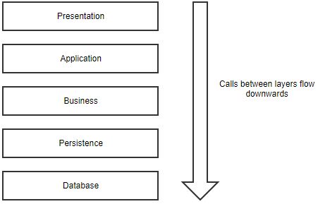
Layered Pattern
Advantages
Most developers are familiar with this pattern.
It provides an easy way of writing a well-organized and testable application.
Disadvantages
It tends to lead to monolithic applications that are hard to split up afterward.
Developers often find themselves writing a lot of code to pass through the different layers, without adding any value in these layers. If all you are doing is writing a simple CRUD application, the layered pattern might be overkill for you.
Ideal for
Standard line-of-business apps that do more than just CRUD operations

Slide 11
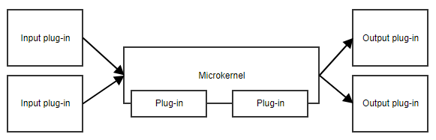
Microkernel
Advantages
This pattern provides great flexibility and extensibility.
Some implementations allow for adding plug-ins while the application is running.
Microkernel and plug-ins can be developed by separate teams.
Disadvantages
It can be difficult to decide what belongs in the microkernel and what doesn’t.
The predefined API might not be a good fit for future plug-ins.
Ideal for
Applications that take data from different sources, transform that data and writes it to different destinations
Workflow applications
Task and job scheduling applications

Slide 12
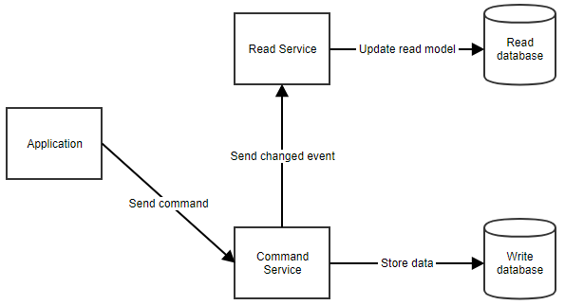
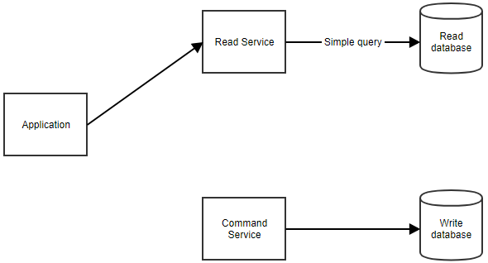
CQRS*
Advantages
Command models can focus on business logic and validation while read models can be tailored to specific scenarios.
You can avoid complex queries (e.g. joins in SQL) which makes the reads more performant.
Disadvantages
Keeping the command and the read models in sync can become complex.
Ideal for
Applications that expect a high amount of reads
Applications with complex domains
* Command and Query Responsibility Segregation

Slide 13
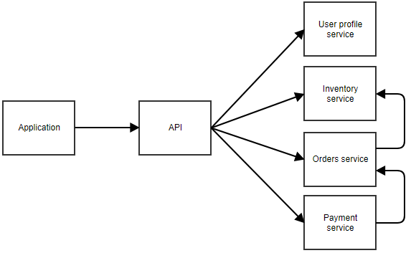
Microservices
Advantages
You can write, maintain, and deploy each microservice separately.
A microservices architecture should be easier to scale, as you can scale only the microservices that need to be scaled. There’s no need to scale the less frequently used pieces of the application.
It’s easier to rewrite pieces of the application because they’re smaller and less coupled to other parts.
Disadvantages
Contrary to what you might expect, it’s actually easier to write a well-structured monolith at first and split it up into microservices later. With microservices, a lot of extra concerns come into play: communication, coordination, backward compatibility, logging, etc. Teams that miss the necessary skill to write a well-structured monolith will probably have a hard time writing a good set of microservices.
A single action of a user can pass through multiple microservices. There are more points of failure, and when something does go wrong, it can take more time to pinpoint the problem.
Ideal for:
Applications where certain parts will be used intensively and need to be scaled
Services that provide functionality to several other applications
Applications that would become very complex if combined into one monolith
Applications where clear bounded contexts can be defined

Slide 14
Kas need on ainsad mudelid?
Ei, mudeleid on veel, samuti on võimalik mudeleid kombineerida.
Esmase mudeli paneb paika projekti muster, kliendi vajadused, võimekus ja võimalikud nõuded.
Mudel võib muutuda esmasel prototüüpimisel, kuid hilisem muutus on üldjuhul võimalik vaid täieliku versiooni vahetusega, ehk teisisõnu eelneva tarkvara mahakandmisel.
Erandiks siin on mudeli kombineerimine / laiendamine kus poogitakse juurde üldjuhul kolmandate osapoolte liideseid.

Slide 15
Kodeerimine
Mustrid, teegid, valikud… (OMG…)

Slide 16
What are Design Patterns?
Design patterns are optimized, reusable solutions to the programming problems that we encounter every day.
A design pattern is not a class or a library that we can simply plug into our system; it's much more than that. It is a template that has to be implemented in the correct situation. It's not language-specific either. A good design pattern should be implementable in most—if not all—languages, depending on the capabilities of the language.
Most importantly, any design pattern can be a double-edged sword— if implemented in the wrong place, it can be disastrous and create many problems for you. However, implemented in the right place, at the right time, it can be your savior.

Slide 17
There are three basic kinds of design patterns:
structural
creational
behavioural
Structural patterns generally deal with relationships between entities, making it easier for these entities to work together.
Creational patterns provide instantiation mechanisms, making it easier to create objects in a way that suits the situation.
Behavioral patterns are used in communications between entities and make it easier and more flexible for these entities to communicate.
Why should we use them?
Design patterns are, by principle, well-thought out solutions to programming problems. Many programmers have encountered these problems before, and have used these 'solutions' to remedy them. If you encounter these problems, why recreate a solution when you can use an already proven answer?

Slide 18
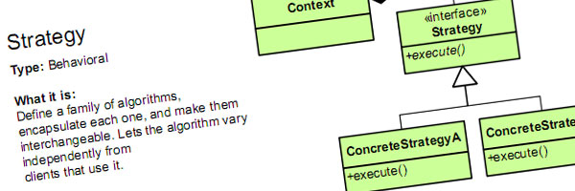
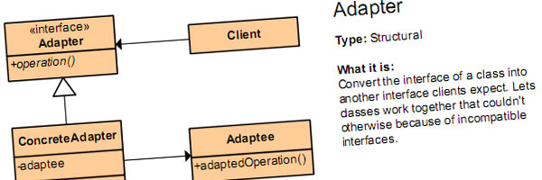
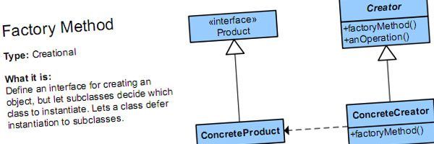
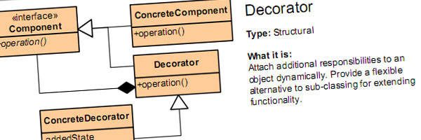
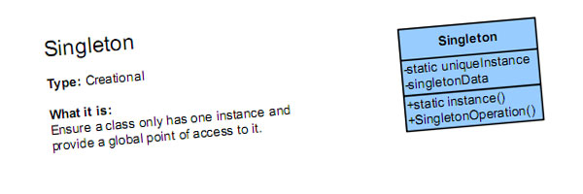
Palju neid mustreid siis on?
JA VEEL OI KUI PALJU…
Algatuseks:
https://en.wikibooks.org/wiki/Introduction_to_Software_Engineering/Architecture/Design_Patterns

Slide 19
AGA IKKAGI… MILLEKS MEIL ON KOODIMUSTREID VAJA ?!

Slide 20
Sest eksisteerivad anti-mustrid
Spaghetti
Spaghetti code is like the noodles: it is very long. Although the noodles are delicious, code the longer it gets is not.
Blob
A blob is a class with a lot of attributes and methods. Quite often these are not even related. You can detect this smell with your favorite code analysis tool, by listing classes with lots of attributes and methods or many lines of code. Usually splitting this class into several smaller classes will help here.
Copy and Paste
As the name implies, somebody copied some code from some place to another place. It is the simplest way to duplicate functionality, but it should be avoided for many reasons. The simplest solution is to turn the code into a method instead, or use inheritance.
Ja palju veel…
https://en.wikibooks.org/wiki/Introduction_to_Software_Engineering/Architecture/Anti-Patterns

Slide 21
Kodeerida või integreerida?
Kodeerida
Integreerida
Kõrgendatud turvanõuded
Minimalistlik funktsionaalsus (või vajadused kergelt kaetavad raamistiku poolt)
Unikaalne funktsionaalsus
Kõrgendatud nõuded optimeeritusele (minimalistic footprint)
Garanteeritud uuendused, koodi kvaliteet, turvanõuded.
Enamus funktsionaalsusest on komponendi poolt lahendatud.
Komponent on saavutanud küpsuse ja omab stabiilset kommuuni / arendajat.

Slide 22
X
Vaatame ühte projekti argipäevast

Slide 23
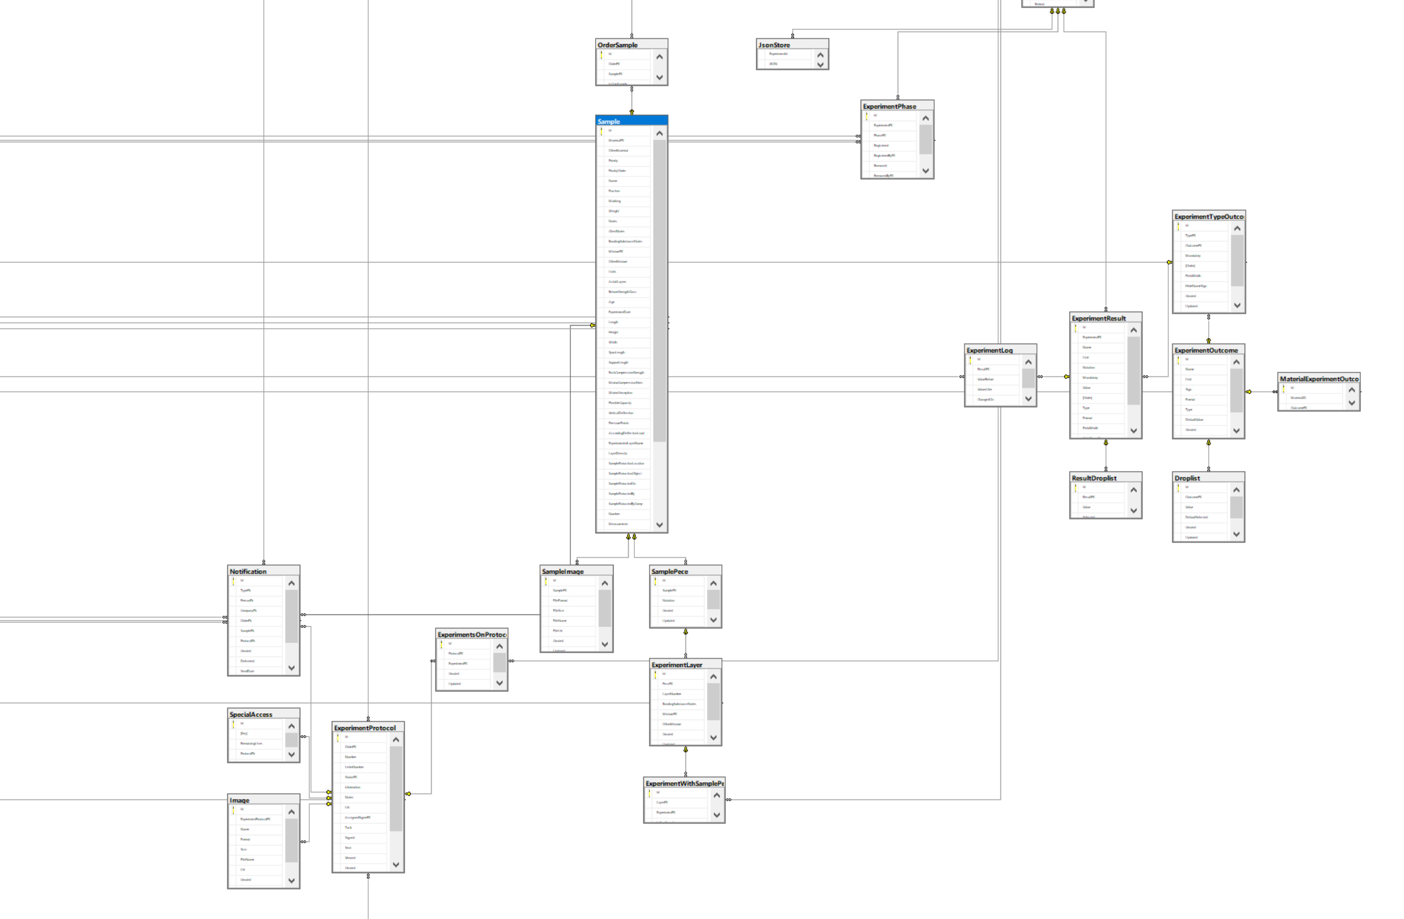
Mõnikord on andmemudel…
60+ Tabelit, vaated, protseduurid, relatsioonid, hierarhilised suhted, genereeritud Domain mudelist.

Slide 24
Koodeerimise statistika
Project | Maintainability Index | Cyclomatic Complexity | Depth of Inheritance | Class Coupling | Lines of Code
BCL | 72 | 976 | 2 | 324 | 2663
Common | 69 | 21 | 1 | 17 | 63
Domain | 93 | 1182 | 1 | 45 | 1190
DTO | 88 | 1518 | 2 | 108 | 2526
Repository | 65 | 1297 | 3 | 592 | 11636
Web | 77 | 2687 | 4 | 849 | 6872
Maintainability Index - Calculates an index value between 0 and 100 that represents the relative ease of maintaining the code
Cyclomatic Complexity - Measures the structural complexity of the code. It is created by calculating the number of different code paths in the flow of the program.
Depth of Inheritance - Indicates the number of class definitions that extend to the root of the class hierarchy.
Class Coupling - Measures the coupling to unique classes through parameters, local variables, return types, method calls, generic or template instantiations, base classes, interface implementations, fields defined on external types, and attribute decoration.
Lines of Code - Indicates the approximate number of lines in the code.

Slide 25
Praktika…
Tehisintelekt + digifoto, mida me saame?
Spagheti näide
Dependency Injection mudeli näide
Koodi laiendamine läbi vajaduste kasvu tuginedes DI mudelile.
Näide Windowsi rakendusest
Automaattest – mis see on ja mida aitab?
Prototüübime ühe idee (kui aega jagub)

Slide 26
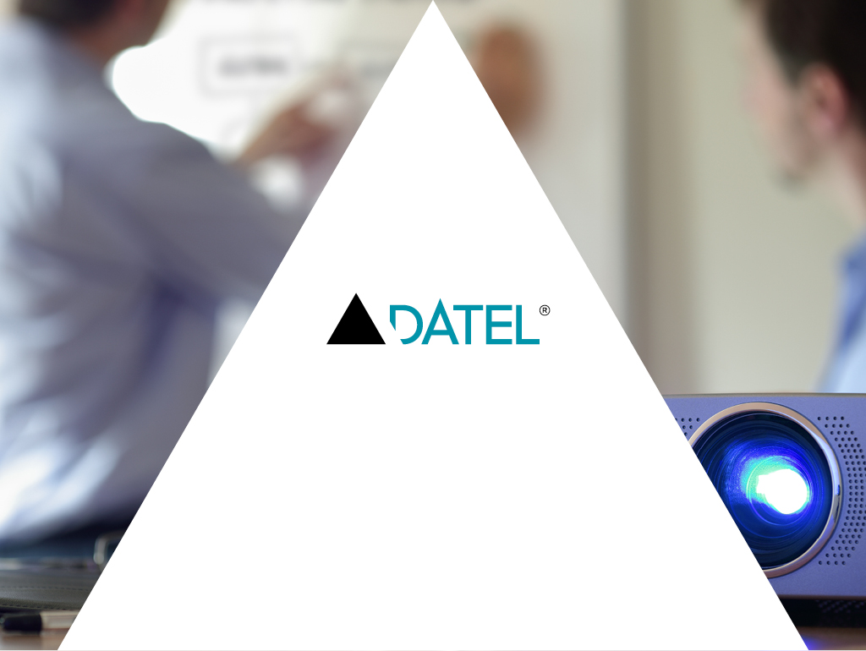
Tänan!
Selle loengu materjalid, koodinäited jms leiab githubist aadressil:
https://github.com/malrock/tyloeng051118

Slide 27
Kasulikud raamatud
Clean Code: A Handbook of Agile Software Craftsmanship (Robert C. Martin)
Code Complete: A Practical Handbook of Software Construction

Slide 28
Kasulikud lingid
https://www.dofactory.com/net/design-patterns
https://en.wikibooks.org/wiki/Introduction_to_Software_Engineering/Architecture/Anti-Patterns
https://en.wikibooks.org/wiki/Introduction_to_Software_Engineering/Architecture/Design_Patterns
https://www.tutorialspoint.com/mvvm/index.htm
https://techbeacon.com/third-party-libraries-are-one-most-insecure-parts-application
https://medium.com/bpxl-craft/evaluating-third-party-libraries-81dce02aa465

Slide 29
Tarkvara ja vahendid
https://code.visualstudio.com/
https://visualstudio.microsoft.com/vs/community/
https://www.jetbrains.com/rider/
http://jsonviewer.stack.hu/
https://jsbin.com/

Slide 30
Kasulikud õppekeskkonnad
https://www.pluralsight.com/
https://www.udemy.com/

Slide 31
Kasutatud materjal
https://medium.com/existek/sdlc-models-explained-agile-waterfall-v-shaped-iterative-spiral-e3f012f390c5
https://medium.com/@nvashanin/the-path-to-becoming-a-software-architect-de53f1cb310a
https://dzone.com/articles/software-architecture-the-5-patterns-you-need-to-k
https://code.tutsplus.com/articles/a-beginners-guide-to-design-patterns--net-12752
https://docs.microsoft.com/en-us/visualstudio/code-quality/code-metrics-values?view=vs-2017

Slide 32
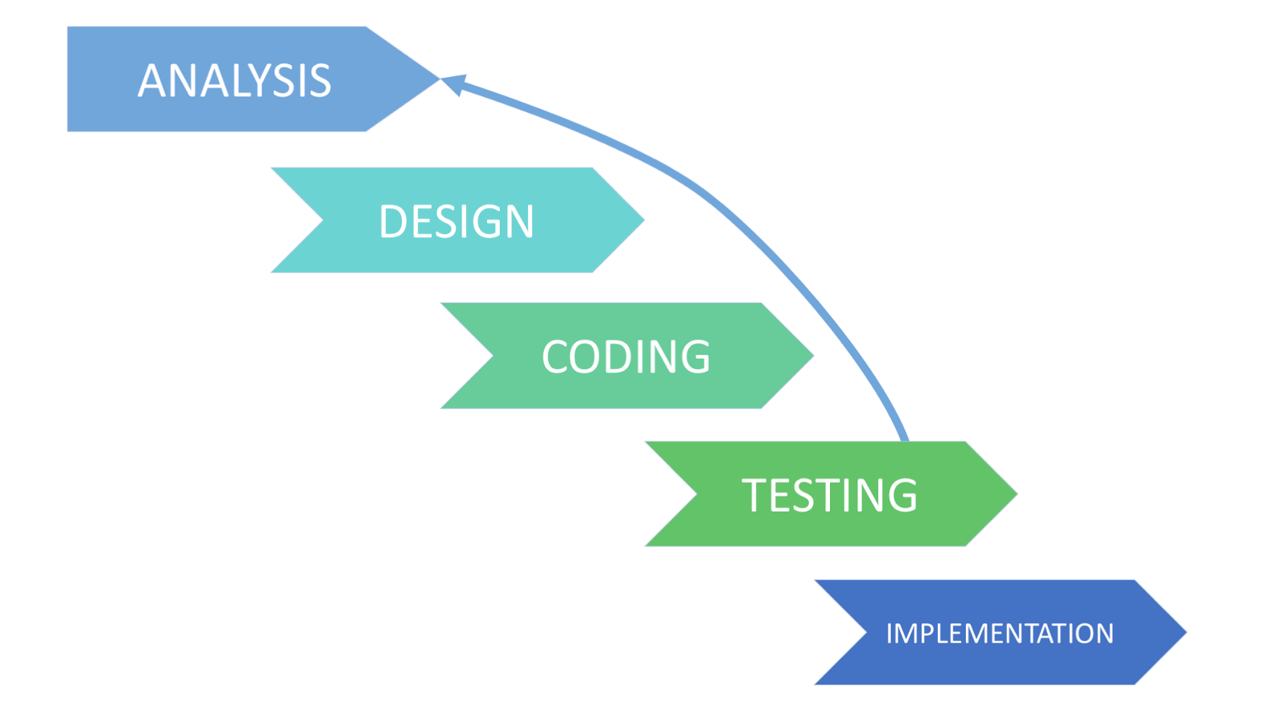
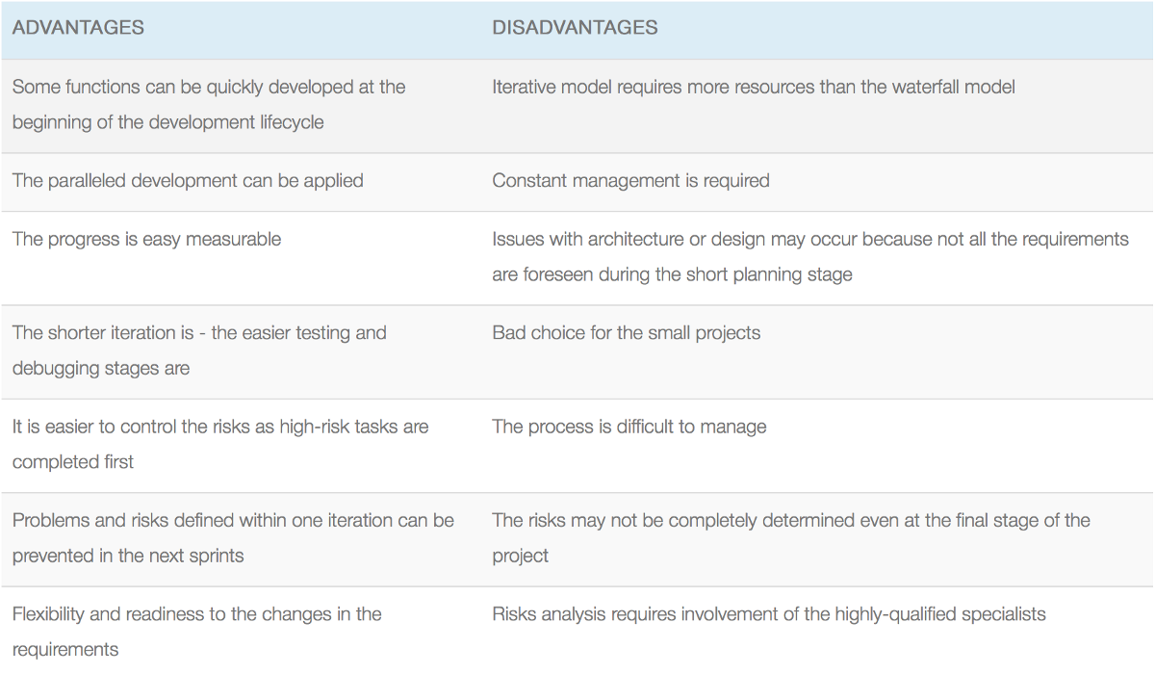
Iterative SDLC Model
The Iterative SDLC model does not need the full list of requirements before the project starts. The development process may start with the requirements to the functional part, which can be expanded later. The process is repetitive, allowing to make new versions of the product for every cycle. Every iteration (which last from two to six weeks) includes the development of a separate component of the system, and after that, this component is added to the functional developed earlier. Speaking with math terminology, the iterative model is a realization of the sequential approximation method; that means a gradual closeness to the planned final product shape.
Use cases for the Iteration model:
The requirements to the final product are strictly predefined
Applied to the large-scale projects
The main task is predefined, but the details may advance with the time

Slide 33
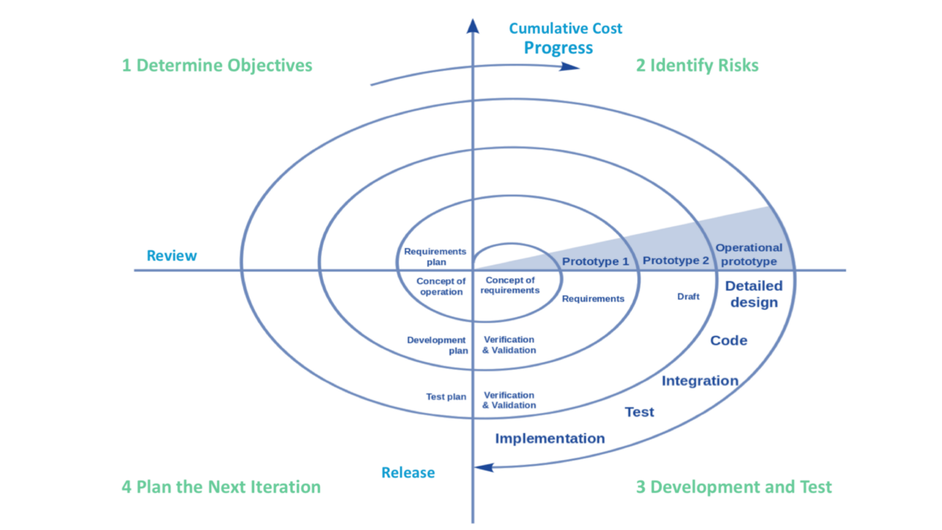
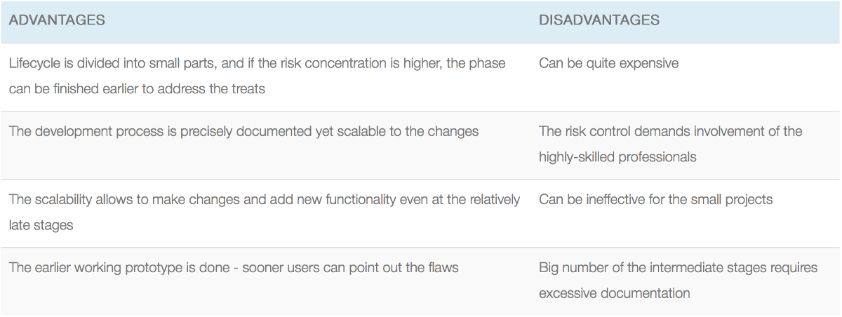
Spiral SDLC Model
Spiral model — is SDLC model, which combines architecture and prototyping by stages. It is a combination of the Iterative and Waterfall SDLC models with the significant accent on the risk analysis. The main issue of the spiral model — is defining the right moment to make a step into the next stage. The preliminary set time frames are recommended as the solution to this issue. The shift to the next stage is done according to the plan, even if the work on the previous stage isn’t done yet. The plan is introduced basing on the statistic data, received during the previous projects even from the personal developer’s experience.
Use cases for the Spiral model
Customer isn’t sure about the requirements
Major edits are expected during the development cycle
The projects with mid or high-level risk, where it is important to prevent these risks
The new product that should be released in a few stages to have enough of clients feedback

Slide 34
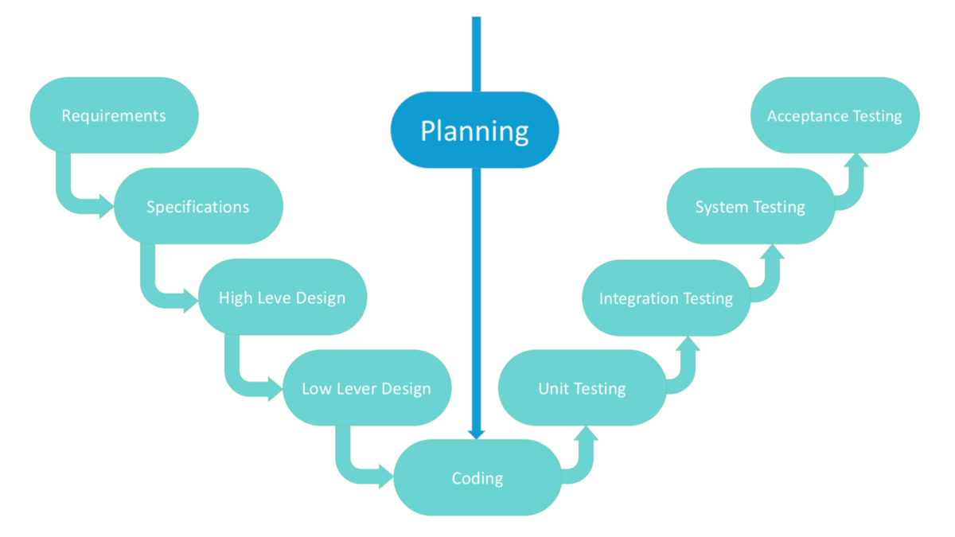
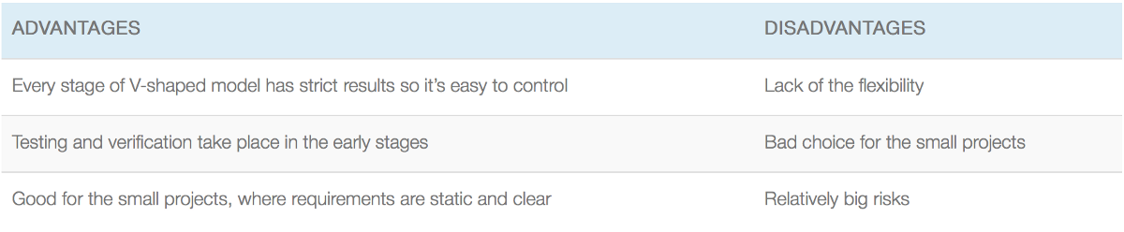
V-shaped SDLC Model
V-shaped SDLC model is an expansion of classic waterfall model and it’s based on associated test stage for the every development stage. This is a very strict model and the next stage is started only after the previous phase. This is also called “Validation and verification” model. Every stage has the current process control, to make sure that the conversion to the next stage is possible.
Use cases for the V-shaped model:
For the projects where an accurate product testing is required
For the small and mid-sized projects, where requirements are strictly predefined
The engineers of the required qualification, especially testers, are within easy reach.

Slide 35
Event Sourcing (+CQRS)
Advantages
This software architecture pattern can provide an audit log out of the box. Each event represents a manipulation of the data at a certain point in time.
Disadvantages
It requires some discipline because you can’t just fix wrong data with a simple edit in the database.
It’s not a trivial task to change the structure of an event. For example, if you add a property, the database still contains events without that data. Your code will need to handle this missing data graciously.
Ideal for applications that
Need to publish events to external systems
Will be built with CQRS
Have complex domains
Need an audit log of changes to the data

