Slide 1


NATIONAL LIGHTING CO.
CAPABILITIES · 2026
LOW CURRENT DIVISION
Intelligent buildings,
made operational.
Lighting control, building management, central battery and emergency monitoring — engineered, integrated, and supported from Dammam.
WEB
EMAIL
ESTABLISHED
LCD
nlc.com.sa
info@nlc.com.sa
1993 · Dammam, KSA
/ 04

Slide 2
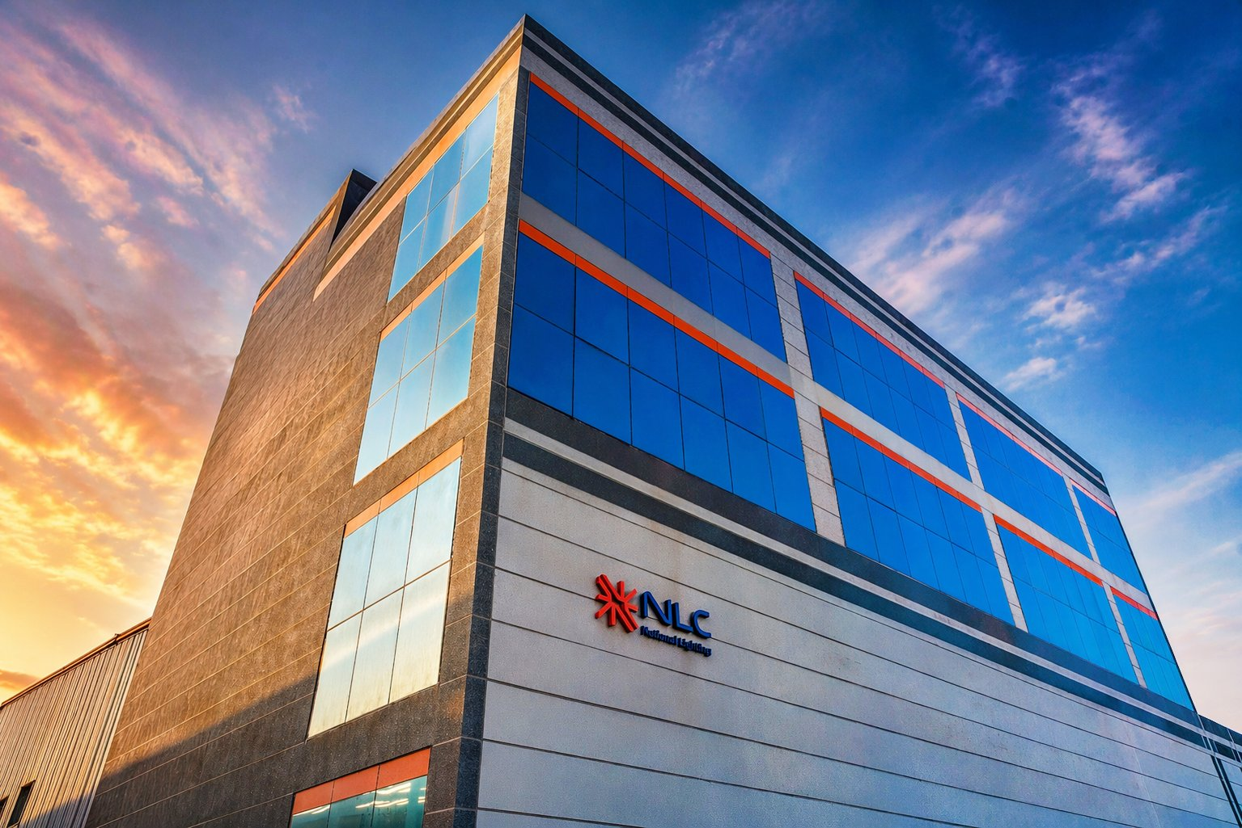
01 — COMPANY
NLC · NATIONAL LIGHTING COMPANY
ABOUT
Saudi-built. Schneider-
approved. Always-on.
National Lighting Company has manufactured LED luminaires and assembled Schneider Electric authorized power panels in Dammam since 1993. Three pillars deliver to every project: Lighting Solutions, Power & Control Systems, and Low Current Systems — engineered as a single integrated stack.
1993
30+
16
KSA
FOUNDED
YEARS
PRODUCT LINES
MANUFACTURED
Lighting Solutions
Power & Control
Low Current
HQ · DAMMAM 2ND INDUSTRIAL CITY
● NLC · LOW CURRENT DIVISION
02 / 05

Slide 3
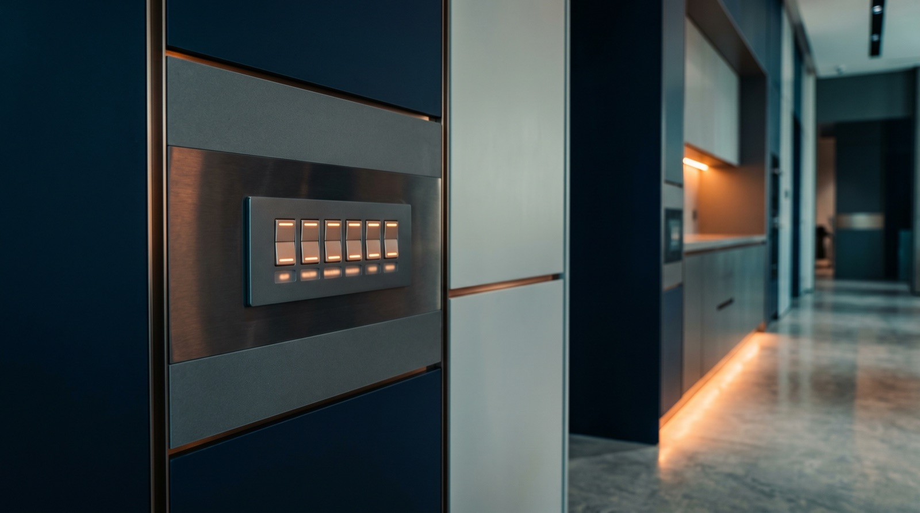
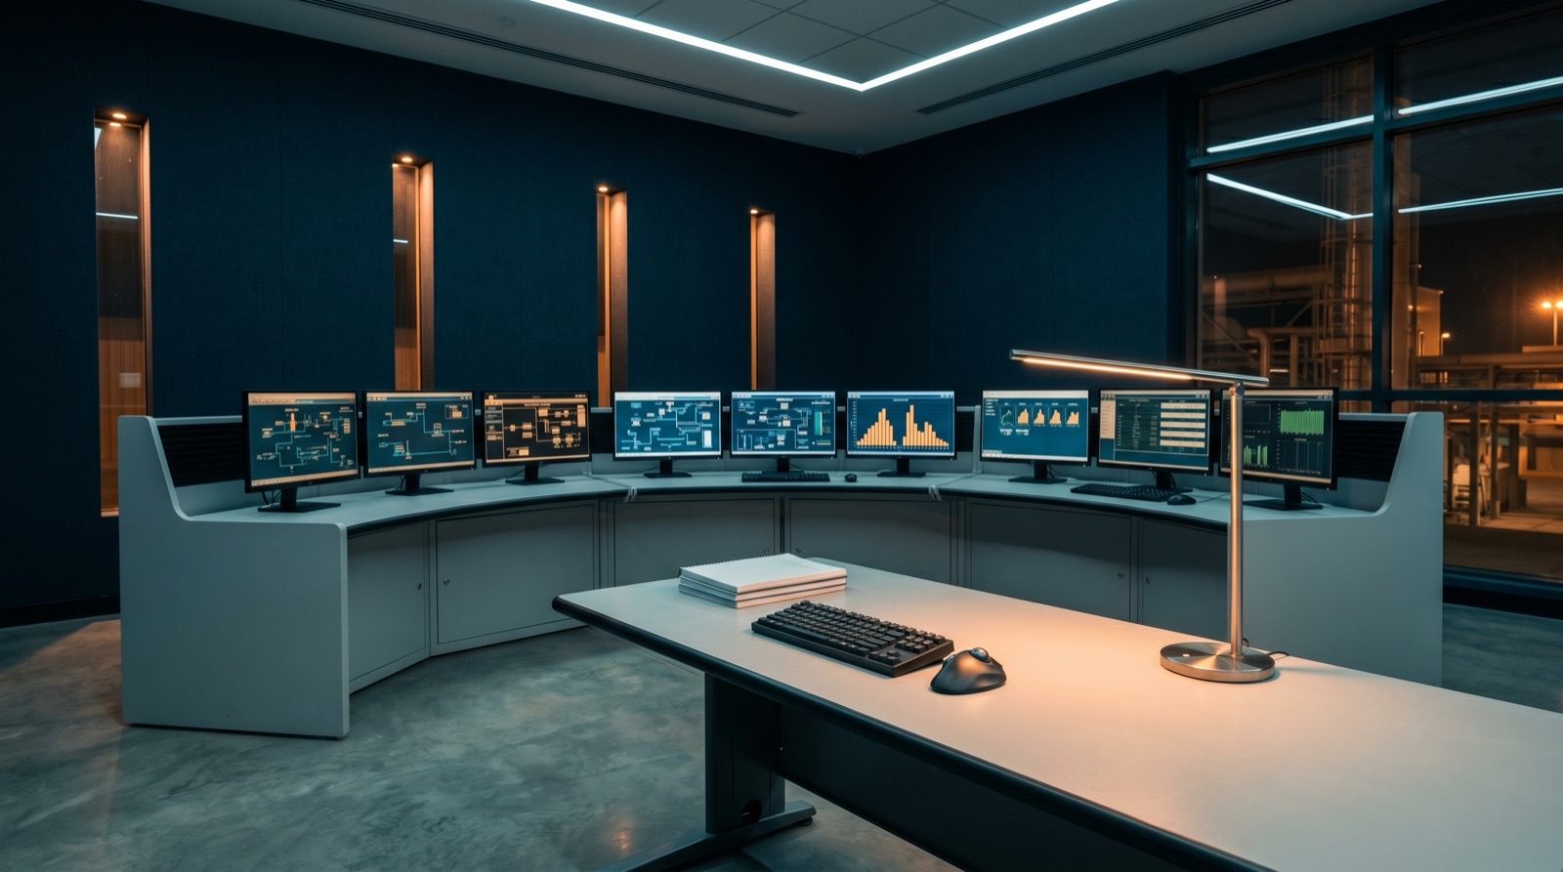
02 — DIVISION
MAIN PRODUCT LINES · 1 of 2
Control the building. Light it intelligently.
LIGHTING CONTROL
BUILDING MANAGEMENT
KNX · DALI · RGBW
BMS — Centralized control
Advanced street and architectural lighting control with flexible integration for efficient energy management and smart-city applications.
Centralized monitoring and control for HVAC, VRV, VAV, pumps and fans — enhancing comfort, efficiency, and operational reliability.
Multi-protocol bus support — KNX, DALI, DALI-2, DMX
Scene programming, daylight harvesting, RGBW color
Integrates with city SCADA / smart-city platforms
BACnet, Modbus, M-Bus across HVAC and plant
VRV/VAV, AHU, FCU, chillers, pumps, fans, gensets
Energy dashboards, trend logging, fault alarms
USE CASES · CITY ROADS · FAÇADES · CAMPUSES
USE CASES · OFFICE · HEALTHCARE · INDUSTRIAL
● NLC · LOW CURRENT DIVISION
03 / 05

Slide 4
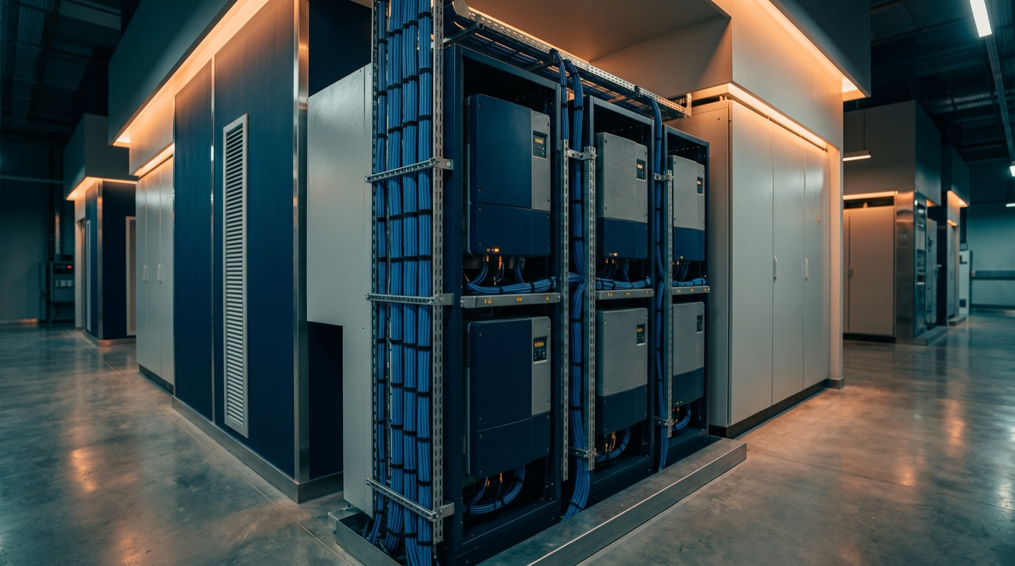
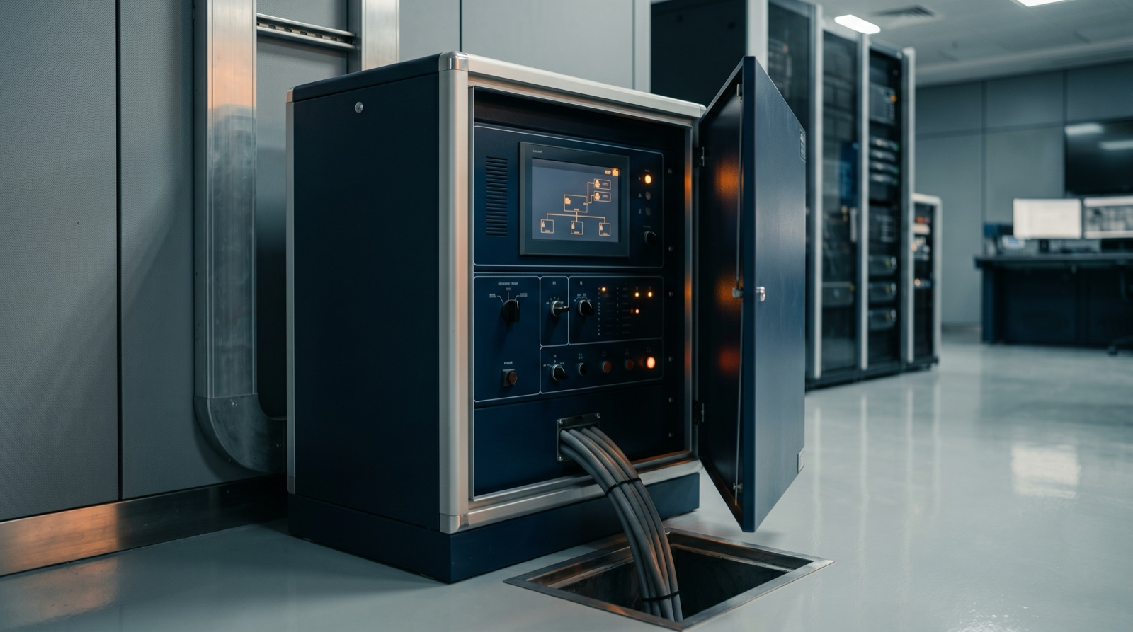
02 — DIVISION
MAIN PRODUCT LINES · 2 of 2
Keep power on. Keep people safe.
CENTRAL BATTERY
EMERGENCY LIGHTING
CBS — Continuous backup
EMS — Smart monitoring
Reliable power backup for emergency and life-safety systems. Ensures continuous operation during outages with full monitoring of every fixture.
Intelligent emergency-light monitoring and control. Supports safety compliance and rapid fault detection across thousands of fixtures.
Centralized DC and DC/AC inverter systems
Automatic transfer with sub-cycle response
Per-fixture status, fault, and battery health
Self-test luminaires (DALI-2 Type 202)
Automated function and duration tests
NFPA 101 / SBC compliance reporting & audit logs
USE CASES · HOSPITALS · HOTELS · MALLS
USE CASES · CIVIL DEFENSE COMPLIANCE · DCD
● NLC · LOW CURRENT DIVISION
04 / 05

Slide 5
NATIONAL LIGHTING CO.
END · v1.0
LET'S SPECIFY TOGETHER
Light isn't decoration.
It's infrastructure.
Bring NLC's Low Current team in early — at design, at tender, or at handover. We work alongside your MEP consultant to deliver a single, integrated stack.
WEB
EMAIL
PHONE
ADDRESS
nlc.com.sa
info@nlc.com.sa
+966 920 016 374
2nd Industrial City, Dammam

