Slide 1

Context-aware advertisement recommendation for high-speed social news feeding
Seminar Data Science – Mohammad Altahan – 13.12.2017

Slide 2
Agenda
Introduction
Related work
Hybrid model construction
Online retrieval algorithm
Safe region algorithm
Hybrid model
Conclusion

Slide 3
introduction
Soicial media Advertisements
Facebook or Twitter
Major revenue
the National University of Singapore.
Static and dynamic user interests.
Hybrid model
Challenges
efficient, real time, less annoying, drive growth

Slide 4
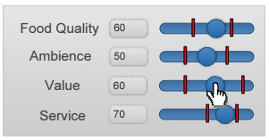
Related work:
Pub/Sub System
Top-K Aggregation Query
Local immutable region
Global immutable region

Slide 5
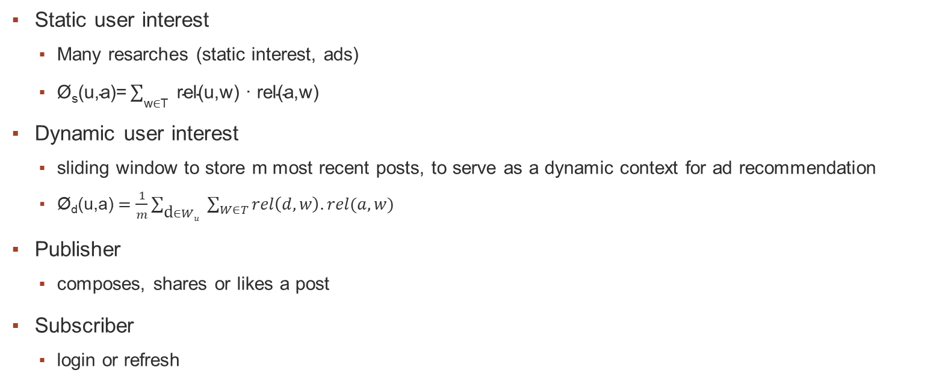
Hybrid model construction
Static user interest
Many resarches (static interest, ads)
$\text{Ø}\text{s}\text{(}\text{u}\text{,}\text{a}\text{)=} \sum_{\text{w}\text{∈}\text{T} }{\text{rel}\text{(}\text{u}\text{,}\text{w}\text{) · }\text{rel}\text{(}\text{a}\text{,}\text{w}\text{)} }$
Dynamic user interest
sliding window to store m most recent posts, to serve as a dynamic context for ad recommendation
$\text{Ø}\text{d}\text{(}\text{u}\text{,}\text{a}\text{)} =\frac{1}{m}\sum_{\text{d}∈Wu }{\sum_{W∈T}{rel\left(d,w\right).rel(a,w)}}$
Publisher
composes, shares or likes a post
Subscriber
login or refresh

Slide 6
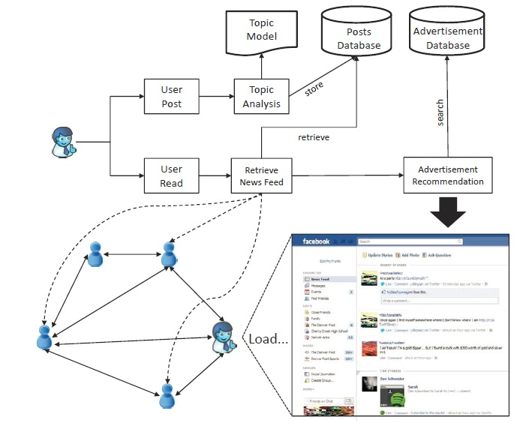
System Overview of Context-Aware Advertisement Recommendation in Social Networks

Slide 7
Combining the two equations
Finally the total relevance between a user u and an ad a is given by the following
Equation which combains the user static interests and dynamic news feed from his friends.
φ(u, a) = α · φ_{s}(u, a) + (1 − α) · φ_{d}(u, a).
Where α is a system parameter can set according to the application requriment.
When α close to 1
Static, easy to maintain, less effort
When close to 0
Dynamic, real time, efficient.

Slide 8
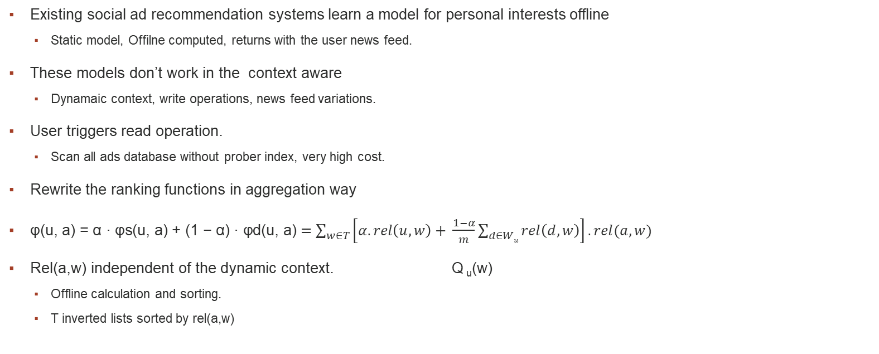
Online retrieval algorithm
Existing social ad recommendation systems learn a model for personal interests offline
Static model, Offilne computed, returns with the user news feed.
These models don’t work in the context aware
Dynamaic context, write operations, news feed variations.
User triggers read operation.
Scan all ads database without prober index, very high cost.
Rewrite the ranking functions in aggregation way
$\text{φ}\text{(}\text{u}\text{, }\text{a}\text{) = }\text{α}\text{ · }\text{φ}\text{s}\text{(}\text{u}\text{, }\text{a}\text{) + (1 − }\text{α}\text{) · }\text{φ}\text{d}\text{(}\text{u}\text{, }\text{a}\text{)}=\sum_{w∈T}{\left[α.rel\left(u,w\right)+ \frac{1−α}{m}\sum_{d∈Wu}{rel\left(d,w\right)}\right].rel(a,w)}$
Rel(a,w) independent of the dynamic context. Q _{u}(w)
Offline calculation and sorting.
T inverted lists sorted by rel(a,w)

Slide 9
Online retrieval algorithm
Example 1: Let the window size m = 3, the weighting parameter α = 0.25 and the number of topics |T| = 2. Given a user u, let Hu = (0.4, 0.6) be the topic distributions of his static interests. Suppose the topic distributions of the three posts in the window are (0.2, 0.8), (0.1, 0.9) and (1.0, 0) respectively. When u triggers a read operation, the context-aware query vector Qu is calculated as Qu = 0.25 · (0.4, 0.6) + 1−0.25/3 [(0.2, 0.8) + (0.1, 0.9) + (1.0, 0)] = (0.55, 0.45) = (0.425, 0.575). Suppose Qu is used to query an ad database with four tuples {a1 = (0.3, 0.9), a2 = (0.4, 0.7), a3 = (0.5, 0.8) and a4 = (1.0, 0)}. To support top-k aggregation, we pre-compute two inverted lists lw1 and lw2 for the topics and get lw1 = {(a4, 1.0), (a3, 0.5), (a2, 0.4), (a1, 0.3)} and lw2 = {(a1, 0.9), (a3, 0.8), (a2, 0.7), (a1, 0.0)}. By calling the TA algorithm presented above, a3 will be returned as the most relevant ad if k is set to 1.

Slide 10
SAFE REGION ALGORITHM
Read and write operations
90% readers, 9%edit, 1%create
Frequently login users
Online retrival will not be appropriate, small context variation.
propose a safe region algorithm that examines whether the top-k ads have changed since the previous user read requests.
This can be done efficiently by maintaining a safe region for each user. As long as the new
context-aware query vector triggered by a user read operation is still located in the safe region, the top-k ads can be directly
presented to the user. Otherwise, we re-compute the new top-k results and update the safe region.

Slide 11
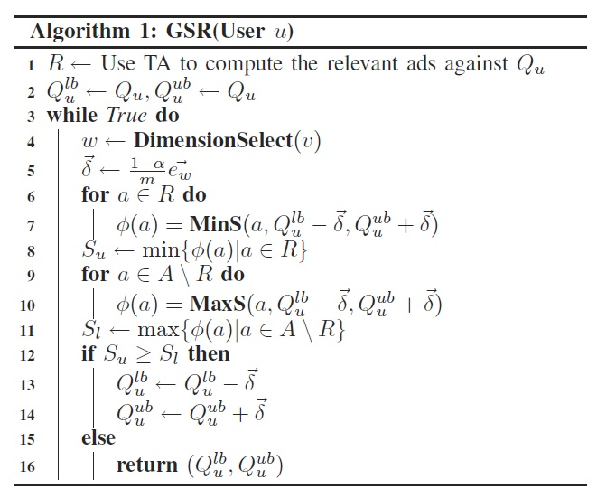
Safe Region Construction
Global immutable region vs greddy safe regoin
Computationally expensive, real time requirments.

Slide 12
Optimization
When the dynamic query vector Qu deviates out of the safe region of user u, we need to adopt the online retrieval to obtain top-k ads on the fly and construct a new safe region in the
meanwhile. Such computations are rather expensive. Thus for our second optimization, we propose a new idea to “salvage”
the maintained safe regions as well as the associated top-k ads from other users. This is because all the query vectors in
a safe region share the same top-k ads. When Qu moves out of the safe region, we can search all the safe regions of other
users. If we can find a safe region from user v that contains the new query vector Qu of user u, its top-k ads are exactly
the same as user u. Moreover, we can assign the safe region of v directly to user u. In this way, the cost of online retrieval and safe region computation can be saved.

Slide 13
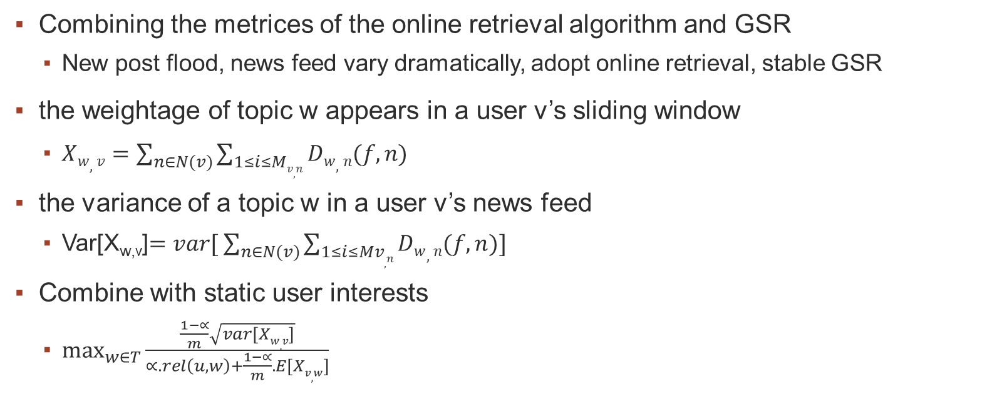
HYBRID ALGORITHM
Combining the metrices of the online retrieval algorithm and GSR
New post flood, news feed vary dramatically, adopt online retrieval, stable GSR
the weightage of topic w appears in a user v’s sliding window
$Xw,v=\sum_{n∈N(v)}{\sum_{1≤i≤Mv,n}{Dw,n(f,n)}}$
the variance of a topic w in a user v’s news feed
Var[X_{w,v}]$=var[ \sum_{n∈N(v)}{\sum_{1≤i≤Mv,n}{Dw,n(f,n)]}}$
Combine with static user interests
$\max_{w∈T}{\frac{\frac{1−∝}{m}\sqrt{var[Xw,v]}}{∝.rel\left(u,w\right)+\frac{1−∝}{m}.E[Xv,w]}}$

Slide 14
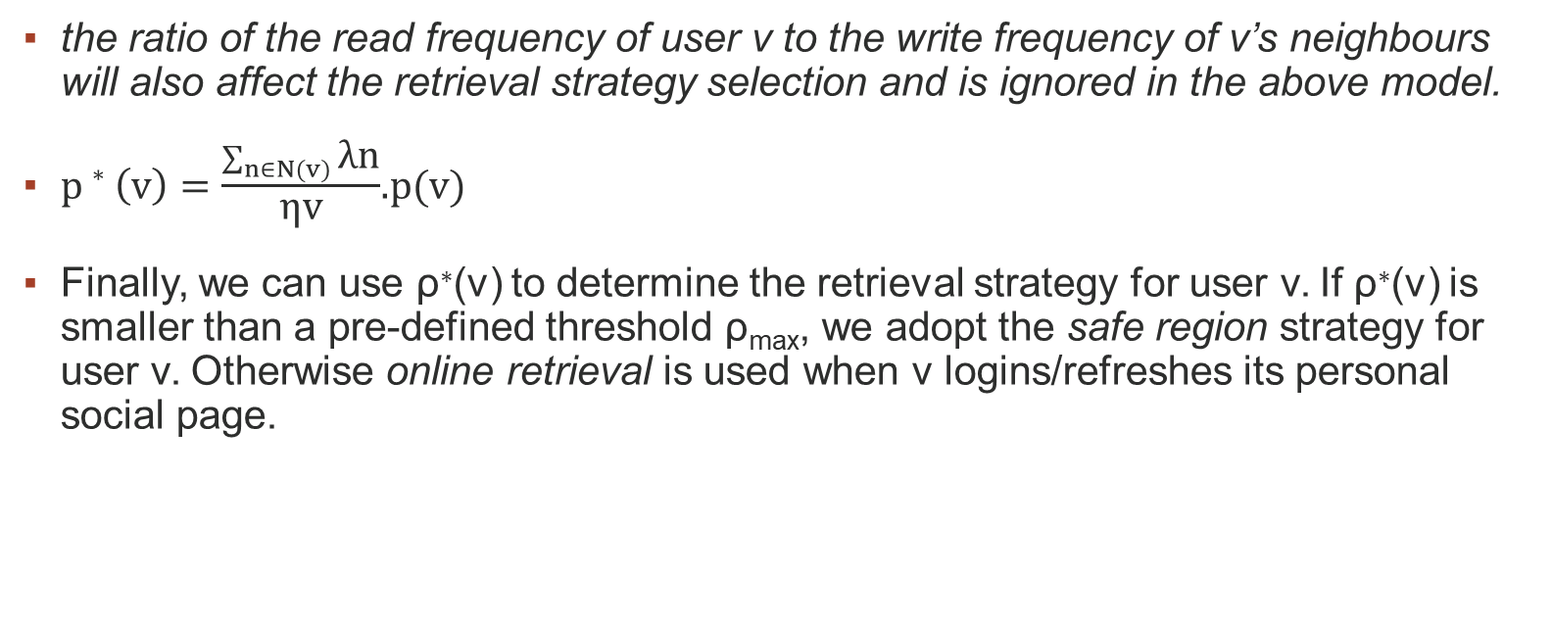
Hybrid model
the ratio of the read frequency of user v to the write frequency of v’s neighbours will also affect the retrieval strategy selection and is ignored in the above model.
$p∗\left(v\right)=\frac{\sum_{n∈N(v)}{\text{λ}\text{n}}}{\text{η}\text{v}}$.p(v)
Finally, we can use ρ∗(v) to determine the retrieval strategy for user v. If ρ∗(v) is smaller than a pre-defined threshold ρ_{max}, we adopt the safe region strategy for user v. Otherwise online retrieval is used when v logins/refreshes its personal social page.

