Slide 1

Context-aware advertisement recommendation for high-speed social news feeding
Seminar Data Science – Mohammad Altahan – 13.12.2017

Slide 2
Agenda
Introduction
Related work
Hybrid model construction
Online retrieval algorithm
Safe region algorithm
Hybrid model
Conclusion

Slide 3
1. Introduction
Social media advertisements
Facebook or Twitter
Major revenue
the National University of Singapore.
Static and dynamic user interests.
Hybrid model
Challenges
efficient, real time, less annoying, drive growth

Slide 4
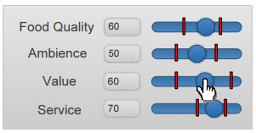
2. Related work
Pub/Sub System
Top-K Aggregation Query
Local immutable region
Global immutable region

Slide 5
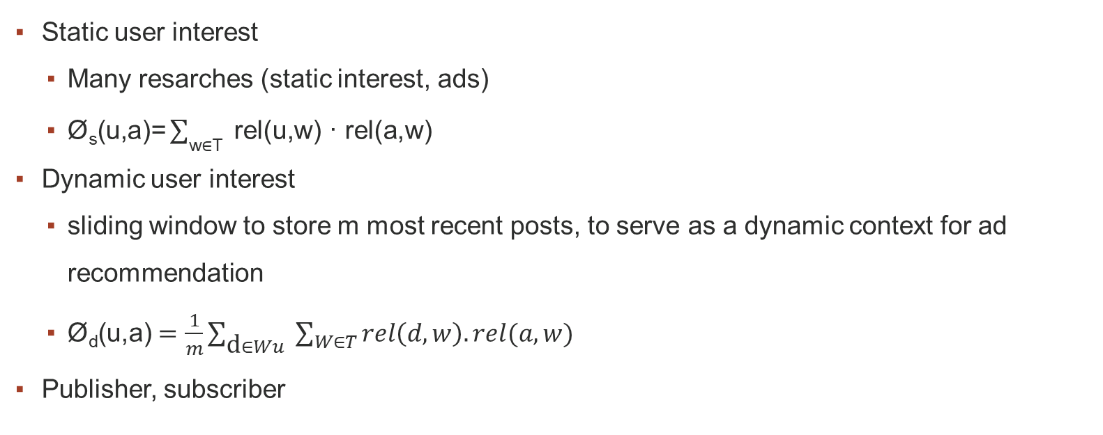
3. Hybrid model construction
Static user interest
Many resarches (static interest, ads)
$\text{Ø}\text{s}\text{(}\text{u}\text{,}\text{a}\text{)=} \sum_{\text{w}\text{∈}\text{T} }{\text{rel}\text{(}\text{u}\text{,}\text{w}\text{) · }\text{rel}\text{(}\text{a}\text{,}\text{w}\text{)} }$
Dynamic user interest
sliding window to store m most recent posts, to serve as a dynamic context for ad recommendation
$\text{Ø}\text{d}\text{(}\text{u}\text{,}\text{a}\text{)} =\frac{1}{m}\sum_{\text{d}∈Wu }{\sum_{W∈T}{rel\left(d,w\right).rel(a,w)}}$
Publisher, subscriber

Slide 6
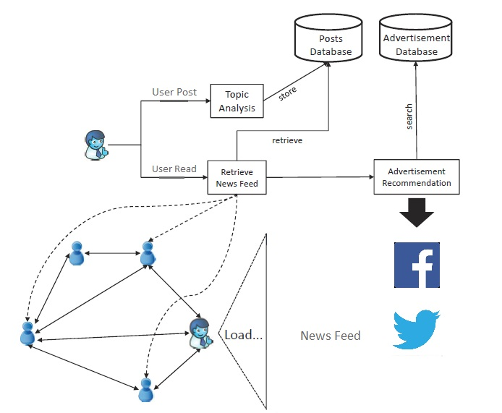
System Overview of Context-Aware Advertisement Recommendation in Social Networks

Slide 7
Combining the two equations
The total relevance between a user u and an ad a is given by the following equation which combains the user static interests and dynamic news feed from his friends.
φ(u, a) = α · φ_{s}(u, a) + (1 − α) · φ_{d}(u, a).
Where α is a system parameter can set according to the application requriment.
When α close to 1
Static, easy to maintain, less effort
When close to 0
Dynamic, real time, efficient.

Slide 8
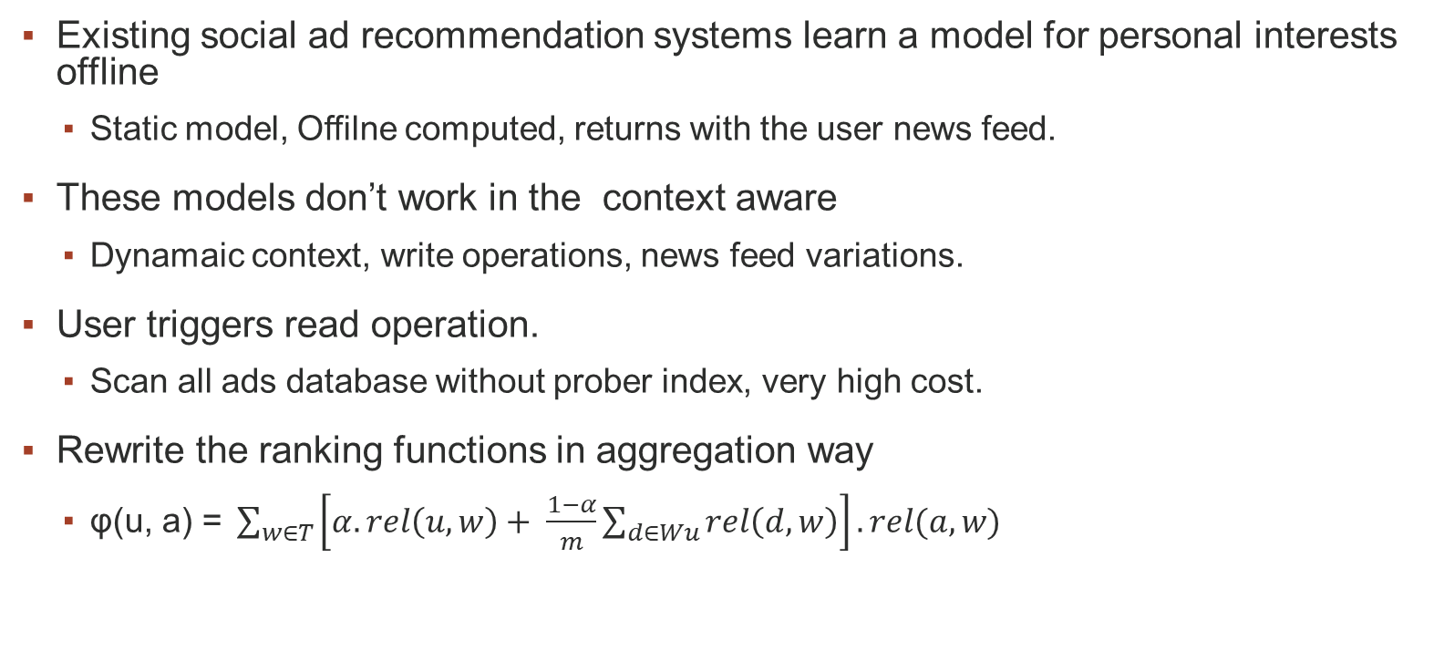
3.1 Online retrieval algorithm 1/3
Existing social ad recommendation systems learn a model for personal interests offline
Static model, Offilne computed, returns with the user news feed.
These models don’t work in the context aware
Dynamaic context, write operations, news feed variations.
User triggers read operation.
Scan all ads database without prober index, very high cost.
Rewrite the ranking functions in aggregation way
$\text{φ}\text{(}\text{u}\text{, }\text{a}\text{) = }\sum_{w∈T}{\left[α.rel\left(u,w\right)+ \frac{1−α}{m}\sum_{d∈Wu}{rel\left(d,w\right)}\right].rel(a,w)}$
Q_{u}

Slide 9
3.1 Online retrieval algorithm 2/3
After rewriting the ranking function in aggregation way we can simplify the online
Retrieval algorithm as follows:
Rel(a,w) independent of the dynamic context so it could be offiline calcultaed and sorted
Therefore, we can maintain |T| inverted lists for each user, each sorted by rel(a,w).
Appliny the threshold algorithm.

Slide 10
3.1 Online retrieval algorithm 3/3
Let the window size m = 3, the weighting parameter α = 0.25 and the number of topics |T| = 2.
Given a user u, let Hu = (0.4, 0.6) be the topic distributions of his static interests.
Topic distributions of the 3 posts in the window are (0.2, 0.8), (0.1, 0.9) and (1.0, 0).
When u triggers a read operation, Qu is calculated as Qu = (0.425, 0.575).
Qu is used to query an ad database with four tuples {a1 = (0.3, 0.9), a2 = (0.4, 0.7), a3 = (0.5, 0.8) and a4 = (1.0, 0)}.
We pre-compute two inverted lists lw1 and lw2 for the topics and get lw1 = {(a4, 1.0), (a3, 0.5), (a2, 0.4), (a1, 0.3)} and lw2 = {(a1, 0.9), (a3, 0.8), (a2, 0.7), (a1, 0.0)}.
By calling the TA algorithm presented above, a3 will be returned as the most relevant ad if k is set to 1.
Notes:
Let the window size m = 3, the weighting parameter α = 0.25 and the number of topics |T| = 2.
Given a user u, let Hu = (0.4, 0.6) be the topic distributions of his static interests.
Topic distributions of the 3 posts in the window are (0.2, 0.8), (0.1, 0.9) and (1.0, 0).
When u triggers a read operation, Qu is calculated as Qu = (0.425, 0.575).
Qu is used to query an ad database with four tuples {a1 = (0.3, 0.9), a2 = (0.4, 0.7), a3 = (0.5, 0.8) and a4 = (1.0, 0)}.
We pre-compute two inverted lists lw1 and lw2 for the topics and get lw1 = {(a4, 1.0), (a3, 0.5), (a2, 0.4), (a1, 0.3)} and lw2 = {(a1, 0.9), (a3, 0.8), (a2, 0.7), (a1, 0.0)}.
By calling the TA algorithm presented above, a3 will be returned as the most relevant ad if k is set to 1.

Slide 11
3.2 Safe region algorithm 1/3
Read and write operations
90% readers, 9% editors, 1% creators
Frequently login users
Online retrival will not be appropriate, small context variation
Safe region algorithm that examines whether the top-k ads have changed since the previous user read requests by maintaining a safe region for each user
still located in the safe region, the top-k ads can be directly presented to the user
otherwise, we re-compute the new top-k results and update the safe region.

Slide 12
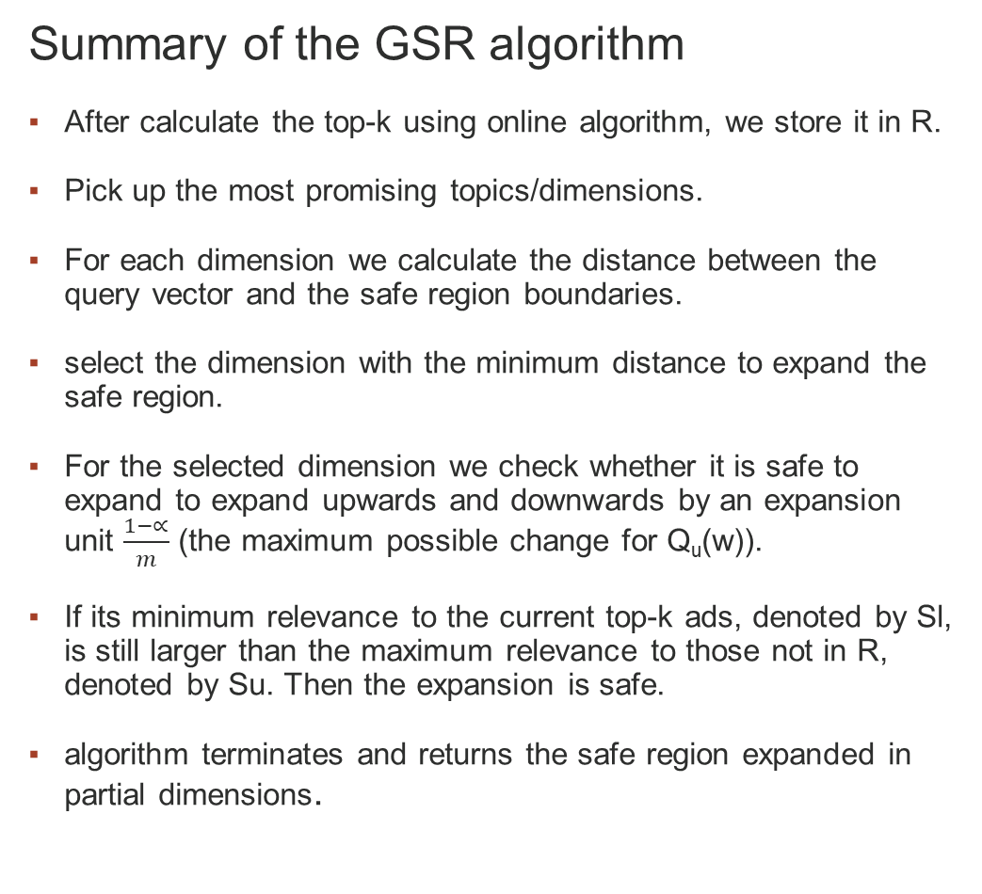
Safe region algorithm: Construction 2/3
Summary of the GSR algorithm
After calculate the top-k using online algorithm, we store it in R.
Pick up the most promising topics/dimensions.
For each dimension we calculate the distance between the query vector and the safe region boundaries.
select the dimension with the minimum distance to expand the safe region.
For the selected dimension we check whether it is safe to expand to expand upwards and downwards by an expansion unit $\frac{1−∝}{m}$ (the maximum possible change for Q_{u}(w)).
If its minimum relevance to the current top-k ads, denoted by Sl, is still larger than the maximum relevance to those not in R, denoted by Su. Then the expansion is safe.
algorithm terminates and returns the safe region expanded in partial dimensions.
Global immutable region vs greddy safe regoin
Computationally expensive, real time requirments.

Slide 13
Safe region algorithm: Optimization 3/3
When the dynamic query vector Qu deviates out of the safe region of user u.
adopt the online retrieval to obtain top-k ads on the fly and construct a new safe region in the meanwhile, expensive
When Qu moves out of the safe region, we can search all the safe regions of other users. If we can find a safe region from user v that contains the new query vector Qu of user u, its top-k ads are exactly the same as user u.
Moreover, we can assign the safe region of v directly to user u. In this way, the cost of online retrieval and safe region computation can be saved.

Slide 14
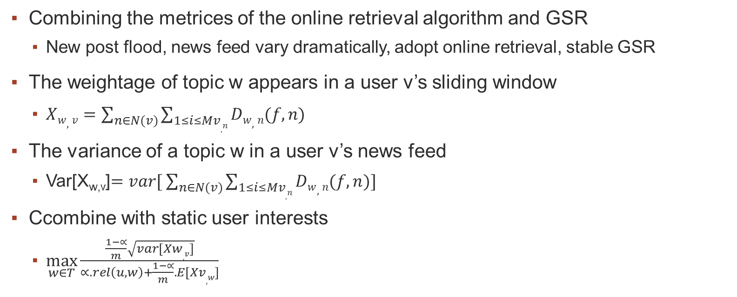
4. Hybrid model 1/2
Combining the metrices of the online retrieval algorithm and GSR
New post flood, news feed vary dramatically, adopt online retrieval, stable GSR
The weightage of topic w appears in a user v’s sliding window
$Xw,v=\sum_{n∈N(v)}{\sum_{1≤i≤Mv,n}{Dw,n(f,n)}}$
The variance of a topic w in a user v’s news feed
Var[X_{w,v}]$=var[ \sum_{n∈N(v)}{\sum_{1≤i≤Mv,n}{Dw,n(f,n)]}}$
Ccombine with static user interests
$\max_{w∈T}{\frac{\frac{1−∝}{m}\sqrt{var[Xw,v]}}{∝.rel\left(u,w\right)+\frac{1−∝}{m}.E[Xv,w]}}$

Slide 15
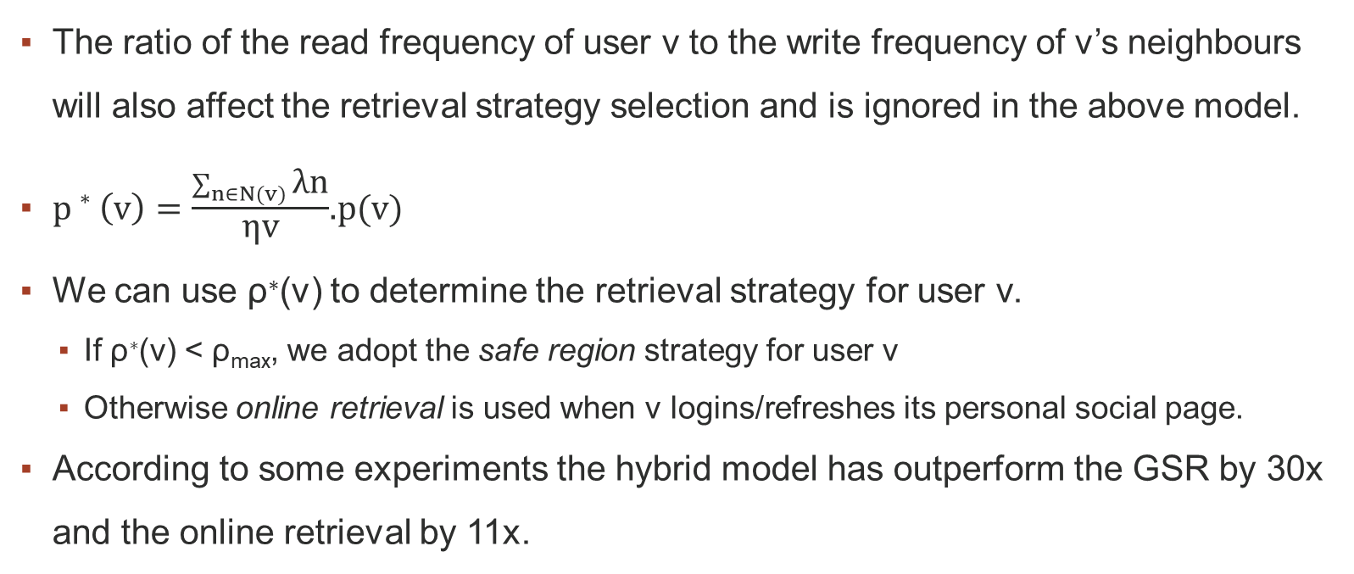
4. Hybrid model 2/2
The ratio of the read frequency of user v to the write frequency of v’s neighbours will also affect the retrieval strategy selection and is ignored in the above model.
$p∗\left(v\right)=\frac{\sum_{n∈N(v)}{\text{λ}\text{n}}}{\text{η}\text{v}}$.p(v)
We can use ρ∗(v) to determine the retrieval strategy for user v.
If ρ∗(v) < ρ_{max}, we adopt the safe region strategy for user v
Otherwise online retrieval is used when v logins/refreshes its personal social page.
According to some experiments the hybrid model has outperform the GSR by 30x and the online retrieval by 11x.

Slide 16
5. Conclusion
As we have seen the hybrid model has combined, the metrices of both GSR and the online, as well as provide a mechanism to choose the proper one, when the user asks for his news feed.
As we have seen before it out performs both of the two algorithms.
According to many experiments on huge datasets, the hybrid model has proved to be efficient and robust.

