Slide 1

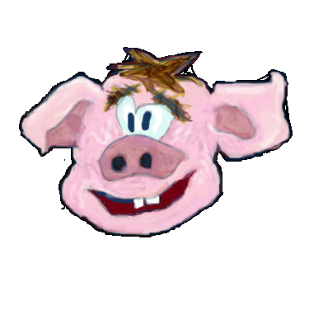
The Hogventure
Slideshow Framework
An on- & offline
Editor and Viewer
to create & play
storytelling games

Slide 2

The Game Engine
Slideshow with slides (rooms)
use objects as verbs
slide with dialogs, objects and background image
  Dialog and Object driven games
  Dialog If - Adventure like storytelling
  Hogventue Modus (Hidden Object)

Slide 3
The Global Paradigm
The five zones
  Top title, preferences
  Left slides
  Bottom dialogs
  Right player
  Center (All) background, objects
The paradigm is used for both game and editor

Slide 4
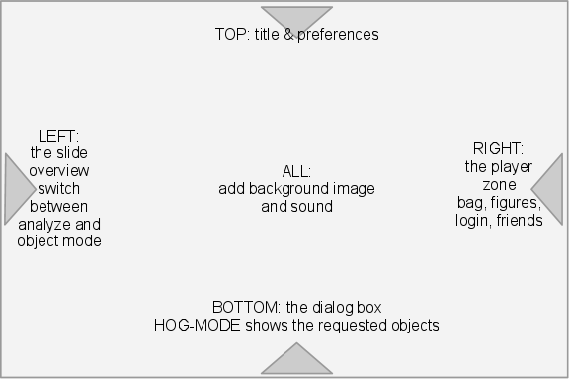
The Global Paradigm

Slide 5
The Viewer
The HSF follows some simple rules:
  high accessibility - only using low, easy technical standards
  easy usability - simple to understand by following the kiss paradigm
  great availability - easy to access, social (twitter, facebook ...), widely to communicate

Slide 6
The Viewer
The framework comes with a player for the games, which is also implemented in HTML and javascript, and a server sided storage solution. Local and session storage is provided by the modern browsers.
The creation of single- and multi-player-games is possible.
The basic idea is to enable the user of this framework to learn how to create new media. Understanding these new culture techniques provides a benefit any social community and
the world.

Slide 7
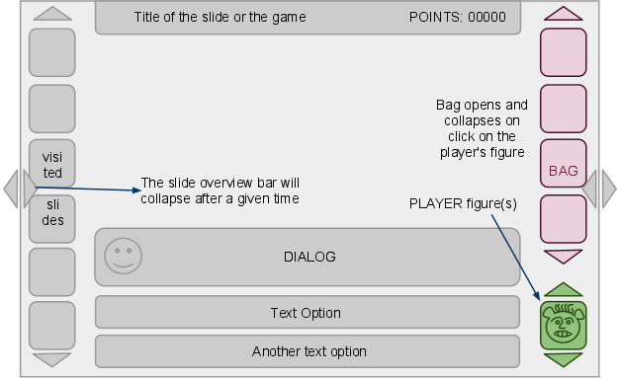
The Viewer

Slide 8
The Editor
The HSF allows you to create story driven interactive multimedia artwork - games.
There are 4 different main ways to do this:
  text, speech and dialog
  pictures - background, object and icons
  sound and music
  environmental

Slide 9
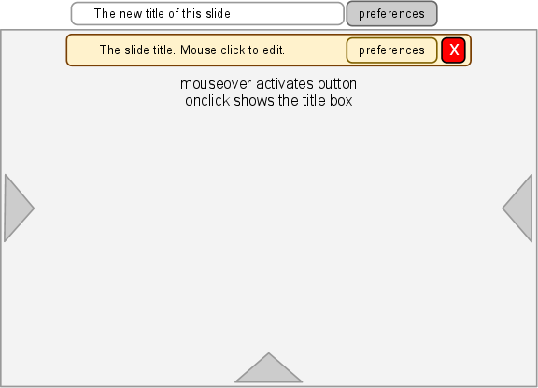
The Editor

Slide 10
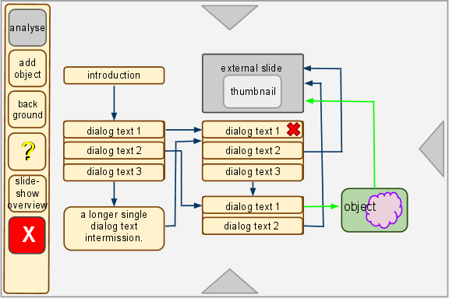
The Editor

Slide 11
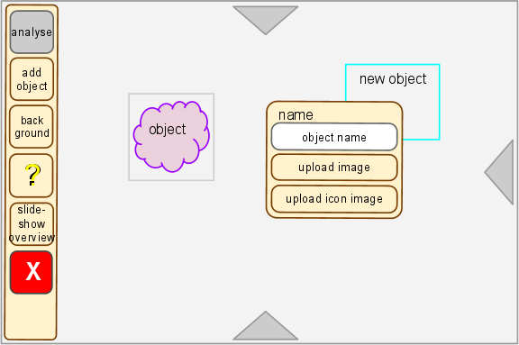
The Editor

Slide 12
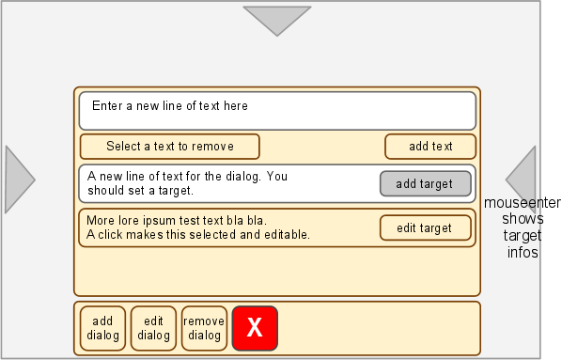
The Editor

Slide 13
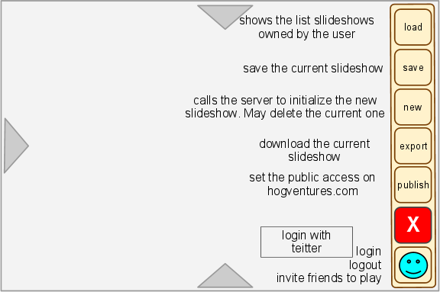
The Editor

Slide 14
The Editor
The framework comes with some editor programs. The basic editor, one for images, an other one for simple 3d content and should have one to record sound and music in the future. The last editor program enables you to write javascript based plug-ins. With these tools you can publish your game as a HTML webpage.
In the future no flash or equal will be required. This depends on the speed the HTML technique evolves.

Slide 15
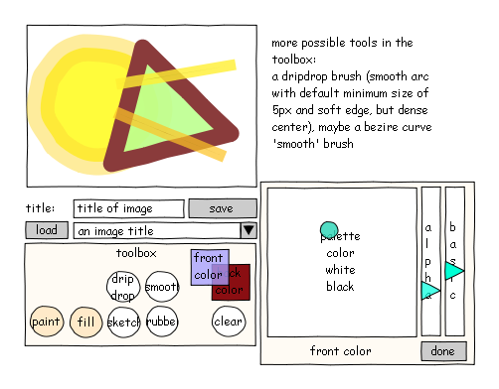
The Editor

Slide 16
The Release Plan
this version anorexic aardvark
  b-girl boar
  crepe salope
  double cross deal(doggy dog)
  early pearly
  farrow marrow
  grumpy gamer
  hot dog, hog ventourist

Slide 17
Contact Information
Contact:
malte.kosian@luckyrats.com
@twitter: maltekosian
tel.: +49 40 71668400
mob.:+49 176 62191530

