Slide 1
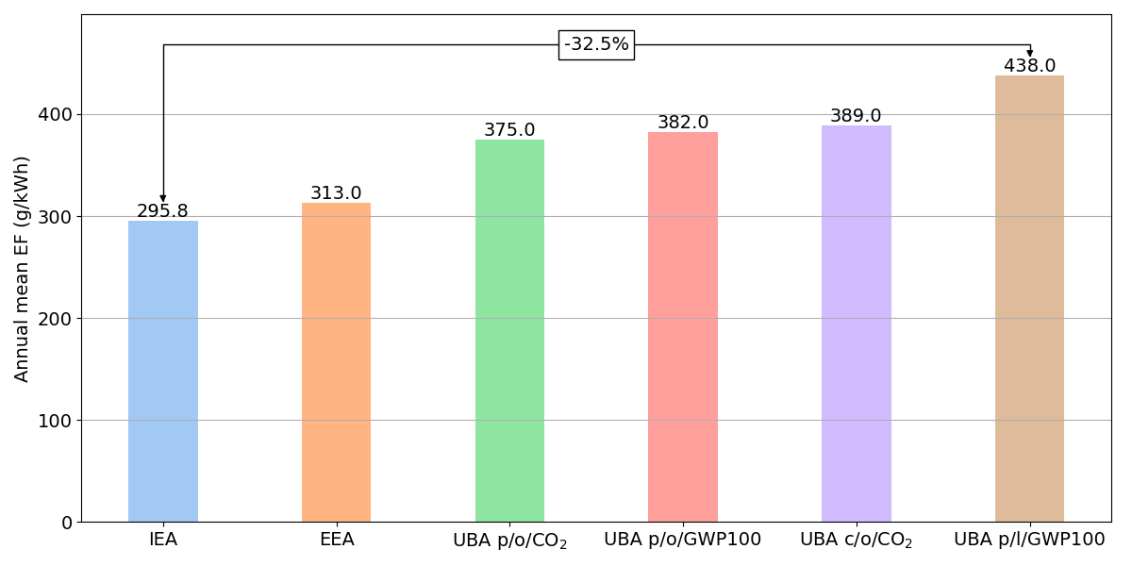
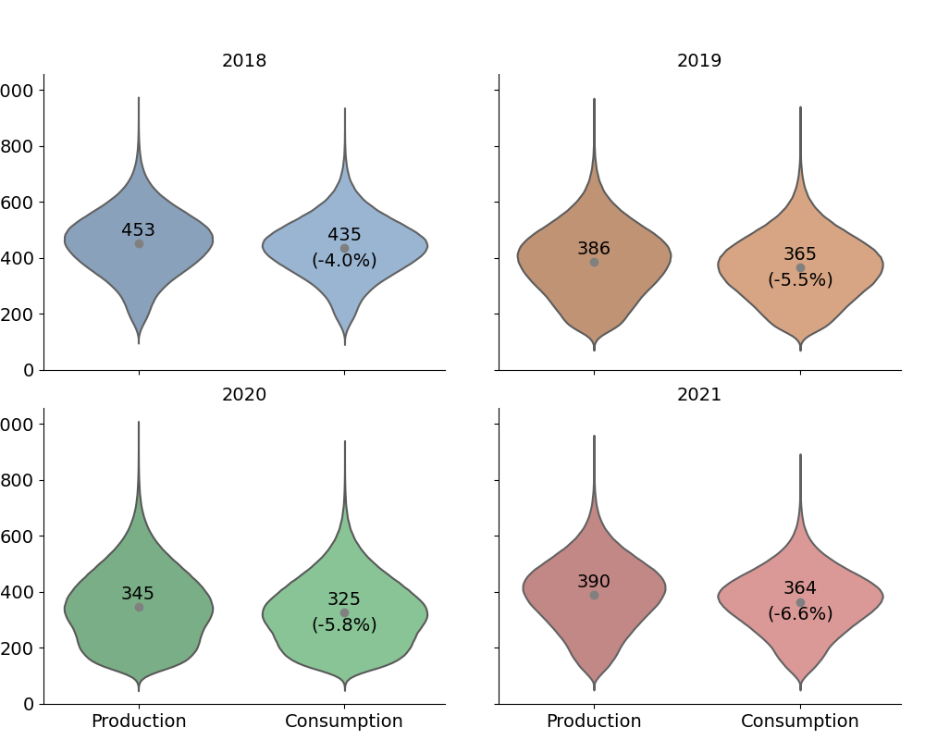
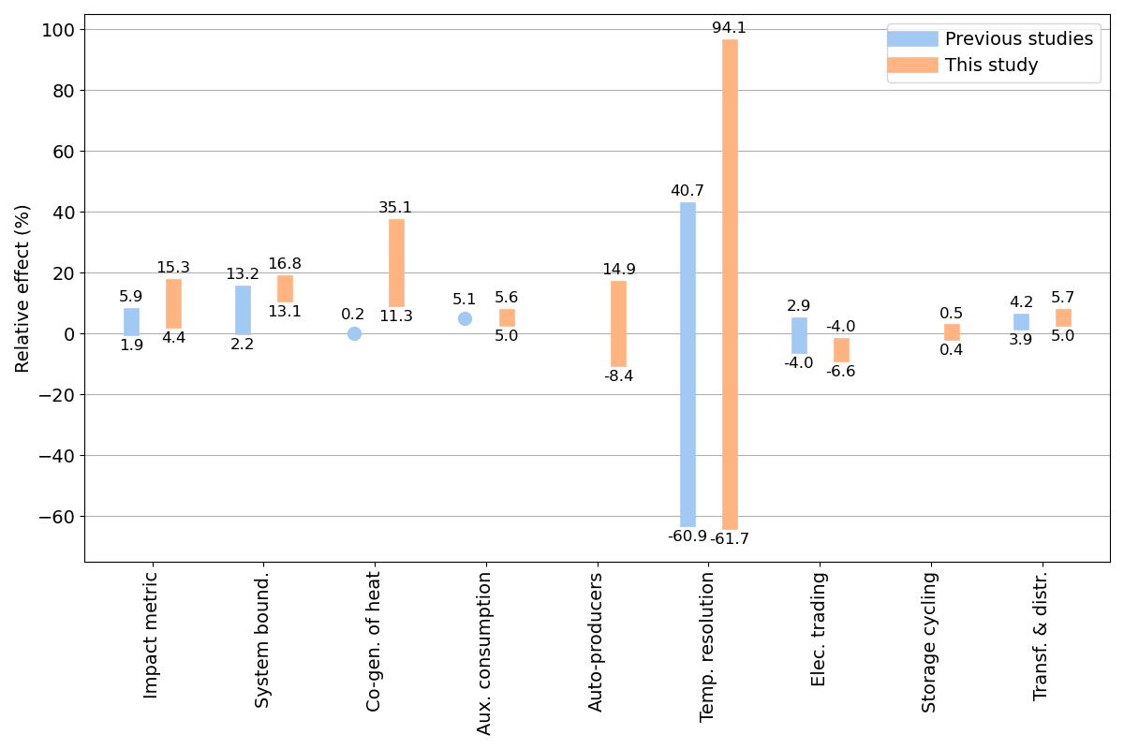
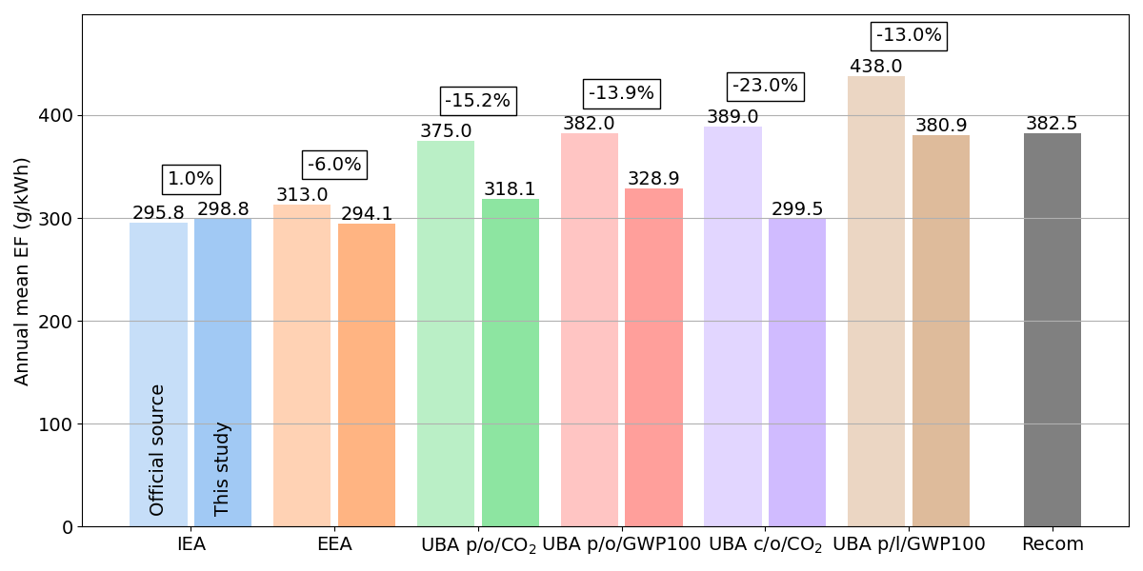
Status quo:
Grid emission factors (EF) show large variability
Aspects explaining variability
Quantifying & comparing aspects‘ effect on grid EF
Recommendation on
grid EF configuration

