Slide 1
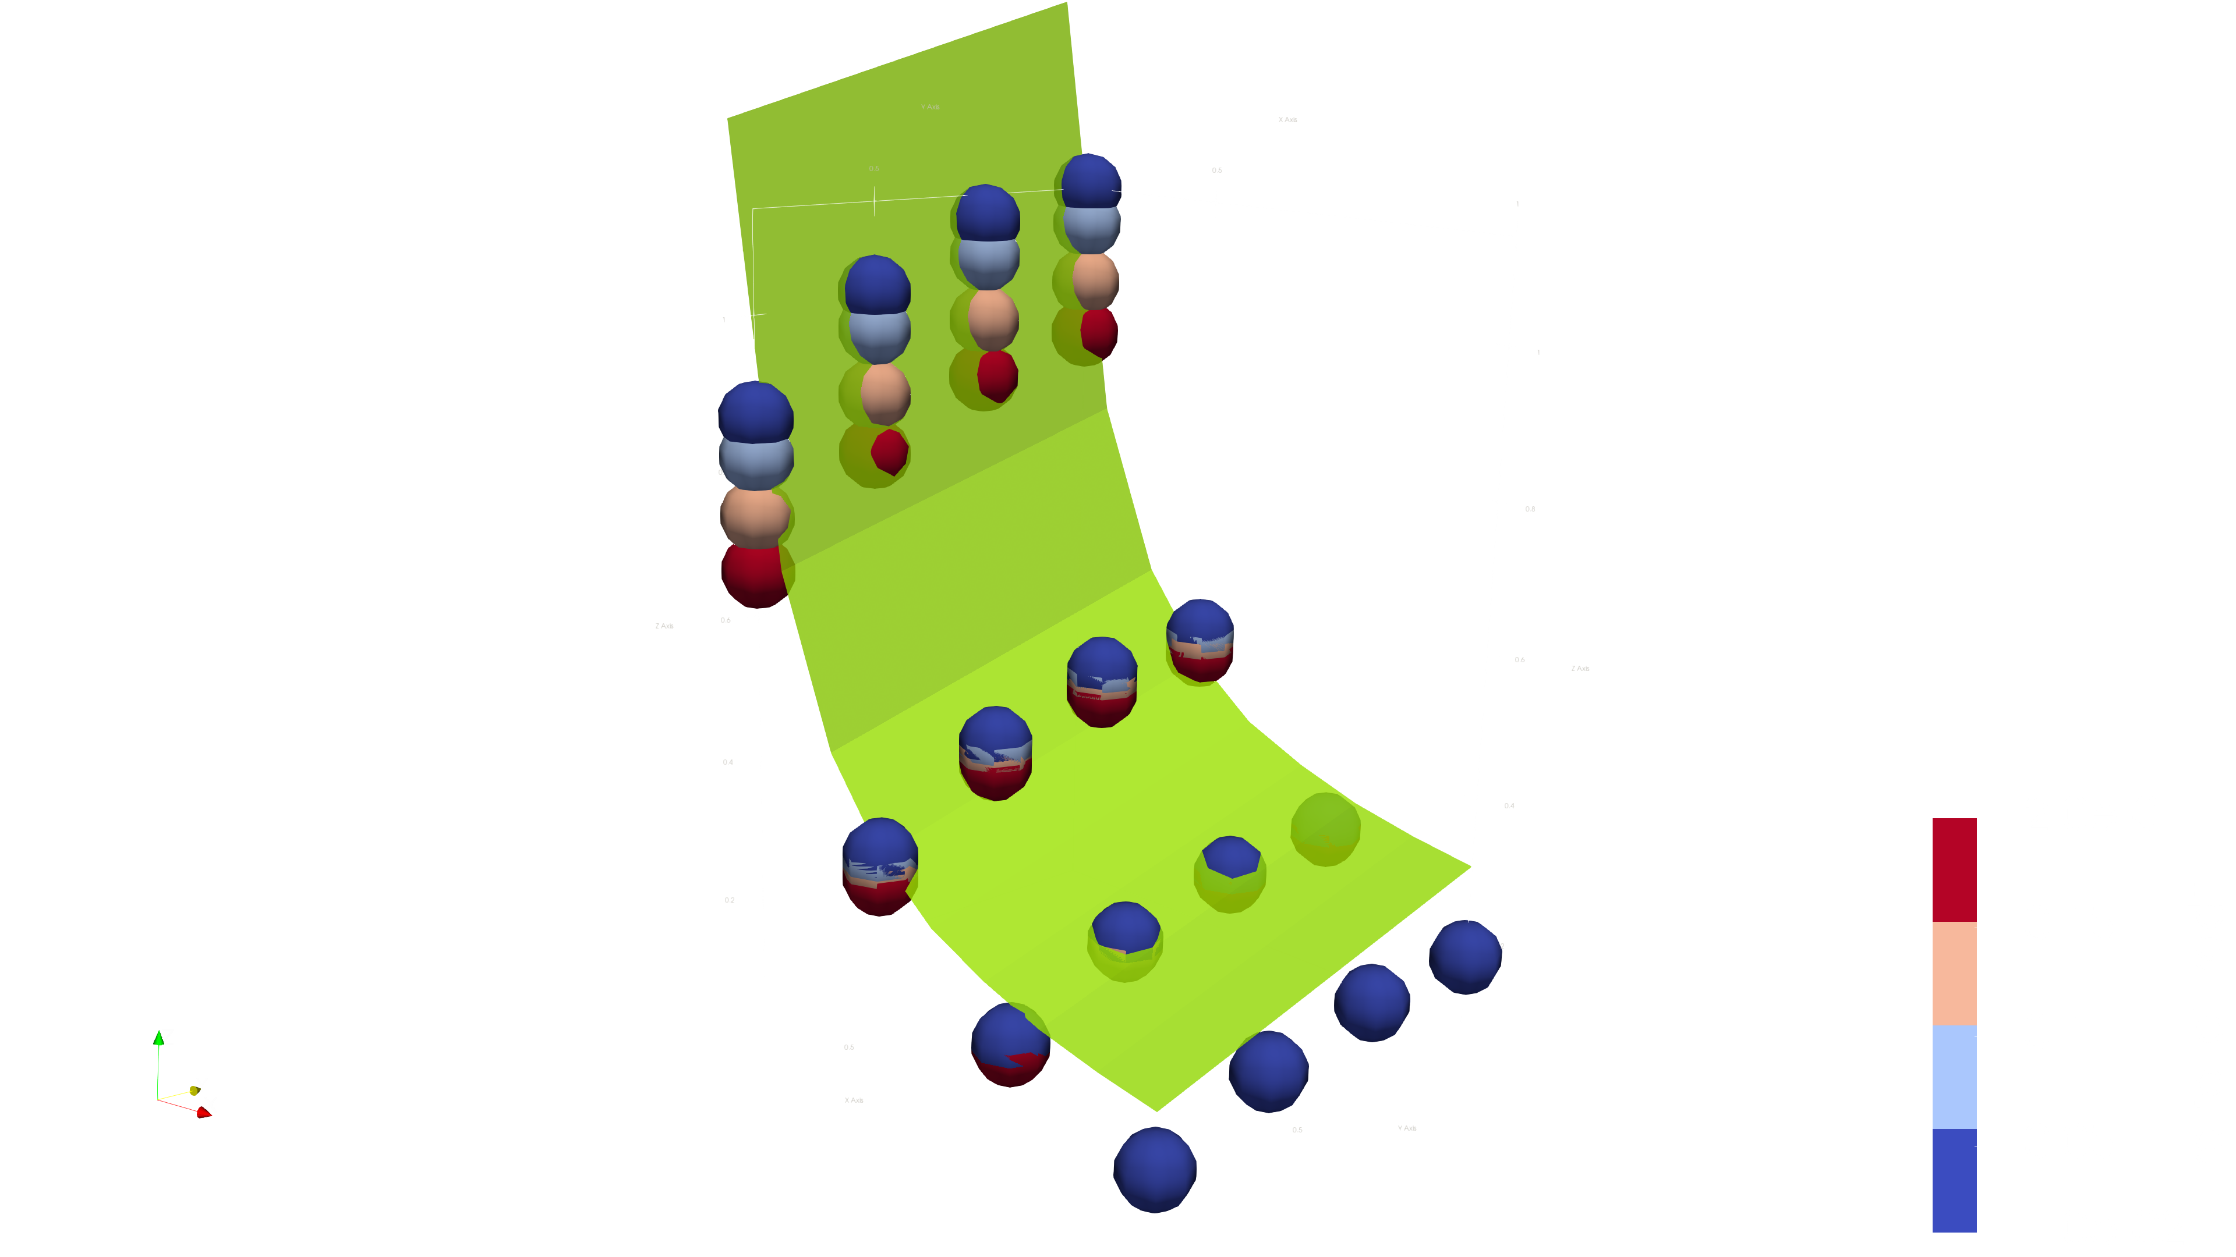
R₁ / R₀
2.27
1 / 30
2.27
1 / 10
1 / 7.5
1 / 5
Result
Result
0.16
0.16
0.25
90°
t
alpha
1.00
30°

