Slide 1
Clean Code Practice

Slide 2
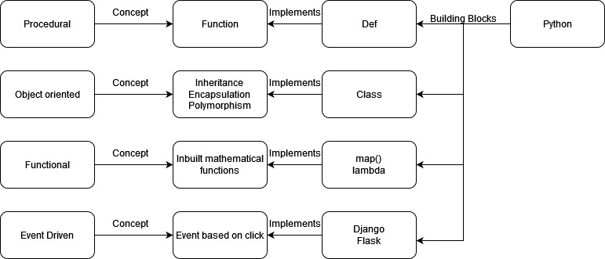
Python

Slide 3
Thank you

