Slide 1
Angular School
Lesson 7. Dependency Injection

Slide 2
LESSON PLAN
Dependency injection
Overview
Configuration
Hierarchy
Services in Angular 4

Slide 3
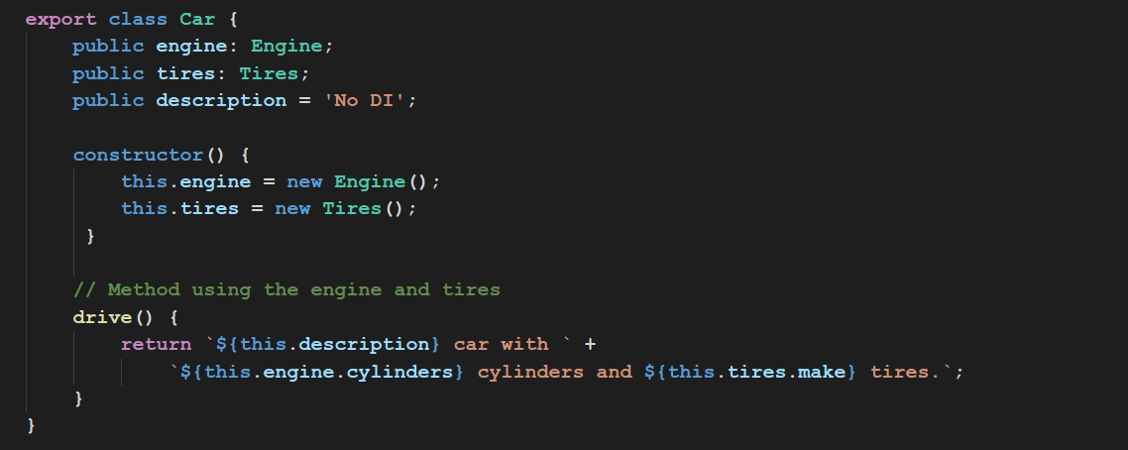
WHY WE NEED DI?

Slide 4
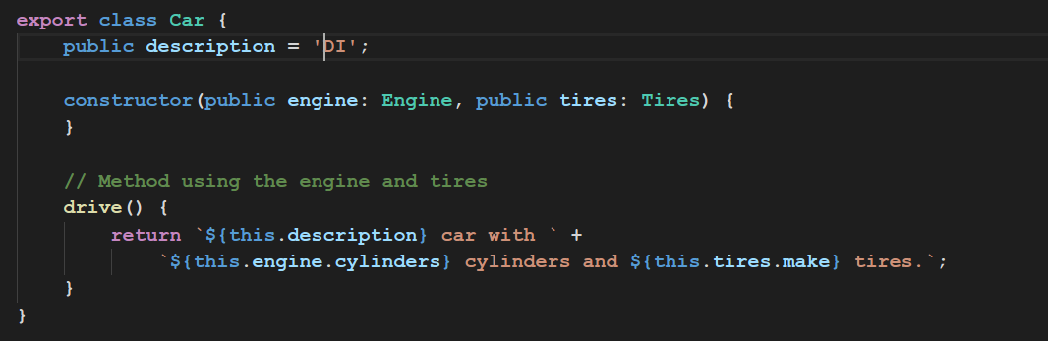
WHY WE NEED DI?

Slide 5
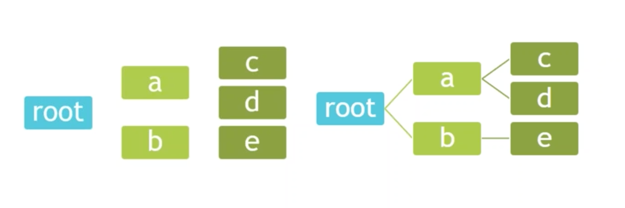
WHY WE NEED DI?

Slide 6
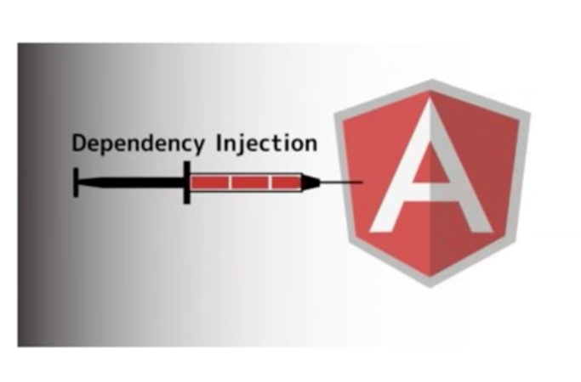
DEPENDENCY INJECTION OVERVIEW
Token
Provider
Injector
Dependency

Slide 7
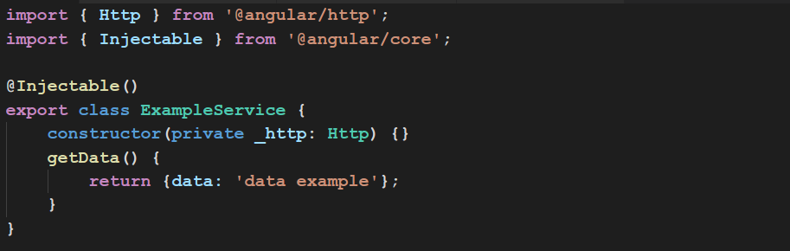
EASY TO DEVELOP

Slide 8
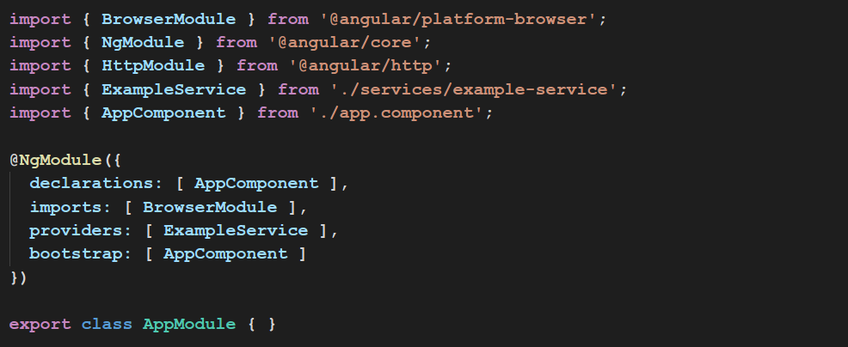
PROVIDERS

Slide 9
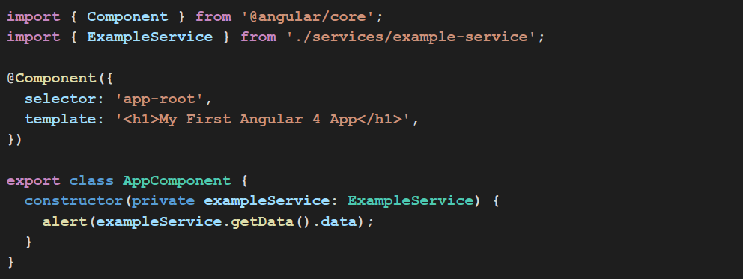
PROVIDERS

Slide 10
SERVICES
Provide streams (data models)
Provide operations with data
Helpers

Slide 11

NAMING CONVENTION
data.service.ts
some-data.service.ts

Slide 12
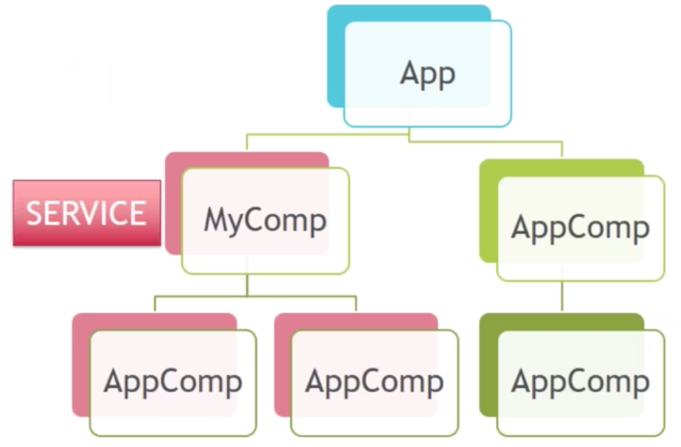
SERVICES

Slide 13
DI CONFIGURATION
Inject a (singleton) instance of a class
Call any function and inject the return value of that function
Inject a value
Create an alias

Slide 14
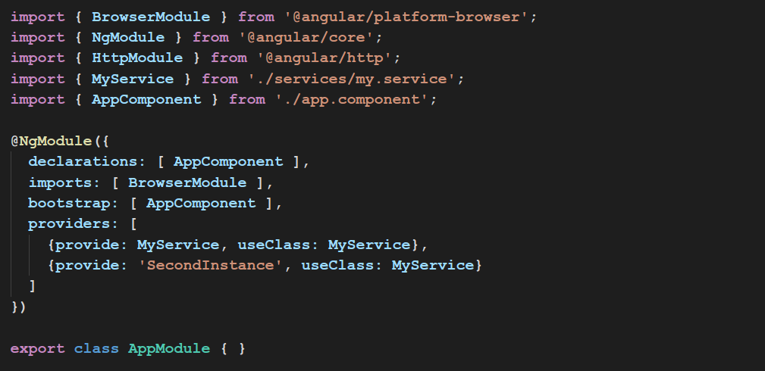
DI CONFIGURATION

Slide 15
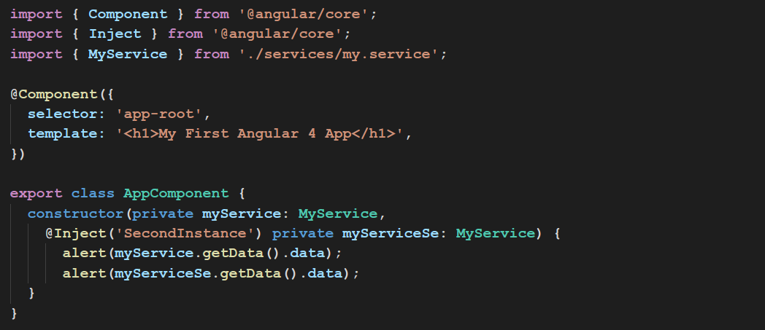
DI CONFIGURATION

Slide 16
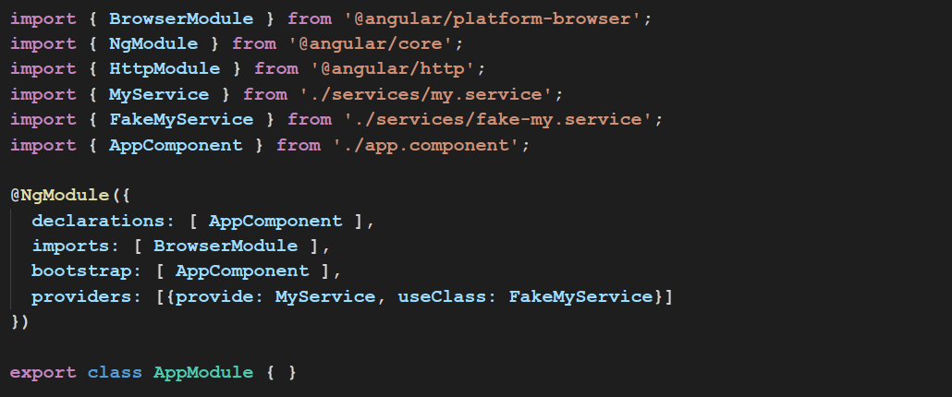
DI CONFIGURATION

Slide 17
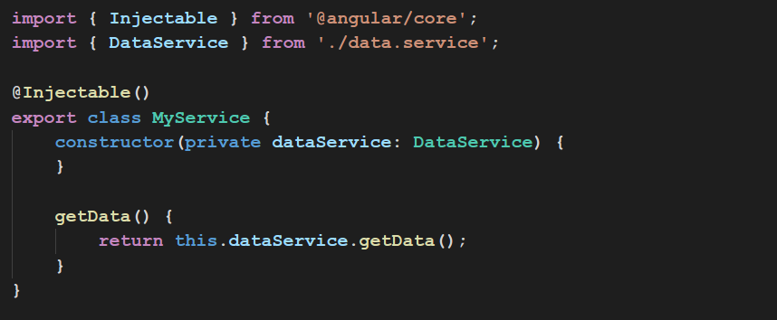
DI CONFIGURATION

Slide 18
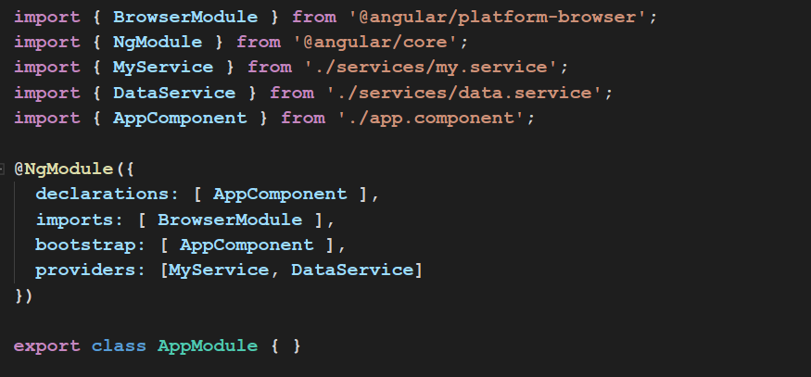
DI CONFIGURATION

Slide 19
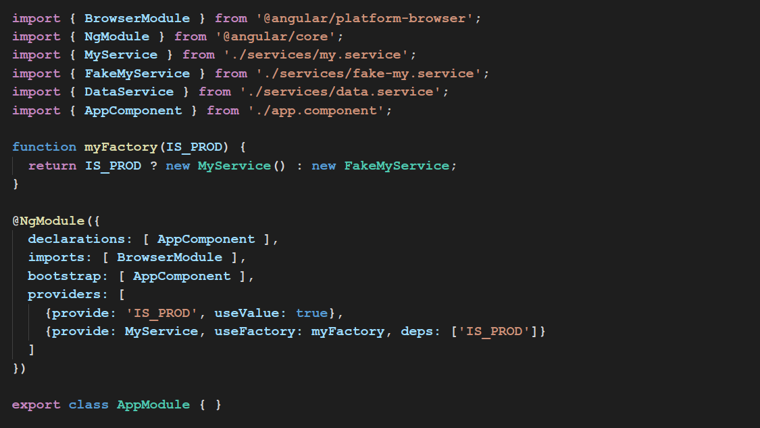
USEVALUE & USEFACTORY

Slide 20
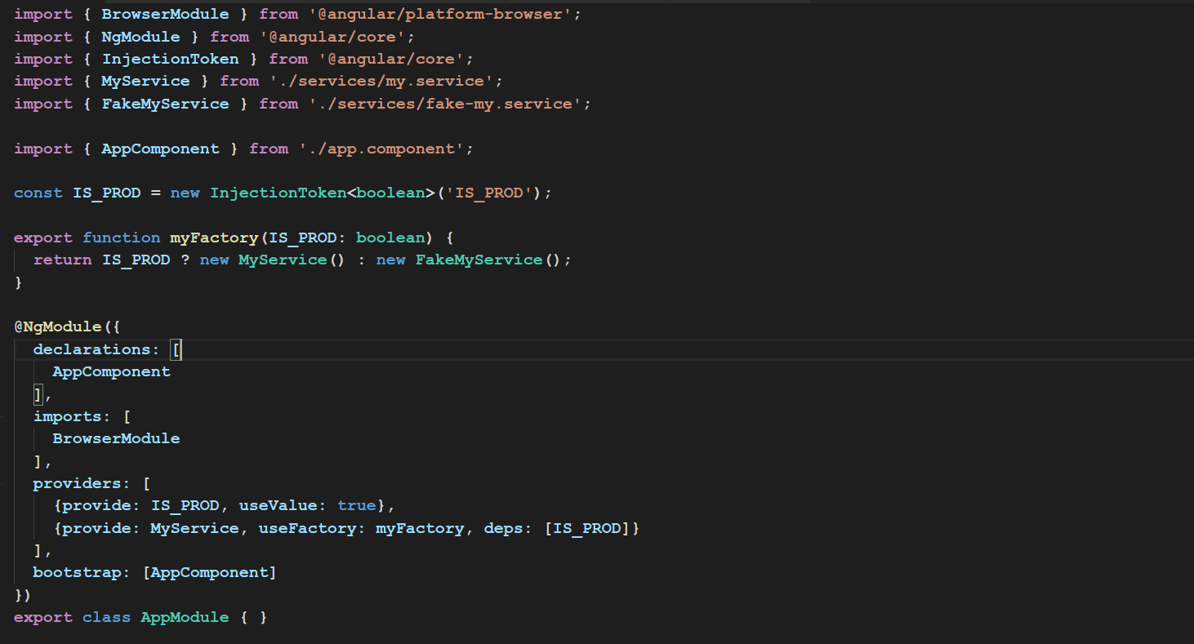
INJECTION TOKEN

Slide 21
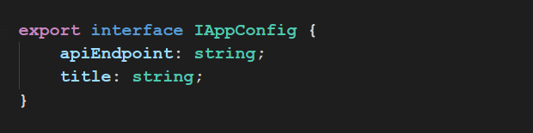
INJECTION TOKEN
app-config-interface.ts

Slide 22
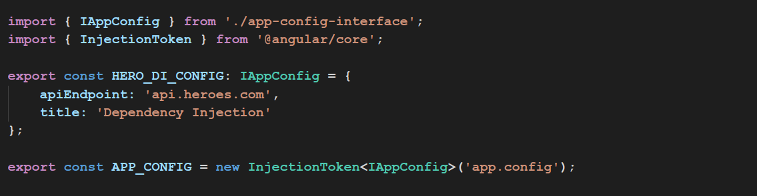
INJECTION TOKEN
app-config.ts

Slide 23
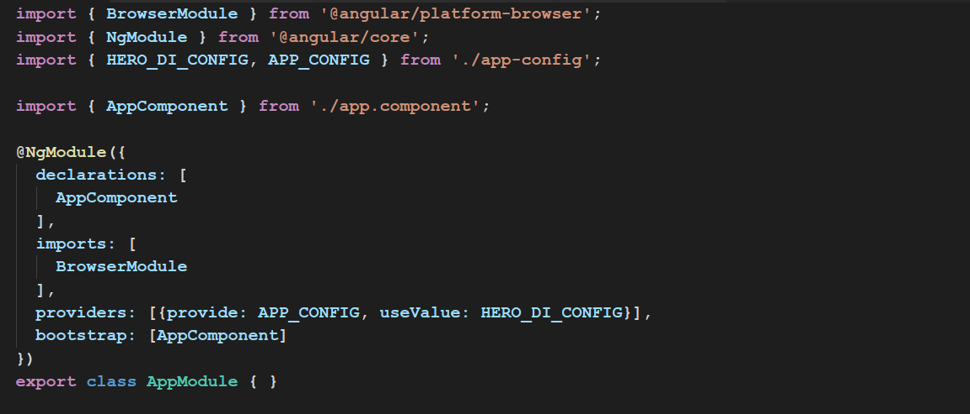
INJECTION TOKEN

Slide 24
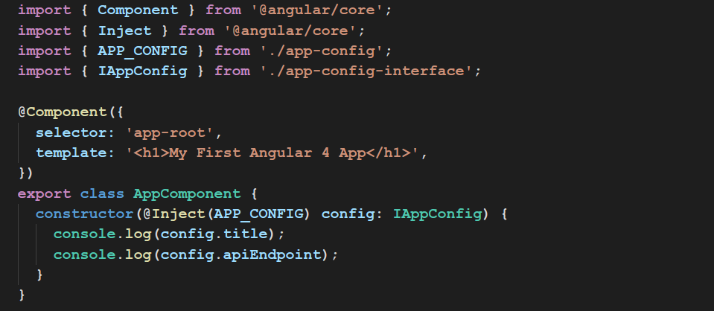
INJECTION TOKEN

Slide 25
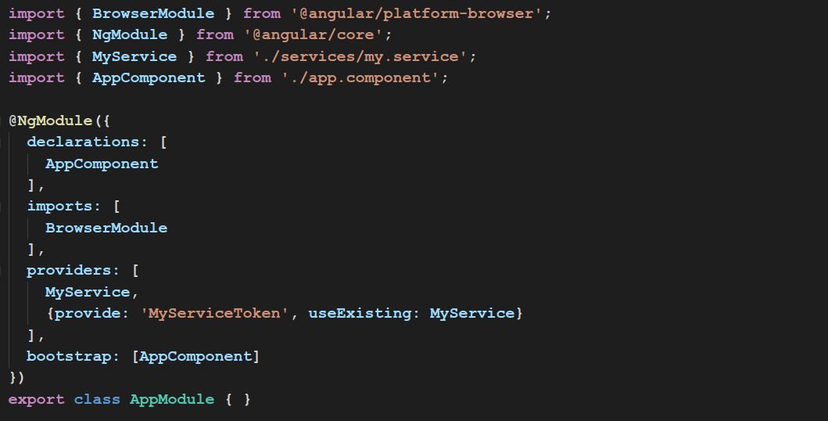
USEEXISTING

Slide 26
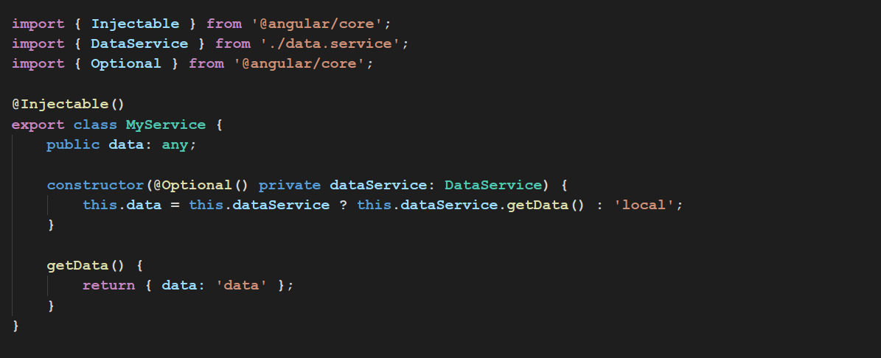
OPTIONAL DEPENDENCIES

Slide 27
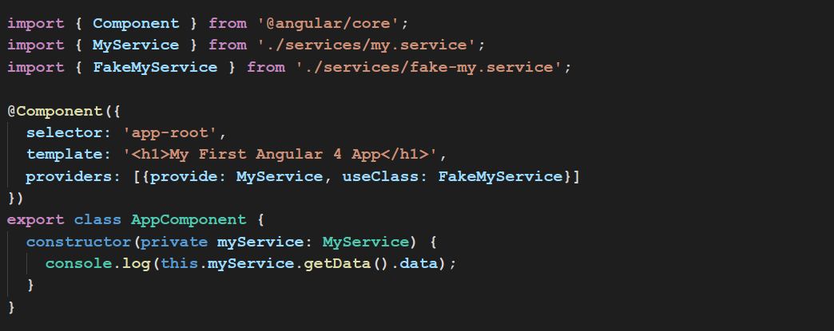
NOT ROOT DEPENDENCY

