Slide 1
Angular School
Lesson 7. Dependency Injection

Slide 2
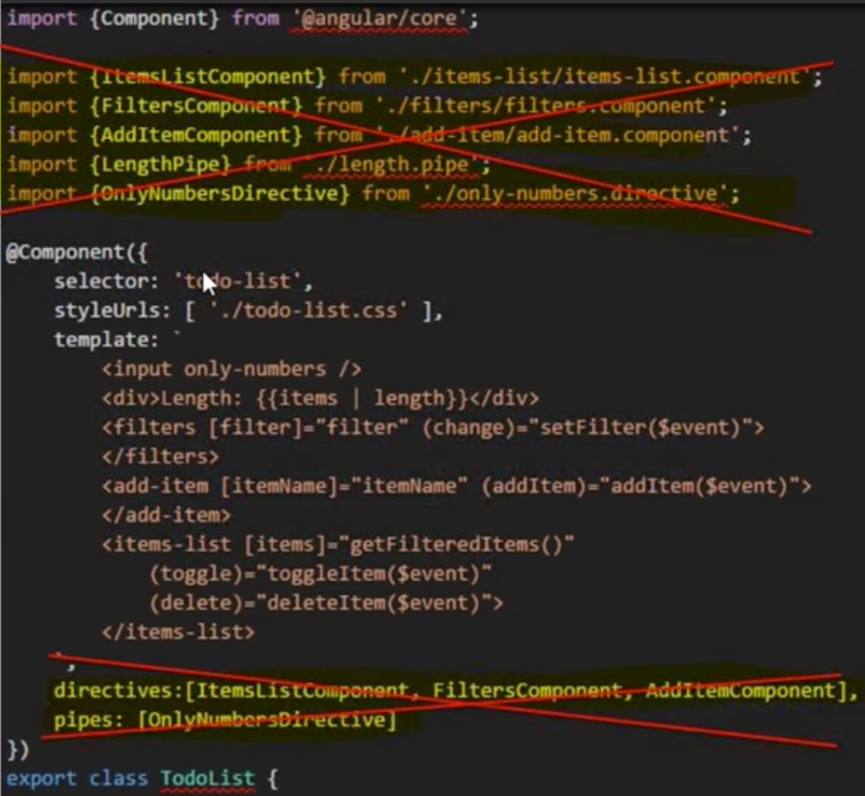
MODULES

Slide 3
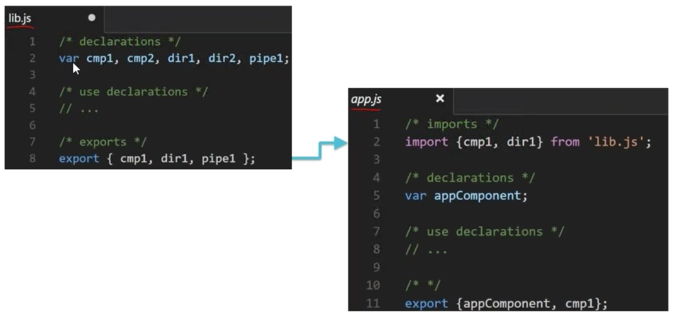
ES6 MODULES

Slide 4
NGMODULE
Angular modules help organize an application into cohesive blocks of functionality
An Angular Module is a class adorned with @NgModule decorator function. @NgModule takes a metadata object that tells Angular how to compile and run module code. It identifies the module’s own components, directives and pipes, making some of them public so external components can use them. It may add service providers to application dependency injectors.

Slide 5
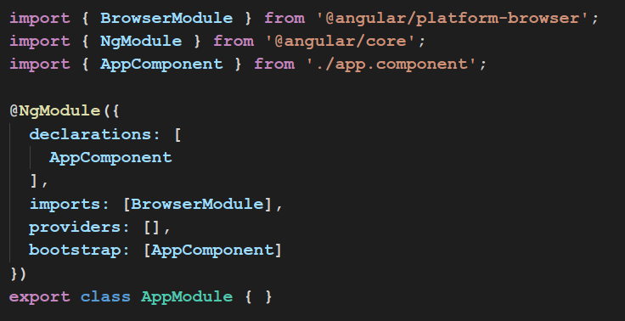
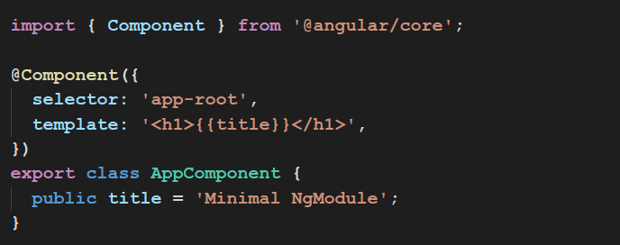
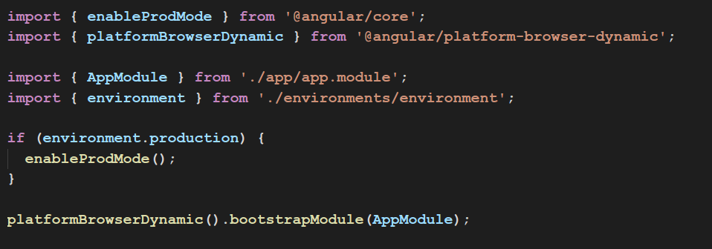
@NGMODULE

Slide 6
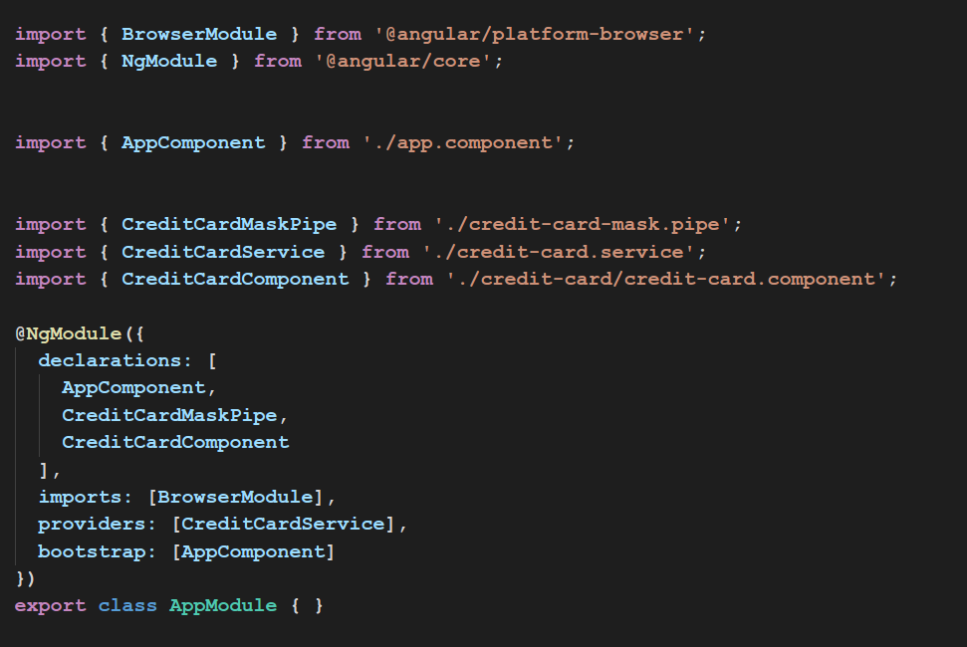
WHY MODULE
credit-card.component
credit-card.pipe
credit-card.service
app.component
app.module

Slide 7
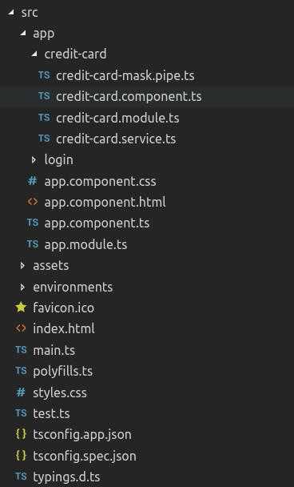
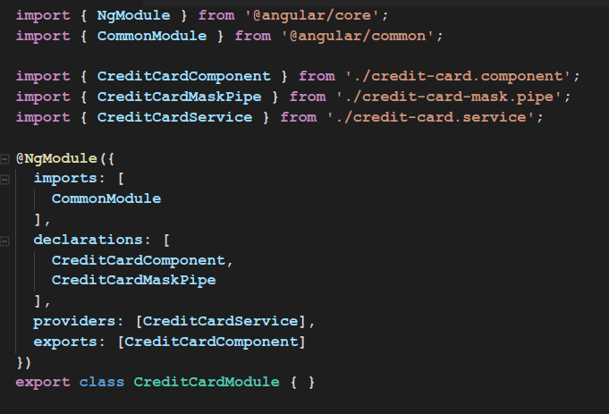
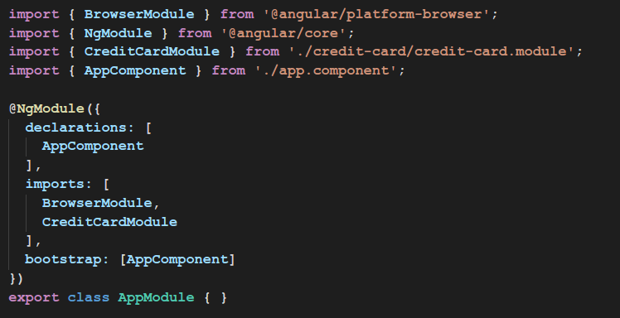
CREATING A FEATURE MODULE
credit-card.module
app.module

Slide 8
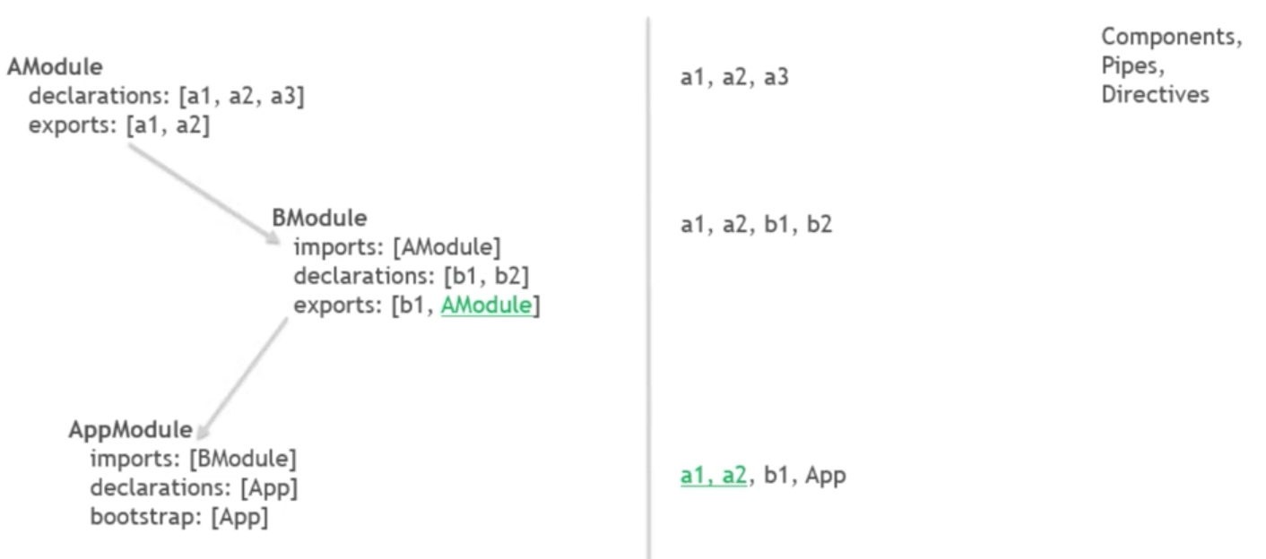
DECLARATIONS, EXPORTS, IMPORTS

Slide 9
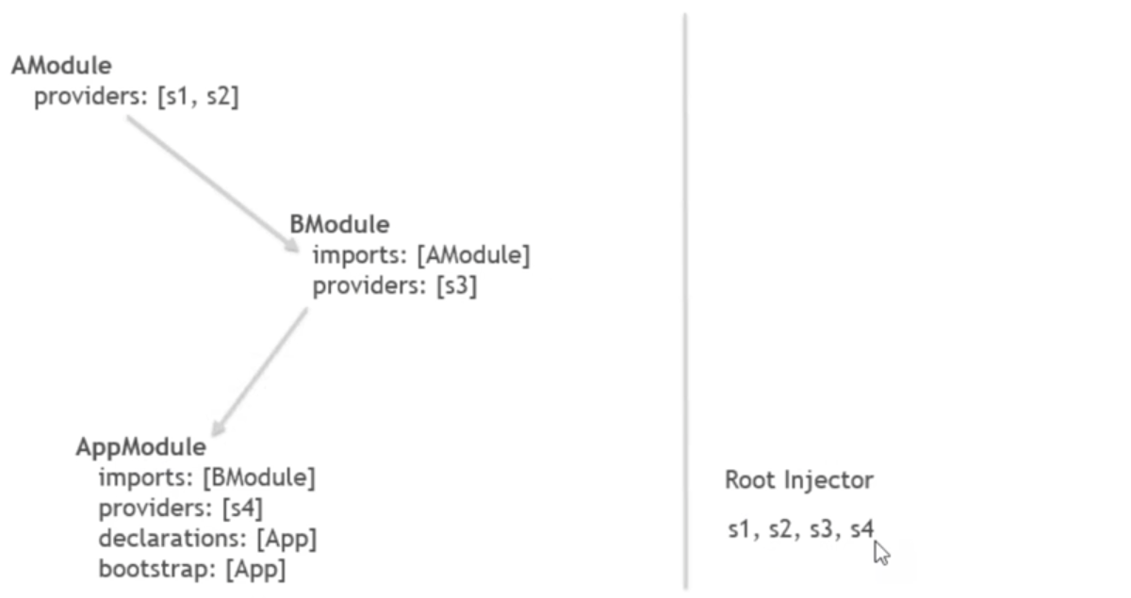
PROVIDERS

Slide 10
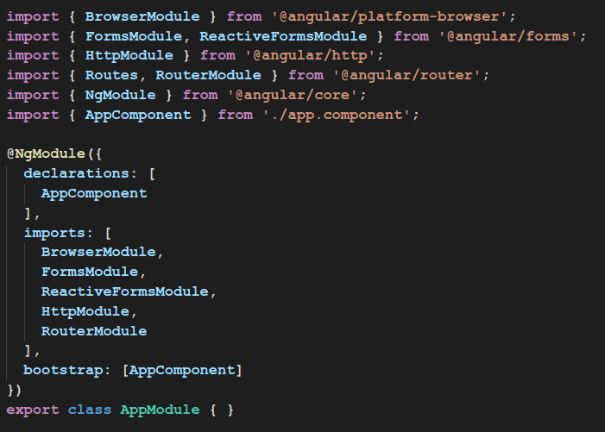
BUILT IN MODULES

Slide 11
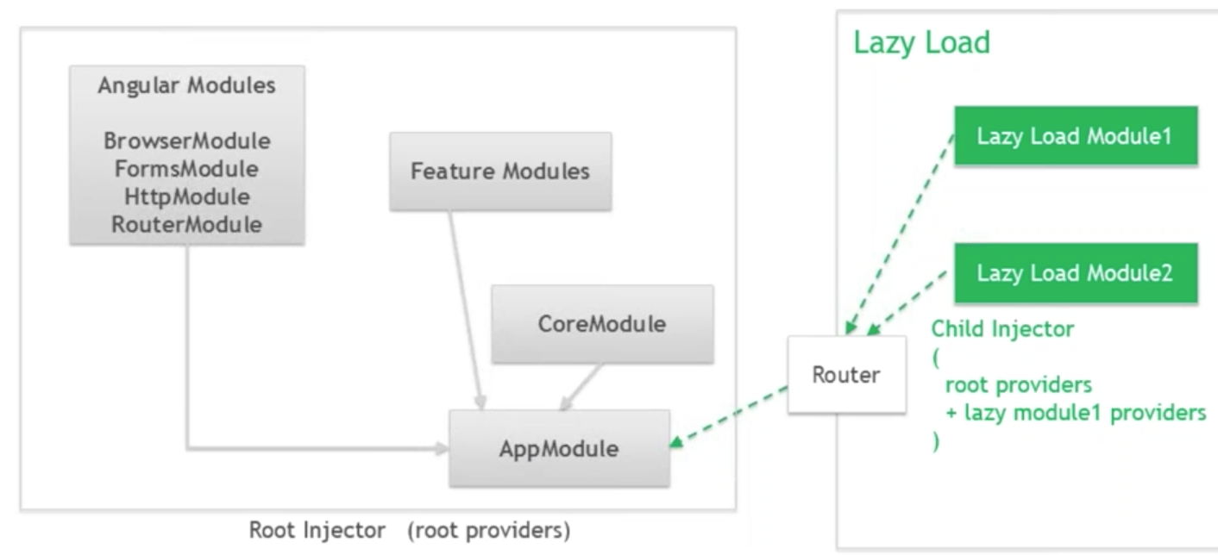
ARCHITECTURE WITH LAZY LOADING

Slide 12
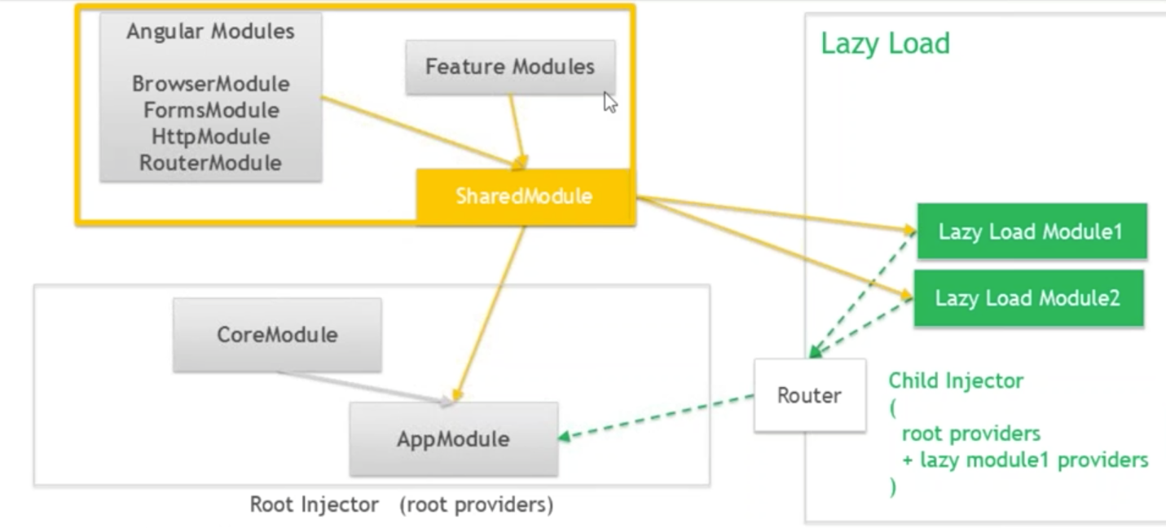
ARCHITECTURE WITH LAZY LOADING

Slide 13
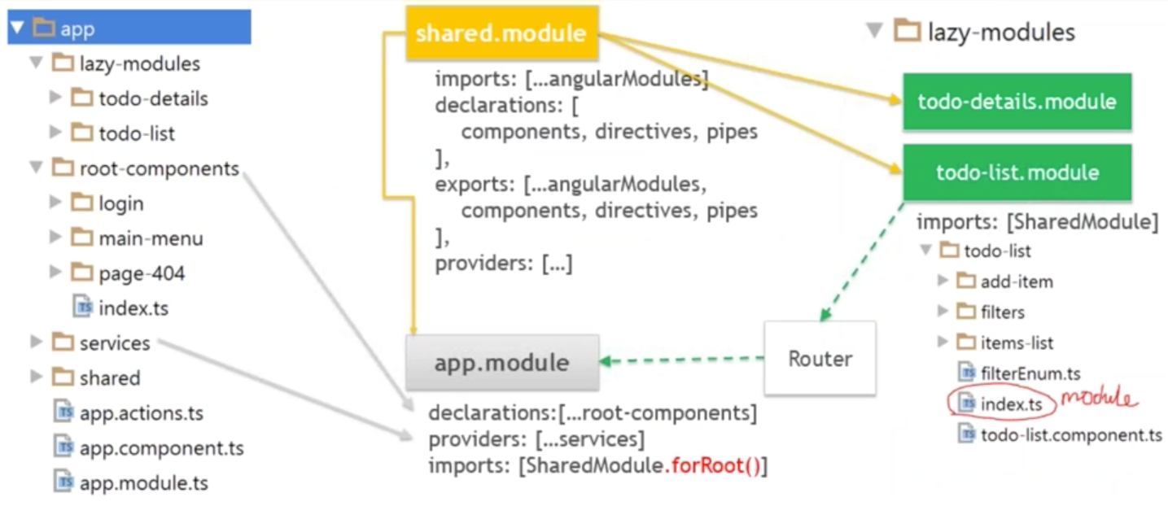
MODULE ARCHITECTURE EXAMPLES

Slide 14
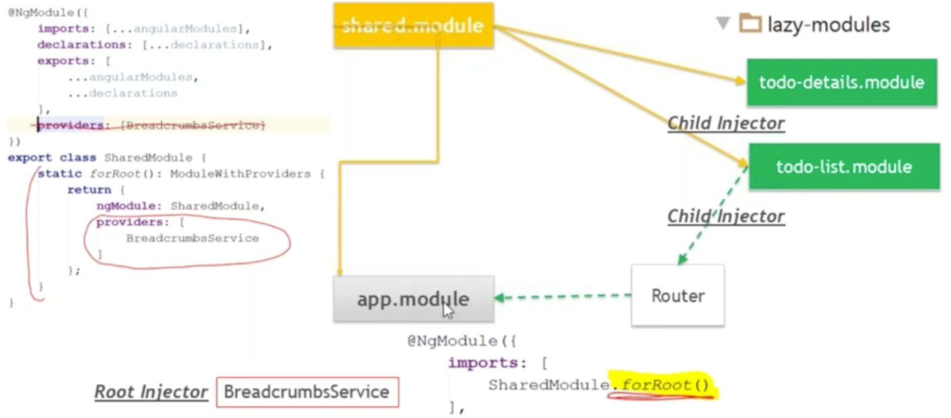
LAZY MODULE PROVIDERS PROBLEMS

