Slide 1
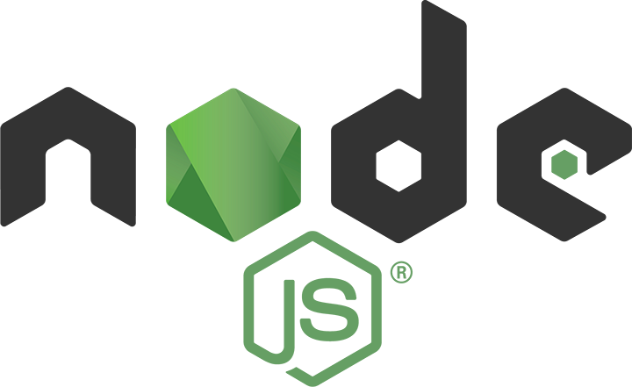
Node.js
Lesson 7. Express.

Slide 2

Agenda:
Connect middleware
Express
Views and layout
Working with Data
Common and Advanced Scenarios

Slide 3
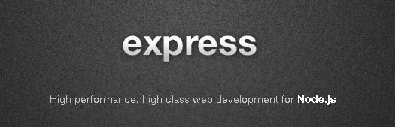
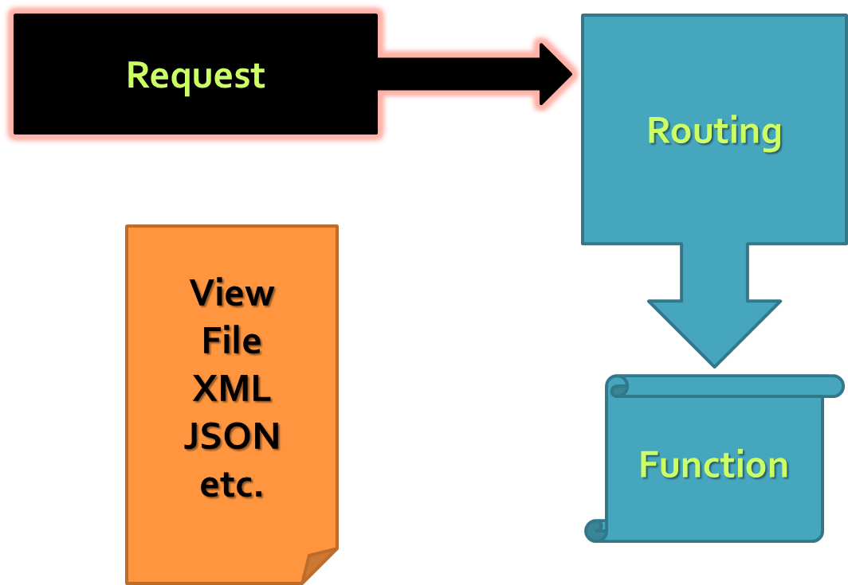
ExpressJS
Web development with ExpressJS

Slide 4
Basic server implementation
var http = require('http');
http.createServer(function(req, res) {
res.writeHead(200, {
'Content-Type': 'text/plain'
}); //return success header
res.write('My server is running! ^_^'); //response
res.end(); //finish processing current request
}).listen(1234);

Slide 5
Connect is a middleware framework for node
$ npm install connect
var connect = require('connect');
var app = connect()
.use(connect.logger('dev'))
.use(connect.static('public'))
.use(function(req, res){
res.end('hello world\n');
})
http.createServer(app).listen(3000);

Slide 6
Request processing pipeline
Request
Response
Middleware (logging, authentication, etc.)

Slide 7
Custom middleware function
var connect = require('connect'),
util = require('util');
var interceptorFunction = function(request, response, next) {
console.log(util.format('Request for %s with method %s', request.url, request.method));
next();
};
var app = connect()
// .use('/log', interceptorFunction)
.use(interceptorFunction)
.use(function onRequest(request, response) {
response.end('Hello from Connect!');
}).listen(3001);

Slide 8
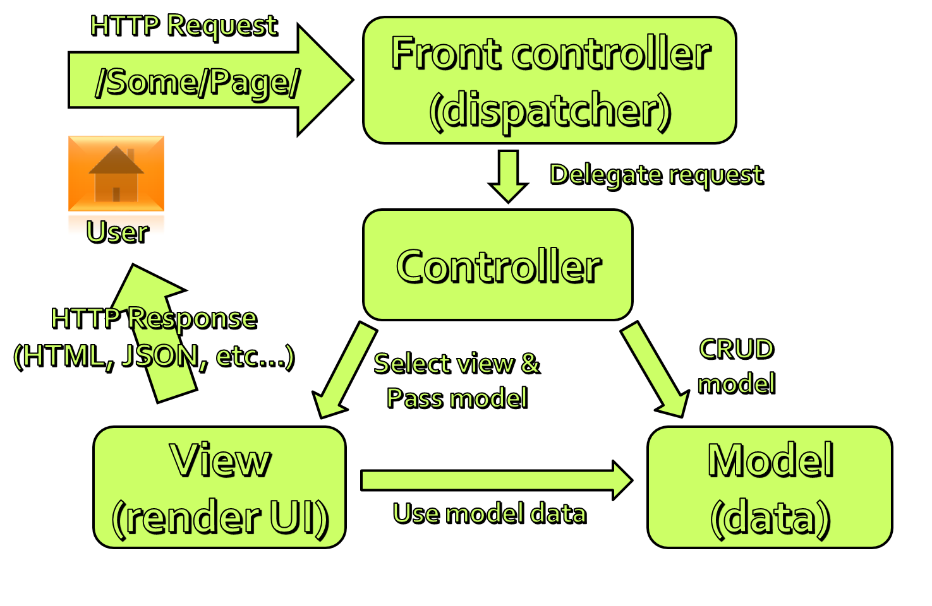
Express

Slide 9
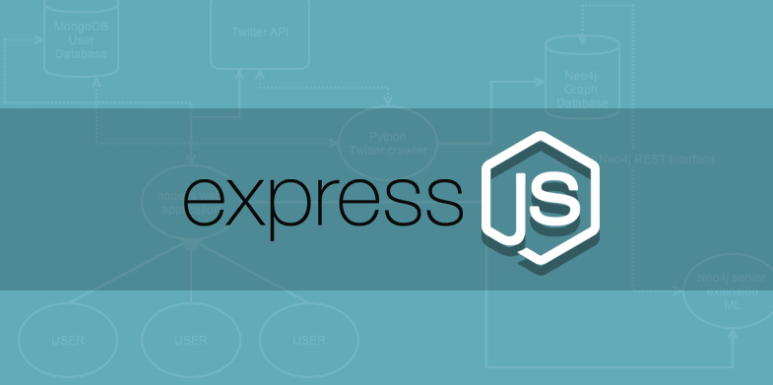
Adds functionality to Connect
Built on top of Connect Middleware
Request / Response enhancements
Routing
View Support
HTML Helpers
Content Negotiation
Exposes Connect Middleware

Slide 10
Basic architecture
Request
Routing
View
File
XML
JSON etc.
Function

Slide 11
First express app
var express = require('express');
var app = express();
app.get('/', function (request, response) {
response.send('Welcome to Express!');
});
app.get('/customer/:id', function (req, res) { res.send('Customer requested is ' + req.params['id']);
});
app.listen(3000);

Slide 12
Demo: Creating Express Applications
Simple ExpressJS application and "nodemon"
Create routes and require() them
Pass parameters
Configure and middleware

Slide 13
Views in express
User Interface
Based on Templates
Support for multiple View Engines
Jade, EJS, JSHtml, . . .
Default is Jade
http://jade-lang.com
app.get('/', function (req, res) {
res.render('index');
});

Slide 14
var express = require('express'),
path = require('path');
var app = express();
app.configure(function () {
app.set('views', __dirname + '/views');
app.set('view engine', 'jade');
app.use(express.static(path.join(__dirname, 'public')));
});
app.get('/', function (req, res) {
res.render('empty');
});
app.listen(3000);
doctype
html(lang="en")
head
title Welcome to this emtpy page
body

Slide 15
Working with data
Pass data to the views
Read data from the views (bodyParser)
Read and send files
Data for all views
res.render('index', { title: 'Customer List' });
res.render('index', { title: 'Customer List' });
var filePath = req.files.picture.path;
// ...
res.download(filePath);
res.sendfile(filePath);
app.locals.clock = { datetime: new Date().toUTCString()};

Slide 16

Demo: Working with data
Pass data to views (customer.index)
Submit data from views (customer.create)
Content negotiation (customer.details)
Upload files (customer.create)
Helpers (app.locals)

Slide 17
Demo: Advanced Scenarios
Cookies
Sessions
Custom middleware
Authentication and authorization

Slide 18
Sessions
Depending on cookies
Store implementations: Memory, Redis, …

Slide 19
Error handling
The app.error() method receives exceptions thrown within a route, or passed to next(err)

Slide 20
Why express
Full-blown feature set
Built on Connect
Good documentation
Lots of examples
Many extensions
Nice community

Slide 21


Semantic versioning

Slide 22
Thank you for your attention

