Slide 1

Dev-Pro Node.js
Advanced Flow
Lesson 3. Streams.

Slide 2

Agenda:
What is the stream
Type of streams
Streams events
Piping
fs module

Slide 3


Slide 4

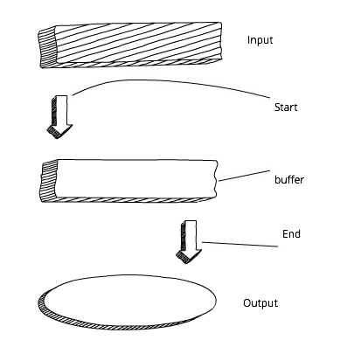
What is the stream?

Slide 5
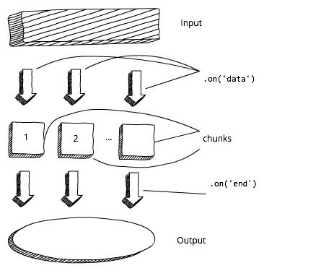
What is the stream?

Slide 6

What is the stream?

Slide 7
What is the stream?

Slide 8
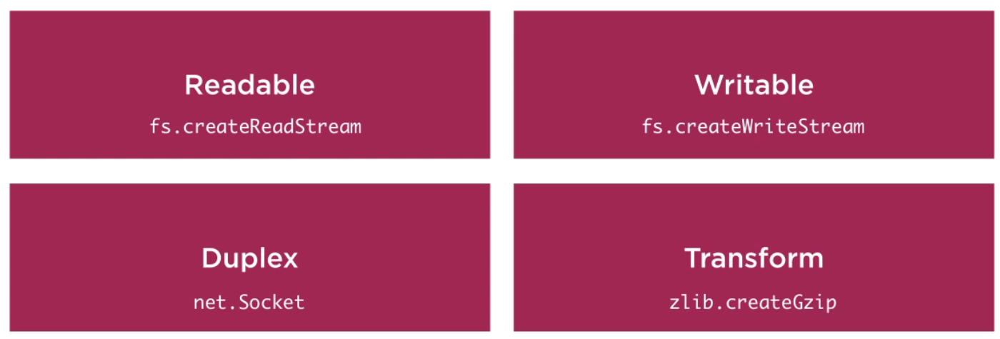
Stream types

Slide 9
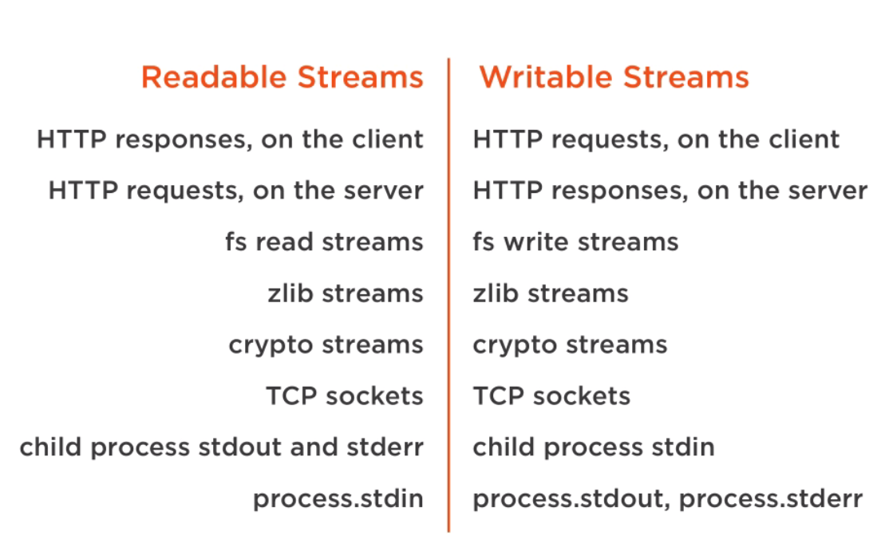
Stream types

Slide 10

Something about streams…

Slide 11

Piping

Slide 12
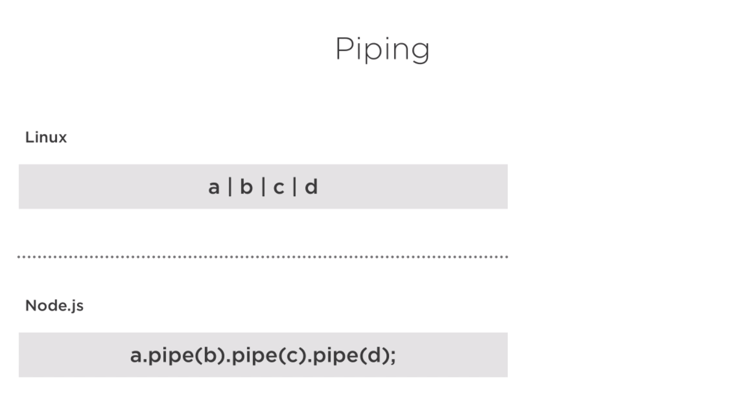
Piping

Slide 13
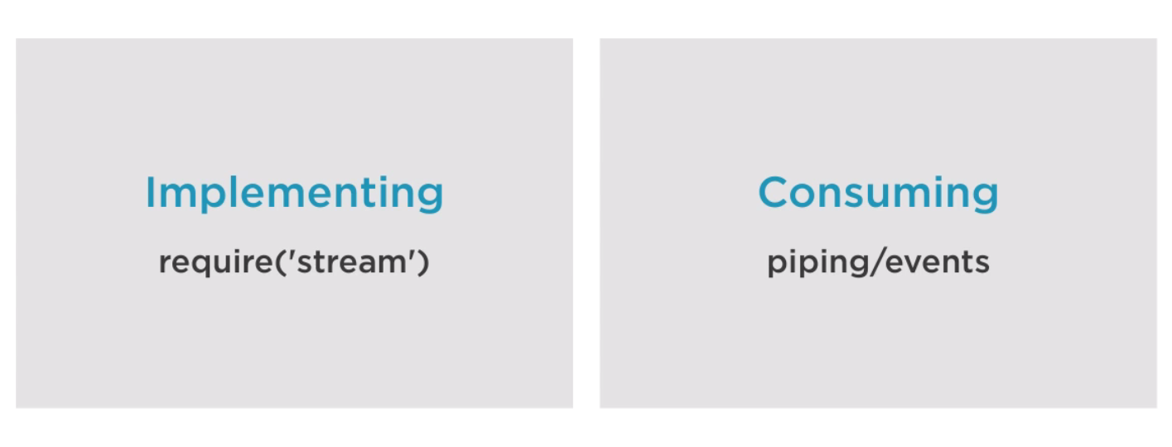
Piping

Slide 14
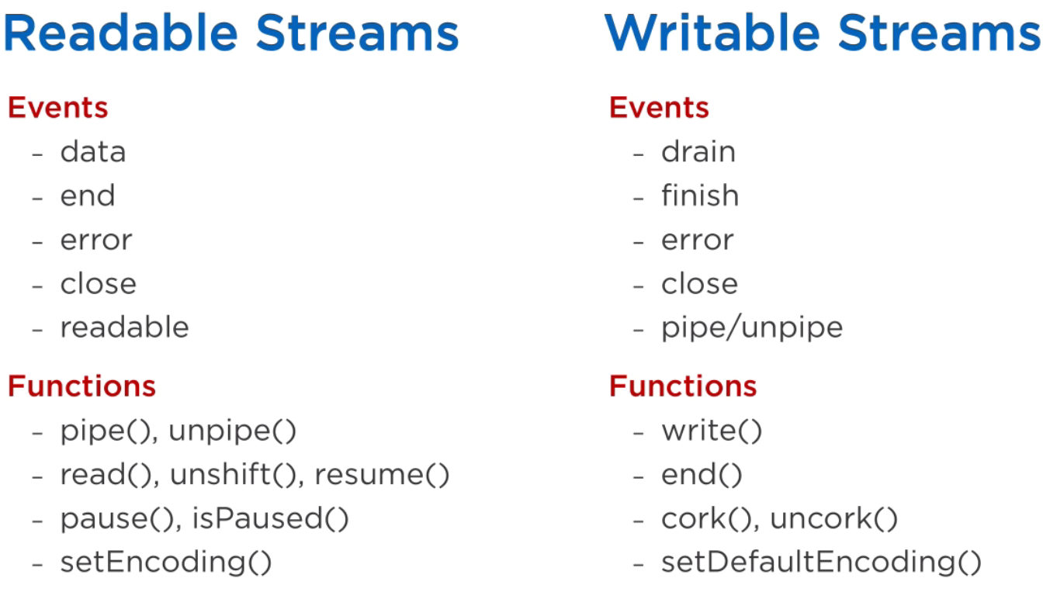
Readable/Writable streams

Slide 15
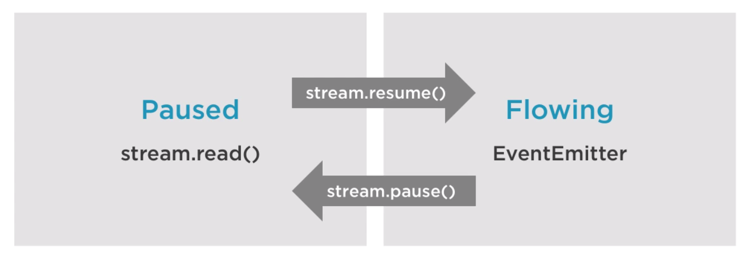
Readable streams

Slide 16
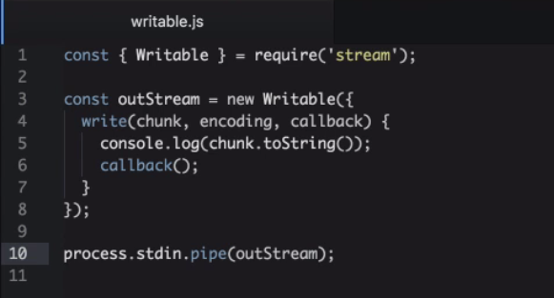
Writable streams

Slide 17
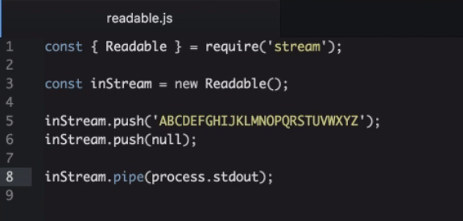
Readable streams

Slide 18
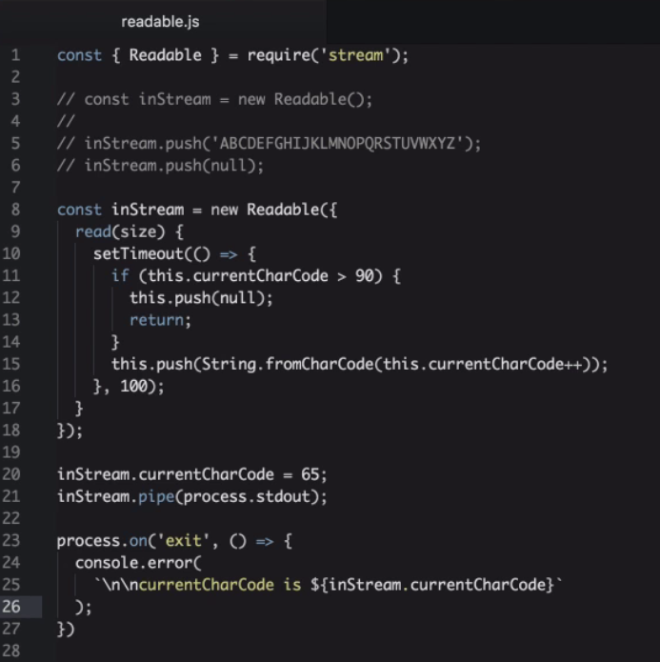
Readable streams

Slide 19
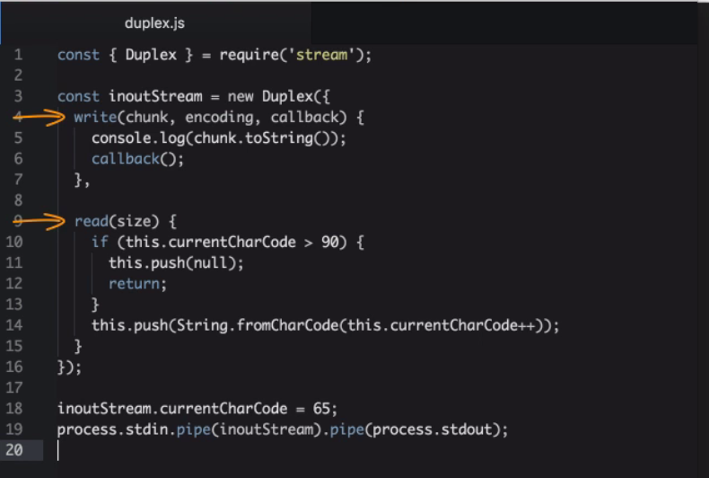
Duplex streams

Slide 20
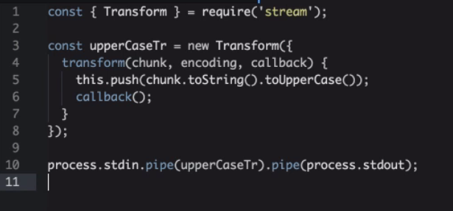
Transform streams

Slide 21
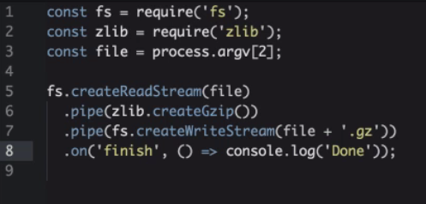
Transform streams - zip

Slide 22
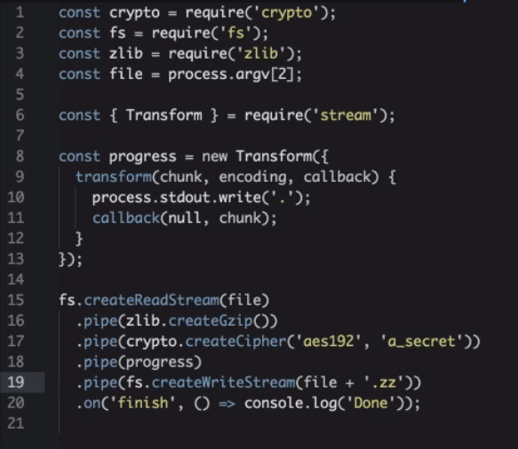
Transform streams - encrypted zip

Slide 23


Mocking the require

Slide 24
Thank you for attention

